Slide 1

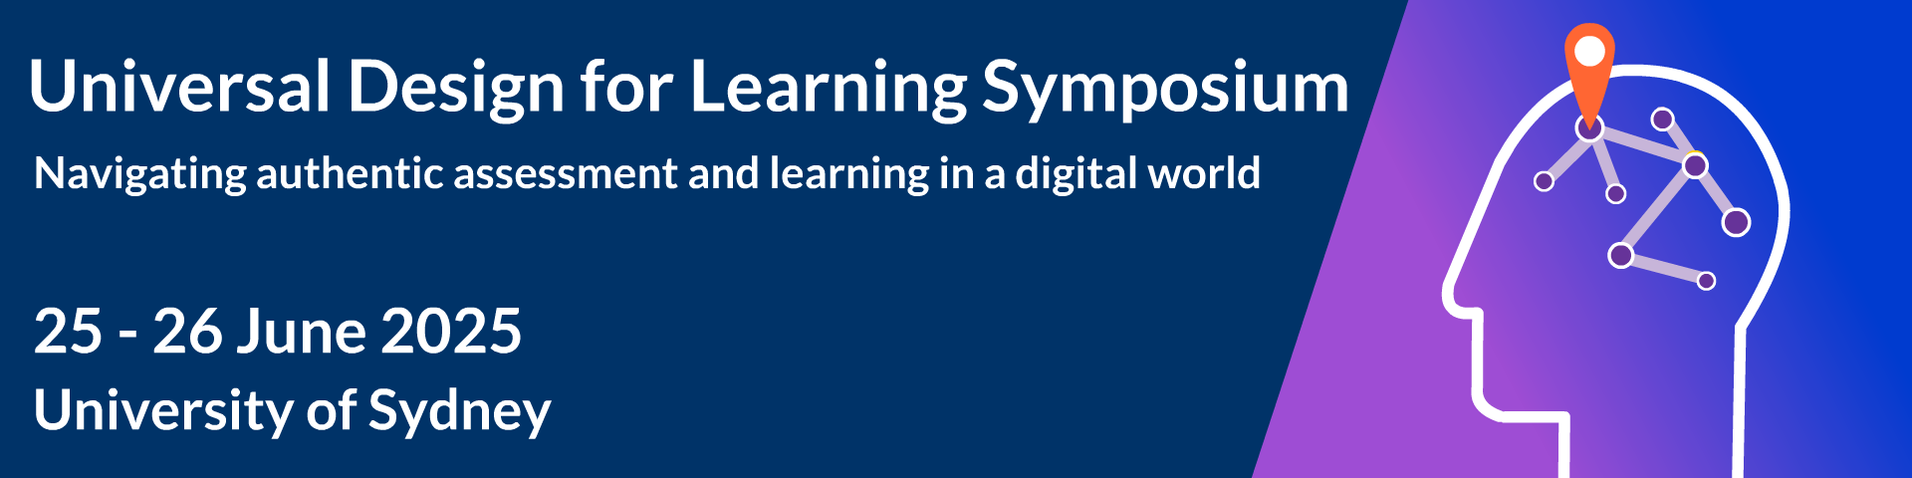
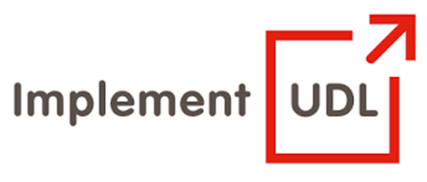
Growth of UDL Implementation among faculty: Understanding the risks that lead to instructors losing momentum
Dr. Frederic Fovet
School of Education, Faculty of Education and Social Work
Thompson Rivers University, BC, Canada
ADCET UDL Symposium
June 25th-26th, 2025

Slide 2
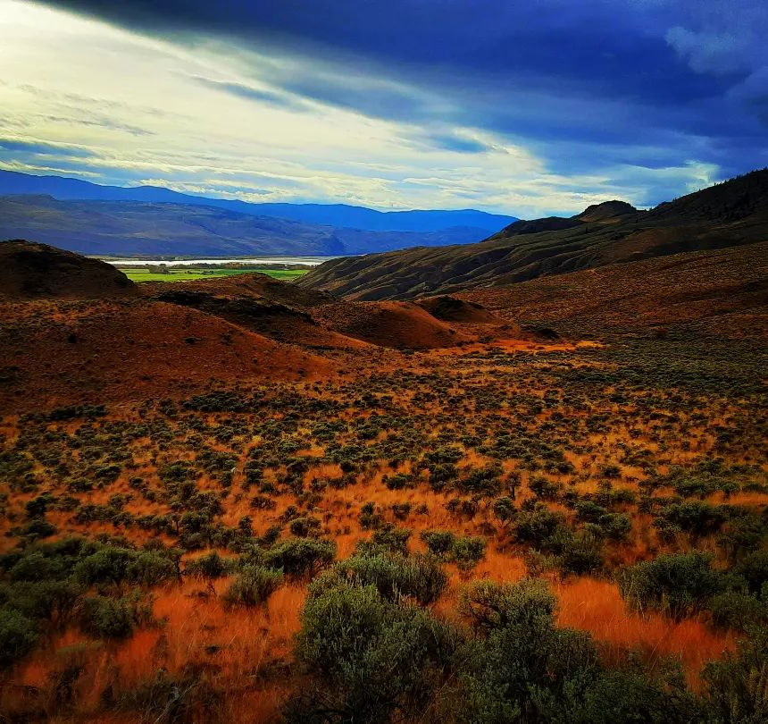
Land Acknowledgement
Thompson Rivers University campuses are on the traditional lands of the Tk'emlúps te Secwépemc (Kamloops campus) and the T’exelc (Williams Lake campus) within Secwépemc'ulucw, the traditional and unceded territory of the Secwépemc. The region TRU serves also extends into the territories of the St’át’imc, Nlaka’pamux, Tŝilhqot'in, Nuxalk, and Dakelh

Slide 3
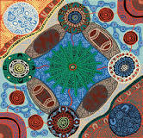
Acknowledgment of
Country
I would like to acknowledge and pay respect to the Gadigal people of the Eora Nation, the traditional owners and custodians of the land on which the University of Sydney has been built, and which were taken from them without their consent, treaty or compensation. We pay respect to Elders past and present.

Slide 4
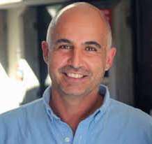
Personal introduction
Frederic is an Assistant Professor in the School of Education at Thompson Rivers University in BC, Canada
The focus of his research is inclusion, UDL, accessibility, and social justice in teaching and learning
He is a UDL and inclusion consultant – both domestically and internationally supporting tertiary organizations and K-12 schools and school boards.
https://kamino.tru.ca/experts/home/main/bio.php?id=Ffovet

Slide 5
Reflecting on UDL in our workshop processes and format
In order to offer participants multiple means of engagement/ action and expression:
We will use two Menti Activities through the session
I have created a Padlet to engage all participants during one of the table discussions and to archive the groups’ reflections
I will share my slidedeck (including the Menti slides) tonight on LinkedIn and Bluesky through SlideShare
If you have any further questions about the paper, you can also contact me on ffovet@tru.ca or via social media

Slide 6

Outcomes of the session
Participants will:
Reflect on factors that impact instructors’ journey with UDL implementation
Examine which of these variables are most pertinent to their own institutional context
Consider implications in terms of developing sustainable UDL growth strategies across institutions

Slide 7

Context – A narrative to highlight current challenges
Frederic will use story telling to explain what led him to this topic and to the idea of organizing this workshop.

Slide 8

First workshop activity
Introduce yourself to your partners at your table.
Clarify your current role and the type of institution in which you are employed.
Consider the following question: “What are expectations we have of instructors’ journey with UDL? How do we picture the way they might become familiar with UDL?” [5 to 7 minutes]

Slide 9
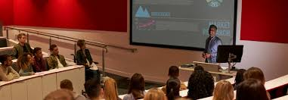
Debrief on first activity
The field has adopted siloed approaches to UDL implementation.
This is reductionist and counter-productive: us vs. them
Tackling the Two Solitudes. Bridging the Conflicting Lived Realities of Faculty and Accessibility Personnel within UDL Implementation: http://www.twosolitudes.ca/index.html
Urgent need for more nuanced approaches to instructor mindset and to the constructs the field is developing around faculty trajectories with UDL.

Slide 10

Second workshop activity
In dialogue with the colleagues at your table, please now consider this second question for discussion:
Beyond individual trajectories, what is the mental map or construct we develop to picture/ forecast the development of UDL across our HE institutions? [5 to 7 minutes]

Slide 11
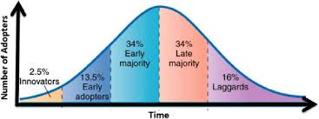
Collective debrief on second activity
Rogers' diffusion for the innovation adoption (Rogers Everett 1995)

Slide 12
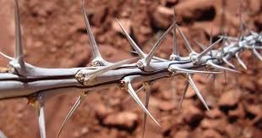
Collective debrief on second activity cont.
Epistemological assumptions here are problematic
The reality on the ground does not seem to support the validity of this model/ representation
Much more unpredictable, non-linear, and challenging as a process of change
Considerable issue as we deploy resources/ plan training/ examine instructor mindset from this model exclusively.
The reality of the implementation process may be far more complex.
The substance of our ‘preparedness’ as institutions will have to be far more nuanced

Slide 13
Short window into the study which serves as a basis for the articulation of the workshop
The study detailed here serves as a canvas for the development of this workshop.
Objective: Examine the factors that support long-term resilience with UDL and the stressors which hinder persistence with the exploration of UDL.
Theory: Social Model/ Ecological theory as applied to organizational/ institutional and strategic dimensions
Methodology: to engage in semi-directive interviews with 40 or so instructors having undertaken an initial PD piece and having engaged with UDL implementation for a period (UDL Facilitator Digital Badge holders or John Kelly Award applicants) across the tertiary Irish landscape– Phenomenological stance
Targeted outcome: to map stressors and facilitators to enable institutions to gauge best practices for successful, longitudinal, sustainable UDL implementation.

Slide 14

Interactive polling: Identifying the main stressors
What do you feel, from your own experience with UDL implementation, might be the most profound stressors for instructors, and those that most hinder successful persistence with implementation? Below are the main deductive codes used in the analysis of the data [themes that appear in the literature and that we knew would come up]
Funding
Leadership support
Lack of ongoing PD opportunities
Networks and collegiate support
Workload recognition
Validation
Resource personnel

Slide 15
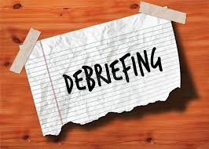
Debrief on the polling activity
All of these factors have come up so far in the data collection and analysis
Difficult to quantify them as being more pressing one than the other
Importance of recognizing the diversity and complexity of the tertiary sector: no two sectors resembles each other
Added complexity in the Irish sector of the FET/ higher education dichotomy/ gap.
Size of institutions and historical mindset have come through as enormously relevant in terms of the factors that impact the UDL journey of instructors.
There may also be individual divergences in relation to persistence and resilience within the UDL implementation process.

Slide 16

Third round table activity
There were other themes that emerged in the study (inductive codes), some more nuanced and inconspicuous. These appear in the next three slides; I will offer a rapid overview. They also appear on a Padlet you will be able to access with your device. Please select two emerging themes and discuss them at your table. To what extent do these surprise you? Are these pertinent within your institution? We will debrief as a whole room with each table offering an oral summary of its discussions but please also add your thoughts to the Padlet my adding a reply comment under each of the themes you discussed. [15 minutes – Table discussion with Padlet interactions]
https://edswgrad.padlet.org/ffovet1/adcet-workshop-activity-on-emerging-themes-4ejv2p1tdxexv1si

Slide 17
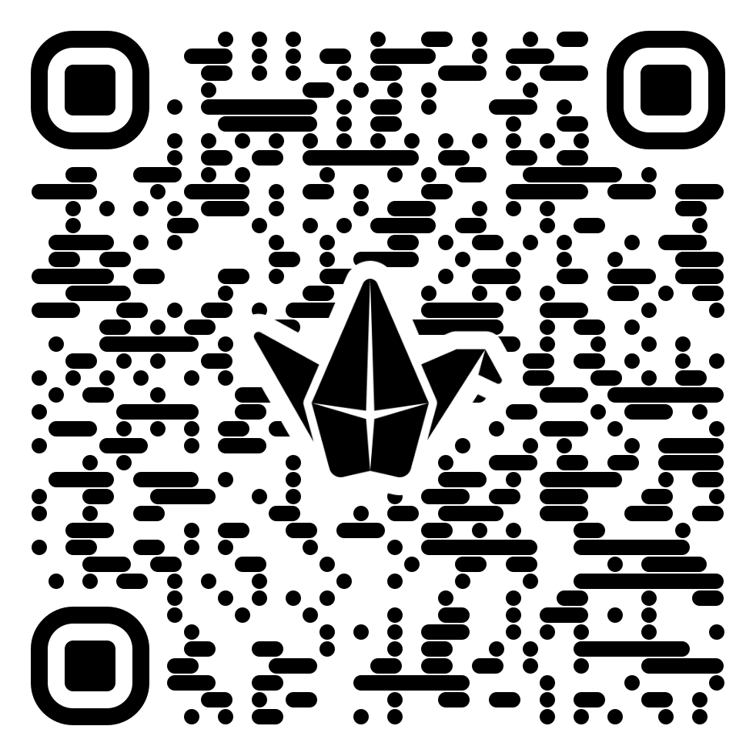
QR code for the Padlet

Slide 18
Emerging themes for discussion with your table (Part 1)
Initiative overload’: Challenges in juggling competing institutional priorities: UDL, EDI, sustainability, AI, etc.
Challenges in dealing with the unpredictability of student reactions, variation in student cohorts.
Issues with the packaging/ branding of UDL (novelty versus organic reflection): too closely connected with neoliberal ‘bling’
Post-COVID dynamics
Fear of workload increase directly connected to sophisticated redesign

Slide 19
Emerging themes for discussion with your table (Part 2)
Intrinsic commitment to the development of T&L versus stand-alone positioning of UDL: Resilience with UDL seems correlated to a wider, life-long engagement with SoTL
Challenges in connecting UDL to other pressing SoTL (issues around the insularity of UDL literature)
Wider issue of SoTL scholarship as motivational lever in a shifting tertiary landscape
Resilience with UDL seems directed connected to personal lived experiences of diversity or encounters with the lived experiences of diverse learners

Slide 20
Emerging themes for discussion with your table (Part 3)
Acknowledgement of complexity of T&L transformation (example of bureaucratic processes that take years to edit – course evaluation, tenure and promotion criteria, etc.)
Issues related to overly enthusiastic approach to UDL implementation: lack of spaces to candidly discuss the complexity of the process, isolation of practitioners
Urgent need for the documentation of failures/ design fails
Need for a wider reflection around scope and implications of diversity in a changing post-secondary landscape (particularly complex now within the EDI pushback)

Slide 21
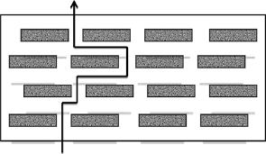
Collective debrief on third activity
We’re very far from the simplicity of Roger’s model of Innovation Diffusion
Complex and subtle landscape of faculty willingness vs. complex tertiary intricacies
Quite likely many faculty dip a toe and move on because the factors of resistance and friction outbalance the concerns
These concerns may have nothing to do with their faith in the benefits of UDL
We are at risk of misunderstanding faculty ambivalence for a lack of commitment to equity.
This has immediate implication on institutional readiness and preparedness for change in relation to UDL implementation

Slide 22

Reflection around the methodological process
There is almost an action-research flavour to the interviewing
The story telling/ narrative enquiry dimension of this large qualitative process is central part of the process
Many stakeholders clearly have few opportunities to discuss these fears/ concerns and take great satisfaction in the dialogue
A current issue with the UDL momentum currently may be the inherent lack of space/ opportunities for the authentic sharing of challenges and concerns.
Call to action: creating candid and frank spaces to acknowledge frustration and concerns.

Slide 23

Identifying actionable goals
No workshop is complete without participants being given a chance to reflect on their take aways and to identify items that will have immediate implications for them. What would be the one actionable step you identify as being urgent in your context, in light of the content we discussed today. We will archive these through an open wall Menti activity.

Slide 24
Ancillary findings emerging from the study and possible implications
More systemic whole institution UDL implementation in rural contexts
More willingness to consider the impact and benefit of UDL beyond disability in these rural settings
Widely diverging needs in relation to UDL implementation, expressed by formal Higher Ed instructors and trades/ vocational/ technical instructors (would be the equivalent of university/ college dichotomy in Canada)
Very little ‘lateral’ sharing among institutions: each seem to be ‘reinventing the wheel’ within a competitive neoliberal climate
Necessity to create archives around UDL implementation as process of management of change
What is the impact of these findings on our own reflection/ preparedness? [Whole room dialogue]

Slide 25

Interactive space for questions

Slide 26


Contact details
Frederic Fovet (PhD.)
Assistant Professor, School of Education, Thompson Rivers University
ffovet@tru.ca
UDL and Inclusion Consultant
@Ffovet
www.implementudl.com

Slide 27
Resources
Baumann, T. & Melle, I. (2019). Evaluation of a digital UDL-based learning environment in inclusive chemistry education. Chemistry Teacher International, 1(2). https://doi.org/10.1515/cti-2018-0026
Burgstahler, S. E. (2015). Universal design in higher education. In S. E. Burgstahler (Ed.), Universal design in higher education (2nd ed., pp.3-28). Harvard Education Press. https://www.washington.edu/doit/resources/books/universal-design-higher-education-promising-practices
Dalton, E. M., Lyner-Cleophas, M., Ferguson, B. T., & McKenzie, J. (2019). Inclusion, universal design and universal design for learning in higher education: South Africa and the United States. African Journal of Disability, 8, 519. doi: 10.4102/ajod.v8i0.519
Darrow, A.-A. (2015). Differentiated Instruction for Students With Disabilities: Using DI in the Music Classroom. General Music Today, 28(2), 29–32
Fovet, F. (2018) Exploring the Student Voice within Universal Design for Learning Work. The AHEAD Journal, 8. https://www.ahead.ie/journal/Exploring-the-Student-Voice-within-Universal-Design-for-learning-Work
Fovet, F. (2014) Social model as catalyst for innovation in design and pedagogical change. Widening Participation through Curriculum Open University 2014 Conference Proceedings, 135-139

Slide 28
Resources (contd.)
Krebs, E. (2019) Baccalaureates or burdens? Complicating ‘reasonable accommodations’ for American college students with disabilities. Disability studies Quarterly, 39(3). https://dsq-sds.org/article/view/6557/5413
Kumar, K.L., & Wideman, M. (2014) Accessible by Design: Applying UDL Principles in a First Year Undergraduate Course. Canadian Journal of Higher Education, 44(1), 125-147. https://eric.ed.gov/?id=EJ1028772
Lubicz-Nawrocka, T. (2022) Conceptualisations of curriculum co-creation: ‘it’s not them and us, it’s just us’. Curriculum Perspectives. https://doi.org/10.1007/s41297-022-00180-w
Masika, R., & Jones, J. (2016). Building student belonging and engagement: Insights into higher education students’ experiences of participating and learning together. Teaching in Higher Education, 21(2), 138–150. https://doi.org/10.1080/13562517.2015.1122585
Mole, H. (2013). A US model for inclusion of disabled students in higher education settings: The social model of disability and Universal Design. Widening participation and lifelong learning, 14, 62-86.

Slide 29
Resources (contd.)
Schreffler, J., Vasquez III, E., Chini, J., & Westley. J. (2019). Universal Design for Learning in postsecondary STEM education for students with disabilities: A systematic literature review. International Journal of STEM Education, 6(8). https://doi.org/10.1186/s40594-019-0161-8
Singleton, K., Evmenova, A., Jerom, M., & Clark, K. (2019) Integrating UDL Strategies into the Online Course Development Process: Instructional Designers' Perspectives. Online Learning, 1(23). http://dx.doi.org/10.24059/olj.v23i1.1407
Valle-Flórez, R.-E., de Caso Fuertes, A. M., Baelo, R., & García-Martín, S. (2021). Faculty of Education Professors’ Perception about the Inclusion of University Students with Disabilities. International Journal of Environmental Research and Public Health, 18(21). http://dx.doi.org/10.3390/ijerph182111667

