Slide 1




Turbocharging Accessibility? Negotiating Paradigm Shifts for Inclusive Learning, Teaching and Assessment
Dr Seán Bracken, PFHEA, Principal Lecturer, Centre for Education and Inclusion, Doctoral Programme Lead College of Education, Culture and Society University of Worcester, Adjunct Professor Curtin University

Slide 2
Objectives
Know a little more about me, and how UD and UDL have informed, my professional experiences.
Identify current Australian, UK and Ireland based contextual legislative and policy developments driving interconnections between UDL, authentic learning and assessment, and GAI.
Propose strategies to ensure collaborative and systemic institutional and sector changes.
Learn from one another's experiences.

Slide 3


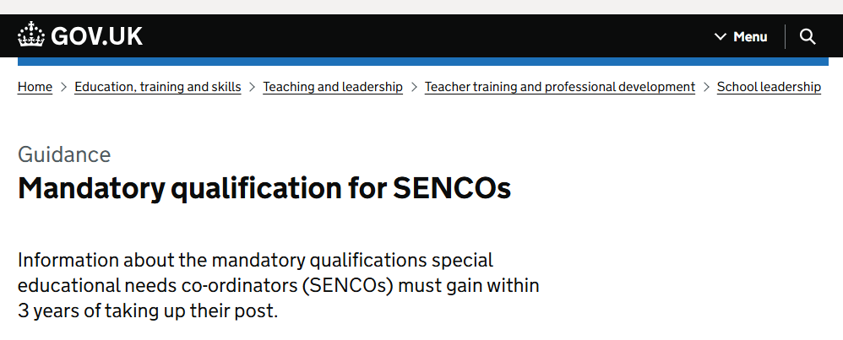

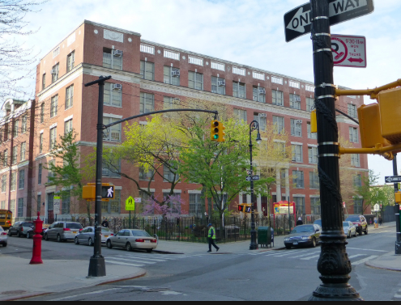

Brief biography

Slide 4

The imperative for change

Slide 5
Changing demographics - Addressing the retention crisis
The requirement for higher education providers to have a Support for Students Policy is set out in section 19-43 of HESA. Providers are required to meet three requirements:
providers must have a Support for Students Policy that details the support made available to the provider’s students to assist them to successfully complete the units of study in which they are enrolled;
the provider’s Support for Students Policy must include information on:
  the provider’s processes for identifying students that are at risk of not successfully completing their units of study; and
  the supports available to assist students to successfully complete the units of study in which they are enrolled;

Slide 6
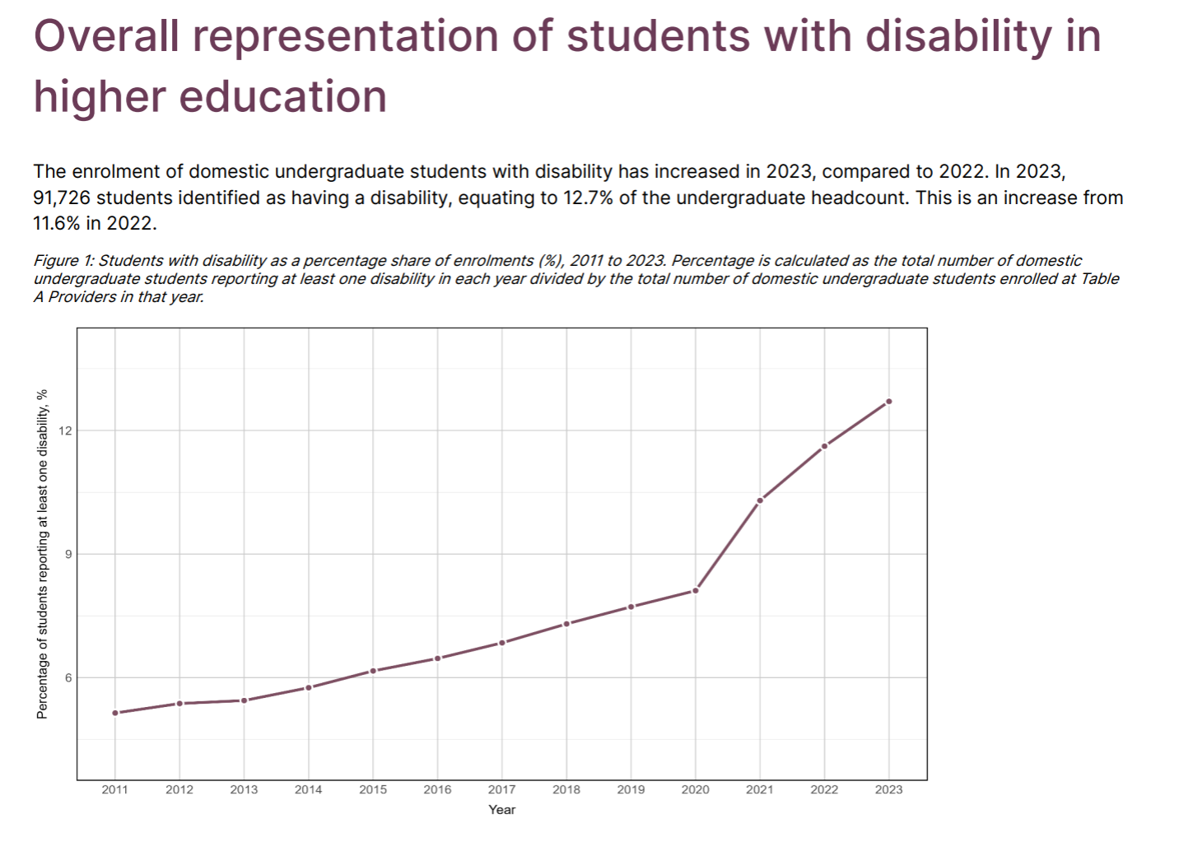
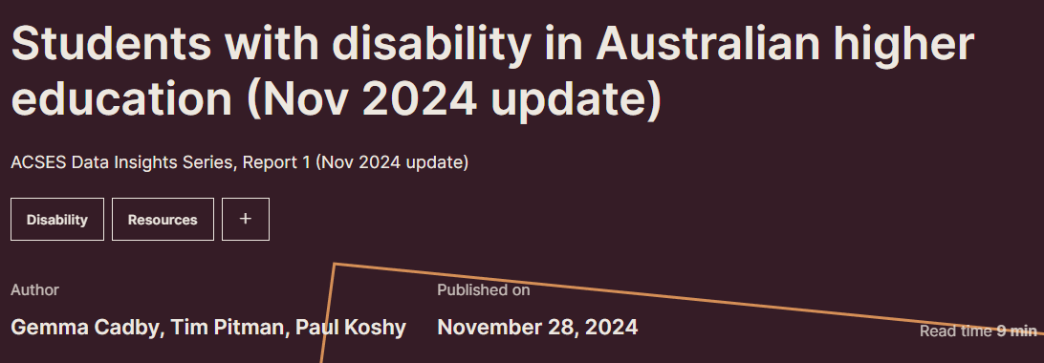
Overall representation of students with disability in higher education

Slide 7
UK Higher Education Statistics Agency (HESA) 2023/24
Disability | Female | Male | Unknown | Total
Blind or have a visual impairment uncorrected by glasses | 2,115 | 2,175 | 15 | 4,305
D/deaf or have a hearing impairment | 4,825 | 2,775 | 40 | 7,640
Development condition that you have had since childhood which affects motor, cognitive, social and emotional skills, and speech and language | 310 | 305 | 5 | 620
Learning difference such as dyslexia, dyspraxia or AD(H)D | 85,200 | 54,640 | 905 | 140,745
Long-term illness or health condition such as cancer, HIV, diabetes, chronic heart disease, or epilepsy | 23,965 | 12,400 | 135 | 36,500
Mental health condition, challenge or disorder, such as depression, schizophrenia or anxiety | 92,050 | 29,235 | 1,145 | 122,430
Physical impairment (a condition that substantially limits one or more basic physical activities such as walking, climbing stairs, lifting or carrying) | 7,095 | 3,915 | 65 | 11,075
Social/communication conditions such as a speech and language impairment or an autistic spectrum condition | 9,225 | 12,920 | 415 | 22,560
An impairment, health condition or learning difference not listed | 21,690 | 10,520 | 210 | 32,420
Multiple impairments, health conditions or learning differences | 62,640 | 26,155 | 1,745 | 90,535
 |  |  |  | 468,830
No known impairment, health condition or learning difference | 964,605 | 729,225 | 5,400 | 1,699,230
Total | 1,273,725 | 884,255 | 10,075 | 2,168,060

Slide 8

Getting a policy steer
In future…areas of focussed work could include (but not limited to) the following:
Transition to HE
Competence standards and the anticipatory duty
Student and staff disability frameworks in HE
Student advocacy and knowledge of rights
Technology in education
Inclusive practice, including alternative assessment methods and
Universal Design for Learning

Slide 9
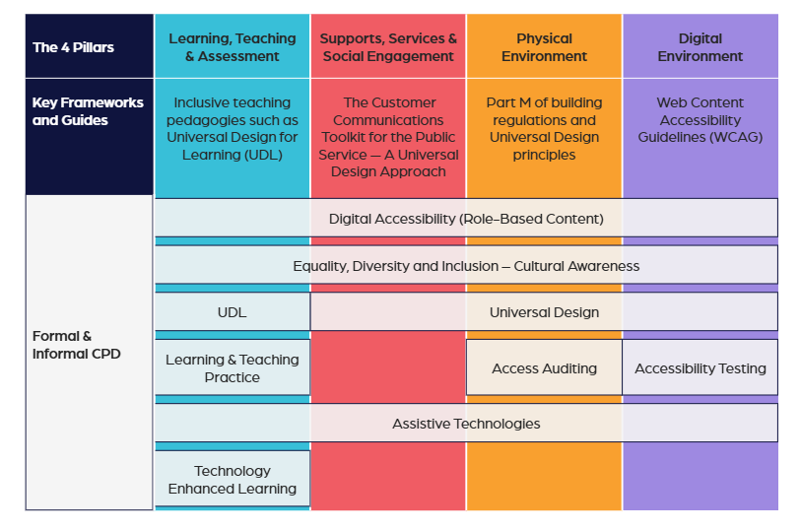
Learning from altitude in Ireland

Slide 10
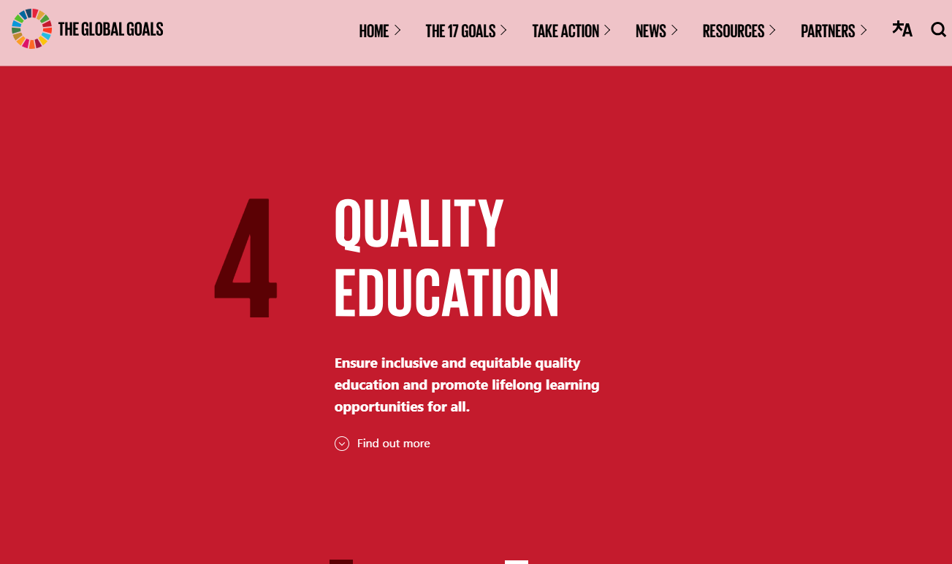
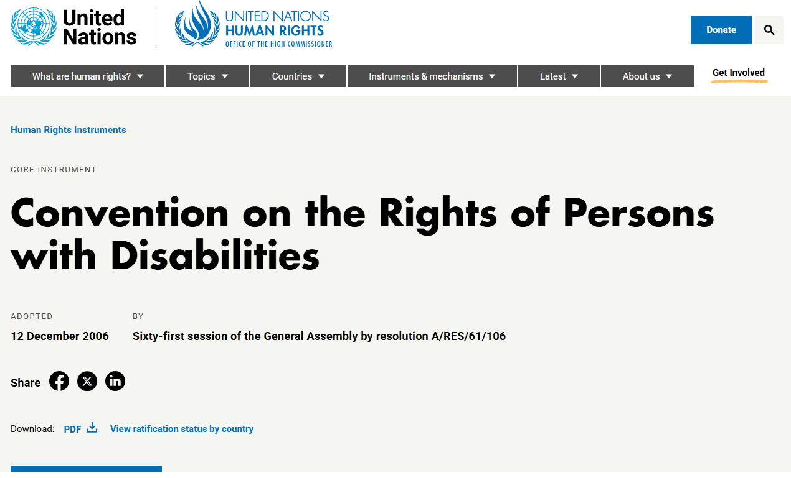
Guiding global considerations

Slide 11

A triple helix approach

Slide 12
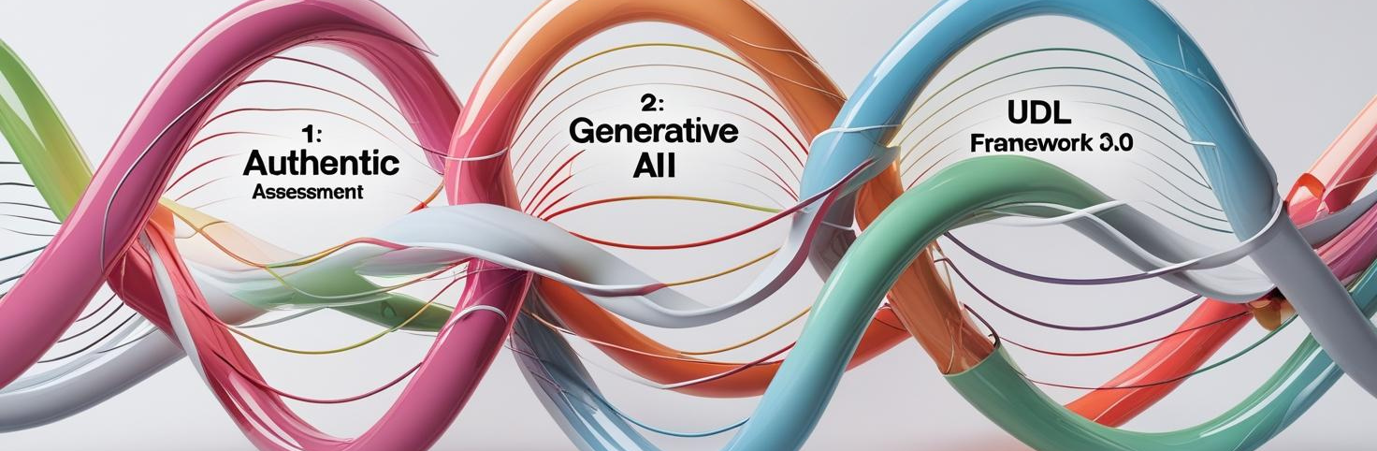
Creating cohesive systemic inclusion at a time of seismic change
Socially just, authentic learning and assessment
Integrating generative technologies as part of teacher/learner/machine co-designing
Providing a shared conceptual perspective using UD and UDL (open to contestation)

Slide 13
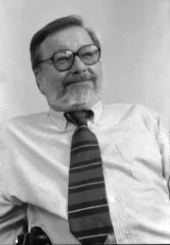

Principles of Universal design
Equitable Use
Flexibility in Use
Simple and Intuitive to Use
Perceptible Information
Tolerance for Error
Low Physical Effort
Size and Space for Approach and Use
  Somewhat dated perhaps: Biophilic design / wellbeing

Slide 14
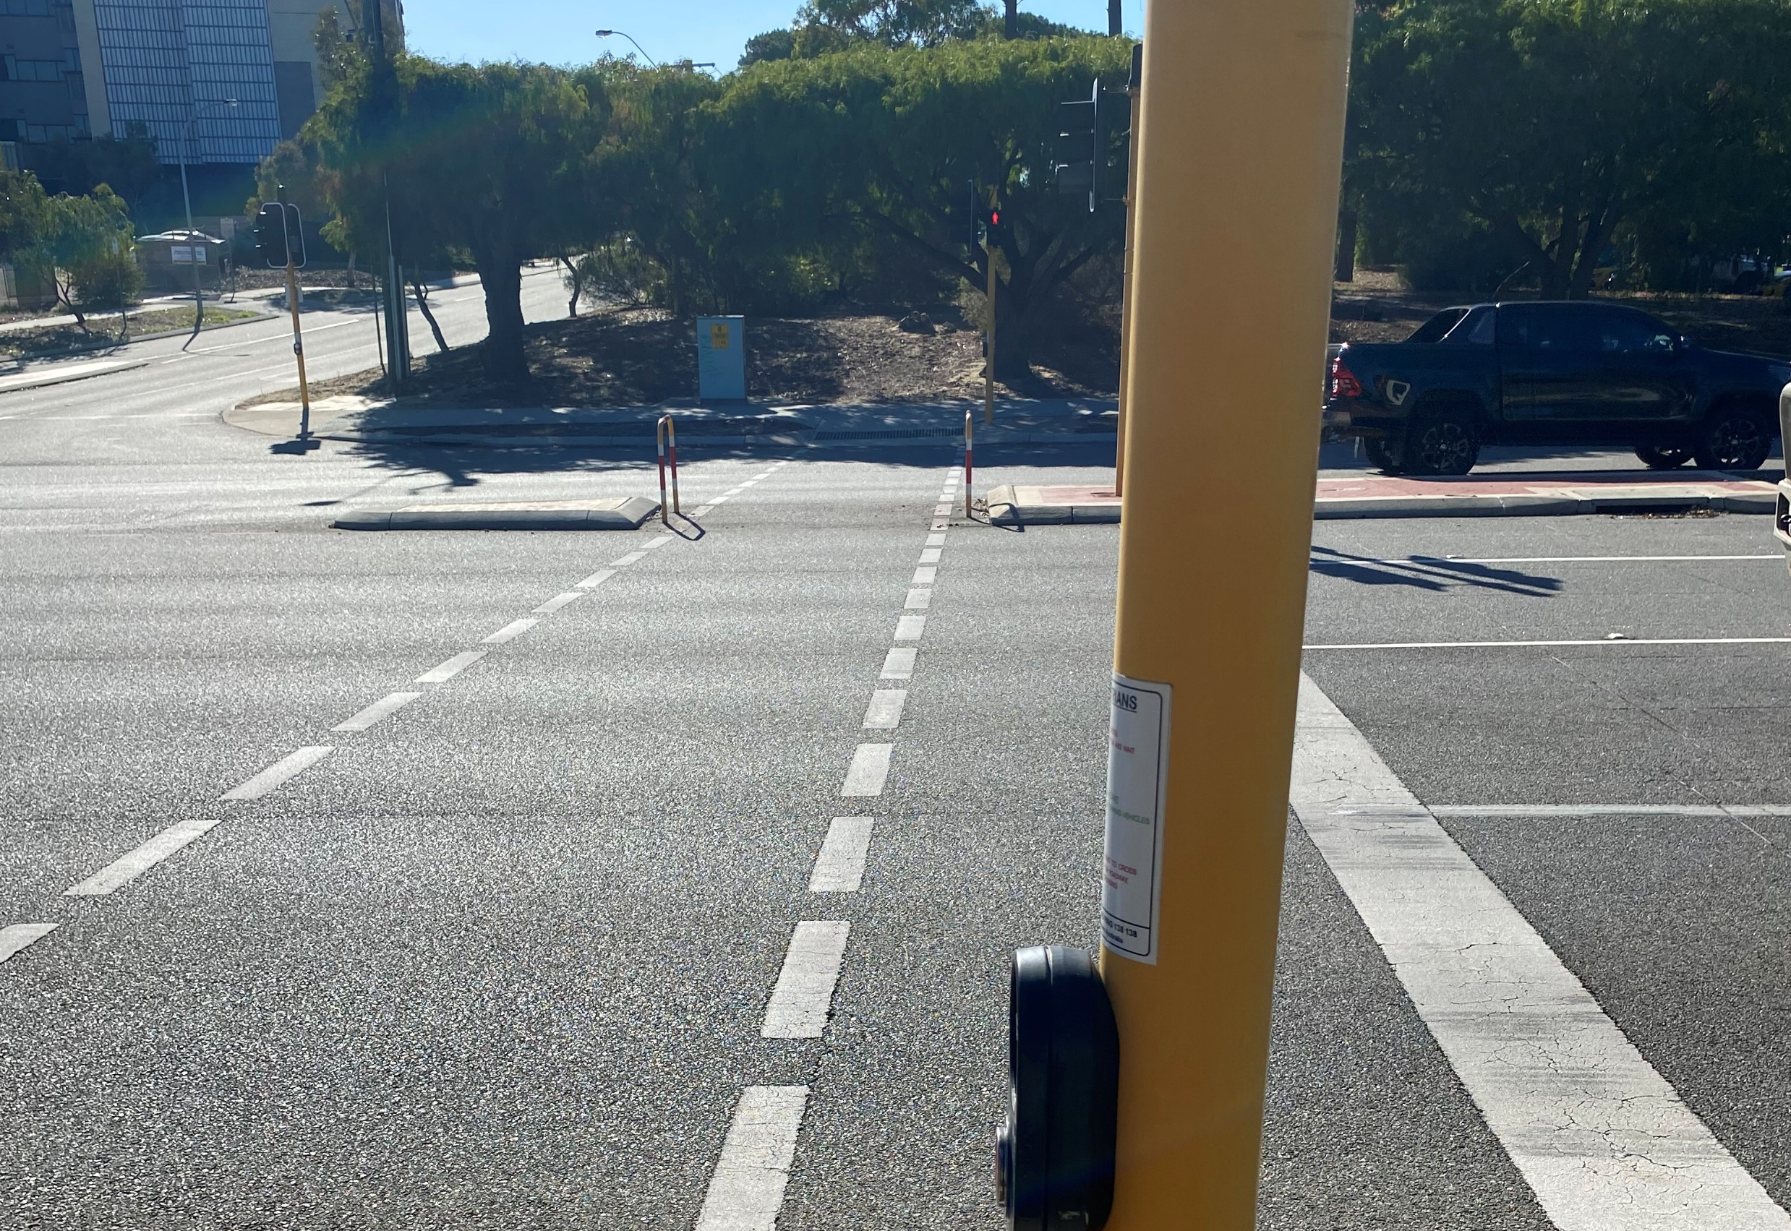
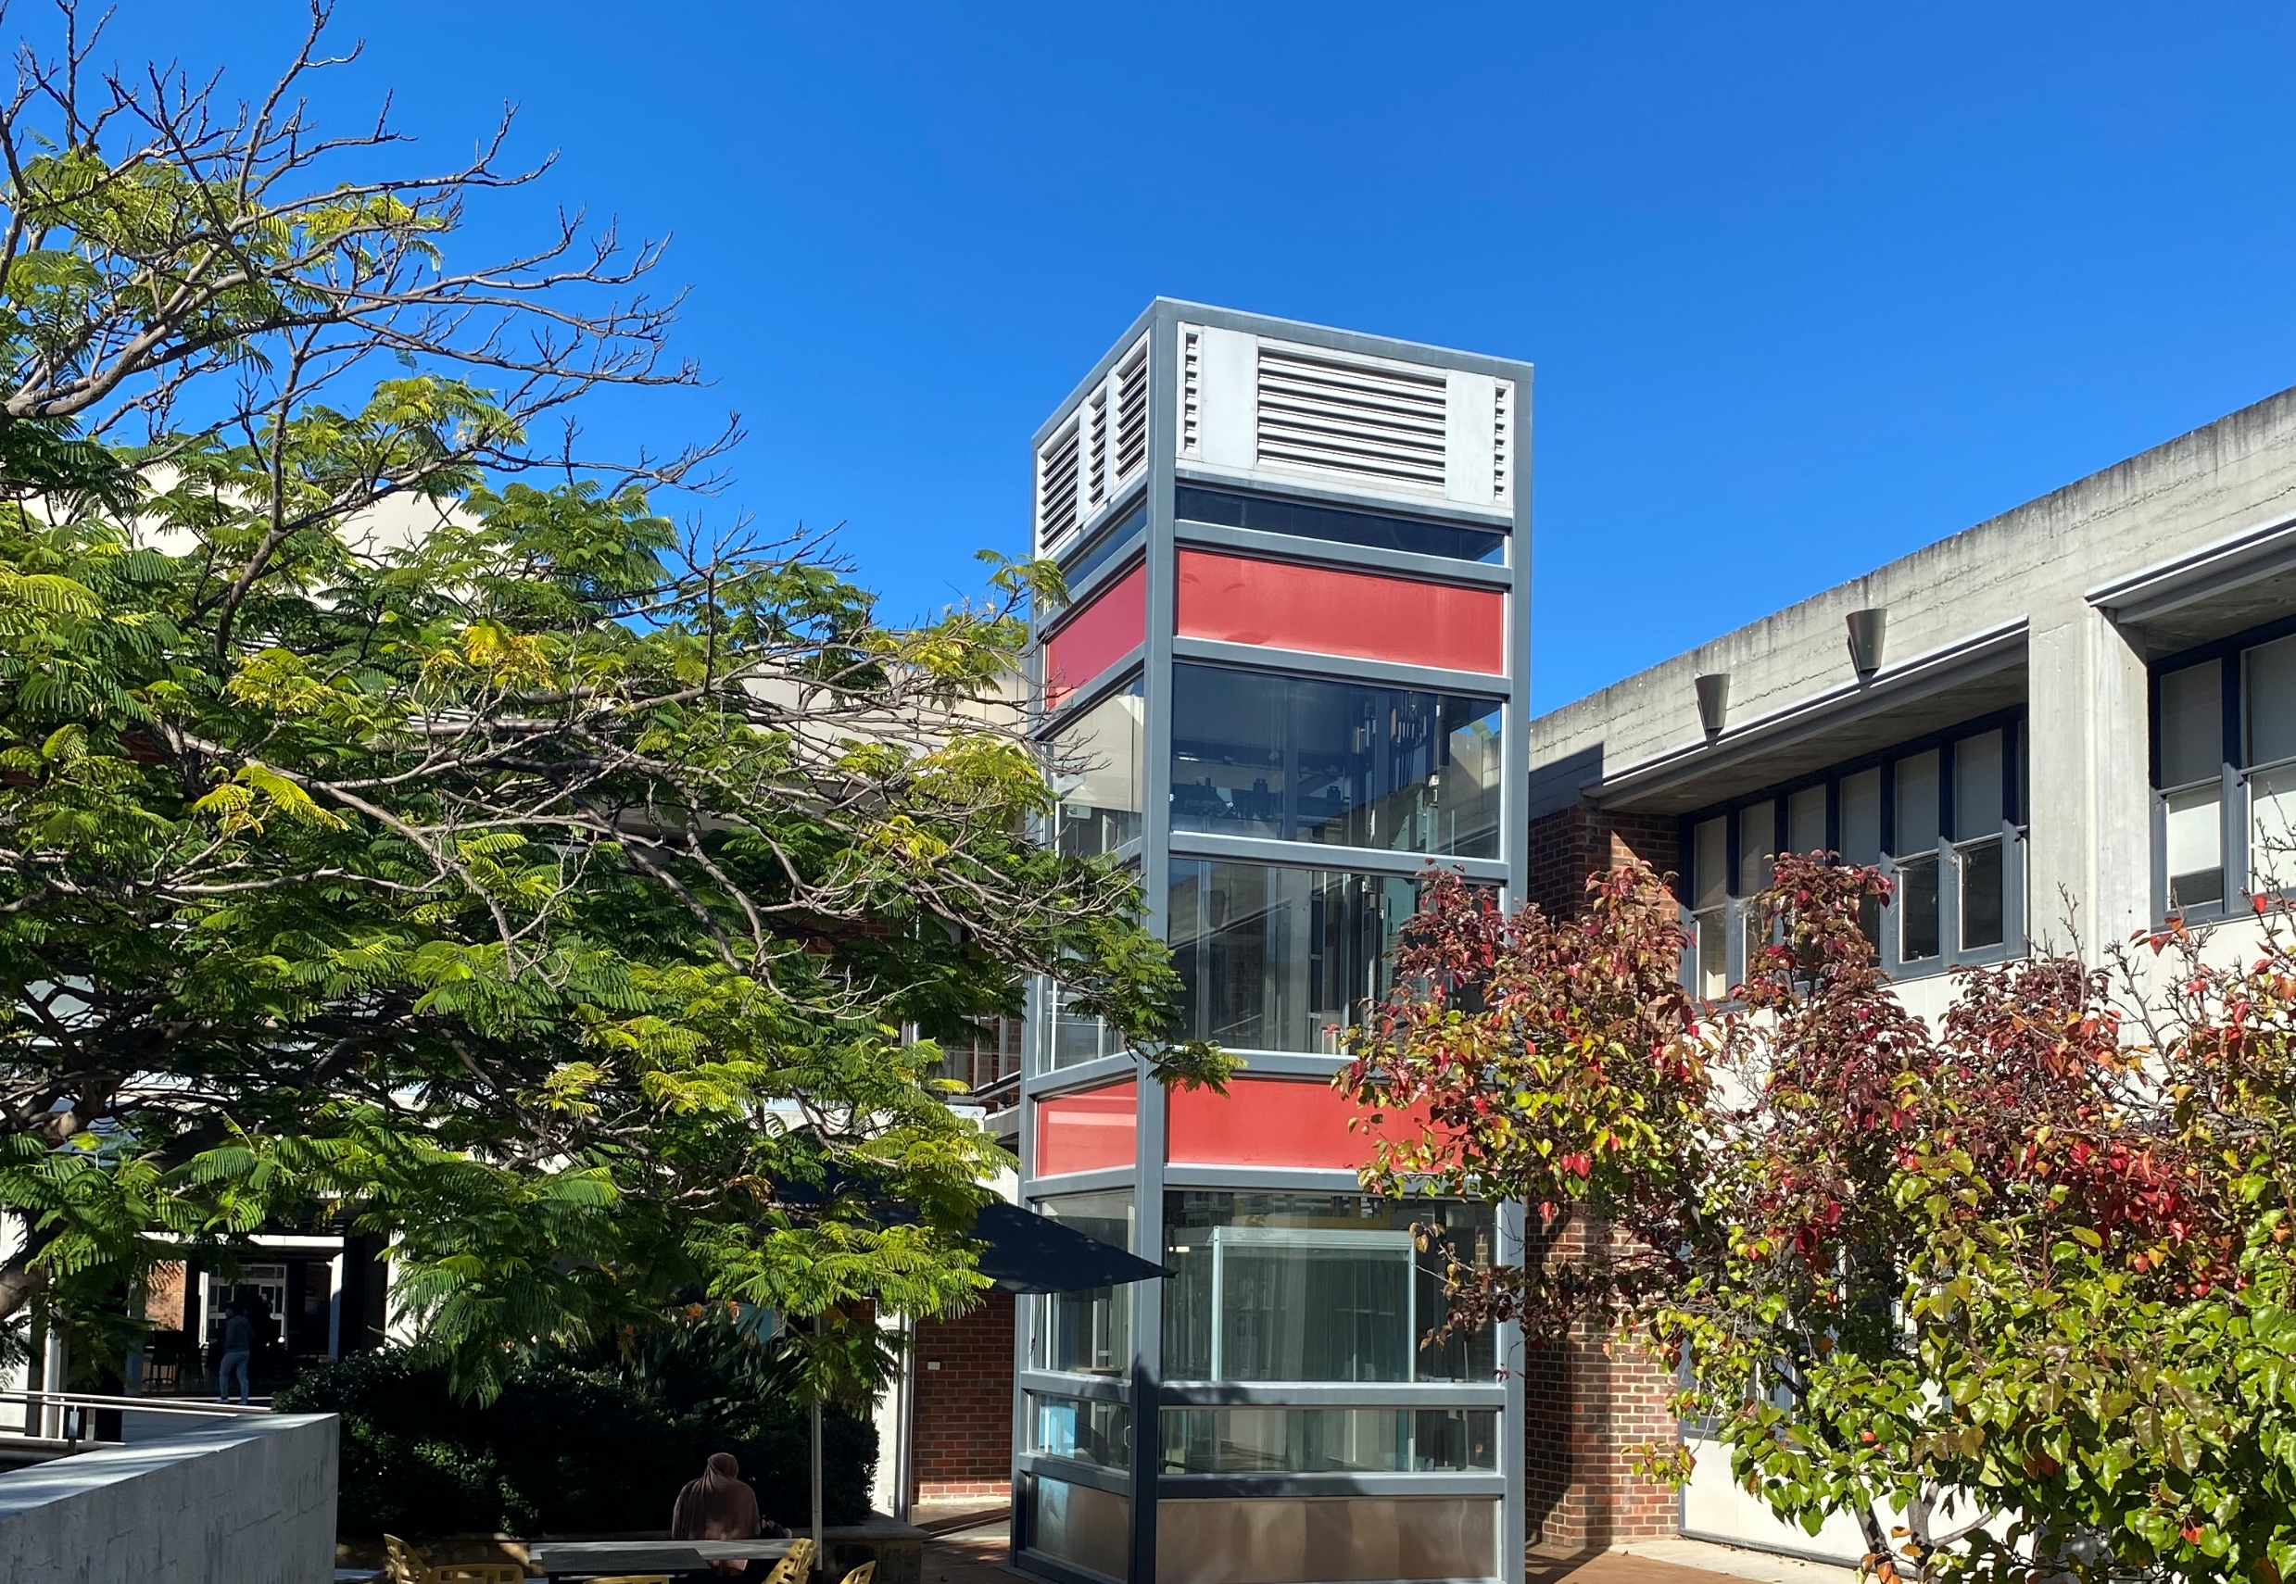
Learning from architecture: anticipatory inclusive design or retrofitting – the role of UD / UDL

Slide 15
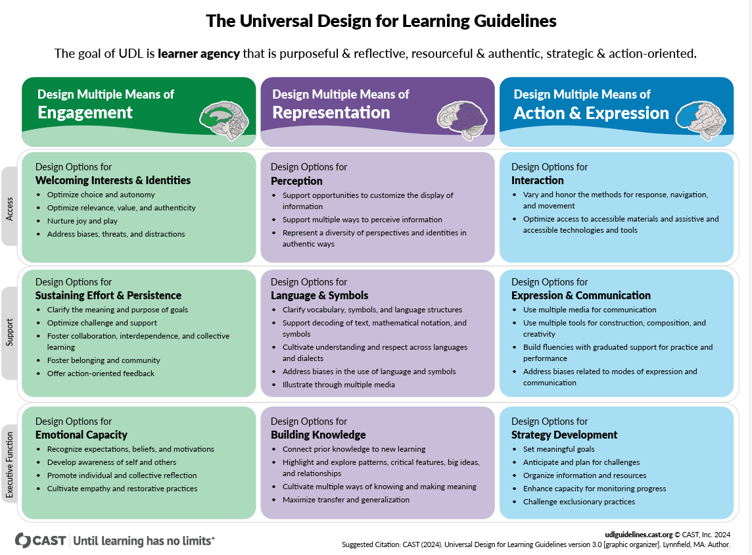



So what’s UDL all about?

Slide 16

What do you understand by the expressions 'authentic learning' or 'Authentic assessment' How are they manifested in your discipline or setting?
Take 7 minutes to reflect and note some insights from current, or possible future, practice.

Slide 17
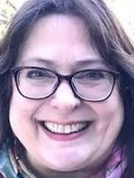
Let's explore learning and assessment authenticity
"I suggest we move from simply focusing on the authentic task to considering why that task matters? This then enables a shift from the student in isolation to the student as a member of society. Senses of achievement can become richer, thus enhancing the students’ sense of self, self-worth, and well-being"
Three Core Principles
  Society-focused learning rather than just workforce preparation.
  Emphasizing the reason behind tasks to validate social belonging.
  Utilizing authentic assessment for transformative social change.
Jan McArthur (2022) Rethinking authentic assessment: work, well-being, and society | Higher Education

Slide 18

We don't have all the answers just yet
Rather than automatically making assessment inclusive, authenticity in assessment opens up possibilities to discuss messy, ethical and complex ideas in relation to the relevance of assessment to broader personal, social and professional contexts. (Fawnes et al, 2025)

Slide 19
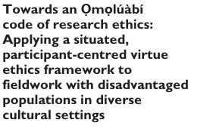

But there's lots of scope for design-based planning differently for diversity
  Addressing the challenge of changing institutional norms.
  Incorporating inclusivity, social justice, and decolonial perspectives
  Exploring boundaries – enabling inclusive assessment, reenvisioning PhD vivas (ideas welcome).

Slide 20
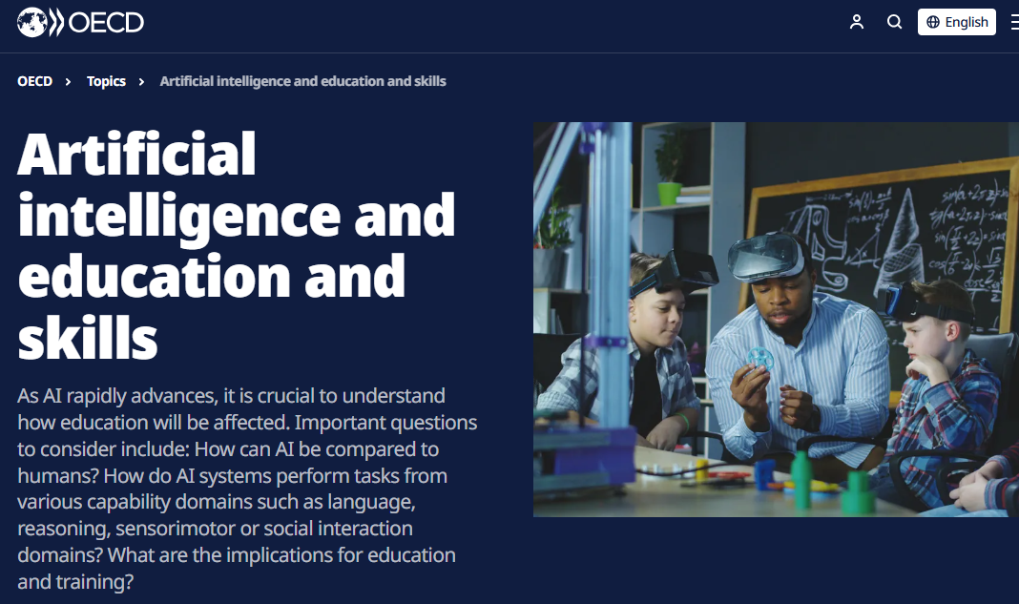
Radically changing learning terrain
The changes that AI is ushering in requires a “transformation in our approaches to teaching, pedagogy and assessment” (OECD, 2023)

Slide 21

Where are you at with AI?
On a continuum, where would you place yourself in terms of your active engagement with Generative Artificial Intelligence, especially as it pertains to advancing inclusive praxis or assessment.

Slide 22
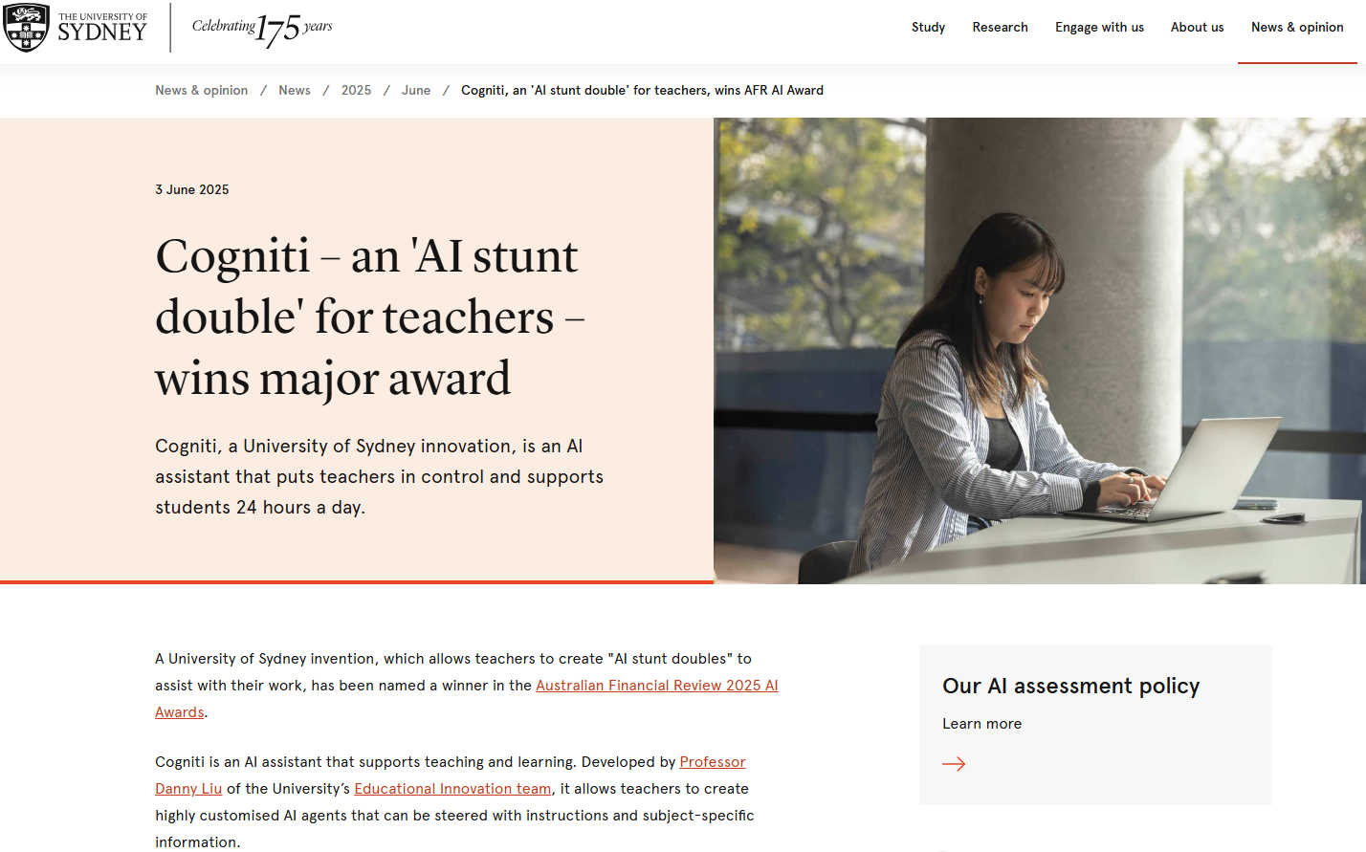
Personalising LEARNING AT UNIVERSITY of Sydney

Slide 23

The yin and yang of GAI
While AI assistants might be attractive, they might not actually help with learning and might reduce rather than improve student agency (Darvishi et al., 2024). Early experiments reveal that approaches grounded in pedagogy are most effective and that the human-in-the-loop is essential to ensure that students learn rather than take shortcuts. The evidence indicates that when learners use GAI tools without guidance it can lead to cognitive offloading (Lehmann et al., 2024), a false sense of cognitive ease (Stadler et al., 2024), a false sense of mastery (Bastani et al., 2024), and overreliance on the tool (Klingbeil et al., 2024).

Slide 24
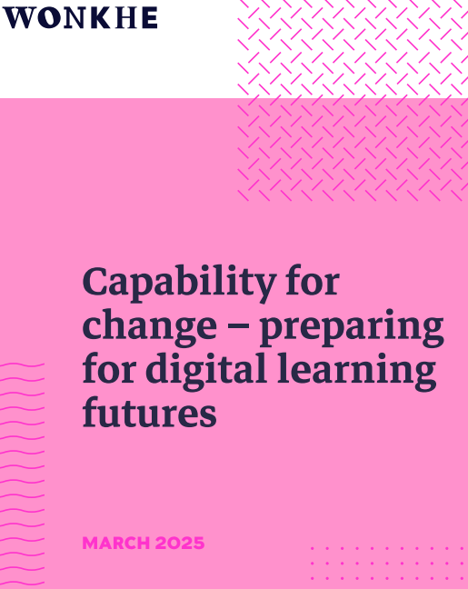
No surprises
"A need for open dialogue and joint working between “digital” and “pedagogy” at every level of the institution – often requiring the dismantling of long-established silos and distinctive ways of working between those two domains".

Slide 25

Possible roadmaps for convergence

Slide 26

The importance of networks for addressing complex challenges
A Universal Design and Ecological Approach to Leadership:
A leadership development ecosystem focuses on creating a holistic and collaborative environment where leaders, lecturers, service providers and students can mutually grow and learn. It operates mindful of internal and external enabling and constraining policies and resources. It seeks to influence these and bring about positive change by purposefully incorporating diverse thought and action-oriented connections. The ecosystem flourishes by fostering a shared purpose and a culture of development within, what is at once, a learning promotion and learning engendering organisation. This conceptual positioning recognises that leadership development isn't just about individual skills, but also about how those skills are applied within a broader network of peers and stakeholders (communities of praxis influencing wider communities). The approach is cognisant of the necessity to provide recognition and agency based on the lived and learned experiences of diverse and disabled staff and students.

Slide 27
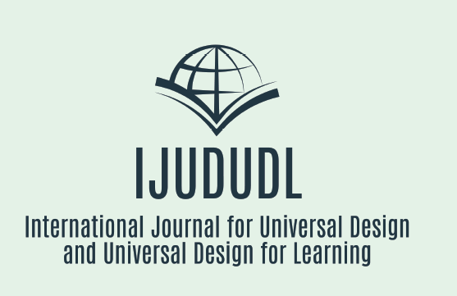
Need for additional research
Consider publishing with us peer reviewed, open access, zero cost, hosted by Ministry for Higher Education in Morocco.
Become part of INCLUDE, reach out to a wider network of UD / UDL practitioners and researchers.

Slide 28

What is your + one ?
How will you change an element of your practice as a consequence of this hour of learning?

Slide 29

Back to my biography
A lifetime of learning disruption and innovation

Slide 30
References and additional reading
Department of Education (2024) Support for Students Policy, Australian Government, Available from https://www.education.gov.au/support-students-policy Accessed 05/05/25
Bracken, S., & Novak, K. (Eds.). (2019). Transforming higher education through universal design for learning: An international perspective. Routledge.
Burgstahler, S. (2021) ‘What Higher Education Learned About the Accessibility of Online Opportunities During a Pandemic’, Journal of higher education theory and practice, 21(7), pp. 160–170.Link
Hanesworth, P., Bracken, S. and Elkington, S. (2019) ‘A typology for a social justice approach to assessment: learning from universal design and culturally sustaining pedagogy’, Teaching in higher education, 24(1), pp. 98–114.
AdvanceHE (2023). The Disabled Student Commitment. Available from AdvanceHE.
Braun, V., & Clarke, V. (2023). Toward good practice in thematic analysis: Avoiding common problems and be (com) ing a knowing researcher. International journal of transgender health, 24(1), 1-6.
CAST (2024). The UDL Framework 3.0. Available from CAST.
Cadby, G., Pitman, T., and P. Koshy, Students with disability in Australian higher education: An overview. ACSES Data Insights Series, Report 1, September 2024. Available from Students with disability in Australian higher education: An overview - ACSES Accessed 08/05/2025

Slide 31
References and additional reading
Harpur, P., Stafford, L., & Ellis, K. (2025). A disability-led disability inclusion strategy for the higher education sector. Journal of Higher Education Policy and Management, 1–18. https://doi.org/10.1080/1360080X.2025.2478537
Herrington, N., & Coogan, J. (2011). Q methodology: an overview. Research in Teacher Education, 1(2), 24-28.
McKim, C. (2023). Meaningful member-checking: a structured approach to member-checking. American Journal of Qualitative Research, 7(2), 41-52.
Ørngreen, R., & Levinsen, K. T. (2017). Workshops as a research methodology. Electronic Journal of E-learning, 15(1), 70-81.
Pitman, T. (2022). Supporting persons with disabilities to succeed in higher education: Final report. National Centre for Student Equity in Higher Education. https://www.ncsehe.edu.au/app/uploads/2022/03/Pitman_Curtin_EquityFellowship_FINAL.pdf
Thoring, K., Mueller, R., & Badke-Schaub, P. (2020). Workshops as a research method: Guidelines for designing and evaluating artifacts through workshops.
Watts, S. (N.D.) How to Develop a Q Methodology. Available from: Cardiff University

Slide 32
References and additional reading
Corbin, T., Dawson, P., Nicola-Richmond, K., & Partridge, H. (2025). ‘Where’s the line? It’s an absurd line’: towards a framework for acceptable uses of AI in assessment. Assessment & Evaluation in Higher Education, 1–13.
Corbin, T., Tai, J., & Flenady, G. (2025). Understanding the place and value of GenAI feedback: a recognition-based framework. Assessment & Evaluation in Higher Education. DOI: 10.1080/02602938.2025.2459641
Fawns, T., Bearman, M., Dawson, P., Nieminen, J. H., Ashford-Rowe, K., Willey, & Press, N. (2025). Authentic assessment: from panacea to criticality. Assessment & Evaluation in Higher Education, 50(3), 396–408.
Hanafin, J., Shevlin, M., Kenny, M., & Neela, E. M. (2007). Including young people with disabilities: Assessment challenges in higher education. Higher education, 54, 435-448.
Forsyth, H., & Evans, J. (2019). Authentic assessment for a more inclusive history. Higher Education Research & Development, 38(4), 748-761.

Slide 33
References and additional reading
Nieminen, J. H. (2024). The paradox of inclusive assessment. Assessment & Evaluation in Higher Education, 1–13.
Ramezandadeh, A., Zareian, G., Reza Adel, S. M., & Ramezanzadeh, R. (2017). Authenticity in teaching: A constant process of becoming. Higher Education, 73, 299–315.
Stanford Encyclopedia of Philosophy. (2014/2020). Authenticity. Retrieved from https://plato.stanford.edu/entries/authenticity/
St-Onge, C (2025). Embracing the next frontier in assessment. Canadian Medical Education Journal, 16(2), 1.
Vu, T. T., & Dall’Alba, G. (2014). Authentic assessment for student learning: An ontological conception. Educational Philosophy and Theory, 46(7), 778–791.

