Slide 1
2025 Accessibility in Action Awards
Celebrating
Global Accessibility Awareness Day
#GAAD

Slide 2
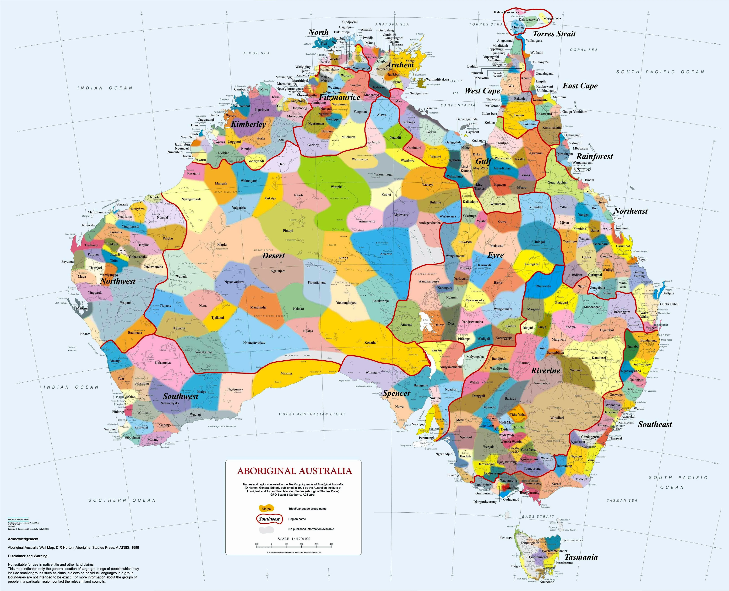
Acknowledgement to country
https://aiatsis.gov.au/explore/map-indigenous-australia

Slide 3
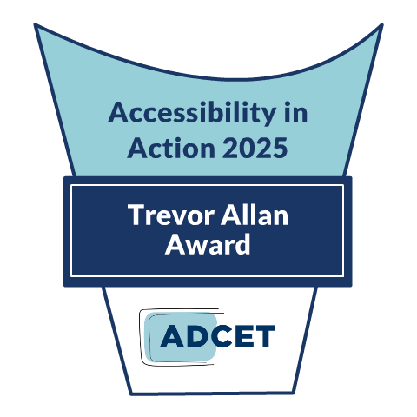
About the
AIA Awards
ADCET is proud to celebrate our Accessibility in Action awards in line with Global Accessibility Awareness Day (annually in May).
These awards provide an opportunity to highlight and showcase the amazing work by individuals and teams in advancing accessibility and inclusive practice across the tertiary education sector in Australia.

Slide 4
Thank you, Thank you
To everyone who nominated an individual or a team/project this year.
To our fabulous panel of judges that assisted us this year in evaluating the nominations.
To everyone who missed out this year, and to the numerous staff and students across the sector that continue to make education more inclusive and accessible.

Slide 5
Winners.......
Judges scored each nomination according to our criteria on a scale from 1 to 10. All scores were then collated and ADCET determined winners based on those who scored 7 and above.
7-8 for entries that comprehensively addressed accessibility barriers, related to accessibility issues for students/staff/community, and demonstrated a strong commitment to accessibility.
9-10 for entries that innovatively and comprehensively addressed accessibility barriers, related to broad institutional and community needs, and demonstrated an exceptional, institution-wide commitment to accessibility that goes above and beyond.

Slide 6
Equity-capable Careers Service
Highly Commended
Deakin University
Lauren Hansen, David Eckstein, Lisa White, Teryn Attwell, Jess Avery
Notes:
Accessible careers programs are critical to shifting the dial on workforce participation, and Deakin's equity -capable careers intitiative is an effective step to support students during their aacdemic journey. A wholistic approach is evident in this program which enables proactive participation by several equity groups that are typically excluded from careers services and programs. This initiative stands as an excellent model for all higer education careers services.

Slide 7
OneDeakin Assessment Task Template
Highly Commended
Deakin University
Sam Purvis, David O’Brien, Lea Piskeiwicz, Linda Corrin, Fabrice Bernard, Susie Macfarlane, Sachin Ranaweera, Penny Manwaring, Sara Dingle, Robyn Yucel, Tiff Gunning, Robyn Barallon, Kirra Minton, Tara Draper
Notes:
A significant impact for access to assessment is evident in this initiative and the collaboration across faculties and engagement with students in the design of accessible and inclusive assessment templates in commendable. Assessment impacts all students and the reach of beneficiaries that this imitative has is vast.

Slide 8
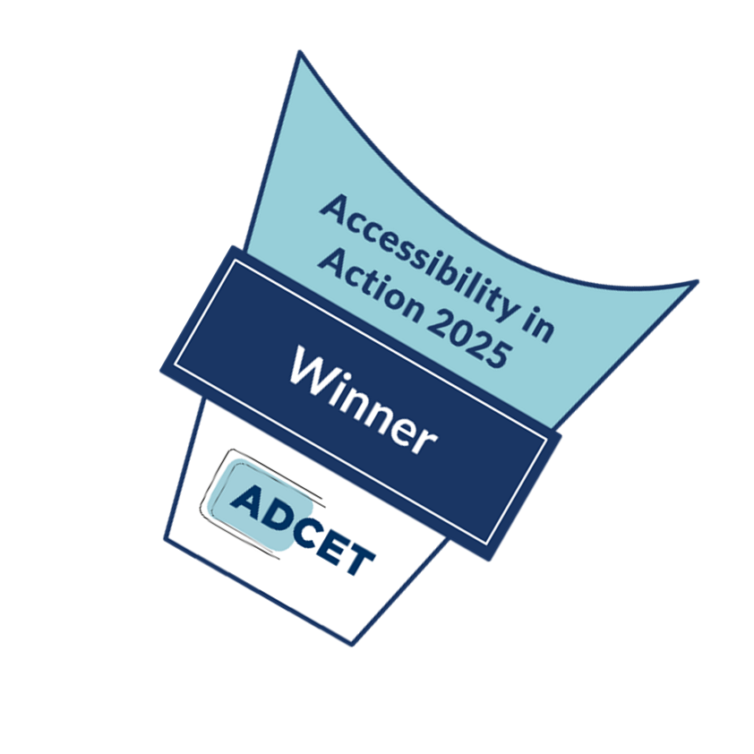
Individual Awards
Champions of Accessibility 7 winners

Slide 9
Trina Bianchini
Individual Award - Champion of Accessibility
TAFE SA Inclusive Education Roadmap
TAFE SA
Notes:
This is a very comprehensive list of achievements! Trina is clearly committed to bringing accessibility and inclusion to the forefront of TAFE SA, and she has proven that over and over again.

Slide 10
Jacinta Jones O'Meara
Individual Award - Champion of Accessibility
Accessibility Leadership and Advocacy
RMIT
Notes:
Jacinta has clearly made a massive impact at RMIT for both students and staff over a range of different events and programs.

Slide 11
Carmel Whitty
Individual Award - Champion of Accessibility
SureStart
(Transition support program for 1st year University students with Autism)
Macquarie University
Notes:
Transition support for 1st yr students with autism is an excellent initiative that responds to relevant needs of higher education students and plays an important role in retention and early intervention for students that may otherwise experience isolation and disconnection to services and support - this pilot contributes significantly to student success.

Slide 12
Associate Professor Laura Gray
Individual Award - Champion of Accessibility
Medical Deans (MDANZ)
Disability Inclusion Self-Assessment tool
Deakin University
Notes:
An innovative and practical tool that uplifts equity and inclusion in an academic environment that poses significant challenges for studying with disability.

Slide 13
Tiana Blazevic
Individual Award - Champion of Accessibility
The Neurodiversity Project:
Neurodivergent Study Skill Workshops
University of Adelaide
Notes:
I love that Tiana is focusing on neurodiverse students who cannot afford a formal diagnosis. I think it helps to break down the financial barrier that is often not talked about when it comes to disability. I also appreciate her understanding of co-morbidities with neurodivergence, such as auditory processing issues and hypermobility.

Slide 14
Brooke Szucs
Individual Award - Champion of Accessibility
UQ Disability Inclusion Advocacy Network (DIAN)
and Associated Initiatives
University of Queensland
Notes:
Incredible to see the comprehensive range of impacts Brooke has had, from setting up communities, advocating for accessibility and inclusion awareness, and doing so within and beyond their institution.

Slide 15
Joe-Anne Kek-Pamenter
Individual Award - Champion of Accessibility
Sustained Advocacy and Commitment to Accessibility
Griffith University
Notes:
Joe-Anne is clearly dedicated to helping d/Deaf and hard of hearing students in the digital world of tertiary study. I'm very glad to see a disabled staff member on this list, as it brings a unique and imperative perspective to how we can integrate accessibility into the tertiary sector.

Slide 16
Trevor Allan Award
Excellence in Disability Inclusion and Accessibility
This award is a prestigious honour that is bestowed annually upon an individual who has demonstrated a sustained and unwavering commitment to promoting accessibility and inclusion for students with disability in tertiary education across Australia.
Named after Trevor Allan, a renowned champion and leader in the disability and tertiary sector, this award recognises and celebrates those who have made significant and sustained contributions to creating an equitable and inclusive learning environment for all students.

Slide 17
Jodie Hoger
Trevor Allan Award - Excellence in Disability Inclusion and Accessibility

Slide 18
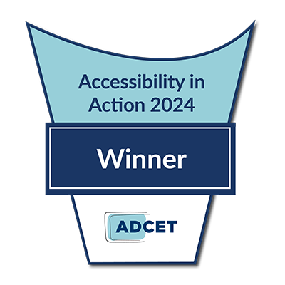
Team / Project Awards 11 winners

Slide 19
Inclusive Assessment Strategies for Educators
Team/Project Winner
RMIT
Alyce Greenwood, Teresa Dowding, Anna Branford, Jacinta Jones-O'Meara, Ronny Andrade Parra, Hilary Wheaton, Jamal Abilmona, Colette Beauregard Seehaber, Rachael Hains-Wesson, Ann Standish, Helen McLean, Chilwin Soh
Notes:
Assessment is a key area that is overlooked in terms of accessible design. It is wonderful to have training and support that provides opportunity for educators to deeply engage with this and design inclusive assessments.

Slide 20
Creating Accessible, Inclusive and Student-Centred Support Practices
Team/Project Winner
Charles Darwin University
Julia Ash, Chloe Hay, Marnie Bruce
Notes:
University-wide cultural, digital, and physical accessibility improvements with strong student voice and measurable outcomes.

Slide 21
Auslan Language and Culture Beginners 1 and 2
Team/Project Winner
University of Newcastle
Tom Doe, Sarah Dearlove, Mali Webb, Patrick Nichols
Notes:
Refreshing to see accessibiity in action through curriculum, the empathy building, capability building and positive impact this initiative brings to allied health practices and education.

Slide 22
UniSC Graduation Ceremonies
Team/Project Winner
University of the Sunshine Coast
Emma Rahui, Stefanie Tropiano, Kylie Williams, Naomi Charlie
Notes:
Accessibility considerations which address a range of barriers to full, inclusive, and safe graduation attendance. What a great example for other events and other universities!

Slide 23
Professional Captioning Dashboard
Team/Project Winner
University of Technology Sydney
Angel Lee, Ashley Willcox, Conrad Frankland, Elizabeth Smith, Jasmeet Bedi, Jean Lei, Jomark Sto Domigo, Katie Duncan, Michael Chan, Sandra Guthrie, Shirin Bayat
Notes:
I appreciate how they acknowledged how they had difficulties in the past and how they improved them for accessibility purposes. I hope that more educators get on board for this. And This is a fantastic effort by the team to ensure equitable access to information by supporting professional captioning. I hope other universities follow suit!

Slide 24
Curtin Specialist Mentoring Program (CSMP)
Team/Project Winner
Curtin University
Sandhya Subarmanian, Debbie Teh, Paul Crestani, Kevin Winder
Notes:
I really like the student to mentor ratio, I think it is beneficial for both parties, both to not overload the mentors with too many mentees, and to keep the mentees with familiar people. I also like that they have a common space for them to meet and spend time, as well as special interest groups within the program.

Slide 25
Biomedicine Technical Services Team
Team/Project Winner
Deakin University
Maria Amodio, Cuong Huynh, Nick Esbert , Liam Nolan, Shea Randall, Khanh Tran
Notes:
This team demonstrates what is possible when we consider accessibility and deeply consider how individuals engage with concepts and lab work beyond simply visual material. An inspiration to other teams!

Slide 26
Inclusive Employability Project
Team/Project Winner
Edith Cowan University
Emma Lovegrove, Denise Bertilone, Prof. Justin Brown
Notes:
Great to see an employability focused initiative that incorporates codesign, lived experience of disability, intersectional disadvantage, staff engagement, ways to focus on inclusive employers, employer engagement and user testing to build organisational capacity for participation of staff with disability.

Slide 27
Implementing a Hive Formation for Accessibility and Inclusion Knowledge Sharing
Team/Project Winner
TAFE New South Wales
Naomi McGrath, John Fardoulis, Kathy Simic, Stephen Belbin, Carla McMillan, Sue Wakefield, Mia Lahey Rudd, Teresita Eslava, Gail Mercado
Notes:
Rich self-service staff resources and tools, great institutional embedding and support for systemic change.

Slide 28
UDL-LevelUp: Implementing Inclusive Practices in Teaching and Learning
Team/Project Winner
TAFE New South Wales / TAFE South Australia
Naomi McGrath, John Fardoulis (TAFE NSW) Trina Bianchini, Tanya Allan (TAFE SA)
Notes:
Level up UDL is a strategic framework that provides an iterative and accumulative methodology to building capability for embedding UDL principles and accessible practices for staff, which when implemented would address accessibility barriers in teaching and learning.

Slide 29
Neurodiverse Student Programs
Team/Project Winner
Deakin University
Meg Mahar, Lisa Kavenagh, Emma Clyne, Tracey Nelson, Kylie Fitzpatrick, Claire Edwards, Andrew Synnot, Craig McGree, Lizeth Rodriguez, Simon Goh, Nikki Bleja, John Laidlaw, Michelle Jepsen, Tracy Ellis
Notes:
Multiple programs, Navigate, body double, sensory mapping, low sensory orientation to address multiple barriers to study.

Slide 30
Congratulations

Slide 31
Coming up!
Look out for some of our amazing winners in future webinars, podcasts and articles!
For more information on AIA visit:
www.adcet.edu.au/our-work/accessibility-in-action-award

Slide 32
Congratulations
& Thank You

