Slide 1
Meeting Our Digital Duty of Care: disability data in practice
Dr Bret Stephenson
ACSES Equity Fellow 2024

Slide 2
Acknowledgement of country
I respectfully acknowledge the Wurundjeri Woi-wurrung people, the Traditional Owners of the unceded lands on which I live and work (Melbourne). I pay my respects to their Elders past, present, and emerging, and recognise their continuing connection to country, waterways, culture, and community.
I would also like to warmly welcome any Aboriginal and Torres Strait Islander peoples joining us today, and acknowledge your presence, your knowledge, and your contributions.

Slide 3
2024 ACSES Equity Fellowship
Centring student equity in data and AI governance: informing policy to empower practice
Dr Bret Stephenson
ACSES Equity Fellow 2024

Slide 4
Four areas of focus
2024 ACSES Equity Fellowship
1. Legislation and regulation (macro-level)
What are unis required to do and how is this changing?
2. Uni policy analysis (meso-level)
What do unis say they are doing?
3. Practitioner interviews (micro-level)
How is it going on the ground (challenges, risks, opportunities, and readiness for digital change)?
4. Emerging good practice
How can we better centre equity concerns and voices in the digital age?

Slide 5
Why do we need to centre equity in data and digital governance?
Let's keep in mind:
power asymmetries,
tensions between individual and group privacy/rights
and differences in information vulnerability

Slide 6
Why data and digital governance?
Our context is now profoundly postdigital (Fawns, 2023) or sociodigital (Sriprakash et al. 2024)
Characterised by:
Datafication – quantification of human life through digital information (Meijas & Couldry, 2019)
Digitalisation – increasing integration of digital technologies into (nearly) all aspects of university operations (Komljenovic, J., 2022)

Slide 7
Why data and digital governance?
Two main reasons…
Digital technologies and data practices are co-constitutive.
Digital systems don’t just transmit or process data— they actively shape what is recognised as data, what remains hidden or exposed, and who holds power over it.
We are concerned with more than just data privacy.
Digital harms – surveillance, algorithmic bias, automated exclusion, psychological harms, platform dependence, group harms, etc.

Slide 8
To be clear
To be clear…
When well governed, data and emerging digital technologies can bring significant benefits to individuals, groups, and to the broader public good.
We need good data.
We need empowering digital technologies.
But we must also work to be good (transparent, responsible and critical) stewards of our student’s digital selves.

Slide 9
“We do an awful lot of work in the grey”
But why is there so much grey?
A quick look at the three levels of governance:
Legislation/regulation (macro-level)
Institutional policies (meso-level)
Individual university staff views and experience at the coalface (micro-level)

Slide 10
Legislation and Regulation: Federal and State/Territory
Macro-Level
What universities are required to do.

Slide 11
Australia’s Fragmented Privacy Framework
Privacy legislation is fragmented between Commonwealth and state and territory legislation.
Health data legislation adds another level of state and territory fragmentation in relation to disability.
Public universities operate under many different (state/territory) privacy frameworks, often with dual responsibilities.
See ADCET’s excellent resource:
“Privacy Legislation and Disability Services”

Slide 12
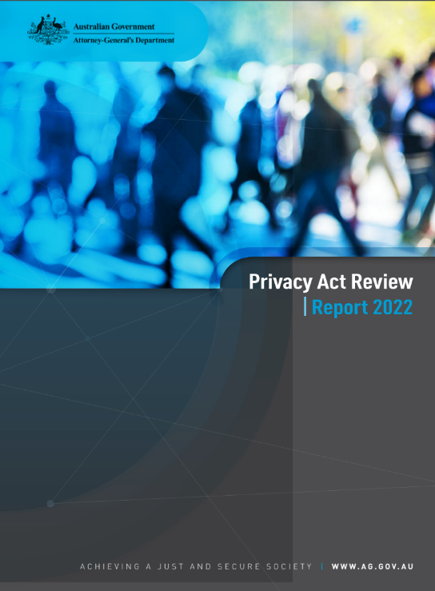
A changing landscape
In a May 2024 speech, Attorney-General Mark Dreyfus, argued that the Privacy Act 1988 (Cth) is
“woefully outdated and unfit for the digital age”
And that…
“Australia can no longer afford to have inadequate privacy protections.”
Attorney-General Mark Dreyfus
(Speech to the Privacy by Design Awards 2024)

Slide 13
A changing landscape
In sum, its time to address the grey…
Privacy Act Review Report, released in February 2023 - 116 proposals to modernise Australia's privacy framework
Government’s response (Sept 2023): 38 Agreed, 68 Agreed in Principle, 10 Noted

Slide 14
Reforms are underway
Tranche 1 Reforms (November 2024) – addressed 23 ‘agreed’ proposals
Organisations must update their privacy policies to disclose when decisions are made through automated processes
Clarifies ‘reasonable steps’ to protect the security of personal information – must implement both ‘technical and organisational measures’
Tranche 2 Reforms (forthcoming) – expected to:
Modernise definitions of personal information and consent
Implement a ‘fair and reasonable’ test to take the privacy burden off individuals alone
Enhance individual rights

Slide 15
Do Privacy Act 1988 (Cth) reforms apply to universities?
Only the Australian National University (ANU) and private universities are strictly obligated to follow the Privacy Act.
Most other Universities will have limited responsibility to follow the Privacy Act reforms:
for HESA data collections, controlled entities, and under some contracts.
Important Point – Many universities voluntarily commit to following the more stringent federal Privacy Act.

Slide 16
Tensions between privacy and openness are particularly
relevant
Tension between
the need for individual privacy/agency and group solidarity.
Privacy law is largely focused on the individual, ignoring group inferences and group privacy erosions.
the need to be both seen and unseen in data collections – conditional or contextual visibility.

Slide 17
Tension between
Tension between
“Nothing about us without us” – group solidarity and sovereignty
or/and
“Nothing about me without me” – individual sovereignty and agency
Digital Self-Determination (DSD)

Slide 18
Tensions between privacy and openness
Office of the Australian Information Commissioner (OAIC)
The independent national regulator for privacy and freedom of information.
“We promote and uphold your rights to access government-held information and have your personal information protected.”
Office of the National Data Commissioner (ONDC)
Data Availability and Transparency Act 2022
Provides the legal framework for the National Disability Data Asset
“serve the public interest by promoting better availability of public sector data…”

Slide 19
Convention on the Rights of Persons with Disabilities (CRPD)
Article 22 – Respect for
privacy
Article 31 – Statistics and data collection
“shall protect the privacy of personal, health and rehabilitation information of persons with disabilities on an equal basis with others.”
The need to be unseen or uncounted
“collect appropriate information, including statistical and research data, to enable…and implement policies…”
The need to be seen or counted

Slide 20
Analysis of University Policies
Meso-Level
What universities say they are doing

Slide 21
Analysis of University Disability Policies
A (very) short summary
Sector wide analysis of all Australian university (Table A) “disability policies”.
The analysis is limited to publicly available policies and procedures that appear to be the primary policy statement(s) in institutional policy libraries.
Disability Action Plans were out of scope.

Slide 22
Analysis of University Disability Policies
39 (Table A) Universities Included
12 Universities had no discernible policy dedicated to students with a disability.
Some had SfSP or broad DEI policies that briefly mentioned the availability of disability support, while others only had staff policies.
27 Universities included in the analysis

Slide 23
Data and digital governance highlights
9 universities reference digital inclusion commitments/efforts
6 reference consultation or participation of people with disability in policy/governance
11 describe privacy protections that are unique to disability data

Slide 24
Data and digital governance highlights
9 describe internal handling/disclosure of Learning Access Plans and clarify distribution responsibilities.
14 indicate how students must evidence disability status – most require medical/health
Only 4 or 5 clarify the gap between disclosure at enrolment and disclosure to central support unit
Very few indicate what data is reported to government.

Slide 25
Semi-Structured Interviews
Micro-Level
How is it going on the ground? Are we ready to meet our digital duty of care?

Slide 26
Participant Selection / Recruitment
They are a staff member of an Australian public university (Table A), and;
their role may be described as a student equity practitioner – or someone significantly involved in providing support services to undergraduate students identified with an ‘equity group.’
or, their role is significantly related to the senior leadership or management of student equity strategy and/or support services, or;
their role is significantly related to the management or governance of student data and/or digital technologies.
Recruitment via purposive sampling

Slide 27
Participant Profile
21 Participants – Avg interview length of 62 minutes
Position Level
Executive 5
Director 5
Manager 5
Professional 6
Role/Responsibilities
Equity All
Evaluation All
Disability 10
First Nations 5
Data/Eval 3
Data (Eval) Steward 5
University Distribution
Uni Groups All
States/Territories 6
Unis 12
Commitments to participant and institutional anonymity in the research ethics protocols allows only for high-level aggregate figures.

Slide 28
It's important to note the changing HE policy context during the course of this research and its influence on the topics of concern.
There has been a lot going on!

Slide 29
Are we ready to cope with more personal data?
“In addition to setting targets, Government must improve data collection to understand and address more granular indicators of disadvantage better.” (Final Report, p. 117)
Calls for more personal/sensitive student data collections to identify and monitor additional equity groups, including:
First-in-family students, mature-aged students, care leavers, refugees, carers, certain language groups, and prisoners.
Particularly notes many problems with disability data collection/reporting.

Slide 30
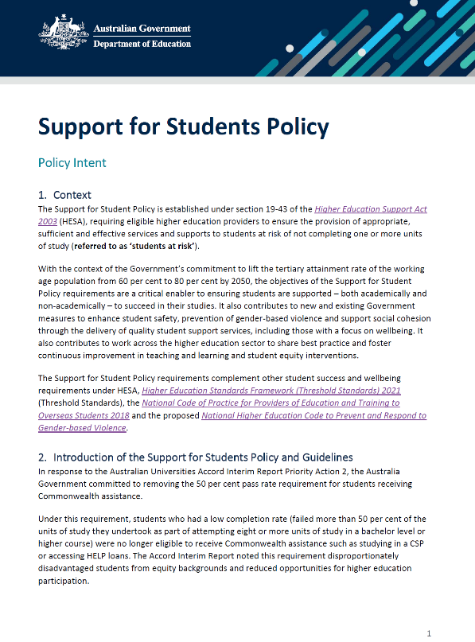
Support for Students Policy
“There are additional concerns about student privacy and appropriate risk management concerning the handling of identifiable information…
…that could be potentially damaging if mishandled (e.g. financial data, access history of wellbeing services, identification of ‘at-risk status) without there being significant, obvious benefit to individual students.”
Universities Australia, Submission to the Support for Students Policy Guidelines Consultation Paper

Slide 31
Governance of equity evaluation activities in universities
Raising issues concerning the governance of evaluation activities.
While the governance of human research is well delineated, socialised and understood, the governance of evaluation activities often exists ‘in the grey’.
Policies, procedures and guidelines?
HREC approval? Privacy Impact Assessment (PIA)? Committee approval? Data Custodian/Steward approval?

Slide 32
Governance of equity evaluation activities
5.1.7
Institutions should have a clearly defined decision-making process for determining whether an activity is research or if it is another activity, such as quality assurance, and have separate mechanisms for the review and authorisation of each.
These mechanisms should be set out in the institution’s policies and procedures.

Slide 33
Greater guidance in health fields
“Irrespective of whether an activity is called research or QA or evaluation, those conducting the activity must consider whether the people involved (e.g. participants, staff or the community) will be exposed to any risk, burden, inconvenience or possible breach of their privacy.”
“In many situations, oversight of the activity is required, but ethical review is not necessary.”
“Organisations should develop policies on QA/evaluation which provide guidance for oversight of QA or evaluation activities.”

Slide 34
Views on the maturity of data management, governance and processes
Many participants report low levels of maturity
“So, [our university] I would say, is at a relatively early stage in terms of its digital infrastructure and it's at an even earlier stage in terms of its data governance, particularly in relation to equity data.” (Director)
“And, you know, speaking very candidly, which I am comfortable doing… So, I don't think our data governance has got to a very mature state in relation to this.” (Director)
Areas of high, but localised, maturity
“And look there will be, absolutely, pockets of excellence at [the university] that I'm not representing because there'll be people who live and breathe this stuff.” (Executive)

Slide 35
Is data/digital policy well socialised and influencing practice?
“So, policies, whether they exist or not, are certainly not in the culture.” (Manager)
“There's a gap between what is rhetoric and what is… well, it is just rhetoric…What the practise is, is not what is clearly stated in the rules. [we have lots of policies]…these are the rules. There's no connection. It's fully known. It's not like, whoops there's a gap!” (Manager)
“No not particularly well socialised. Yeah, I think there's a lot of vibes that vary from team to team. But yeah, no, not like a socialised idea of this is what we should use it for. This is what we can't use it for because it's too private... I don't think people have really had that conversation.” (Professional)

Slide 36
Views on transparency and consent
“But my view is that it's probably not explicit and clear enough about how we… govern that [internal access to student equity data] across the institution and it's a bit slippery.” (Executive)
“I mean… while we take all this information from students, we never talk to them about how it gets used or how it’s going to go sit on this dashboard.” (Manager)
“I think that we need to be more robust in the way in which we evidence voluntary and informed consent for the use of those data.” (Executive)

Slide 37
Gatekeepers and Local Heroes
Many participants mentioned individual data gatekeepers, who are privacy, equity and “human-rights minded”. They step-in to make up for poor institutional governance.
Although some more junior gatekeepers report that expressing their concerns to seniors can be “career limiting”.

Slide 38
Who owns the data?: conflicting data privacy cultures
“[We frequently have the problem of] whose data is it? … that's been coming up in both our disability and our counselling team, we have a lot of clinicians of various types… obviously counsellors… and OTs and different kinds of clinicians, social workers that come into work in these teams…
and we have policies and procedures that are quite strict…
But we're also in this department with these multiple teams supporting a student moving through and everyone's, you know, trauma informed now, so we can't repeat our stories.
So, we've had these kind of challenges where an individual team is like [no, you can’t have any of this data]…Whereas [the university] wants a bit more flow.” (Director)

Slide 39
Data and digital systems frequently unfit for disability support work
Unfit CRMs
“So, at [the university], the CRM that we are using is out of date and incredibly clunky and not flexible. And the disability team have to work by pen and paper or Excel spreadsheets…” (Manager)
On Learning Access Plan distribution:
“ …we have data security concerns around the platform that we use as well… we have concerns about who can access that data sometimes. So, we're having to deplatform… and consider what we move it to. But at the moment it's Excel spreadsheets and PDFs which is less than ideal. “ (Executive)

Slide 40
Data and digital systems for disability work often poorly resourced
“The process of having the [disability] data management system built was horrendous and having it matched to our needs, it was the most unpleasant process I've ever been through in my university career.” (Manager)
“The university is now looking at [a particular software product] and it's been years of just non-stop meetings and we're not a priority despite…that we keep being told we are and then we're not…” (Manager)

Slide 41
The AI excitement and worry among disability/accessibility support staff
Excitement
“It's been an extraordinary enabler…students said. And I think we're only just starting to look at the possibilities…
[It can provide] agency, absolutely, the capacity to work in a workplace, the capacity to act independently.
We have an absolute responsibility in higher education to teach students about this stuff and to teach them how to use it.” (Manager)

Slide 42
The AI excitement and worry among disability/accessibility support staff
Worries
[Regarding DA staff entering student information into generative AI]
“…now that information is somewhere on the record and [in the cloud]. So where is the “do no harm?” We have seen the harm that can come even with the best intentions.
But people are just giving the data over freely into some of these tools unchecked.” (Professional)

Slide 43
Part 4: Examples of good, innovative and emerging practice

Slide 44
The Enterprise Data Ethics Framework
The Enterprise Data Ethics Framework provides a consistent enterprise-wide approach for the ethical use of data for non-research purposes across The University of Queensland (UQ).
Internal data sharing agreements
Data ethics principles and handbook
Handbook for Information Stewards
Several training courses available to staff
Data Ethics Advisory Group - responsible for reviewing and providing advice in non-research data use cases.
https://data.uq.edu.au/enterprise-data-ethics-framework

Slide 45
Equity, Diversity, Inclusion and Ethics in Data Advisory Group
The objective of the EDIE in Data Advisory Group is to consider and advise on matters pertaining to equity, diversity, inclusion, and ethics in data as they relate to the management and use of information across UniSC.
Protocols address
1. Data consent and transparency
2. Data minimisation – collect only necessary data
3. Respect data privacy and confidentiality
4. Actively promote inclusion and fair representation
5. Ensure transparency in data and decision-making
6. Engage in ethical data practices and governance
7. Continuous learning and improvement
Currently in draft -

Slide 46
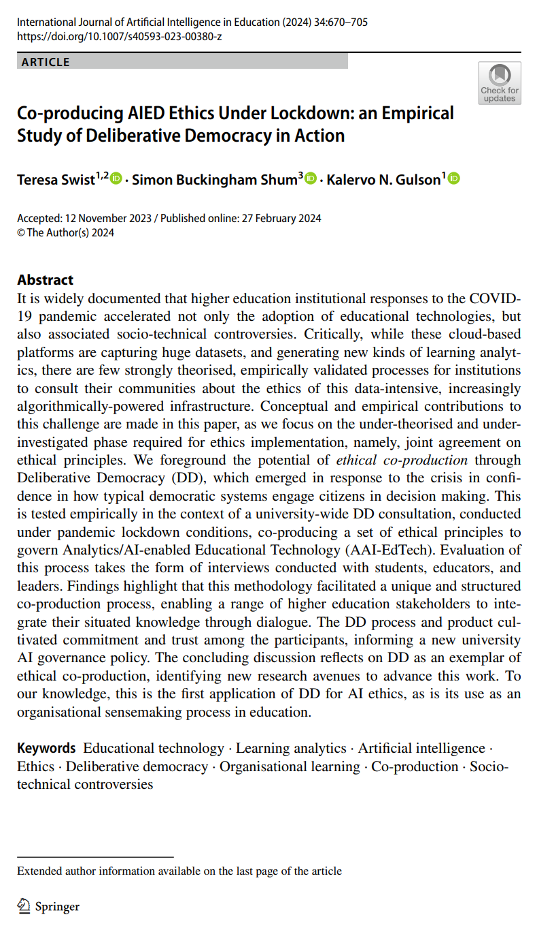
Deliberative Mini-Public (DMP)
Utilising a Deliberative Mini-Public (DMP) to develop principles to govern the use of analytics and artificial intelligence in teaching and learning at UTS.
To increase diversity of representation and minimise response bias, the DMP was selected through stratified sampling.
Demographic attributes: Gender, Indigenous (self-identified), English as a Second Language (ESL), Undergraduate (Years 1–4), Postgraduate, Staff (Academics and Tutors), and Faculty
20 participants recruited from 131 applicants
Swist, T., Buckingham Shum, S. & Gulson, K.N. Co-producing AIED Ethics Under Lockdown: an Empirical Study of Deliberative Democracy in Action. Int J Artif Intell Educ 34, 670–705 (2024). https://doi.org/10.1007/s40593-023-00380-z

Slide 47
Questions
Are we ready to be good stewards of student information in the digital age?
What are your thoughts on our digital duty of care? Are we meeting it?

Slide 48
References
Fawns, T. (2023). Postdigital Education. In P. Jandrić (Ed.), Encyclopedia of Postdigital Science and Education (pp. 1–11). Springer Nature Switzerland. https://doi.org/10.1007/978-3-031-35469-4_52-1
Komljenovic, J. (2022). The future of value in digitalised higher education: Why data privacy should not be our biggest concern. Higher Education, 83(1), 119–135. https://doi.org/10.1007/s10734-020-00639-7
Mejias, U. A., & Couldry, N. (2019). Datafication. Internet Policy Review, 8(4). https://doi.org/10. 14763/2019.4.1428
Sriprakash, A., Williamson, B., Facer, K., Pykett, J., & Valladares Celis, C. (2024). Sociodigital futures of education: Reparations, sovereignty, care, and democratisation. Oxford Review of Education, 1–18. https://doi.org/10.1080/03054985.2024.2348459

