Slide 1
Inclusive placements for students with disability
A/Prof Amani Bell
Link to slides: bit.ly/AmaniBell

Slide 2
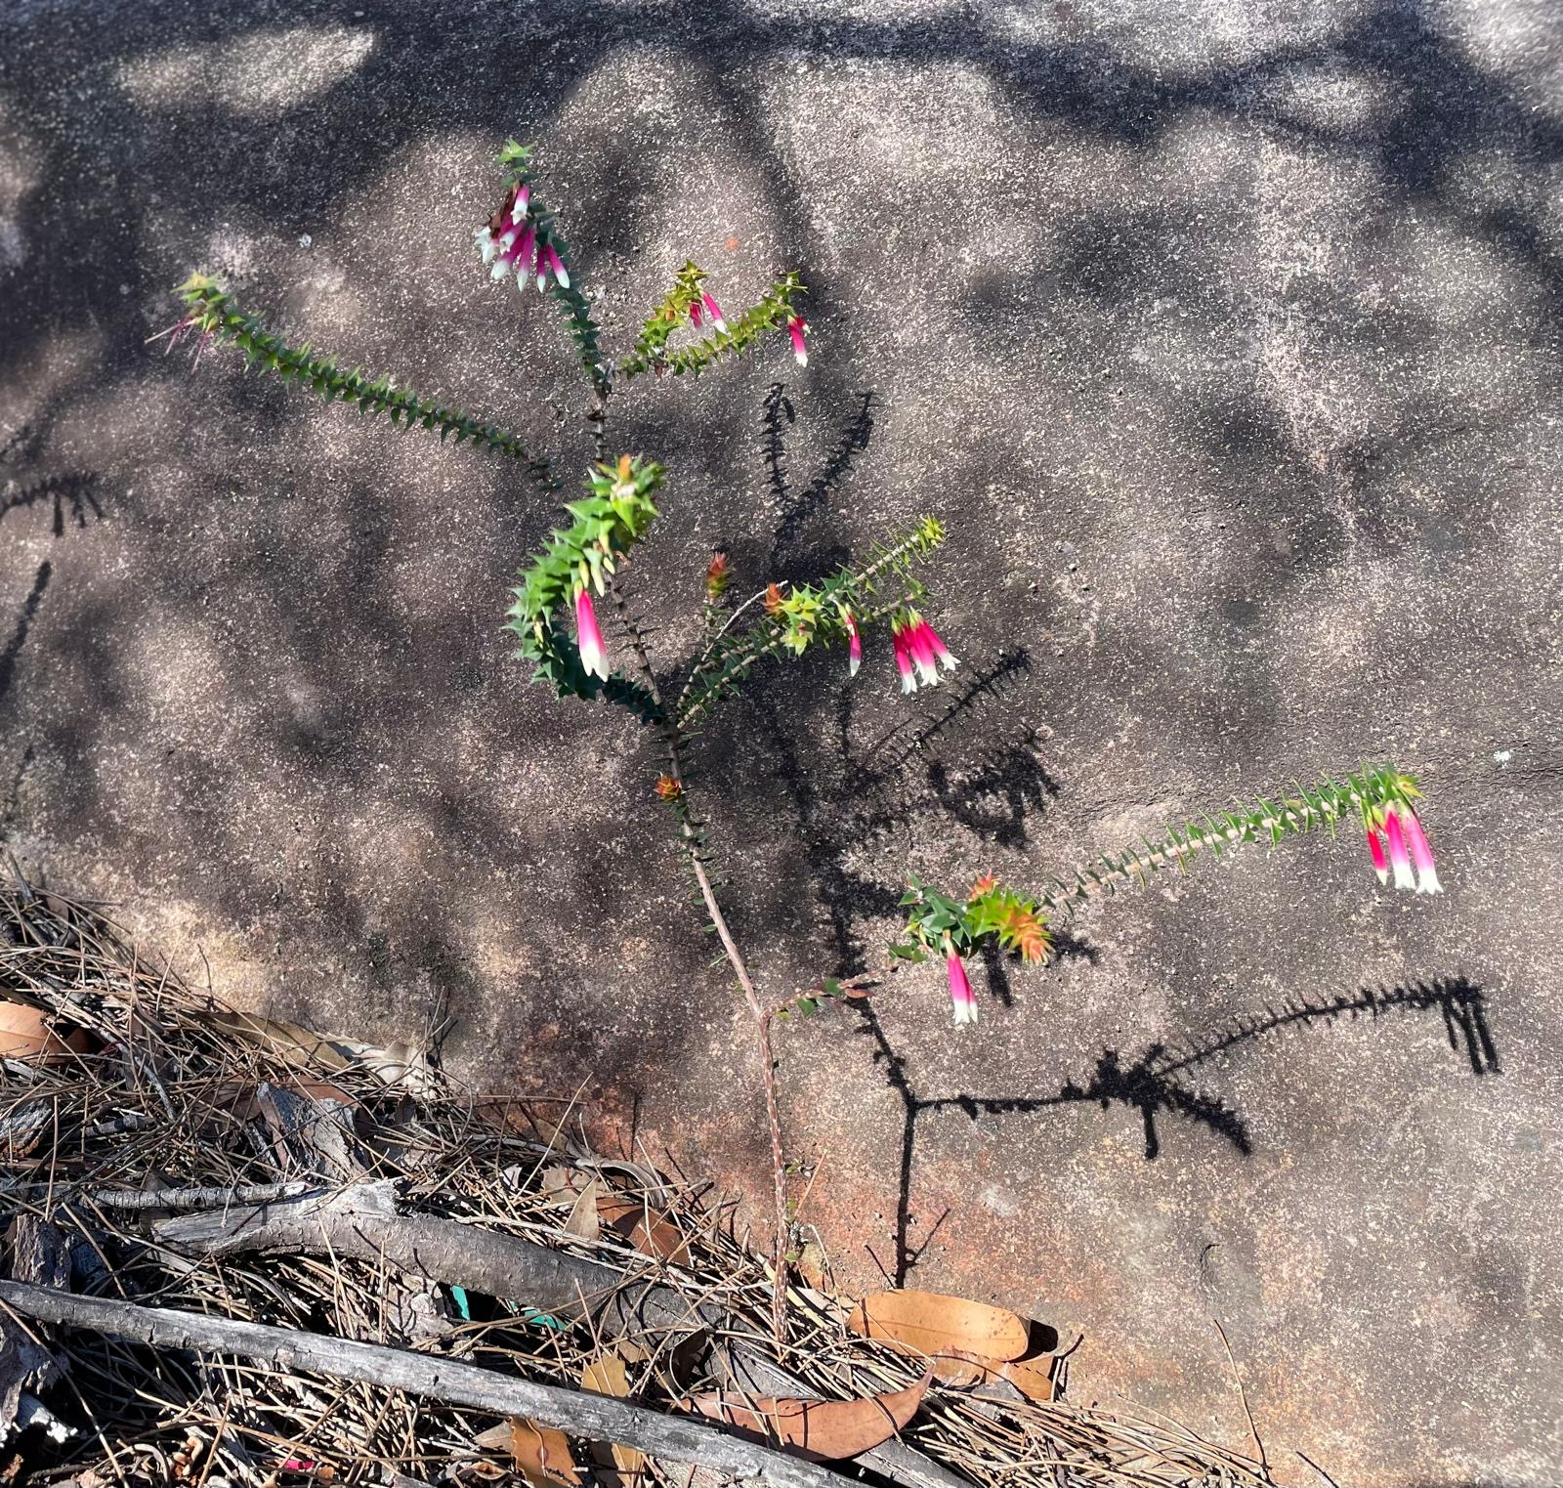
Always on Country

Slide 3
Fellowship aims:
Develop solutions to the inequalities caused by unpaid placements
Develop solutions to ensure that placements are inclusive for all students, particularly those from equity-deserving cohorts
Via participatory action research
Four student co-researchers
Four co-design workshops

Slide 4
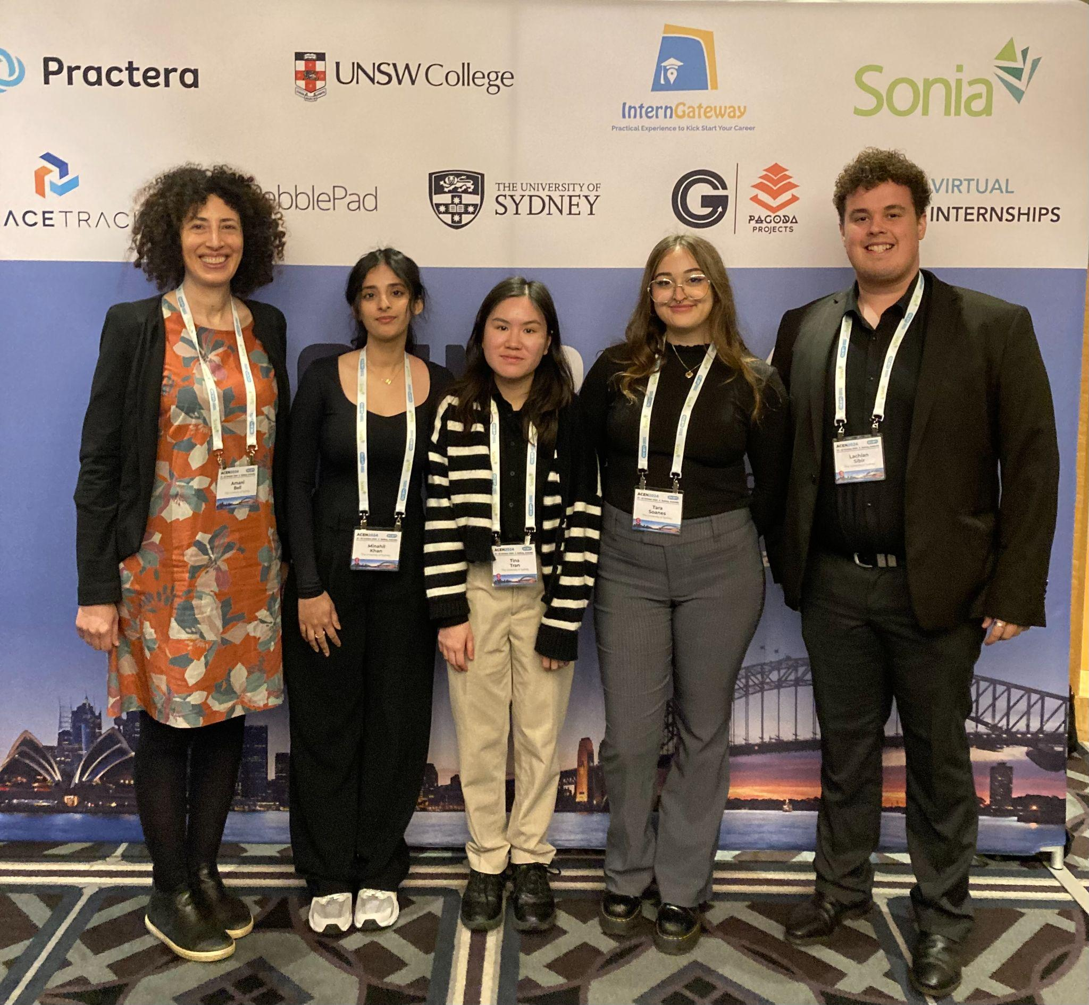
The team

Slide 5
Background

Slide 6
Placements are valuable learning experiences
Students with disability perceive that placements are good preparation for future work
Linked with full-time job attainment for students with disability
(Jackson et al. 2023)

Slide 7
Students with disability face significant inequities
Access placements at lower rates (Jackson et al. 2023, Universities Australia 2019)
Encounter stigma, lack of accessible placements & difficulties seeking accommodations (cyda 2022, Lawlis et al. 2024, Dollinger et al. 2022).
Limited change from 2005-2022 (Lawlis et al. 2024)
Limited work experience a major barrier to securing meaningful employment (Eckstein 2020)

Slide 8
Our Approach

Slide 9
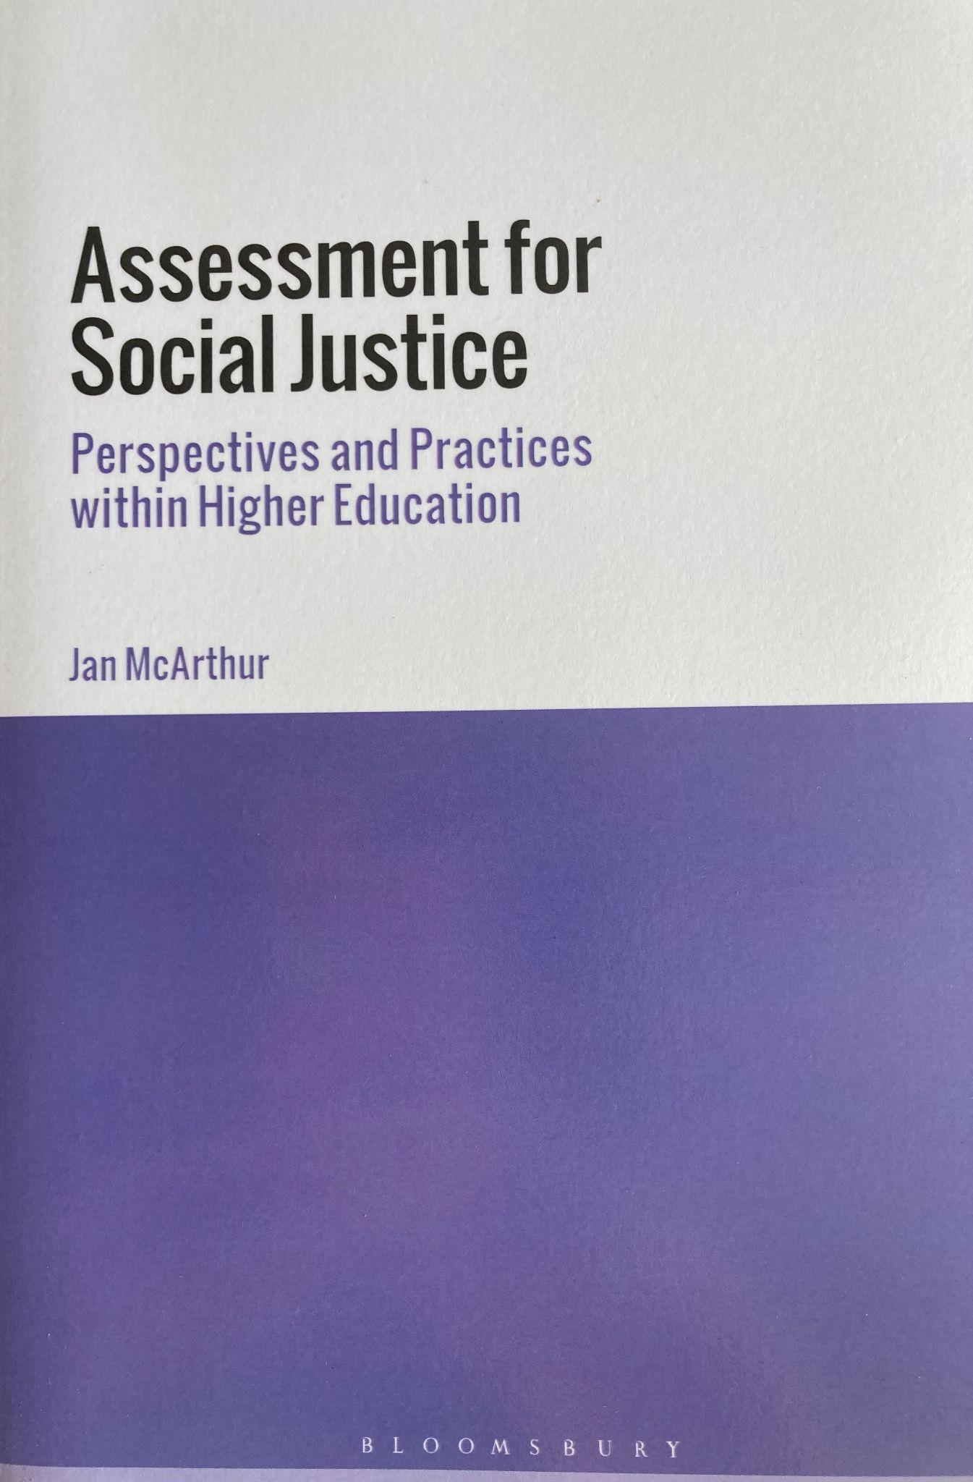
Framing concepts
Work-integrated learning for social justice
Lived expertise
Participatory action research

Slide 10
Fellowship co-design workshops
Educators & students from across Australia (n=74)
Researchers, activists, advocates, lived experience / expertise
Workshop 1: Sharing experiences and solutions
Workshop 2: Placement poverty focus
Workshop 3: Placement inclusion focus
Workshop 4: Communicating solutions & staying in touch

Slide 11
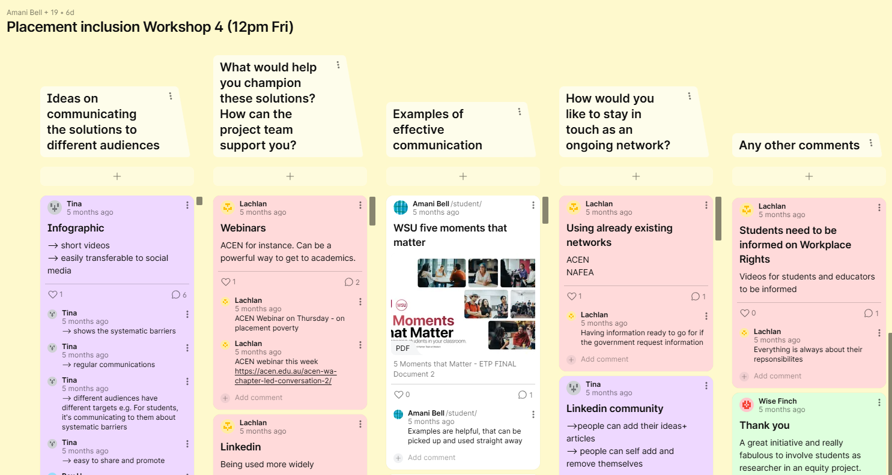
Padlet example

Slide 12
Findings

Slide 13
Challenges
Difficult to access placement accommodations
Have to continually ‘prove’ disability
Lack of awareness of how to support neurodiverse students
Power dynamics
Who is responsible?

Slide 14
Proposed solutions for placement exclusion
Mentoring & tailored support
Advocacy
Wellbeing & support
Capacity building for educators
Curriculum design
A focus on inclusive practices
Flexible placements

Slide 15
Proposed solutions for disability placement exclusion
Meeting the Disability Standards for Education
What is provided for placement site staff?
Small grants for placement sites
Advocacy about the benefits of a diverse workforce
Get out of siloes
Review inherent requirements
Part-time placement options
Professional learning for staff
Clear, easy processes for students
Follow up / feedback

Slide 16
Recommendations

Slide 17
Partnership is key
Keg de Souza

Slide 18
2. Flexible placement options are needed
Slinky by Ryk Neethling
(CC BY-ND 2.0)

Slide 19
3. Take a whole of degree approach to inclusive WIL
Pixabay CC0

Slide 20
4. WIL is an ecosystem that needs to be resourced

Slide 21
5. Join us at the WIL Equity Collective
Please join us!
Instagram: https://www.instagram.com/wil_equity_collective/
Youtube: www.youtube.com/@WILEquityCollective
LinkedIn: https://www.linkedin.com/groups/14624138/
Email: amani.bell@sydney.edu.au

Slide 22
Thank you!
Expert Reference Group: Kylie Austin, Christine Morley, Tai Peseta & Isaac Wattenberg
Mentor: Cathy Stone
ACSES team
2024 ACSES Fellows
Workshop participants

Slide 23
References

Slide 24
References
Clifton, S., Fortune, N., Llewellyn, G., Stancliffe, R. J., & Williamson, P. (2020). Lived Expertise and the Development of a Framework for Tracking the Social Determinants, Health, and Wellbeing of Australians with Disability. Scandinavian Journal of Disability Research, 22(1).
cyda Children and Young People with Disability Australia (2022). LivedX Series: What Young People Said, Tertiary Education and Learning. https://cyda.org.au/wp-content/uploads/2023/08/1.-Tertiary-Education-and-Learning.pdf
Dollinger, M., Finneran, R., & Ajjawi, R. (2023). Exploring the experiences of students with disabilities in work-integrated learning. Journal of Higher Education Policy and Management, 45(1), 3-18.
Eckstein, D. (2020). “Nothing inevitable about exclusion”: Careers support for students with disability. National Centre for Student Equity in Higher Education snapshot. https://issuu.com/ncsehe/docs/davideckstein-issuu-final
Herbert R., & White-Wall, N. (2024). Ditching Disability Disclosures: Interventions to improve inclusion in Internships. Poster at ACEN conference. https://www.monash.edu/__data/assets/pdf_file/0020/3790010/Group-1_Rosemary-Herbert_2024-ACEN-poster.pdf
Jackson, D., Dean, B. A., & Eady, M. (2023). Equity and inclusion in work-integrated learning: participation and outcomes for diverse student groups. Educational Review, 1-22.
Lawlis, T., Mawer, T., Andrew, L., & Bevitt, T. (2024). Challenges to delivering university health-based work-integrated learning to students with a disability: a scoping review. Higher Education Research & Development, 43(1), 149-165.
Lowe, K., Barajas, J., & Coren, C. (2023). “It's annoying, confusing, and it's irritating”: Lived expertise for epistemic justice and understanding inequitable accessibility. Journal of Transport Geography, 106, 103504.
McArthur, J. (2018). Assessment for social justice: Perspectives and practices within higher education. Bloomsbury.
Universities Australia. (2019). Work Integrated Learning in Universities. Final Report. https://internationaleducation.gov.au/International-network/Australia/InternationalStrategy/EGIProjects/Documents/WIL%20in%20universities%20-%20final%20report%20April%202019.pdf

