Slide 1
Inclusive assessment design: from access to participation
Juuso Henrik Nieminen Deakin University (Senior Research Fellow)
juuso.nieminen@deakin.edu.au @JuusoNieminen
Anabel Moriña & Gilda Biagiotti
University of Seville

Slide 2
Acknowledgement

Slide 3
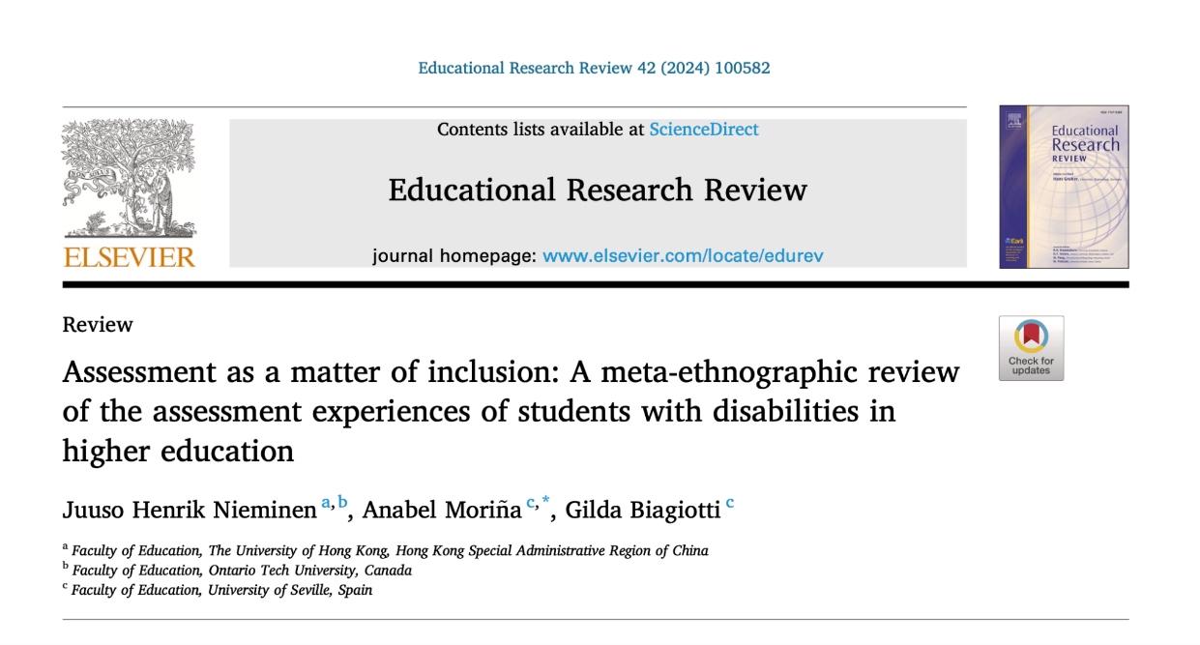
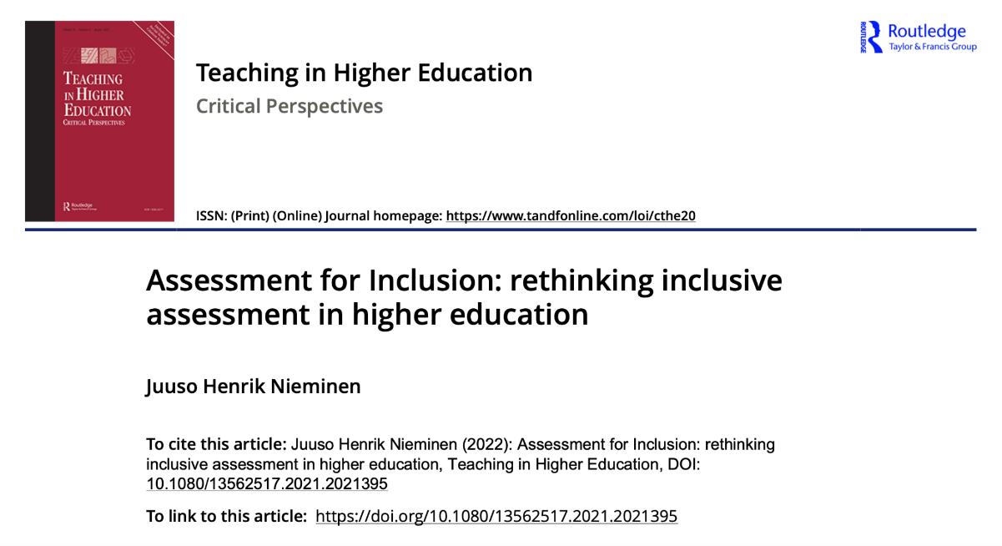
Research Screenshots

Slide 4
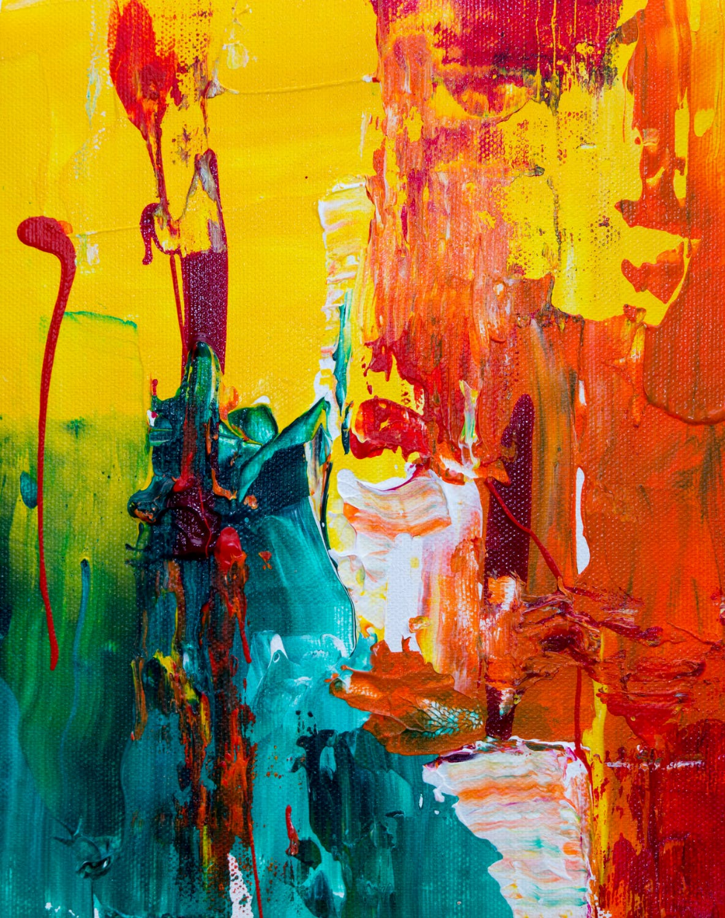
INCLUSION IN HIGHER EDUCATION
The universal higher education model has enabled access and widened diversity
Yet we have no clear definition of ‘inclusion’ in this contested space (Nieminen & Pesonen, 2021; Stentiford & Koutsouris, 2021)

Slide 5
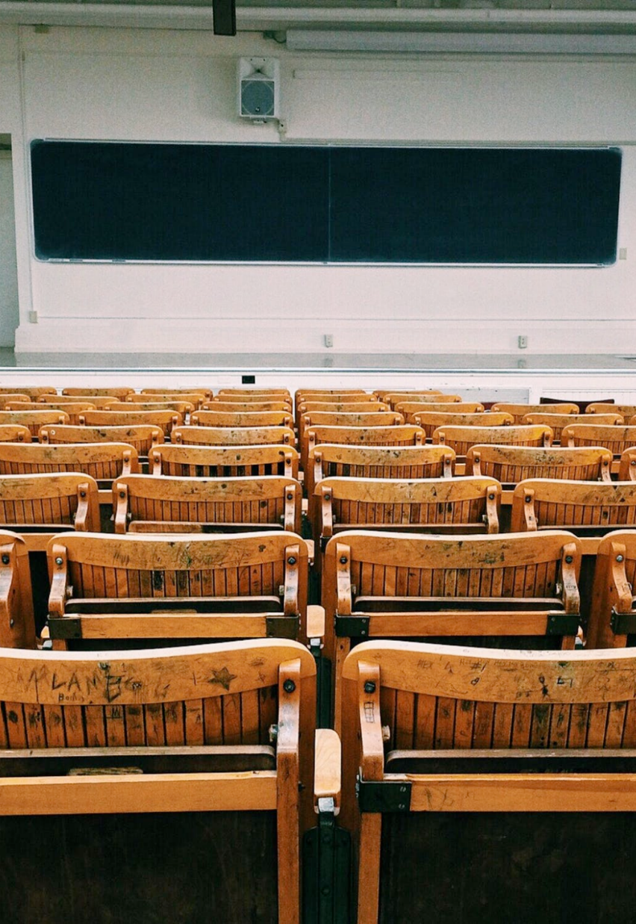
THE CASE OF ASSESSMENT
Inaccessible assessment is a major barrier for students with disabilities (Brandt, 2011; Edwards et al., 2022; Fuller et al., 2004a, 2004b; Hanafin et al., 2007; Nieminen, 2020, 2021, 2023b; Nieminen & Pesonen, 2020, 2022; Lopez-Gavira & Moriña, 2015; Redpath et al., 2013; Ryan, 2007…)
Reasonable adjustments are provided in legislation, inclusive assessment design is not

Slide 6
Why focus on assessment?
Assessment determines what success and abilities look like in higher education…
…as well as their opposites, failure and disabilities
Assessment drives learning and defines futures

Slide 7
How could assessment be made more inclusive for a diverse body of studens?

Slide 8
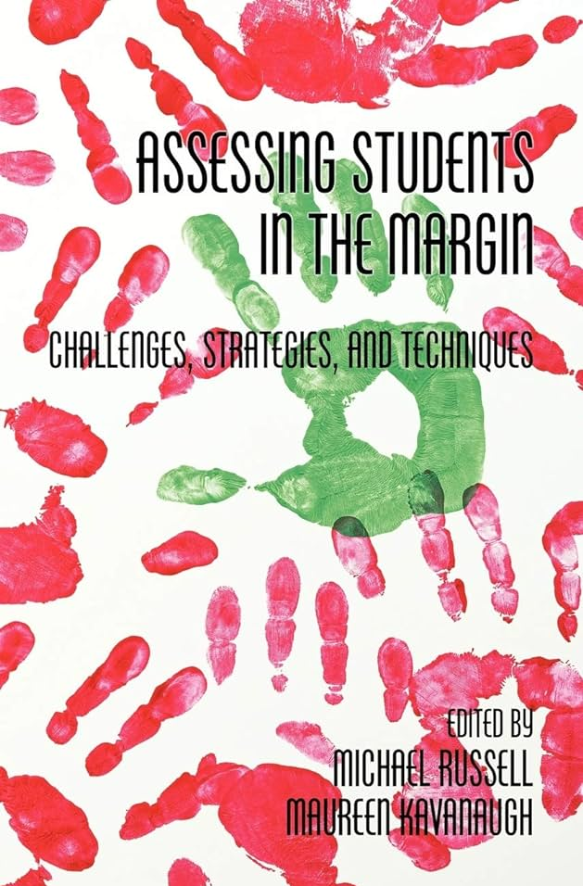
Dilemma stemming from the world of measurement
How could assessment be made more inclusive for a diverse body of students?
Dilemma stemming from the world of measurement How to assess ‘the students in the margin’? (Russell & Kavanaugh, 2011)

Slide 9
Rethinking the dilemma itself…
How could assessment be made more inclusive for a diverse body of students?
Dilemma stemming from the world of measurement How to assess ‘the students in the margin’? (Russell & Kavanaugh, 2011)
Rethinking the dilemma itself… Assessment pushes students to the margins (Campbell, 2024)

Slide 10
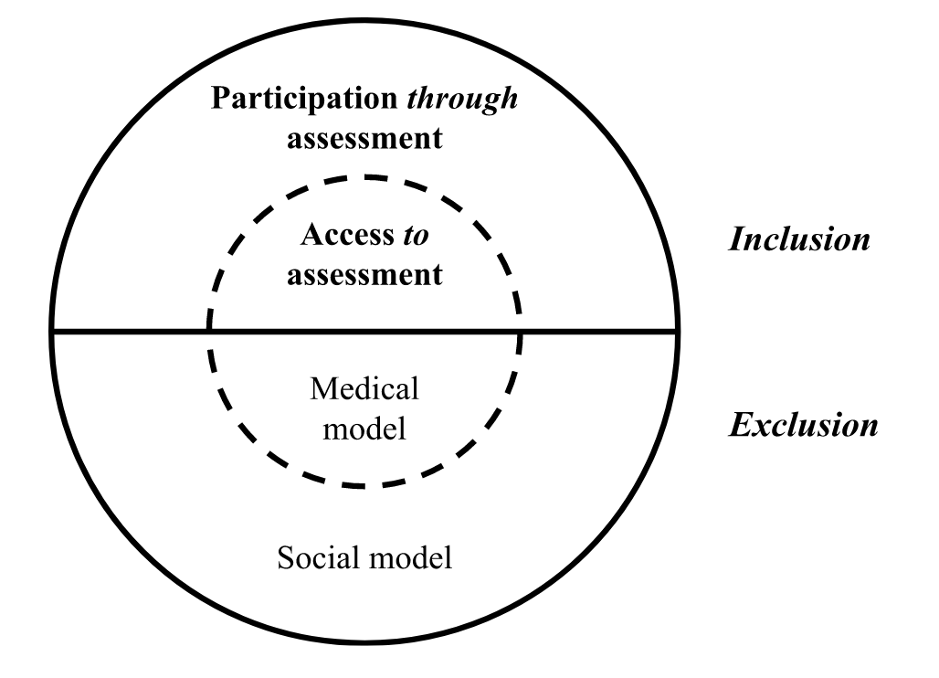
INCLUSION IN ASSESSMENT? (ANETTE BAGGER, 2022)

Slide 11
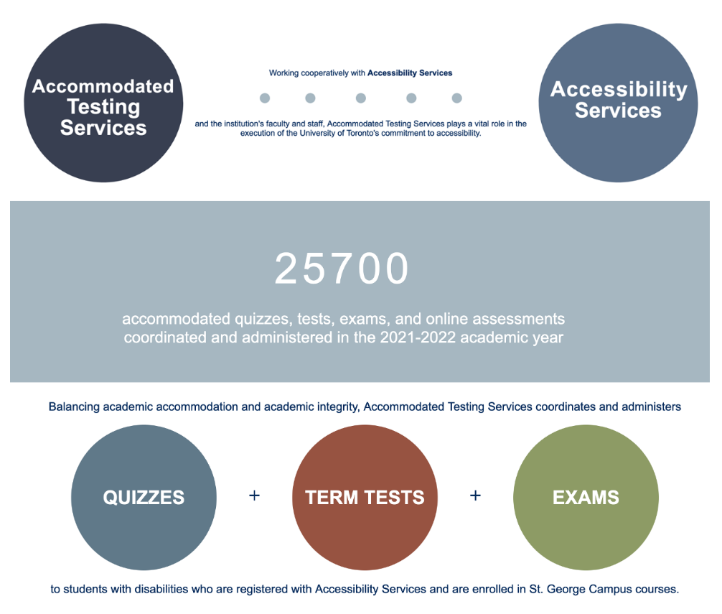
Access to assessment
INCLUSION IN ASSESSMENT? (BAGGER, 2022)
Access to assessment “Accommodations (...) should be viewed as simply the tools for accessing or demonstrating knowledge, no different than reading glasses.” (Cohen et al., 2005, p. 232)
University of Toronto, ATS

Slide 12
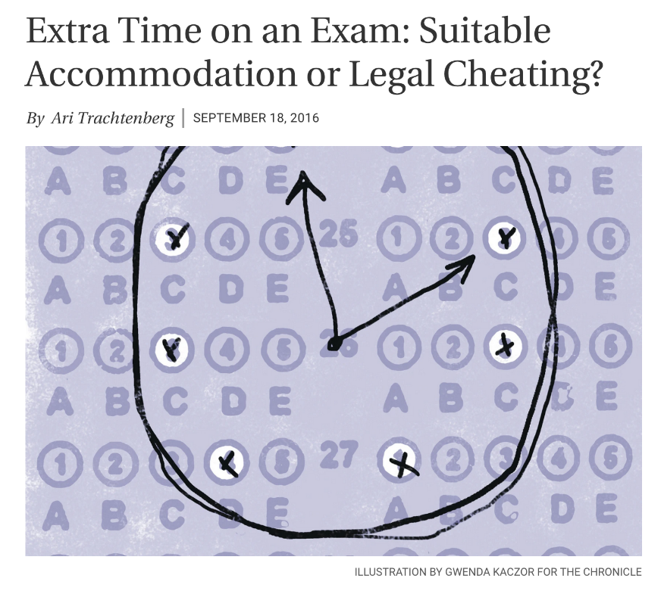
Societal participation through assessment
INCLUSION IN ASSESSMENT? (BAGGER, 2022)
Societal participation through assessment
Students’ inclusion as fully accepted members of academic communities?
Who does assessment disable, how, and what are the consequences?

Slide 13
Who is seen as ‘normal’ and ‘able’ in assessment?
”
Pictures and colours help us dyslexics a lot. Nowadays, I colour-code my materials, particularly if there’s much mathematical yarn. I use green, turquoise… All the colours are in use. It’s much easier to read than just black and white. (…) An image can be worth more than a thousand words. Yö in Nieminen et al., 2024, p. 20
Does assessment provide diverse ways of knowing, being and becoming?

Slide 14
LITERATURE REVIEW
How could inclusion be conceptualised in assessment?
What kinds of experiences do students with disabilities have about assessment and assessment accommodations?
How do these experiences reflect inclusion and exclusion, as understood through Bagger’s (2022) conceptualisation of access and participation?

Slide 15
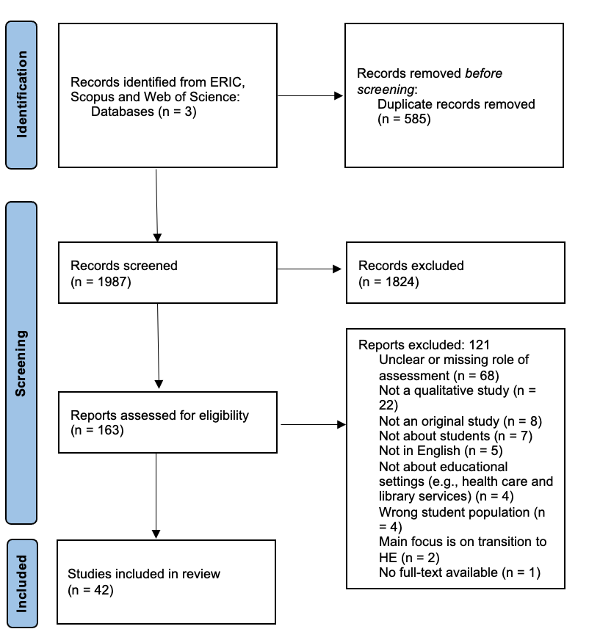
Metaethnography
Building theory based on qualitative studies: hearing the student voice
Published between 2010-2022
Studies that provided sufficient information about assessment
42 studies, 868 students with disabilities in total; almost completely interview studies
An emotionally draining process!

Slide 16
ACCESS: EXPERIENCES OF INCLUSION (22/42)
Some students went as far as saying that extended time has made a profound difference in their academic career. (...) ‘I think it’s definitely one of the things in my college career that’s helped me the most.’ Slaughter et al., 2020, p. 9
Students largely experienced that testing accommodations provided an access to exams, which promoted inclusion in assessment

Slide 17
ACCESS: EXPERIENCES OF EXCLUSION (40/42)
I wish I could have more breaks during an exam and not have to sit still for 3 hours in front of the computer… Anna in Kourea et al. 2021, p. 117
Closed-book examinations as “the most significant structural barrier” (Lewis & Lynn, 2018, p. 14)

Slide 18
ACCESS: EXPERIENCES OF EXCLUSION (40/42)
I had to wait for two months to make a provision of scribe services available in my role book. I made three trips to the main campus of the university to get this done. I was alone and there was no help. Kunnath & Mathew, 2019, p. 180
Issues in accessing assessment adjustments: “a troublesome process” (Goegan et al., 2020, p. 5)”

Slide 19
PARTICIPATION: EXPERIENCES OF INCLUSION (5/42)
When I had to go to the physical place, I would see other people also getting extra time and stuff to go have breaks. It was really nice to feel normal, I guess, in that sense. I haven’t really felt excluded. Tai et al., 2022, p. 7
Counter-spaces in inaccessible and even discriminatory academia

Slide 20
PARTICIPATION: EXPERIENCES OF INCLUSION (5/42)
Through self-assessment you become more aware of the training in mathematics, because just like in any sport, you constantly need to track your own performance. Nieminen & Pesonen, 2020, p. 9
Authentic assessment providing an inclusion for the longer term, beyond the university

Slide 21
PARTICIPATION: EXPERIENCES OF EXCLUSION (24/42!)
Sometimes we don’t have volunteer readers [in exams] because the sighted students are not ready to be insulted by lecturers.
Udoka in Nnama-Okechukwu et al., 2020, p. 7
Outright discrimination: bullying by teachers and fellow students, denial of adjustments
Most of the time you are afraid of speaking. They will think that you don’t study, you don’t care. So it’s up to you to keep your fears or fight against them.
Stampoltzis et al., 2015, p. 163

Slide 22
PARTICIPATION: EXPERIENCES OF EXCLUSION (24/42!)
It does cause physical separation in that respect. You don’t get to do things the way everyone else does. Writing them with extra time and not writing them with class. You can’t fix that but it’s always a little frustrating because you don’t want to be ‘abnormal,’ you want to be ‘normal.’ You want to fit with the rest of the class. Terry in Ertem, 2011, p. 108
Stigmatisation and marginalisation: assessment renders certain students as abnormal and unfit

Slide 23
PARTICIPATION: EXPERIENCES OF EXCLUSION (24/42!)
Do you think it is actually a good thing sticking someone in an exam room for 3-hours anyway whether they are disabled or not? C’mon. Think about it!
Alan in Madriaga & Goodley, 2010, p. 124
Inauthentic assessment as a barrier for participating in the society

Slide 24
CONCLUSION: ASSESSMENT AS A MATTER OF INCLUSION
So far, we have conceptualised assessment as a way of measuring learning objectives
In doing so, we have neglected the social effects of assessment – in good and bad!
Every assessment situation regulates students’ experiences of inclusion/exclusion

Slide 25
CONCLUSION: ASSESSMENT AS A MATTER OF INCLUSION
Inclusion in assessment is a matter of access and participation
At the moment, inclusive assessment practices and policies predominantly focus on accessibility
We need to understand the deeper aspects of inclusion in assessment

Slide 26
CONCLUSION: ASSESSMENT AS A MATTER OF INCLUSION
The big question for future research and practice:
We can never forget the importance of access! However, how could we ensure assessment also promotes participation of traditionally marginalised students?

Slide 27
THANK YOU!
Interested in some of these ideas? Let’s collaborate!
DR. JUUSO HENRIK NIEMINEN
juuso.nieminen@deakin.edu.au
juusonieminen.com
@JuusoNieminen

Slide 28
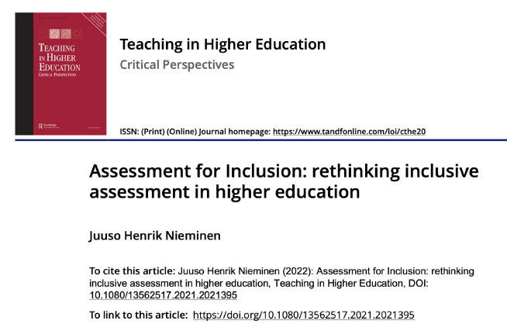
HOW TO MOVE FURTHER? SOME THOUGHTS…
Rethinking the assessment adjustment model
Anti-ableist work in and beyond assessment
Student partnership
Centring human diversity in assessment
Interdependence rather than individualism

Slide 29
Q & A

Slide 30
References
Bagger, A. (2022). Opportunities to display knowledge during national assessment in mathematics: a matter of access and participation. European Journal of Special Needs Education, 37(1), 104-117.
Brandt, S. (2011). From policy to practice in higher education: The experiences of disabled students in Norway. International Journal of Disability, Development and Education, 58(2), 107-120.
Campbell, P. I. (2024). ‘Pray (ing) the person marking your work isn't racist’: racialised inequities in HE assessment practice. Teaching in Higher Education, 29(5), 1166-1180.
Cohen, A. S., Gregg, N., & Deng, M. (2005). The role of extended time and item content on a high‐stakes mathematics test. Learning Disabilities Research & Practice, 20(4), 225-233.
Edwards, M., Poed, S., Al-Nawab, H., & Penna, O. (2022). Academic accommodations for university students living with disability and the potential of universal design to address their needs. Higher education, 84(4), 779-799.
Erten, O. (2011). Facing Challenges: Experiences of Young Women with Disabilities Attending a Canadian University. Journal of Postsecondary Education and Disability, 24(2), 101-114.
Fuller, M., Bradley, A., & Healey, M. (2004). Incorporating disabled students within an inclusive higher education environment. Disability & society, 19(5), 455-468.
Fuller*, M., Healey, M., Bradley, A., & Hall, T. (2004). Barriers to learning: a systematic study of the experience of disabled students in one university. Studies in higher education, 29(3), 303-318.
Goegan, L. D., Le, L., & Daniels, L. M. (2023). Online learning is a rollercoaster: Postsecondary students with learning disabilities navigate the COVID-19 pandemic. Learning Disability Quarterly, 46(3), 166-179.
Hanafin, J., Shevlin, M., Kenny, M., & Neela, E. M. (2007). Including young people with disabilities: Assessment challenges in higher education. Higher education, 54, 435-448.
Kourea, L., Christodoulidou, P., & Fella, A. (2021). Voices of undergraduate students with disabilities during the COVID-19 pandemic. European Journal of Psychology Open.
Kunnath, S. K., & Mathew, S. N. (2019). Higher education for students with disabilities in India: Insights from a focus group study. Higher Education for the Future, 6(2), 171-187.
Lewis, K. E., & Lynn, D. M. (2018). Access through compensation: Emancipatory view of a mathematics learning disability. Cognition and Instruction, 36(4), 424-459.
López Gavira, R., & Moriña, A. (2015). Hidden voices in higher education: Inclusive policies and practices in social science and law classrooms. International Journal of Inclusive Education, 19(4), 365-378.

Slide 31
References (cont.)
Madriaga, M., & Goodley, D. (2010). Moving beyond the minimum: Socially just pedagogies and Asperger’s syndrome in UK higher education. International Journal of Inclusive Education, 14(2), 115-131.
Nnama-Okechukwu, C. U., Chukwuka, P. N., & Okoye, U. O. (2020). Challenges with institutional support services for undergraduate students with visual impairment in University of Nigeria Nsukka. Journal of Evidence-Based Social Work, 17(6), 677-695.
Nieminen, J. H. (2024). Assessment for Inclusion: rethinking inclusive assessment in higher education. Teaching in Higher Education, 29(4), 841-859.
Nieminen, J. H. (2023). A spanner in the works: The portrayal of disabled students in assessment adjustment research. International Studies in Sociology of Education, 32(1), 30-55.
Nieminen, J. H., Reinholz, D. L., & Valero, P. (2024). “Mathematics is a battle, but I’ve learned to survive”: becoming a disabled student in university mathematics. Educational Studies in Mathematics, 116(1), 5-25.
Nieminen, J. H. (2023). Unveiling ableism and disablism in assessment: A critical analysis of disabled students’ experiences of assessment and assessment accommodations. Higher Education, 85(3), 613-636.
Nieminen, J. H., & Pesonen, H. V. (2022). Politicising inclusive learning environments: how to foster belonging and challenge ableism?. Higher Education Research & Development, 41(6), 2020-2033.
Nieminen, J. H., & Pesonen, H. V. (2019). Taking universal design back to its roots: Perspectives on accessibility and identity in undergraduate mathematics. Education Sciences, 10(1), 12.
Redpath, J., Kearney, P., Nicholl, P., Mulvenna, M., Wallace, J., & Martin, S. (2013). A qualitative study of the lived experiences of disabled post-transition students in higher education institutions in Northern Ireland. Studies in Higher Education, 38(9), 1334-1350.
Russell, M., & Kavanaugh, M. (2011). Assessing students in the margins. Charlotte, NC: Information Age Publishing.
Ryan, J. (2007). Learning disabilities in Australian universities: Hidden, ignored, and unwelcome. Journal of Learning Disabilities, 40(5), 436-442.
Slaughter, M. H., Lindstrom, J. H., & Anderson, R. (2022). Perceptions of extended time accommodations among postsecondary students with disabilities. Exceptionality, 30(4), 246-260.
Stampoltzis, A., Tsitsou, E., Plesti, H., & Kalouri, R. (2015). The Learning Experiences of Students with Dyslexia in a Greek Higher Education Institution. International Journal of Special Education, 30(2), 157-170.
Stentiford, L., & Koutsouris, G. (2021). What are inclusive pedagogies in higher education? A systematic scoping review. Studies in Higher Education, 46(11), 2245-2261.
Tai, J., Mahoney, P., Ajjawi, R., Bearman, M., Dargusch, J., Dracup, M., & Harris, L. (2023). How are examinations inclusive for students with disabilities in higher education? A sociomaterial analysis. Assessment & Evaluation in Higher Education, 48(3), 390-402.

