Slide 1

Building Digital Accessibility Skills

Slide 2

Hello!
Amelia Dowe
Online Learning Support Officer
(EPHEA Tas Chapter Co-Convenor)
Doug McGinn
Accessibility Adviser
Adrian Reader
Student Administration Business Lead

Slide 3

Overview
Aims of the event
Event set-up
Mini-training session!
Experiences of the event
Thoughts for the future

Slide 4
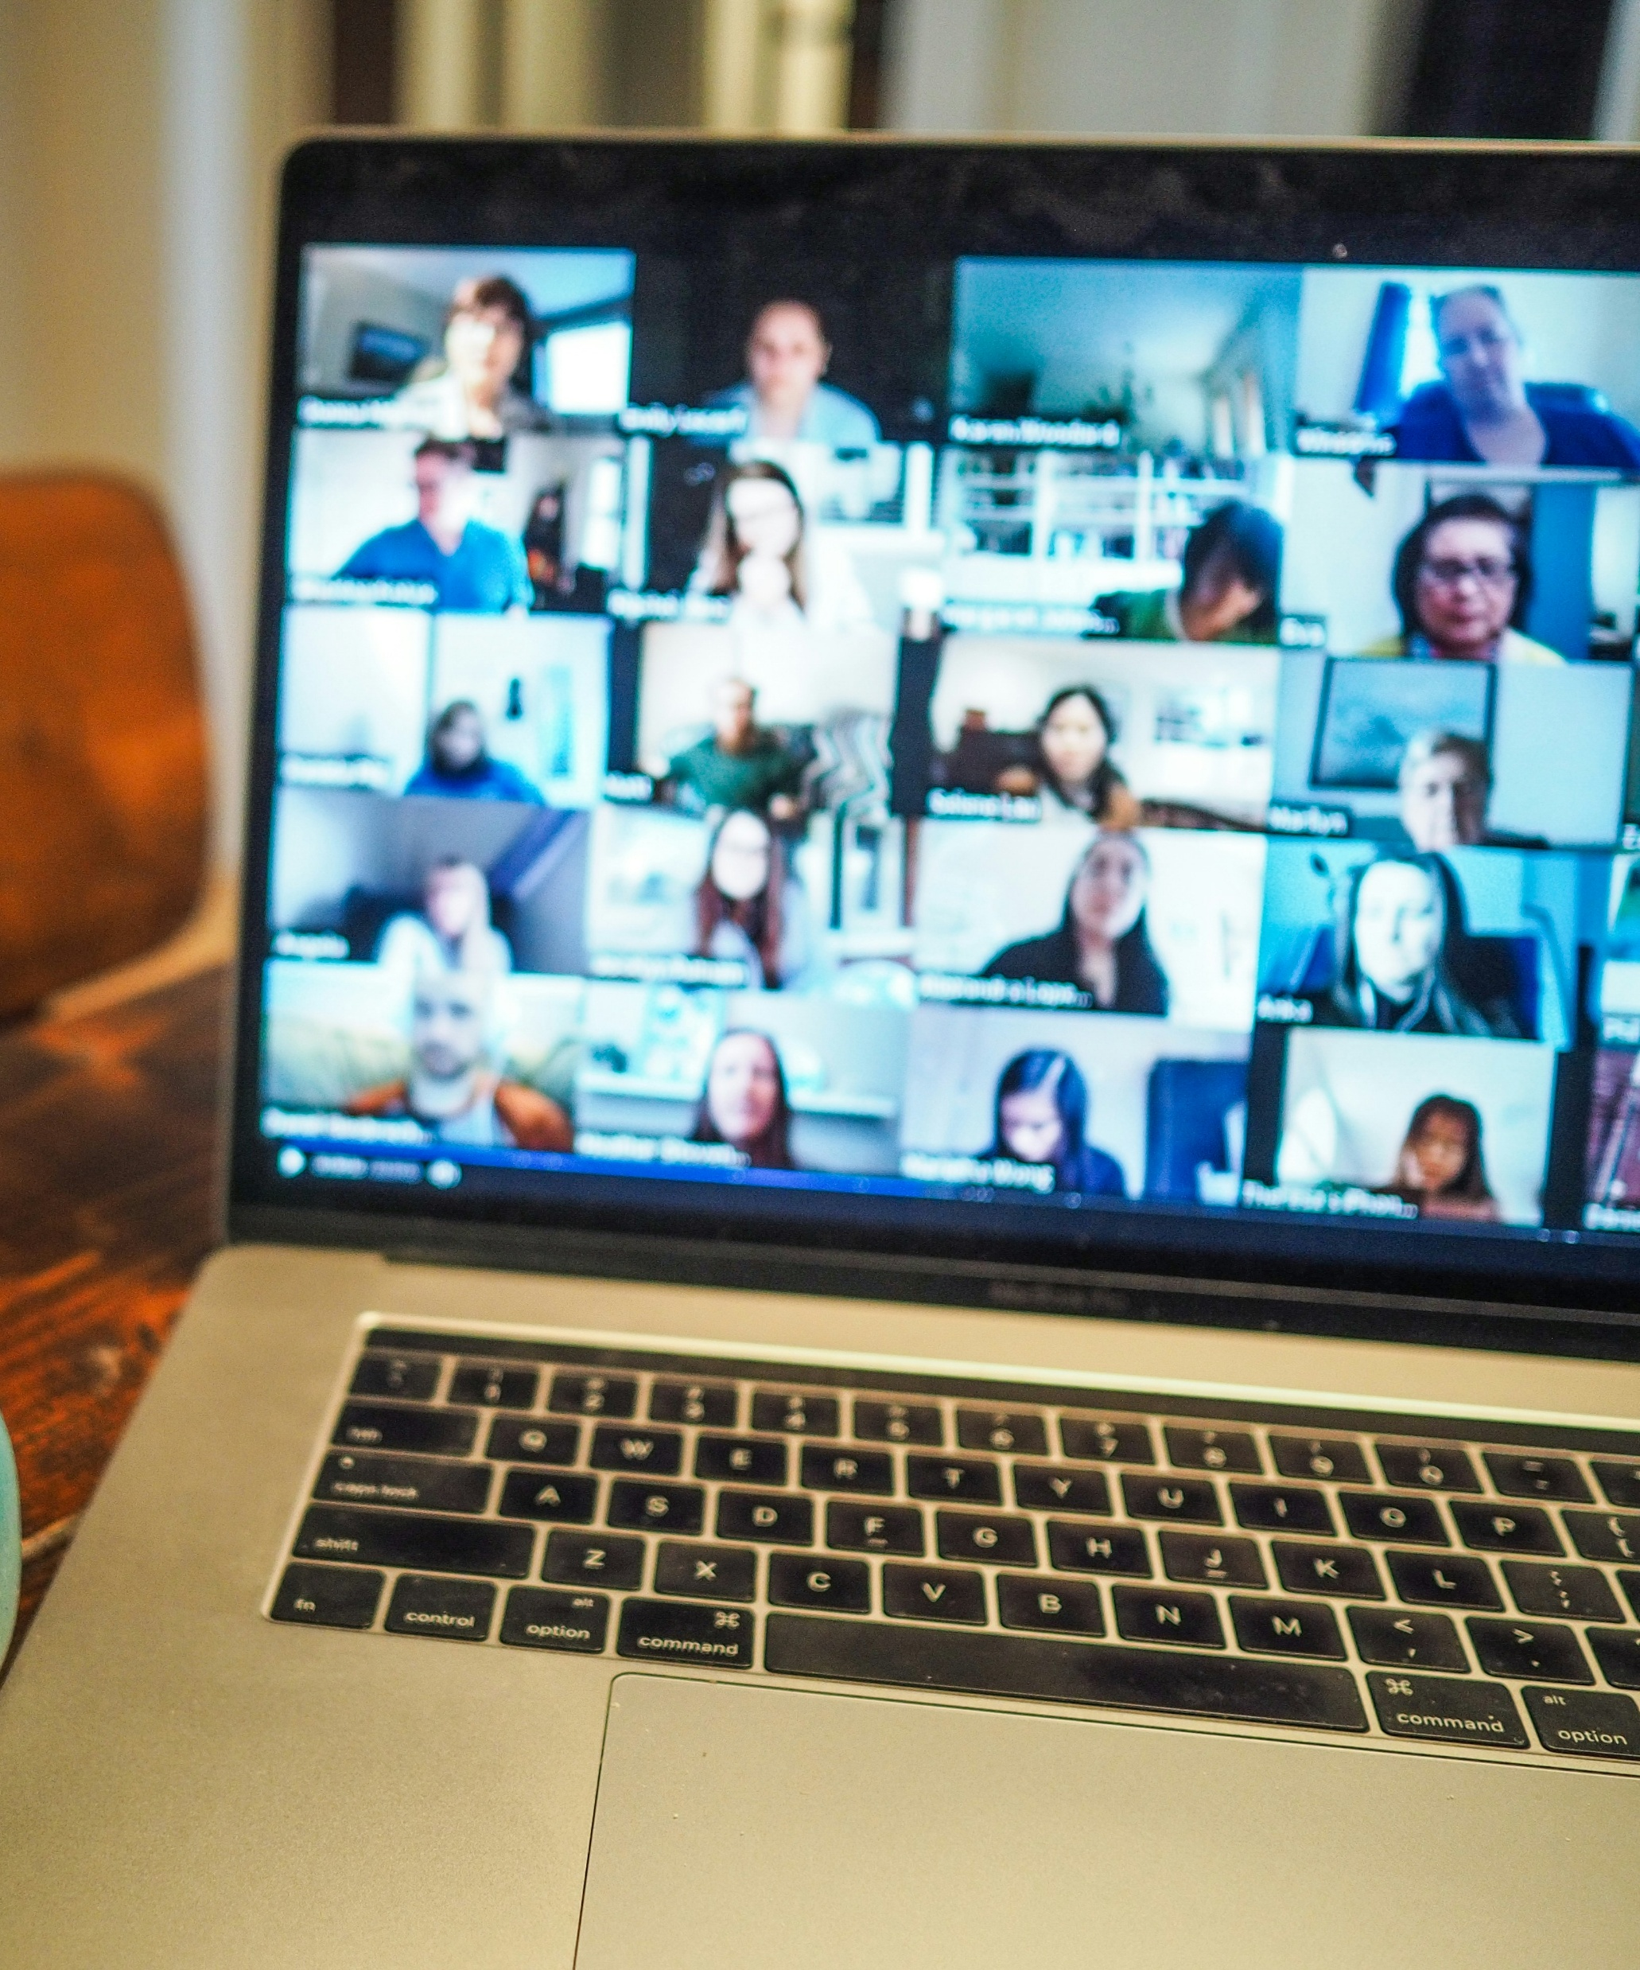
Why an event?
International Day of People with Disabilities
Harness enthusiasm
Offer company and support
Build connections
Develop skills
Surface accessibility issues
Photo by Chris Montgomery on Unsplash

Slide 5
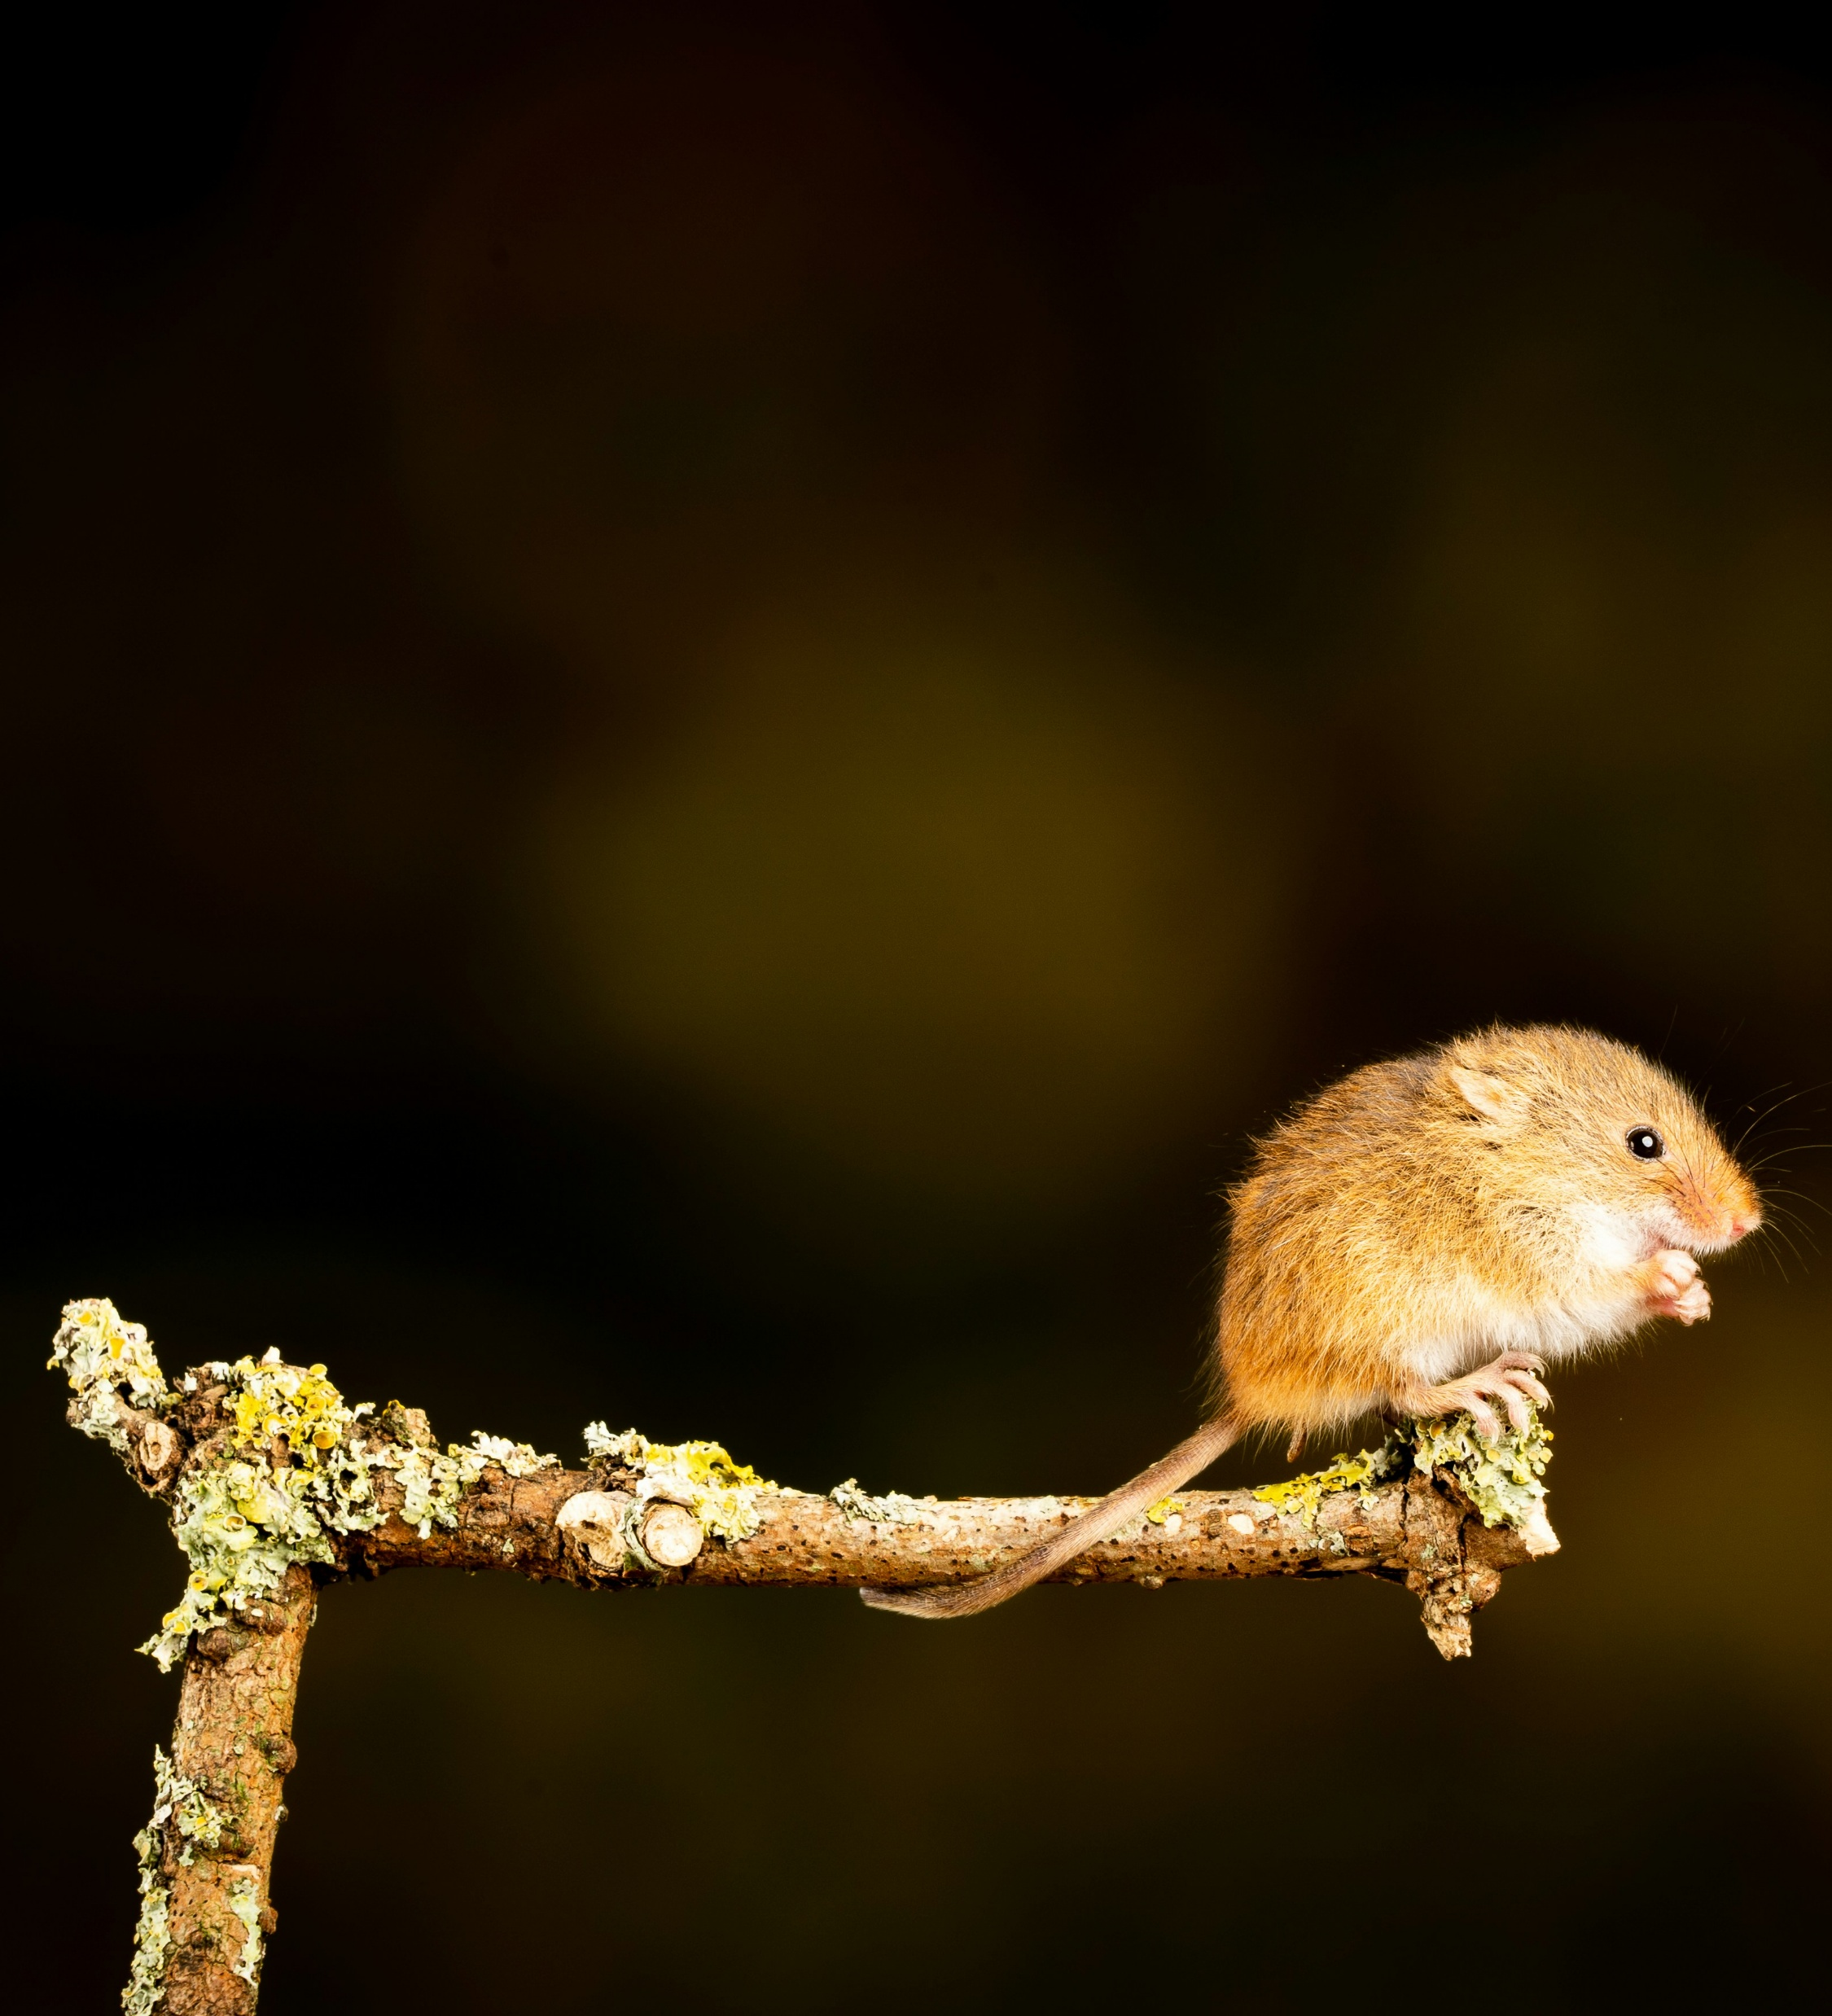
Why No Mouse?
Practical entry point to digital accessibility
Web Content Accessibility Guidelines (WCAG)
  2.1 Keyboard accessible
Many reasons, including:
  Visual navigation not an option
  Motor impacts
Photo by Nick Fewings on Unsplash

Slide 6
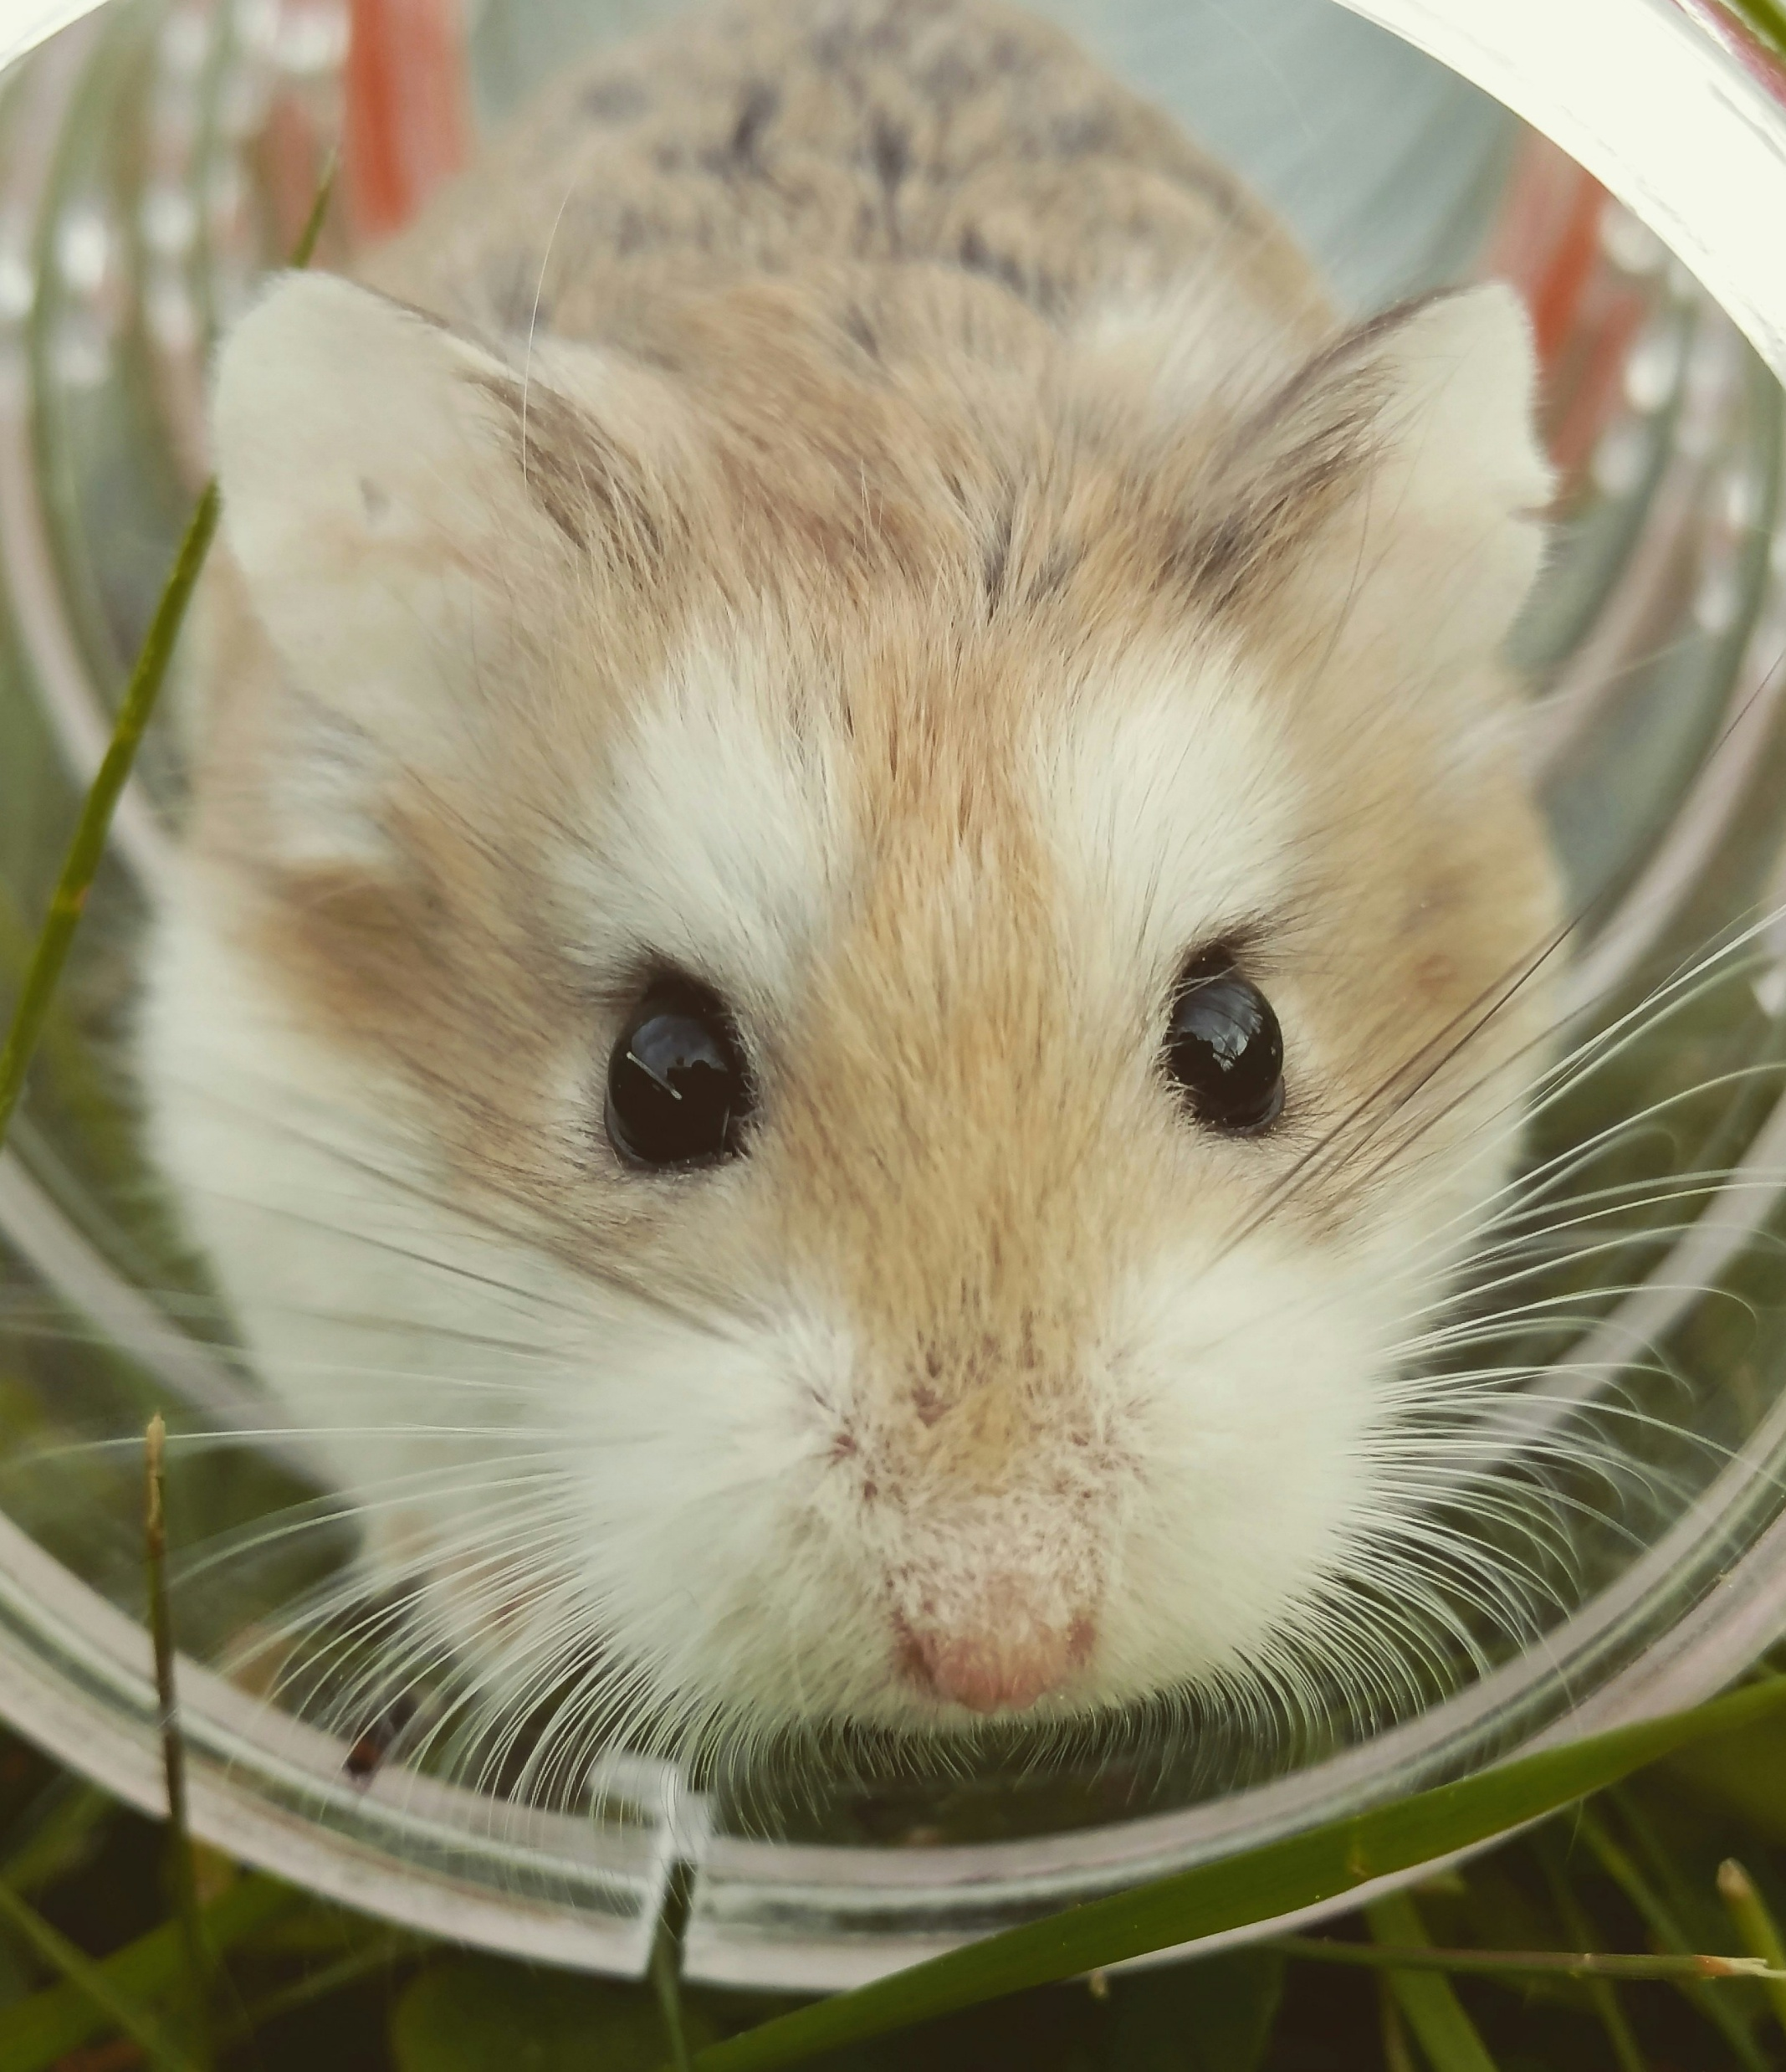
Why No Mouse?
Photo by Nick Fewings on Unsplash
Prevent Repetitive Strain Injuries and similar
Save time
Some tasks more precise
Handy when your mouse breaks
Photo by Silje Roseneng on Unsplash

Slide 7
Why is keyboard navigability important from your perspective?

Slide 8
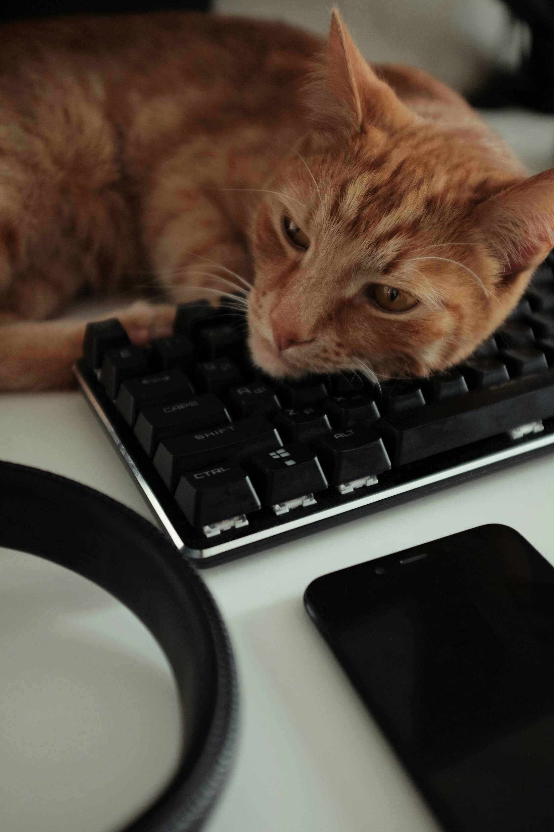
Event set-up
Photo by Nick Fewings on Unsplash
  Zoom backgrounds & email signatures
  Training session
  A4 survival guide for wall
  Opt-in Teams channel for moral and technical support during the event
Photo by Victoria Aleksandrova on Unsplash

Slide 9
Zoom background created by UTAS Marketing

Slide 10

EPHEA support
Equity Practitioners in Higher Education Australasia
Tasmanian Chapter funding
Prizes thanks to this support!
  Marathon Mouse Avoider
  Accessibility Ally Supreme
  Learning Luminary
  Application Adventurer
  Shortcut Sorcerer
  Special Mentions
Photo by RDNE Stock project

Slide 11
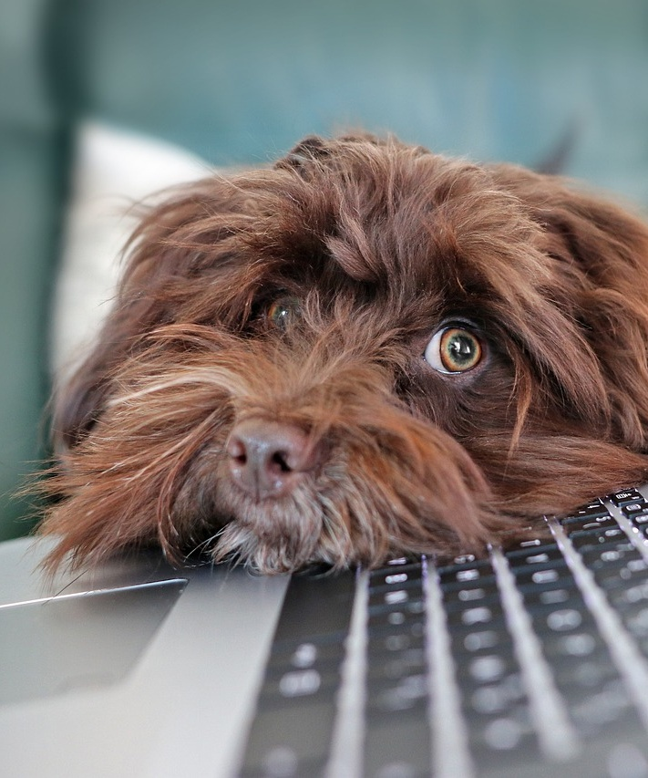
Training time!
Photo by Nick Fewings on Unsplash
Image by Martine Auvray from Pixabay
  Global shortcuts:
    Tab & Shift + Tab
    Alt + Tab
    Windows + . (full-stop)
    Alt + spacebar

Slide 12

Zoom
Photo by Mariia Shalabaieva on Unsplash
Mute/unmute: Alt + A
Stop/start video: Alt + V
Open chat: Alt + H
Open emojis: Windows + .
Resize/move options: Alt + spacebar
End/leave meeting: Alt + Q

Slide 13
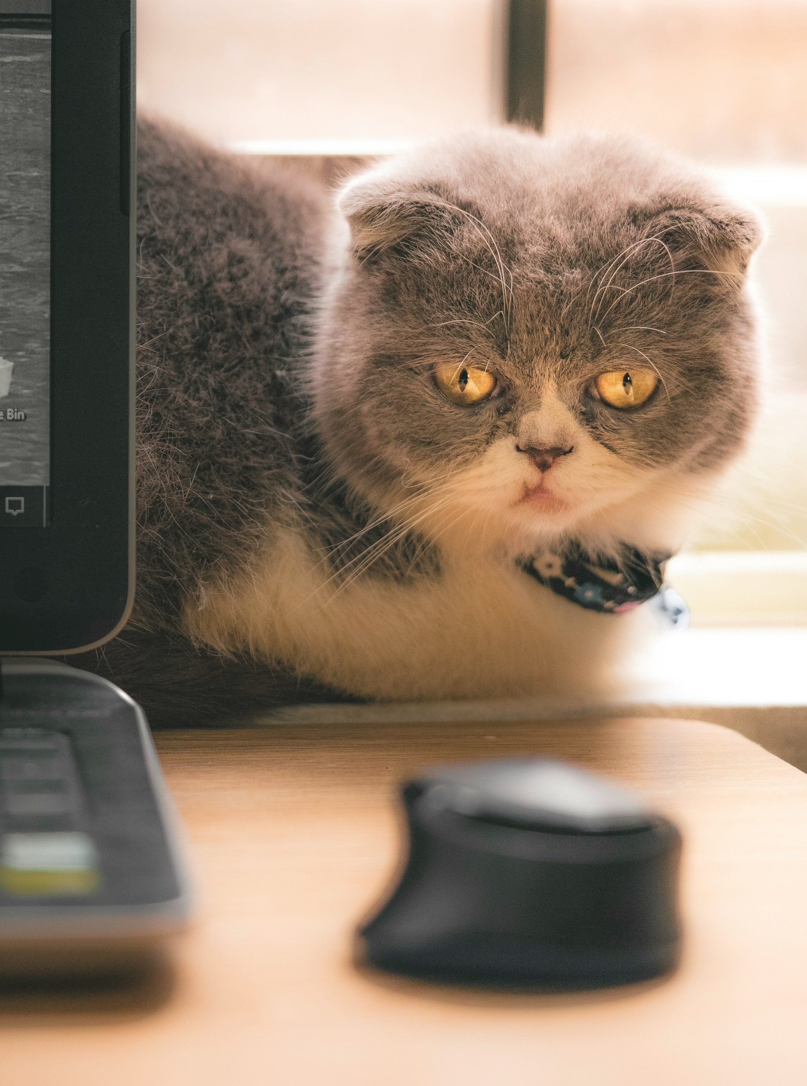
Event participation
4 teams & 35 individuals signed up
Wide range of work areas and roles
20 people in Teams channel
21 responses to post-event survey
Photo by Victoria Aleksandrova on Unsplash

Slide 14
Event feedback
“Thank you for organising this brilliant exercise. 'Living' a limited version of the barriers that a person who could not use a mouse experiences was very effective in highlighting just how important accessible design is, and how much of a barrier a single inaccessible feature presents to someone who relies on a feature being universally accessible […]”
Photo by Victoria Aleksandrova on Unsplash

Slide 15
Event feedback cont.
“Big thank you to the team that organised this - it was such a fun (and difficult at times) challenge - and I feel like I've really been awakened both to the important causes, but also the potential of improving my digital literacy and efficiency. The group chat/brains trust was such a lovely vibe, and I really appreciated how helpful everyone was (especially Adrian - big shout out for fixing my taskbar dilemmas).”
Photo by Victoria Aleksandrova on Unsplash

Slide 16
Experiences of event
David Quinn
(Educational Technologist)
Beale Gurney
(User Experience Designer)
Photo by Victoria Aleksandrova on Unsplash

Slide 17
Discussion
How did you go on the day?

Slide 18
Discussion part 2
What were your main learnings from the event?

Slide 19

Future thoughts
Photo by Nick Fewings on Unsplash
Image by Martine Auvray from Pixabay
  Do it again!
  Capture accessibility trouble spots
  Expand to other topics
  Recognise as professional development
  Find out what others are doing
Photo by Alex on Unsplash

Slide 20
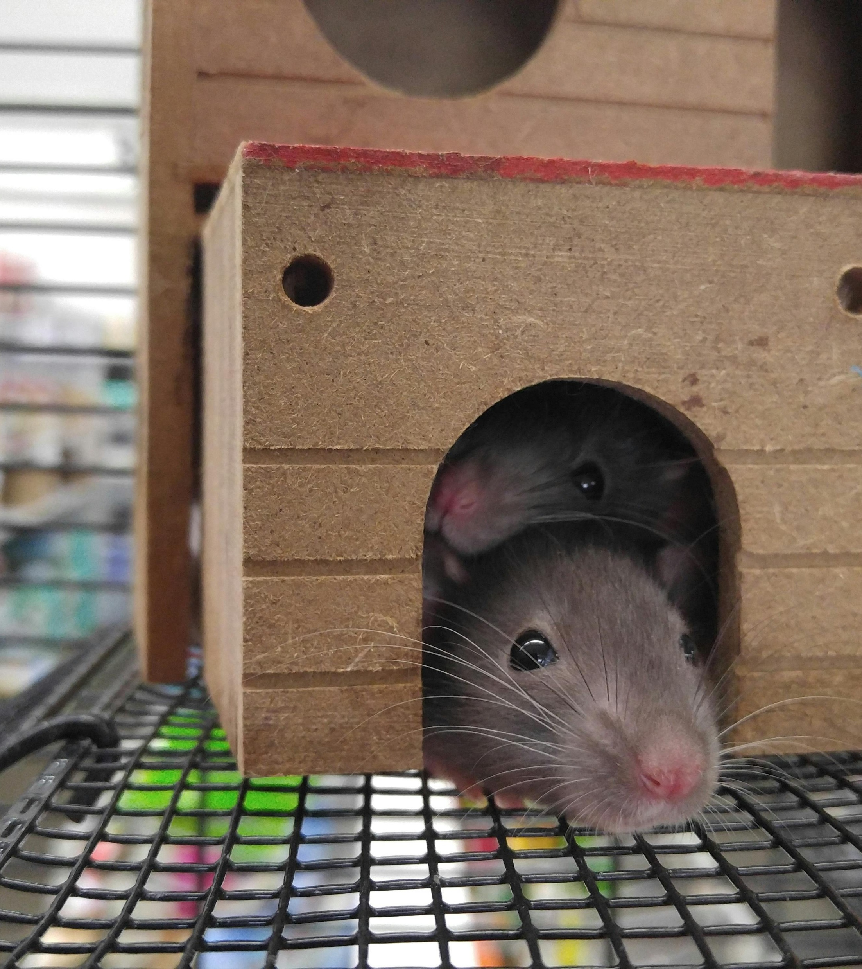
Questions for you
Photo by Tanner Johnson
  What is happening at your institution to build digital accessibility skills and awareness?
  Do you have a favourite shortcut to share?

Slide 21
Zoom
Photo by Mariia Shalabaieva on Unsplash
Mute/unmute: Alt + A
Stop/start video: Alt + V
Open chat: Alt + H
Open emojis: Windows + .
Resize/move options: Alt + spacebar
End/leave meeting: Alt + Q

