Slide 1
ADCET Webinar: Accessibility in Office 365 - Inclusive isn’t elusive (Refresher)

Slide 2




Andrew Balzer
Education Success Manager
Andrew.Balzer@microsoft.com
@AlphaBalzer
Linkedin.com/in/andrew-balzer

Slide 3

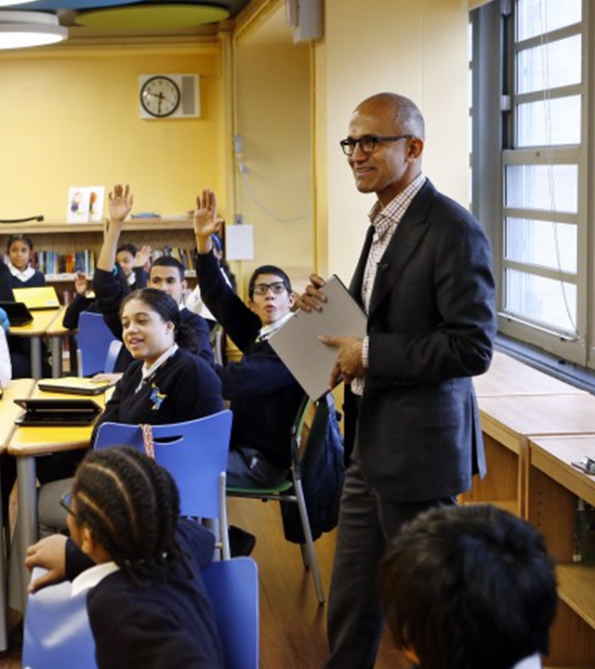
"Our mission is to empower every person and every organisation on the planet to achieve more."

Slide 4

Promoting independent learning
Accessible technologies help students with disabilities unlock their full potential by addressing a diversity of needs:
Learning
Visual
Hearing
Mobility
Neurodiversity
Mental Health
Dyslexia
Dysgraphia
Dyscalculia
Low vision
Blind
Colorblind
Deaf
Hard of Hearing
Cerebral Palsy
Muscle Dystrophy
Amputation
Autism
ADD/ADHA
Seizure
Anxiety
Depression
OCD
See Microsoft Accessibility features for every classroom: http://aka.ms/AccessibilitySway

Slide 5
Empowering every student with Microsoft Education
All students can achieve more when they have access to the right tools.
Immersive Reader
Assist with
comprehension, fluency, and decoding
Word, OneNote, Outlook Web Access, and Edge
Word Prediction
Save typing time and
word input with predictive text in multiple languages
Windows 10
Dictate
Use voice to dictate directly into documents
Word, Excel, PowerPoint, OneNote, Outlook
Editor
Write easy-to-read documents
Word, Excel, PowerPoint,
OneNote, Outlook
Ease of Access
Make accessibility
easier to discover,
learn, and use
Vision, hearing,
mobility, cognition

Slide 6
There are many different types of disabilities—and most are invisible
Per the World Health Organization (WHO):
“Disability results from the interaction between individuals with a health condition [and] personal and environmental factors including negative attitudes, inaccessible transportation… and limited social support.”¹
Disability is everywhere, even if not in plain sight
62%
>1B
10%
Some types of disabilities:
of employees with disabilities in one study classified their disabilities as invisible²
of people today experience some form
of disability³
of people
have access
to the assistive devices they need³
Mobility
Vision
Hearing
Neurodiversity
¹WHO. “Disability and health.” November 24, 2021. ²Center for Talent Innovation. “Disabilities and Inclusion: US findings.” Sherbin, L., Kennedy, J. T., Jain-Link, P., & Ihezie, K. 2017. ³WHO. “Assistive technology.” May 18, 2018.

Slide 7
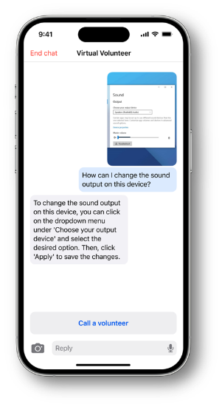
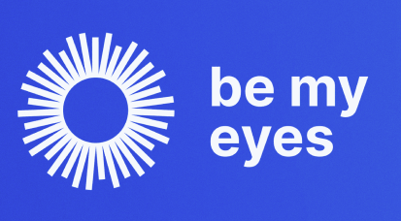



The impact of Generative AI on Accessibility
Paradigm shifting innovation
From virtual assistants and job seeking to speech and productivity, AI has the opportunity to:
Revolutionize accessible technology
Create more inclusive digital experiences
Empower the 1.3+ billion people in the world with disabilities

Slide 8




Accessible AI is Responsible AI
Be Accessible: Inclusive
and accessible by design
Incorporate Disability Data
and protect against ableism
Foster Innovation: Push for
paradigm shifts to empower disabled

Slide 9

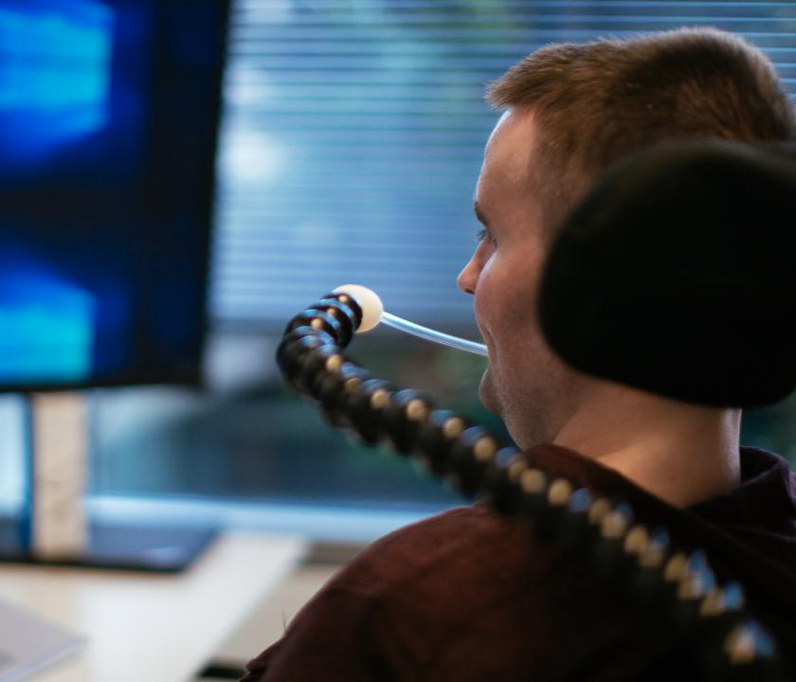
Disability Support
Disability Answer Desk

Slide 10
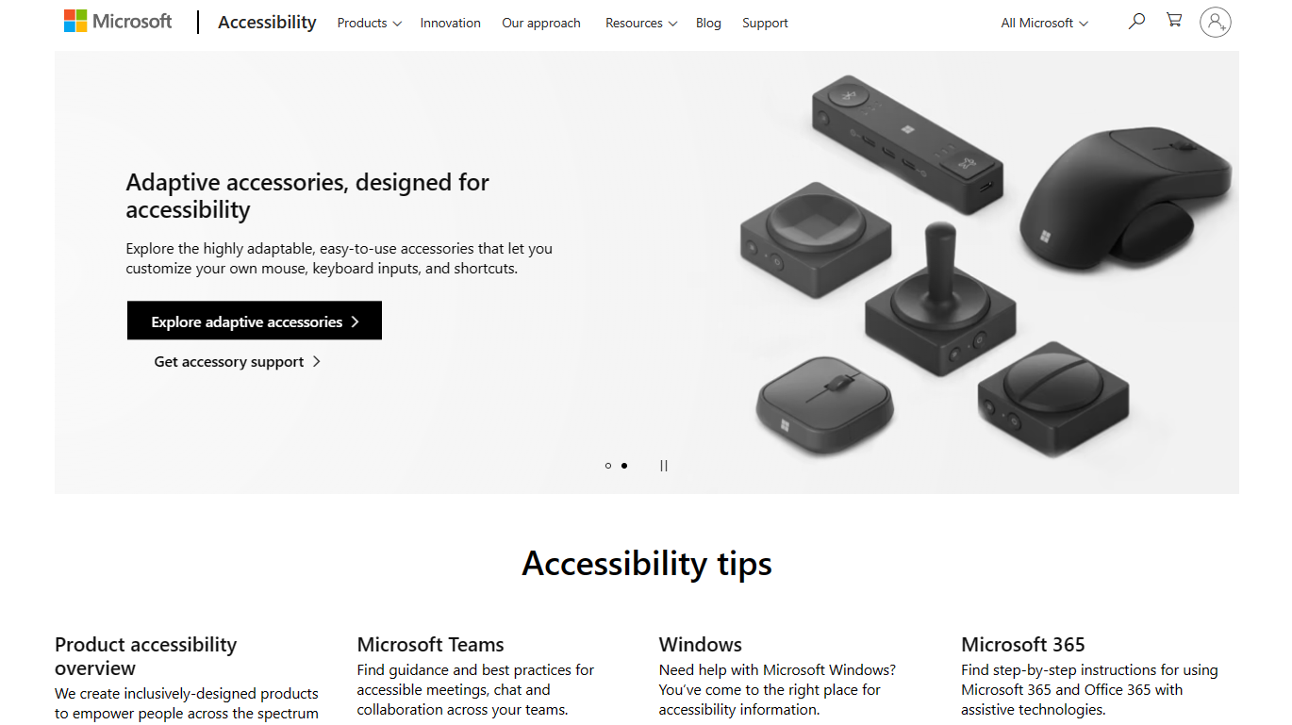
Accessibility tips
Disability Answer Desk (Non enterprise)

Slide 11
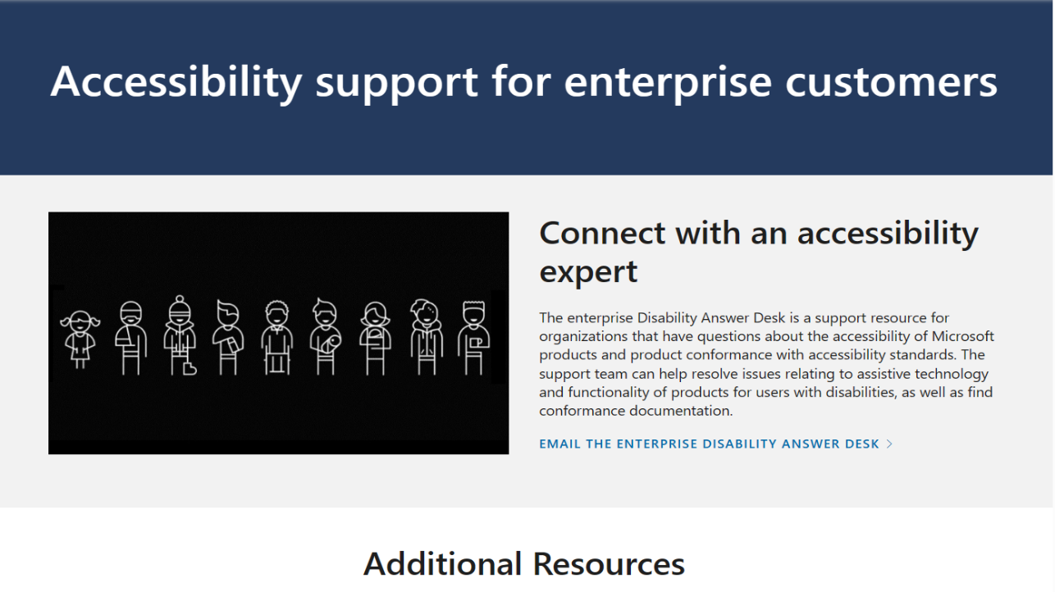
Accessibility for enterprise customers
Disability Answer Desk (Enterprise)

Slide 12
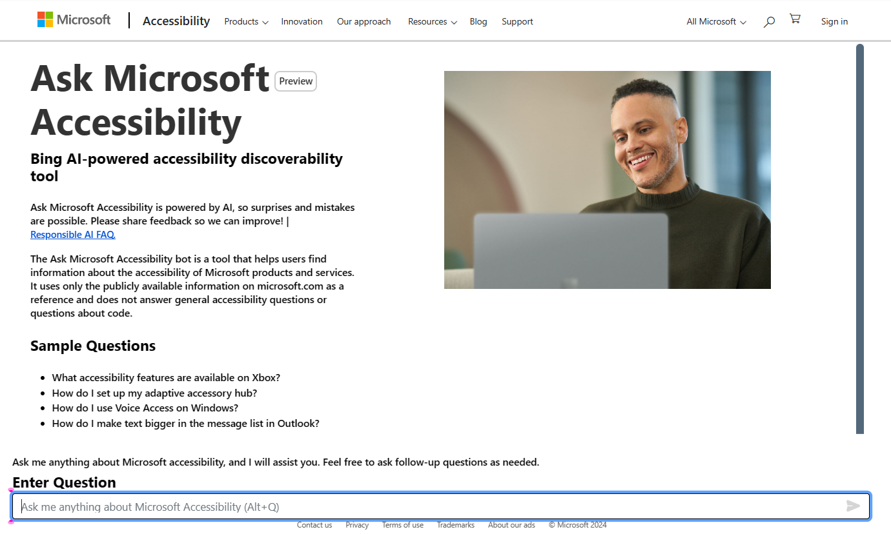
Ask Microsoft Accessibility
Ask Microsoft Accessibility

Slide 13
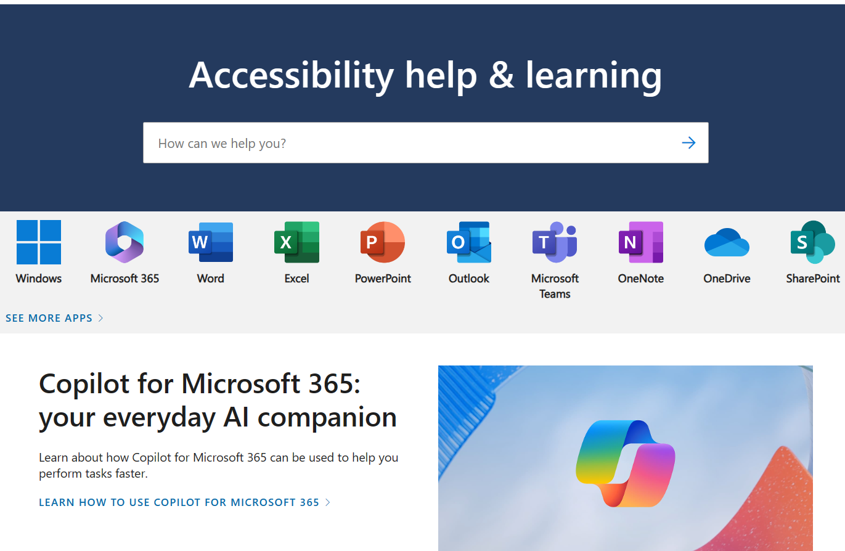
Accessibility help and learning
Accessibility help and learning

Slide 14

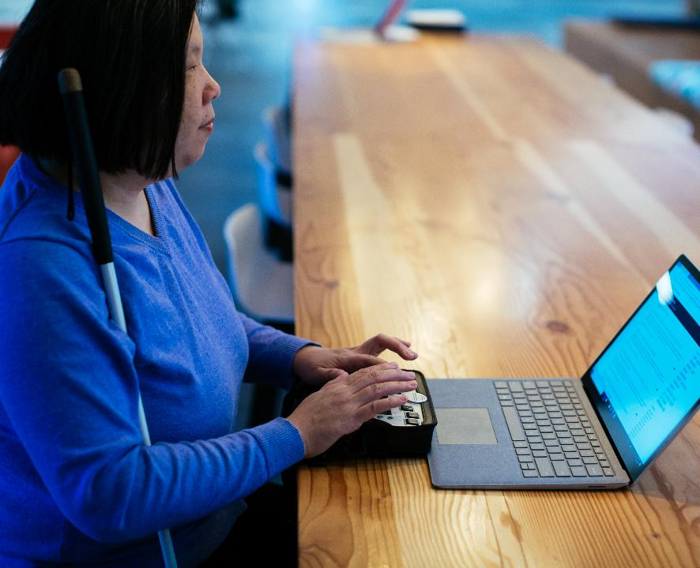


AI has incredible potential to improve the lives of people with disabilities
Image recognition
Speech
recognition
Natural language interaction
Notes:
This is a massive opportunity for AIP in particular.
Think about the AI that we build: we literally provide the ability to see, hear, speak and understand. Technology can make things possible that weren’t possible before for people with disabilities. Apps like Seeing AI bring about a massive jump in personal independence for people with disabilities.
AI has the potential to extend access and broaden inclusivity in a transformative way, and as the AI Platform team, we play a hugely pivotal role in this future.

Slide 15
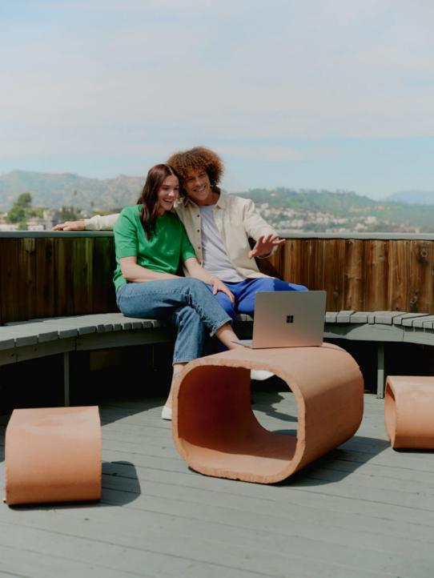
Alt Text
“The first image on this page is a photograph of a Microsoft 365 lifestyle scene. It shows a male and female adult sitting on a bench together, looking at a Surface Laptop 5 on the table in front of them. The male adult is waving at the device, presumably using a gesture control feature. The image has a warm and cozy tone, with soft lighting and natural colours.”

Slide 16
Artificial Intelligence
Cognitive Services
Generative
AI
Vision
Speak
Language
Decision

Slide 17
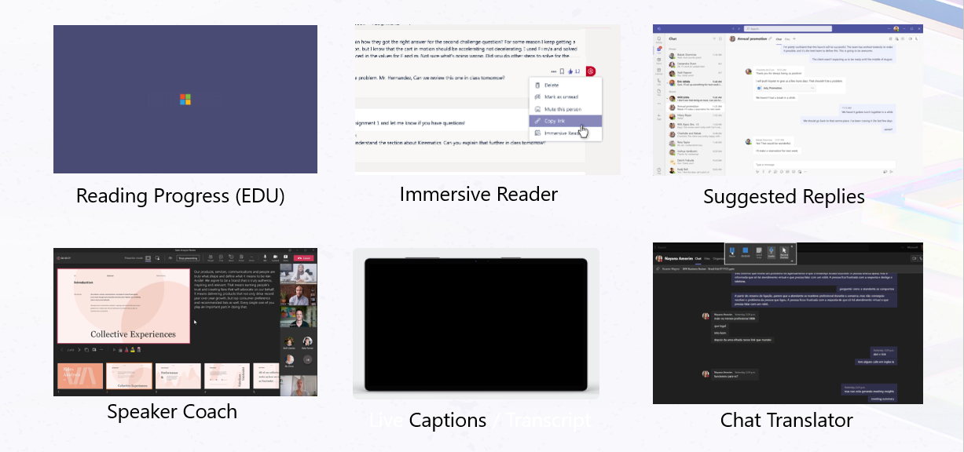
Built-in AI Cognitive Services for Microsoft 365

Slide 18

AI-powered assistant enabling an accessible workforce
Microsoft Copilot
Inclusively embedded within Microsoft 365 Apps
Dyslexia
Neurodiversity
Mobility
Vision
c
Summarize a document or webpage
Writing an email reply
Inspire me in Word
Rewrite the following text in plain language
Change the tone of my email
Summarize past projects, stakeholders, and resources
Teams meeting chat interrogation
Teams meeting recap
Create first draft of a document or presentation
Search for conversations-email, Teams chat, documents
Access companywide information
Summarize an inaccessible document
Summarize a whiteboard
Create a first draft of a document or presentation
This is my Copilot. How can yours help you?
This is my Copilot - YouTube

Slide 19
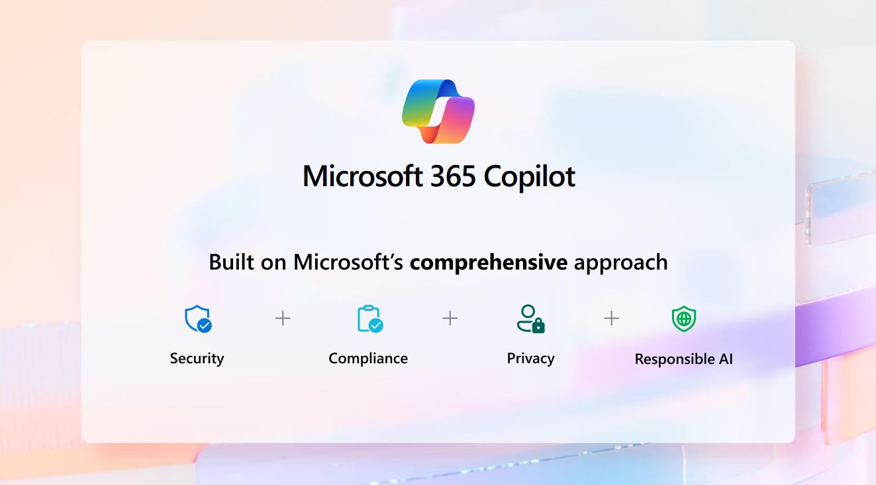
Microsoft 365 Copilot

Slide 20
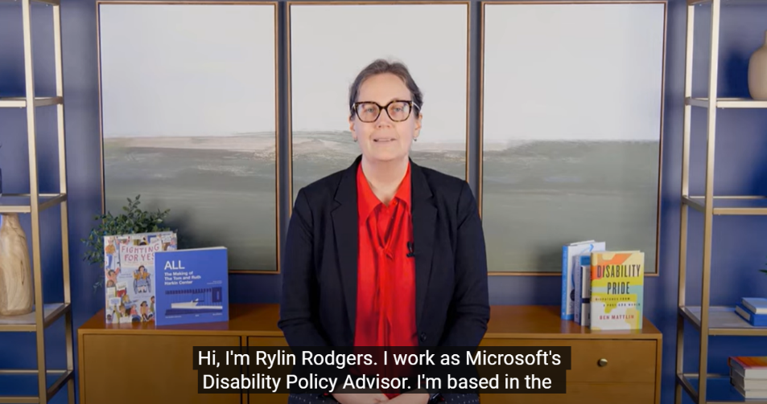
Video – Click to play on YouTube

Slide 21
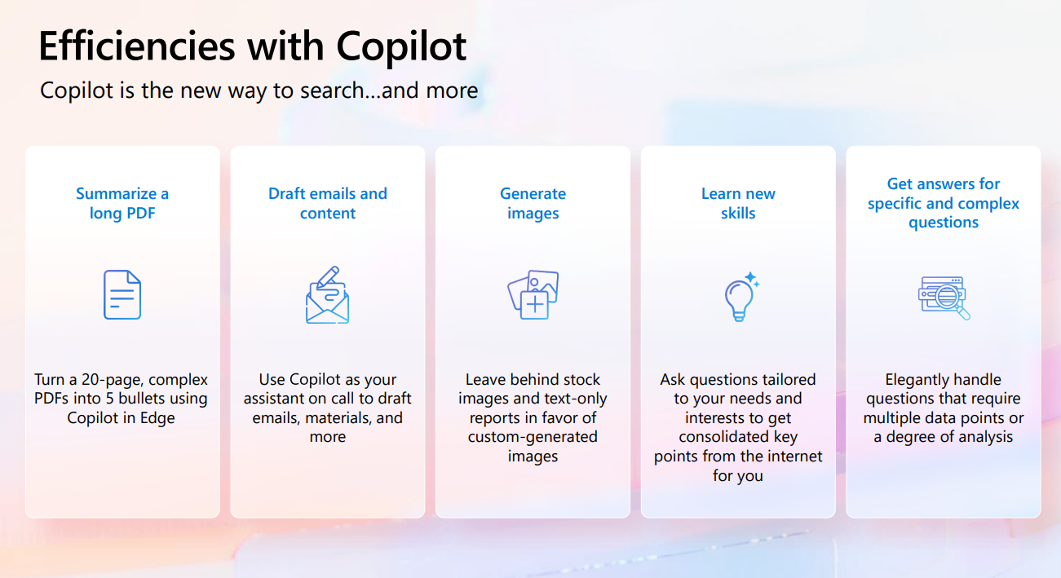
Efficiencies with Copilot

Slide 22



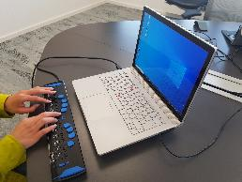



A day in the life of a person who is blind
Accessibility
Create content without sighted assistance
Make inaccessible content accessible
8:30 AM
9:00 AM
9:30 AM
Lena starts working from her home-office and asks M365 Copilot to summarize her emails and chats for any customer requests.
She receives a Word document that is inaccessible with her screen reader. She asks Copilot in Word to summarize the document resulting in an accessible summary.
Lena has an upcoming meeting in the afternoon and needs to get prepared. She uses the catch up function in M365 Copilot to get prepared.
M365 Copilot
Copilot in Word
M365 Copilot
Summarize questions from customers sent yesterday from my email and chat messages and prioritize my top 3 action items for today.
Summarize this document.
Help me prepare for [Review Meeting]
4:00 PM
2:00 PM
10:30 AM
Lena receives an email which includes an image that does not have any alternative text. She uses Copilot in Bing and asks what the image shows.
She attends a large meeting which takes place every week. She needs to find a message from the chat from last month. To save a lot of clicks, she uses Copilot in Teams .
Lena need to prepare a slide deck for the upcoming meeting. She already has her notes created in Word. She asks Copilot to create a presentation from that document which she can do without sighted assistance.
Copilot in Bing
Copilot in Teams
Copilot in PowerPoint
Lena is blind and uses a screen reader and braille keyboard to consume and create content
What is described in this image?
What did /Anna ask in last week`s meeting?
Create a presentation from /[file]

Slide 23

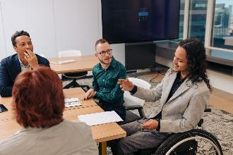
A day in the life of a person with a mobility disability
Accessibility
Reduce keystrokes
Reduce speech to text
8:30 AM
9:00 AM
9:30 AM
In preparation for a customer meeting, Jordan uses M365 Copilot to find all emails, teams chats, documents, and presentations related to that customer, significantly reducing keystrokes.
Jordan joins the Teams call with his customer but is not able to type meetings notes during the call, so he leverages Teams Meeting Recap to capture meeting notes and action items.
Following the meeting, Jordan needs to send a message to the customer with a summary of the meetings and next steps using Copilot in Outlook.
M365 Copilot
Copilot in Teams
Copilot in Outlook
Following the meeting, Jordan selects View Recap to review meeting notes and follow-up tasks.
Draft email to [customer] summarizing the meeting with next steps and request a date for the next meeting.
Find all my conversations about [customer].
4:00 PM
2:00 PM
10:30 AM
Jordan needs to create an account plan for a new customer. He uses M365 Copilot to research his new customer.
After refining the outline, Jordan now needs to create a PowerPoint file based on the outline he created in Word using Draft with Copilot .
Jordan needs to create a presentation for his customer about the benefits of an inclusive environment for employees with disabilities. He starts with an outline in Word. He leverages prompts to reduce the amount of dictation required.
M365 Copilot
Copilot in PowerPoint
Copilot in Word
Jordan has a mobility disability and uses his voice to navigate his computer and create content
Provide a one paragraph commercial summary about [customer].
Draft an outline about the benefits of an inclusive environment for employees with disabilities.
Create a presentation from /[file].

Slide 24
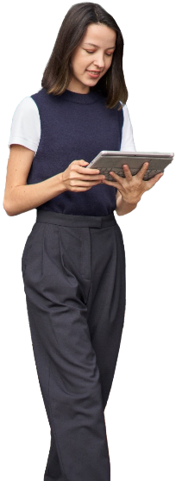

A day in the life of a person who is Dyslexic (neurodivergent)
Accessibility
Reduce cognitive load
Improve reading comprehension
Get started and maintain writing flow
9:00 AM
9:15 AM
10:00 AM
To prepare for her day, Ana asks M365 Copilot to summarize all emails and chat over the past day.
She received a lengthy document with complex language from a customer. She asks Copilot in Word to summarize the document and simplify the language.
Ana also received a long video in Stream. She uses Copilot in Stream to get the main points of the video while reducing cognitive load.
M365 Copilot
Copilot in Word
Copilot in Stream
Summarize all my emails and Teams chats in the past day.
Summarize this document and simplify the language.
Summarize the video.
4:00 PM
3:00 PM
1:00 PM
Ana has missed a few chats during the day. She sees that her team has been discussing a new product launch and asks Copilot to summarize the conversation.
Next, Ana is going to write a blog about a grant recipient for her company website. She creates a first draft using Copilot in Word, then refines the content for the target audience.
She needs to send an email back to her customer but struggles to get started from a blank email. She uses Draft with Copilot to create the first draft without worrying about grammar and spelling, then she can refine and send.
Copilot in Teams
Copilot in Word
Copilot in Outlook
Create a draft about [grantee] including [grantee] overview, project description, and project results.
Revise the tone for an external corporate blog.
Ana has Dyslexia and uses technology to create and consume content
Summarize this chat and include the key points and who made them.
Create draft to [customer] outlining our last meeting and provide suggested next steps.

Slide 25


A day in the life of a person who is autistic (neurodivergent)
Accessibility
Assess tone of a meeting
Change tone of email
Suggest questions to ask
8:00 AM
8:15 AM
9:00 AM
Ricardo starts his day by asking M365 Copilot to summarize his emails from the day and prioritize them.
Ricardo joins a call with several attendees, all actively participating in the conversation. He uses Copilot in Teams to assess the tone of the meeting.
As the meeting continues, Ricardo asks Copilot to list the questions asked during the call to ensure they are all answered.
M365 Chat
Copilot in Teams
Copilot in Teams
Summarize all my emails from the past day and help me prioritize.
What is the tone of this meeting?
How does [meeting participant} feel about this topic?
What questions were asked during the meeting that have not been answered?
4:00 PM
2:00 PM
11:00 AM
At the end of his day, Ricardo drafts an email in Copilot in Outlook, then uses Coaching by Copilot to assess and adjust the tone.
As Ricardo prepares for a team meeting, he asks M365 Copilot what questions he should raise to quickly create an agenda.
Switching gears, Ricardo received the latest financial numbers from his business planning lead. He uses Copilot in Excel to analyze the complex data quickly.
Copilot in Outlook
Microsoft 365 Copilot
Copilot in Excel
Ricardo is autistic and uses Copilot in meetings and communications
Coaching by Copilot.
What questions should I ask about [project]?
What is the percentage of [total revenue from each region]?
Are there any trends in my data?

Slide 26
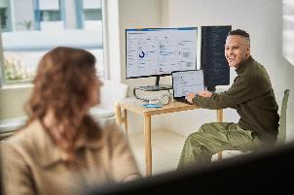

A day in the life with focus on your mental well-being
Accessibility
Summarize meetings
Create clear communications
Focus on important tasks
8:00 AM
8:15 AM
9:00 AM
Kyle starts his day with a team meeting with many attendees. He uses Copilot in Teams to recap what each person says, hone in on the key information, and secure a feeling of being informed instead of lost.
Kyle needs to create a draft project proposal and refine it leveraging Copilot in Word to get him 70% along the way and use Inspire Me to alleviate writer’s block and stay in flow.
Kyle needs to write an email to his leadership team about the project and refine the email to ensure he is clear and understood.
Copilot in Teams
Copilot in Word
Copilot in Outlook
Recap the meeting and summarize what each person said.
Draft a proposal for [project] including project goals, timeline, and budget.
Use Inspire me to create the next paragraph.
Draft an email with an overview of [project]
Use Coaching with Copilot to assess tone and improve clarity.
.
4:00 PM
2:00 PM
11:00 AM
Kyle is working on a stretch project to develop his coding skills. He uses GitHub Copilot to complete the simple tasks that give him more time/space to focus on the important code.
After reading feedback from his colleagues, Kyle needs to do additional research to continue building out a project plan. He uses M365 Copilot to research which supports his way of thinking and writing better than other tools.
Kyle receives feedback from the team on the project. He uses M365 Copilot to summarize conversations on [project] to surface emails that he missed or needs to revisit.
Copilot in GitHub
M365 Copilot
M365 Copilot
Kyle leverages technology to create clear communications and create work/life balance
Refactor this function to improve its readability and performance
Give me a concise summary of recent news about [project topic].
Summarize all my conversations about [project]

Slide 27
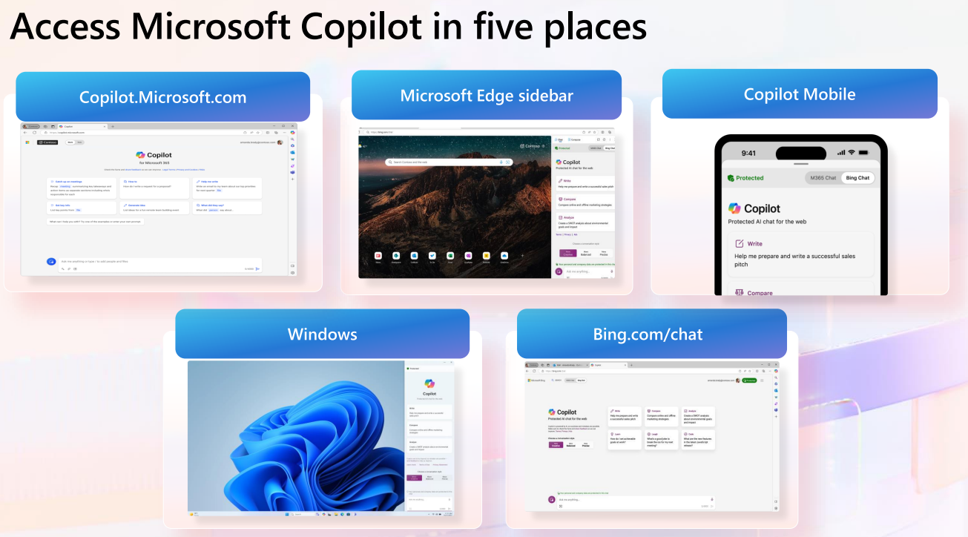
Access Microsoft Copilot in five places

Slide 28
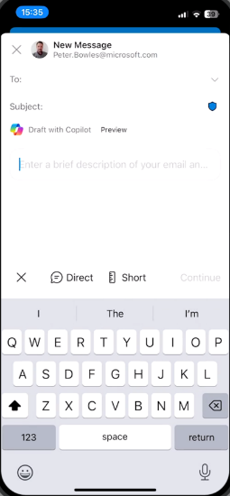
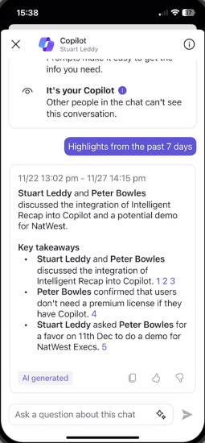
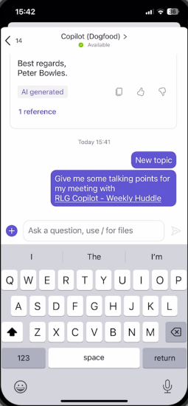
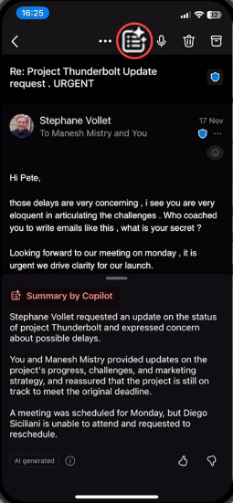
Copilot – Your AI digital assistant: Go Mobile

Slide 29
Creating Accessible Content
Accessibility in Office

Slide 30
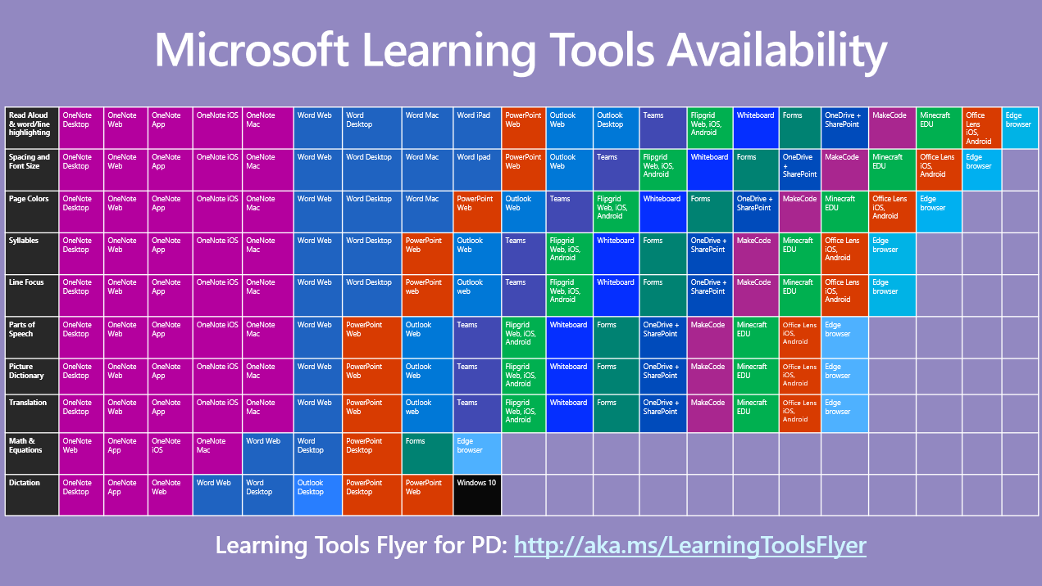
Microsoft Learning Tools Availability.

Slide 31




Accessibility tools improve outcomes
Educators are better able to support academic improvement for all students with tools that enable inclusive teaching.
Microsoft Translator
Get real-time subtitles and translations of text, websites, pictures,
and voice
Office Lens
Digitise whiteboard or blackboard notes and convert them to Microsoft Word, PowerPoint, or PDF
Accessibility Checker
Make sure your Word, PowerPoint,
and Excel documents are accessible
Automatic
alt text
Using AI, Microsoft Translator will automatically provide image descriptions
Microsoft Stream
Get automatic transcriptions of
audio or video recordings

Slide 32
Quotes from Aditi, data scientist at Microsoft who uses a screen reader

Slide 33
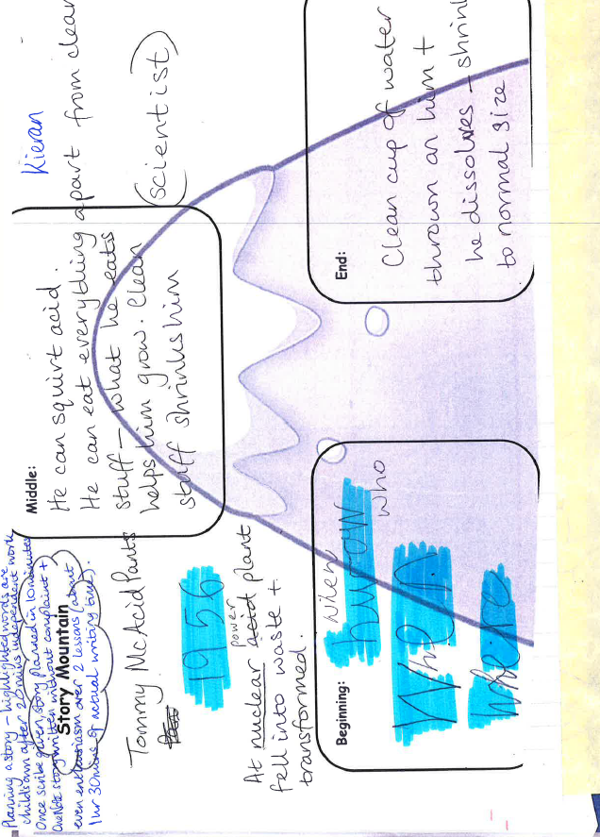
Picture of 9 year old old student writing sample
This is a story planning sheet for a student who is dyslexic

Slide 34
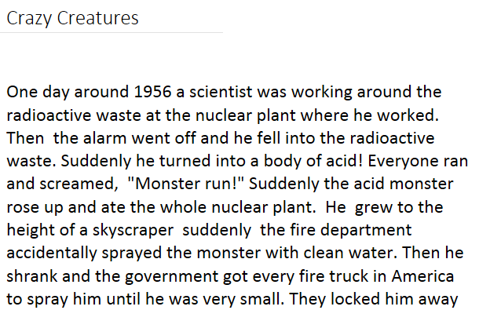
Crazy Creatures Story
The same child then wrote this story based on the plan, completely independently, on OneNote.

Slide 35
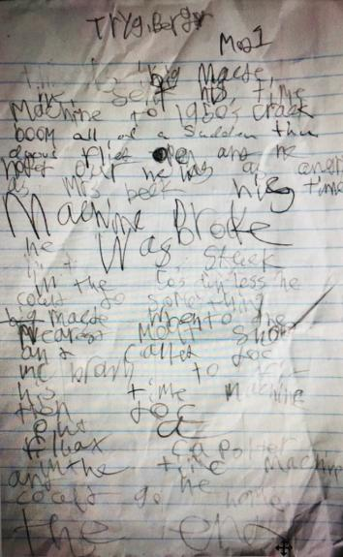
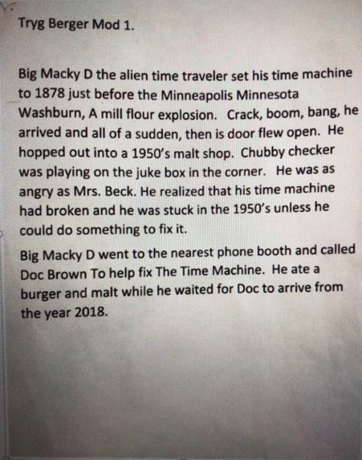
A student Before and After with Dictate

Slide 36
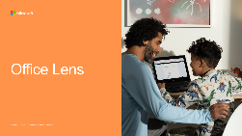
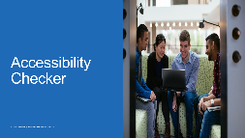
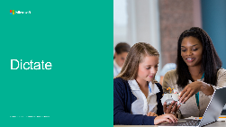
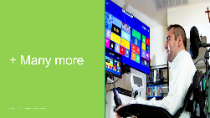
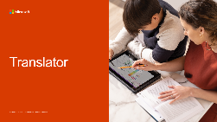

AI is sprinkled throughout Office

Slide 37
Windows accessibility
Inclusively designed for everyone

Slide 38

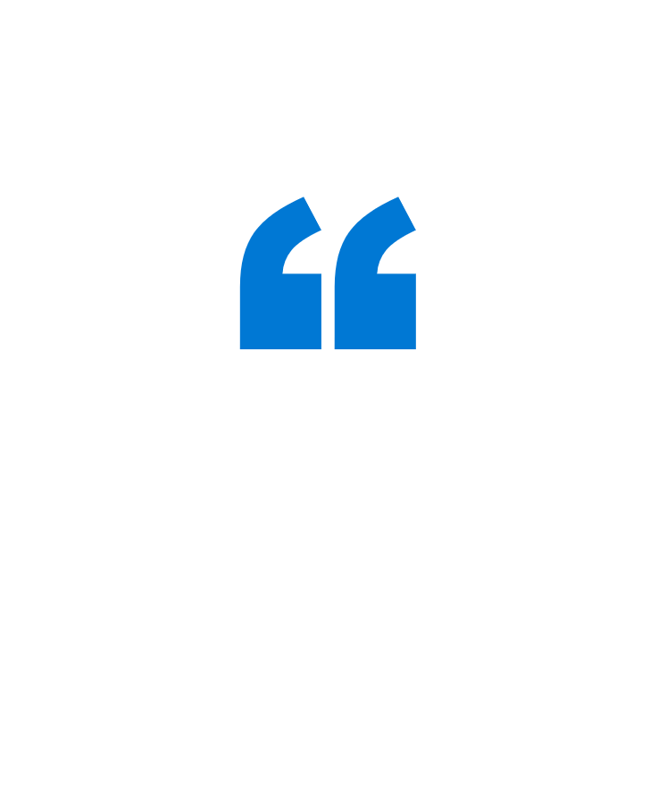
Microsoft’s inclusive design principles
A more accessible Windows experience has the power
to help tackle the ‘disability divide’—to contribute to more education and employment opportunities for people with disabilities across the world.
— Jeff Petty, Windows Accessibility Leader at Microsoft¹
Recognize exclusion
Reflect how people really are
Solve for one, extend to many
Design to benefit people universally
Learn from diversity
Put people in the center from the start
¹Microsoft. “What’s coming in Windows 11 Accessibility.” Jeff Petty. July 1, 2021. ²Microsoft Inclusive Design website.

Slide 39

Christine Douglas – The way you see it video
Click the image to play the video

Slide 40
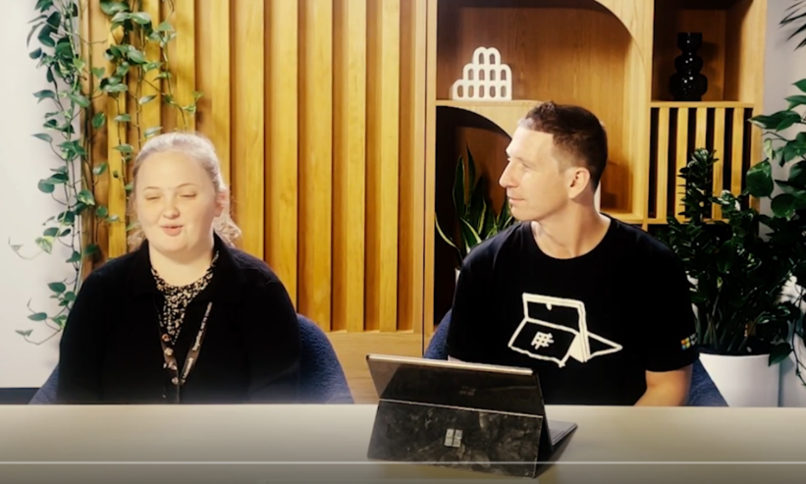
Christine Douglas – Inclusive isn’t elusive video
Click the image to play the video

Slide 41
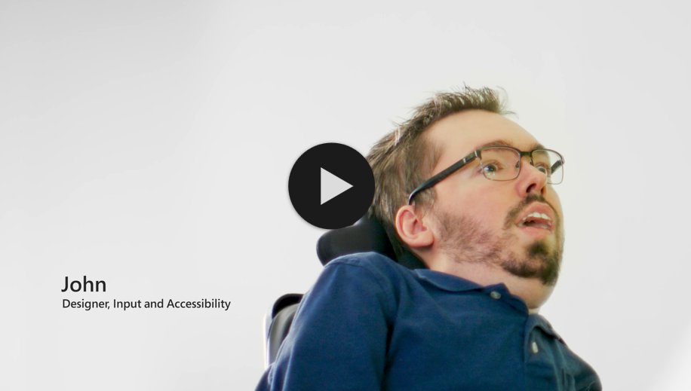
Windows 11 inclusive design video
Click the image to play the video

Slide 42
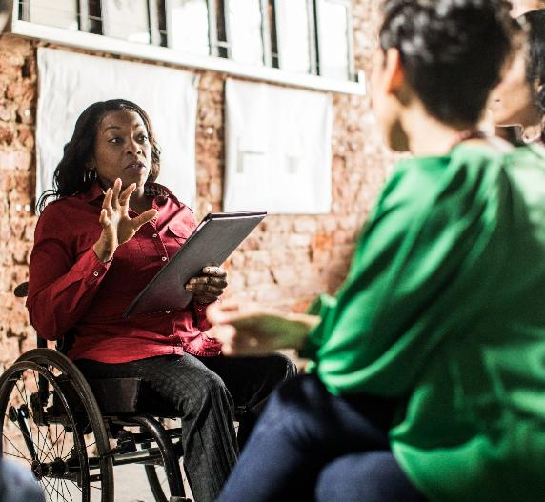
Redesigned for productivity, creativity, and ease—for everyone
People with disabilities were engaged in designing Windows 11 from the start. The resulting operating system aims to provide a delightful experience for everyone—with disabilities and without.
Your device, your way
Navigate your computer with keyboard shortcuts, voice, or eye control
Tailor your view
Customize your display to see every detail—or skip
the screen entirely
Catch every word
Experience full-spectrum sounds or use captions instead
Get in the zone
Cut down on distractions and focus on the task at hand
At its core, Windows 11 provides
Best productivity and collaboration experiences
Industry-leading security from chip to cloud
Simplicity and lowest total cost of ownership

Slide 43
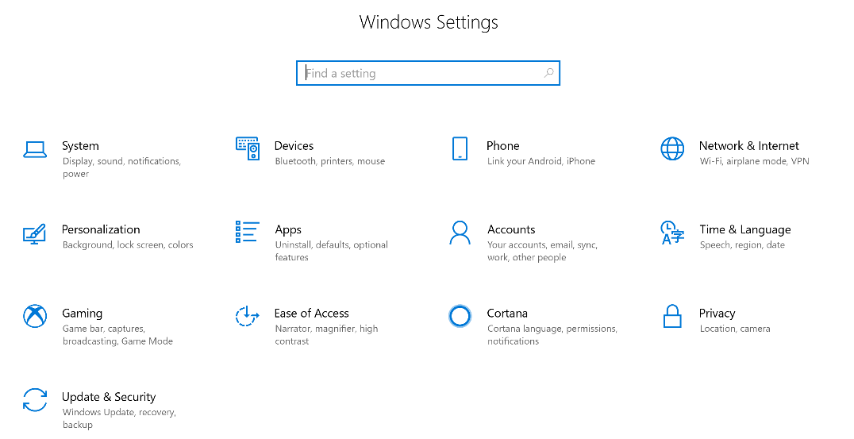
Make your PC easier to use - Windows 10 Ease of Access

Slide 44
Windows 11 builds on the strengths of Windows 10
Mobility
Vision
Hearing
Neurodiversity
Maintain current Windows 10 capabilities
Touch gestures for Windows
On-Screen Keyboard
Speech recognition commands
Voice recognition
Windows Hello
Improve usability of mouse,
keyboard, and other input devices
Touch keyboard
Eye control
Support for third-party screen readers
Adjust screen display size and color
Make the mouse pointer more visible
Color filters
Magnifier
Keyboard shortcuts in Windows and across apps
Hear all sounds in one channel
Display audio alerts visually
Extend notifications on screen
Enable text suggestions in Windows
Turn off animations, background images, and more
Make notifications stick around longer
Modify notification settings with Focus assist
Snap, order, and create multiple desktops
Improve on Windows 10 capabilities
Voice Typing
Narrator
Use a new, more attractive set of contrast themes
Live captions
Change Closed Caption themes
Use text or other alternative to sound
Simplify the Start menu
Read with fewer distractions
Choose which apps display notifications
Task bar personalization
¹Use Windows DVD player app with Narrator is a retired Windows 10 feature. ²Basic tasks with news and interests is a retired Windows 10 feature. Visit the Accessibility support for Windows support page for a full list of accessibility features across Windows versions.

Slide 45
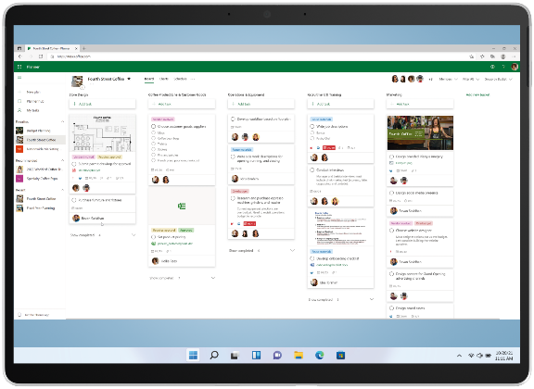

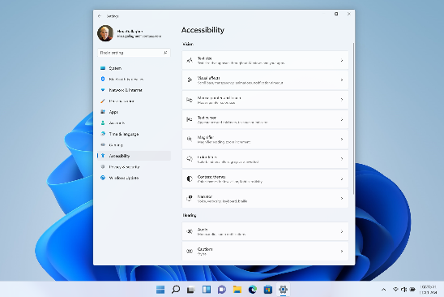
Reimagined Accessibility Settings
Easily identify the newly renamed Accessibility Settings (formerly “Ease of Access”)
Personalize your Windows 11 experience for vision, hearing, and interaction method from just one menu
The redesigned settings illustrate our overall approach to accessibility in Windows 11. It’s easier to find and control, incorporates feedback from users of various backgrounds and abilities, and, ultimately, celebrates the fullness of human ability.
= Feature improved for Windows 11

Slide 46
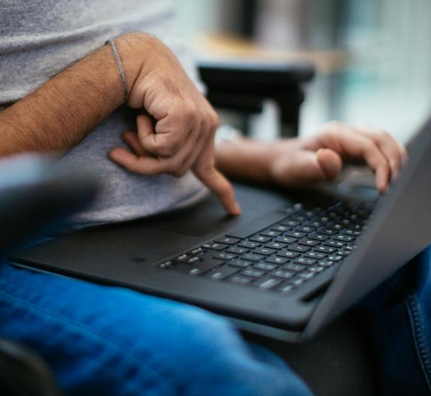
Learn more about Windows 11 accessibility
Websites
Windows 11 accessibility homepage
microsoft.com/accessibility/windows
Accessibility support for Windows
aka.ms/Windows/AccessibilitySupport
Accessibility information for IT Professionals
aka.ms/AccessibilityAdminGuide-Windows
Blogs
New accessibility features coming to Windows 11
aka.ms/Windows/A11yBlog05-2022
Making Windows 11 the most inclusively designed version of Windows yet
aka.ms/Windows/A11yBlog10-2021
Video
Designing an inclusive Windows 11 for a hybrid world
aka.ms/Windows/Accessibility-Ignite2021 or watch on next slide

Slide 47






Achieving more with accessibility – Inclusion in Action series
Andrew, a young boy who read for the first time with Learning Tools.
Justin, a young man who uses Office 365 to communicate with the world.
Veronica, a student with low vision who created a perfect Sway.
Cameron, a university lecturer who believes it is an exciting time to be a blind person with Seeing AI.
Jack, a teacher who shows students what is possible with Office 365 and Narrator.
Steve, who navigated a medical crisis with OneNote to access printed documents.

Slide 48

Accessibility Learning
Webinar Series
Interactive online event where anyone can learn about the latest Microsoft accessibility features, productivity tips for school and work, or technology that enables a more independent and full life.
Sign up for webinars:
Accessibility Learning Webinars
Watch completed webinars on YouTube
48

Slide 49
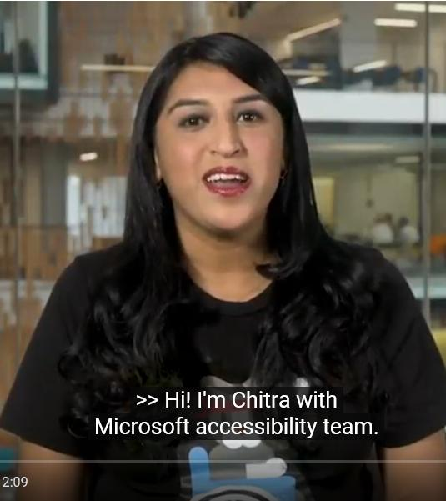
Do-it-yourself accessibility
A series of videos from Microsoft Customer Support covering eye control, text size, screen reader use, assistive technology, and more.
Accessibility videos playlist
Chitra with the Microsoft Accessibility team.

Slide 50
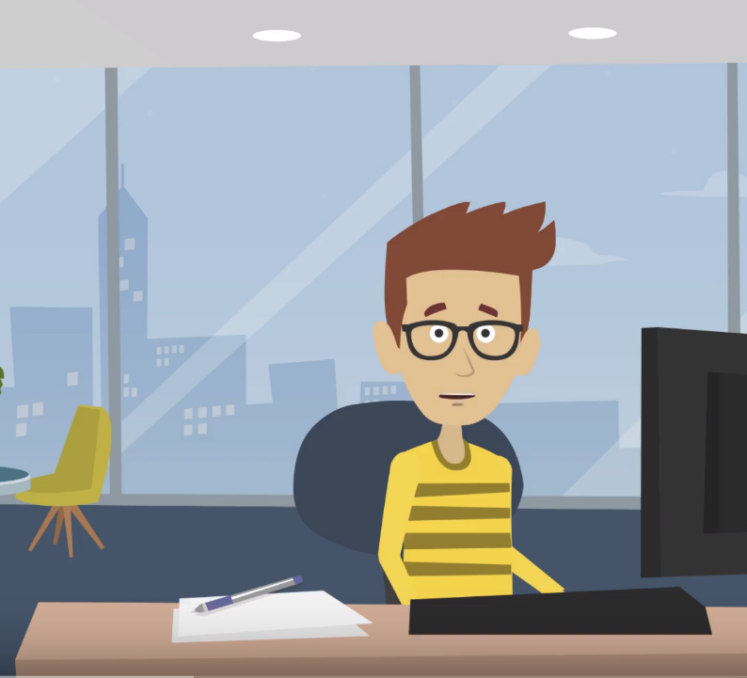
Accessibility At-A-Glance series
Accessibility at a Glance is a series of short videos built to help you learn how to create an inclusive digital experience for people with disabilities.
Watch Accessibility At-A-Glance videos
An animated Guy Barker is among Microsoft employees featured in the Accessibility At-A-Glance series.

Slide 51
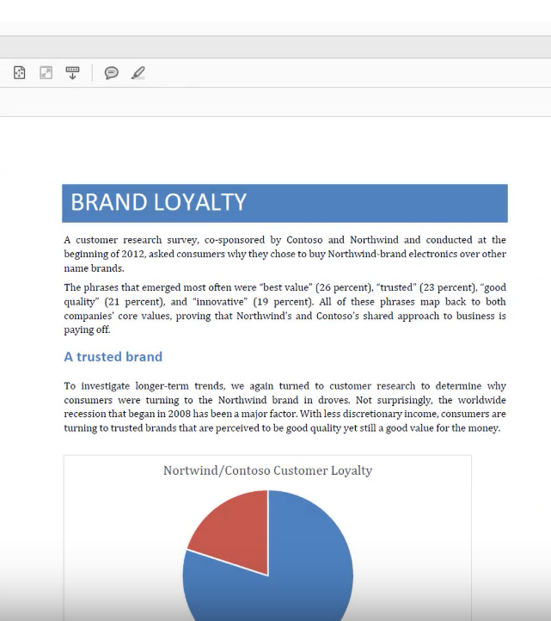
PDF Accessibility Training
Learn how to create accessible PDF documents in this series.
Watch the PDF Accessibility Training videos
51

Slide 52

Office Accessibility
Find resources for people with disabilities and how
to make content accessible
for everyone at the Office Accessibility Center
Office 365 provides best-in-class
apps and powerful cloud services with accessibility built-in. Learn about accessibility capabilities in Office 365
Get accessible templates for Office
Office accessibility video training
52

Slide 53
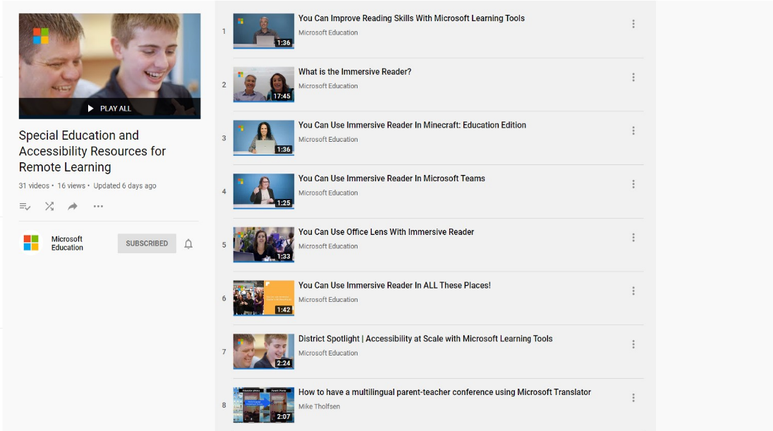
Learning Tools – Accessibility Playlist

Slide 54
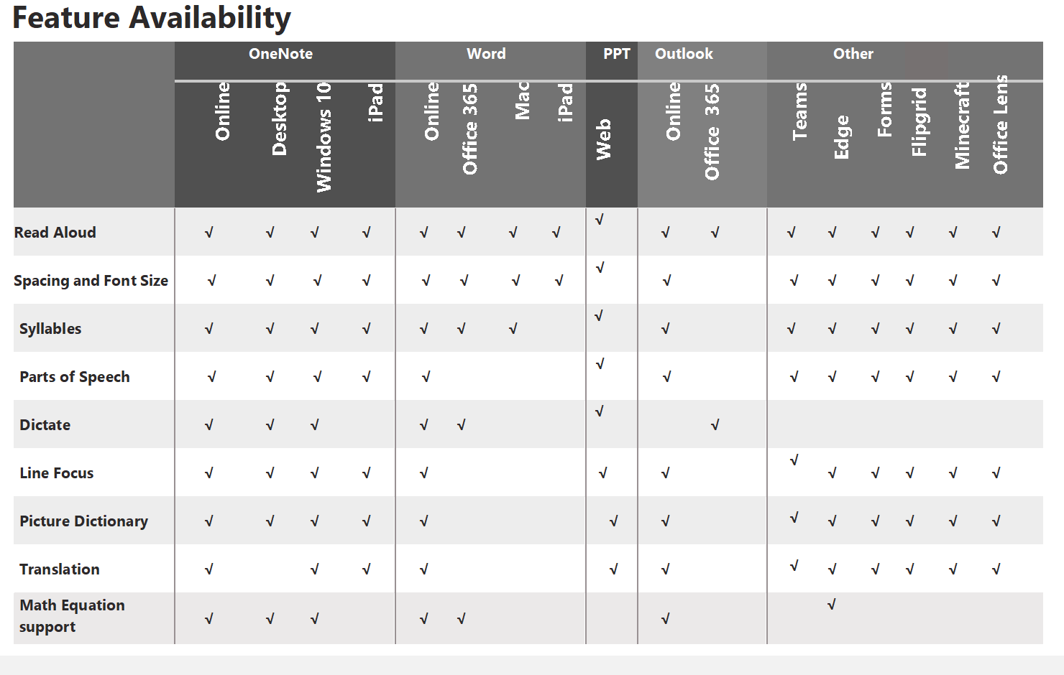
Learning Tools Flyer – aka.ms/learningtoolsflyer

Slide 55
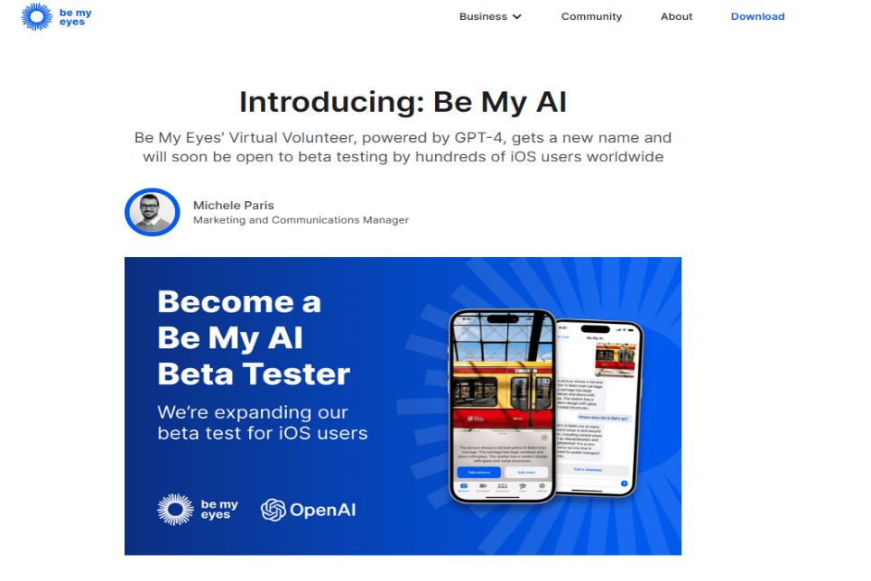
Be My AI

Slide 56
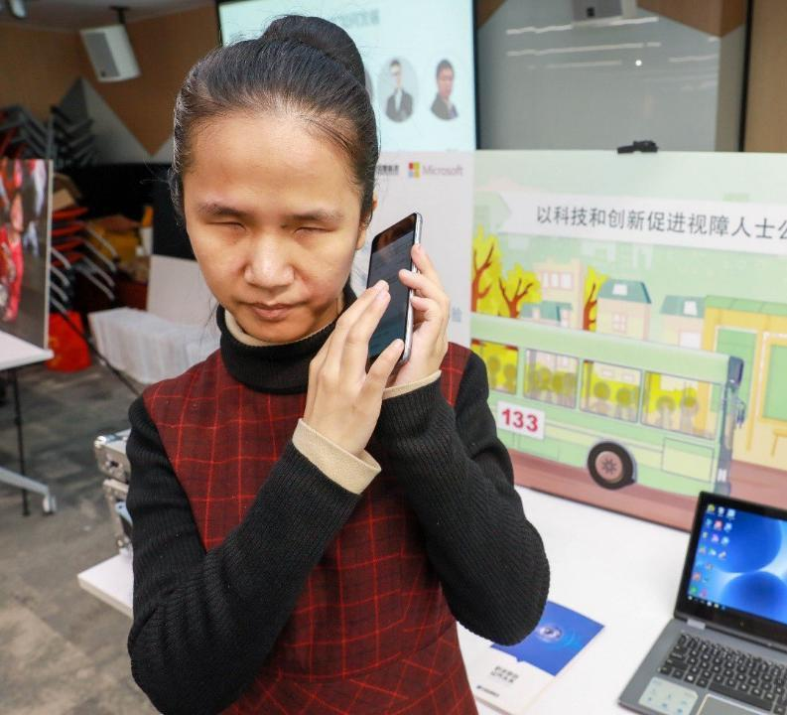
Windows 10
Get Windows 10 accessibility help
Learn about Ease of Access features
Complete guide to Narrator
Color filters
Resources for low vision
Closed caption settings

Slide 57
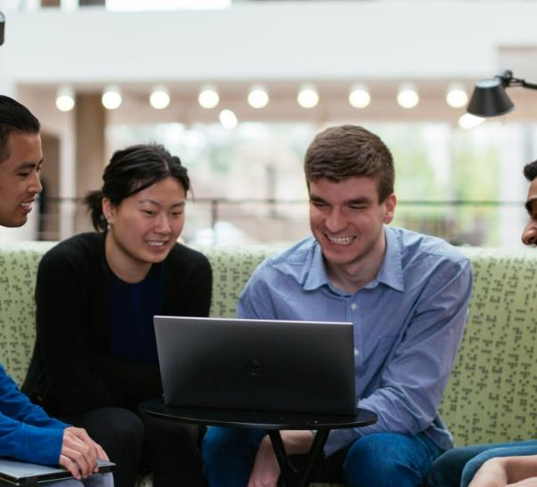
AI for Accessibility
AI for Accessibility is a $25 million,
5-year program to accelerate the development of accessible and intelligent AI solutions to benefit persons around the world with disabilities.
AI for Accessibility website
Check out how our grantees are using AI powered technology to make the world more inclusive. Accessibility Projects

Slide 58
Thank you!
Education Success Manager
Andrew.Balzer@microsoft.com
@AlphaBalzer
Linkedin.com/in/andrew-balzer

