Slide 1
Embedding neuro-affirming practices and building a neurodiverse community in the Library
"I feel like the University is not made for people like me..."
RMIT University Library
RMIT Equitable Learning Services

Slide 2
Acknowledgement of Country

Slide 3
Presenters
Adam Ferris, Academic Skills Advisor (Writing and English), RMIT Library Study Support (he/him)
Josh Muir, Academic Skills Advisor (Writing and English/STEM), RMIT Library Study Support (he/him)
Jacinta Jones-O’Meara, Coordinator, Accessibility (she/her)

Slide 4
How can we make education more neuroaffirming?
Neurodiverse
Study Sessions

Slide 5
Overview
Neurodiverse
Study Sessions —
Background & Rationale
Development of NSS @ RMIT
Features of NSS
Impacts & Outcomes
Challenges & Future Directions

Slide 6
RMIT Snapshot: Growing Diversity in Student Needs
Number of students with Equitable Learning Plans were growing every year as well as the complexity of student needs
Change in learning experiences – hybrid (exposed new complexity for many students)
Equitable Learning Service (ELS) and the Library – increased need for disability awareness and supports within the Library due to increased referrals

Slide 7
RMIT enrolled students with disability
9000
8000
7000
6000
5000
4000
3000
2000
1000
0
2020
2021
2022
2023
2024

Slide 8
Navigating Rising Needs: The need to look for opportunities to partner and lessen the load of the disability service
Increased demand for appointments to register with ELS
More students with neurodivergence sharing diagnoses
Increased demand for study support

Slide 9
The disability advisors found themselves wondering…
Do students with disability use the Library?
How do students with disability use the Library?
Do we know of any current barriers that are in place in accessing the Library’s services and facilitates?

Slide 10
Connecting with the Library
ELS found a leader in the Library to discuss the Library’s services and explore whether they were accessible and used by all students
Library leadership agreed to explore what students with a disability thought about the library and it’s spaces and services
ELS and Library sent a survey out to all students who received the ELS Newsletter (over 3000 students)
Proposal of what a neuro affirming study session could look like which included co-design and space searching led by those with lived experience
Partnership with RMIT's Student Union – the inaugural Disability and Carers Rep, supported and provided snacks and fidget/sensory toys!
Pilot was launched 2021 (6 weeks)

Slide 11
Key findings from pre-pilot survey (2021)
Physical Spaces are overstimulating - “lighting is too bright”
Unsure where the service can meet their needs - “I’d just like to be able to talk and clarify instruction very thoroughly”
Being directed to a ‘Library’ for help – “I need to be able to visualise and understand how everything works prior to attending. Trying to figure out expectations and norms can be difficult and cause so much stress that I will avoid the space all together. It may also be nice, if established disability groups have walk-thru/tours, as learning about a new space with similar minded people takes away a lot of the anxiety.”

Slide 12
What were students asking for?
I want to find a space that caters to my needs for a dimmed study space, separated from the Library that is usually very crowded, noisy and too bright.
I want a place where I could actually study and not feel self- conscious with my fidget toys.
I need a quiet place to get work done and be with other people like me.

Slide 13
ELS: A Snapshot
In 2022 : 3118 Equitable Learning Plans were published
98% of Equitable Learning Plans included ‘Extensions’
Group Work is the most common ‘alternative’ sort by students who are neurodivergent and with complex medical conditions
Students Surveyed in 2021 express that they were experiencing discrimination based on lack of awareness from educators

Slide 14
Development of NSS at RMIT
Began as 6-week pilot program in 2021
“Shut Up and Write” → NSS
Original focus of tailored academic skills support → community
2021: 6- weeks, 2022: 8-weeks,
2023: 10 weeks, 2024: 14 weeks
Co-design process with students, staff with lived experiences
For some, these resources are as fundamental as ramps & elevators, glasses, hearing aids, internet access, drinking water, computers and the library. - RMIT Student

Slide 15
It takes a village...
Students
Equitable Learning Services
Study Support Team
RMIT Student Union
(RUSU)
Library Business Partners
Communications and Engagement
Sites and Facilities
Learning from other institutions/professional development

Slide 16
Key Features of NSS
Environment Setup:
Spacious room
Dimmable lighting
Chairs facing inwards: students wanted to feel like no one behind them could watch them → less judgment
Moveable banners in front of glass walls ensuring privacy
Blue noise/ADHD study music on YouTube
No mention of neurodiversity/disability on screen → ensure privacy of medical conditions from passersby

Slide 17
Key Features of NSS
Structured Study Sessions:
Pomodoro technique → focus periods and rest periods, promoting effective study techniques for students who struggle to get work done
Mostly 5-minute breaks, one longer 15-minute break → students socialise, support each other, build community
Body doubling → even staff (and staff from visiting institutions have taken part: ‘I get more done in these sessions than I do in the office, too!’

Slide 18
Key Features of NSS
Wellness Support:
Healthy snacks (and some unhealth treats, of course)
Snacks/sensory toys provided by RUSU funding
Hidden Sunflower lanyards
Informal chats with ASAs during breaks → encouraging students not registered with ELS to create an ELP, talk about nutrition/hydration/mindfulness/rest
Remind students of support services: counselling, RMIT Medical Hub, Study Support Hub

Slide 19
Key Features of NSS
Academic Support:
ELS/Neurodiverse students were not accessing traditional support services (including Study Support) in the same way as their neurotypical counterparts → creation of tailored program
Access to ASAs (academic skills advisors) → referencing, academic writing, English language support, presentation skills, cover letter/resume help, study skills, time management techniques
2023 program included Information Literacy Librarians → 2025 again?

Slide 20
Key Features of NSS
Inclusive Atmosphere:
Non-competitive, welcoming environment
Students can work on anything at all → Brainstorming? Essay writing? Sorting through 15,000 emails? Finally booking that doctor’s appointment? Do it! Work smarter, work harder.
Any students can attend → students often bring friends and classmates
93% of participants identify as neurodiverse; 64% registered with ELS (Equitable Learning Services)

Slide 21
Student Experiences of NSS
For some, these resources and sessions are as fundamental as ramps and elevators, glasses, hearing aids, internet access, drinking water, and the Library itself.
The social element was also a surprise. I've never really craved a "safe space", but finding myself in one, I felt a positive influence just from the vibe of acceptance and belonging.
The neurodiverse study sessions are the reason why I stayed in my degree and kept going.
Everywhere else at school has too bright lighting and it creates headaches and loss of concentration.
Space with limited distractions, a collective and collegiate emphasis on focused work and UNDERSTANDING of the challenges (tribe membership) is a key resource for success.
The science is there, the pedagogical knowledge is there.
This is so good, more please! I get so much more done at these sessions.
They should be on all day every day.
Why can’t we have more?

Slide 22
Student Experiences of NSS

Slide 23
Who comes to the sessions?
A short feedback survey revealed that:
Participants come from all of the RMIT colleges
From vocational education to doctorate level
93% identify as neurodiverse
64% were registered with RMIT's Equitable Learning Services

Slide 24
Impact & Outcomes
Themes in data collected from the Neurodiverse Student Survey (SM2, 2023).
1. Increased productivity & focus
Students reported high levels of productivity with their studies during NSS sessions.
Quotes: “I get so much done! Such a great space to study."
“These are the only times I can study.”
“Useful body doubling gets me committed to a certain task.”

Slide 25
Impact & Outcomes
2. Sensory-friendly environment enhances learning Students commented on the sensory-friendly adjustments in the NSS
Quote: "Everywhere else at school has too bright lighting and it creates headaches and loss of concentration.”
3. Enhanced sense of community / belonging Being among peers who share similar experiences reduced feelings of isolation and loneliness.
Quote: “I was looking forward to being in an environment with other people like me."

Slide 26
Impact & Outcomes
4. Overall student satisfaction Students reported consistent satisfaction with the sessions, environment, and support provided. Strong desire for the continuation and expansion of sessions. Quote:
"Everything's perfect, just wish it were more frequent!”
“I get so much more done at these sessions.”

Slide 27
Impact & Outcomes
Quote: “For me, the Neurodiverse Study Sessions have been the most productive hours in my weeks. I have even occasionally achieved more in these sessions than in the week between 2 of them. The difference between these inclusive 'islands' and every other study environment on campus is profound. I can see this may be difficult to really understand. Indeed, I could not really appreciate the difference until I was finally offered such a space in the pilot Neurodiverse Study Sessions last year.
And then it is ripped away.
Imagine offering ramps and elevators for only 3 hours per week. Or large print text. Or PCs with adaptive technology for only 3 hours per week. Or multilingual resources. Or closed caption video. Or gender-neutral bathrooms for only 3 hours per week.”

Slide 28
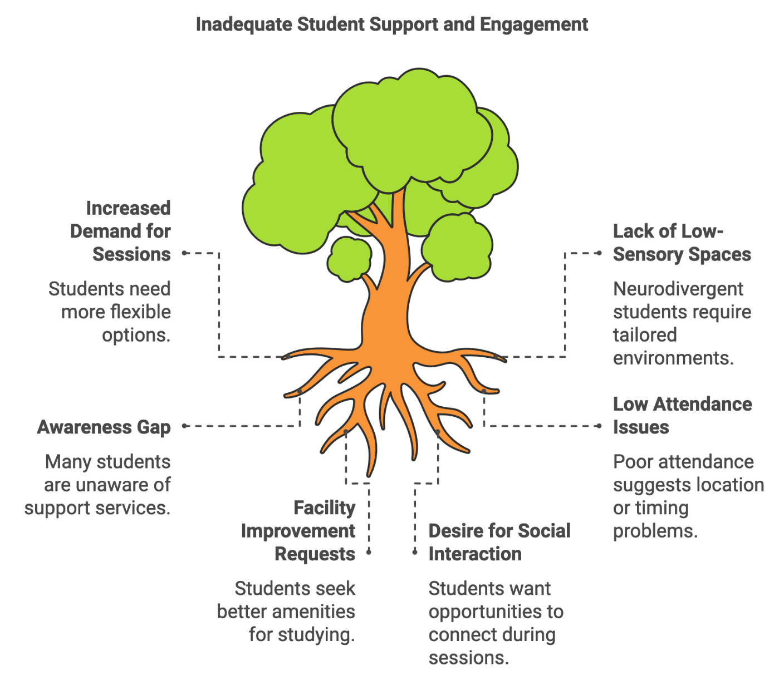
Challenges & Lessons Learned

Slide 29
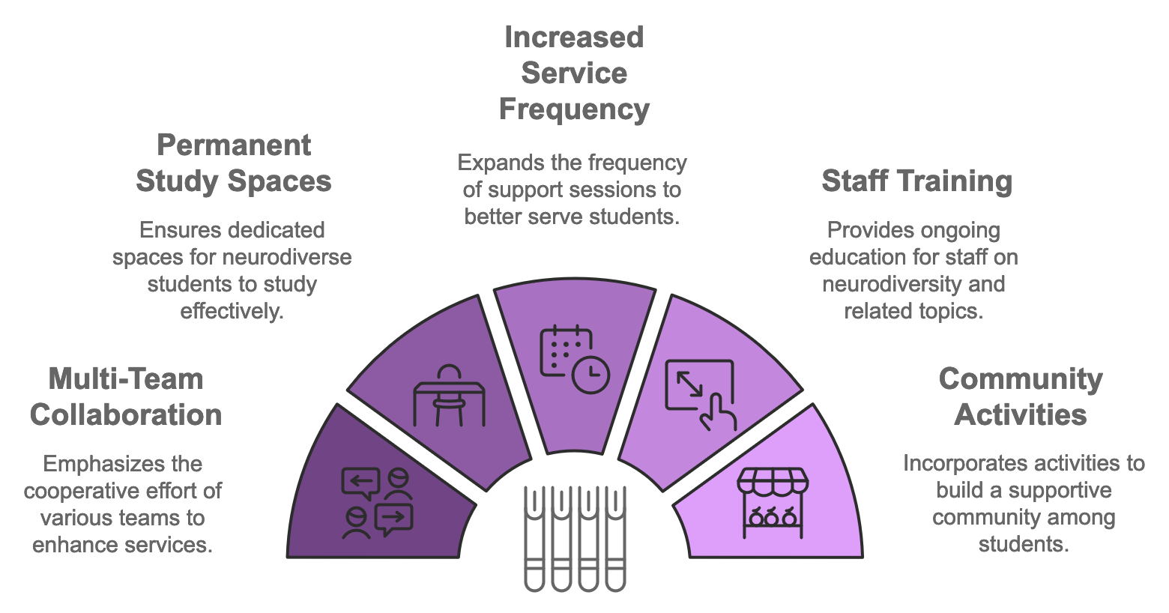
What's next?

Slide 30
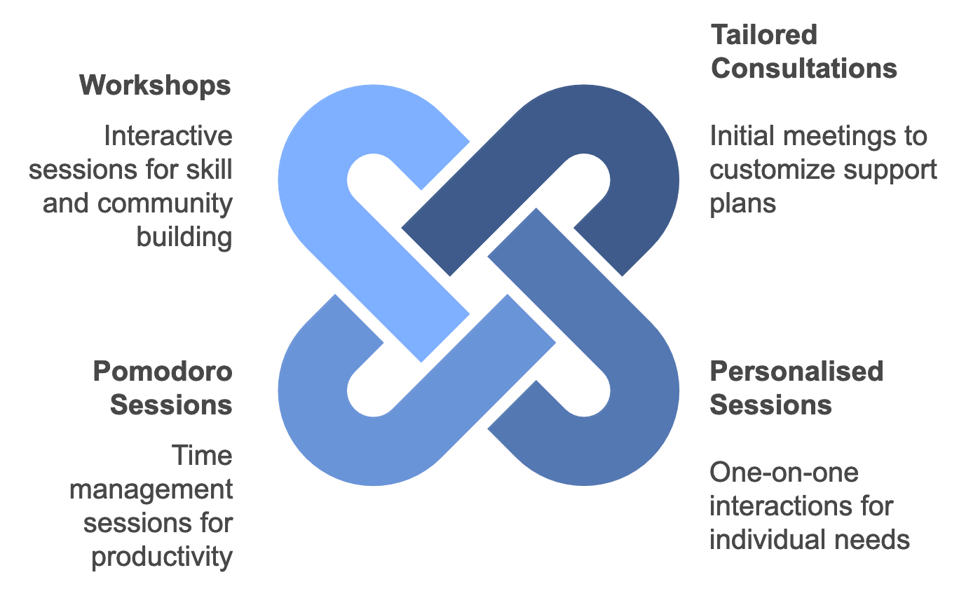
Our Vision for the Future of NSS @ RMIT

Slide 31
Students need YOU
"I feel like the world and the University is not made for people like me and I feel like every day is a challenge, trying to compete in a world and in degrees that are clearly catered towards people who love talking, who are extroverted, who love interacting with strangers, and whose brains work the same."

Slide 32
Contact us
Adam Ferris, Academic Skills Advisor (Writing and English), RMIT Library Study Support (he/him)
Josh Muir, Academic Skills Advisor (Writing and English/STEM), RMIT Library Study Support (he/him)
Jacinta Jones-O’Meara, Coordinator, Accessibility (she/her)
adam.ferris@rmit.edu.au joshua.muir@rmit.edu.au jacinta.jones@rmit.edu.au

