Slide 1
Serving as a reminder that you are not alone: Building community and support through neurodivergent study skill workshops.
Tiana Blazevic
Disability Support Project Officer and Academic learning Advisor

Slide 2
Acknowledgement of country
I would like to acknowledge the Kaurna people, the original custodians of the Adelaide Plains and the land on which the University of Adelaide's campuses at North Terrace, Waite, and Roseworthy are built.
I pay my respects to Elders past, present, future, and extend this acknowledgement to all Aboriginal and Torres Strait Islander and First Nations People.

Slide 3
Your Speaker
I am a specialist but not an expert, nor do I have a degree in a related field such as psychology or psychiatry.
I have been working directly with neurodivergent students in 1:1 capacity since 2020 as an Academic Learning Advisor. I have been teaching since 2019 across two institutions: The University of Adelaide and Macquarie University. I also worked at Kaplan Business School for 9 months in the Academic Success Centre developing workshops and working with international students before accepting a role as the Disability Support Project Officer for The University of Adelaide where I coordinate the Neurodiversity Project.
My research area is in philosophy, medieval medicine, and epilepsy. My field of philosophy is epistemic knowledge ( a fancy way to say knowledge building and how that intersects with belief systems).
I served on two governance boards: The Council of Australian Postgraduate Association and the Association for Academic Languages and Learning (AALL). I am also currently a co-lead for the developing Higher Education Neurodiversity Global Network, and I sit on a specialist interest group for Neurodivergence with other neurodivergent academics as part of AALL.
I am Dyslexic (diagnosed at 16), a late diagnosis of ADHD (31). I am also a childhood cancer survivor (12) I had a rare blood disorder (ITP) at (18) which resulted in me becoming immune compromised as they had to remove my spleen. Safe to say, I am well versed in the lived experience of navigating hidden disabilities.
Yes, I do plan on writing a book about my life.

Slide 4
Neurodiversity project
Create a peer mentoring program for undergraduate neurodivergent students to pilot in 2025.
Establish a Neurodivergent Hub web page that directs neurodiverse students to university support services in one convenient place.
Create additional resources for both staff and students related to neurodivergent learning.
Develop and run workshops for neurodivergent students to assist with study skills and transition.
Raise further awareness of neurodiversity and hidden disabilities on campus through events and workshops.
Collaborate with both professional and academic staff on the needs of neurodiverse students.
Connect with students on their experience as a neurodivergent person through a student survey and incorporate that feedback into the project aims.

Slide 5
Neurodivergent conditions at the University of Adelaide 2020-2023
ADHD registrations of new students have increased by an average of 34.88% every year since 2020.
ASD registrations of new students have increased by an average of 22.63% every year since 2020.

Slide 6
Webform data 2024 ADHD

Slide 7
Webform data 2024 ASD

Slide 8
Webform data 2024 Specific Learning Disability

Slide 9
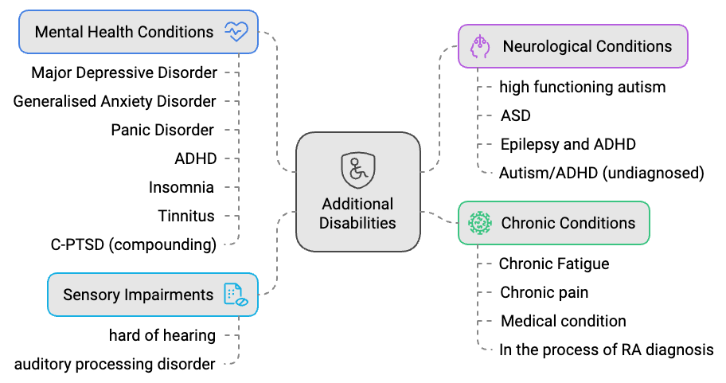
Co-Conditions tell a different story: August

Slide 10
Why workshops?
As soon as I began my role and reflecting on the last few years as a Learning Advisors, I noted that there is a gap for our undiagnosed or awaiting diagnosis students.
Whilst the core of the project is to create a peer mentoring program, these workshops are critical for student retention and experience beyond peer mentoring and focus on the 2nd largest concern for students (academic skills) as recently outlined in the University Accords.
These workshops grew from both a need to bridge this gap for the Disability Support Service but also from a deeply personal reason as I am neurodivergent myself.
I always felt isolated or misunderstood by peers and colleagues and wanted to create a space that cultivated community and support for neurodivergent students.

Slide 11
Neurodivergent Study Skill workshop pilot Semester 2 2024
Session 1: Introduction to Neurodiversity and Self-Advocacy​
Session 2: Time Management and Organization
Session 3: Creating a Conducive Study Environment​
Session 4: Note-Taking Strategies
Session 5: Reading and Comprehension Skills​
Session 6: Understanding and Managing Executive Function
Session 7: Memory Techniques and Retention​
Session 8:Writing Skills and Overcoming Writer's Block​
Session 9: Research Skills and Using the Library​
Session 10: Drafting and Revising Written Work​
Session 11: Presentation Skills and Public Speaking Skills​
Session 12: Stress Management and Self Care

Slide 12
Creating the workshops
Each workshop builds on the other, beginning with key foundations around understanding neurodivergence, advocacy, sensory needs, and discovery of those needs through self-reflection worksheets that I create on Canva.
I use research-based evidence, but also consult general readings on neurodivergence as I have found that those sources more often contain practical strategies from lived-experience.
Each workshop contains a variety of worksheets, activities, self-reflection, and optional group tasks.
Students always have an option to participate individually through their self-reflection worksheets or discuss on their table their self-reflection and there is no expectation they must talk to each other, and I mention this to them explicitly and consistently re-affirm that throughout the workshop.

Slide 13
Marketing of the workshops
I used a variety of marketing channels to spread the word about these workshops as I did not have a lot of lead in time:
Presenting at Learning and Teaching Committees at each of our faculties and encouraged leadership to advertise the workshops in their courses
I had a global announcement published on our learning system canvas
I contacted our social media department who posted every Tuesday before the workshop
I used my network that I had built over 10 years of being a student and 7 years of being a staff member
I had our Disability Advisors also promote these workshops in their consultations with students.
I utilized our digital hub screens around campus.

Slide 14
Universal design learning before they enter the workshop
Slides are always different and incorporate accessible colours in their design (such as pastels), with some sensory stimulation.
The workshop structure is kept the same, but students will not see the same slides or images, and this keeps a balance of both routine and interest.
Only specific fonts are used that are suitable for neurodivergent students.
In the booking form, students are asked what sort of support they need to access the workshop (physical access, captions, materials etc.)
Text reminders have very specific instructions on how to find the location.
I consistently check in with students to see if I am missing anything whether that is through the booking form or prior to their arrival i.e. access routes and wayfinding in the library.

Slide 15
Universal design learning in the workshop space
No judgement for being late. I affirm in every workshop that I do not mind if they come for 20 minutes or arrive at any time as these are optional workshops.
No requirement to participate in the group (online Slido/self-reflection worksheets alternative).
Students encouraged to get up and walk around or stretch at the back of the room if they need (due to hypermobility issues) or have stimming items close to them.
I provide paper on tables for anyone who wants to draw or doodle to maintain focus.
I ask the students discuss and agree on how many lights to keep on so we can all have an optimal learning environment.

Slide 16
Workshop Attendance
Workshops held in person (20-30 students each week) with an average of 21 students so far.
Workshops were held on a Tuesday from 10:00-11:30AM.
Content uploaded weekly to the Disability Support webpage along with further reading. This content is only available for University of Adelaide students and is not available publicly.
Holding workshops in person has created a sense of community and students have emphasized the need to be around other neurodivergent students for sense of self and safety. Exploring online and face-to-face options for 2025 once funding is confirmed.
Students asked to fill out a survey after each session. They’ve reported that they enjoy the community atmosphere.
The surveys provide immediate feedback for me to adjust my teaching where necessary.
Students have shared they do not feel as isolated anymore, after attending a workshop.

Slide 17
The approach of the workshops
The workshops are scaffolded in way that students first discuss common assumptions about neurodivergent students. I often discuss how neurodivergent learners are "boxed" into neuro-typical study routines and ideas about what is "best" academic practice.
I draw heavily on my own experiences as a student and neurodivergent person and some of the stereotypes and assumptions that I have encountered as a way for students to know that they are not alone. I also often talk about my "quirks" that I did not realize were neurodivergent traits before my diagnoses. This vulnerability is hard but necessary if I wanted to achieve my goals.
The workshops often examine how learning should first be situated within its cultural and social context rather than a deficit model.

Slide 18
The approach of the workshops
For example, instead, of discussing how to prioritize in our session on time management, I discussed peak productivity (hours of the day they work best and for how long) and how to work with your fatigue levels as well as an interest-based nervous system. I then asked them, who defines what it means to be productive?
Every workshop will provide tools and examples for students to incorporate. Such as virtual study tools, immersive YouTube sessions, 8D audio, goblin tools, Zotero, obsidian, to assist with their learning and academic practices. There is also a focus on how to use artificial intelligence when you are neurodivergent.
Whilst most of the workshops will contain some sort of tool that they can implement, I emphasizes to the students that finding what tools work for you is an activity she calls the discovery process.

Slide 19
The discovery process
I have found that students with ADHD, Autism, and Dyslexia often feel shame and isolation in university and are more prone to burnout. We also see this recurring theme in the literature that is growing daily.
Many of the neurodivergent students in the workshops discussed their shared experiences (both good and bad) in high school and primary school.
Our discussions sometimes revolved around learning trauma from school (especially if they are late-diagnosed).
As a result, I am always emphasizing the following in the workshops; specifically, these three areas.

Slide 20
The discovery process
The workshops are about discovering what works best for them. They can pick and choose the strategies they wish to try, and I ask them to tell me when something is not working.
Reflection worksheet activities can be kept as a journal to reflect on what works for them in the past, present, and future. Often, certain strategies will work for a while but then do not work and the student needs to adjust.
I often approach neurodivergent students holistically. For example, when a neurodivergent students asks her how to study better or plan time better, her firsts questions are always around wellbeing, sleep, and nutrition.
Recent research has highlighted the growing co-occurring conditions in our neurodivergent population, such as PCOS, PMDD, Hyper mobility, Ehlers-Danlos Syndrome, Insomnia, circadian rhythm issues, restless leg syndrome, fatigue, sleep issues, as well as other various immune disorders.

Slide 21
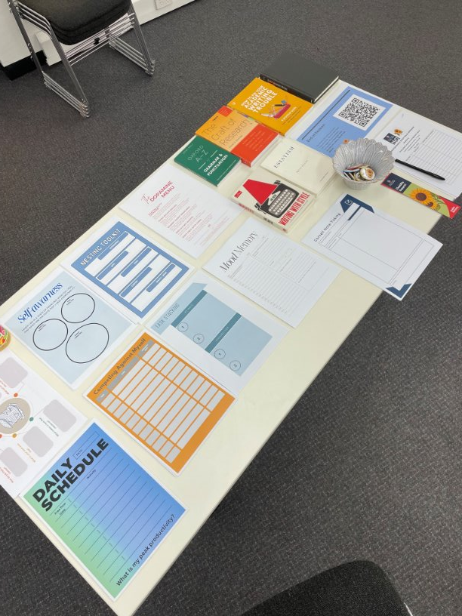
Why reflection as an activity?
Reflection worksheets are a synchronous activity that allows collaboration, learning, self-acceptance, and community, while also allowing neurodivergent students autonomy and agency over their academic practices.
The reflections also allow them to ask one another what each other's strategies and experiences are with that specific topic and provides a collaborative and community building exercise.
Worksheets ask students to reflect on what academic practices have worked for them in the past, instead of focusing on a deficit model.
Critical reflection worksheets are a strength-based approach that allows the student to discover more about what works for them rather than telling them what to do.

Slide 22
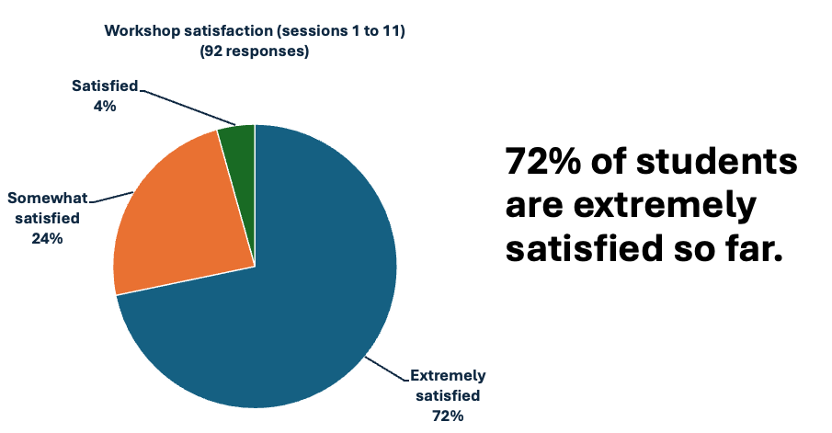
Satisfaction so far

Slide 23
Feedback from the pilot so far (2024)
Normalising memory issues rather than a personal failure, and focus on stimming, and also the different types of neurodivergence that impact different types of memory
I really enjoyed the short demonstration on the Obsidian and Zotero, giving me a little hope that I can lift myself out of my misery in regard to the semester-wide research project I'm currently undertaking.
I was really glad this covered the aspects of executive functioning (paralysis) that I struggle with most
I love to listen to the presentation and the short reflections that I have not done before especially through note taking
The worksheets and talking to be able to identify things that work for me specifically
visual reminder reflection and daily schedule sheet to see when my peak productivity is

Slide 24
Building community feedback
Getting to be around neurodiverse people and having it run by someone who is neurodiverse and has lived experience
Knowledge sharing
Felt very inclusive and relaxed, at the same time, delivered key information and felt very relevant
Open and supportive atmosphere
Shared community
I liked talking in a group about strategies. That really helped with figuring things out and understanding new strategies
The supportive environment and engaging activities
Serving as a reminder that you are not alone, negative outcomes are expected and plethora of strategises to try

Slide 25
Email feedback: participating without pressure
This was my first time participating in such a workshop, and I truly appreciate that you did not pressure me to interact with you or my classmates. At that moment, I was overwhelmed with anxiety and was not ready to speak, so your understanding meant a lot to me. The overall impression I got from the workshop was one of inclusivity, and it deeply moved me. This feeling of acceptance is particularly meaningful to me...I genuinely wish I could attend next week’s workshop on grammar, but unfortunately, I have to go to the airport that day to see off a friend who is leaving Australia. I hope to have the opportunity to join the following workshop instead, and I am very much looking forward to seeing you again. Thank you once again for creating such a welcoming space.

Slide 26
Slido as a way to build community
It is very difficult to separate what we know and what we believe, perceive, and sense. In his chapter, “The Propensity to Believe”, James Alcock argues that:
Virtually every society is a society of contradiction, valuing and promoting reason and logic to some degree, but at the same time valuing and promoting deeply held transcendental beliefs that defy that logic. In consequence, individuals learn to question, to analyse, to apply logic in one belief system, but not to do so in the other.
James Alcock, “The Propensity to Believe,” in Flight from Science and Reason, ed. Paul R. Gross, N. Levitt, and Martin W. Lewis, 1st edition (Baltimore, Md. London: JOHNS HOPKINS UNIVERSITY PRESS, 1997).

Slide 27
Slido poll - what is the first one that comes to mind when you are told to write?

Slide 28
Slido poll - what has been your experience with reading and interpreting texts?

Slide 29
Slido poll - In what ways do you find that stimming helps your memory?

Slide 30
Bridging the gap through workshops
These workshops were marketed specifically to students with no official diagnosis or medical records or students awaiting diagnosis 12-week bridge the gap in our service. These workshops were open to all students no matter their level of study or diagnosis status.
In most sessions, there was an even split between students who ticked "yes" I have an access plan or "no" I do not have an access plan when they registered for the workshop.
There was a total of 157 students who ticked "no” and indicated that they had no access plan.
In total there were 338 registrations and 204 students who attended over the 12-week period.
Many of the students who ticked "no" to having an access plan stated that they were either:
Awaiting diagnosis
Not sure and exploring
Self-diagnosed
Did not want to disclose to the university

Slide 31
Bridging the gap through workshops
We can provide students with reasonable adjustments but what is the next step beyond that?
How do we help students who are undiagnosed or coming against a financial barrier of diagnosis? Also, how do we help HDR students who have limited supported in this area and access plans are not always applicable?
These workshops are just one step that universities can take to acknowledge those barriers and provide students with assistance that goes beyond the legal requirement.

Slide 32
My final word
I often acknowledge the struggles and challenges of the neurodivergent experience. There are, of course, situations such as inherent requirements or poor infrastructure that do not allow for changes, but this acknowledgement lets the students know that you are aware of the potential barriers.
I acknowledge this either through my own personal lived experience as a neurodivergent educator, research-based evidence, and the voices of other neurodivergent writers, researchers, and colleagues to show them they are not alone.
I think we need to start reducing stigma within the academic and professional university community. How can we expect our students to disclose and not feel shame if we still feel that way?
I find that students have appreciated my own disclosure of my struggles both past and present.
This disclosure allows them to feel safe and included and reminds them I am human, like them, with layers of complexities (I am not an academic robot).
I also like to emphasize that I am not the source of truth on neurodivergence. I encourage students to read the sources I provide and to follow up with their own research and to discover themselves and trust that they know what is right for them.

Slide 33
Reference List
James Alcock, “The Propensity to Believe,” in Flight from Science and Reason, ed. Paul R. Gross, N. Levitt, and Martin W. Lewis, 1st edition (Baltimore, Md. London: JOHNS HOPKINS UNIVERSITY PRESS, 1997).
Aldridge, Beren, and Ronen Stilman. 2024. “Unmasking Neurodiversity: Revisiting the Relationship Between Core Self and Sense of Self to Examine Common Neurodivergent Script Decisions.” Transactional Analysis Journal 54 (1): 47–62. https://doi.org/10.1080/03621537.2024.2286576.
Alexander, David A. 2024. “The Dyslexic Academic: Uncovering the Challenges Faced as Neurodiverse in Academia and Establishing a Research Agenda.” Disability & Society 0 (0): 1–6. https://doi.org/10.1080/09687599.2024.2312227.
Dorani, Farangis, Denise Bijlenga, Aartjan T. F. Beekman, Eus J. W. van Someren, and J. J. Sandra Kooij. 2021. “Prevalence of Hormone-Related Mood Disorder Symptoms in Women with ADHD.” Journal of Psychiatric Research 133 (January):10–15. https://doi.org/10.1016/j.jpsychires.2020.12.005.
Dwyer, Patrick. 2022. “The Neurodiversity Approach(Es): What Are They and What Do They Mean for Researchers?” Human Development 66 (2): 73–92. https://doi.org/10.1159/000523723.
Friedman, Zahava L., and Denise Nash-Luckenbach. 2024. “Has the Time Come for Heutagogy? Supporting Neurodivergent Learners in Higher Education.” Higher Education 87 (6): 1905–20. https://doi.org/10.1007/s10734-023-01097-7.
Csecs, Jenny L. L., Valeria Iodice, Charlotte L. Rae, Alice Brooke, Rebecca Simmons, Lisa Quadt, Georgia K. Savage, et al. 2022. “Joint Hypermobility Links Neurodivergence to Dysautonomia and Pain.” Frontiers in Psychiatry 12 (February). https://doi.org/10.3389/fpsyt.2021.786916.
Hours, Camille, Christophe Recasens, and Jean-Marc Baleyte. 2022. “ASD and ADHD Comorbidity: What Are We Talking About?” Frontiers in Psychiatry 13 (February):837424. https://doi.org/10.3389/fpsyt.2022.837424.
Weiting Tan, Diana, Marion Rabuka, Tori Haar, and Elizabeth Pellicano. 2023. “‘It’s a Symbolic Violence’: Autistic People’s Experiences of Discrimination at Universities in Australia.” Autism, December, 13623613231219744. https://doi.org/10.1177/13623613231219744.

Slide 34
Connect with
You can connect with me via email or LinkedIn
tiana.blazevic@adelaide.edu.au

Slide 35
Questions?

