Slide 1
Integrating Assistive Technology and Study Skills Strategies with FindMyFlow. Neuro-inclusive eLearning for AT users.

Slide 2
Agenda
Introductions: Lucy & Team FindMyFlow.
The problem space & how FindMyFlow came to be.
FindMyFlow - product demonstration.
User testimonial: Amir.
Time for questions and reflections.

Slide 3
A bit about me
Team FindMyFlow since Jan 2024
15+ years in EdTech / AT:
Training Manager at Sonocent
Product & Content Manager at Glean
I’m a twin 👨‍🤝‍👩
I’m “neurospicy” & still learning to find my flow!

Slide 4
Team FindMyFlow
20+ years’ experience as AT Trainers
Trained in media production + accessibility
Neurodiverse team 🌶️ Neuro-inclusive design is at the heart of what we do
We’re (hyper)focused on enabling students to thrive - by scaffolding how and when to use their AT

Slide 5
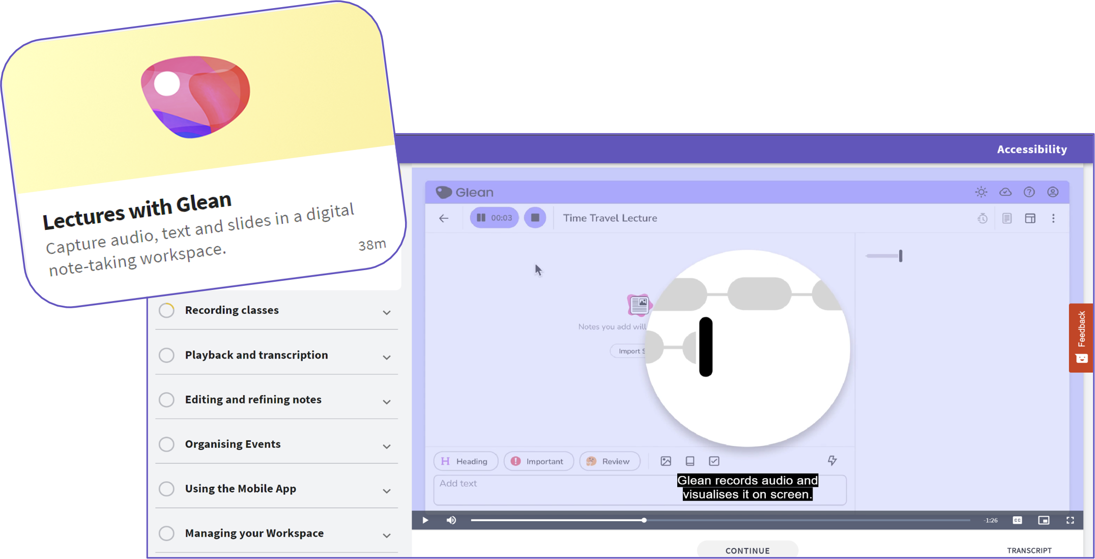
What is FindMyFlow?
Neuro-inclusive eLearning platform for AT users
Most recommended in the UK 🏆 (Disabled Students Allowance)

Slide 6
The Problem?

Slide 7
To be transformative, AT needs to be used⚡
Remembering how – and when – to use different AT is challenging!

Slide 8
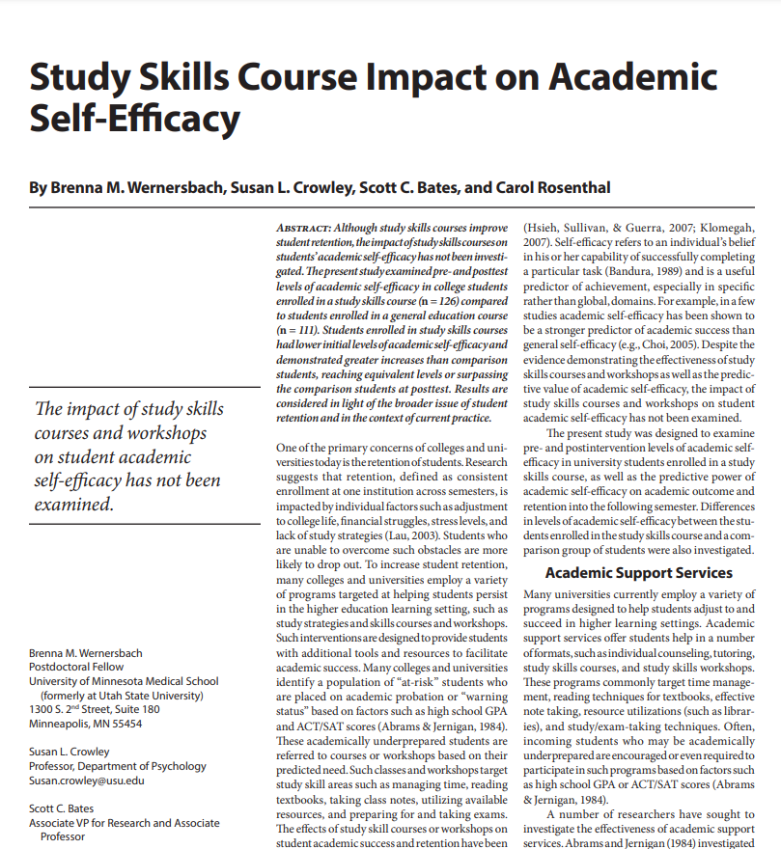
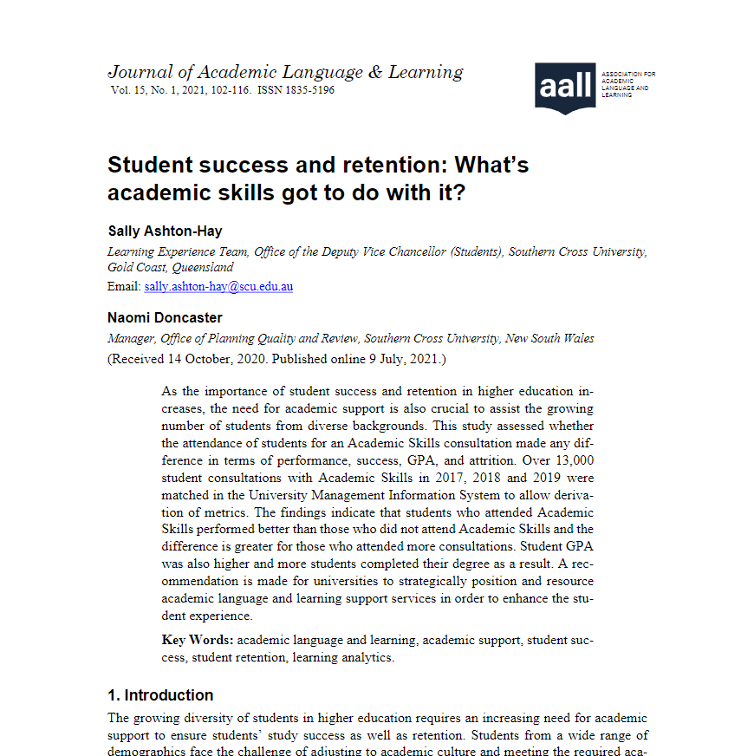
Research: the impact of study skills instruction
Engagement with Study Skills sessions is linked to higher course completion rates, and higher GPAs (up to 1 grade point).
Ashton-Hay et al (2021): Attending Academic Skills = 10-14% higher student success rates.
Male students & students studying online were underrepresented

Slide 9
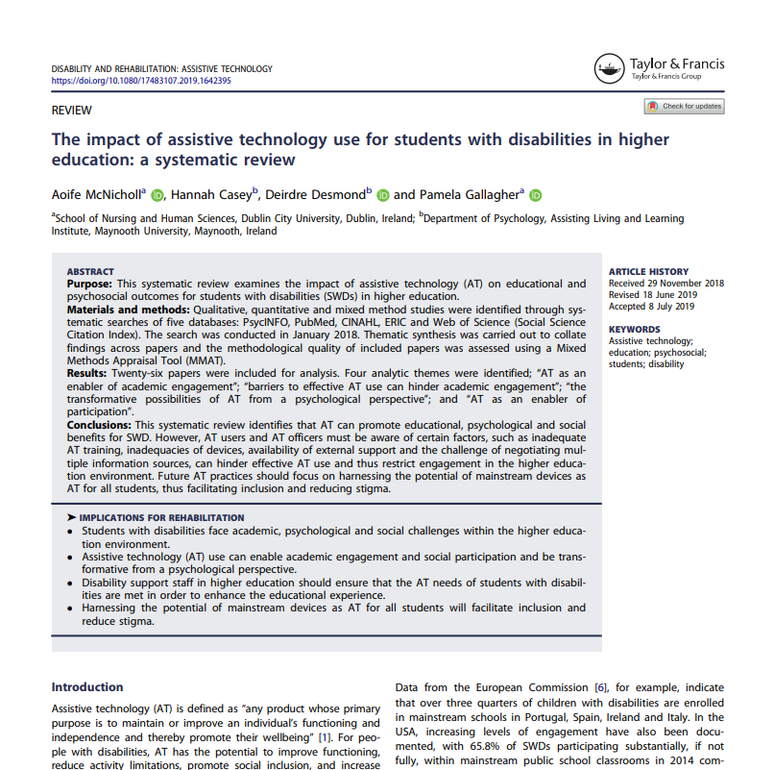
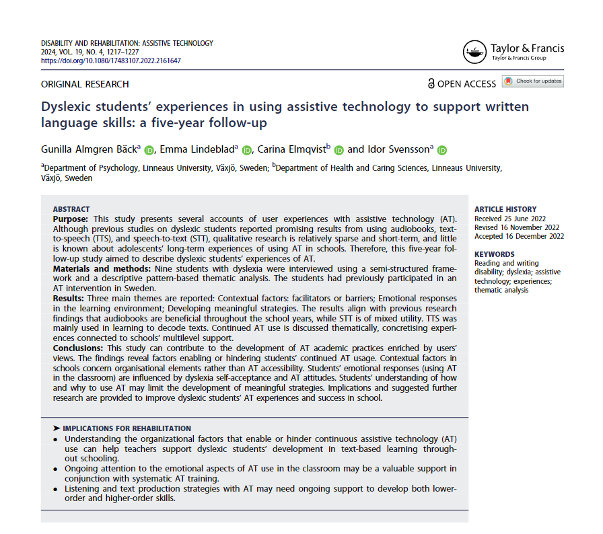
Research: the impact of AT use
AT use is linked to improved academic performance
Students are more autonomous, motivated, and confident as a result of AT use.
AT use also improved students’ sense of autonomy and self-expression.
Factors that hinder effective AT use / or lead to ‘AT abandonment’:
Inadequate training
Lack of ongoing support
Lack of knowledge about useful features
McNicholl et al (2019), Nordströmet al. (2018)

Slide 10
The AT & Study Skills Gap
Study Skills
AT

Slide 11
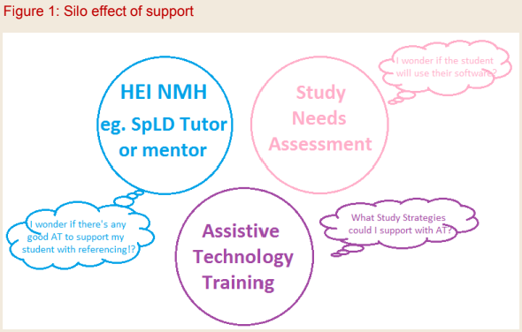
Support silos (in the UK)
Will the student use their software?
Study Skills Support
Disability Assessor or Advisor
Is there any good AT to support my student with referencing?
AT Trainer
What Study Strategies could I support with AT?
Image Source: Journal of Neurodiversity in Higher Education 2016, Issue 2, 2016

Slide 12
Challenges for Institutions (in the UK)
Siloed departments: Disability Services not closely linked to Academic Skills.
Separate disciplines – there’s so much to know across AT & Study Skills.
Resource & time constraints
Peaks in demand – key assignment & exam periods
Demand outstrips capacity

Slide 13
Poll Question
On a scale of 1 – 10, how integrated are Academic Skills & AT in your institution? 1 = highly siloed – 10 = highly integrated

Slide 14
How does FindMyFlow help?

Slide 15
eLearning amplifies the reach of 1:1 training
24/7, course-long support.
Available out-of-hours as well as at peak service usage times.
Web-based, accessible on any browser on any device, including mobile.
Scaffolds the development of AT-based study skills, long after 1:1 support has ended.

Slide 16
The AT & Study Skills Gap (again)
Study Skills
AT

Slide 17
Bringing AT & Study Skills Together
Study Skills
AT

Slide 18
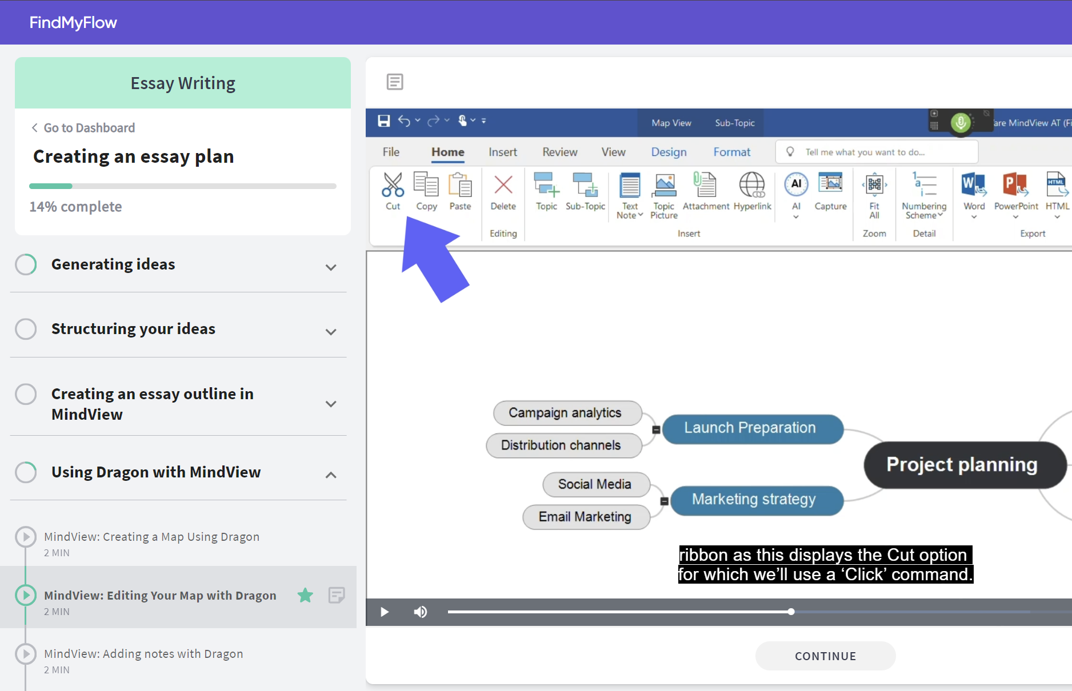
Latest Update: Multi-Software Tutorials
Help students to make best use of their specific AT toolkit.
Video explainers on combining AT tools for maximum benefit.
E.g. A student with both Dragon + MindView will see the module Using Dragon with MindView.

Slide 19
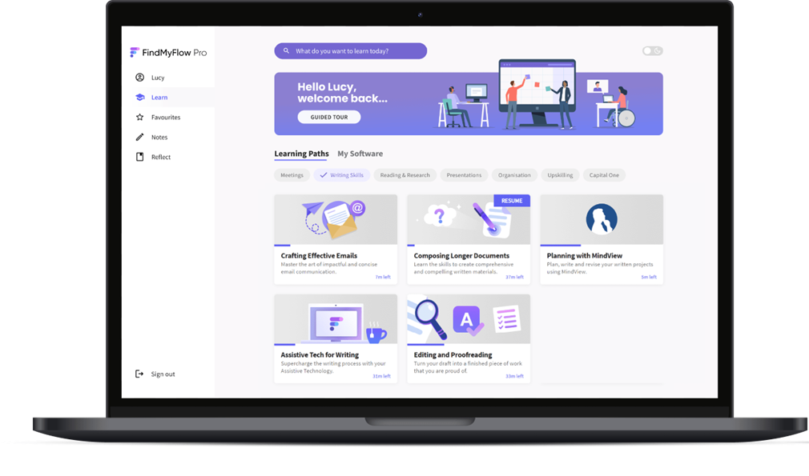
Demonstration

Slide 20
Key takeaways
Interweaves AT into Study Skills
Tailored & streamlined
Amplifies the reach of training
Integrates metacognition & wellbeing

Slide 21
User Testimonial: Amir
Law LLB at London South Bank University
Recently graduated with 1st class hons
Undergraduate of the year 2024 finalist
Credits FindMyFlow with helping him master his AT and develop softs skills for university & beyond…

Slide 22
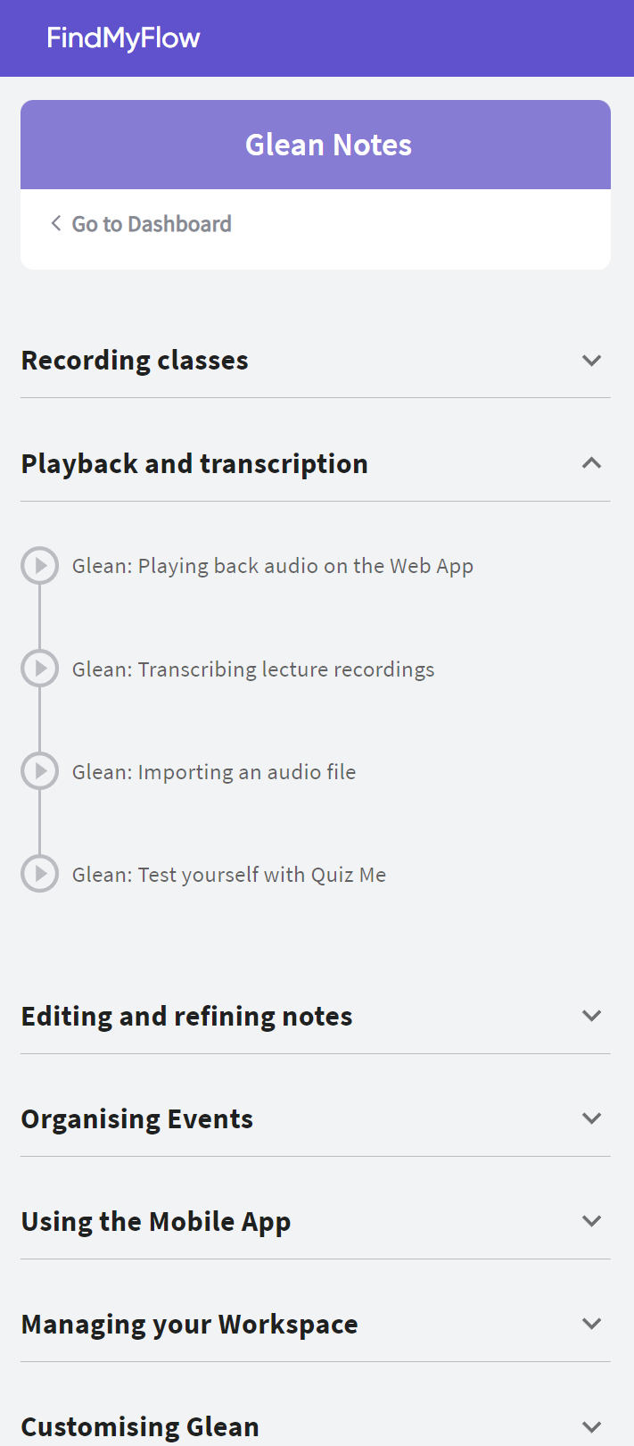
User testimonial: Amir - part 1
“
FindMyFlow really helped me learn about the software, organise my learning, and maximise my productivity.
”
Amir, Law LLB

Slide 23
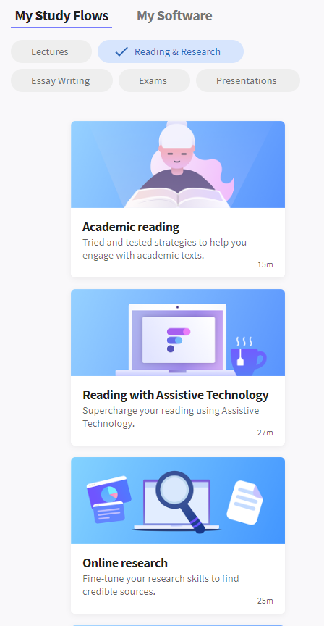
User testimonial: Amir - part 2
“
It has a lot of useful information about notetaking, revision, etc. It helped me learn different techniques and strategies and use them during my course.
”
Amir, Law LLB

Slide 24
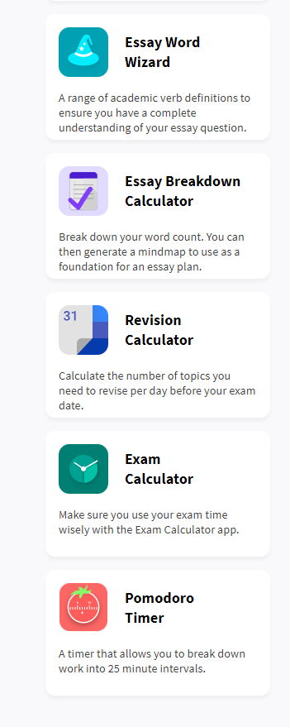
User testimonial: Amir - part 3
“
My most favourite part are the tools. The Essay Calculator helps me get a rough idea of how my essays should look. The Essay Wizard is my ABSOLUTE FAVOURITE! It literally explains the key parts of the essay questions and helps me understand what I need to do. I never knew that ‘evaluating’ is different from ‘explaining’ or ‘outlining’.
”
Amir, Law LLB

Slide 25
Any questions?
lucy@findmyflow.co.uk
linkedin.com/in/lucy-toffolo

