Slide 1
UNMASKING LITERACIES: A model for developing literacy in the neurodiverse classroom. Dr Angela Jones
Access and Equity

Slide 2
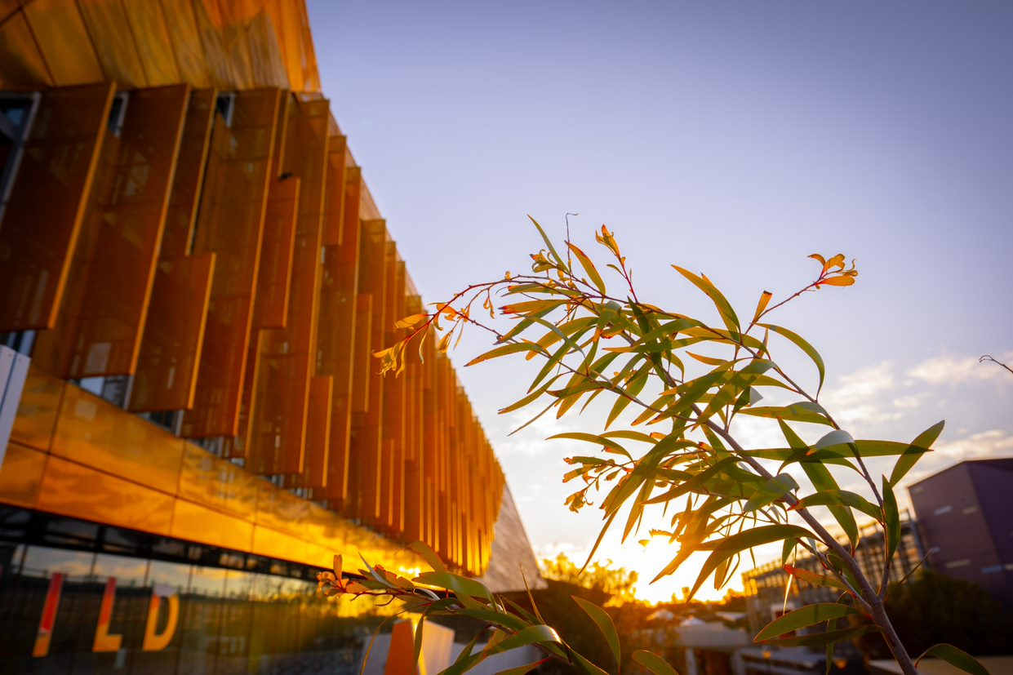
Acknowledgment of Country
I respectfully acknowledge the past and present traditional custodians of this land on which we will be meeting: The Nyoongar Elders and people.
Edith Cowan University is committed to reconciliation and recognises and respects the significance of Aboriginal and Torres Strait Islander peoples’ communities, cultures and histories.

Slide 3
Overview: A model for developing literacies in the neurodiverse classroom
My positionality
Context:
The enabling space
The goal
Action research project
Planning
UniPrep Context
Understanding Literacy
Understanding Neurodivergence
Action
Example of Learning Skills Unit
Analysis
Autoethnographic reflections
Conclusion
The model
Tips

Slide 4
Positionality Statement: Awareness, advocation and reflection
Academic Experience
I am an enabling educator
I have a research focus on student wellbeing, anxiety and social emotional learning
I have taught students with disclosed autism, ADHD, dyslexia and other neurodivergences from enabling to postgraduate
Lived Experience
I have ADHD
I grew up in a neurodiverse household
Neurotypical mother
Neurodivergent father and brother with ADHD
I have lived experience raising a daughter with, anxiety and AUDHD for 19 years
I have worked with an autism specialist for 12 years on techniques for communication, engaging learning and de-escalation
I am an inclusive practitioner who strives to live my ethos

Slide 5
The Wider Context
THE ENABLING SPACE
Pre-university enabling programs are part of a widening participation strategy in higher education to provide people from under-represented backgrounds entry to university
ENABLING STUDENTS:
Often commence their educational journey with mental health challenges such as anxiety and depression. (Crawford & Johns, 2018; Jones, Lisciandro & Olds, 2016; Lisciandro & Gibbs, 2016)
Disclosure of neurodivergence is now growing in enabling cohorts (Jones, 2023).
THE GOAL:
Embrace the “Brainbow”: to develop students’ academic literacy and self efficacy for a smooth transition to undergraduate studies.

Slide 6
1. Planning: The UniPrep Pathways context
Figure 1: Proportion of students with disability in C28, 2018-2023
There is a higher proportion of students identifying with disability in 2023 than previous years, which has been increasing over time.
There is a significant portion of these students who are neurodivergent

Slide 7
1. Planning: UniPrep Pathways Context cont.
The Context
25 enabling/pathway students
Multiple students shared they were “neuro-spicy” early in the semester
Autism
Autism and ADHD
Autism, ADHD, Dissociative disorder, PTSD
ADHD Anxiety and Depression
Small amount of students shared OC, ADHD mid-sem and toward the end of semester
18 students engaged with the classroom in a neurotypical way

Slide 8
1. Planning: Understanding literacy
Literacy: Develop the knowledge, skills and dispositions to interpret and use language confidently for learning and communicating in and out of school and for participating effectively in society (ACARA, 2024).
New Literacy studies: views literacy as a “social practice”, including autonomous and ideological models (Street, 2003).
Ideological model of literacy: The plurality of literacies “contingent no time and place and developed with specific purposes in mind” (Bailey 2023, p.122).
Neurodivergent literacies = the ideological model of literacy + concept of neurodiversity (Bailey 2023, p.122).

Slide 9
2. Planning: Understanding Neurodivergence
Neurodivergent = Diverse from dominant societal standards. Recognising overlapping diversity under this umbrella (Jane, 2023)
Neurotypical Classroom = Diverse people with diverse brains, with diverse learning needs often placed in an environment that is designed for neurotypical students
Embracing the Brainbow: Diverse brains + neurodivergent literacies (Jones, 2023)

Slide 10
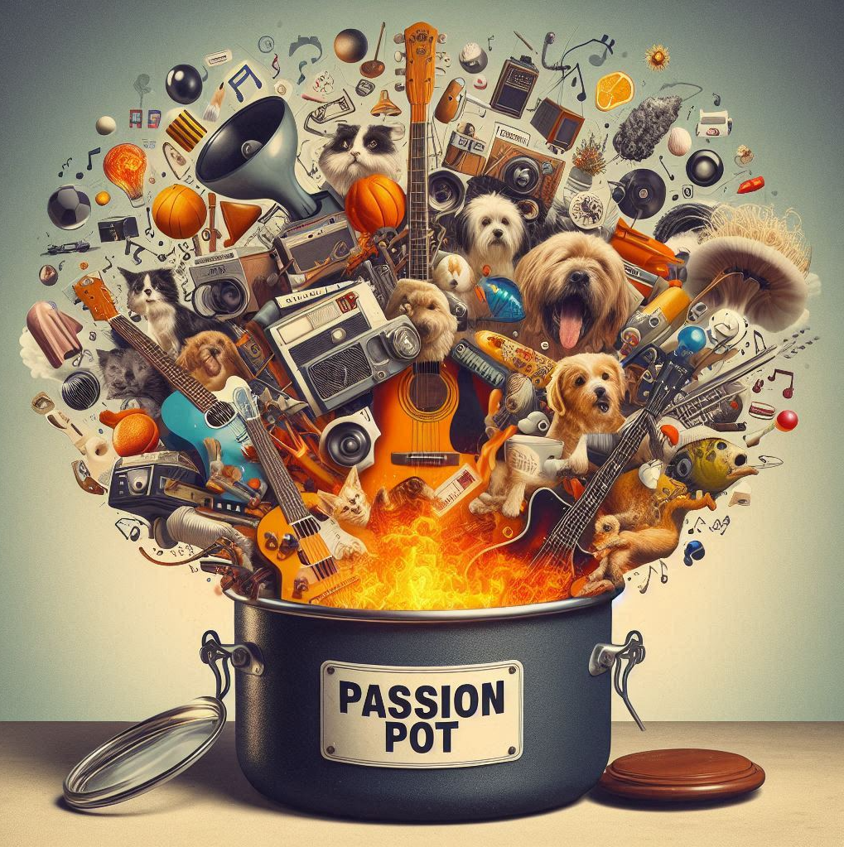
2. Action: Example teaching academic reading in a learning skills unit
I developed a series of activities to create psychological safety and understand my learners, their passions and literacies
We co-created a 'passion pot' - a collection of readings, activities, memes, songs etc. that focused on these interests and skill
I developed a PowerPoint focused on the learning intention for a particular academic literacy with explicit instruction.

Slide 11
2. Action: Teaching Academic Reading
I used multiple ways (diagrams, texts, pictures, oral) to explain the context, breaking down the elements of academic reading:
What we read -scholarly texts that are written with particular structures and voice.
Why we need to read - to gather data for a particular academic purpose (provide examples),
How we read - with intention, framed by questions, look for particular attributes and using a method that we are going to discover in class together
I returned to the 'passion pot with the student to choose a passion or skill – example dogs
Once an understanding or the elements or an academic reading was demonstrated, we shifted back to the unit's academic readings
I modelled the process again to create “cognitive pegs” (Jones, Olds &Lisciandro, 2016).
To demonstrate the literacy the students were then asked to repeat the process using a unit reading and their preferred/choice of communication method – spoken, written and diagrammatic (Cast, 2024).

Slide 12
3. Analysis
The goal of this action research was to reflect on my own pedagogies for teaching academic literacies. Thus, the analysis focused on my auto-ethnographic reflections
Spending time in understanding the learners created strong trust and relationship
While it took time to create the passion pot early on it was useful for teaching academic literacies
Some literacies took longer than others to develop, and I recognised the need to have an awareness of student processing time
While I drew no multiple literacies and passions to teach academic literacies I needed a clear process to stick to, so I and the students didn’t get stuck in the land of passions
Create a model/cycle to follow’
Next Steps – research application of the model in other units

Slide 13
4. Conclusion: The Brainbow Toolkit for Inclusive Practice
5. Student demonstrates the academic literacy:
2. Practitioner Provide
The Context (the what, why and how),
1. Practitioner and Student Understanding of student's:
Learning style/preference
Neurodivergent literacies (hyper fixations, passions, skills and knowledge to use as cognitive pegs)
Given multiple ways to demonstrate literacy
3. Student and Practitioner:
Student engages with skill using 'passion pot' - neurodivergent literacy
Cognitive processing time
4. Student and Practitioner:
Relate it back to unit specific academic/disciplinary content
Using the 'passion pot' the practitioner models and links to neurodivergent literacy
Multiple was of explaining
Explicit instruction
Create 'Passion Pot'
Identify attributes of the academic literacy
Create new cognitive peg

Slide 14
Tips – a UDL approach for Curriculum and Pedagogy
Embracing the Brainbow
Multiple ways of explaining and presenting information
Simple and not overwhelming
Conscious choice of colours and contrast
Explicit instruction
Knowing your learners
Creating psychological and physical safety without creating a trauma dump

Slide 15
Adding to your toolkit
Being conscious
Explicit instruction
Multiple ways of explaining
Classroom dynamics/management
One-on-one
Communication
Turn taking
Impulsivity
Sound in videos
Pre-watching videos for sound levels
Warnings

Slide 16
Questions

