Slide 1
Celebrating Student Success: Embedding Inclusive Practices into Graduation
JAYMEE BEVERIDGE & DR KYLIE AUSTIN

Slide 2
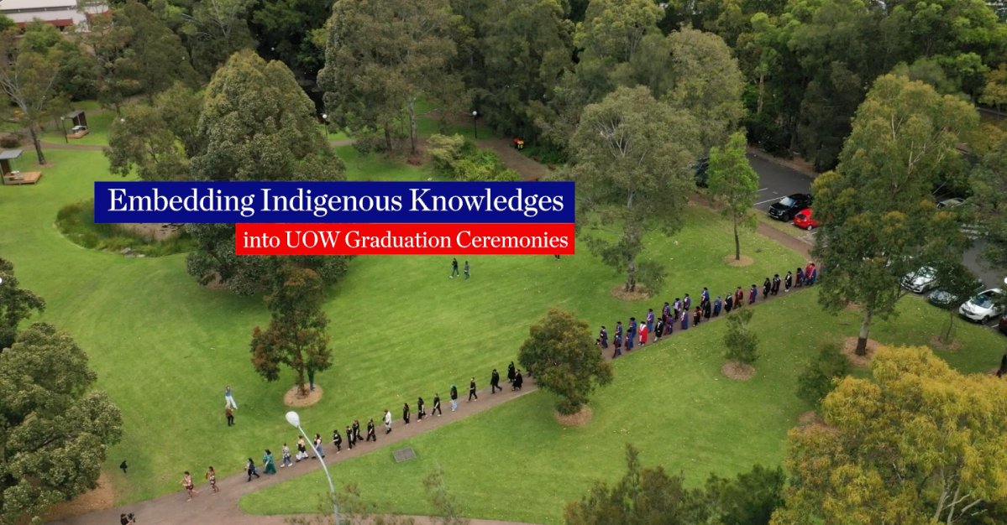
Video

Slide 3

Acknowledgement of Country
We acknowledge that Country for Aboriginal peoples is an interconnected set of ancient and sophisticated relationships.
The University of Wollongong spreads across many interrelated Aboriginal Countries that are bound by this sacred landscape,
and intimate relationship with that landscape since creation.
From Sydney to the Southern Highlands, to the South Coast.
From fresh water to bitter water to salt. From City to Urban to Rural.
The University Acknowledges the devastating impact of colonisation on our campuses’ footprint and commit ourselves to truth-telling, healing and education.

Slide 4
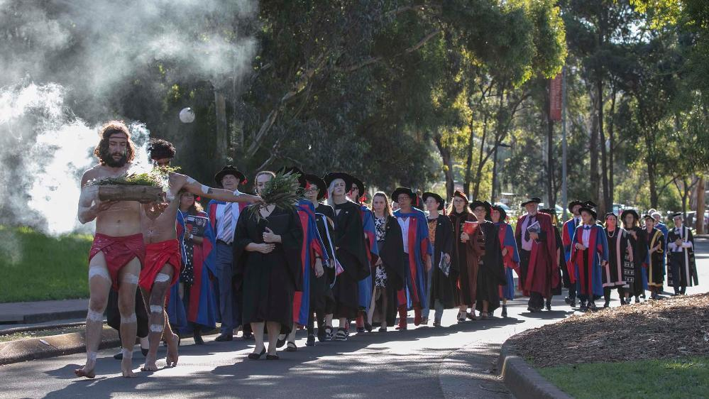
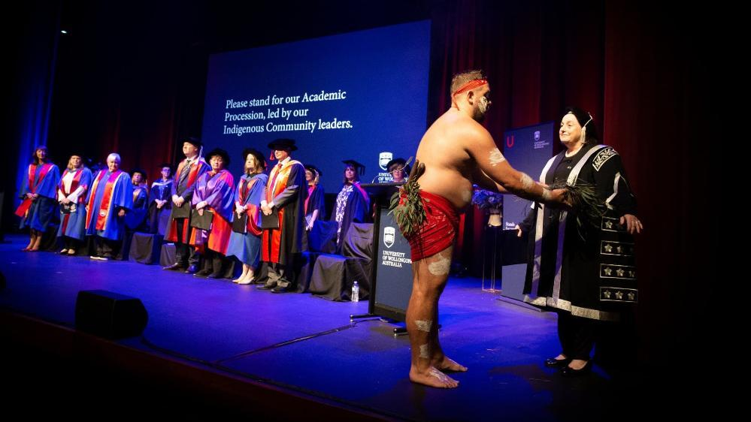
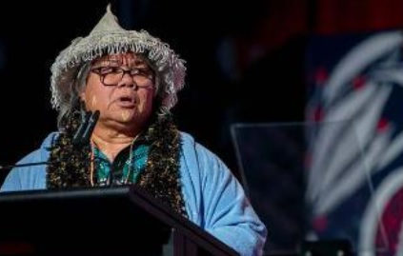
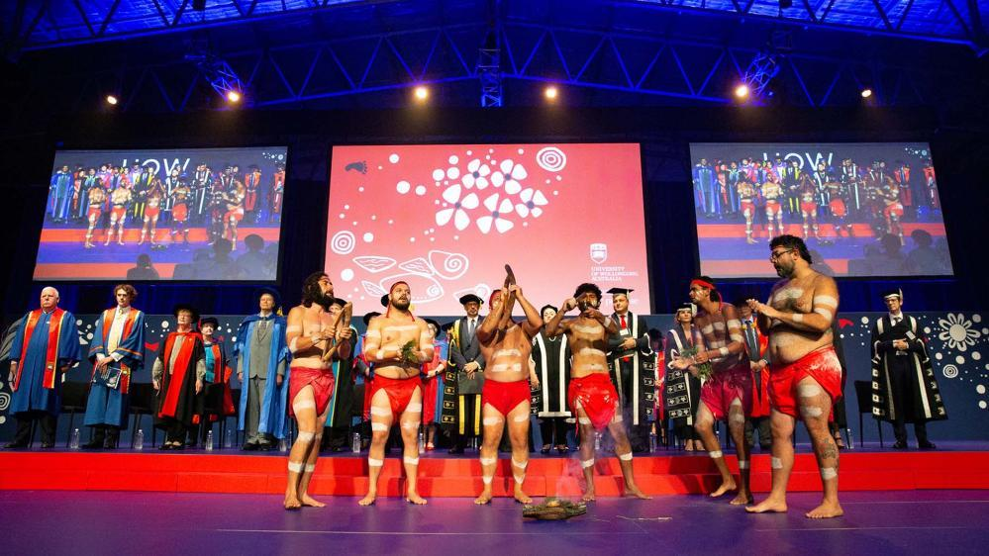
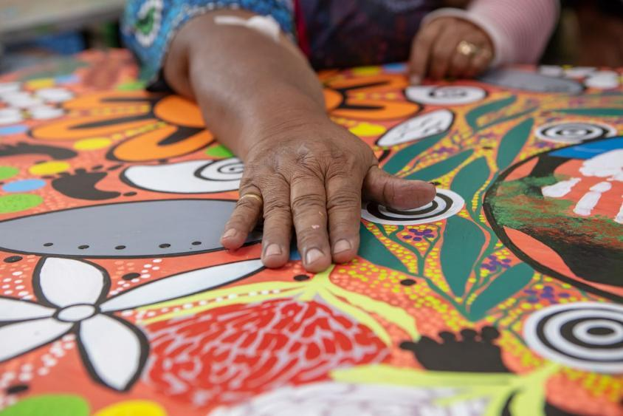
Embedding Indigenous Ceremony into Graduation
LEADING THE PROCESSION
WELCOME TO COUNTRY
SMOKING CEREMONY
Aboriginal community members lead the Academic Procession.
As Aboriginal Community enter, the Graduates are smoked, followed by the Academic Procession.
Local elders then undertake a Welcome to Country.
INDIGENOUS SONG
The smoking ceremony concludes with a song. The entry and exit music to Graduation includes sounds from the local region, developed by a UOW Alumni.
ARTWORK
The artwork for Graduation was developed by the Coomdaditchie Aboriginal Cooperation, located in Kemblawarra and is used in the stage design, on booklets and guest tickets.

Slide 5
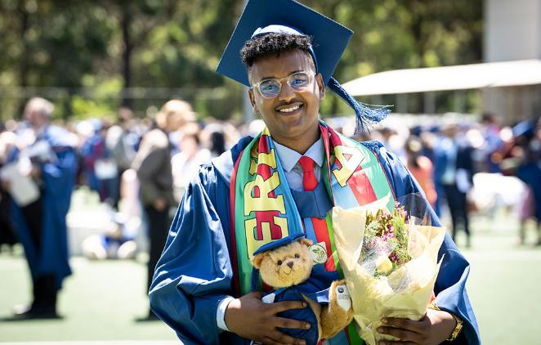
An accessible and inclusive Graduation experience
ACCESSIBILITY FOR PEOPLE WITH DISABILITIES AND LONG-TERM MEDICAL CONDITIONS
The stage design features a ramp, rather than a lift, so that every Graduate has the same journey across the stage.
Hearing loops and captioning.
Accessible parking and priority seating for guests.
Fully accessible Graduation booklets and website.
CELEBRATING OUR DIVERSITY
Students and staff are encouraged to wear cultural dress, alongside their Graduation gowns.
Text in the Graduation booklet is provided in different languages.
Accommodation and dining discounts for overseas and regional visitors.
INCLUSION
The proceedings and accompanying documents are all gender neutral and have been endorsed by colleagues in the Ally Network.
Access to all gender bathrooms
Specific activities for children during Graduation.

Slide 6
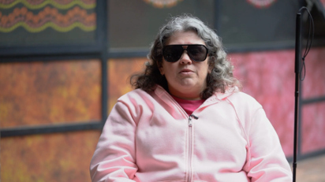
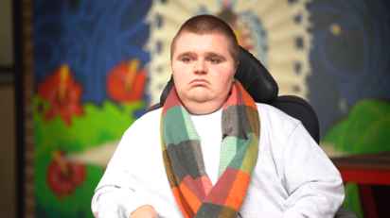
An accessible and inclusive Graduation experience cont.
ACCESS PLANS FOR GRADUATION
We work with each individual student to understand their accessibility needs and put in place adjustments to ensure that they have a wonderful Graduation experience.
^{Meet Rhiannon}
Rhiannon had a sighted guide for her Graduation ceremony.
^{Meet Jack}
Jack discusses the universal design of the stage, so that everyone has the same experience.

Slide 7
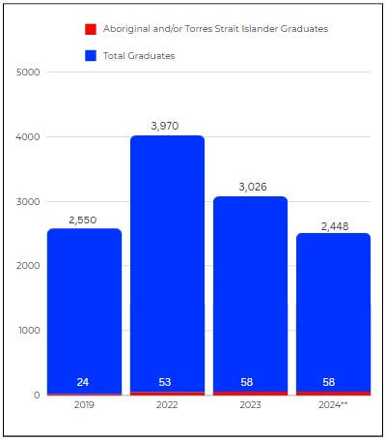
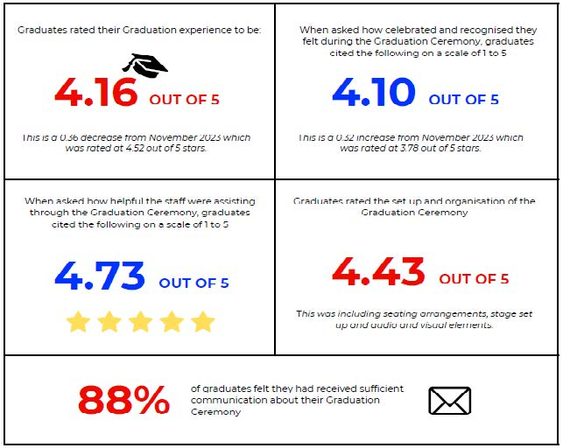
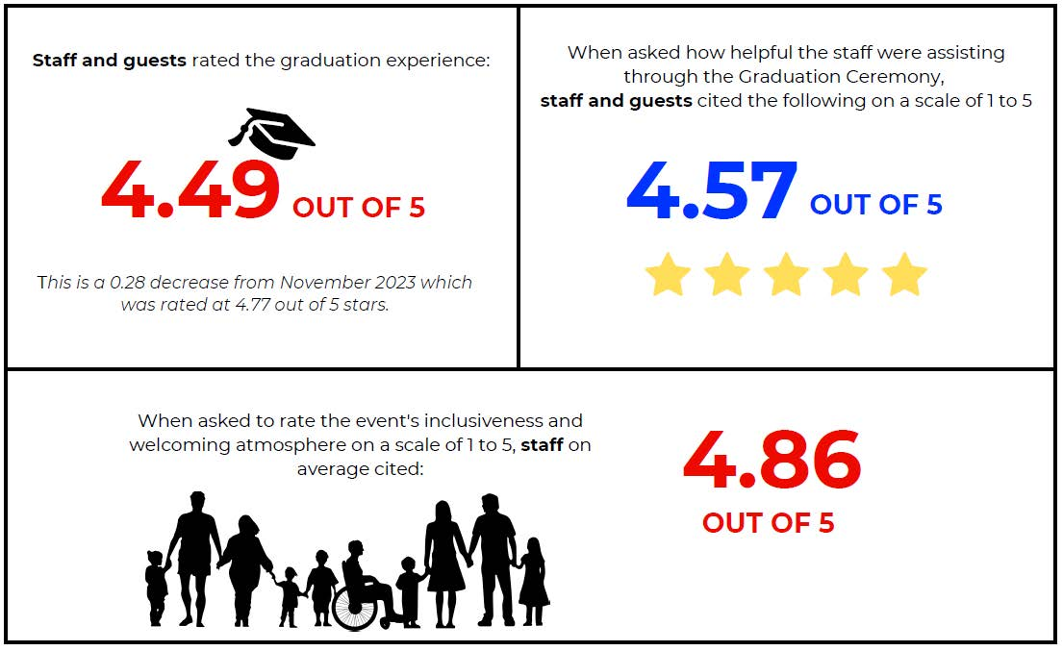
Outcomes
1. INCREASED ENGAGEMENT OF ABORIGINAL AND TORRES STRAIT ISLANDER STUDENTS.
2. ENHANCED STUDENT EXPERIENCE
3. ENHANCED GUEST AND STAFF EXPERIENCE
“Such a professional and structured event. Every detail and every word is meaningful and creates a memorable experience for graduates and guests. The First Nations content was BRILLIANT and reduced me to tears with the power and aesthetics and sentiment created. Two worlds binding together the ancient and contemporary. Amazing!!!!!!!!!” – Guest, 2024.
“I loved how the ceremony integrated so much First Nations culture and custom into it. I really appreciated the respect and dedication given to our Aboriginal and Torres Strait Islander students, staff, and community.” – Student, 2024
“The beautiful Welcome to Country and embedding of Aboriginal culture and ceremony should be commended. I also felt that the honorary award recipients were very inspiring.” – Staff, 2024.

Slide 8
Thank you

