Slide 1
Are inherent requirements a barrier to diversity?
Dr Joanna Tai (Deakin University)
Prof Mollie Dollinger (Curtin)
ADCET Webinar, 6 August 2024

Slide 2
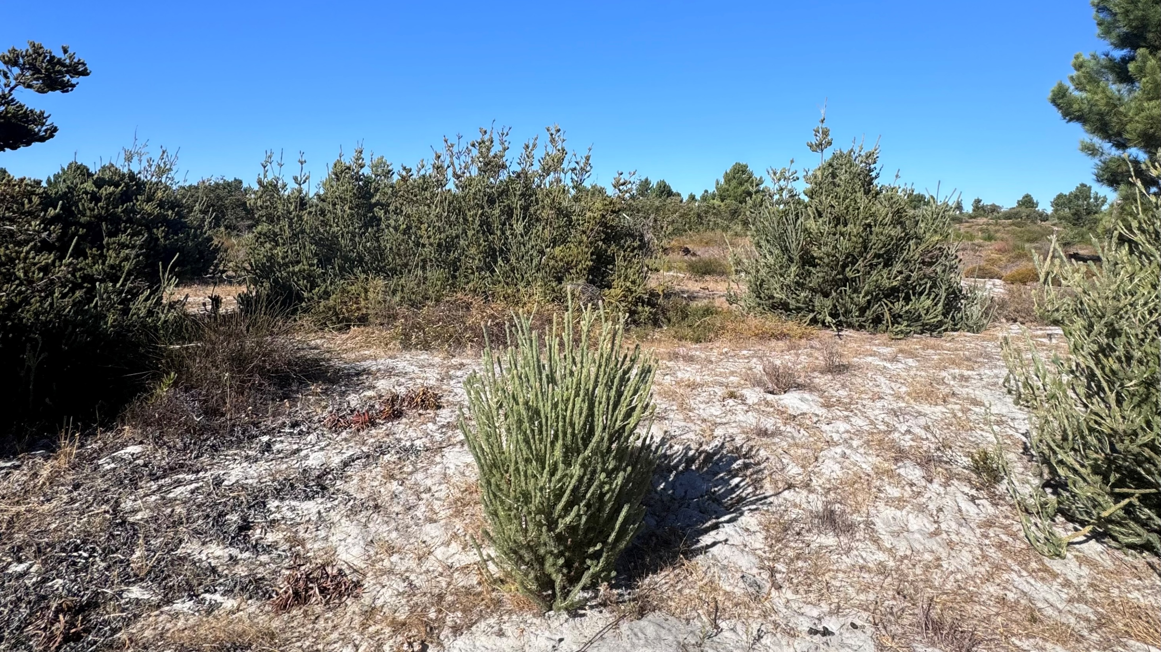
Acknowledgement of Country

Slide 3
Outline of Today’s Talk
Background: Inclusion in higher education, and healthcare professional education
Part 1: an analysis of how inherent requirements are communicated across Australian nursing and midwifery courses
Part 2: participatory design to inform more inclusive healthcare professional courses
Discussion: How could principles of assessment for learning support inclusion?

Slide 4
From ‘widening participation’ to ‘inclusion’
Expansion of higher education has (re)emphasised the importance of inclusion for diverse students
Subsequent investigations have sought to explore inclusion in assessment, students as partners, learning analytics and more (e.g., Cook-Sather et al., 2023; Khalil et al., 2023; Nieminen, 2024)

Slide 5
DEI in health professional context and society
An expectation for healthcare professionals to uphold and enact “principles of diversity, culture, inclusion and cultural safety for all people” (Australian Nursing and Midwifery Accreditation Council, p.17)
Legislation supports this, e.g. in the Australian context, the Disability Discrimination Act 1992
Increasing diversity in the health professions workforce may go towards addressing workforce shortage or maldistribution within and across countries
Makes the world a better place!

Slide 6
Are values of diversity and inclusion demonstrated in health professional education?
A diverse workforce can contribute to improved patient care: this has been demonstrated for racial and ethnic diversity, but still remains a “work-in-progress” with respect to disability (Bowen et al 2020, Wilbur et al 2020, Meeks et al 2018)
Supporting diverse student populations to participate in health professions education begins with ensuring entry requirements are equitable and accessible.

Slide 7
An overview of inherent requirements (IRs)
Outline core abilities or minimum requirements expected of students
Particularly prevalent in accredited courses such as health (with focus on patient care)
In nursing and midwifery, most leverage the IRs identified in 2010 by Johnson et al. (2012) in the IRONE project at WSU, with the intention to support the determination of “reasonable adjustments” (Johnson et al 2012)
Aligns with Australian workplace case law regarding the “essential tasks” relating to a job or occupation
Course accreditation demands publication alongside other entry requirements (ANMAC 2019)

Slide 8
Example Definition
Inherent requirements are the essential requirements or characteristics (mental, physical and emotional) necessary for successful completion of a course or component that are inherent to the achievement and demonstration of its learning outcomes.
*Varying levels of objectivity

Slide 9
Inherent requirement of nursing education (Johnson et al 2012)
Five framework components
Inherent Requirement statement
Description of skills & capabilities required
Inherent because (why/justification)
Characteristics of Adjustments
Exemplars
Eight categories of IRs
Ethical Behaviour
Emotional Stability
Legal
Communication (Verbal, Non-Verbal, Written)
Cognition (Incl. Literacy & Numeracy)
Sensory (Auditory, Vision, Olfactory, Tactile)
Motor Skills (Fine & Gross)
Sustainable Performance

Slide 10
Problematising IRs – a balancing act and a paradox?
Inclusion in HE
Assessment
IRs
Provision of Future Workforce
Workforce Contexts
Industry Expectations
Accreditation
AND:
In what started as a goal to enhance transparency, may actually serve as a deterrent for disclosure and amplify exclusion

Slide 11
Our Study
Part 1: To investigate how IRs are currently communicated across Australian university accredited nursing and midwifery courses (n=37)
Desktop review of website documents, drawing on discourse analysis
Part 2: To understand how health courses could be inclusive
A series of participatory design workshops (supplemented with interviews*) on academics, supervisors, placement staff, and accrediting body perspectives on how health courses could be more inclusive (approx. n = 20)

Slide 12
Part 1: Inherent requirements across 37 universities
16 institutions adopted Johnson et al (2012)’s IR statements directly
Most frequently modified or omitted: ethical, legal responsibilities, sustainable performance
Additional requirements added: relational skills, reflective skills, digital/technology, financial literacy

Slide 13
Part 1. Continued
Additionally troubling was the significant variation in how information was presented to prospective students and the reasonable adjustments available
‘We are inclusive’ common, yet many university claims of inclusion were unsubstantiated with clear, accessible pathways to discuss Irs
Only 5/37 mentioned the Disability Discrimination Act

Slide 14
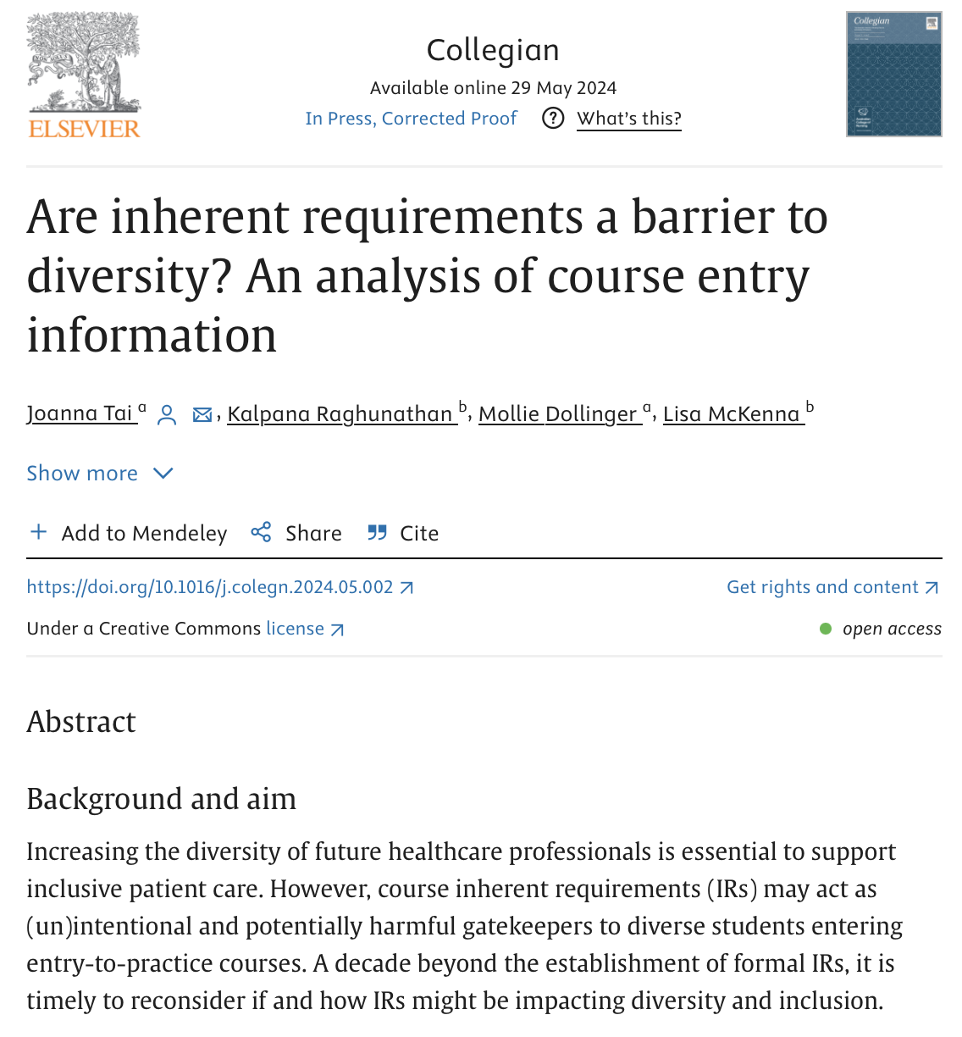
For more on Part 1: Tai, J., Raghunathan, K., Dollinger, M., & McKenna, L. (2024). Are inherent requirements a barrier to diversity? An analysis of course entry information. Collegian.

Slide 15
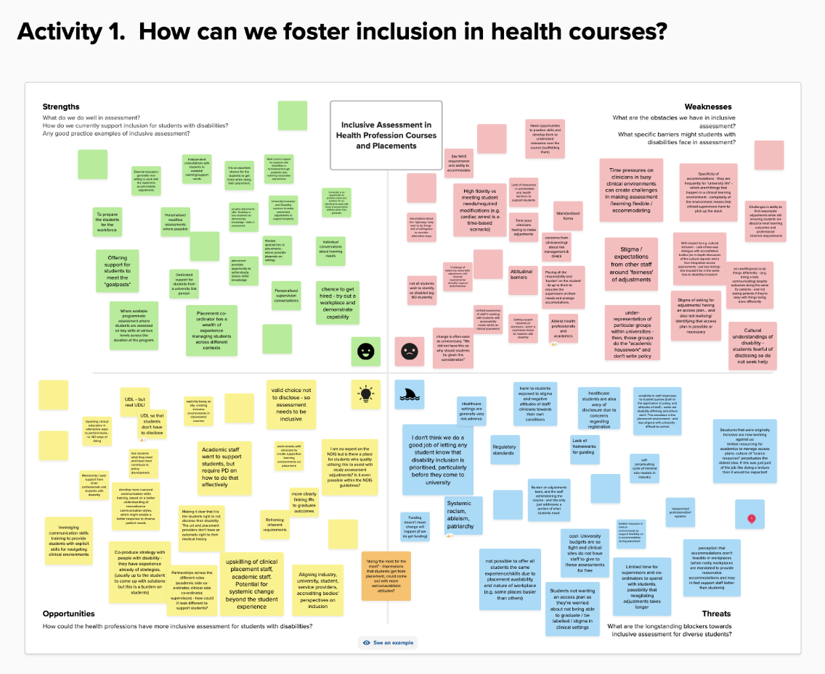
Part 2. A participatory design approach

Slide 16
Preliminary findings
Strengths: Universities’ role in preparing students, scale of learning access plans
Weaknesses: Systems rely on students’ disclosure and not good at handling more complex cases
Opportunities: Staff are hungry for more training! Growing recognition of co-design
Threats: Healthcare sector is risk adverse, attitudinal barriers, admin burden

Slide 17
We wonder…
How could principles of “assessment for learning” support inclusion?

Slide 18
Assessment for Learning
Assessment of learning
Assessment for learning
Assessment as learning
Sustainability: Prepare students beyond the current task
Learning: Develop students’ capabilities
Certification: Ensure learning outcomes are met
Boud & Soler 2016

Slide 19
Assessment is where the rubber hits the road…

Slide 20
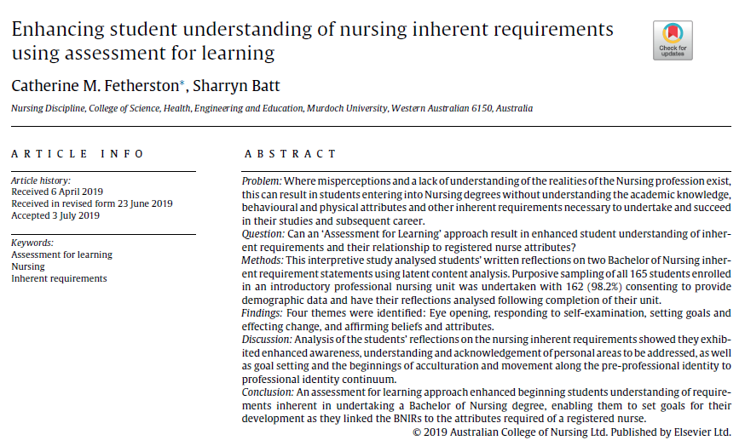
Article Abstract

Slide 21
A learning approach to meeting inherent requirements
Principles of good assessment (Boud 2007) | How it would impact IRs
Assessment supports students’ learning, and their learning on the process itself | A continuous dialogue throughout the course with regular opportunities to demonstrate capability with respect to IRs
Offers opportunities for feedback loops between students and teachers | Aim to create more immediate feedback loops, which includes industry and professional accreditation current expectations
Personalisation or adaptability (according to own starting point, goals and capabilities) | How IRs are met would vary from student to student, according to context

Slide 22
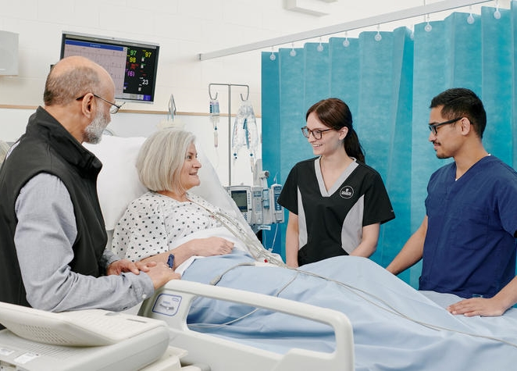
Can we go further? Inherent requirements as part of Assessment as Learning
Developing students’ own capability to judge for themselves if they meet requirements at any point in time
“Fitness to practice” is an authentic example of inclusion (or) exclusion within the profession, which is not tied to [dis]ability status or disclosure
Asking students and supervisors to consider IRs together during placement offers opportunities to consider what is truly an ‘inherent requirement’

Slide 23
Zooming out… how do we foster inclusion in courses?
Training & support for everyone: topics of UDL, disclosure, legal rights, flexible assessment
Greater co-production of course design to facilitate dialogue between academics, clinicians, supervisors, students, accrediting bodies (which may have ripples in industry)
Tackling ableism directly – communications around likelihood of stigma if students disclose, unpacking long-standing ableist assumptions of ‘fairness’, creating spaces for dialogue on varying cultural understandings of disability

Slide 24
Practically, what might this entail?
Removing current IR lists – instead, linking to any current professional standard requirements and providing clear discussion on how reasonable adjustments could be facilitated to help
Supporting early conversations with students, advocates, academics, industry to discuss ways learning and performance can be supported (for everyone, not just those with a declared disability)
Regular dialogue with professional accreditation bodies, industry, and academics to reflect, gather exemplars, and consider how professions might be changing

Slide 25
Other considerations
Adoption of Universal Design for Learning (UDL) to raise the benchmark first
Ongoing professional development for staff – potentially in a ‘students as partners’ approach
Work with accrediting bodies to have people with lived experiences consulted more regularly
Remember: students shouldn’t have to disclose!

Slide 26
References
Australian Nursing and Midwifery Accreditation Council. (2019). Registered Nurse Accreditation Standards 2019. 1–28. https://www.anmac.org.au/search/publication
Boud, D. (2007). Reframing assessment as if learning was important. In D. Boud & N. Falchikov (Eds.), Rethinking assessment in higher education: Learning for the longer term (pp. 14–25). Routledge.
Boud, D., & Soler, R. (2016). Sustainable assessment revisited. Assessment & Evaluation in Higher Education, 41(3), 400-413. https://doi.org/10.1080/02602938.2015.1018133
Bowen, C. N., Havercamp, S. M., Karpiak Bowen, S., & Nye, G. (2020). A call to action: Preparing a disability-competent health care workforce. Disability and Health Journal, 13(4), 100941-100941. https://doi.org/10.1016/j.dhjo.2020.100941
Cook-Sather, A., Slates, S., Acai, A., Aquilina, S., Ajani, K., Arm, K., ... & Winstone, N. (2023). How can students-as-partners work inform assessment?. International Journal for Students as Partners, 7(1), 218-234.
Disability Discrimination Act, (1992). https://www.legislation.gov.au/Details/C2018C00125
Disability Standards for Education, (2005). (Cth)
Johnson, A., Allan, T., Phillips, K., Azzopardi, T., Dickson, C., Goldsmith, M., & Hengstberger‐Sims, C. (2012). Inherent requirements Resource package. Inherent requirements of nursing education (IRONE).
Khalil, M., Slade, S., & Prinsloo, P. (2023). Learning analytics in support of inclusiveness and disabled students: a systematic review. Journal of Computing in Higher Education, 1-18.
Meeks, L. M., Herzer, K., & Jain, N. R. (2018). Removing barriers and facilitating access: Increasing the number of physicians with disabilities. Academic Medicine, 93(4), 540-543. https://doi.org/10.1097/ACM.0000000000002112
Nieminen, J. H. (2024). Assessment for Inclusion: rethinking inclusive assessment in higher education. Teaching in Higher Education, 29(4), 841-859.
Tai, J., Ajjawi, R., Bearman, M., Boud, D., Dawson, P., & Jorre de St Jorre, T. (2023). Assessment for inclusion: Rethinking contemporary strategies in assessment design. Higher Education Research & Development, 42(2), 483-497.
Wilbur, K., Snyder, C., Essary, A. C., Reddy, S., Will, K. K., & Mary, S. (2020). Developing Workforce Diversity in the Health Professions: A Social Justice Perspective. Health Professions Education, 6(2), 222-229. https://doi.org/10.1016/j.hpe.2020.01.002
World Health Organization. (2020). State of the world's nursing 2020: investing in education, jobs and leadership. Geneva: World Health Organization; 2020. Licence: CC BY-NC-SA 3.0 IGO.

