Slide 1
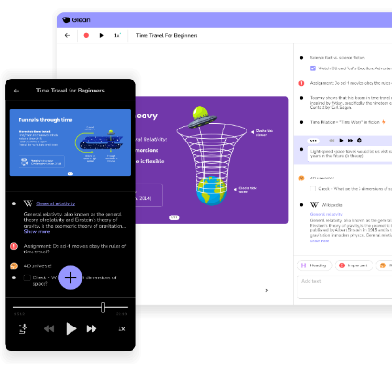
Unlock the power of Glean's newest features for more streamlined note taking

Slide 2
Your note-orious hosts...
Jim Sprialis
supporting Australia and New Zealand
Lee Chambers
supporting the UK, Ireland and Canada

Slide 3
The #1 note taking accommodation and study tool for independent learning
Trusted by students at 1,700+ Higher Education institutions

Slide 4
How is Glean impacting students?
More Confident
85% said Glean helped them become more confident
Less Overload
91% said they can better manage information overload
Better Results
84% said Glean had helped them achieve better grades

Slide 5
Poll Question:
Not every student with a disability wishes to disclose and register with accessibility services.
What % of students with disabilities will register with your office?

Slide 6
65% of students with disabilities
will not register with your office
Newman, L. A., Madaus, J. W., Lalor, A. R., & Javitz, H. S. (2019). Support Receipt: Effect on Postsecondary Success of Students With Learning Disabilities. Career Development and Transition for Exceptional Individuals, 42(1), 6-16. https://doi.org/10.1177/2165143418811288

Slide 7
If we build accessibility and inclusivity into campus, students won’t need to self-advocate

Slide 8
Universal Design For Learning
“Universal Design for Learning (UDL) is an educational framework that minimizes barriers and maximizes learning for all students.
UDL guides the design of instructional goals, materials, methods, and assessments, as well as the policies surrounding these curricular elements with the diversity of learners in mind.”
CAST, creators of UDL

Slide 9
The benefits of a whole site approach
(
)
Students with disabilities are
When they do, they are
The graduation rate is
2x
+70%
<50%
more likely to access universal support
more likely to graduate
so that’s a big deal
Newman, L. A., Madaus, J. W., Lalor, A. R., & Javitz, H. S. (2019). Support Receipt: Effect on Postsecondary Success of Students With Learning Disabilities. Career Development and Transition for Exceptional Individuals, 42(1), 6-16. https://doi.org/10.1177/2165143418811288

Slide 10
Introducing
Glean - Site Wide
Note taking support for any student that needs it, whenever they need it.

Slide 11
How we support you with this: Glean Site Wide
Drive accessibility for all with UDL principles
Support the 65%
of students that aren’t requesting help
Simpler admin
for your department and beyond
Cost effective support for those who need it

Slide 12
Interested in site wide?
Please get in touch to further the conversation.

Slide 13
Students have different accessibility needs, so continued product development is essential
Discover the latest feature releases in 2024

Slide 14
Product feedback
Students asked, and we listened!

Slide 15
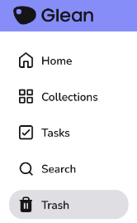
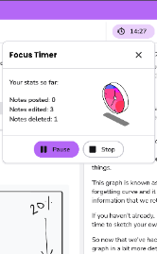
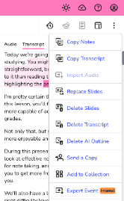
A number of useful feature enhancements
Recycle Bin
Focus Timer
Transcription
Quick Notes

Slide 16
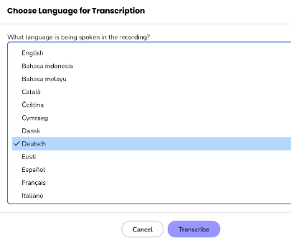
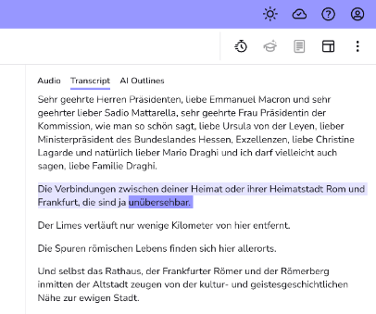
Choose language for transcription & captions

Slide 17
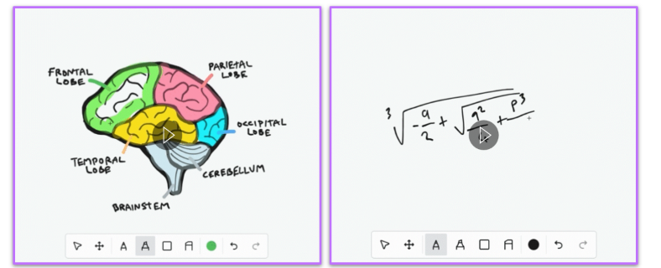
Capture drawings & equations with Scribble

Slide 18
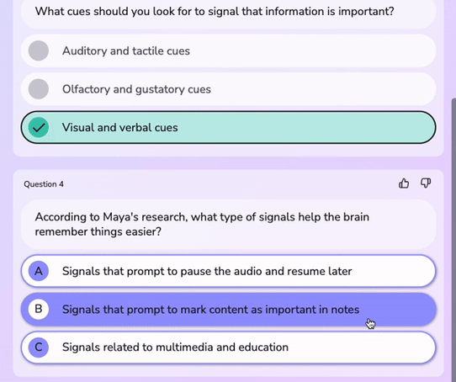
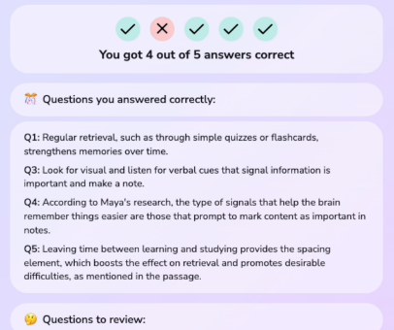
Test your subject knowledge with Quiz Me

Slide 19
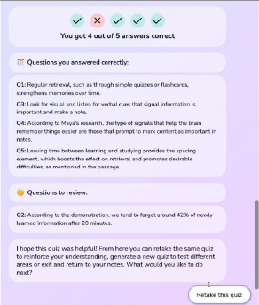
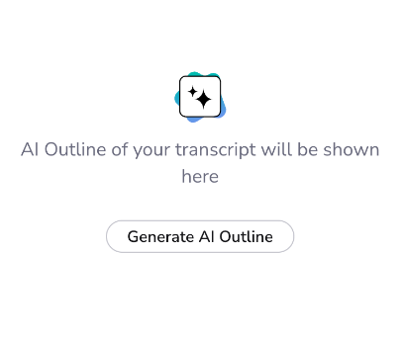
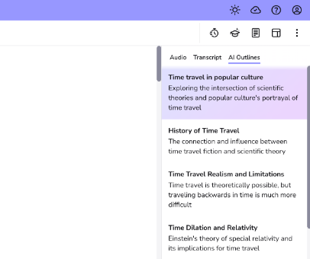
Navigate recordings easier with AI Outlines

Slide 20
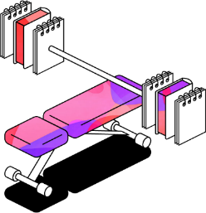
Demo time
A look at the new features in action

Slide 21
Any questions?
jim.sprialis@glean.co

