Slide 1
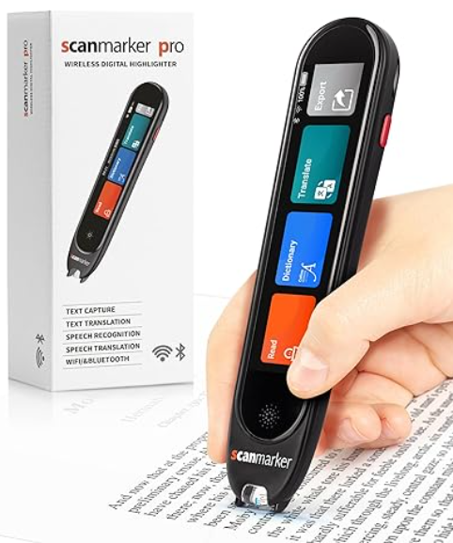
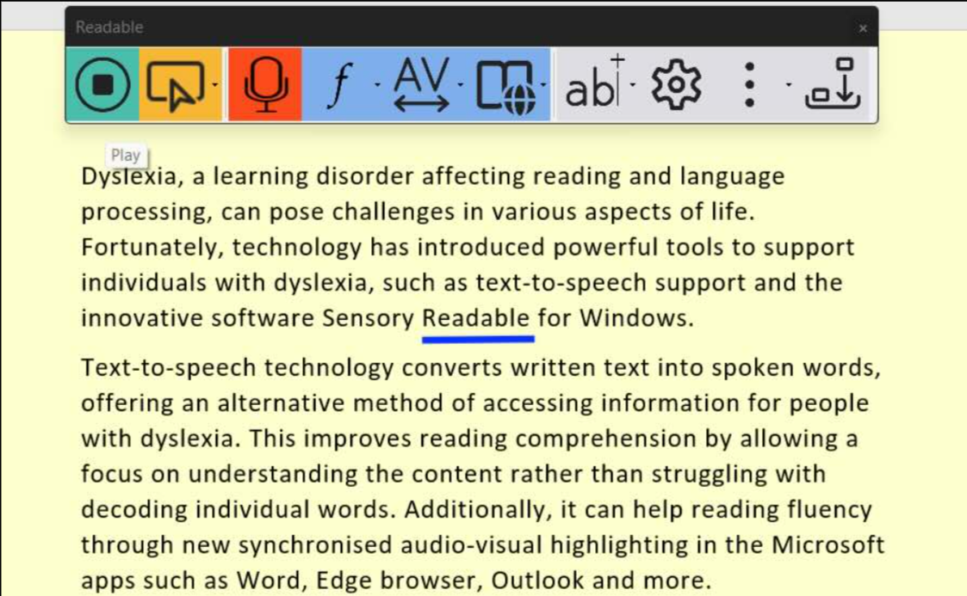
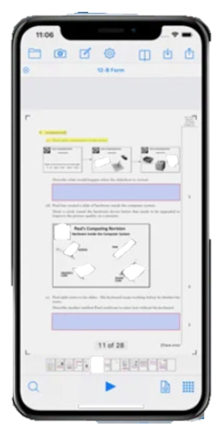
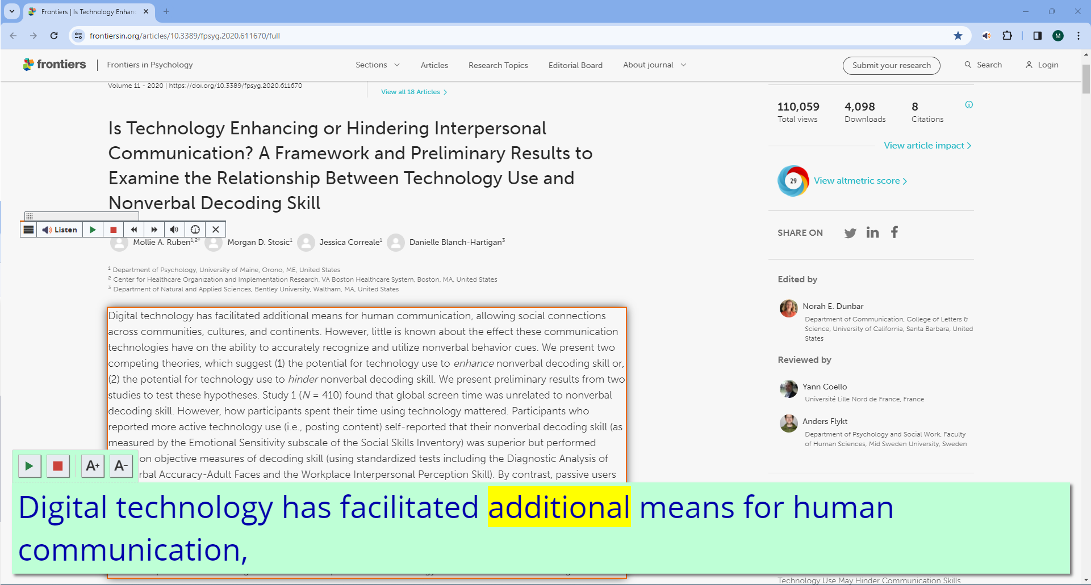
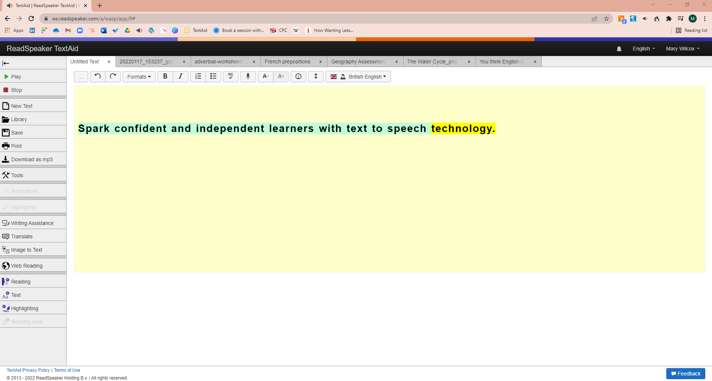
Text to speech options?
Physical reader pen
Computer Software
iOS & Android app
Browser extension
Web app

Slide 2
What is a web app?
A web app is technology which is accessed on a website.

Slide 3
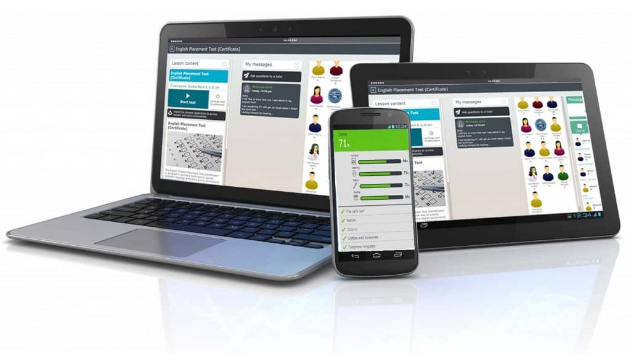
What are the benefits?
Can be used on any device : Windows, MacBook, iPad, phone
No need to download so doesn’t use any memory
Automatic updates
Multi device use e.g. image to text

Slide 4
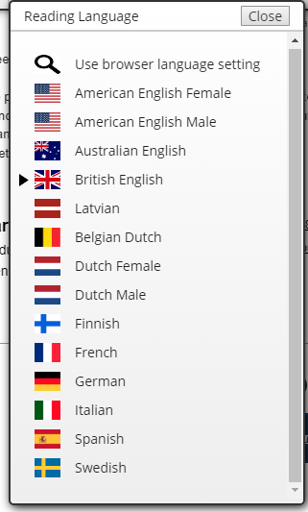
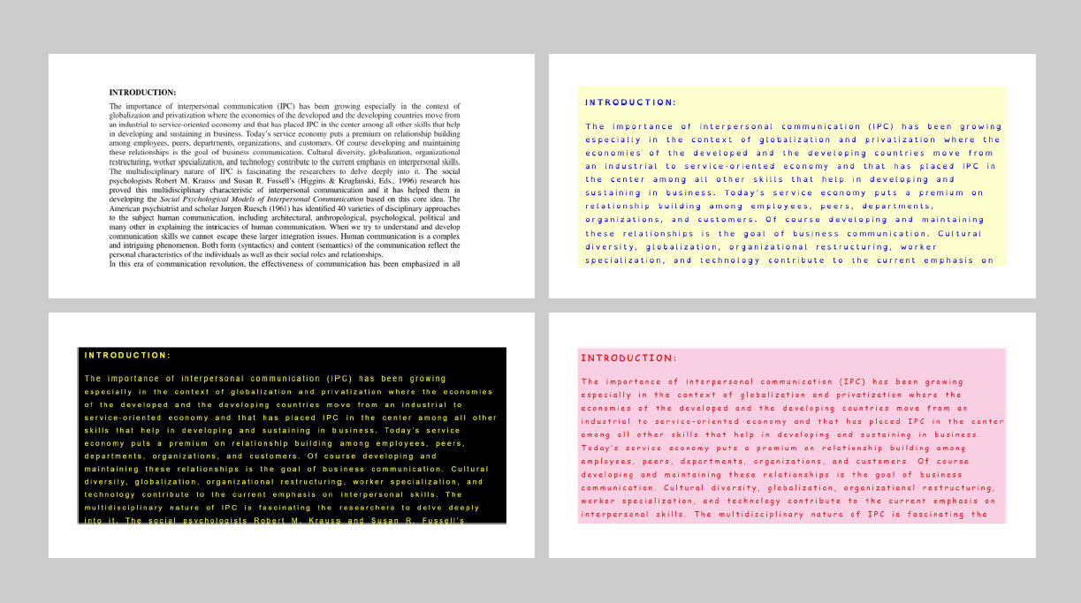
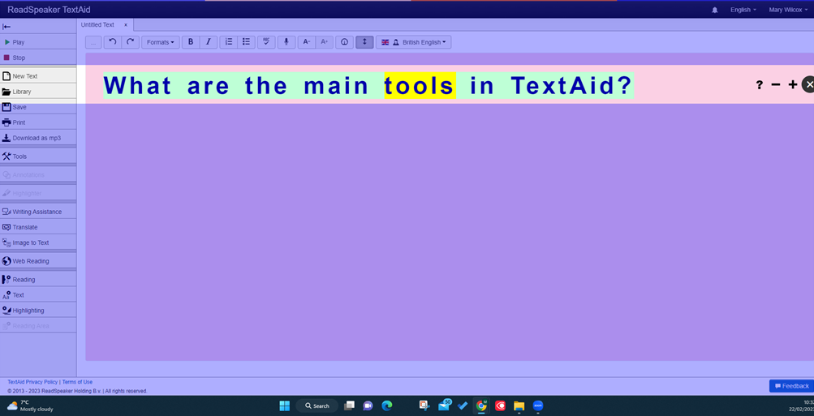
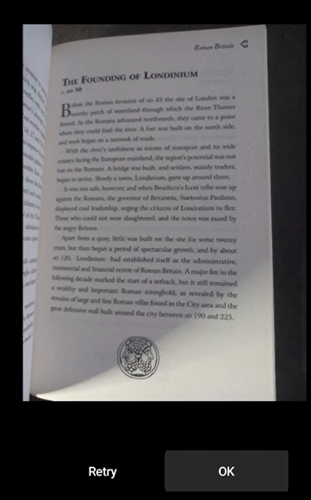
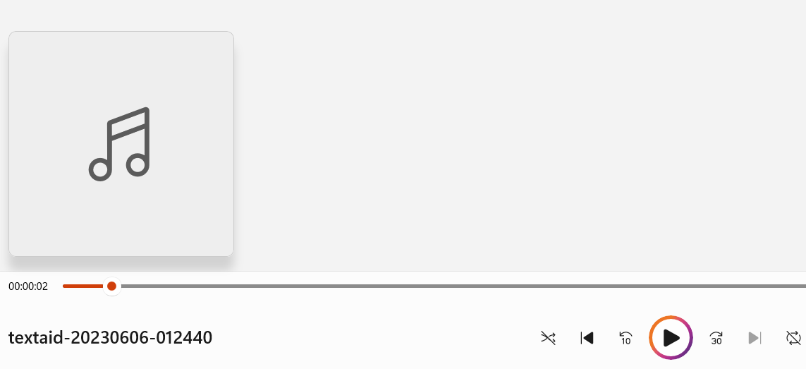
Reading
Award winning, natural sounding voices including with highlighting
Text Mode makes any document easier to read
Documents are automatically accessible because it OCRs as you open it
Translates very quickly – full documents or selected text
Webpages read on a tablet or phone
Screen ruler and page mask to help focus
Save a document as an audio file to listen away from a screen
Listen to text in images
Reading with highlighting
Text Mode
Page mask

Slide 5
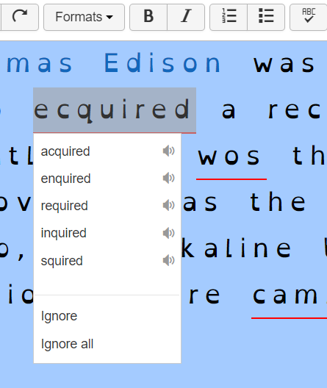
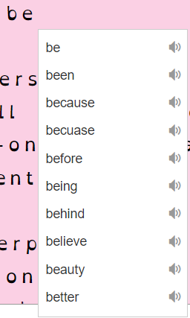
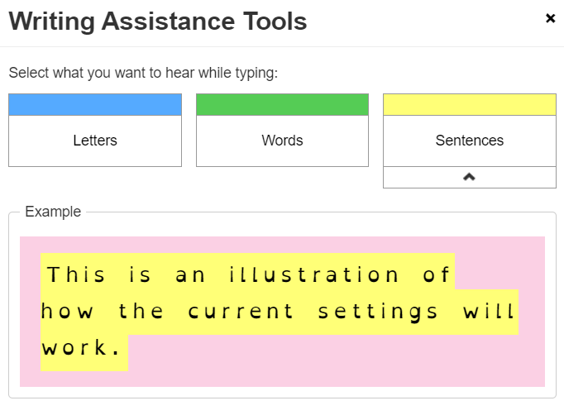
Writing
Very easy and quick to look up the meaning of a word, translate and correct spellings
Word prediction helps find the words you need
Spell checker helps to correct errors
TextAid will read back letters, words and sentences so you can proofread straight away and correct errors

Slide 6
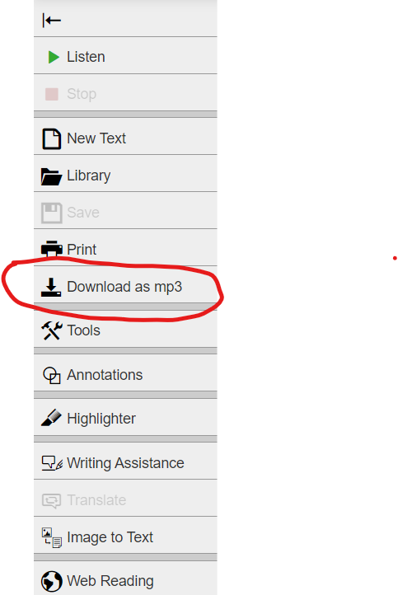
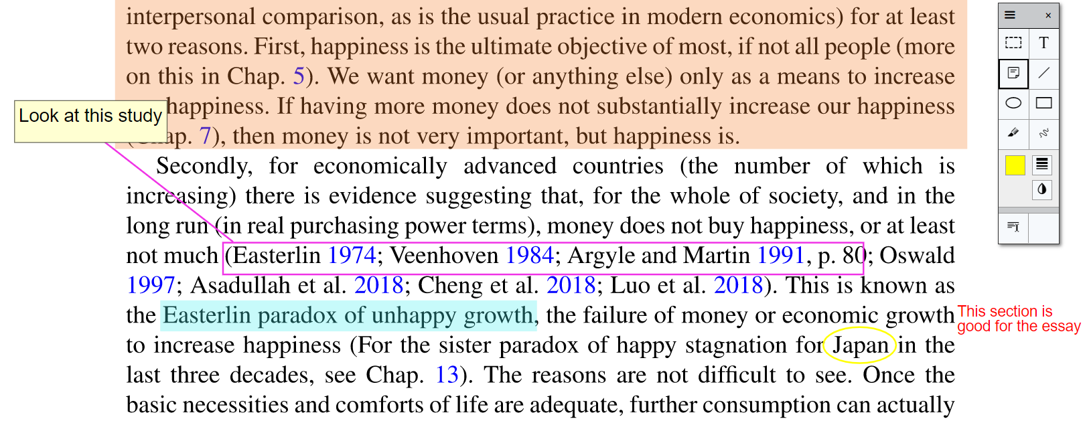
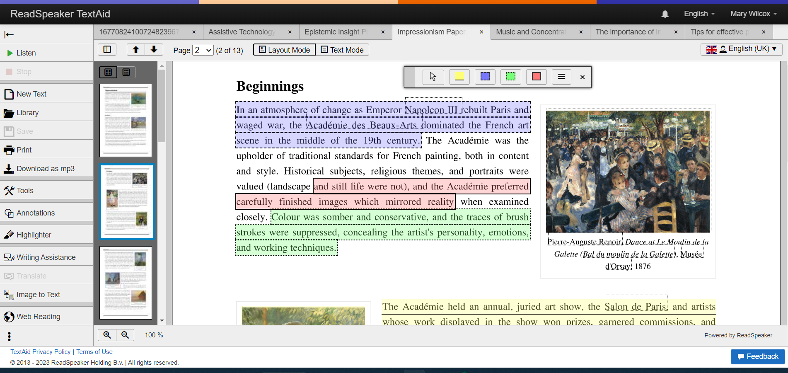
Study Skills
Annotate a document with text, post-its, shapes etc on any device and complete forms without anxiety
Automatically keeps your tabs open for next time
Capture using border styles as well as colours to help with revision and summarising

Slide 7
Overall Advantages
Use in any browser on any device
Use Text Mode so it’s easier to read (background colour, spacing etc)
Natural, award-winning voices
Page mask and reading ruler helps to follow text
Easy to find tools and automatically OCRs, saves and updates
Sentences and individual word highlighting including on websites
Easily to use on multiple devices (especially for image to text and save to MP3)
Just one click and it translates
Annotate any document including forms and worksheets
Extract key information for revision and summarising

Slide 8
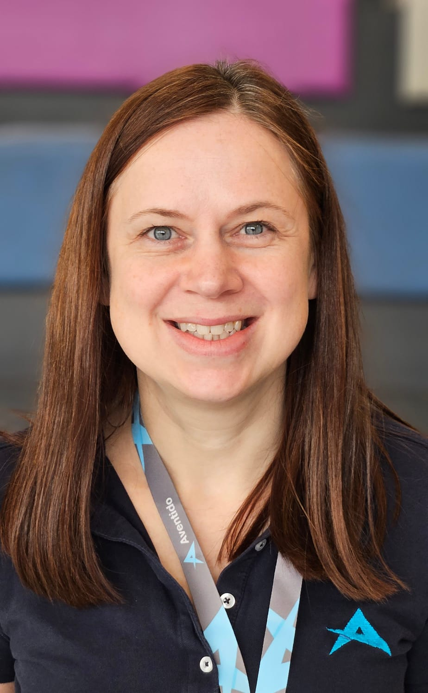
For more information contact Mary Wilcox at Aventido
mary.wilcox@aventido.com

