Slide 1
Navigating Inclusivity on a Shoestring: Casual Convenorship and UDL Implementation
(Almost Dr) Susannah French, Australian National University

Slide 2
About Me
I have submitted my PhD in Sociology about the female* experience of autism
I have previously been a sessional lecturer and tutor from 2014 to 2022
I am currently working as a Project Support Officer with the Inclusive Communities Team in the University Experience Division at ANU. The offer to work on a permanent basis with a cushier salary made it very easy to quit teaching for good. Unfortunately, there is no incentive to come back for reasons I’m about to tell you.
I have been diagnosed with Autism and ADHD at age 30 and paid $4000 for the privilege #bless ☺
I have many things to say about being a neurodivergent casual.
Image Description: A dark-haired femme presenting person in a red and black dress with a tiara posing in an ornately decorated room.

Slide 3
But… but… tHe CaSuAl LoAdInG iS mEaNt 2 cOvEr SiCk LeAvE
Those of us who have worked on a casual basis (and have lived on that money) are all very aware of that claim and we would like you to be quiet. But the reality is that casuals are more likely to be renters, working other jobs and cannot afford to take time off work without the risk of missing a whole week’s worth of pay. The result is that casuals would often come to work sick rather than risk no job at all.
Tertiary education has become increasingly reliant on casual and fixed-term contracts, making permanent full-time positions a rare and valuable asset.
You will be more inclined to endure unreasonable working conditions for fear of getting fired, not getting your contract renewed or losing out on valuable connections that could get you a more permanent job.
When you are stressed out with competing tasks and priorities, job hunting becomes too stressful and time consuming, so it is easy to get stuck in the casualised cycle for a very long time.
Even if you do have a PhD qualification, you are still treated with lower status compared to tenured and permanent staff. So, if there is a conflict between two experts, the casual is at more risk of job loss despite their qualifications.
Being on a perpetual casual basis, makes you more likely to put the brakes on life plans like having a child, getting a mortgage or even finding a rental property.
Casual workers also don't feel like they are part of the workplace community as they are often not invited to staff meetings and face financial pressure when they don't get paid over non-teaching periods like the Christmas break.
All these things cause negative psychosocial health consequences for casuals. And yet they are still expected to provide a premium education despite being stretched thin.
Ultimately, we really need to reconsider about what jobs actually should be casualised and ensure this important structural change happens. As teaching staff, we are on call for students all the time and that kind of work is not able to be properly remunerated in a casual way.
Recommended sources:
McGann, M., White, K., & Moss, J. (2016). “Labour casualization and the psychosocial health of workers in Australia”. Work, Employment and Society, 30(5), 766–782. https://doi.org/10.1177/0950017016633022
Whyte, S. (2018, May 1). Casual workers call for job security at union rally. Brisbane Times. Retrieved from https://www.brisbanetimes.com.au/national/act/casual-workers-call-for-job-security-at-union-rally-20180501-p4zcp7.html

Slide 4
Mismatched Expectations: UDL and Casual Convenorship

Slide 5
UDL as the Gold Standard
Universal Design for Learning (UDL) should be the gold standard in higher education.
Systems must better support casual convenors (or just abolish it completely and put them on a permanent basis)

Slide 6
Challenges for Casual Conveners
Reflecting on my time in UDL training, I noticed it assumes (intentionally or not) that implementers have ample time and resources. While institutions and tenured staff often set the standard, it's frequently the casual tutors and conveners who create innovative activities and undertake most administration of courses.
Casual conveners face precarious conditions and lack of time.
Paid for only two hours of preparation per week.
Tasks like course design, topic research, tutorial organisation, assessment moderation meetings, student meetings, academic integrity meetings require so much more time.

Slide 7
Extra Effort and Inadequate Compensation
University administrations exploit casual academics' dedication.
Many strive for good evaluations and student engagement, going above and beyond.
Casual academics do not earn enough for the extra work and often work additional jobs.
Balancing extra responsibilities and research makes UDL implementation challenging.

Slide 8
Need for Institutional Support
It's unfair to rely on individual conveners' goodwill for inclusive education.
Institutional support is necessary for sustainable and effective UDL implementation.
Best practices cannot be implemented effectively when casual academics are overburdened.
After the COVID-19 Lockdowns, students often requested having hybrid classes, which would make things so much more accessible. However, many of the actual physical rooms are not built for purpose and many students would lose out if they had a chronic condition or disability that made in-person attendance difficult.

Slide 9
Case Studies of best practice: inclusive Tutorial activity Design

Slide 10
DISCLAIMER
I understand that it would be unreasonable to expect non-sociologists to fully grasp these theories. However, the goal of this section is to explore how UDL principles can make complex theory more accessible to first-year sociology students. These connections are the key focus. However, I diluted the theory to ensure that attendees can follow along.

Slide 11
Modelling Durkheim's Solidarity with Play-Doh Bugs
All credit for the creation of this activity and the handouts goes to Dr Clare Southerton and Dr Hannah McCann

Slide 12
Mechanical Solidarity Team Instructions
Organic Solidarity Team Instructions

Slide 13
Student Feedback and Discussion
Some students assigned the Mechanical Solidarity instructions reported that they enjoyed following their instructions as it provided them with structure, and it was fun to build something with a partner.
Relevance to Theory: This situation aligns with Durkheim's idea that societies bound by mechanical solidarity have a strong sense of collective consciousness and adherence to shared norms. The students’ comfort and enjoyment in the clear guidelines, mirrors how individuals in traditional, homogeneous societies derive security and satisfaction from conformity and uniformity.
Other students despised how stringent the instructions were. One pair of students tried to ignore the instructions and add extra attachments to the bug. We also unpacked why not following instructions felt a like let down (for me as an instructor and for them participating).
Relevance to Theory: This situation reflects the potential rigidity and resistance to change in mechanically solid societies. The pair who tried to deviate from the instructions exemplified the tension and potential for dissatisfaction when individuals feel constrained by rigid societal norms.
Some students assigned the Organic Solidarity instructions absolutely thrived on the freedom they had, while others found it way too stressful not having any structure at all.
Relevance to Theory: Those who enjoyed the freedom embody Durkheim's notion of organic solidarity, where individuals in modern, heterogeneous societies enjoy the benefits of interdependence and the flexibility to pursue personal interests and creativity. This mirrors the diverse roles and functions in such societies that allow for personal growth and innovation. Those who were stressed reflected the downside of organic solidarity: the anxiety and uncertainty that can arise from too much autonomy and insufficient guidance, reflecting the complexities and challenges of interdependence in modern societies.

Slide 14
The Goffman Spy Game
In Person Version
You will each be given a card. Some of you will be spies, some will not be spies.
Spies will be fabricating things about their lives. Non-spies will be truthful. Only share what you are comfortable with!
You will talk to each other for four minutes and talk about your lives.
I will randomly assign your partners out of my hat.
Online Version
You will be each assigned a partner in a separate break out room and you will be having a 4-minute conversation with them (you’re just getting to know one another).
I will privately message each of you in the Zoom chat to let you know whether you are a “spy” or “not a spy”.
If you are a spy, you will have to make up some lies about yourself. If you are not, just keep talking about yourself and share whatever information you feel comfortable with.
After the 4 minutes is up, we will reveal who the spies were!
All credit for the creation of this activity goes to McCoy, C. A. (2017). “Playing Goffman’s Information Game: A Classroom Activity Involving Student Interactions”. Teaching Sociology, 45(3), 260-268. https://doi.org/10.1177/0092055X17690793

Slide 15
Post Game Reflection Questions
Who had suspicions? Why? What possibly made you doubt what your partner was saying? What made you believe them?
Who was a spy? How did they lie, how did they feel about lying?
How did non-spies stage their “true” self?
Consider a few extra things: How do we make things sound true? How do we orient our presentation depending on the situation? How do these interactions abide by some implicit rules for people to look credible?

Slide 16
Student Feedback and Discussion
Some students enjoyed lying and creating a whole new lives for themselves. Some students reported that they would make up some white lies that are close enough to being believed and if their partners “fell for it”. The enjoyment of lying and creating new personas illustrates the performative aspect of social interactions, emphasising how people can manipulate their "front stage" to create desired impressions.
Other spies did not enjoy having to lie about themselves and were incredibly relieved when the four minutes was up! This reaction underscores Goffman’s notion that maintaining a front can be psychologically taxing, especially when it conflicts with one’s “true self” or ethical comfort zone.
Some non-spies were eager to figure out if their partner was lying especially if they didn’t know them. This eagerness to detect deception reflects the interactive nature of impression management, where individuals not only project images but also critically evaluate the images presented by others. The eagerness also highlights the duality of social interaction, where individuals are both performers and audience members, constantly assessing the authenticity of others' performances.
All students that they became more acutely aware of Goffman’s impression management (where individuals actively construct and present a particular image or identity to others) and the “front stage” they wanted to project to their partner.
They became more aware of their own facework especially those who felt less comfortable being a spy. Facework is where individuals engage in subtle manipulations of truth to maintain a believable and consistent image. This discomfort highlights the challenges and vulnerabilities individuals face when their “true identity” is at odds with the role they are performing, emphasising Goffman’s point about the complexities of maintaining a consistent and convincing front.

Slide 17
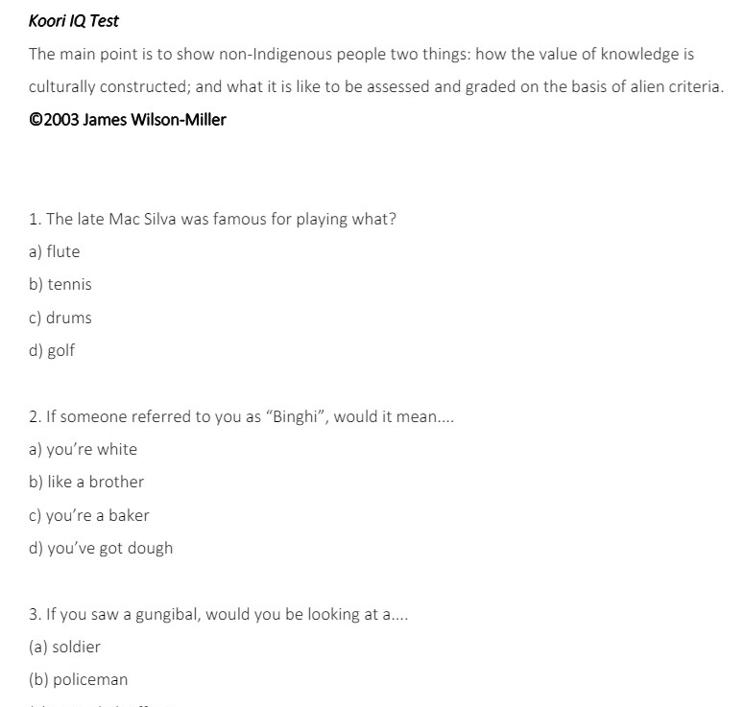
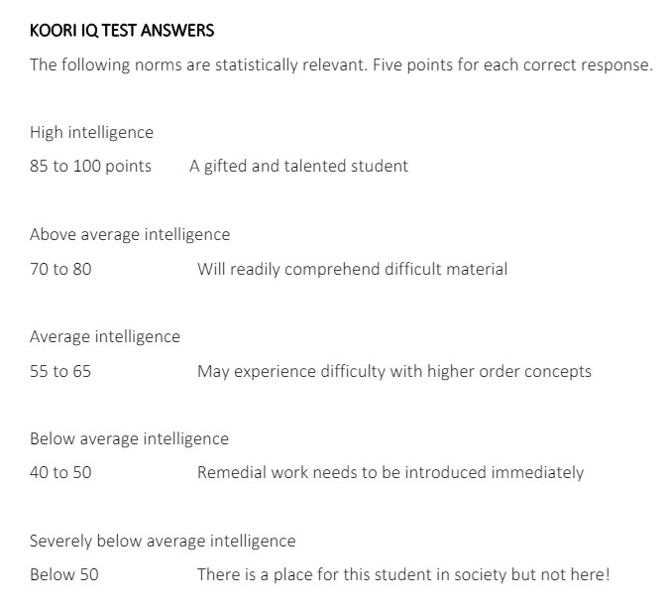
The Koori IQ Test
All credit for the Creation of this Activity Goes to Uncle James Wilson-Miller
Miller, J. (2018). Koori IQ Test. Retrieved from https://www.nesst.org.au/wp-content/uploads/2018/06/Koori-IQ-Test_Miller.pdf

Slide 18
Student Feedback and Discussion
As you can expect, most if not all students scored well below 50. Some students reported to feeling very uncomfortable that they couldn’t answer this information. We decided to unpack this discomfort and discussed the arbitrary nature of ‘intelligence’ and how even how smart you are is culturally constructed and can disadvantage you if you are not born within this system.
Relevance to the Social Construction of Racism: This discomfort highlights how knowledge and intelligence are often defined by dominant cultural standards. The feeling of inadequacy experienced by the students mirrors the challenges faced by marginalised groups when subjected to biased educational and evaluative systems.
Most students who grew up in Australia at least were able to answer who Debra Mailman was and she wasn’t a postal worker!
Relevance to the Social Construction of Racism: This demonstrates how cultural context influences what is considered common knowledge. The ability to answer certain questions correctly is often dependent on one's cultural background and experiences. This situation underscores the point that intelligence and knowledge are not universally defined but are instead shaped by cultural narratives and experiences. It reflects how individuals from different backgrounds may be unfairly judged or misunderstood when evaluated against a culturally biased standard.
Some students reported to just guessing the answers even if they knew it was likely going to be wrong. We discussed how that would have been like for an Aboriginal person who is now suddenly having to learn completely foreign concepts (and a lot of revisionist history).
Relevance to the Social Construction of Racism: This reflects the pressure and alienation that individuals from marginalized backgrounds might feel when forced to navigate and conform to a dominant culture’s knowledge system. The comparison to Aboriginal experiences emphasizes how systemic racism in education requires marginalised groups to learn and internalise foreign concepts, often erasing their own histories and knowledge systems. This process contributes to the social construction of racism by reinforcing a dominant cultural narrative while devaluing and marginalizing other perspectives.

Slide 19
Honourable Mentions
Drawing Pictures of “Emotion Work”
Social Worker Activity: Family Structures and Deviance
Growing Up Poor: 4 Corners Episode on Claymore
Gender Performativity in Chocolate Ads
Identifying Marx’s “False Consciousness” in New (c)Age Affirmations
Drawing Cooley’s “The Looking Glass Self”
Applying Weber’s concept of “Disenchantment” and “Re-Enchantment” in advertisements

Slide 20
Integrated Analysis of UDL Principles in Educational Activities

Slide 21
Multiple Means of Engagement
Play-Doh Activity:
Diverse reactions show the need for multiple engagement strategies.
Structured guidelines and freedom reflect Durkheim's mechanical and organic solidarity.
Varied methods cater to different student preferences.
Goffman Spy Game:
Autonomy in choosing deception complexity increased engagement.
Relevant to real-world interactions, boosting student investment.
Varied challenge levels ensured meaningful participation.
Koori IQ Test:
Engaged students with culturally relevant content.
Highlighted value of students' cultural knowledge.
Fostered inclusion and enhanced engagement.

Slide 22
Multiple Means of Representation
Play-Doh Activity:
Varied instructional approaches accommodated different learning styles.
Flexibility ensured engagement with material.
Goffman Spy Game:
Used diverse instructional materials (videos, readings, visual aids).
Clear, multi-format instructions and additional resources on theories ensured understanding.
Koori IQ Test:
Presented questions based on Koori culture, demonstrating diverse knowledge.
Visual aids and culturally relevant examples made content accessible.

Slide 23
Multiple Means of Action and Expression
Play-Doh Activity:
Freedom in task approach enhanced learning outcomes.
Flexibility fostered a supportive learning environment.
Goffman Spy Game:
Post-game expression through reflections, discussions, or presentations.
Digital tools and flexible timing supported diverse participation (this was important when we did this activity during lockdown).
Koori IQ Test:
Test questions discussed varied formats of expressing knowledge (written, oral, artistic).
Flexible assessment methods ensured effective demonstration of understanding.

Slide 24
When You’ve Already Got Good Content, There’s No Need to Reinvent the Wheel
The most valuable lesson that I took away from teaching is that it is really important to foster this community. Not only does this enable you to learn from others but it also gives you the opportunity to pass on important knowledge to newbies and veterans alike!
It is okay to take on lesson plans from others, it will save you the stress and mental load of creating a whole new course. We are not getting paid anywhere near enough to design a whole new course.
Co-designing activities with my tutoring team did foster that camaraderie, which created some great employment, research and personal connections down the line.

Slide 25
However… with all this dynamic and wonderful work, keeping this work casual is unacceptable!
Institutions cannot expect staff to provide premium and accessible teaching if they are so under resourced and under supported.
According to Dr Joe McCarthy, “If ANU had paid me and my other colleagues for the whole year, then I would have had a wage similar to a Level B academic. A full-time Level B academic is expected to undertake teaching, research, non-course administration and outreach”. Funny how I got used to doing all these things for FREE! FOR YEARS! I expect compensation of some kind!
Until there is a huge upheaval of our systems, casual convenorship is here to stay for a while. It is a given that we must do better to ensure that casual staff are better supported and that institutions foot the bill to better compensate for their time.
However, this does not mean that you cut the casual staff and put the teaching load onto already overworked permanent academic staff. I see you university administrators!
The ANU have updated their Enterprise Agreement to ensure that casual staff are not entitled to sick leave, annual leave and long service leave. We will wait and see what patterns emerge now that it has been enacted.
While casual conversion is a thing, very rarely do even long-term casual employees obtain it despite the number of unpaid hours they do for their courses and departments every year.
Recommended Source: McCarthy, J. (2020, November 9). Reflection on academia before and after the pandemic. Green Agenda. Retrieved from https://greenagenda.org.au/2020/11/reflection-on-academia-before-and-after-the-pandemic/

Slide 26
Special Thanks to my Teaching Comrades and Mentors
Dr Miranda Bruce
Dr Hannah McCann
Dr Clare Southerton
Dr Baptiste Broussard
Associate Professor Kevin White
Associate Professor Gavin Smith
Professor Alastair Greig
Dr Joe McCarthy
Dr Michelle Black
Dr Nicole Stirling
Associate Professor Jenny Davis
Dr James Choiunaird
Dr Rebecca Cross
Associate Professor James Connor
Fiona Navilly
Jessie Liu
Will Orr
Ayesha Kaak
Florim Binakaj
Juniper Sutherland

