Slide 1

Building inclusive learning communities
Monique Laura
Sarah Humphreys
Educational Innovation Team

Slide 2
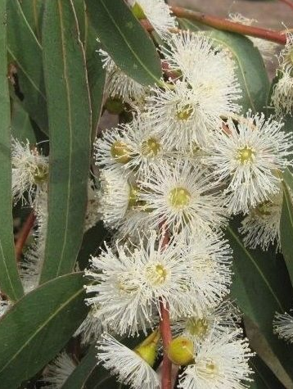
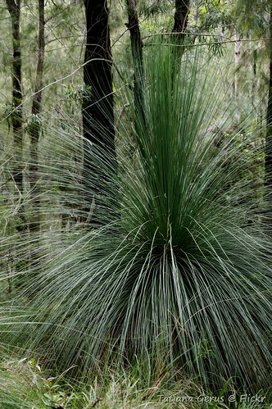
Acknowledgment of Country
Wurundjeri people of the Kulin Nations
Gadigal of the Eora Nation
Manna Gum (flower), image Alan Fairley
This Photo of Grass tree Unknown author is licensed under CC BY-SA.

Slide 3

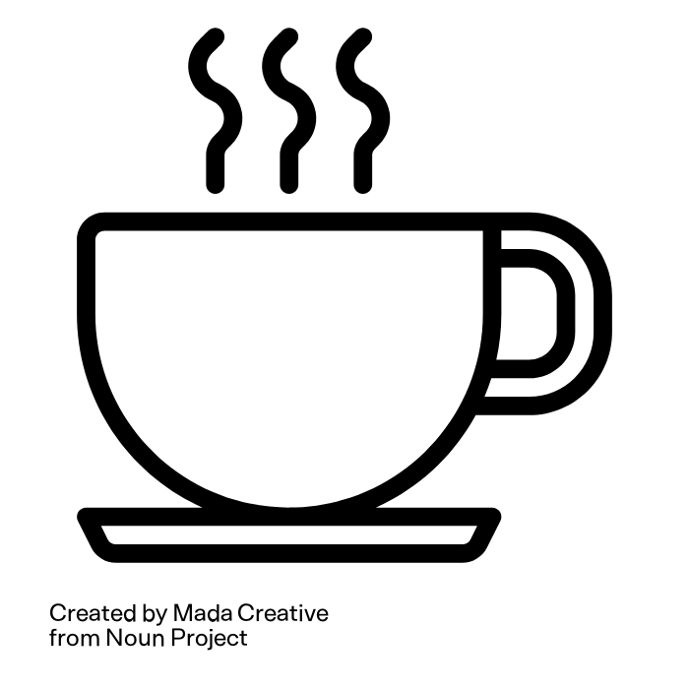

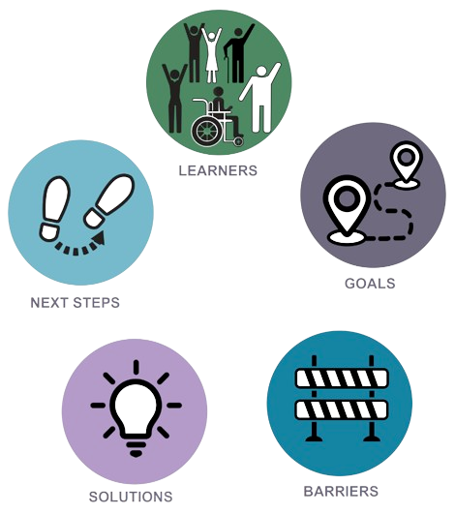
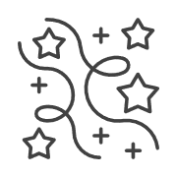

Learning communities
How can we foster a university-wide culture of intentionally designing for diversity?
Canvas resource & interactive site
UDL chat / coffee
Community of Practice
Professional learning opportunities

Slide 4
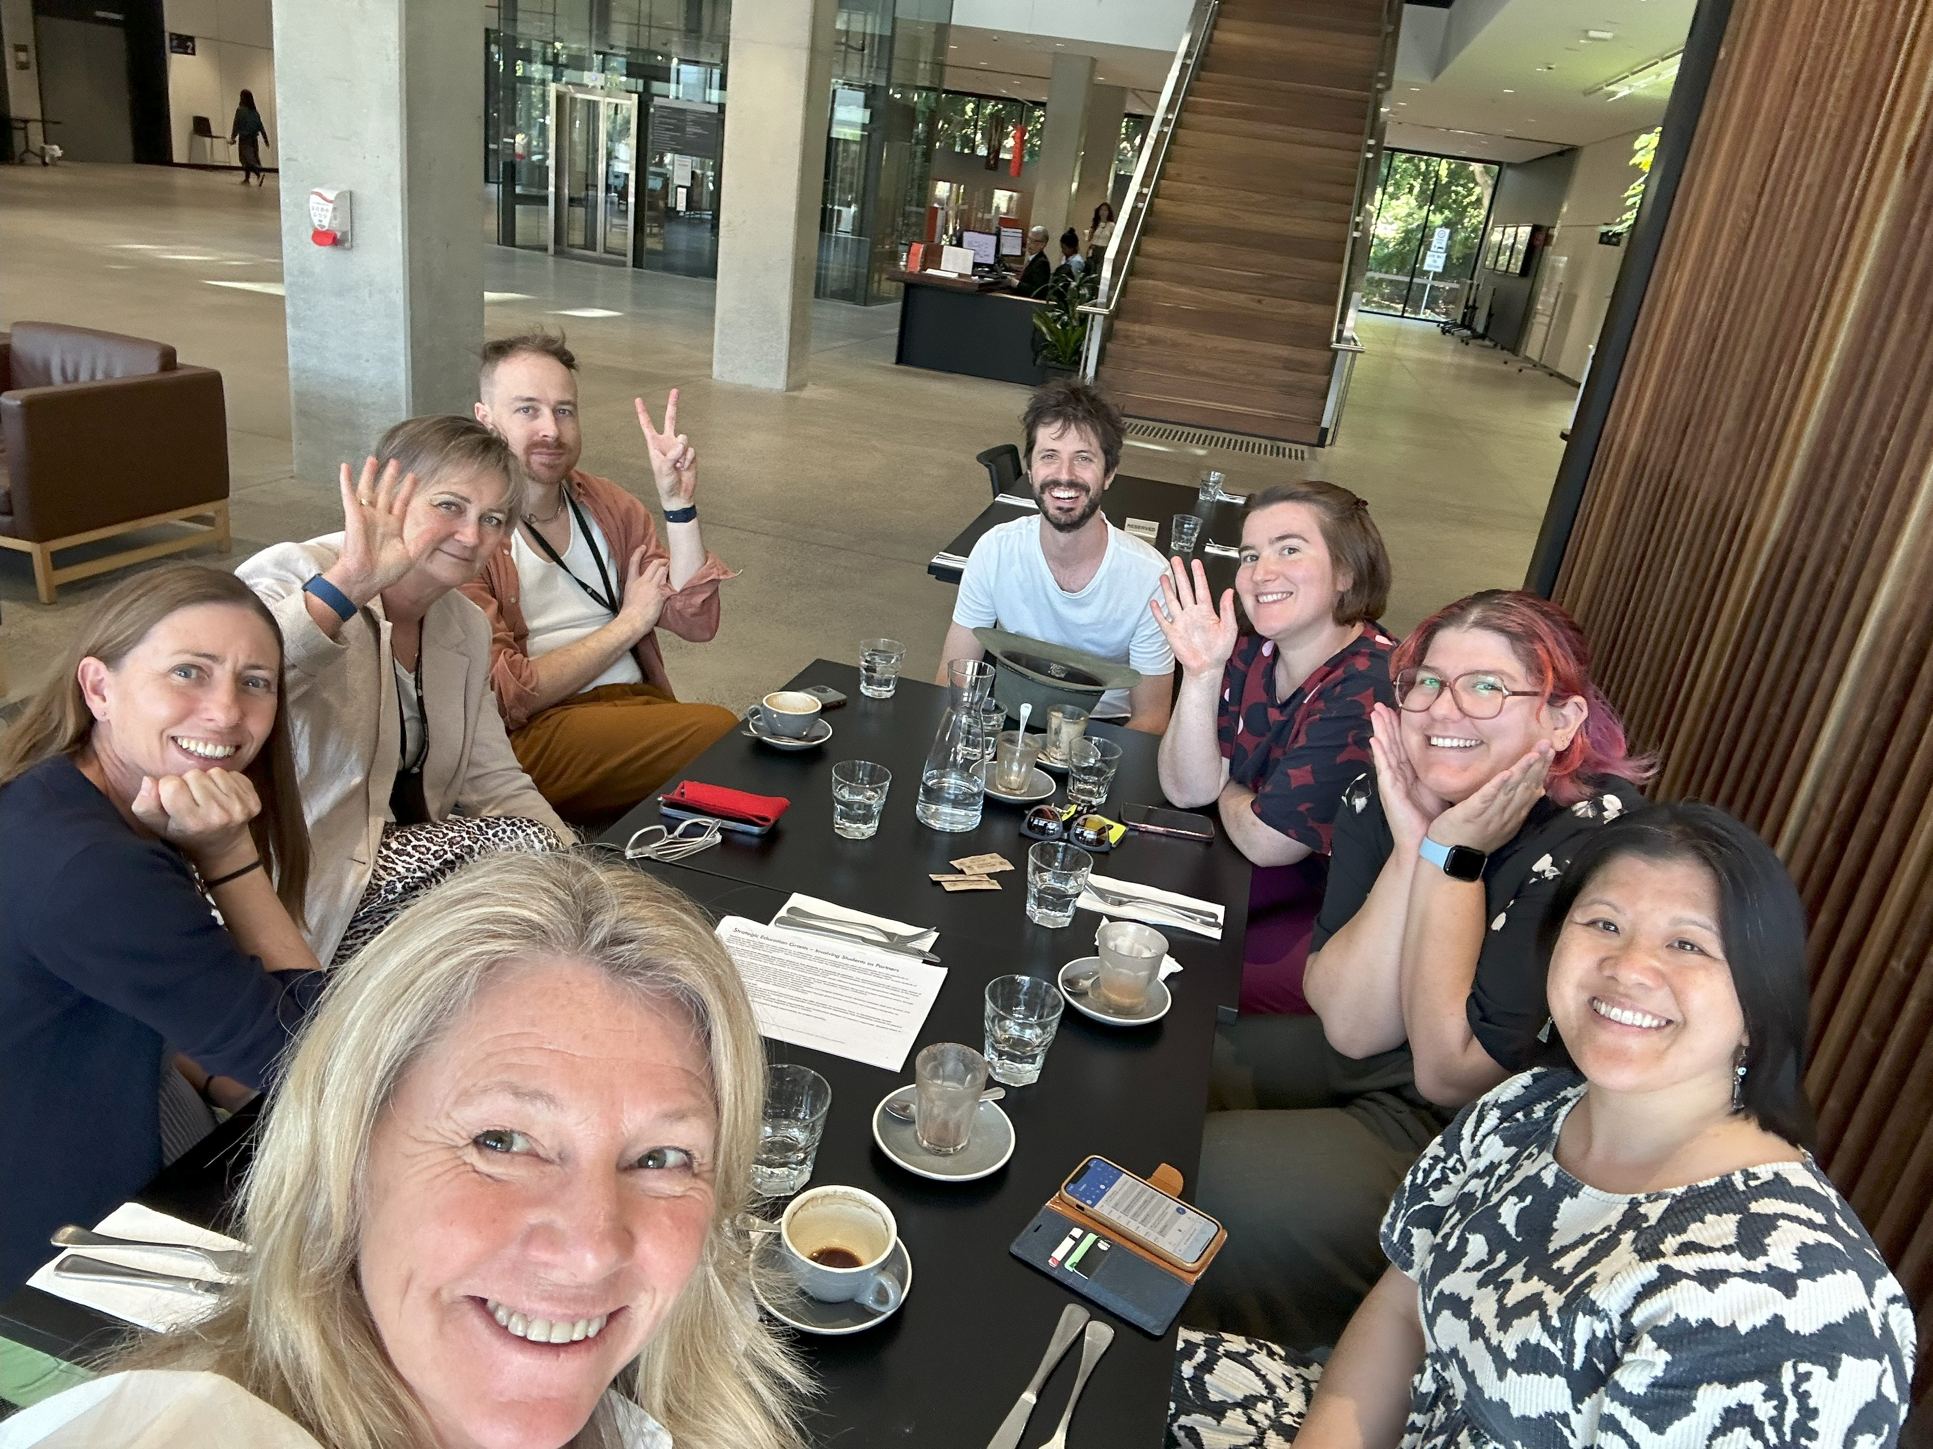
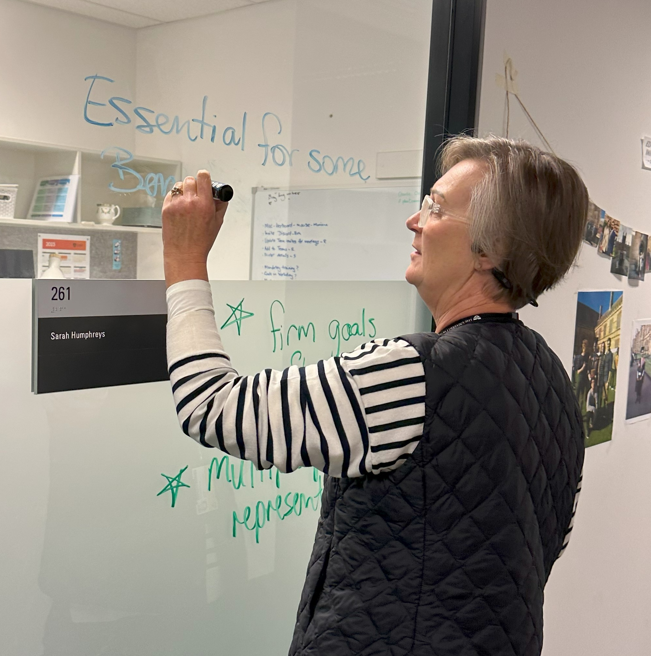
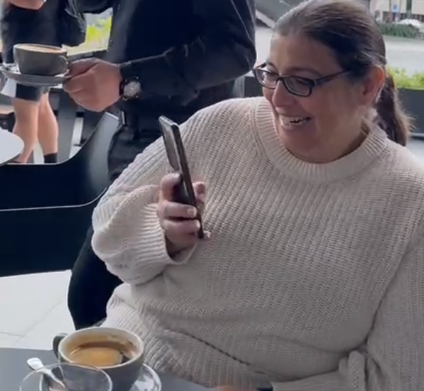
UDL coffee

Slide 5
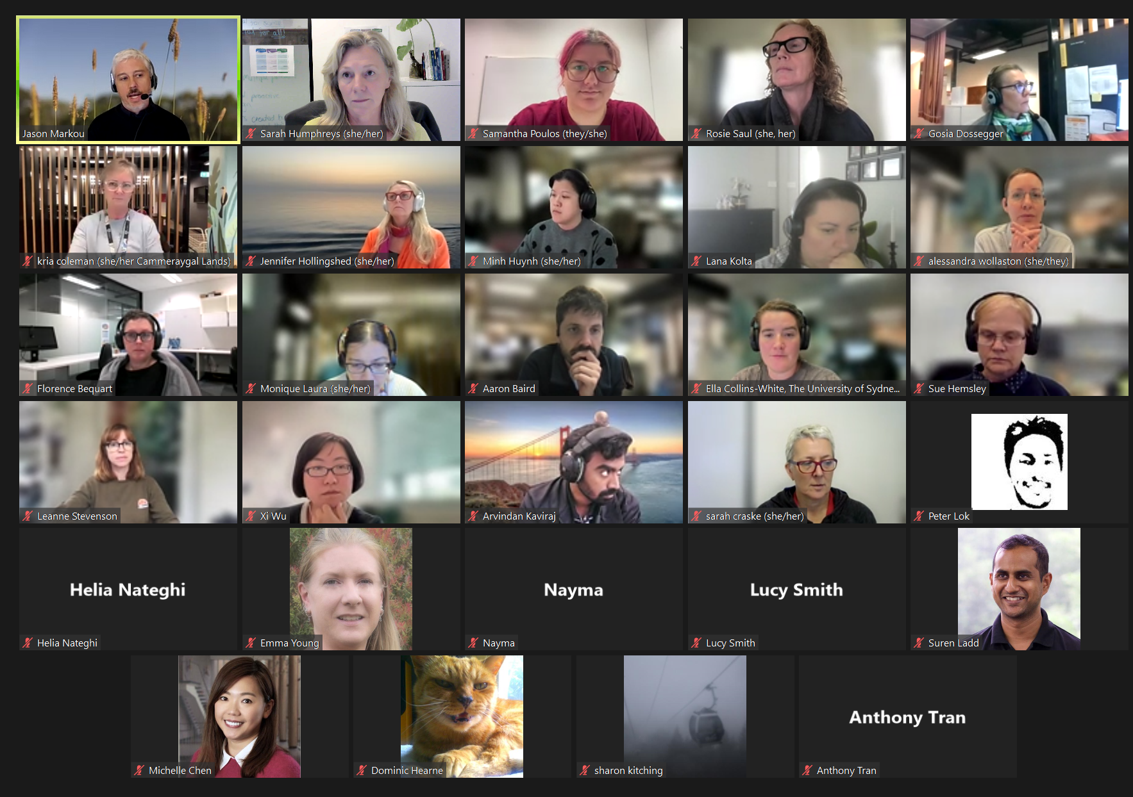
UDL chat
Flipped classrooms
Building efficiency into LMS workflow
Digital accessibility
A Canvas UDL re-design
UDL 3.0 update
Academic stress and UDL research
Tutor training in FASS
Using warm-up tasks to prepare students for their final exam in Engineering
Proactive teaching design for sensitive material in Sexual Health

Slide 6

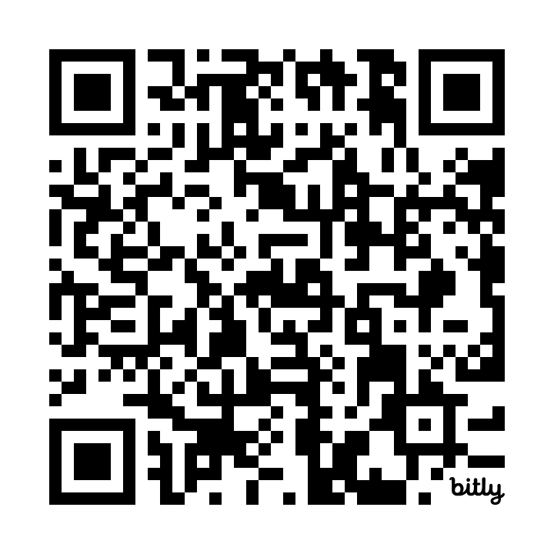
Canvas resource and interactive site
bit.ly/TeachingAtSydney

Slide 7
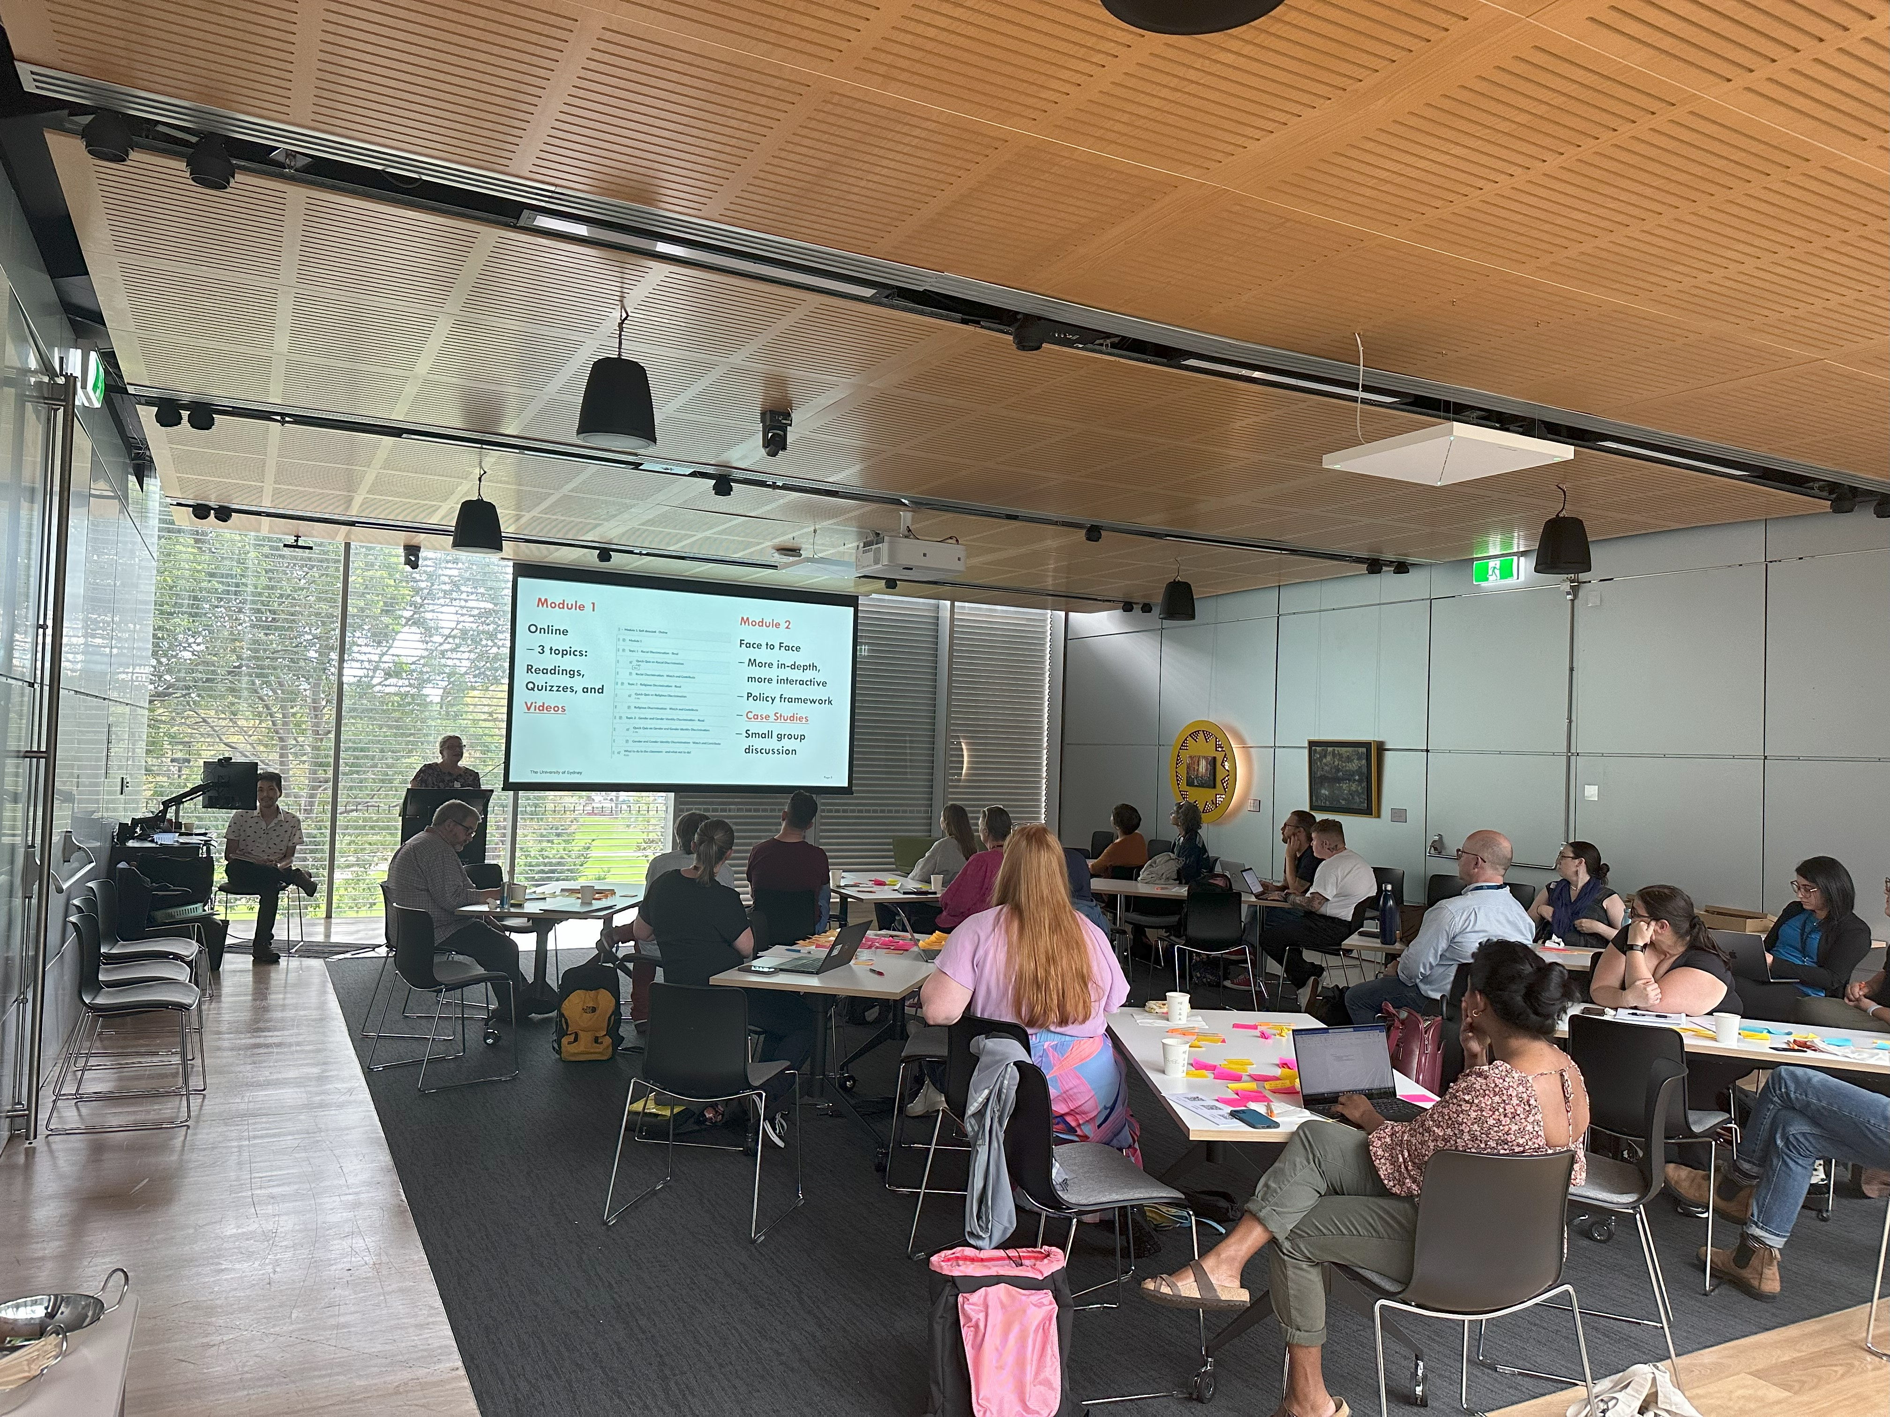
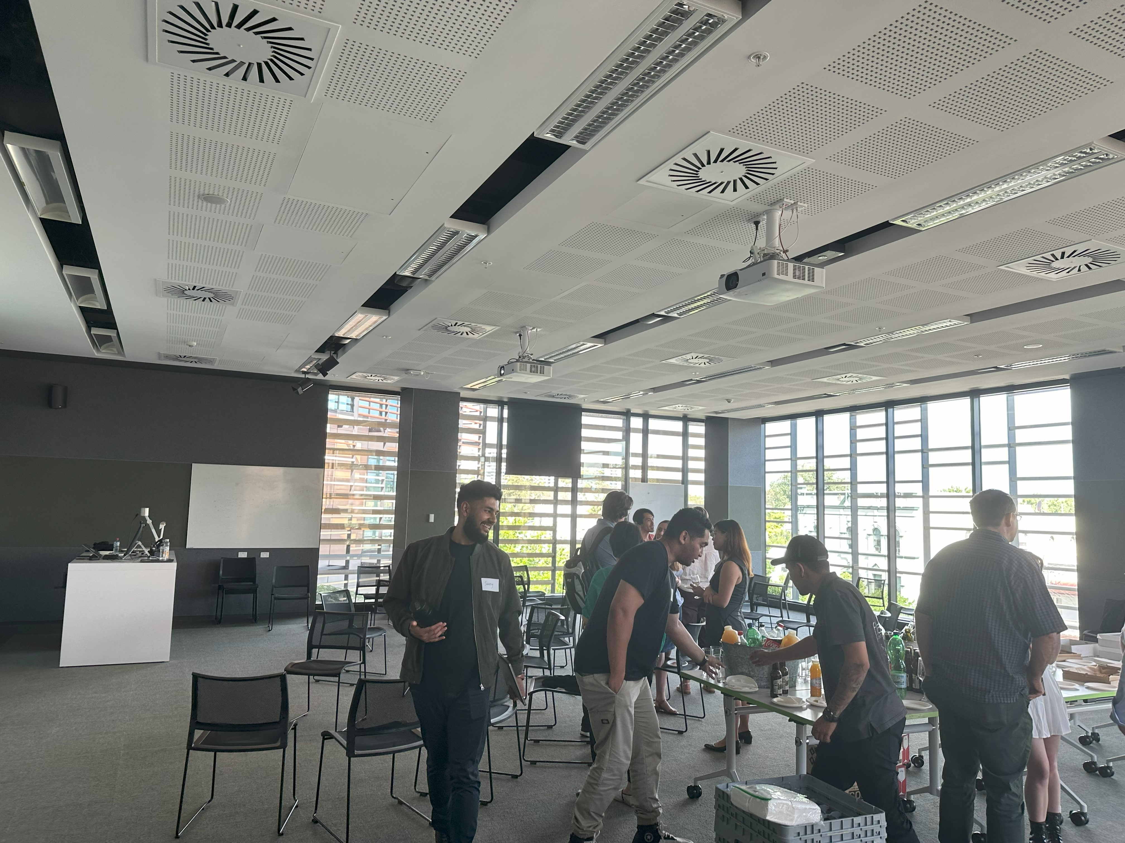
Community of Practice

Slide 8
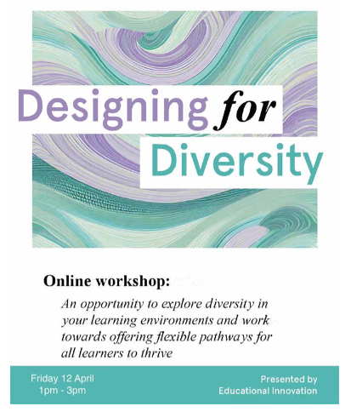
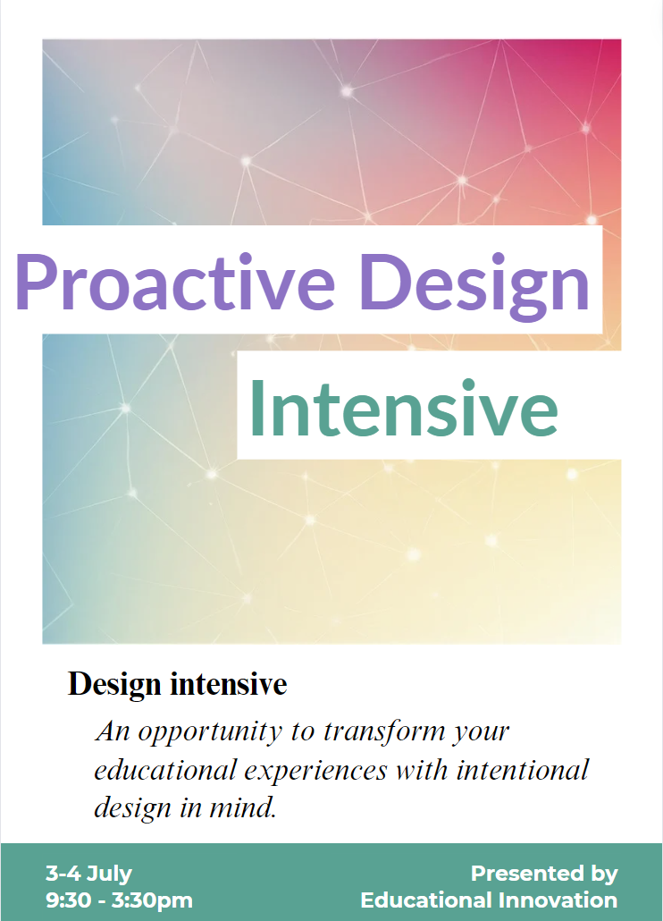
Professional learning opportunities
Workshop
2 hours
Proactive Design Intensive
2 days

Slide 9
Impact ...
A shared language
Affirming of practices already aligned to UDL
Challenges and shifts thinking
Offers choice and flexibility in how to learn about UDL
Influencing others by sharing stories of success
Developing a collaborative, problem-solving approach to teaching and learning design
Creates opportunities for recognition and reward
Reference:
Berquist, L., Neopolitan, J. (2019). Using professional learning communities to redesign learning environments in HEIs. In S. Bracken, K. Novak (Eds), Transforming Higher Education Through Universal Design for Learning (1st ed, pp 101-111).
https://www.taylorfrancis.com/chapters/edit/10.4324/9781351132077-7/using-professional-learning-communities-redesign-learning-environments-heis-liz-berquist-jane-neapolitan

Slide 10

Connect with us!
If you'd like to connect with our community
please get in touch
monique.laura@sydney.edu.au
sarah.humphreys@sydney.edu.au

