Slide 1
UDL, Technology, and Disability Support
“We influence UDL by being around the table...”
Presenter: Jacquie Tinkler
Co Authors: Ella Dixon & Gene Hodgins

Slide 2
Background
We are exploring the use UDL for online learning design for students with poor mental health or mental illnesses.
Our previous study involved online students who were and their experiences of studying with poor mental health.
Building on that work, we focused on those who are supporting these students in universities: the Disability Support Officers (DSOs) and Managers (DSMs).

Slide 3
The aim of this project
This project investigates how educational technologies and UDL approaches are used by university Disability Liaison Officers and Disability Liaison Mnagers (DLO/Ms) to assist online students with poor mental health and how these technologies can be integrated into online subjects.

Slide 4
A note about terminology
We use the terms “poor mental health” and “mental illness” to describe the mental health of the students in this study. Despite the stigma attached to “mental illness”, it used by most DSO/Ms as students need a formal diagnosis to access support.
We use the term “Disability Support (Officers and Managers)” to describe those who support these students. Other terms included: Accessibility Advisor, Disability Advisor, Access and Inclusion Advisor, Accessibility and Disability Support, Disability Liaison Officer, Learning Accessibility Advisor, and Access Ability Advisor.

Slide 5
Literature – what do we know?
Australian university students experience significantly higher levels of poor mental health than the general population
Students don’t always recognise they have poor mental health so don’t seek help or are unaware they can access help.
Individual ‘adjustments’ are the most common approach to support.
Little is known about the digital tech needs of these students or how UDL approaches have impact on their learning success.
We know little about DSO/Ms’ views of these students’ technology needs, and how they think UDL could help.

Slide 6
The research questions
What learning technologies are used to assist online students with a mental health disability to support their university studies?
In what ways could learning technologies be integrated into online subject design to better support online students with mental health disabilities?
To what extent does the successful use of learning technologies by Disability Support Officers reflect or utilise the principles of UDL?

Slide 7
How did we investigate?
We surveyed (n=33) and interviewed (n=7) DSO/Ms from a number of Australian universities (n=22) – these findings are from the qualitative data.
80% of participants had support roles, and 20% Managerial roles.
Our survey asked about the types of tech used and its purpose (e.g. Glean for note-taking for organisation, managing anxiety, and/or concentration, etc.), and how they considered and used UDL in their approaches to the use of tech and student support.
Semi-structured interviews unpacked these ideas in more detail

Slide 8
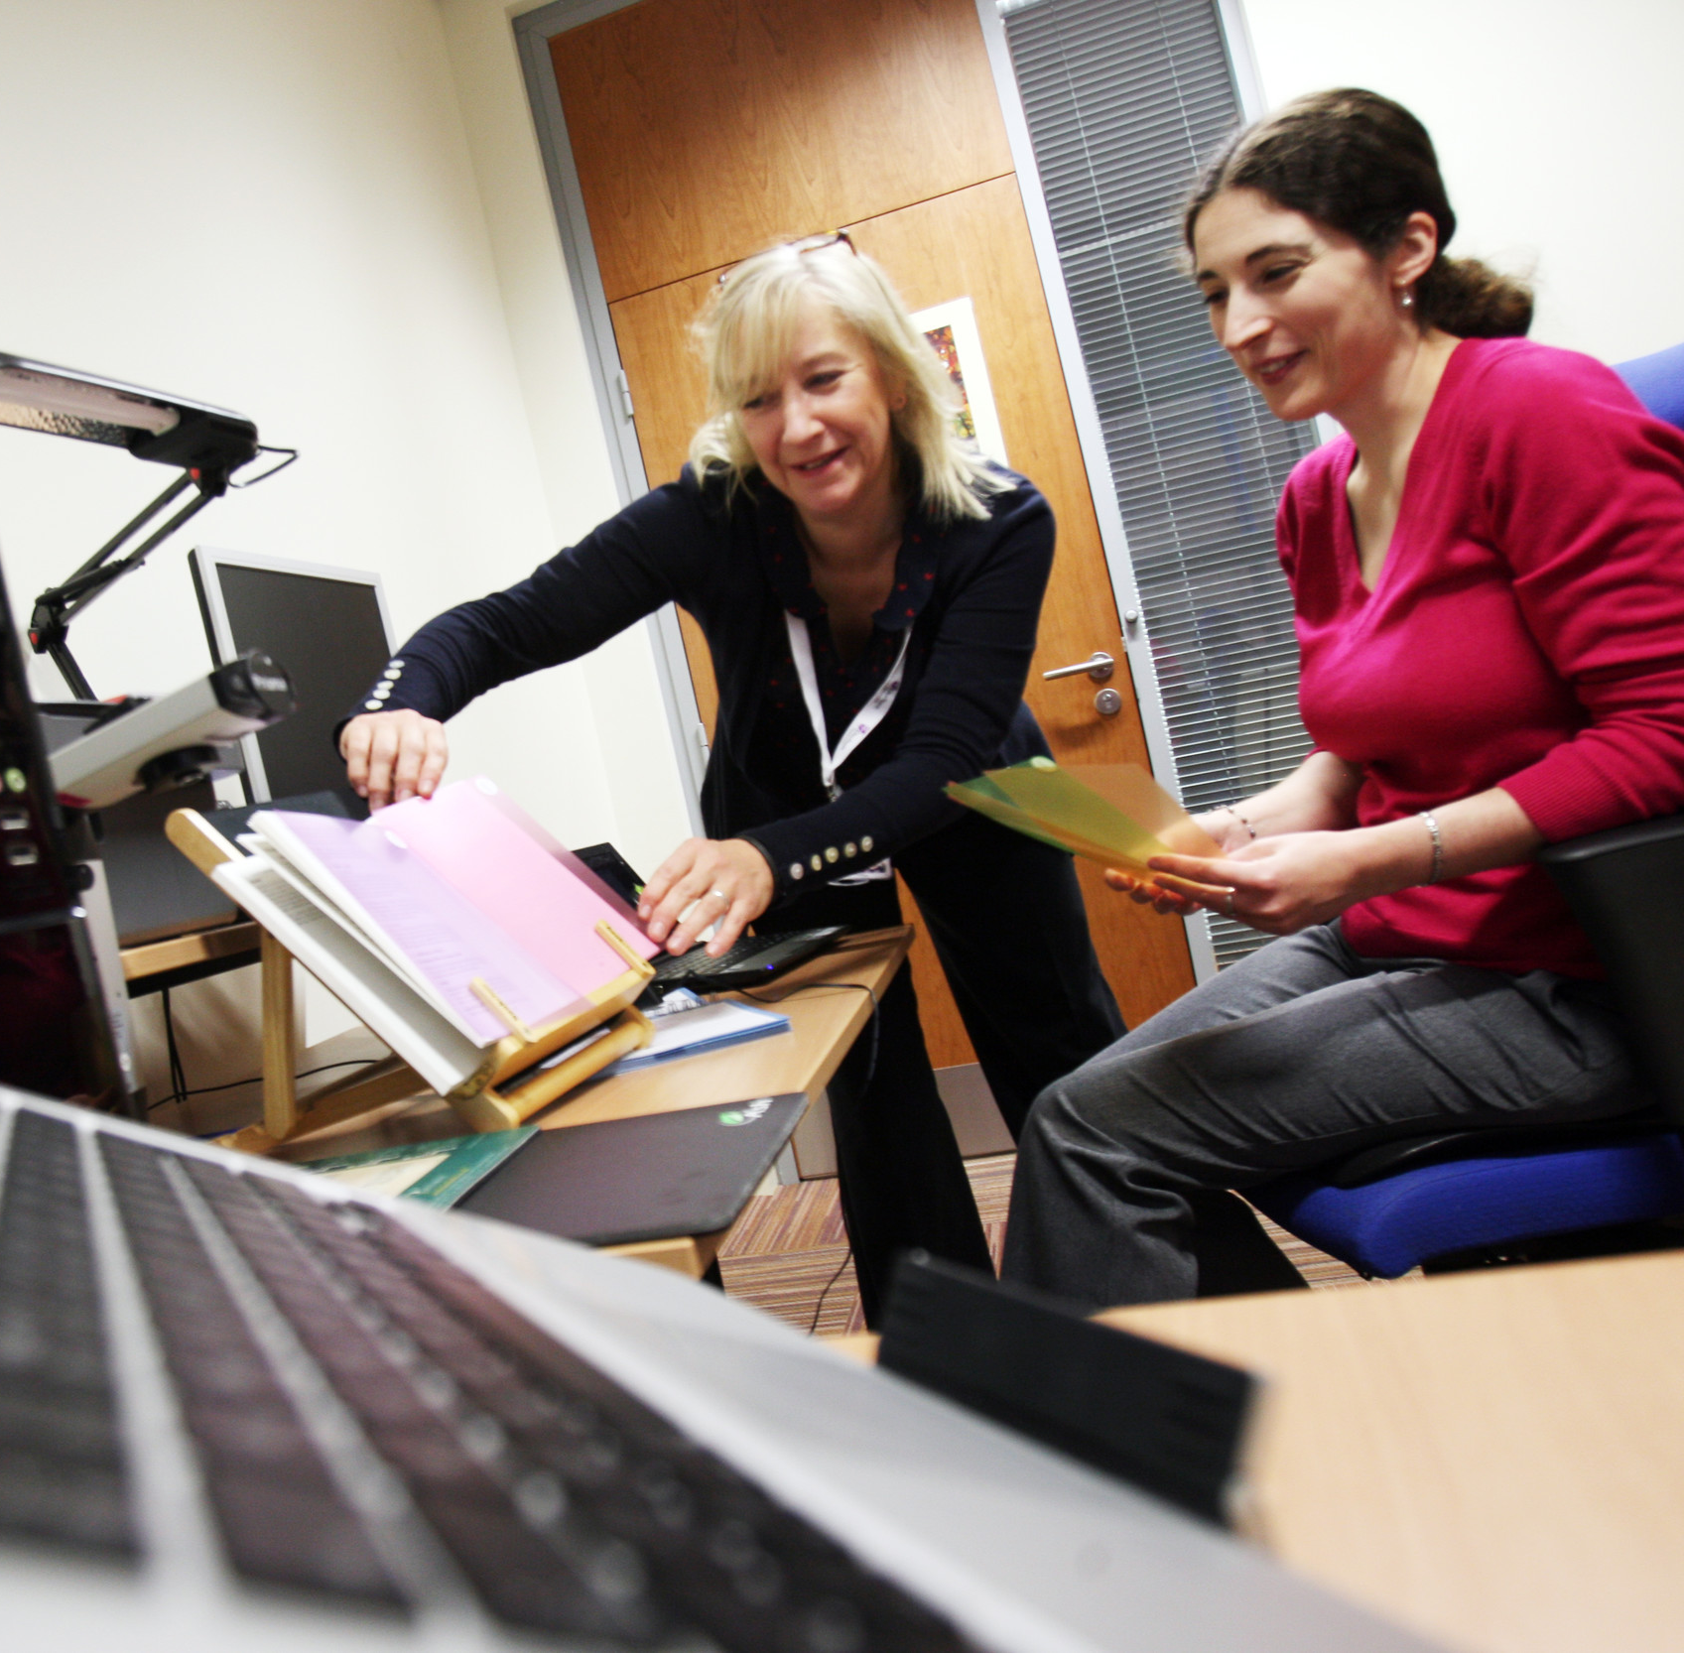
What did we find?
The accommodation model meant technology was tailored to students, but excluded students not in this ‘system’
Concern that technology might be replacing skills that ‘should’ be learned
DSO/Ms played a vital role in the push for supportive technology and UDL
DSO/Ms are keen to use UDL approaches with the range of technology available but struggle to get buy in across the organisation

Slide 9
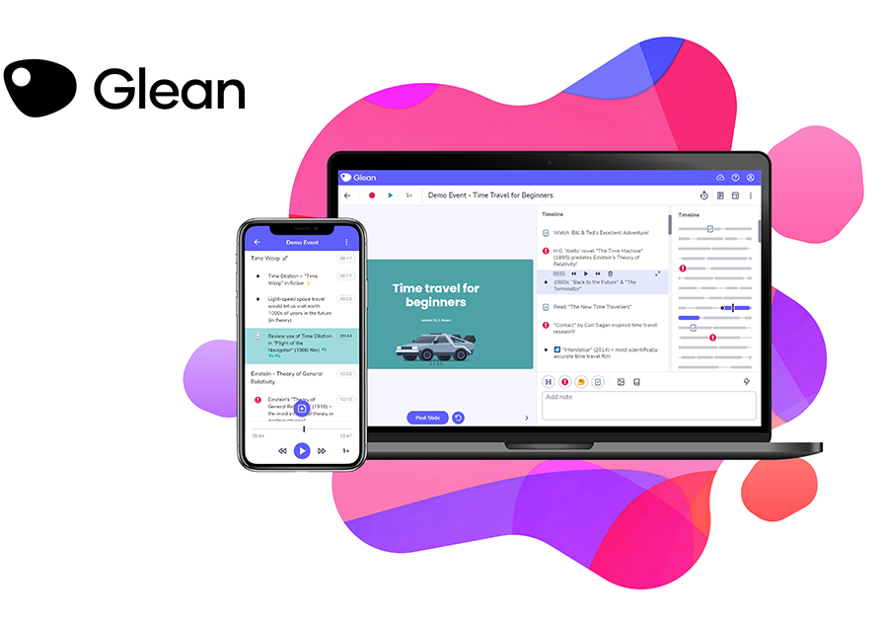
Access to effective technologies
The accommodation model means tailored support and training, but technologies are not always accessible to others due to cost
Top software recommendations included: readers, notetaking tools, recordings, text to speech/speech to text, and captions
Common software such as Microsoft office, Google Docs, webinar software, etc, have a range of accessibility features, but are not well known by students and academics

Slide 10
Is technology replacing ‘needed’ skills
Some concern that the use of tech removes the need to learn some skills
“…I think one of the barriers is how easy it is for students to access some of these assistive techs in terms of not having that engagement and it's difficult, because for some students it's really valuable. And then for others, they're not necessarily then building those skills. …having access to notes…means then never having to take their own notes. And I'm not sure how valuable that is for some students
Sometimes ‘need to learn’ can be ’professional gatekeeping’ by academics, for example the assumption that students need to do group work for their profession, but it’s not part of the learning outcomes

Slide 11
Advocating for students and their technology use
DSOs can also see where tech assistance or study skills assistance is needed when training students
“we have allocated what we call ‘assistive technology appointments’ where we'd look at what's the presenting issue… access or learning? …often it's note taking. So… are there assistive technology options to assist there, or is it more around skill development?”
DSOs can also recommend to an academic a UDL approach to tech or advocate for university-wide technology purchase and support
DSO/Ms (and accessibility/inclusion) are not always a part of discussions

Slide 12
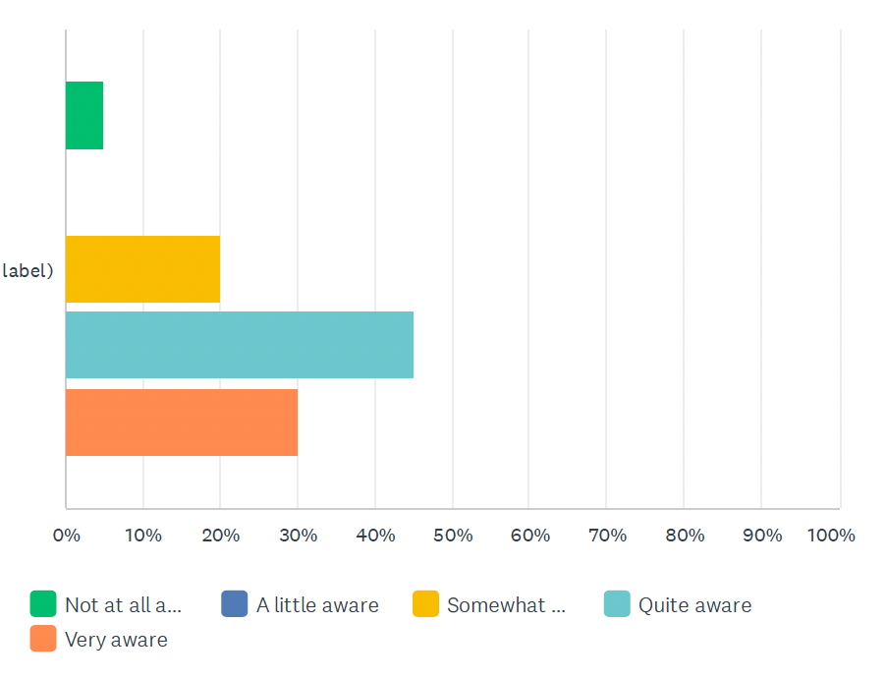
How aware of the principles of UDL are you?

Slide 13
To what extent do UDL principles guide your use of technology to help students with mental illness?

Slide 14
1. UDL and Tech for students with poor mental health
Technology can be very beneficial but support is necessary:
“We find discussion posts are the ones that students get most distressed about, because there is not a lot of guidance around what a discussion post needs to be… they are concerned about the peer feedback that happens with discussion posts. And …if we're working with students who may be socially anxious who worry about their communication skills they can often cause a lot of worry and concern for students.”
Tech that is used to ‘mix things up’ can be inadvertently inaccessible, and create barriers (such as group work or presentations)

Slide 15
2. UDL and Tech for students with poor mental health
Tech still has enormous potential for creative, accessible, inclusive, and UDL-aligned ways of helping these students
“Within the sort of teaching and learning space there’s sort of that, all that oral presentation aspect of it. And we know through the work that we do, that there's some really creative things you can do about that, you know, recordings, different ways to deliver information. And that's what we sort of encourage that sort of multi-mode style of expression.”
DSO/Ms work hard to be advocates for UDL and have very mixed results with individual academics and university administration

Slide 16
1. What next?
The strength of the accommodation model is the individual and tailored support that DSO/Ms provide, and what is learned here can inform approaches that could be achieved through a UDL model, but requires a great deal of advocacy work within the organisation
How to incorporate DSO/Ms knowledge, experiences, and that of their students into the decision making process in universities – UDL, technology acquisition and support, learning design, and student care.

Slide 17
2. What next?
What does “need to learn” mean? E.g., to what extent is note taking effective because of the cognitive work involved, and do automatic note taking tools mean it is less affective as a learning tool? At what point? When does an ‘accommodation’ (a UDL-informed one, or an individual one) remove a ‘needed’ cognitive load for learning?
Who decides someone ”can” or “should” learn a skill someone with poor mental health finds a struggle? Can – or should – a student with acute exam anxiety learn to sit exams? Who would teach this – is this a psychologist’s role, do academics need to scaffold “how to do exams” into their work, or is this learning design work? Why do we do this to cognitive disabilities and not physical disabilities?

Slide 18
What next? – AI…
This data was collected over 12 months ago – a lot has changed, but this was one comment:
“The use of AI technology, especially ChatGTP has been transformative for students with mental health challenges and ADHD, especially in writing emails to their lecturers or rephrasing assignment briefs in simple language as well as assisting in planning assignments. Our university's approach to these tools are to create awareness with students in the tool's limitations and ethics of use rather than a ban on its use as it does help students in surprising ways.”

Slide 19
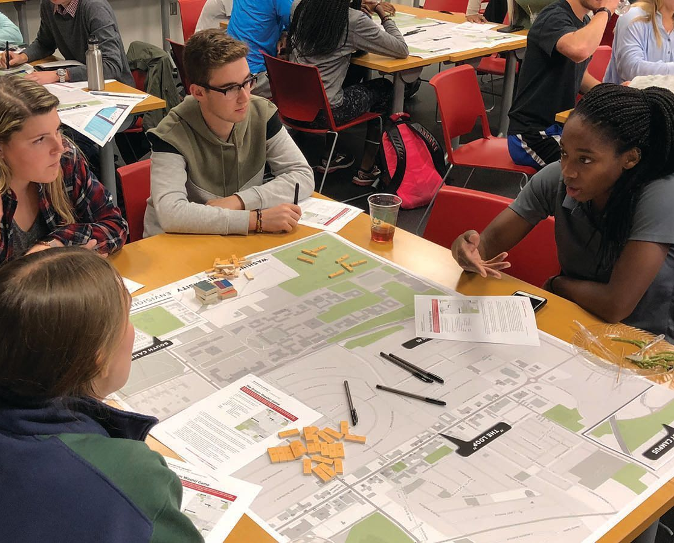
Back around that table!
“So I kind of feel like the way that we win is to get in early on things. And that's about relationships and being known and being seen as a competent team. So I think …that's kind of how I see that we influence UDL, and I suppose, you know, being around the table for conversations about many things helps to get a better outcome for our students."

Slide 20
Thank you
A huge thank you to the Disability / Accessibility / Inclusion Officers and Managers who participated in this study – and to those who did not but continue to support our precious and capable students throughout their studies.

