Slide 1





Breaking the Performative Façade
June 12, 2024
RMIT
Melbourne
Genuine Universal Design in Higher Education
Terra Starbird
Assistant Director
CIT
Bhavani Kannan
Educational Designer/Developer
UNSW at ADFA
Jen Xiang
Education Designer
UNSW

Slide 2

Acknowledgement of Country
We acknowledge, celebrate, and pay our respect to the Woi wurrung and Boon wurrun language groups of the eastern Kulin Nation on whose traditional lands we meet today.
We further extend that respect to all First Nations Australians whose cultures are among the oldest continuing cultures in human history.
We welcome the opportunity to share and learn from each other in valuing education for all.

Slide 3

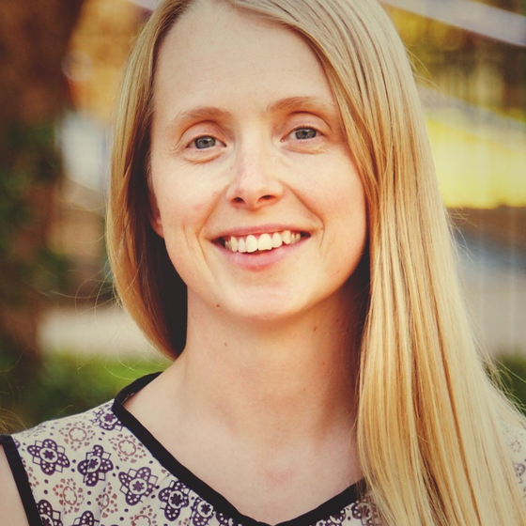
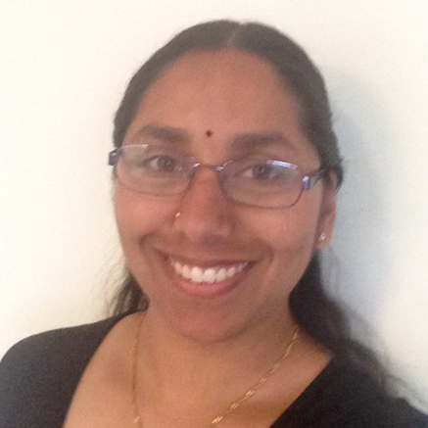
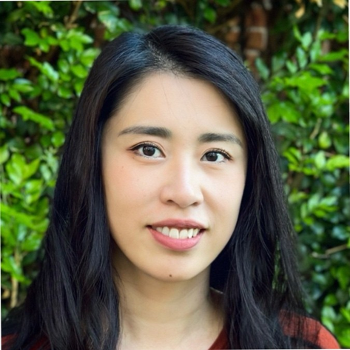
Facilitators
Terra Starbird
Bhavani Kannan
Jen Xiang
she/her
Assistant Director Workplace Inclusion
Canberra Institute of Technology
SFHEA
she/her, they/them
Educational Designer/Developer
ADFA at UNSW, Canberra
she/her
Education Designer
School of Clinical Medicine
UNSW, Sydney

Slide 4



Challenges of Performative UDL
“This is a weight that is bearing down on me; it is a pressure that I feel now every moment of my life – it frustrates me and drives me crazy; at night it is like a splinter in my mind. The solutions to the future, simple though I thought they were, have become harder and harder to grasp. I have learnt from experience that nothing is ever what it seems.”
- Yunupingu

Slide 5




Scenario
Universal Design for Learning has been identified as a key strategic area for development at your institution/university. As a result, senior leadership have drafted a plan for review to increase adoption of UDL principles across all domains.
Join one working group focusing on a specific stakeholder within your institution.
Faculty
Students
Executive
Industry and Community

Slide 6
Activity 1
Scenario: Universal Design for Learning has been identified as a key strategic focus area for your institution/university. As a result, senior leadership have drafted a plan to increase adoption of UDL principles across all domains.
As a group, review and discuss the suggested actions/initiatives.
Task: Determine which are performative UDL, which are genuine UDL, and why.

Slide 7


Activity 2
Task: Select one initiative that the working group deemed performative UDL.
Develop strategies to persuade Senior Management:
  That it is performative UDL; and
  Why a genuine UDL initiative would be better.

Slide 8


Key Take Aways
  Performative UDL is often detrimental
  Genuine UDL is measurable and meaningful
  Consultative, co-design practice
  Students as partners
  Executive and leadership buy-in is essential
  Continue to advocate - understand that setbacks are institutional rather than personal

Slide 9




New UDL Policy
Employers have a positive duty to take reasonable and proportionate measures to eliminate relevant unlawful conduct

Slide 10

Resources
01 | https://www.humanrights.vic.gov.au/for-organisations/positive-duty/
02 | https://www.education.gov.au/disability-standards-education-2005
03 | https://www.adcet.edu.au/resource/11654/file/1/Ableism%20in%20the%20Universities%20Accord_Joint%20Submission_Final.pdf

Slide 11

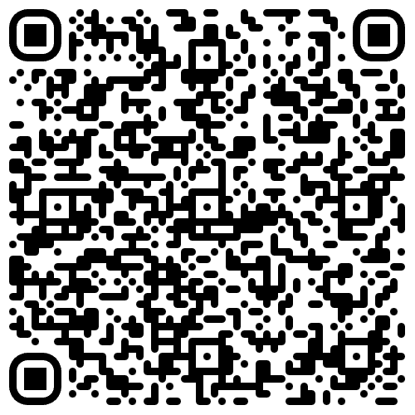


Feedback

Slide 12

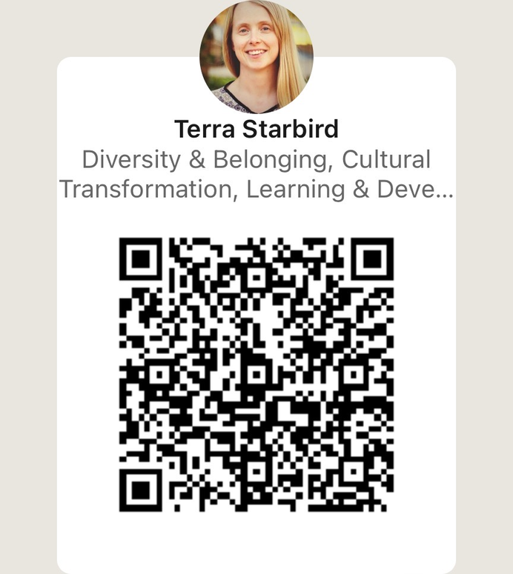
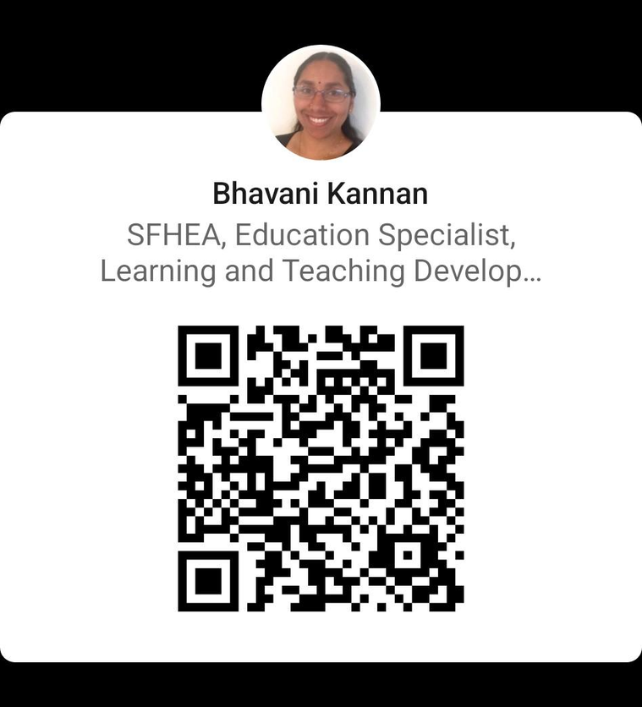
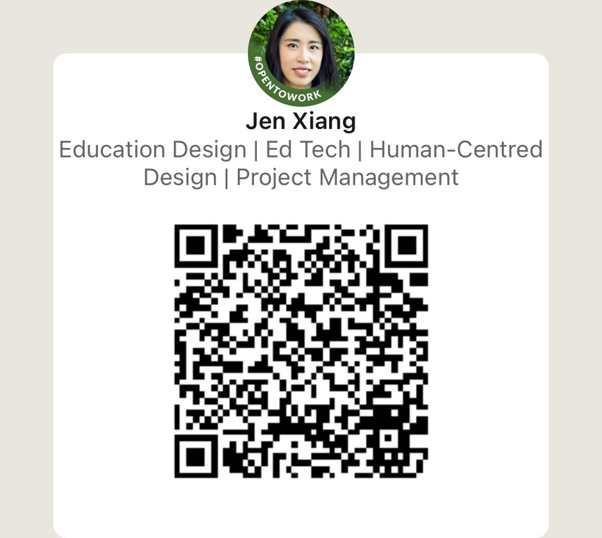
Connect with us

