Slide 1
UDL Strategies for Inclusive Animation
Dianne Herft
June 2024

Slide 2
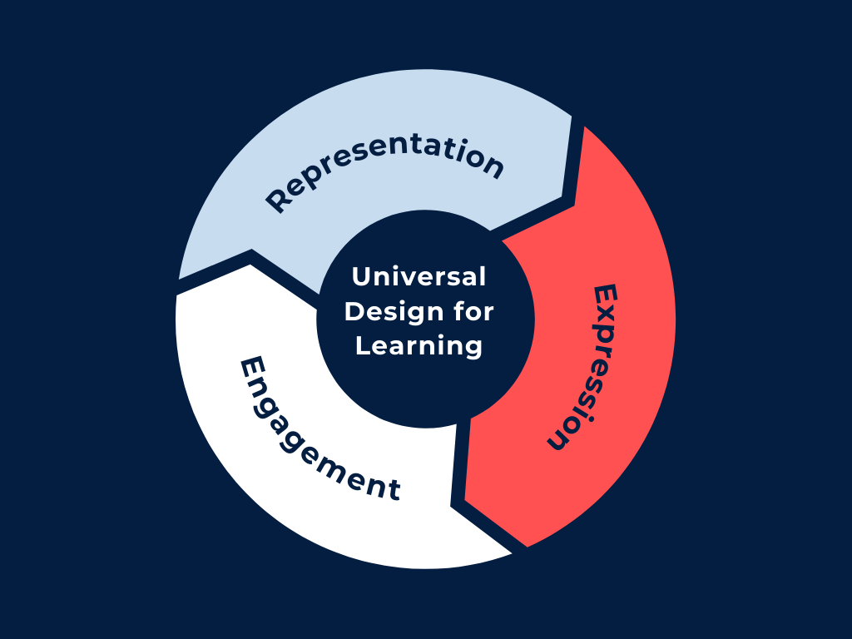
Introduction to UDL and Animation
What is UDL? Universal Design for Learning (UDL) is founded on the idea that education should be adaptable to accommodate the diverse needs and strengths of different learners.
Importance of Inclusivity and Accessibility Ensures all learners, regardless of their abilities, can access and benefit from educational content.
Role of Animation - Engages students, makes learning interactive and dynamic. Can be tailored to meet diverse learning needs.

Slide 3
Starting the Journey
Personal motivation - I excelled in my studies only after discovering an alternative learning method that differed from conventional approaches. This realization inspired me to help others learn in unique ways, empowering them to achieve their best.
Initial Steps
Researching UDL principles.
Participate in training on accessibility standards by joining workshops
Beginning with initial projects that incorporate UDL with the support of our central team

Slide 4
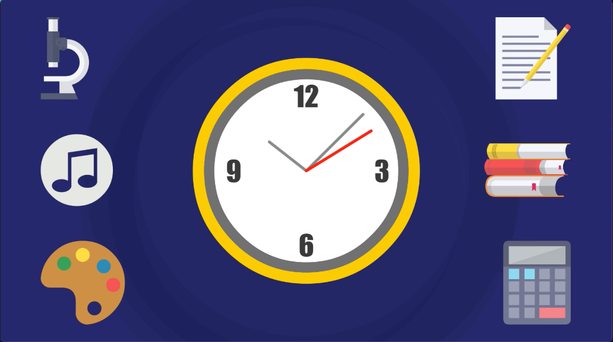
Choosing Accessible Colour Palettes
Principles for Selection
Ensuring sufficient colour contrast is crucial for accessibility.
Avoiding reliance on colour alone to convey information.
Choose colours supposed to be more conducive to learning.
Incorporating Visual Cues
Use of patterns and symbols
alongside colour.

Slide 5
Enhancing Visual Accessibility
Importance of Colour Contrast
Key for individuals with visual impairments.
Helps all learners to better distinguish content.
Before
After

Slide 6
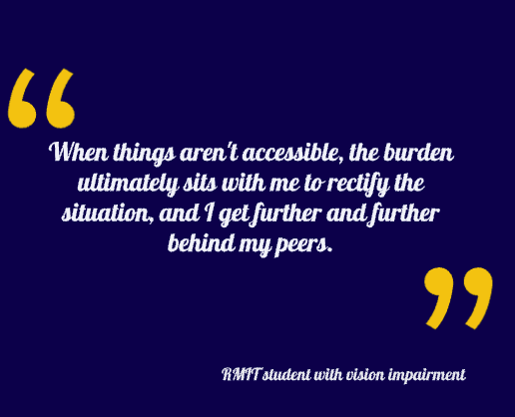
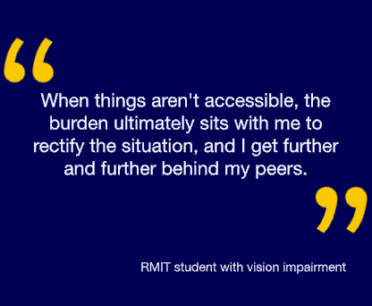
Improving Text Readability
Use of Fonts- Clear fonts that enhance readability.
Spacing - Adequate spacing between characters and lines to improve comprehension.
Benefits - Aids learners with various visual abilities and reading preferences, including dyslexia.
Poor legibility
Good legibility

Slide 7
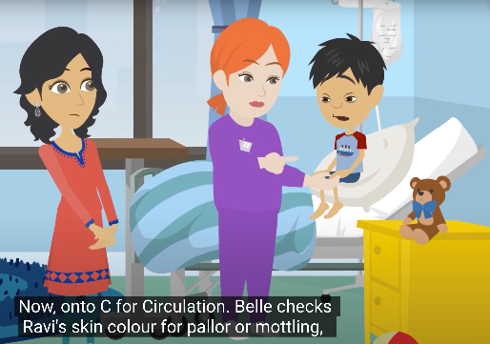
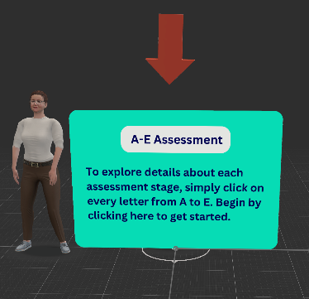
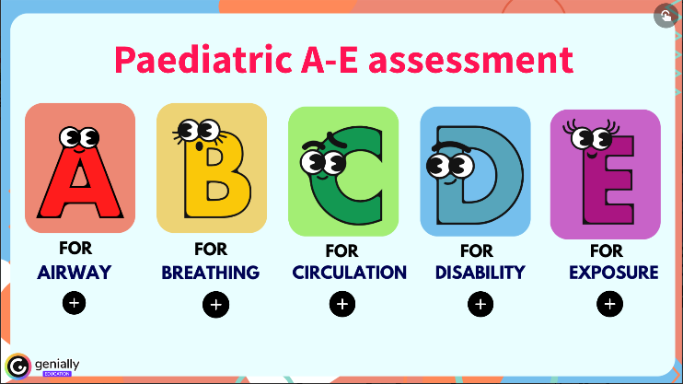
Providing Multiple Learning Alternatives
Importance of Multiple Formats - Ensures all students can access and engage with learning materials in ways that suit their individual needs.
Comprehensive Transcripts and Captions - both accompany each animation, making auditory content accessible to students with hearing impairments.
Interactive Alternatives - Incorporate interactive elements such as quizzes, simulations, and interactive diagrams to cater to different learning styles.
Benefits- Facilitates deeper understanding, caters to varied learning preferences, and promotes an inclusive learning environment.

Slide 8
Empowering Education: Access for all in collaboration with Dr. Ronny Andrade Parra, Jacinta Jones-O'Meara and Teresa Dowding

Slide 9
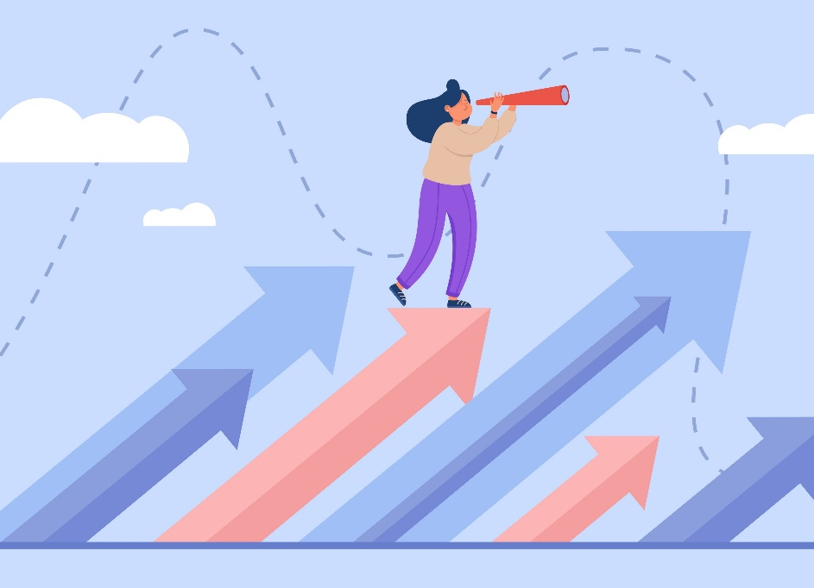
Conclusion and Future Directions
Summary of Key Points
Integrating UDL principles into animation creation.
Steps taken to enhance accessibility and inclusivity.
Future Plans
Ongoing efforts to improve and expand on current practices.
Future projects and areas
of exploration.

