Slide 1

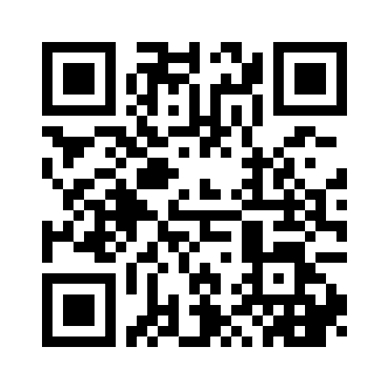
Rhetorical Storytelling and UDL:
How are you feeling today?
Leveraging Narratives for Systemic Change
www.menti.com 7642 8834
Ella Collins-White
Educational Innovation

Slide 2
Acknowledgment
As we begin, I would like to acknowledge and pay respect to the Woi wurrung and Boon wurrung language groups of the eastern Kulin Nation on whose unceded lands we meet today.
I would also like to acknowledge the land on which I live and work, the land of the Gadigal of the Eora Nation. I pay respect to their Elders past and present, and to any First Nations people in attendance.
As we share our own knowledge, teaching, learning and research practices within this space may we also pay respect to the knowledge embedded forever within the Aboriginal Custodianship of Country.

Slide 3
Outline
Why create a case study?
How to create a case study: share and scaffold (15 minutes)
Think: Time given to individuals to think through and/or finesse ideas for what might be a useful case study for your context (5 minutes)
Discuss: Participants will then be placed in breakout rooms to work in groups together on challenges and to share their ideas (20 minutes)
Pitch: Participants will be given the option to pitch in the workshop and receive feedback (15 minutes)

Slide 4

Why create a case study?
Barriers to UDL implementation are often discussed as…
Lack of confidence in UDL
Misunderstanding of impact of UDL
Time constraints and perceived complexity of implementing UDL
“I think that when people feel busy they are reluctant to change because change takes thought and effort. With more understanding of some of the techniques that can be used [in UDL], and even relatively small changes that can have a big impact.”
Hills, M., Overend, A., & Hildebrandt, S. (2022). Faculty Perspectives on UDL: Exploring Bridges and Barriers for Broader Adoption in Higher Education. The Canadian Journal for the Scholarship of Teaching and Learning, 13(1). https://doi.org/10.5206/cjsotlrcacea.2022.1.13588

Slide 5
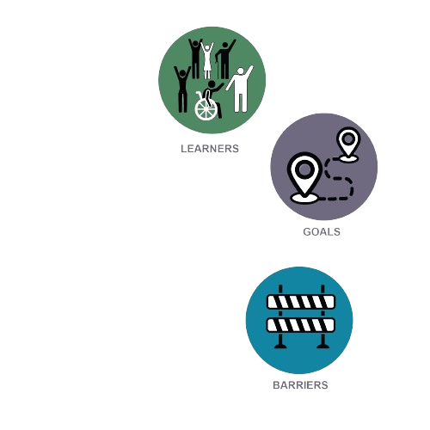
Creating a case study
Establish background and context
Who are our learners? What are their challenges, goals and barriers?

Slide 6
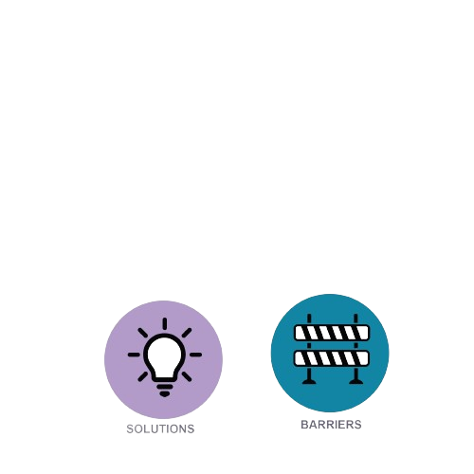
Creating a case study
Explain the process
How did we explore these barriers? What data, knowledge or experience did we draw on? What changes and solutions did we use in this context?

Slide 7
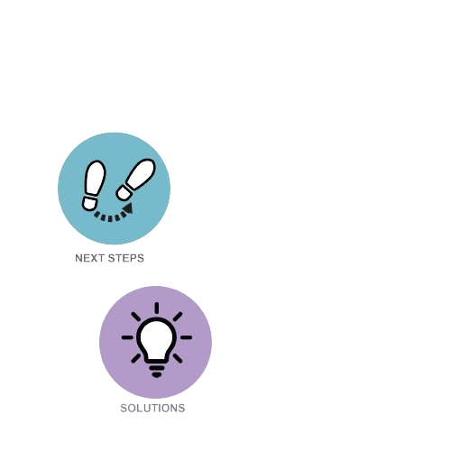
Creating a case study
Describe the outcome and impact
What impact did these changes have? How did it support, challenge, or innovate our learning environment in ways that support our learners?
What our our next steps? How can we evaluate and iterate?

Slide 8
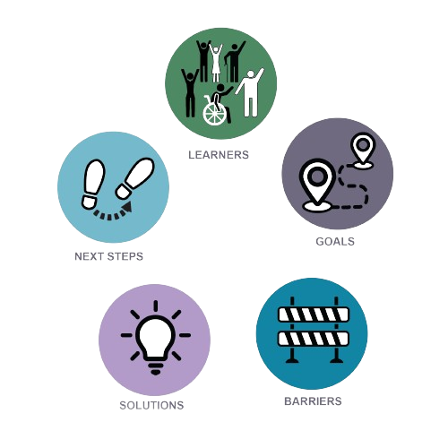
Creating a case study
Establish background and context
Who are our learners? What are their challenges, goals and barriers?
Explain the process
How did we explore these barriers? What data, knowledge or experience did we draw on? What changes and solutions did we use in this context?
Describe the outcome and impact
What impact did these changes have? How did it support, challenge, or innovate our learning environment in ways that support our learners?
What our our next steps?

Slide 9
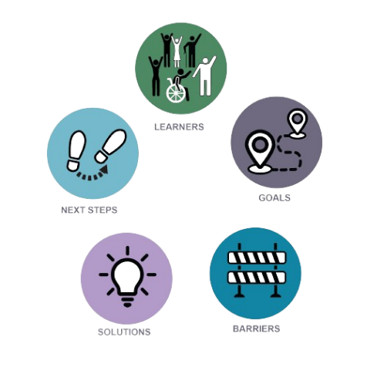
Home Hub: a case study in progress
Background and context
Learners: first year students in exercise science
Goals: to foster belonging and connection to their course, the university and to their peers, teachers and community
Barriers: being new to university, unsure what to expect or how to succeed.

Slide 10
Process
Drawing on the expertise of unit coordinators who had taught the unit before, we challenged our assumptions about what students needed by partnering with past students to reshape the teaching material for the course. Together the students and teachers worked on identifying pain-points throughout the semester, reimagining how their challenges might be met.

Slide 11
Process
Drawing on the expertise of unit coordinators who had taught the unit before, we challenged our assumptions about what students needed by partnering with past students to reshape the teaching material for the course. Together the students and teachers worked on identifying pain-points throughout the semester, reimagining how their challenges might be met.
reconsidered – what is my goal for this case study? Which story am I trying to tell and why?

Slide 12
Process
Solution: Drawing on the expertise of unit coordinators who had taught the unit before and data drawn from across our first-year units, we recognised that belonging was a key challenge to success at university. Drawing on this research we changed the model of learning in 3 significant ways:
Tutors took only 1 class through the semester
Tutors were given specific time and instruction to cultivate relationships with students, both in-class and outside of class
A “peer-tutor” was employed to co-teach with main tutor for 4 tutorials throughout the semester

Slide 13
Outcome
The teaching team observed that fostering a space where students felt they belonged had significant impact on attendance, peer to peer interaction and connection with tutors.
Students reported that these changes supported both them as individuals and as learners in their new context of university.

Slide 14
Students are telling us…
“The tutor classes have been far more intimate, with the ability for staff and students to learn each others names and to help exactly what I need. This relational style has made it easier to learn, and enabled me to learn in ways that support my abilities.”
“I have really enjoyed being in a smaller tutorial group with the same tutor, it has allowed me to form a good relationship and feel comfortable in my environment and therefore have a sense of belonging as I am respected”
“great teacher-student relationships and made me feel comfortable and excited to go to uni.”
“Through these classes and the support staff I have felt a better sense of belonging as they have been able to help me through the nuances of uni life.”

Slide 15
Your turn…
Think (5 minutes)
Take some time to individually think through and refine your ideas for a useful case study that applies to your specific context. Consider the following questions:
What are the key challenges or opportunities in your context?
How can a case study highlight these aspects?
What information and examples will be most impactful?
Discuss (20 minutes)
You will be placed in groups. During this time:
Share your initial ideas with your group.
Discuss the challenges and opportunities each of you has identified.
Provide feedback and suggestions to help each other improve your case study ideas.
Work together to refine your concepts and develop a more detailed outline.
Pitch (15 minutes)
You have the option to pitch your refined case study idea to the larger workshop group. During your pitch:
Present the key points of your case study.
Explain the context, challenges, and potential solutions or insights your case study offers.
Receive feedback from the group to further refine and improve your case study.

Slide 16

Connect with us!
Further questions or ideas? Please get in touch with us!
ella.collins-white@sydney.edu.au
samantha.poulos@sydney.edu.au
sarah.humphreys@sydney.edu.au

