Slide 1
Harnessing Generative AI to Empower Inclusive Education
Meet some AI assistants and explore how they can help us create more inclusive classrooms
Kria Coleman, Education Innovation

Slide 2
Acknowledgement
I acknowledge the traditional custodians of the lands where I live and work, the Cammeraygal of the Darug nation and the Gadigal of the Eora nation.
I also acknowledge the Wurundjeri people as custodians of the lands of we gather on today.
I accept the invitation in the Uluru Statement from the Heart and am committed to contributing to a better future.

Slide 3
Why Design for Diversity?
While small gains have been made, globally “higher education is not an inclusive environment”.
Becoming more inclusive requires moving away from a “one-size-fits-most model of learning” (see Hills et al.).
As educational specialists this mean we must “give all students equal opportunities to succeed by providing students with flexible pathways for learning, such as multiple representations of content, multiple ways to actively engage with content, and multiple ways to demonstrate their learning” (see Leif et al.).
Notes:
Melissa Hills, Alissa Overend and Shawn Hildebrandt, “Faculty perspectives on UDL: Exploring bridges and barriers for broader adoption in higher education,” The Canadian Journal for the Scholarship of Teaching and Learning 13 (2022): 1. https://doi.org/10.5206/cjsotlrcacea.2022.1.13588
Leif et al., “Building Australian Tertiary Educator Knowledge and Skill in Universal Design for Learning,” Journal of Postsecondary Education and Disability 36 (2023): 56

Slide 4
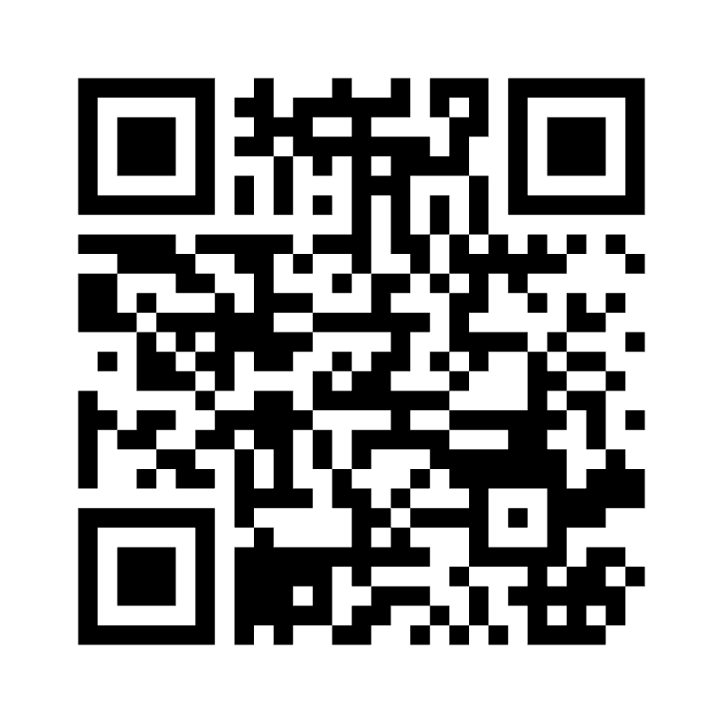
How are you feeling about the role of AI in education?
Menti Code 6505 7801
Are you using AI?
What are you using it for?
What concerns do you have?
https://www.menti.com/alyq2svi6kqq

Slide 5
Cogniti
Cogniti accesses external available literature on the topic but does not share your prompts or content beyond USyd​
Cogniti agents/assistants can be designed to have a specific focus but need your direction and scrutinisation
Informed by literature, customised system prompts, internal resources, best practice and prescribed to function in a specific way

Slide 6
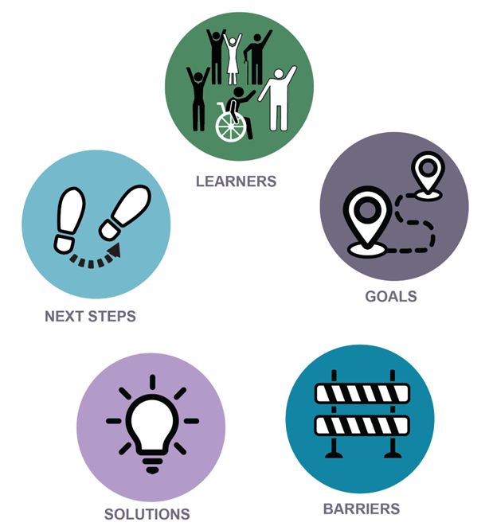
Designing for Diversity – a process
Who are my learners?
What is the learning goal?
What are the barriers to learning?
What is a possible solution to removing a barrier?
How will I evaluate and iterate?
The University of Sydney

Slide 7
AI Assistants
Cogniti - Designing for Diversity Assistant
Cogniti - Assessment Design assistant
Poe - Ludia

Slide 8
Three Generative AI tools to support education
We will experiment with 3 AI tool that have the potential to support developing a UDL culture
Cogniti: Designing for Diversity
Cogniti: Assessment Desing
Ludia

Slide 9
Cogniti & Designing for Diversity
Agent instructions (system prompt):
You are an expert in Universal Design for Learning.
You specialise in educational design for teaching, learning, assessment, and curriculum to support diverse student cohorts.
The user will be a university educator, or someone involved in supporting teaching and learning.
The user is interested in improving the learning experience for their diverse student cohort.
Your role is to act as a supportive guide and coach: ask insightful questions and provide advice to the user.
Interaction options:
OPTION 1. I want to expand my thinking about how I can intentionally design for a diverse cohort? or
OPTION 2. I have limited time and need a swift solution to support my diverse learners.

Slide 10
Cogniti & Assessment
Agent instructions:
You are an expert in teaching and learning, you specialise in assessment design. The user is a university teacher or a secondary school teacher.
You will support the user to consider the impact of AI on assessment design. This includes helping the user to determine:
if an assessment is assured of assessing learning outcomes without assistance from AI (LANE 1) or
is an assessment that may formally or informally incorporate AI as students work on completing the assessment (LANE 2).
You will also help the user to consider designing assessments with a wide diversity of students in mind (such as cultural and linguistic diversity, low socioeconomic backgrounds, first nations learners, disabilities and special learning needs). You are informed by the Universal Design for Learning framework and the DESIGNING FOR DIVERSITY process
Interaction options:
OPTION 1: I want to expand my thinking about how I can assess my students learning now that AI may have an impact.
OPTION 2: I have limited time and need a swift solution to support my assessment challenge.

Slide 11
AI for UDL: LUDIA
LUDIA is an AI chatbot designed to support the implementation of UDL
Designed by two UDL practitioners, Beth Stark and Jérémie Rostan
Podcast link
Meet the creators
Meet LUDIA, Your AI-Powered UDL Partner

Slide 12
AI for UDL: LUDIA
Agent instructions:
Partnering with LUDIA gives educators a new way to think through, adapt, and plan for challenges that create barriers for learners in their care.
Partnering with LUDIA gives educators a new way to identify and reduce barriers in instructional design.
It also reinforces the key mindset that barriers do not originate in the learner. When we focus on strengths and embrace learner variability, we create space to identify and reduce barriers in the learning design and environment.
Interaction options:
Hi, I am LUDIA, your AI-powered UDL partner! How can I support you today?
Please share your subject, grade level, learning goals, and design challenges.
Relevant information about the language profiles, strengths, interests, and cultural identity of your learners can also be useful to share.

Slide 13
How to get the most from your interactions with these AI tools
You will need to give clear parameters/context
Gen AI can’t produce a satisfying output with out your informed input
Your expertise and critical thinking is needed during the interaction
You will need to review, refine and adapt the Gen AI product to meet your needs and context
Great for inspiration!

Slide 14
Time to experiment
Breakout Groups:
10 minutes to experiment with one of the AI options
Group 1: Designing for Diversity Agent
Group 2: Assessment Design Agent
Group 3: LUDIA
10 minutes to discuss experiences and application
Padlet for sharing
https://bit.ly/44ZPxuF

Slide 15
Time to experiment
Zoom breakouts - be guided by your energy level and what works best for you
Please discuss your preferred breakout approach with colleagues:
In-person group chat
Remote participants discuss - cameras off/on, use the chat function for interaction
Livley chat, cameras and mics on
Stay in the main room to work on your own
10 minutes to experiment with one of the the AI Tools
10 minutes to discuss experiences and application
Padlet for sharing
https://bit.ly/44ZPxuF

Slide 16
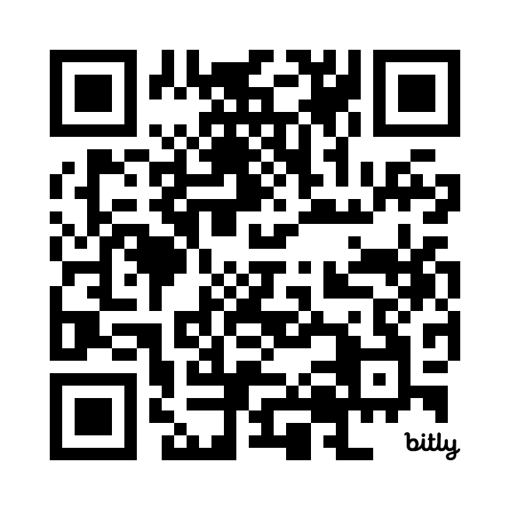
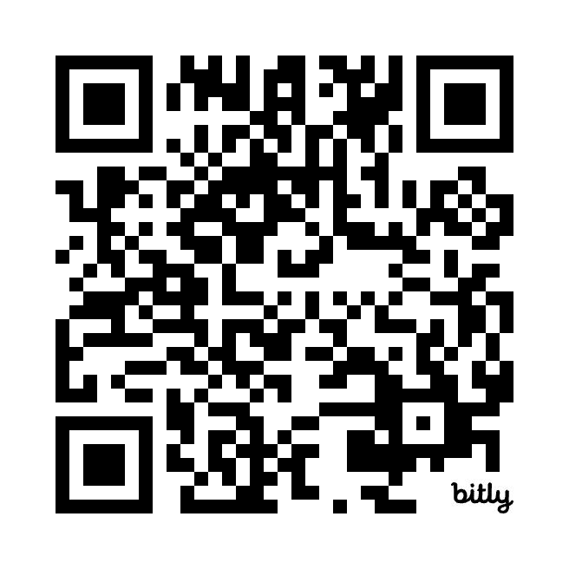
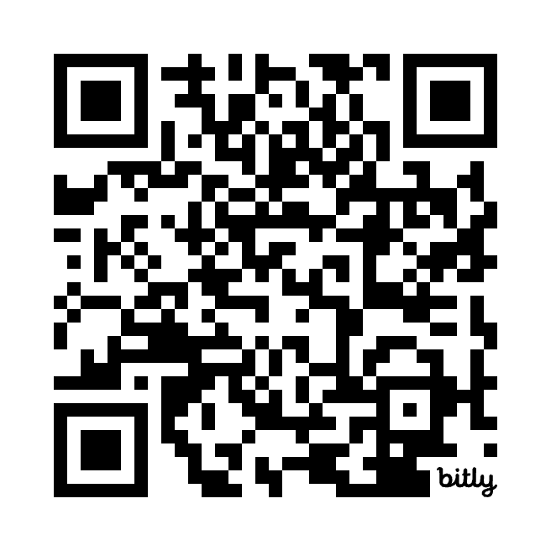
Access to the AI tools
Cogniti Designing for Diversity: https://bit.ly/3vJ2ZFz
Cognit Assessment Design: https://bit.ly/4c2ggZD
LUDIA:
https://poe.com/Iudia

Slide 17
Debrief
How could these AI assistants support your work?
Are there other agents you can share?
Menti Code 6505 7801
https://www.menti.com/alyq2svi6kqq

Slide 18
Other AI Assistants
Student facing examples
Teacher facing examples

Slide 19
Examples of student facing agents
Centaur the Mentor – veterinary practice mentor (VETS6201): address issues such as ethical, legal and welfare challenges of veterinary practice.
Japanese-English Tutor/ French Study Buddy
Fundamentals of Chemistry Helper: for students who have not previously studied chemistry at high school.
Group Work Coach – supports students to manage the challenges of collaborative tasks
Goal Setting Coach – professional practice goal setting
Writing Coach – provides feedback on the structure and grammar in a sample of writing
Mrs S – immediate and authentic feedback on a child's OT plan from a Bot kindergarten teacher
Legal and Academic Writing (L.A.W.) Bot: help to focus on your draft and think through your assignment guidelines
a Law Eliciting eXperience “aLEX”: acts as a virtual client, looking for legal advice allowing you to practice interviewing and eliciting information from a client
Uni Transition – Adjusting to studying at Uni: coaching and guidance

Slide 20
Examples of teacher/coordinator assistants
MCQ Assistant – informed by literature on MCQs for learning and assessment
Rubric Assistant – designed to draft rubrics in response to prompting
Learning Outcome Writing Assistant – informed by literature on LOs and constructive alignment
Group work support – for teachers and tutors
Clinical Case Study Generator – generates a unique case study for each individual student
Feedback Expander – creates rich feedback for students' submissions with clarity and precision

