Slide 1
Practical applications of accessible and diverse UDL techniques
AJ Penrose, Multimedia Developer Digital Learning, RMIT University Library

Slide 2
Acknowledgement of Country

Slide 3
In this session: our approach to UDL
The IDEA Framework
Launch before it’s ready
Continuous improvement
Staying current
Testing
Understanding the audience
Knowledge sharing
Photo by Matt Walsh on Unsplash

Slide 4
RMIT IDEA Framework Quote
“RMIT knows that when a system is built with inclusion in mind, enabling practices become the norm, and fewer barriers impede a person's agency and ability to thrive.”
RMIT IDEA Framework

Slide 5
RMIT University Library Quote 2
We “uphold the IDEA framework principles for inclusion, diversity, equity and access of all services, resources and spaces for all RMIT staff and students.”
RMIT University Library

Slide 6
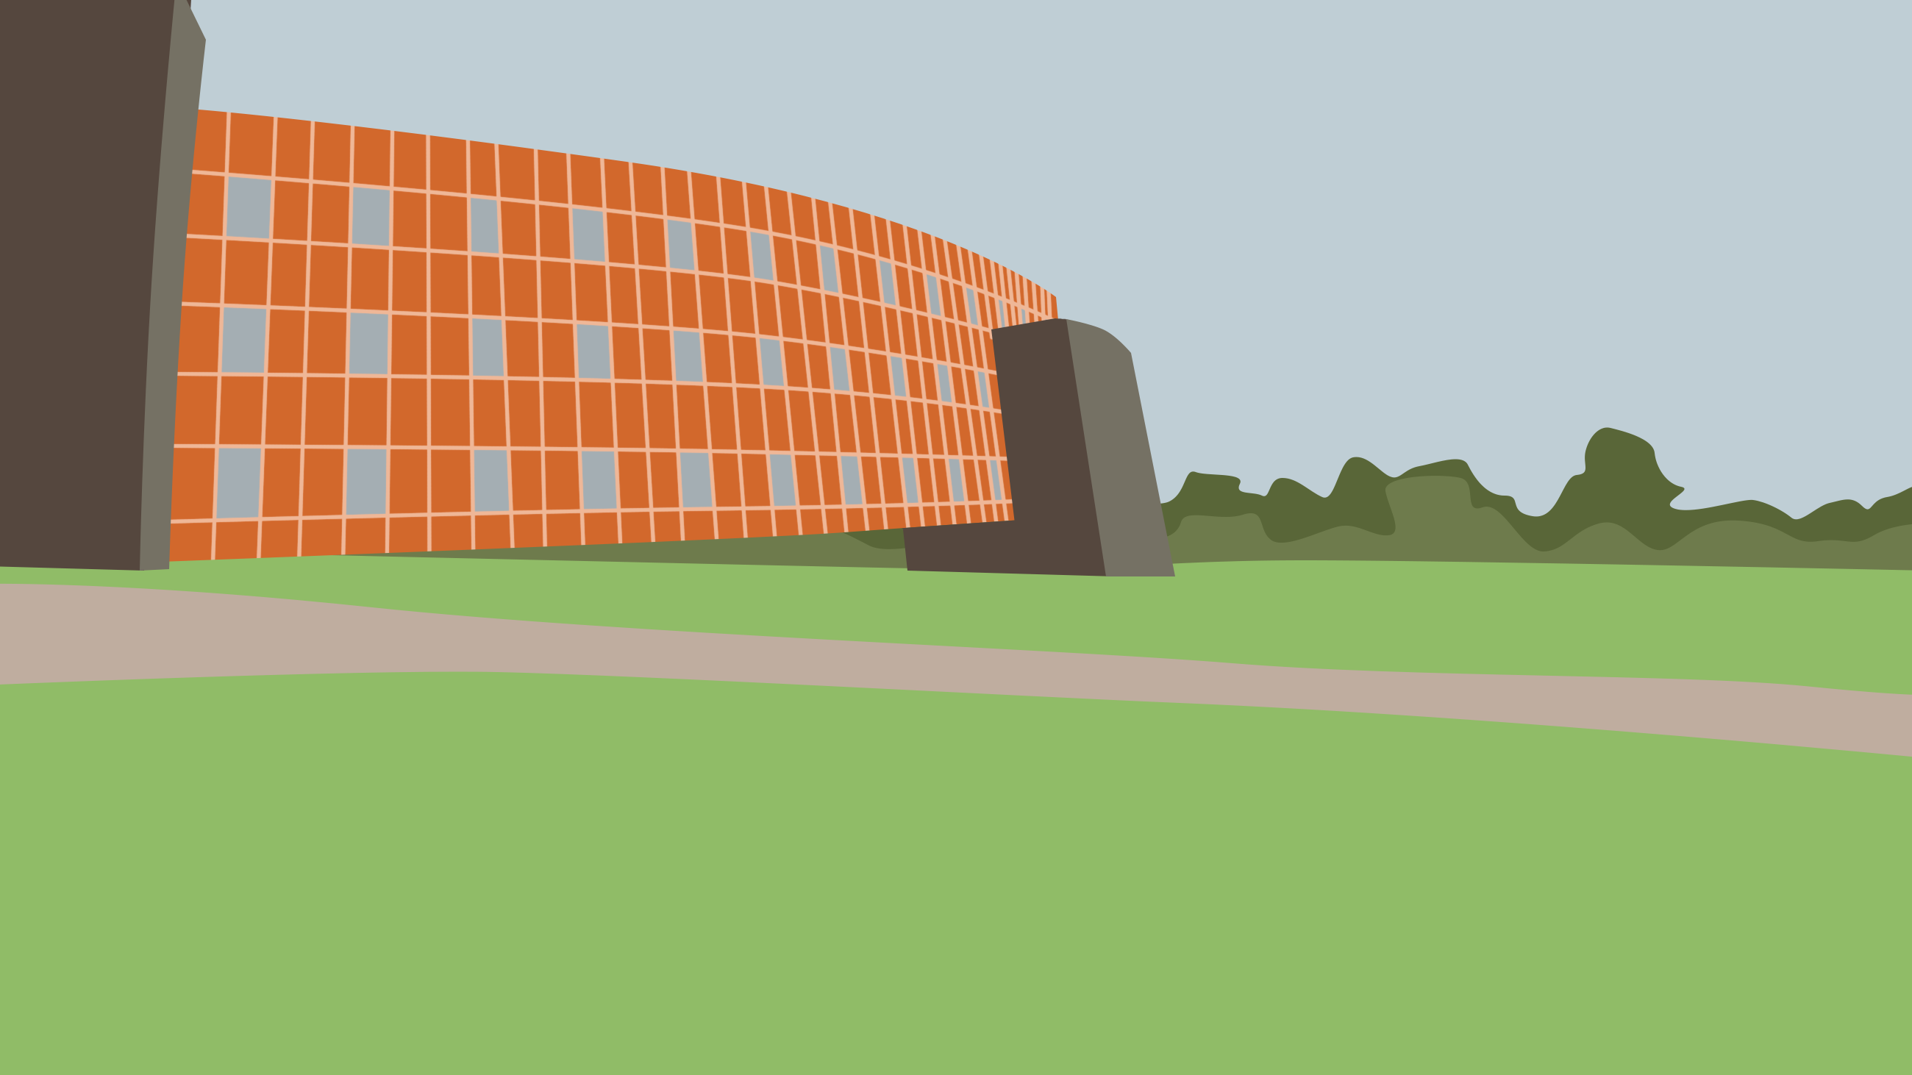
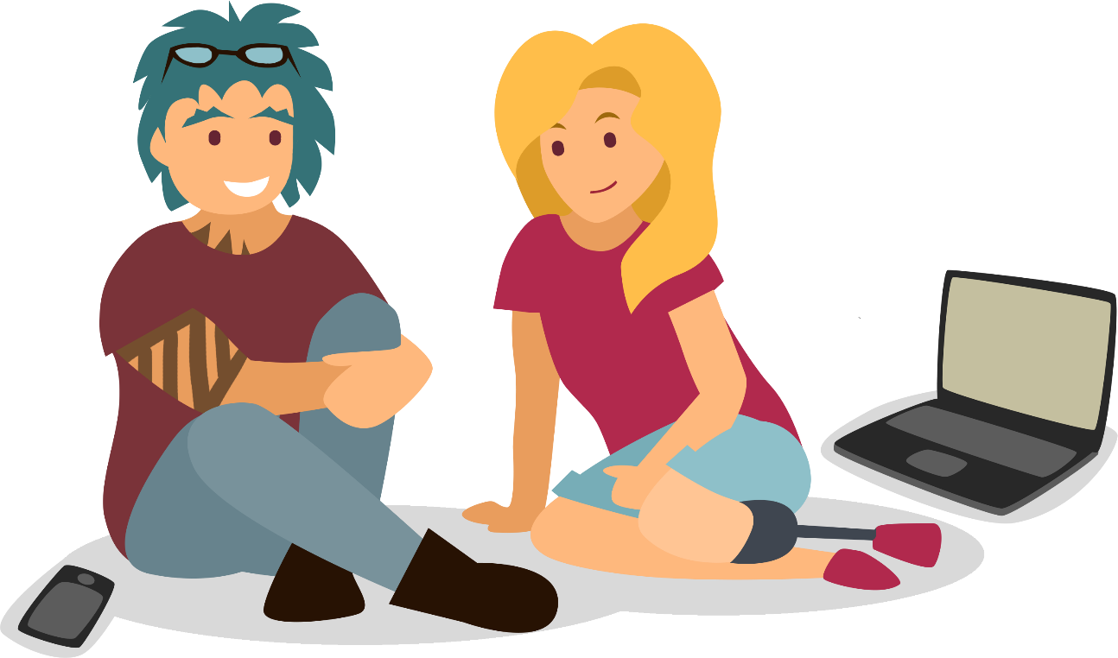
Representation

Slide 7
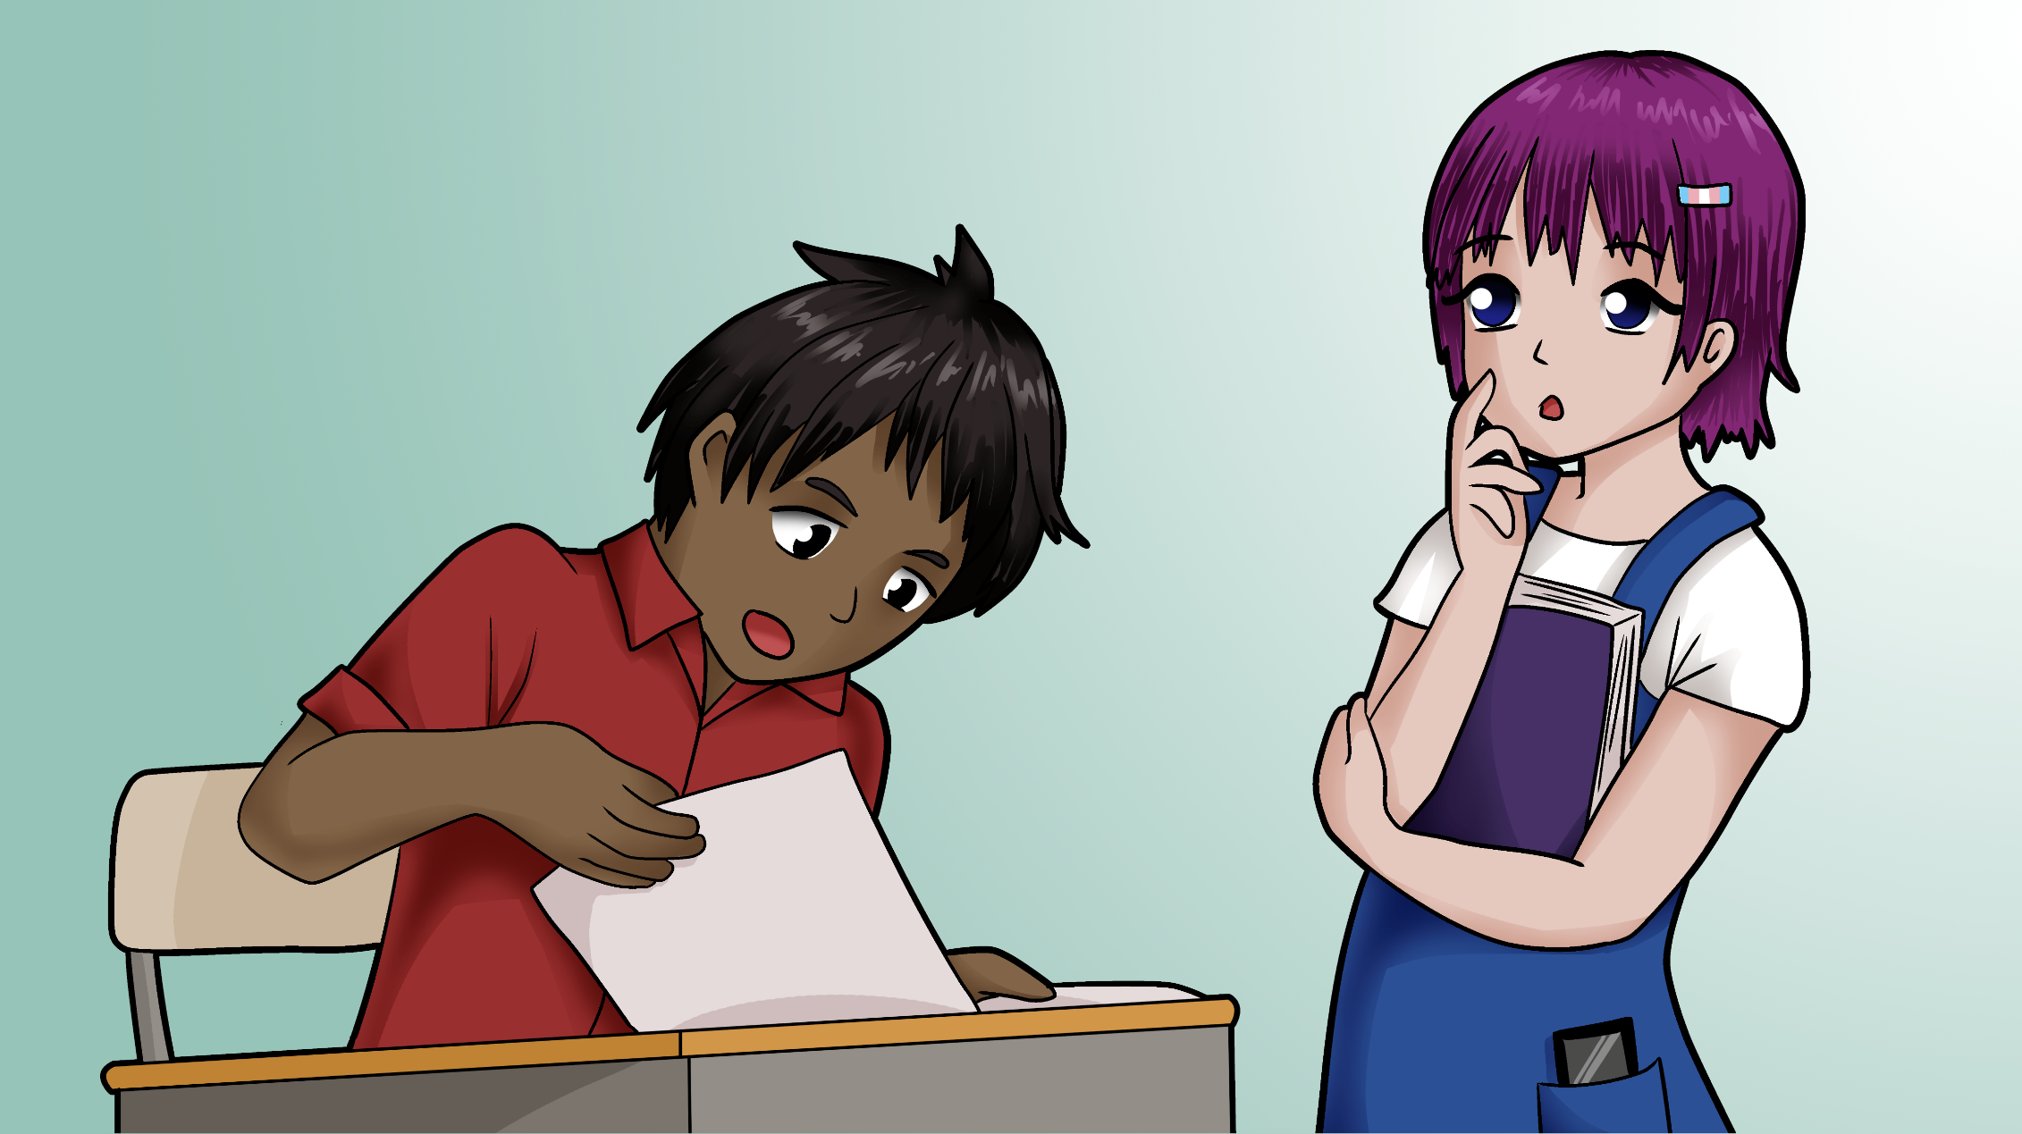
Representation 2

Slide 8
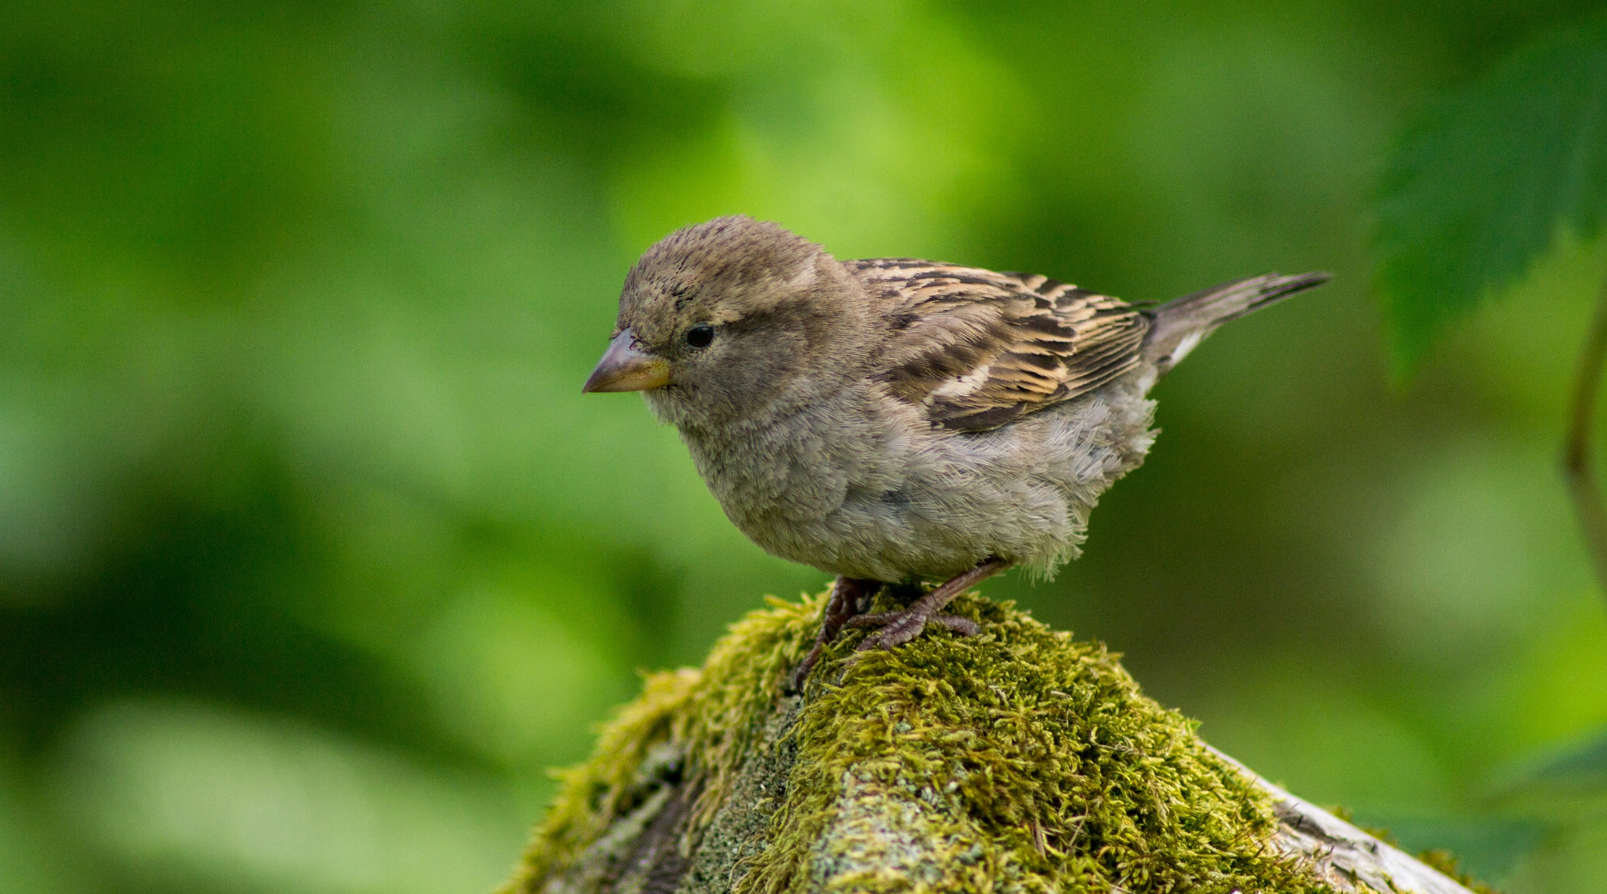
Launch before you’re ready
Photo by Håkon Helberg on Unsplash

Slide 9
Seth Godin Quote
“…you will never be ready. Ready implies you know it's going to work, and you can't know that. You should ship when you're prepared, when it's time to show your work, but not a minute later.”
Seth Godin
https://seths.blog/2016/03/show-your-work/

Slide 10
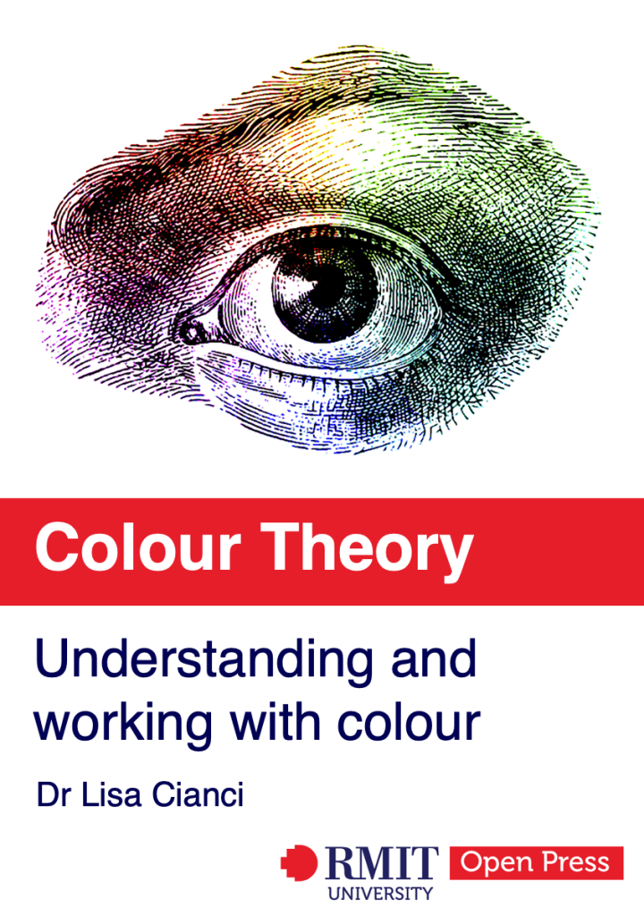
Colour Theory
>100,000 visits
>60,000 users
so far!

Slide 11
New images for Colour Theory

Slide 12
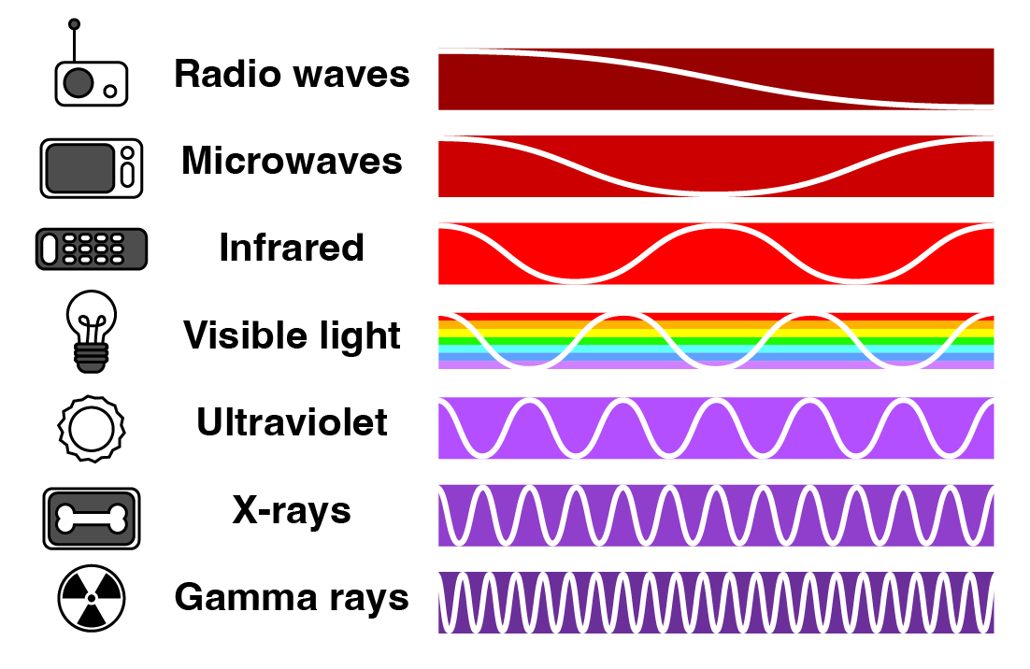
New images for Colour Theory

Slide 13
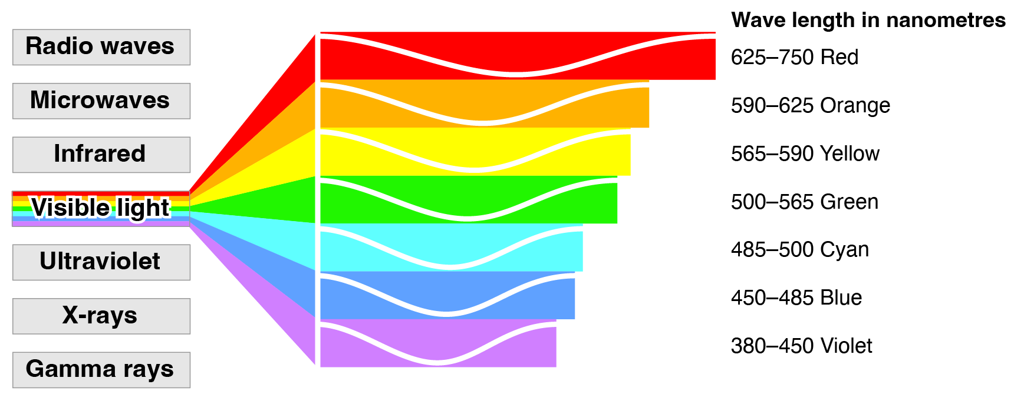
New images for Colour Theory

Slide 14
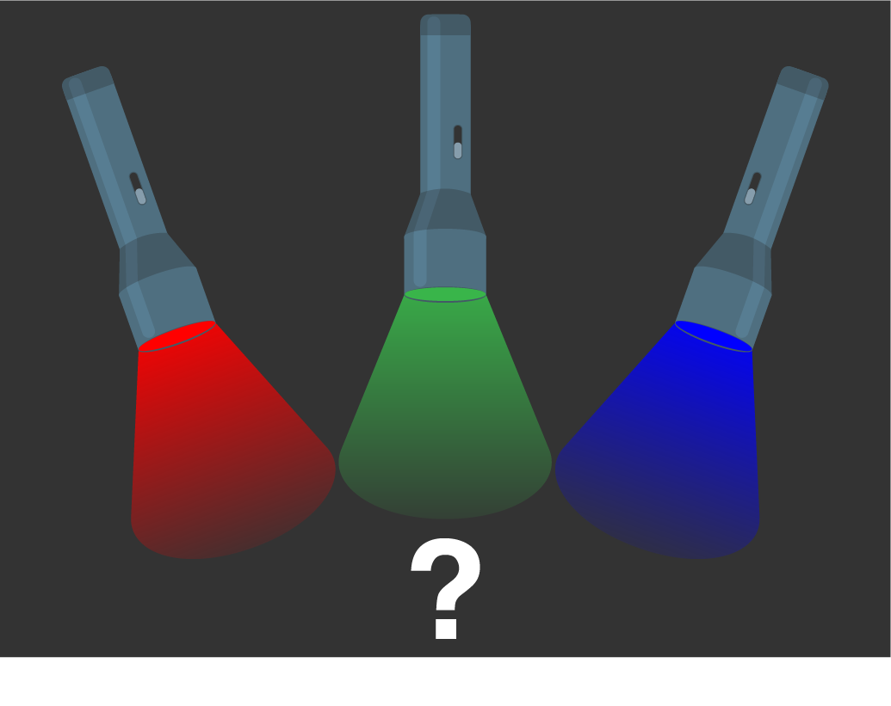
Question

Slide 15
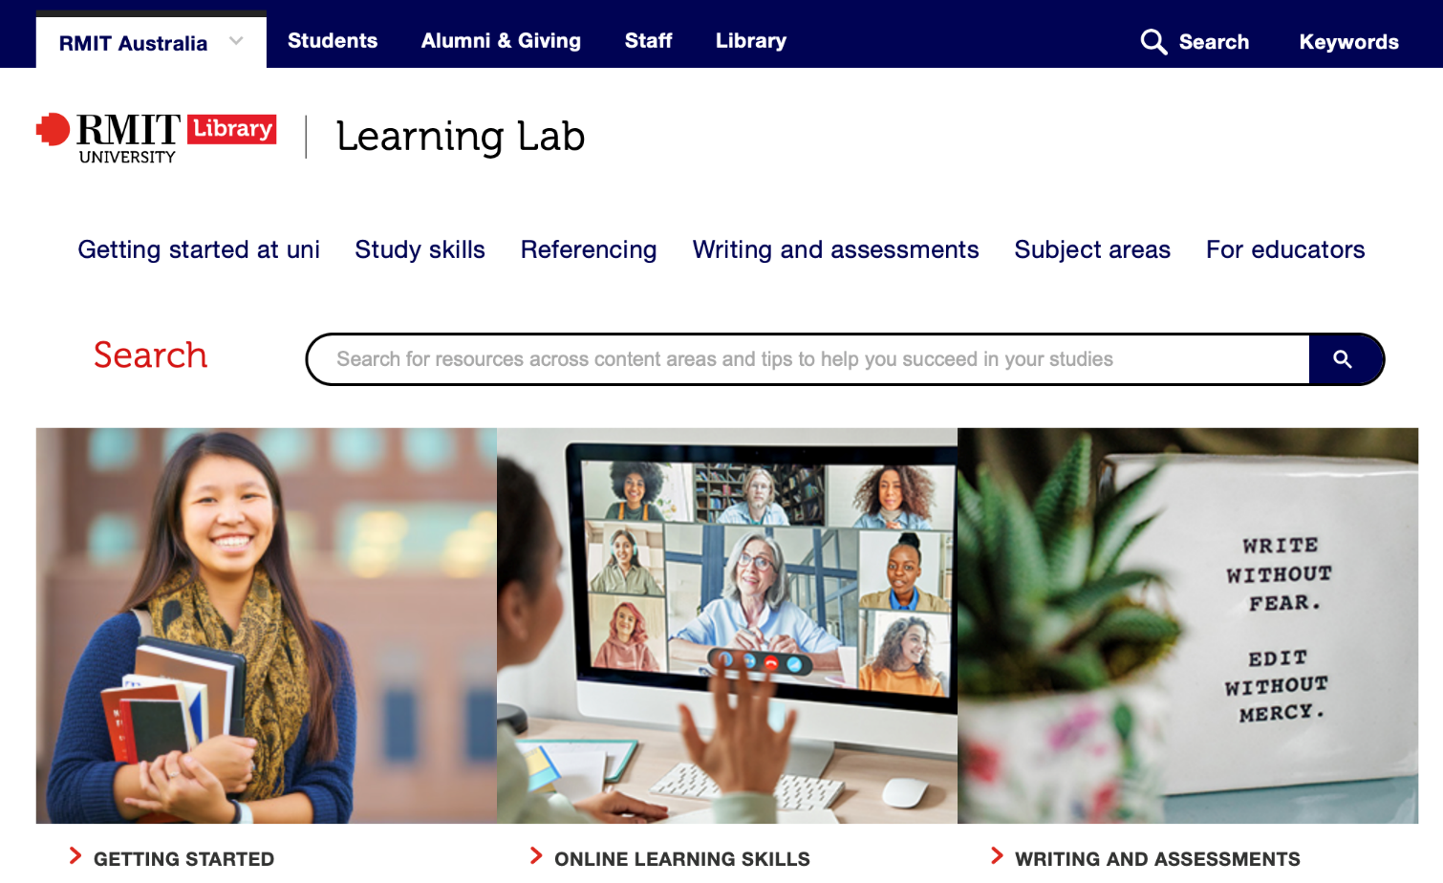
The Learning Lab

Slide 16
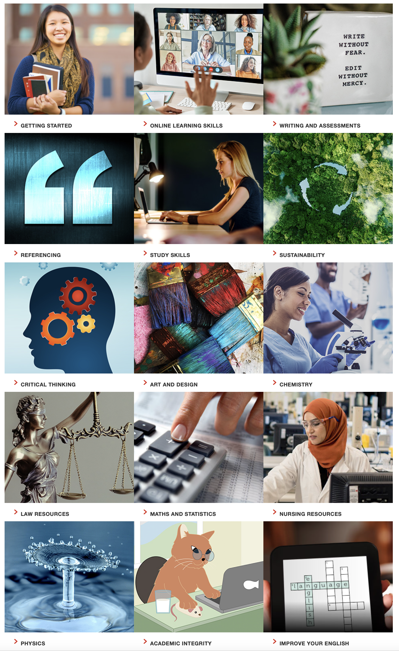
Learning Lab

Slide 17
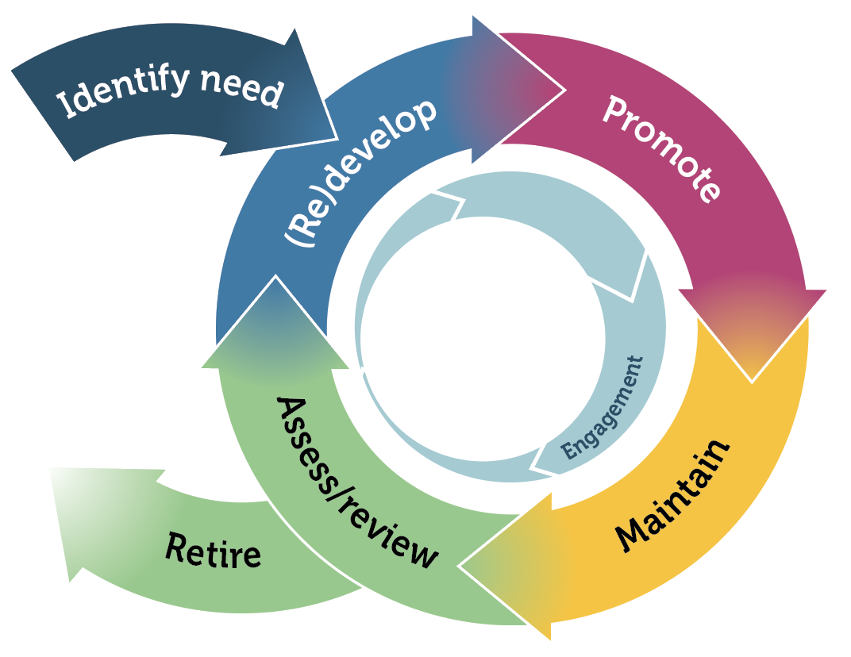
Digital Learning Asset Lifecycle

Slide 18
New colours

Slide 19
PDF to HTML

Slide 20
PDF to HTML

Slide 21
New expertise
Photo by No Revisions on Unsplash

Slide 22
Testing
Photo by Steve Buissinne on Pixabay

Slide 23
Student advisory board
Domestic / international
Under- and post-graduate
All four colleges at RMIT
High school/workforce
Language diversity
Cultural diversity
Neurodiversity
Disability
LGBTQIA+
Socioeconomic diversity
Photo by Naassom Azevedo on Pixabay

Slide 24
Image only
Photo by UX Indonesia on Unsplash

Slide 25
Student experience

Slide 26
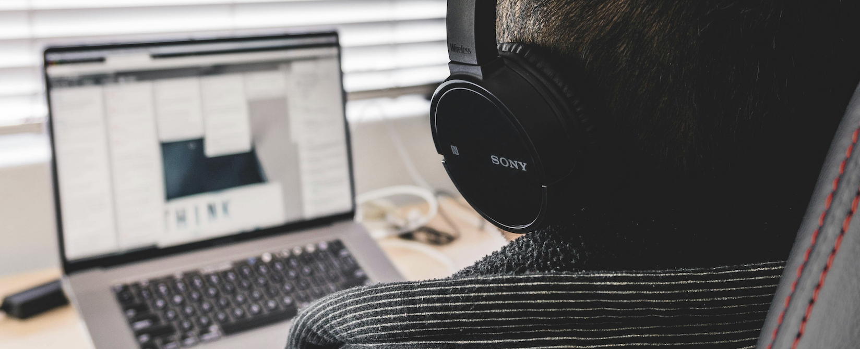
Accessibility testing
Photo by Sora Khan on Unsplash

Slide 27
Higher Education Participation and Partnership Program (HEPPP)
Supporting students who are:
from regional and remote Australia
Aboriginal and/or Torres Strait Islander​
from low socioeconomic background​s​

Slide 28
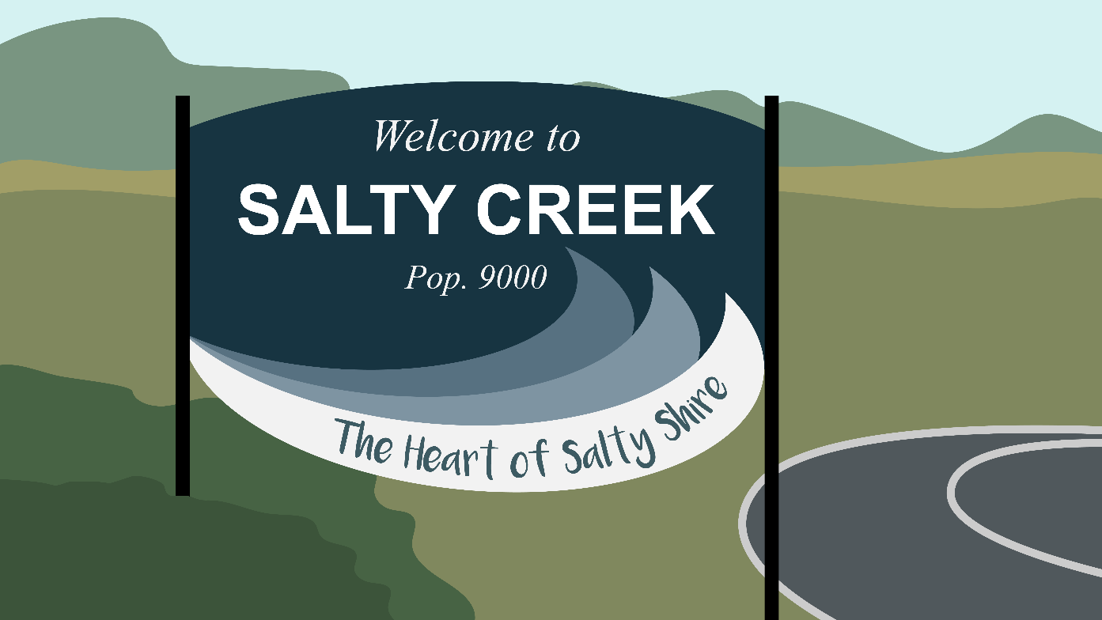
Learning Lab Contextualised Content
Authors
Profile pics via Blush

Slide 29
Representation
Relevance
Reassurance
Reliability

Slide 30
Consider barriers
Photo by Louis Moncouyoux on Unsplash

Slide 31
Representation
“Sammie, Hayden, and their advisors are ready to get to work and start preparing for the best festival Salty Creek has ever seen! Get to know the Festival Planning Committee…”
Images via Blush and Adobe Firefly

Slide 32
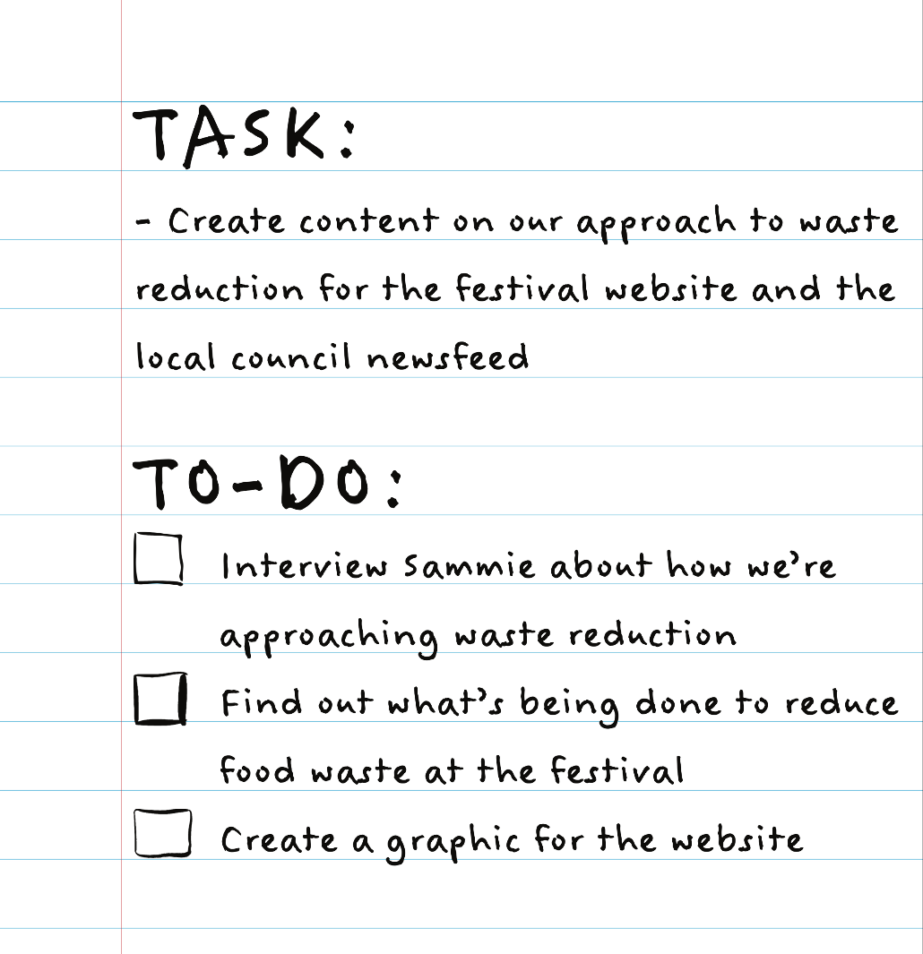
Practical application

Slide 33
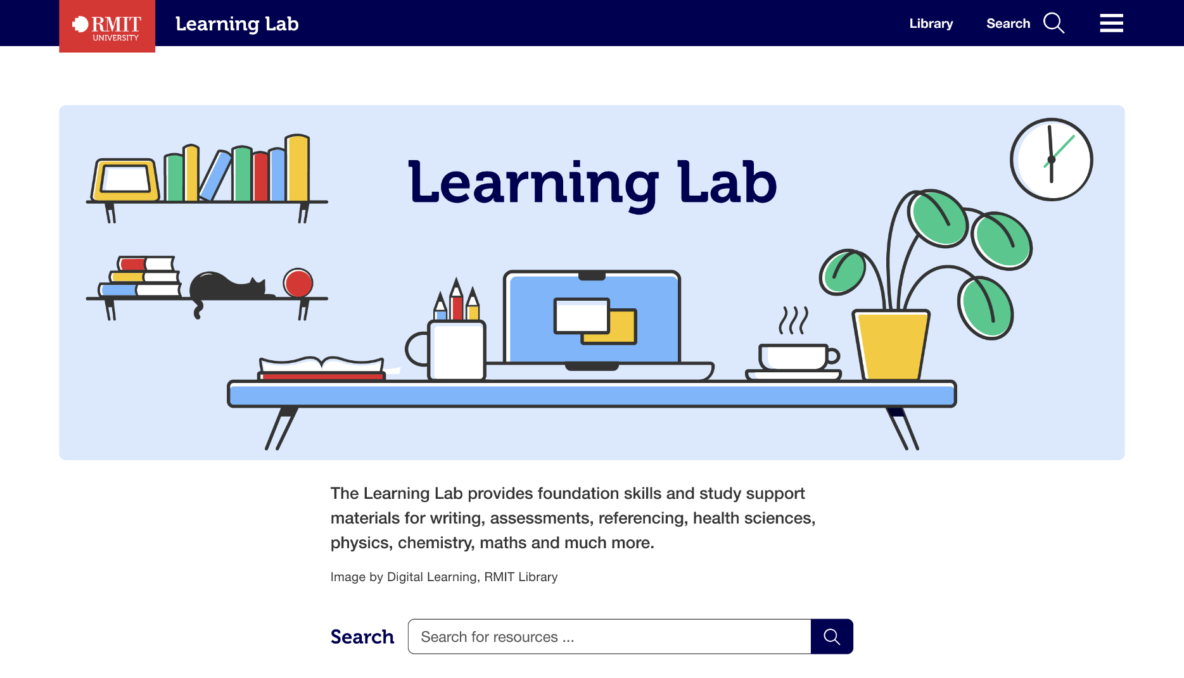
Learning Lab Screenshot image

Slide 34
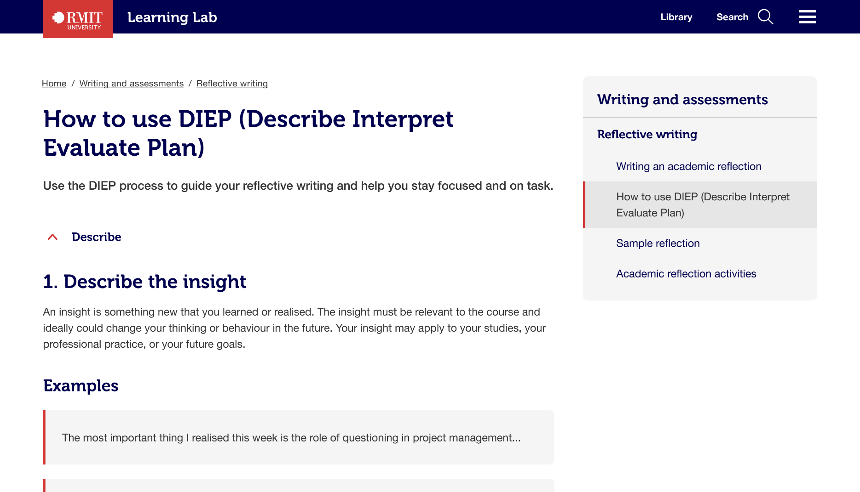
Learning Lab Screenshot image

Slide 35
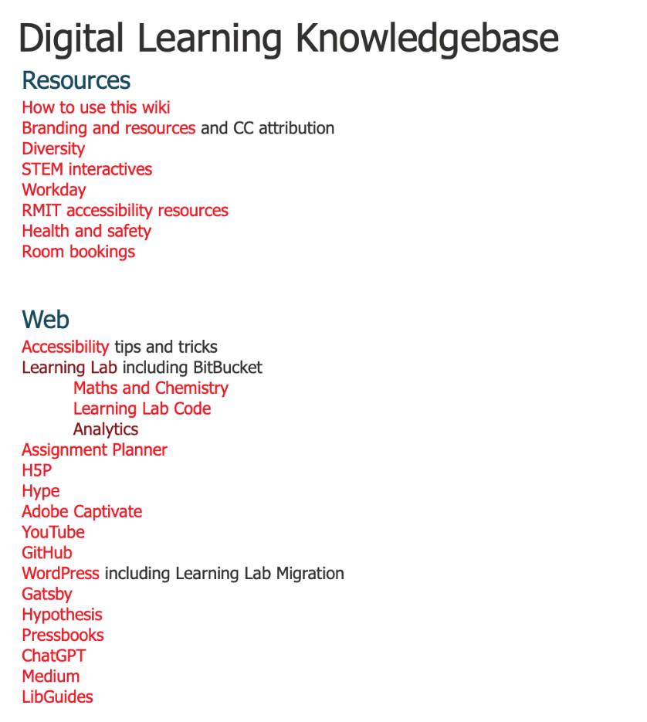
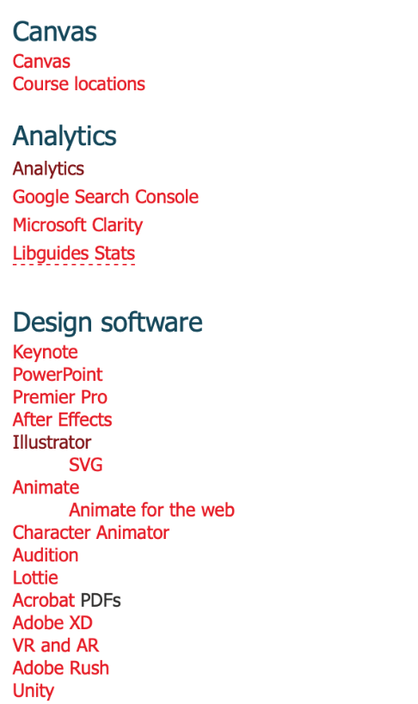
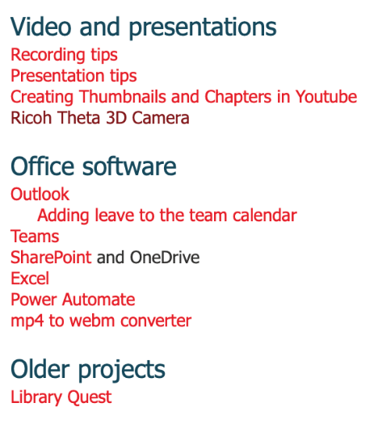
Wiki

Slide 36
RMIT Library Digital Learning Team

Slide 37
Resources
RMIT Diversity and Inclusion
https://www.rmit.edu.au/about/our-values/diversity-and-inclusion
Colour Theory: Understanding and Working with Colour
https://rmit.pressbooks.pub/colourtheory1/
The Learning Lab
https://learninglab.rmit.edu.au/
Learning Lab Contextualised Content
https://rmit.pressbooks.pub/llcc/
Images not otherwise credited in this presentation are by the Digital Learning team:
AJ Penrose, Lisa Cianci, Sandy Houston, Kelly Ann Smith

