Slide 1


Enacting UDL at the Tertiary Level:
Enabling universal asynchronous approaches to reach more learners
Assoc Prof Stuart Woodcock
& Elizabeth Hitches

Slide 2

Acknowledgement of country
We acknowledge the Traditional Custodians of the various lands on which we join from today and recognise their valuable contributions to Australian and global society.
We pay our respects to their Elders, Ancestors and their descendants, who continue cultural and spiritual connections to Country.
We acknowledge Aboriginal and Torres Strait Islander people participating in this event.
We are joining from the lands of the Jagera and Turrbal peoples.

Slide 3

Housekeeping
This session is being recorded. If you do not wish to appear on screen please hide camera.
This session will be captioned.
Session etiquette
Please feel free to use the Chat for discussion.
Submit questions via the Q+A function or use the Raised hand emoji during question time.
Ensure your surrounding environment is quiet when mic is on (e.g., phones, pets etc).
Turn off mic when not speaking.

Slide 4

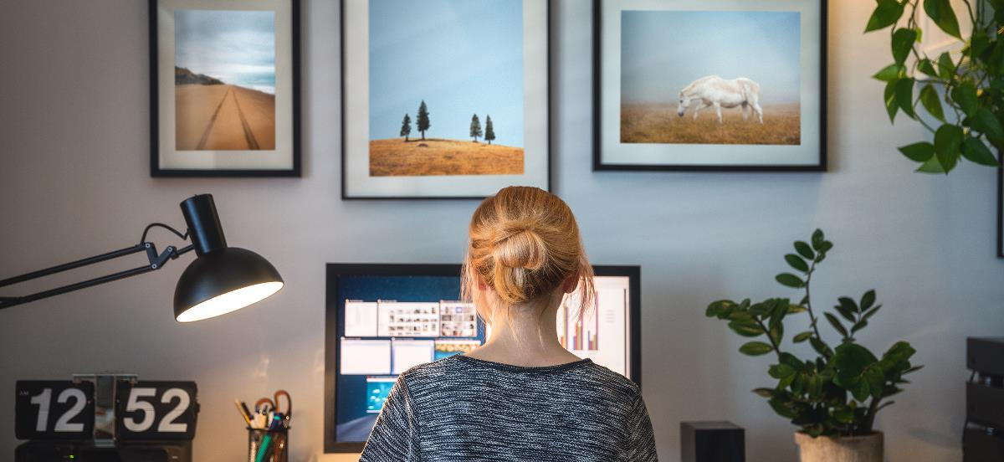
UDL at Tertiary Level
Course Overview:
  Course: Inclusive Classrooms.
  Pre-service teachers (primary/secondary).
  Approx 400 students across three university campuses & online.

Slide 5
Overview of the course modes:
Student Voices
Inclusiveness
Regardless of the mode, students should:
feel welcomed, valued, and considered.
have equitable access and participation to learning.
be actively engaged= motivation/persistence/autonomy.
Modes available:
Weekly face-to face
Weekly online (day/night)
Intensive days (face-to-face)
Recorded classes
Observed benefits:
Learning: options for perception, action and expression, and engagement.
Personal circumstances: enable equitable learning for a diversity of experiences (e.g., health, finances, carer responsibilities).

Slide 6
'Typical' recorded classes
Recordings implemented as a 'back up’
Misconceptions:
    Live-time classes are a pedagogical preference.
    Attendance to live classes can often be compulsory.
    Recorded classes should not be relied upon.
      They are not engaging.
      They do not allow students to demonstrate understanding.
      They are only a 'quick fix' approach.
Result: non-inclusive recording.
  Recording is clearly centred on students in the live class.
  Miss out on 'learning' activities.
  Recordings only capture part of the learning experience.

Slide 7
Who might depend on the recordings?
'Pregnant and have a lot of appointments'
'Professional Experience'
'I work all day'
'Life throws an unexpected curve ball'
'Take in information at your own pace'
'Travel a lot'
Examples from students:

Slide 8
First iteration of a more universal inclusive approach (1)
How might we provide equitable ways for students accessing and engaging in the recorded classes, and also show them they are considered and valued (and are not just onlookers!)?
Welcome students joining live and watching the recording.
While students engaging synchronously get settled into breakout rooms, address students watching the recording directly.
Provide instruction on how they can engage in the learning activity independently and meaningfully (asynchronously).
UDL: 7.3 Minimise threats (foster an accepting, supportive environment), 7.2 Optimise relevance

Slide 9
First iteration of a more universal inclusive approach (2)
How might we provide equitable access to the co-constructed knowledge which develops during the class, and foster a sense of belonging in a learning community?
Provide the links to shared working documents on the slides and in the recorded chat.
After breakout group discussions, ensure groups summarise their learning for the whole class, meaning those watching the recording have access to these shared insights and feel part of the learning community.
UDL: 1.2 offer alternatives to auditory information, 1.3 offer alternatives to visual information, 8.3 Foster collaboration and community

Slide 10

First iteration findings: Students’ voices
Benefits for personal circumstances:
Accessibility (can access at a time and place that suits).
Stress reducing (knowing there is a backup when the unexpected happens).
Benefits for learning:
Pace (own pace giving additional processing time; pause and rewind).
Depth of understanding (revision to build understanding).

Slide 11

What needed strengthening?
How can students truly be part of that co-construction of knowledge?
How can we build in opportunities for formative feedback?
How can students give/imply feedback to us?
UDL: 8.3 foster collaboration and community, 8.4 increase mastery-orientated feedback

Slide 12
Strengthening this in the second iteration
Use additional slides (while the live class is in break out rooms) specifically for asynchronous students to participate in an engaging activity online.
Asynchronous students will access a shared document (throughout the course) to engage with this. Engagement is fostered in two ways:
    Part one – Students engage with the week's activities
    Part two - The instructor will asynchronously join in the discussion
      from students' input into the activities
      answer any questions that students had for each activity as well as at the end of the session; an equivalent Q&A opportunity.

Slide 13

Concluding remarks
Current Goal – how can we provide equitable and inclusive learning for those currently missing out?
Students’ voices – how can we draw on students' perspectives to strengthen inclusion and quality learning?
Future Goal – how can this be provided as another valid learning option alongside other modes?
Reminder – students are illustrating the benefits of various options for learning modes (e.g., a/synchronous)

Slide 14

Contact us
Stuart Woodcock
Griffith University
s.woodcock@griffith.edu.au
Elizabeth Hitches
Griffith University
e.hitches@griffith.edu.au

Slide 15

Q & A

