Slide 1
Linking Connect and UDL to support postgraduate online students
JCU Postgraduate Nursing Online
Linking
and UDL to support postgraduate online students
Dr Tracey Ahern, Tracey Gooding, Dr Narelle Biedermann

Slide 2
Acknowledgement of Country
Notes:
To start today, I would like to acknowledge the Juru people of the Birri Gubba Nation who have been caring for the lands known as Ayr for many generations. This was and always will be their land. I pay my respects to Elders past and present and extend that respect to other Aboriginal peoples and Torres Strait Islander peoples who are present here today.
The artwork on display here was chosen to accompany my acknowledgement to country because it explores the local artist, Aicey Zaro’s connection to Country and place through his mother and her Country. The artist’s mother is a Juru Traditional Owner of the Birrigubba Clan, the people of the area in which both the artist, and myself are based.

Slide 3
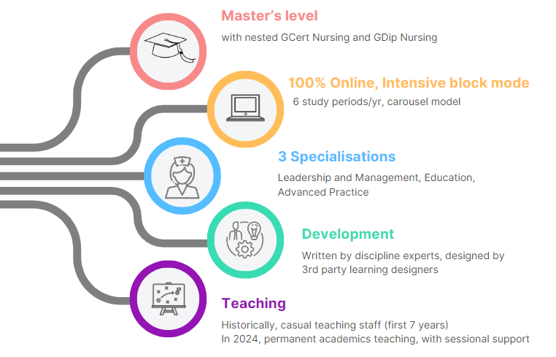
Course Characteristics

Slide 4
Cohort Characteristics
Notes:
Registered Nurses
Cohort size varies each study period (approx. n=450)
Online, Australia-wide
70% full time, 30% part-time
Many years since previous study

Slide 5
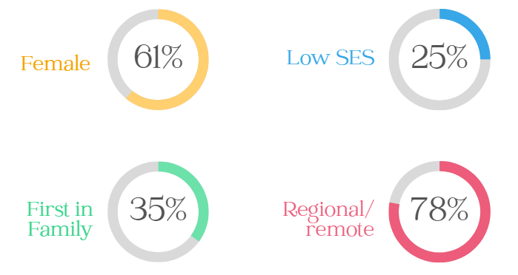
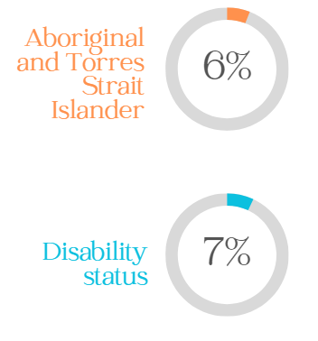
Cohort Demographics

Slide 6
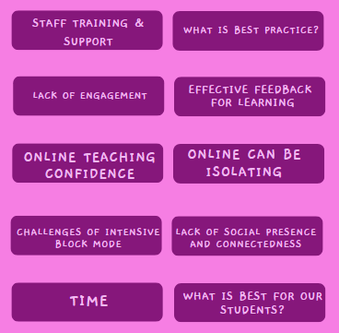
Initial Limitations

Slide 7
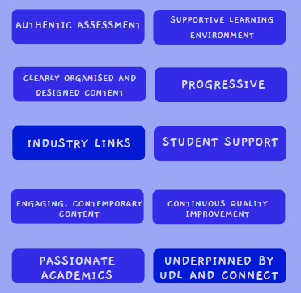
Course Strengths

Slide 8
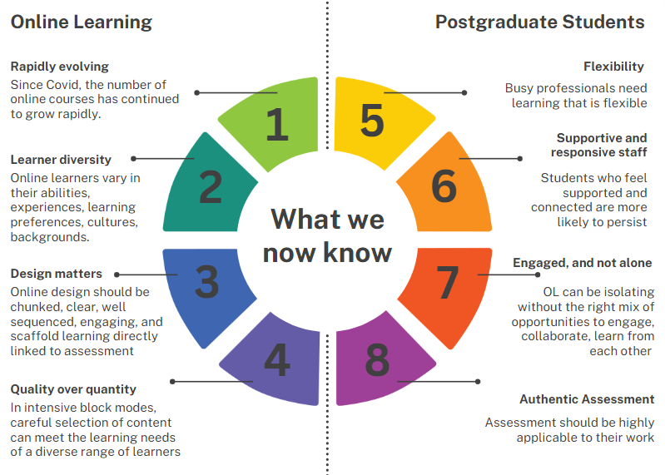
What we now know

Slide 9
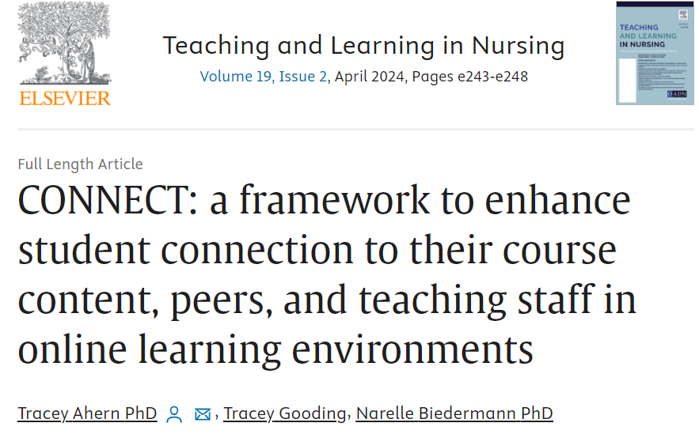
Connect Article
https://www.sciencedirect.com/science/article/pii/S1557308723002159
(Ahern et al., 2024)

Slide 10
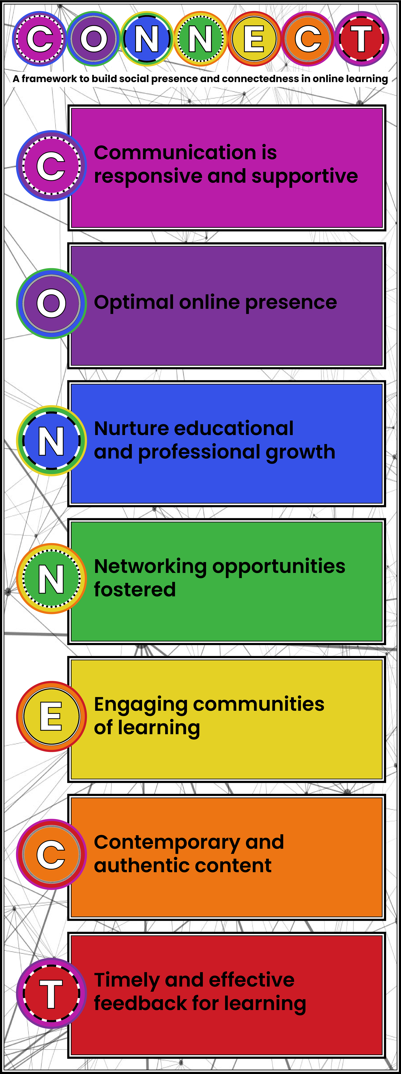
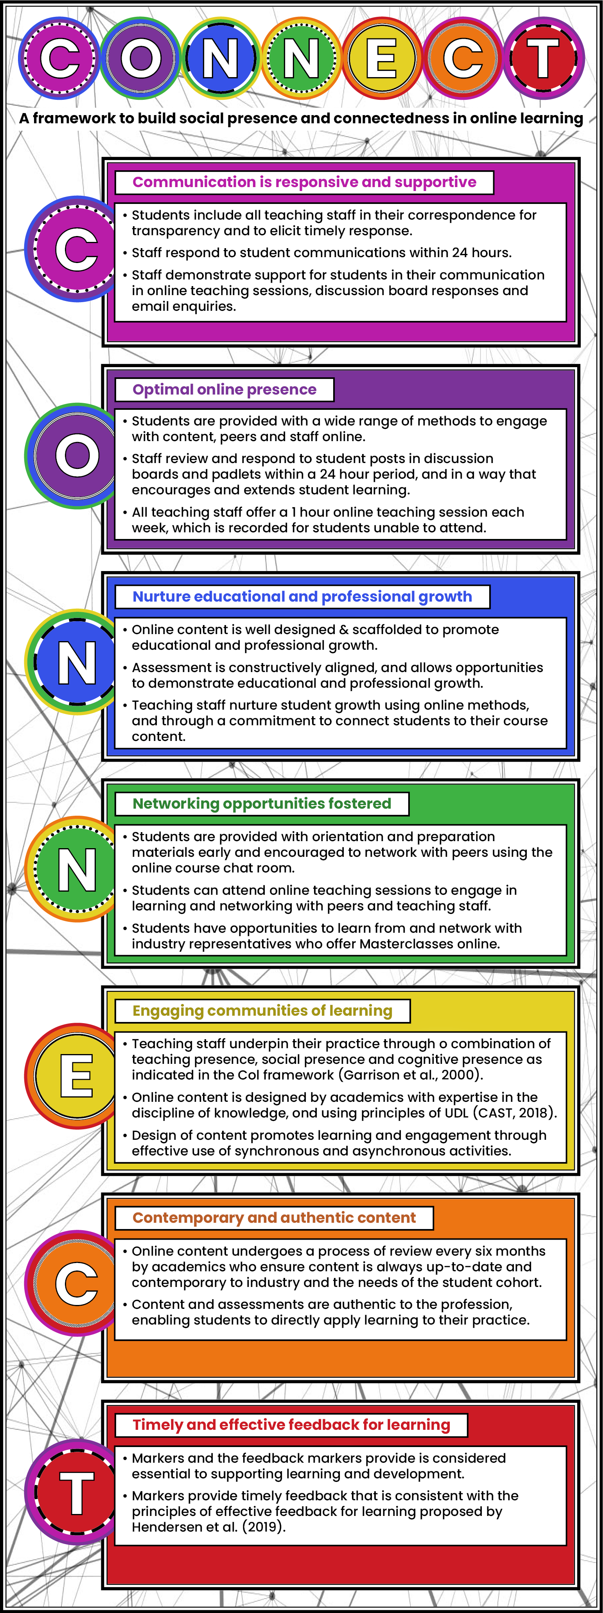
CONNECT Acronym
(Ahern et al., 2024)

Slide 11
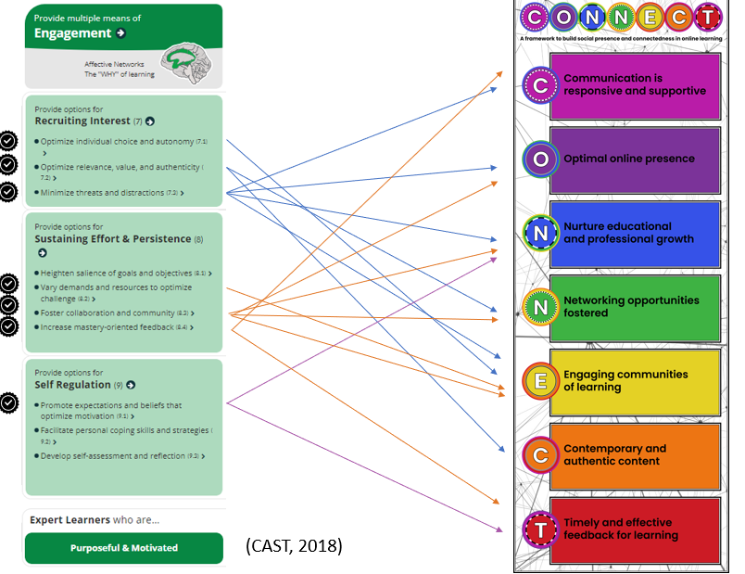
Engagement mapped to CONNECT
(Ahern et al., 2024)

Slide 12
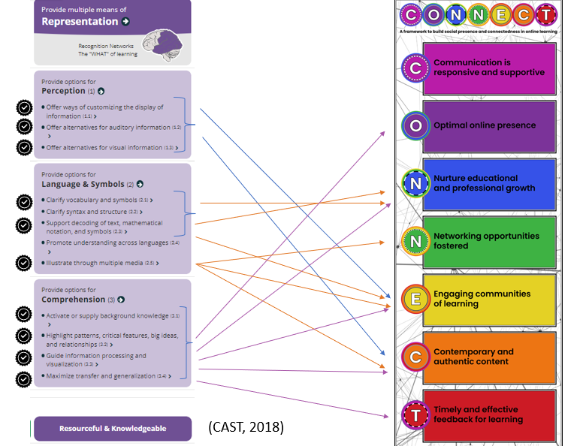
Representation mapped to CONNECT
(Ahern et al., 2024)

Slide 13
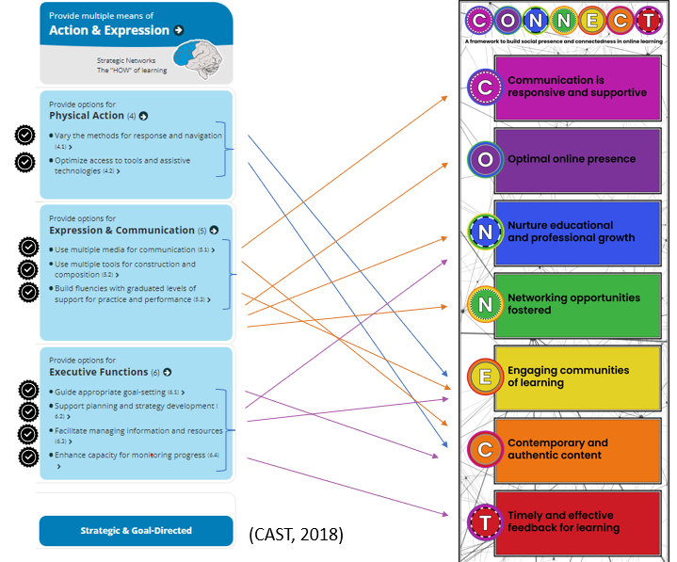
Action and Expression mapped to CONNECT
(Ahern et al., 2024)

Slide 14
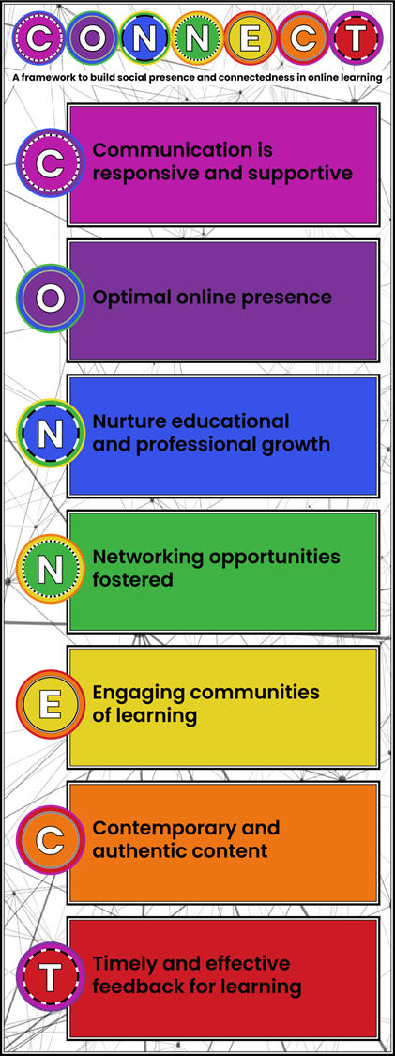
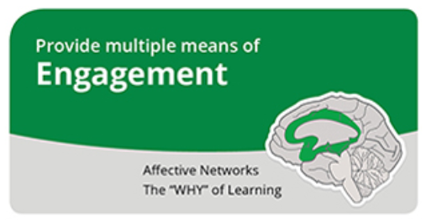
Practical examples showcase
(CAST, 2018)

Slide 15
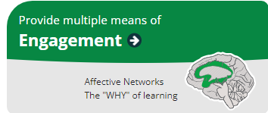
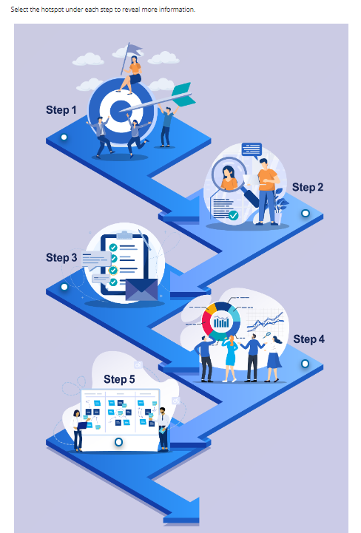
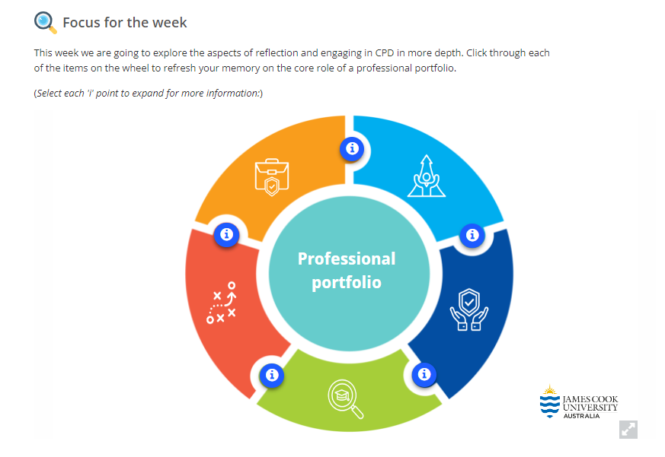
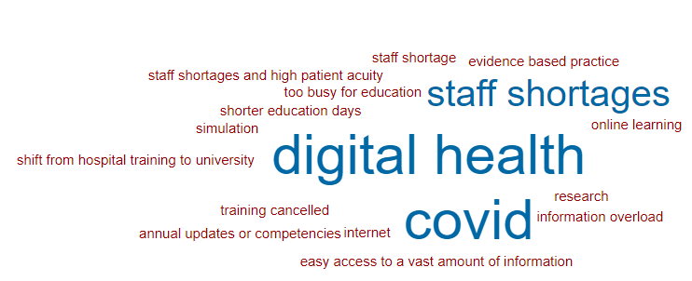
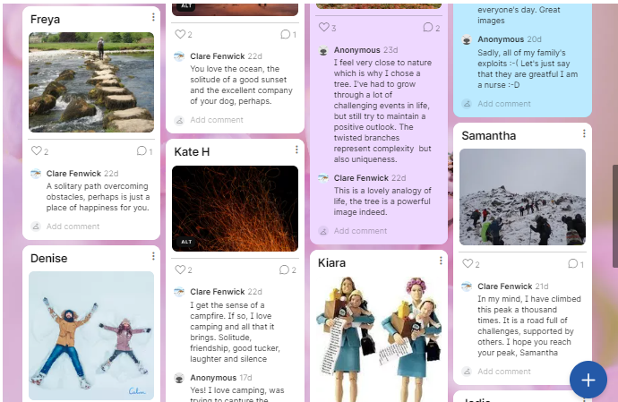
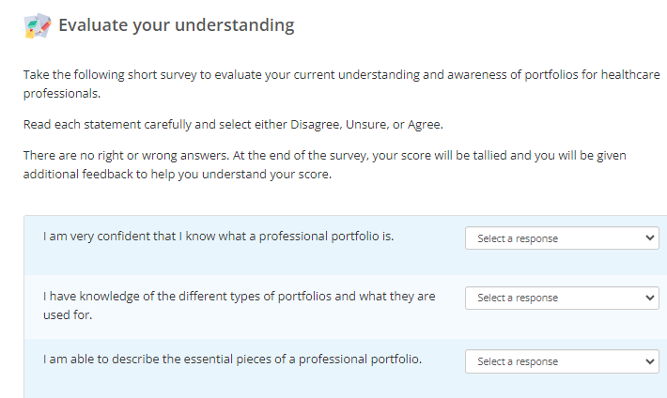
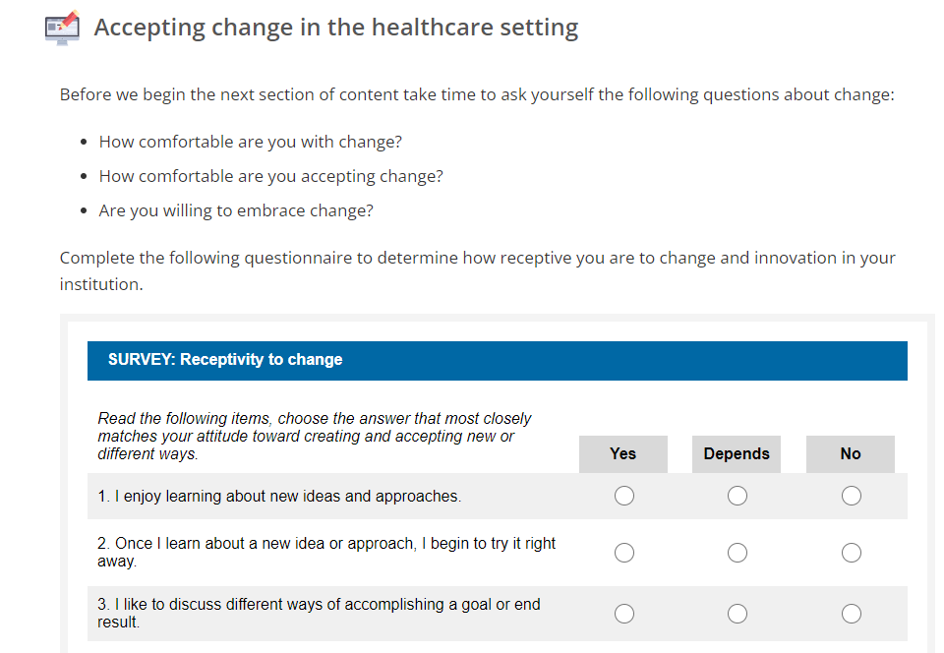
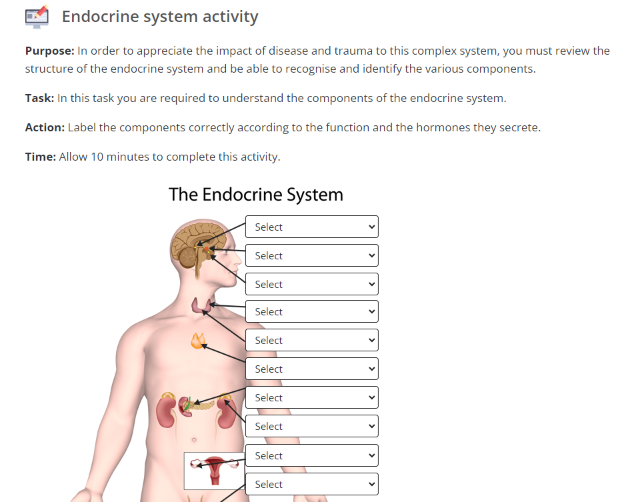
Options for recruiting interest

Slide 16
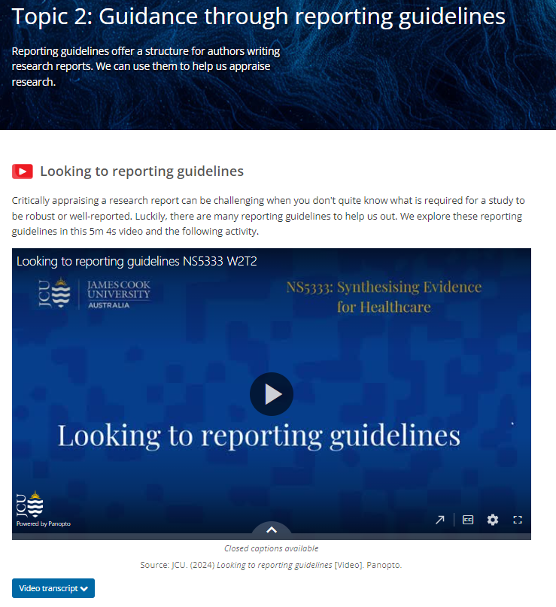
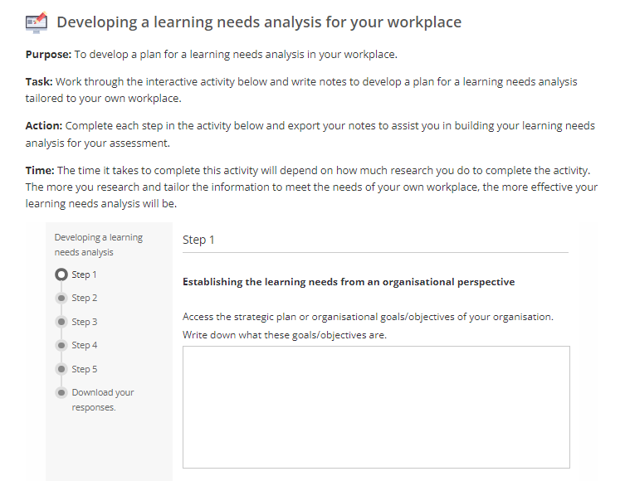
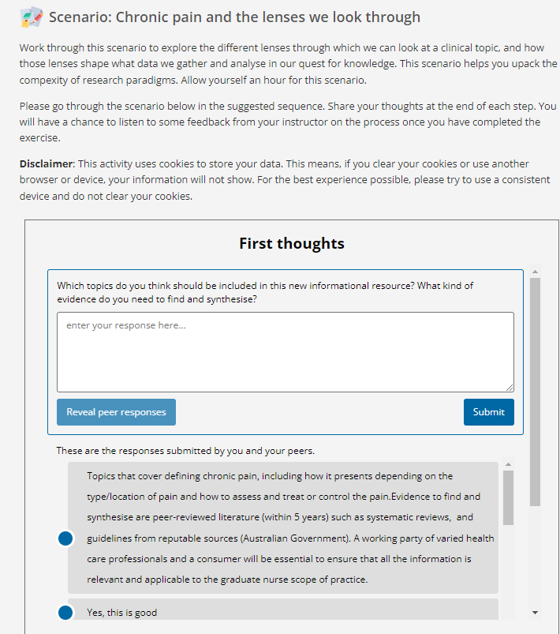
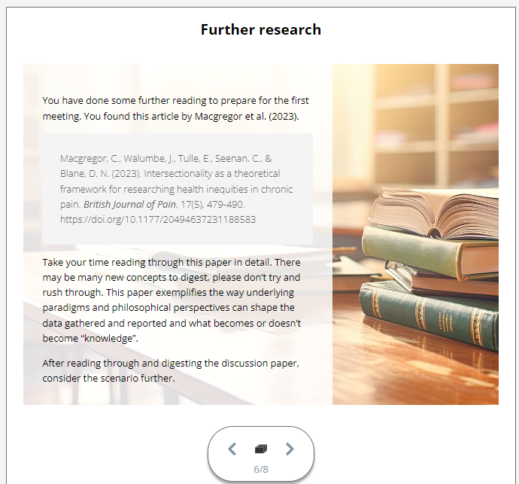
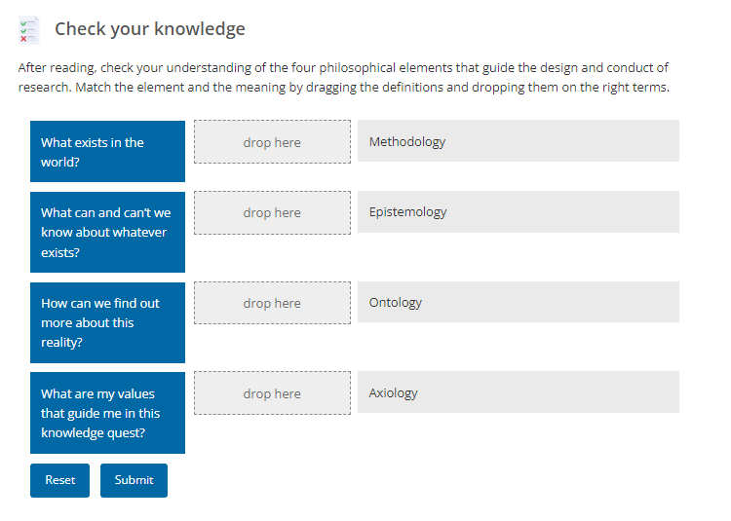
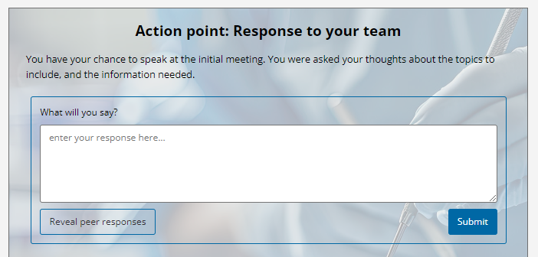
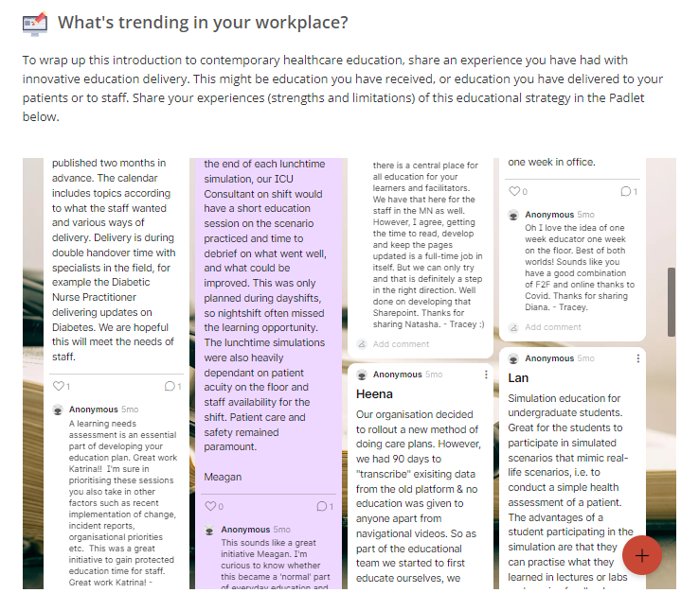
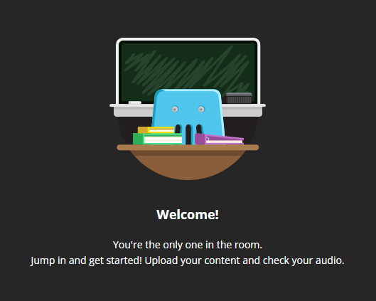
Options for sustaining effort & persistence

Slide 17
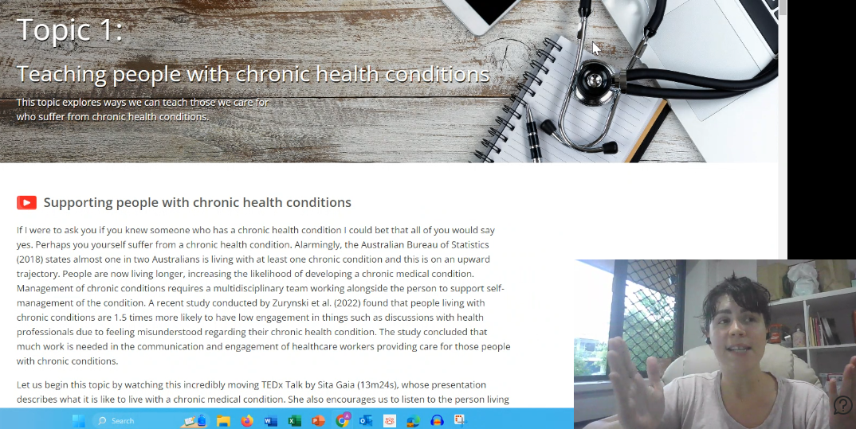
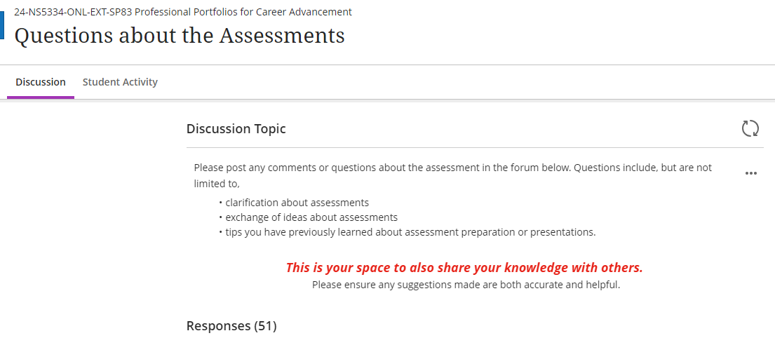
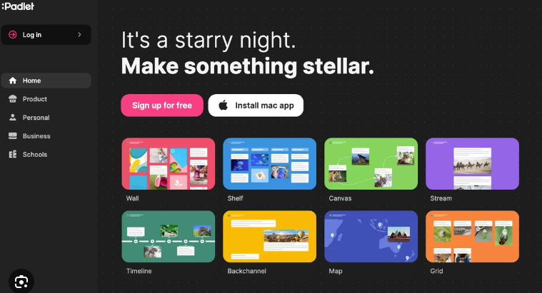
Foster collaboration and community

Slide 18
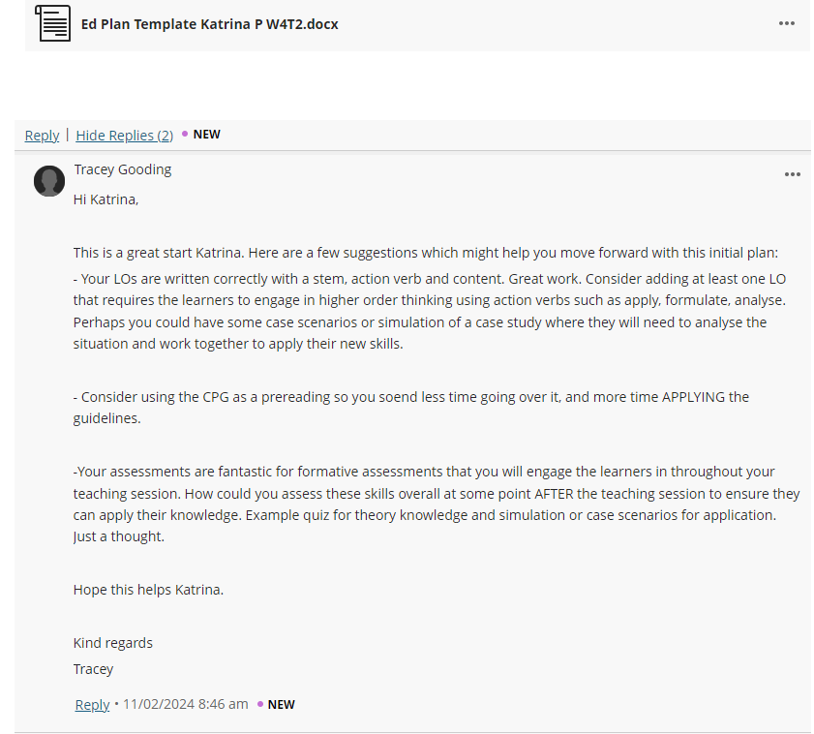
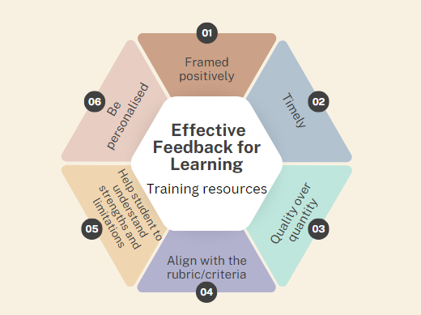
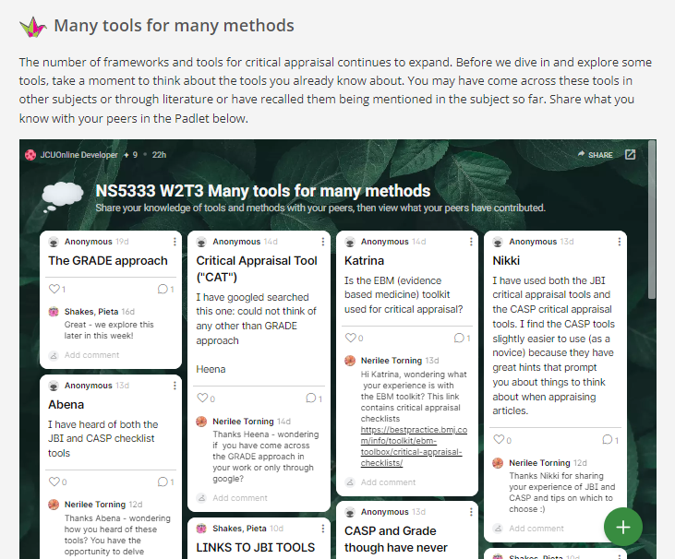
Increase mastery-orientated feedback

Slide 19
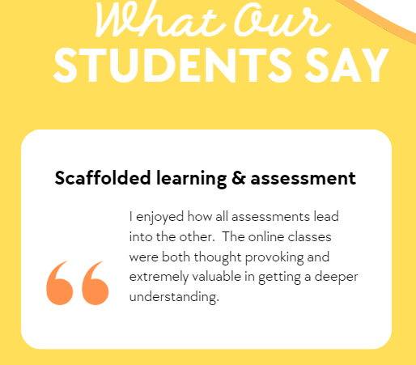
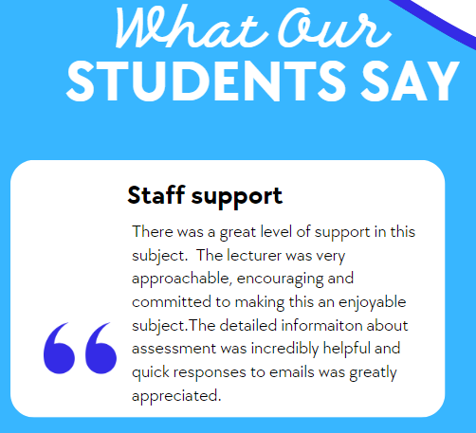
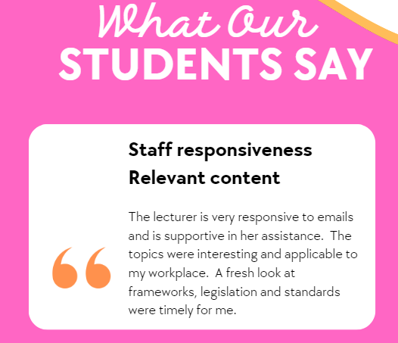
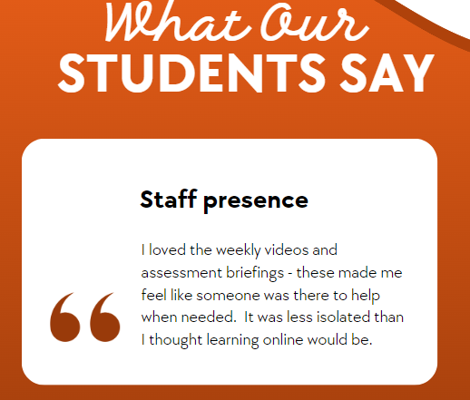
What our Students Say

Slide 20
References
Ahern, T., Gooding, T. & Biedermann, N. (2024). CONNECT: a framework to enhance student connection to their course content, peers, and teaching staff in online learning environments. Teaching and Learning in Nursing, 19(2), e243-e248. https://doi.org/10.1016/j.teln.2023.10.015
CAST (2018). Universal Design for Learning Guidelines version 2.2. Retrieved from http://udlguidelines.cast.org

Slide 21
Questions
Dr Tracey Ahern
Senior Lecturer, James Cook University
Email: tracey.ahern@jcu.edu.au

