Slide 1
The Disability Officer – a Linchpin on the UD Campus?
Presenters:
Patricia McCarthy, Mary Quirke and Conor Mc Guckin

Slide 2
Welcome!
Dr Patricia McCarthy Research Fellow, TCD - School of Education
Dr Mary Quirke Research Fellow, TCD - School of Education
Dr Conor Mc Guckin, Assistant Professor, TCD - School of Education
This presentation will involve PowerPoint with Images + Text on slides
We will speak to the images where they are not decorative.

Slide 3

Today’s Presentation
The challenge: As disability officers, where do you believe inclusion in learning starts and stops…
The solution: Design a “shared” appreciation of inclusion - for all across campus.

Slide 4
Higher Education today
Expanding post-compulsory education opportunities for a variety of students, including students with disabilities
Legislation underpinning a policy of inclusion
The implementation of national and international policies
Change in supports available to students with disabilities also contributing to change.
Global phenoma

Slide 5

Dr. McCarthy
Segregationist and institutional education policies were the norm in Ireland up to the 1990s.
School over 250km away from family
Amongst the 1st cohort to sit state examinations
A decade after leaving compulsory education commenced 3rd level education
15+ years - Doctorate

Slide 6

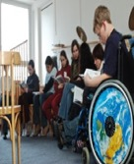





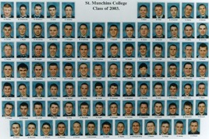
Yet issues for inclusion persist today…

Slide 7
Reflection
What worked well then that would not work now?
What works well now that would not work then?

Slide 8

Having had a deeper consideration as to ‘who’ our thinking matters ‘for’ … we can now consider the environment we work in

Slide 9

Challenges Continue…
…assumption that because of impairment learners with disabilities inevitably have more apparent learning needs than their peers. (Griffin and Shevlin, 2011)
Moreover, past thinking continues to influence inclusion in education – in adopting special education approaches (Slee, 2020, Thomas and Loxley, 2022)

Slide 10
Universal Design (UD)
The term “Universal Design” was first proposed by the architect Ron Mace in 1985.
UD is an approach that sets about creating inclusive thinking in the design of buildings, products, and services so that they can be accessed by the greatest number of users possible – from the “get-go” (Story, Mueller, & Mace, 1998).

Slide 11
Our Time To Adopt Universal Design (UD)
A design approach - architecture and built environment (Story, Mueller, & Mace (1998).
PRINCIPLE ONE: Equitable Use.
PRINCIPLE TWO: Flexibility in Use.
PRINCIPLE THREE: Simple and Intuitive Use.
PRINCIPLE FOUR: Perceptible Information.
PRINCIPLE FIVE: Tolerance for Error.
PRINCIPLE SIX: Low Physical Effort.
PRINCIPLE SEVEN: Size and Space for Approach and Use.

Slide 12
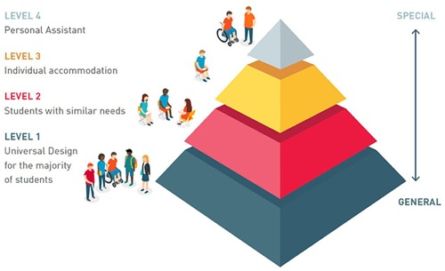
Inclusive Triangle
The tiered approach illustrates different levels of support required within an inclusive education environment model in line with UD principles.
Reference: Quirke, M., McCarthy, P. (2020). A Conceptual Framework of Universal Design for Learning (UDL) for the Irish Further Education and Training Sector Where Inclusion is Everybody's Business. SOLAS, Ireland.

Slide 13
UD and UDL – what the literature tells us…
UD - A design process
UDL - Approach
UDL - Practice
UDL – Developed in the main for teachers and pedagogical practices in USA
UDL – A relatively new phenomena
UDL – Multidisciplinary and interdisciplinary

Slide 14
UD and UDL – what the literature tells us…
A Rights based approach to the inclusion of people with disabilities in education and employment.
Move to position Teaching and Learning in a UD/UDL framework
A collaborative approach that requires the development of key strategic partnerships – beyond the lecture hall.
The incorporation of the new principles demands a new engagement.

Slide 15
Disability Officer
– 4 positions on a UDL campus
Position 1 – To influence campus policy to positively impact on the inclusion of students with disabilities across campus
Position 2 – To ensure that this growing population will have the optimal learning experience by ensuring that the environment is designed for inclusion
Position 3 – To encourage and advocate for the adoption of UD and UDL on campus in learning spaces and places
Position 4 – To become the go-to expert for staff and those what require necessary add-on supports
Can you think of any-more?!

Slide 16
Position 1 – To influence campus policy to positively impact on the inclusion of students with disabilities across campus
By engaging with national and international policies
By providing information as necessary
By influencing key decision makers
By advocating for the rights of students with disabilities
By developing key strategic relationships

Slide 17
Position 2 - To ensure that a growing population have the optimal learning experience – in a UD environment
By being cognisant of participation rates and increasing diversity of demand
By continuing to contribute to collection of data so that it supports UD developments
By utilising the needs assessment process to drive and redesign provision of supports
By maintaining a level of disability expertise so that faculty and others can utilise this resource across campus

Slide 18
Position 3 To encourage and advocate for the adoption of Universal Design for Learning (UDL) on campus
By becoming the cornerstone of campus for all things UD and UDL
By finding a place on the UDL framework
By building knowledge and expertise (of UDL) through developing and engaging with national and international partnerships

Slide 19
Position 4 - To become the go-to expert for staff and those what require necessary add-on supports
By ensuring that the needs assessment process is understood
Act as a conduit for both staff and students/ learners
By keeping up to date with developments in the teaching + learning and disability fields.

Slide 20
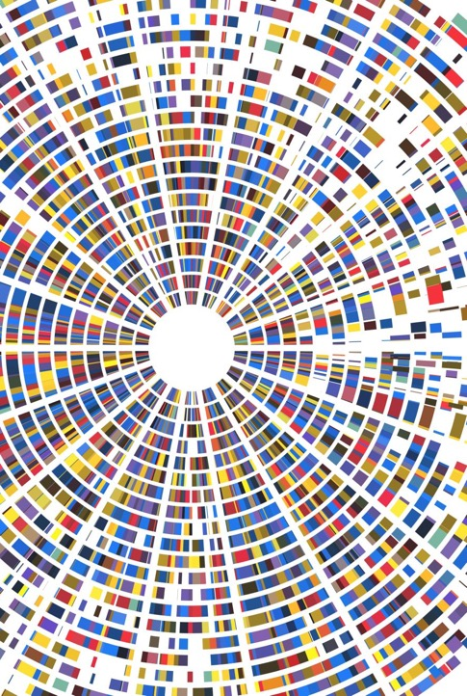
Some fun! Think of yourself as a Jedi! What does design for inclusion mean to you?
To save our galaxy, we need to open the door for different perspectives, welcome them to a seat at the table, embrace them, actively listen in order to understand, and then take action.
Princess Leia in Star Wars!

Slide 21
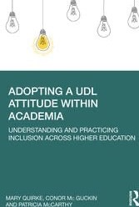
Adopting a UDL Attitude within Academia Understanding and Practicing Inclusion Across Higher Education
By Mary Quirke, Conor Mc Guckin, Patricia McCarthy https://www.routledge.com/Adopting-a-UDL-Attitude-within-Academia-Understanding-and-Practicing-Inclusion/Quirke-Guckin-McCarthy/p/book/9780367684686

Slide 22
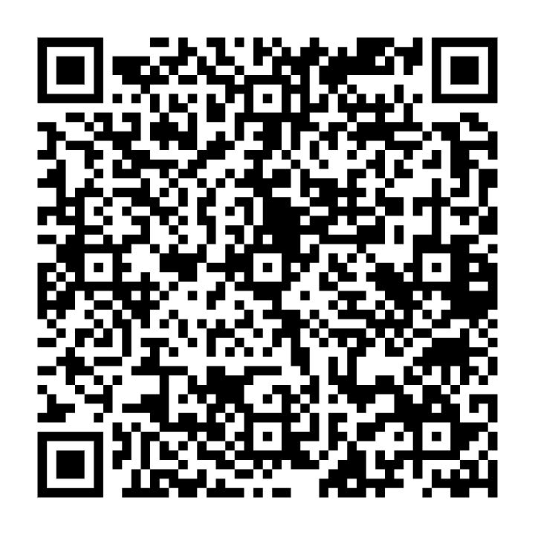
Book Voucher!

Slide 23
Reflection

Slide 24
Our email addresses
Patricia McCarthy:
mccartpm@tcd.ie
Mary Quirke:
msmaryquirke@gmail.com
Conor Mc Guckin:
conormcguckin@gmail.com

Slide 25
Thank You

