Slide 1
Autistic students and the transition to university: Findings and recommendations
Presented by Dr Alison Nuske
Supervisors: Dr Fiona Rillotta, Associate Professor Michelle Bellon, Dr Jessie Shipman (Flinders University) & Professor Amanda Richdale (La Trobe University)
WWW.ALISONNUSKE.COM.AU
23 APRIL, 2024

Slide 2
Acknowledgment of Country
23 APRIL, 2024

Slide 3
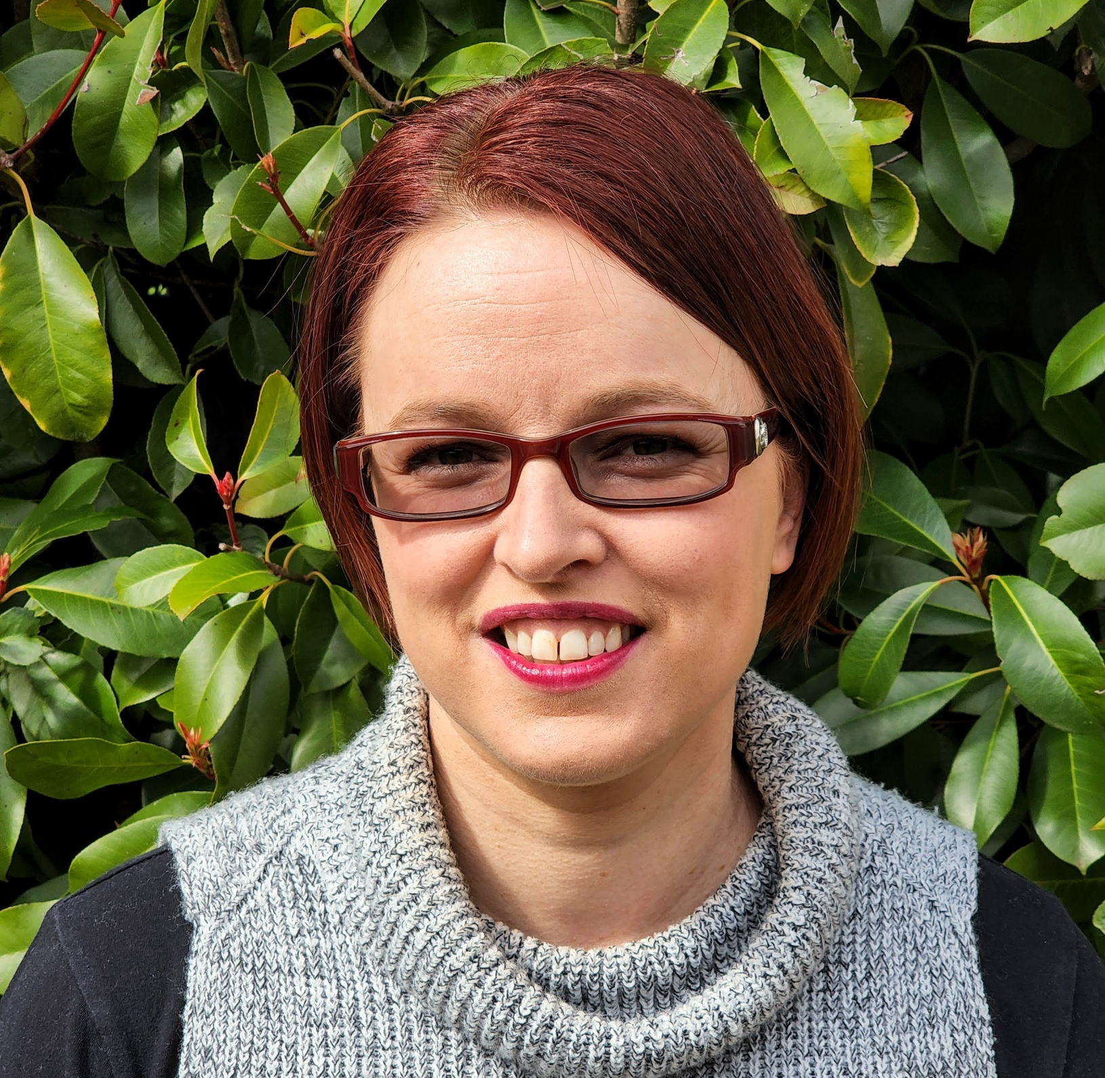
About Me
9 years’ experience as an Access and Inclusion Advisor
15+ years’ experience working with autistic people and their families
Autistic autism researcher
PhD Graduate Flinders University
23 APRIL, 2024

Slide 4
Outline
BACKGROUND
METHOD
FINDINGS
RECOMMENDATIONS
23 APRIL, 2024

Slide 5
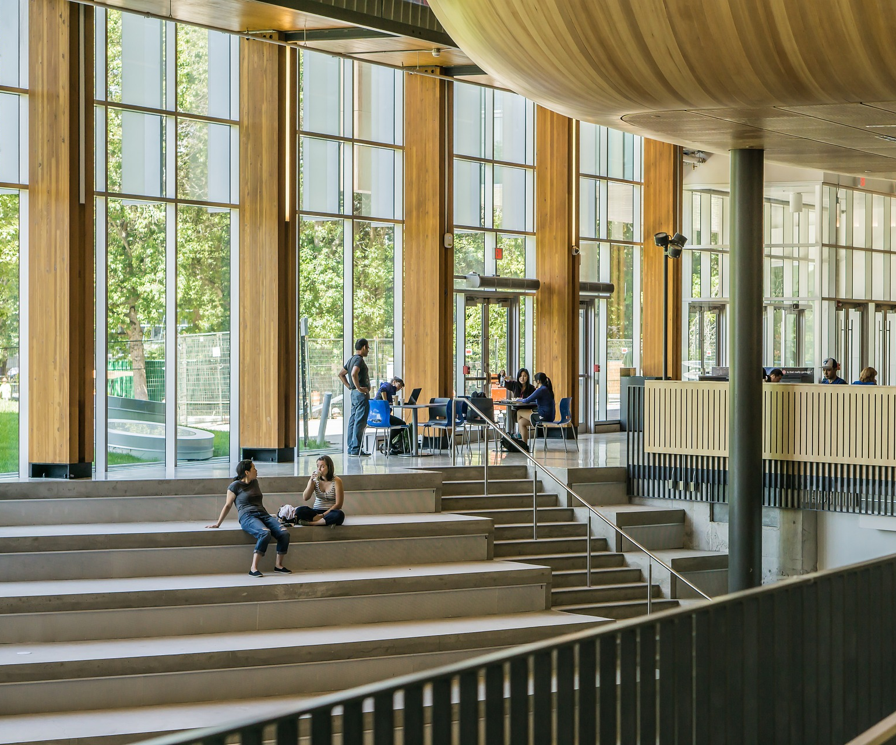
Background

Slide 6
Background
HIGHER EDUCATION
FIRST YEAR
AUTISTIC STUDENTS
Widening participation
Underpinned by anti-discrimination and equal opportunity legislation
Critical to student success
Help-seeking challenges and difficulty accessing support
Increasing enrolment
Lower completion rates than their peers
Higher rates of un/under employment
23 APRIL, 2024

Slide 7
Transition
Not fixed or linear
Period of adaptation and adjustment
Change in role, relationship, routines and assumptions
Higher education policy and practice must embrace inclusivity and diversity in their transition planning and support
23 APRIL, 2024

Slide 8
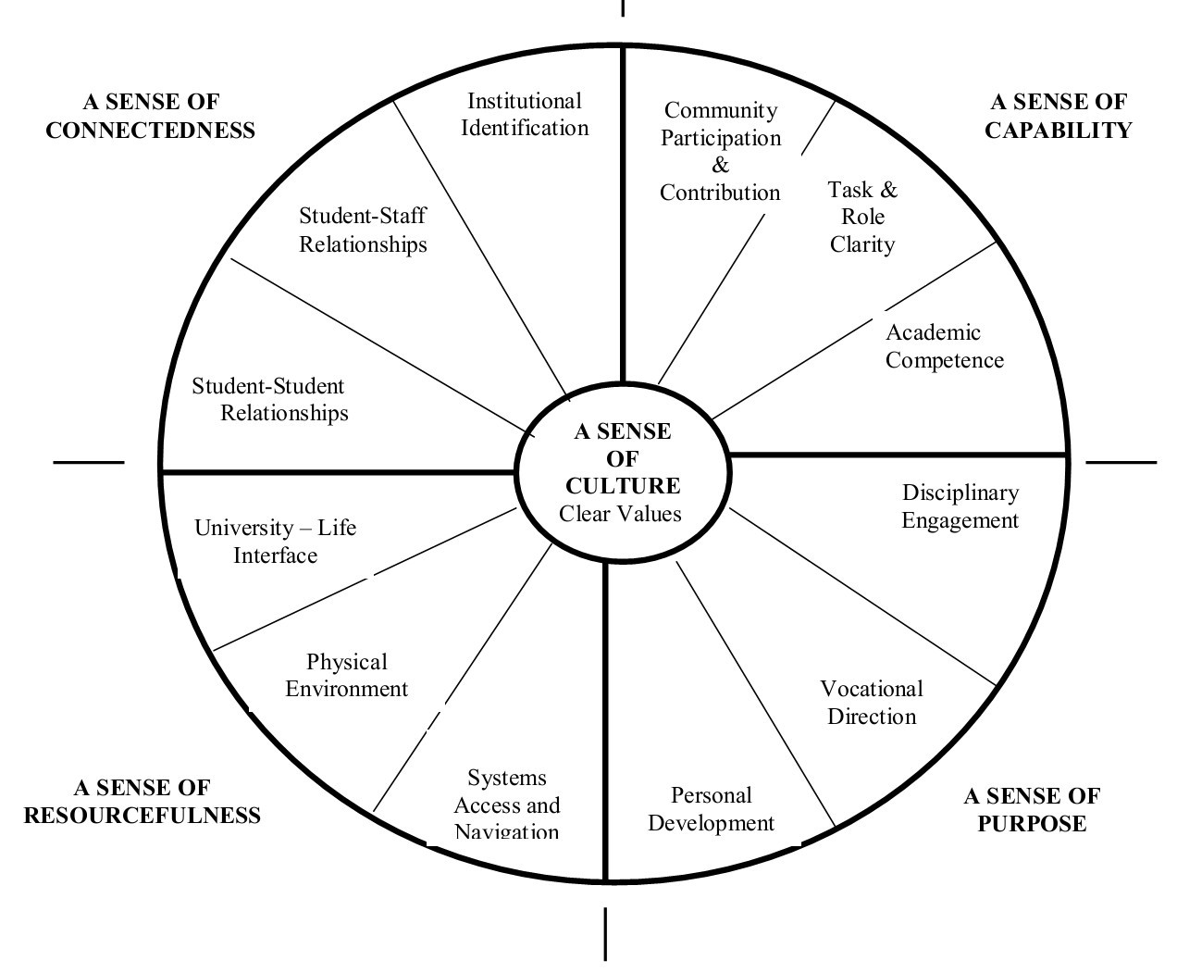
Lizzio’s Five Senses
The 'Five Senses' of Successful Transition
Lizzio, 2006
23 APRIL, 2024

Slide 9
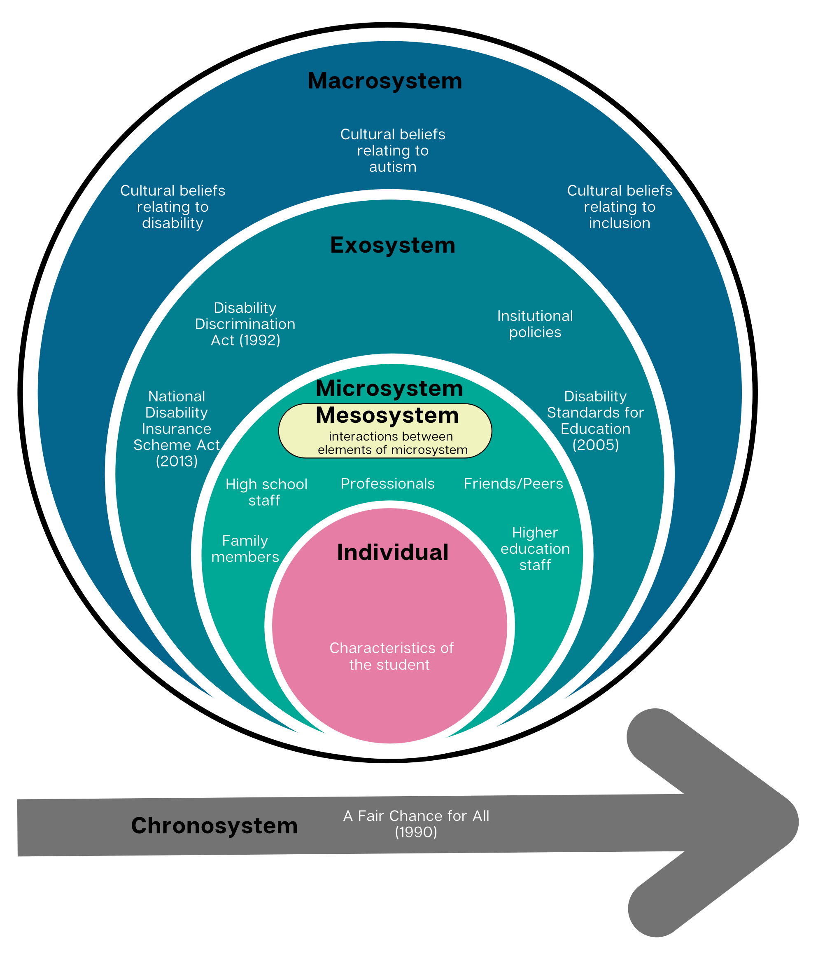
Bioecological theory model
Bronfenbrenner, 1979
23 APRIL, 2024
Adapted from Pinder-Amaker, 2019

Slide 10
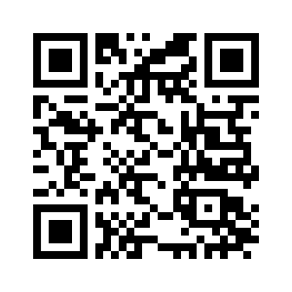
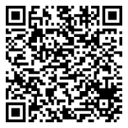
Systematic Literature Review
Transition to higher education for students with autism: A systematic literature review.
ADCET Webinar (April 2020): Transition to Higher Education for Autistic Students
Nuske, A., Rillotta, F., Bellon, M., & Richdale, A. (2019). Transition to higher education for students with autism: A systematic literature review. Journal of Diversity in Higher Education. 12(3). 280-295. https://doi.org/10.1037/dhe0000108
www.adcet.edu.au/resource/10293/webinar-transition-to-higher-education-for-autistic-students
23 APRIL, 2024

Slide 11
Method

Slide 12
Method
STUDENTS
FAMILY MEMBERS
STAFF
Semi-structure interviews
Interpretative Phenomenological Analysis
Semi-structure interviews
Surveys
Reflexive Thematic Analysis
Semi-structure interviews
Surveys
Reflexive Thematic Analysis
23 APRIL, 2024

Slide 13
Findings

Slide 14
Student Interviews
23 APRIL, 2024

Slide 15
Participant Information
Participant (pseudonym) | Sex | Age (at interview) | Pathway to current degree
Conrad | M | 20 | Direct from high school
Ester | F | 30 | Previously attempted university TAFE
Harry | M | 25 | 2 previous attempts at university
Kimberley | F | 36 | Previously attempted university
Ryan | M | 26 | 2 previous attempts at university
Sean | M | 23 | Vocational Education pathway
Taylor | Prefer not to say | 21 | University pathway course
Tristan | M | 19 | Direct from high school
23 APRIL, 2024

Slide 16
Student Themes
Importance of understanding oneself
Deciding to disclose is complex
Family support: Emotional, practical, financial
Peer support: Seeking social connection, but not always finding it
Anxiety: “Enormously stressed, but very determined”
Self-awareness versus internalised ableism
Camouflaging and masking to overcome difficulties
Transition and first year as a period of adjustment
The journey to and through first year at university
University support: Programs and people
Genuine understanding of autism
Sense of self and identity
Persistence and resilience
Accessing and receiving support

Slide 17
Support Network Interviews
23 APRIL, 2024

Slide 18
Support Network Themes - Interviews
Early and ongoing support
The first year of university is a critical period
Delays and difficulties with help seeking impact support provision
Transition support is needed before, during, and beyond the first year
Peer-to-peer support
Benefits and challenges associated with autism specific mentoring programs
Facilitated social groups also provide peer-to-peer support
Support networks outside of the university
External supports: Emotional and practical
External support networks: Barriers to providing support
The challenges of balancing support need and autonomy
Supporting autistic university students
Recognising the diversity and individuality of autistic students
Providing appropriate support requires time and resourcing
Developing a university wide understanding of autism
Autistic students would benefit from a safe space on campus

Slide 19
Family Member Surveys
23 APRIL, 2024

Slide 20
Family Member Themes - Survey
Parents as advocates: “Fighting” for support
Benefits of parent support
Parents played a functional and practical support role
The challenges of balancing autonomy and support need
Delays and difficulties with university support
Recommendations for university transition support
Parent Support
University supports

Slide 21
Staff Member Surveys
23 APRIL, 2024

Slide 22
Staff Member Themes - Survey
The benefits and challenges of providing support to autistic students during transition
Improving support for autistic students’ transition in the future
University staff support: Emotional, Practical and academic
Interacting with family members: Advocacy and developing independence
23 APRIL, 2024

Slide 23
Bioecological theory model: Factors which influence transition
23 APRIL, 2024

Slide 24
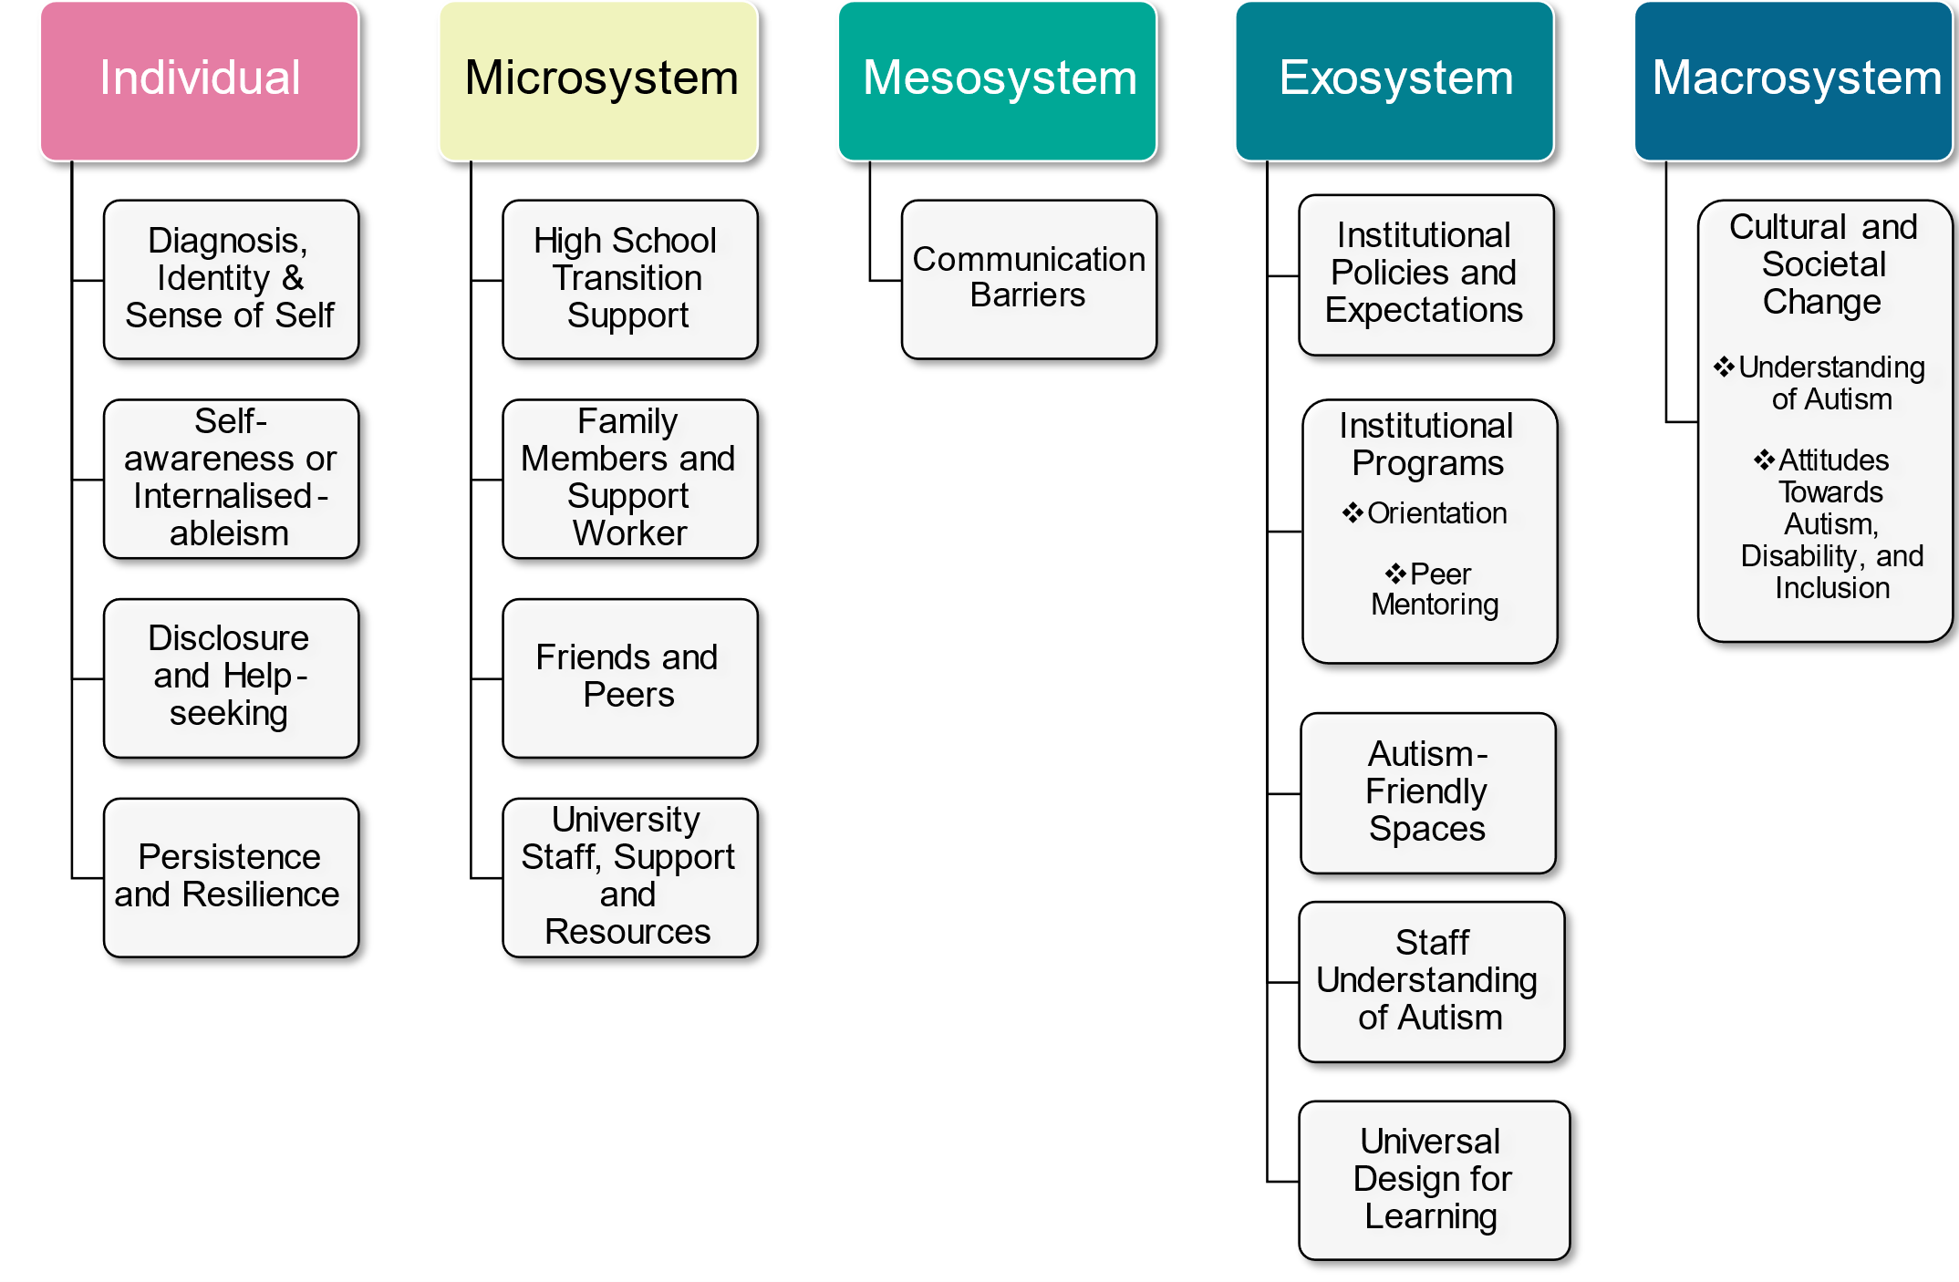
Bioecological Theory Model Factors That Impact Transition

Slide 25
Recommendations

Slide 26
Recommendations
Recommendation 1
Recommendation 2
Recommendation 3
Recommendation 4
Implement strategies that support autistic students to develop skills in help-seeking and disclosure.
Develop and promote resources which inform family members about students’ rights and responsibilities at university.
Implement strategies that are responsive to the potentially disrupted transition experiences of autistic students.
Implement and promote mechanisms which enable autistic students to identify a family member or support worker as a key contact or advocate.
23 APRIL, 2024

Slide 27
Recommendations Continued
Recommendation 5
Recommendation 6
Recommendation 7
Recommendation 8
Implement and promote strategies which enable early engagement of prospective autistic students with relevant university disability or equity services.
Ensure university disability and equity services are adequately funded and resourced to provide early and ongoing funding to support the transition needs of autistic university students.
Implement strategies which support the attendance, participation, and inclusion of autistic students at orientation programs.
Create an inclusive and welcoming campus culture, which celebrates neurodiversity and encourages autistic students to embrace their autistic identity.
23 APRIL, 2024

Slide 28
Recommendations Continued
Recommendation 9
Recommendation 10
Adopt Universal Design for Learning approaches and inclusive teaching and learning practices.
Develop and implement transition strategies which support a holistic approach to orientation and transition, such as the Five Senses of Success model.
23 APRIL, 2024

Slide 29
Contact
LinkedIn: https://www.linkedin.com/in/alison-nuske
alison@alisonnuske.com.au
alisonnuske.com.au
23 APRIL, 2024

Slide 30
Thank You
23 APRIL, 2024

