Slide 1
Autistic students’ experiences of university in Australia
Diana Tan (she/her), Marion Rabuka (she/her), Lara Hardy, Tori Haar, & Liz Pellicano
Email: diana.tan@mq.edu.au

Slide 2
Agenda
Background
Research Aim 1
Method
Results: Research Aim 1
Research Aim 2
Preliminary Results: Research Aim 2
Discussion

Slide 3
Background

Slide 4
Background
Australian policies:
Fair Chance for All (1991)
Disability Discrimination Act (1992)
Disabled students’ university enrolment increased 10-fold in the last 30 years
But what do their academic outcomes and university experiences look like?

Slide 5
Autistic students
Completion rate? Autistic people are:
Twice less likely than people with other disabilities to hold a bachelor’s degree or higher
Four times less likely than people without disabilities (ABS, 2018)

Slide 6
Autistic students
Experiences?
Sense of otherness at universities (Cage & Howes, 2020; Vincent et al., 2017)
Stereotype and stigma (Goddard & Cook, 2021; Gurbuz et al., 2019; Sarrett, 2018; Scott & Sedgewick, 2021)
Lack of understanding (Anderson et al., 2020; Cage & Howes, 2020)
Fear of discrimination (Bolourian et al., 2018; Cai & Richdale, 2016; Van Hees et al., 2015)
Lack of appropriate support and accommodations (Anderson et al., 2020; Cage & Howes et al., 2020)

Slide 7
2022 Senate Inquiry
Fear of discrimination, isolation, and low expectation at universities
“His life at university has been impacted by his refusal to tell the university that he is autistic, he feels that it would single him out and expose him to the same bullying he experienced at high school” (parent of an autistic person)
“I desperately wanted to fit in though. So I masked ... It’s basically pretending. Acting. Camouflaging. Masking is when autistic people hide their autism and try to appear neurotypical in order to fit in.” (autistic submitter)

Slide 8
Research Aim 1

Slide 9
Research Aim 1
Stigma and discrimination at universities:
Highly prevalent and pervasive
Nuanced and context dependent
Aim: Conduct an in-depth qualitative investigation into the context and circumstances in which experiences of stigma and discrimination at universities occur

Slide 10
Method

Slide 11
Participants
Advertised in November 2021
Included autistic people who were:
18 years +
English user
Diagnosed or self-identified
Prior experience with university
21 autistic people completed interview
23-56 years old
Mostly domestic students
Mostly women (including transfeminine)
About half identified as autistic before or during uni
About half were current students

Slide 12
Interview
One-on-one, semi-structured interview
Flexible choices:
Autistic or non-autistic interviewer
Interview formats (Zoom, phone, email, live text messaging)
Notes:
Not mentioning stigma or discrimination unless participants brought this up.

Slide 13
Interview
Topics covered their experiences with their:
Autism diagnosis or self-identification
Transition into university life
Interactions with their peers
Interactions with academic and professional staff
Navigating the university systems
Transcripts analysed using reflexive thematic analysis

Slide 14
Results: Research Aim 1

Slide 15
Results
1. “My disability is something that people just don’t have a clue about”
1.1 “Being profoundly misunderstood”
1.2 “Fear of not being believed”
2. “The system is really stacked against you”
2.1 University being inaccessible
3. The onus is on autistic students
4. “Grit and stubbornness”
1.3 “Autistic people are never just autistic”
2.2 Unequal power dynamics
3.1 To advocate for their own support needs
3.2 Advocacy came at a cost
4.1 “[Making] my study work for me”
4.2 Caring and advocating for other marginalised students

Slide 16
Theme 1: “My disability is something people just don’t have a clue about”
Sub-theme 1.1: “Being profoundly misunderstood”
“University supports have a very poor understanding how [autism] affects capacity … How we approach university tasks.”

Slide 17
Theme 1: “My disability is something people just don’t have a clue about”
Sub-theme 1.2: “Fear of not being believed”
Upon disclosing being autistic, one participant was told that:
“I wouldn’t make a very good teacher and that I should probably not continue with my course.”
Another participant who was an autistic autism researcher shared their experiences applying for ethics approval:
“I felt like I had to prove more because I was seen as a potential harm because of the fact that I am autistic – as in, how can I be trusted to understand when somebody is distressed”

Slide 18
Theme 1: “My disability is something people just don’t have a clue about”
Sub-theme 1.3: “Autistic people are never just autistic”
“My history is complicated as an autistic person by also being half Italian. When I went to uni, I actually had people say how exotic it was that I was there. So, some of the stuff is hard to pull apart from getting an extra set of messages that I didn’t deserve to be there anyway.”

Slide 19
Theme 2: “The system is really stacked against you”
Sub-theme 2.1: University being inaccessible
University processes that are meant to help autistic students were described as:
“Massive bureaucracy”
“Lots of hoops to jump through”
“A million forms that you need to fill out”
“A symbolic violence – a deliberate process to make people like me give up”

Slide 20
Theme 2: “The system is really stacked against you”
Sub-theme 2.2: Unequal power dynamic
“… [a lecturer] said, she doesn’t want any adjustments for students with disabilities. And also, she said she got lots of emails from Access and Inclusion that I was struggling with her course, but she said, ‘when I got those emails, I didn’t trust those emails because you didn’t look like you were struggling with my course. You didn’t need so much support. You should be more confident with yourself’. Though, the truth was I needed support, but she refused to implement adjustments for the entire semester.”

Slide 21
Theme 3: The onus is on autistic students
Sub-theme 3.1: To advocate for their own support needs
Many autistic students had to:
“keep pushing until it resolves”
“continuously ask for it”
“prove your worthiness as a disabled person”
“This is the sort of thing they’re saying, we help all people, we like diversity, and all that – that’s complete bullshit. You expect a person who’s from the minority … to do all of that work and what are you actually giving in return?”

Slide 22
Theme 3: The onus is on autistic students
Sub-theme 3.2: Advocacy came at a cost
Many participants felt the “emotional burden” that “impacts on one’s dignity” – that “somehow it’s a failure if I ask for help”.
“The stigma that a lot of people carry and have internalised around disability services because they’ve internalised the shame of disability for whatever reasons.”

Slide 23
Theme 4: “Grit and stubbornness”
Sub-theme 4.1: “[making] my study work for me”
Many felt that through their university experience, they:
had “a better understanding of how I work”
“learned a little bit more about what I can and can’t do”
recognised “when things are getting too much and [drew] boundaries”
but it is all “a very expensive lesson to learn”

Slide 24
Theme 4: “Grit and stubbornness”
Sub-theme 4.2: Caring and advocating for other marginalised students
Despite the toll that advocacy could take, many participants were passionate about advocating for other marginalised students:
Provided “peer support” or “mentoring”
Founded “Pride society”
Developed “disability ally training”
Sat on “Academic Board”

Slide 25
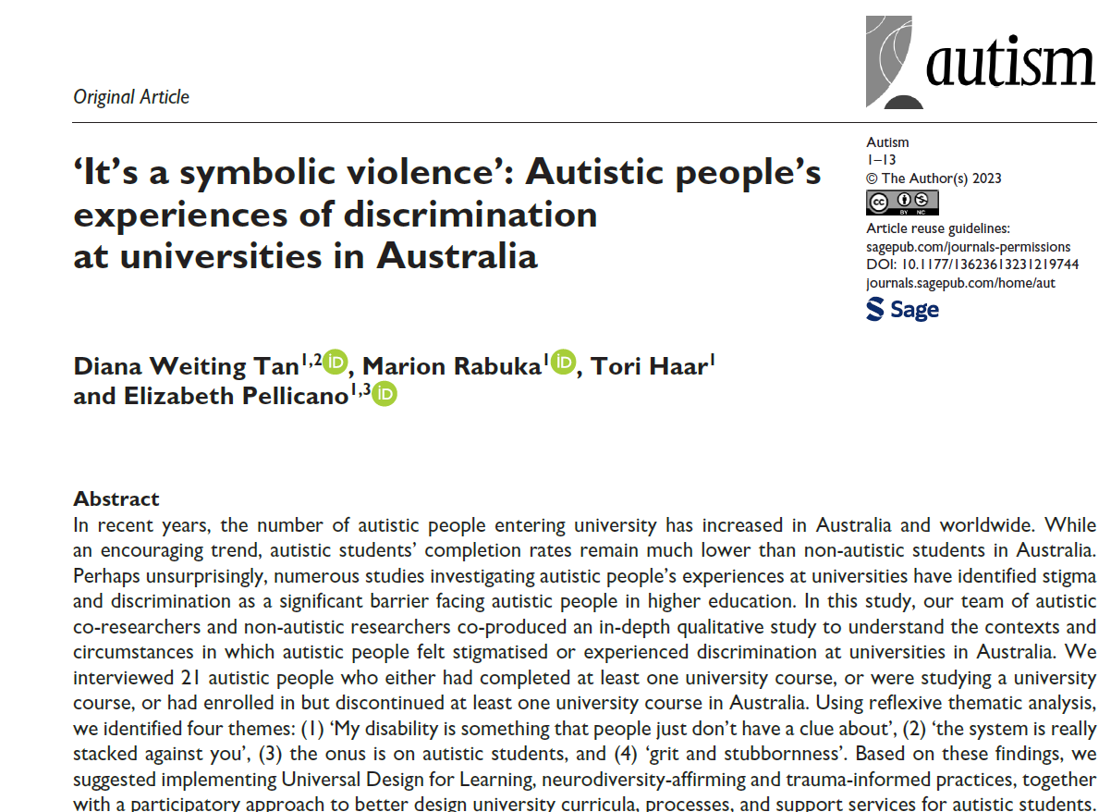
Published
Free to access: https://journals.sagepub.com/doi/10.1177/13623613231219744

Slide 26
Research Aim 2

Slide 27
Research Aim 2
In light of results from Research Aim 2, we are now analysing the same set of transcripts to address the following research questions:
How do autistic students approach university?
How can university support autistic students’ ways of learning?

Slide 28
Preliminary Results: Research Aim 2

Slide 29
Preliminary Results
1. “I had to fight really hard to get through”
1.1 “I have had a pretty rough life”
2. “Took me a lot longer to make sense of the system”
2.1 “You hit uni and you’re on your own”
3. Fostering an enabling environment
4. Building a sense of belonging
1.2 “A sensory nightmare”
2.2 “There were a lot of unwritten rules”
3.1 “Induction into university life”
3.2 “Normalising alternative forms of communication and assessments”
4.1 “The freedom to just be”
4.2 “It’s an individual responsibility”
1.3 “I process information in a different way”
3.3 “It was okay to ask for more help”

Slide 30
Theme 1: “I had to fight really hard to get through”
Sub-theme 1.1: “I have had a pretty rough life”
While going through university, many were also:
Being “homeless” and in “unsafe living situations”
Dealing with “harassment and discrimination”
Processing “a lot of trauma in childhood”
Many entered university from “a high school experience that was pretty horrific” where they “weren’t accepted” and were “chronically bullied”.
All of these experiences affected how autistic students approached university.

Slide 31
Theme 1: “I had to fight really hard to get through”
Sub-theme 1.2: “A sensory nightmare”
Several participants experienced “so much difficulty around class sizes and lecture halls”, with “so many people, so many smells”.
So much so that they could not “process the auditory stuff” or “hear what the lecturers were saying” – they just “couldn’t be in that space”.
For exams, students found that “smaller locations were better”. For one participant who wasn’t given the accommodation she needed, her grade
“… wasn’t a reflection of my ability, it was a reflection of my intense anxiety when I am in a bad sensory environment.”

Slide 32
Theme 1: “I had to fight really hard to get through”
Sub-theme 1.3: “I process information in a different way”
Often there was “no processing time” even though “it takes me a bit longer to process things”.
“I’m a good student, not despite the fact that I’m autistic, it’s because I’m autistic. The hyper focus and just the attention to detail, organisational skills. These things make me a good student. … But at the same time, the poor working memory, the inability to get instructions, the social stuff, the networking stuff, all of that stuff I can’t do … it doesn’t make sense against this thing that seems really academic.”

Slide 33
Theme 1: “I had to fight really hard to get through”
Sub-theme 1.3: “I process information in a different way”
To compensate for these processing differences without much support, many autistic students felt that they “spend so much time covering up” these challenges that other people always see the “high achiever … [but] none of them ever saw the burnout” – “they don’t see the work underneath”.
“It takes me about 200 hours to write 2,000 words. And I’ll get a HD, but it’s just such a slow process.”

Slide 34
Theme 2: “Took me a lot longer to try to make sense of the system”
Sub-theme 2.1: “You hit uni and you’re on your own”
Many autistic students initially felt excited about going to university as they saw it as “an opportunity to reinvent myself”.
But their transition into university life was “really difficult” and they were “on your own” to “figure out what’s the norm” in a “completely different environment” and “form of studies” to school, without any “good frame of reference for what you’re supposed to do”.
“… it was not only the transition in learning environment, but it was also the transition to living independently and having to self-manage so many aspects of my life”.

Slide 35
Theme 2: “Took me a lot longer to try to make sense of the system”
Sub-theme 2.2: “There were a lot of unwritten rules”
Many participants found that “there were a lot of unwritten rules” they didn’t understand, like “teacher student relationship”, “expectations from lecturers and tutors”, the “online portal” , etc.
Wayfinding was a particular issue experienced by many:
“… campus maps didn’t have the room numbers, and the room numbers didn’t make sense … And different buildings had different room numbers. And the naming conventions. … I would be an hour early to class because it’s like I have to find this room … I found it really difficult.”

Slide 36
Theme 3: Fostering an enabling environment
Sub-theme 3.1: “Induction into university life”
“Sometimes the biggest step is getting to know the people and the uni, and feeling comfortable in your environment, not actually your capability of doing the study.”
“Induction or a transition process where all of the ins and outs and all of that unwritten rules, that hidden curriculum stuff, was explained”
“Having someone show me around initially would’ve been good [for the] wayfinding stuff in the university”

Slide 37
Theme 3: Fostering an enabling environment
Sub-theme 3.2: “Normalising alternative forms of communication and assessment”
Flexible structures and pedagogical approaches work well for autistic students:
“Priority timetable preferencing”
Communication mode: phone call, in-person/online meeting, email
“Providing information in different formats is good for lots of students”
Recorded lectures available online: “lets me pause, rewind and understand”
Closed captioning and transcripts because “I find reading a lot easier”
Flexible marking rubric
“We see the world differently; we produce differently. So having the option to present our work differently would be wonderful.”
Notes:
Normalising asking for help

Slide 38
Theme 3: Fostering an enabling environment
Sub-theme 3.3: “It was okay to ask for more help”
“I had a tutor tell me that more than half the people in psych had an EAP and she herself had an EAP and that normalised it for me and made feel like it was okay asking for more help.”

Slide 39
Theme 4: Building a sense of belonging
Sub-theme 4.1: “The freedom to just be”
“… it was built into the ethos and spirit of the school, that there are lots of different people with lots of different lives and lots of different reasons and lots of different challenges. And so, it was just the done thing to be understanding.”
In an affirming environment, autistic students felt:
“deep acceptance and lack of judgement … a sense of freedom”
“I really thrived … when I found people like me”
“because they have autistic tutors, … they’ve got to be at least open to seeing value in who we are”

Slide 40
Theme 4: Building a sense of belonging
Sub-theme 4.2: “It’s an individual responsibility”
Most positive experiences come from those lecturers who were:
“really proactive and reaching out to me and making sure I was doing okay”
“willing to take time out to explain things to me”
“willing to go away and do a bit of [work to understand] … understand how to support them” so it is not entirely up to autistic people to educate them

Slide 41
Discussion

Slide 42
Discussion
Lack of autism understanding → Improve autism understanding (Gillespie-Lynch et al., 2015; Someki et al., 2018)
Caveat: “attitude-behaviour gap” (von Below et al., 2021)
Neurodiversity affirming universities (Dwyer et al., 2022)
Investing in neurodivergent-led initiatives
Embracing participatory approach and user-led involvement

Slide 43
Discussion
Support services are paradoxically difficult to access
Re-consider requirements to provide diagnostic letters
Consider academic pressures + administrative burden + executive dysfunction
Universal Design for Learning
Trauma-informed practice
Many students have experienced trauma which affect the way they engage
Self-advocacy comes at a cost
Useful resource: Blue Knot Foundation’s Disability Guidelines for Trauma-Informed Practice (URL: https://blueknot.org.au/product/guidelines-for-trauma-informed-practice-disability-digital-download/)

Slide 44
Thank you! Email: diana.tan@mq.edu.au

