Slide 1
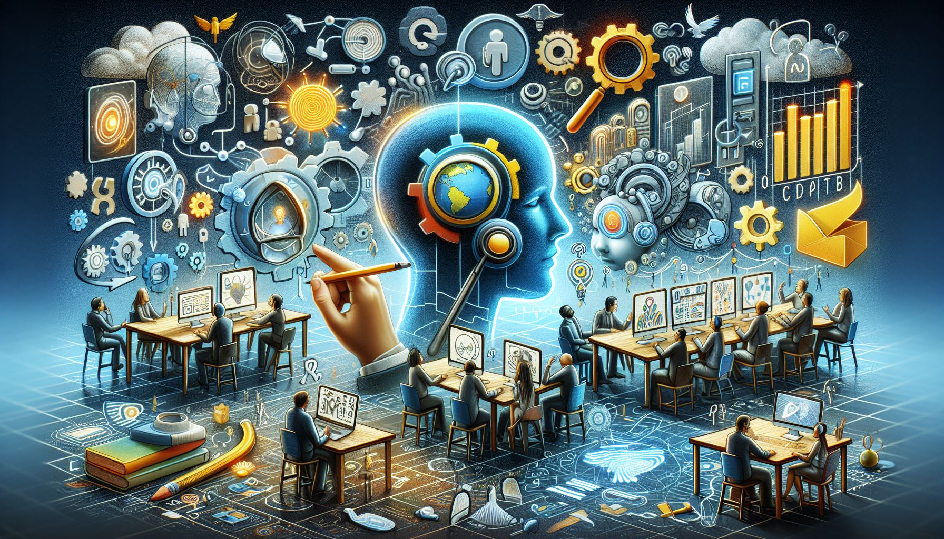
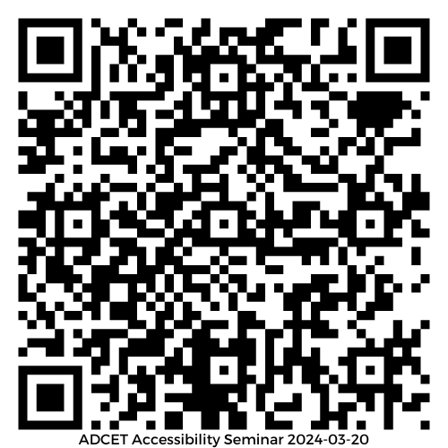

Applying AI and UDL for Inclusive Learning:
Perceptibility, Flexibility, Accessibility
Presented by Elizabeth Hitches & Joe Houghton

Slide 2
Acknowledgement of Country
We acknowledge the Traditional Custodians of the various lands on which we are all joining from today and recognise their valuable contributions to Australian and global society.
We pay our respects to their Elders, Ancestors and their descendants, who continue cultural and spiritual connections to Country and acknowledge Aboriginal and Torres Strait Islander people joining here today or engaging with recording.

Slide 3
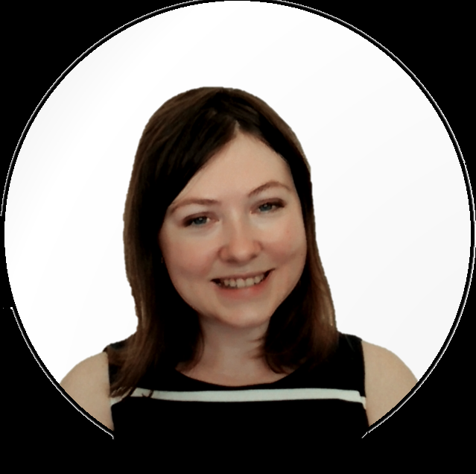
Elizabeth Hitches
Sessional academic teaching inclusive education and research methods
Member of CAST's National Faculty
Associate Fellow of the Higher Education Academy
Consultant on UDL and academic stress
PhD candidate exploring students' stress in higher education, taking an inclusive and UDL approach
Elizabeth’s research is available via Google scholar: Elizabeth Hitches or Elizabeth’s ORCiD
Contact Elizabeth on LinkedIn or via Elizabeth’s email

Slide 4
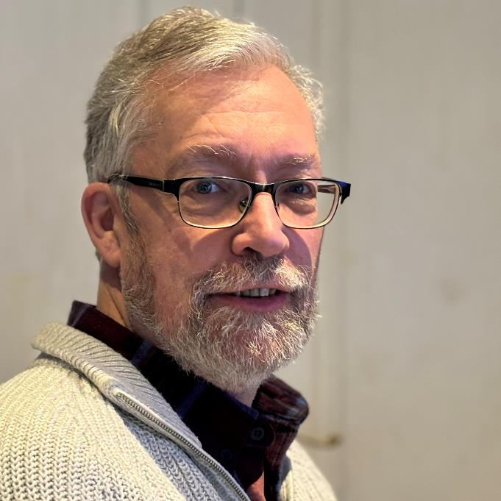
Joe Houghton
Joe is an Assistant Professor based in Dublin, Ireland. He's married to Penny, a psychotherapist, and has 4 children aged 21 down to 11.
He created and directs 2 Masters programmes in Project Management at the UCD Smurfit Graduate School of Business.
Joe regularly consults with educational institutions, companies and non-profits on business planning, and more recently AI use and implementation.
He has written 6 books to date, 2 on AI in Education & Accessibility, a project management textbook and 3 on photography. Find out more on Joe’s ORCID
Connect with Joe on LinkedIn or via Joe’s email

Slide 5
Why should you stay for an hour?
We’ll show you how easy it is to incorporate accessibility into your materials using tools you already know, plus some AI ones
It’s not just about text, but imagery as well – multiple means of representation!
This will be a practical and interactive session, so heckling, questions and comments are encouraged ☺

Slide 6
AI generated image on accessibility and AI
Image created by Microsoft CoPilot using the prompt "generate me an image around accessibility, perception (in UDL) and AI"

Slide 7
Universal Design for Learning
Reduce potential barriers through "multiple means" of perceiving, participating and engaging in learning
Universal approach with options available to all

Slide 8
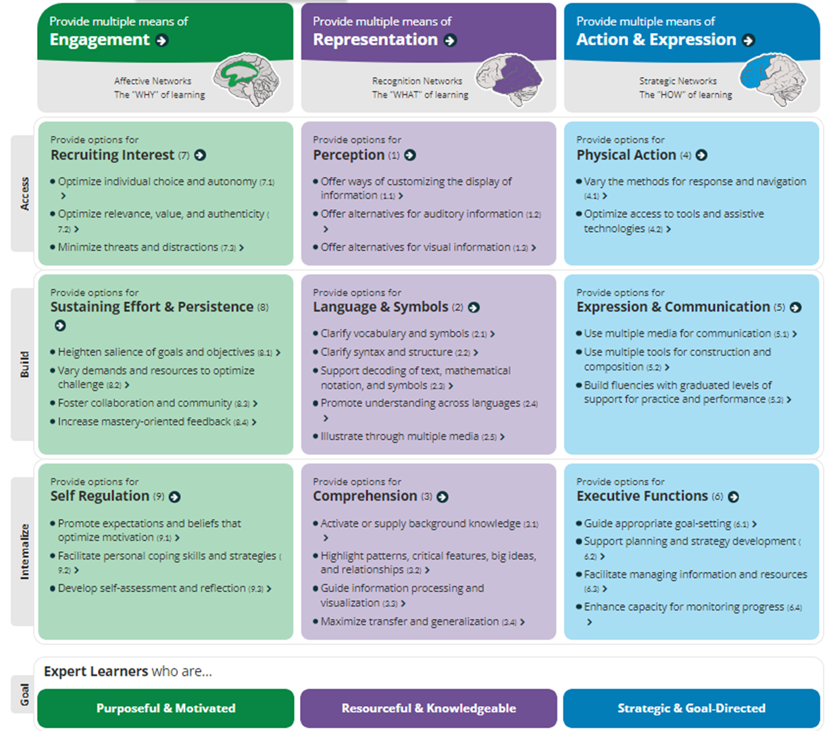
UDL and Accessibility
(CAST 2018)

Slide 9
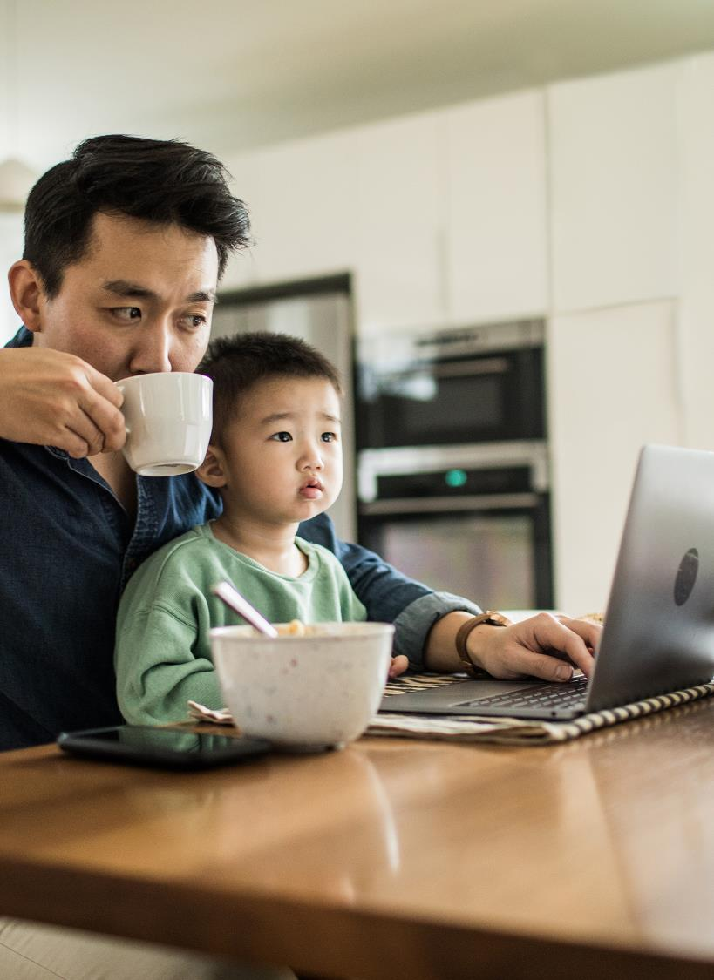
Perception
Is the information presented accessible and able to be comprehended or understood?
Perceptible by all, including:
Individuals with sensory or perception disabilities
Individuals engaging with resources in different environments
Individuals drawing on technology to provide access or to enhance or personalise their experience

Slide 10

UDL, Perception and Accessibility
Provide options for Perception:
  Offer ways of customising the display of information
  Offer alternatives for auditory information
  Offer alternative for visual information

Slide 11
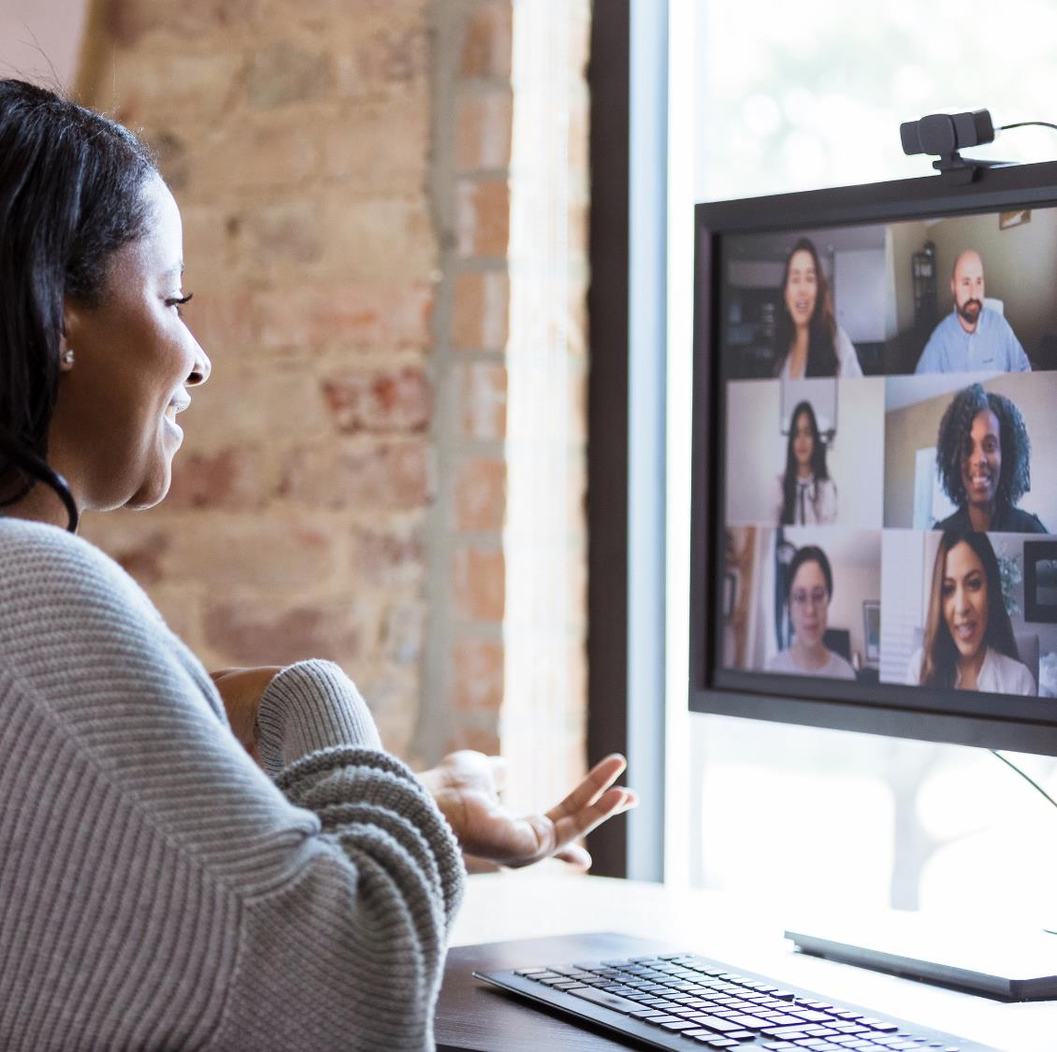
Practical examples
Zoom
  Closed captions and audio options
  Visual introductions
  "Integrating the chat"
  Recording
Word
  Immersive reader
  Headings
  Sharing a customisable format
PowerPoint
  Alt text
  Verbal descriptions
  Sharing a customisable format

Slide 12
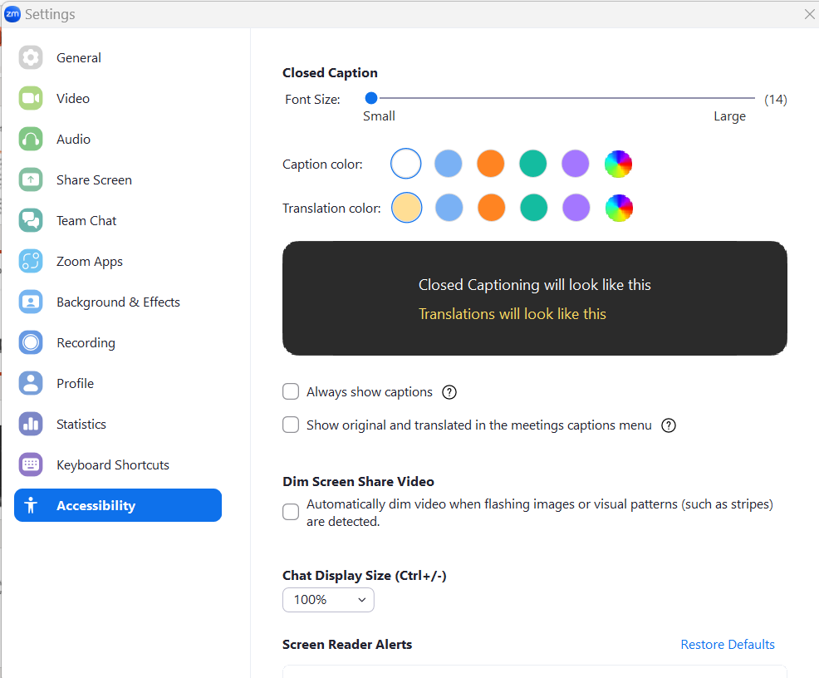
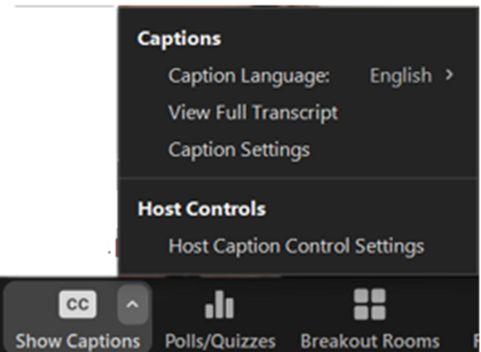
Zoom – closed captions and customisation

Slide 13
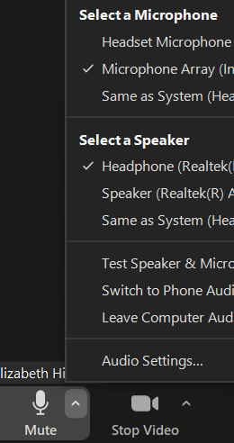
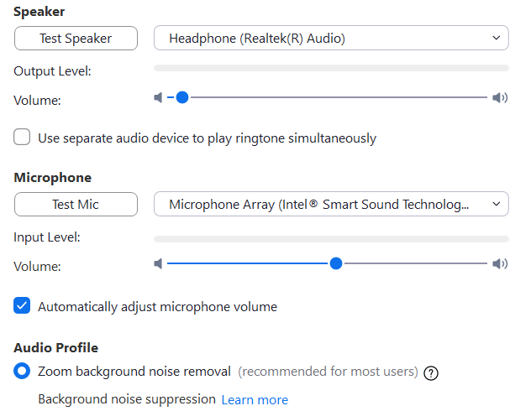
Zoom – optimising and customising audio

Slide 14
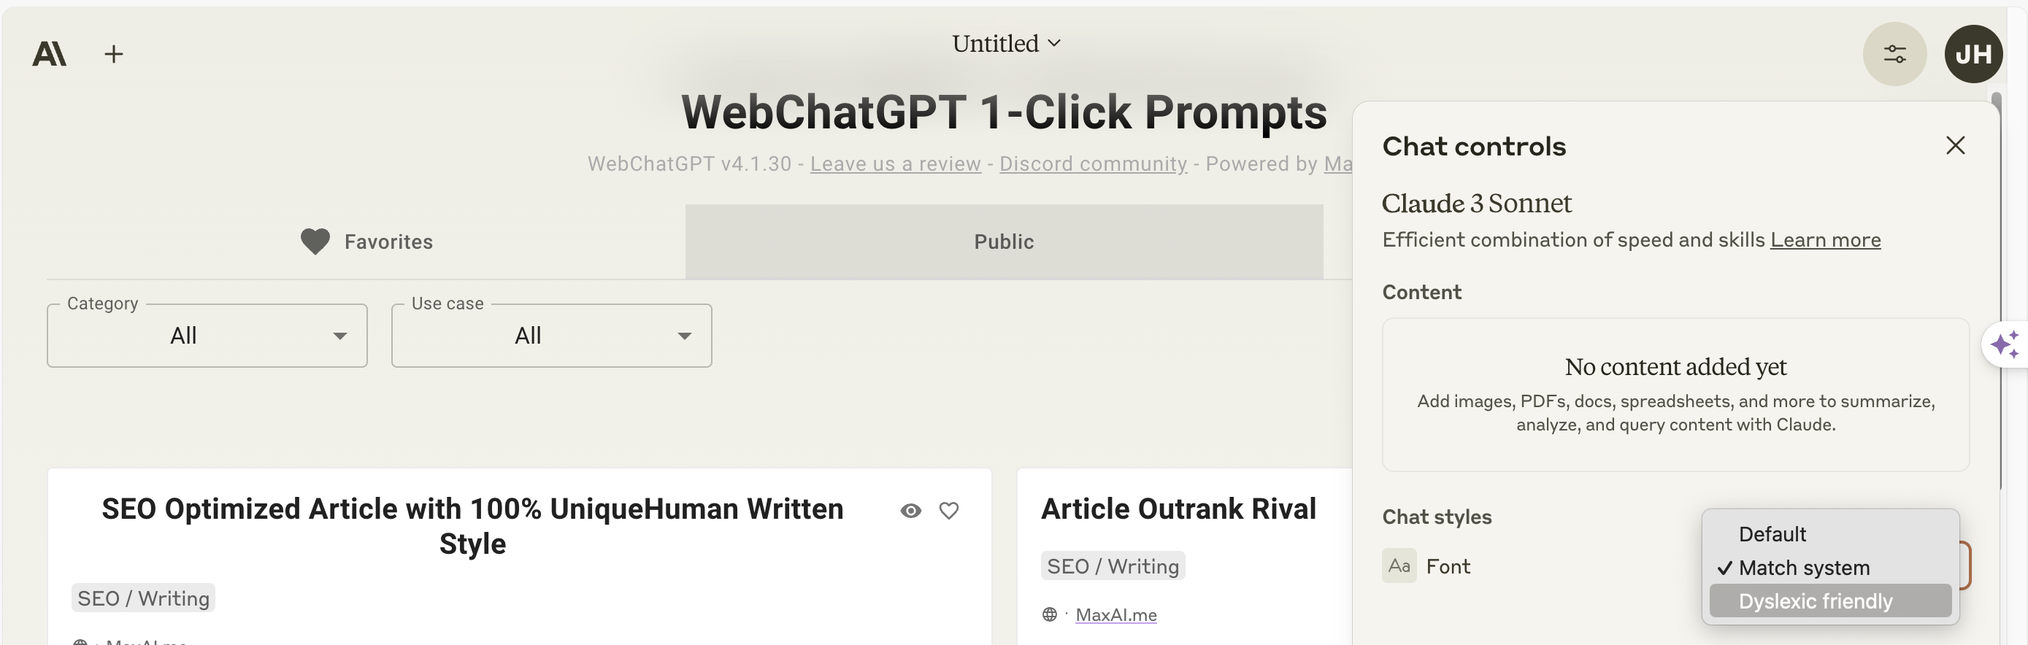
Claude AI – display for dyslexics
Claude AI - https://claude.ai/ has a setting to show a dyslexic friendly font. Click the button top right next to your initials then select under chat styles.

Slide 15
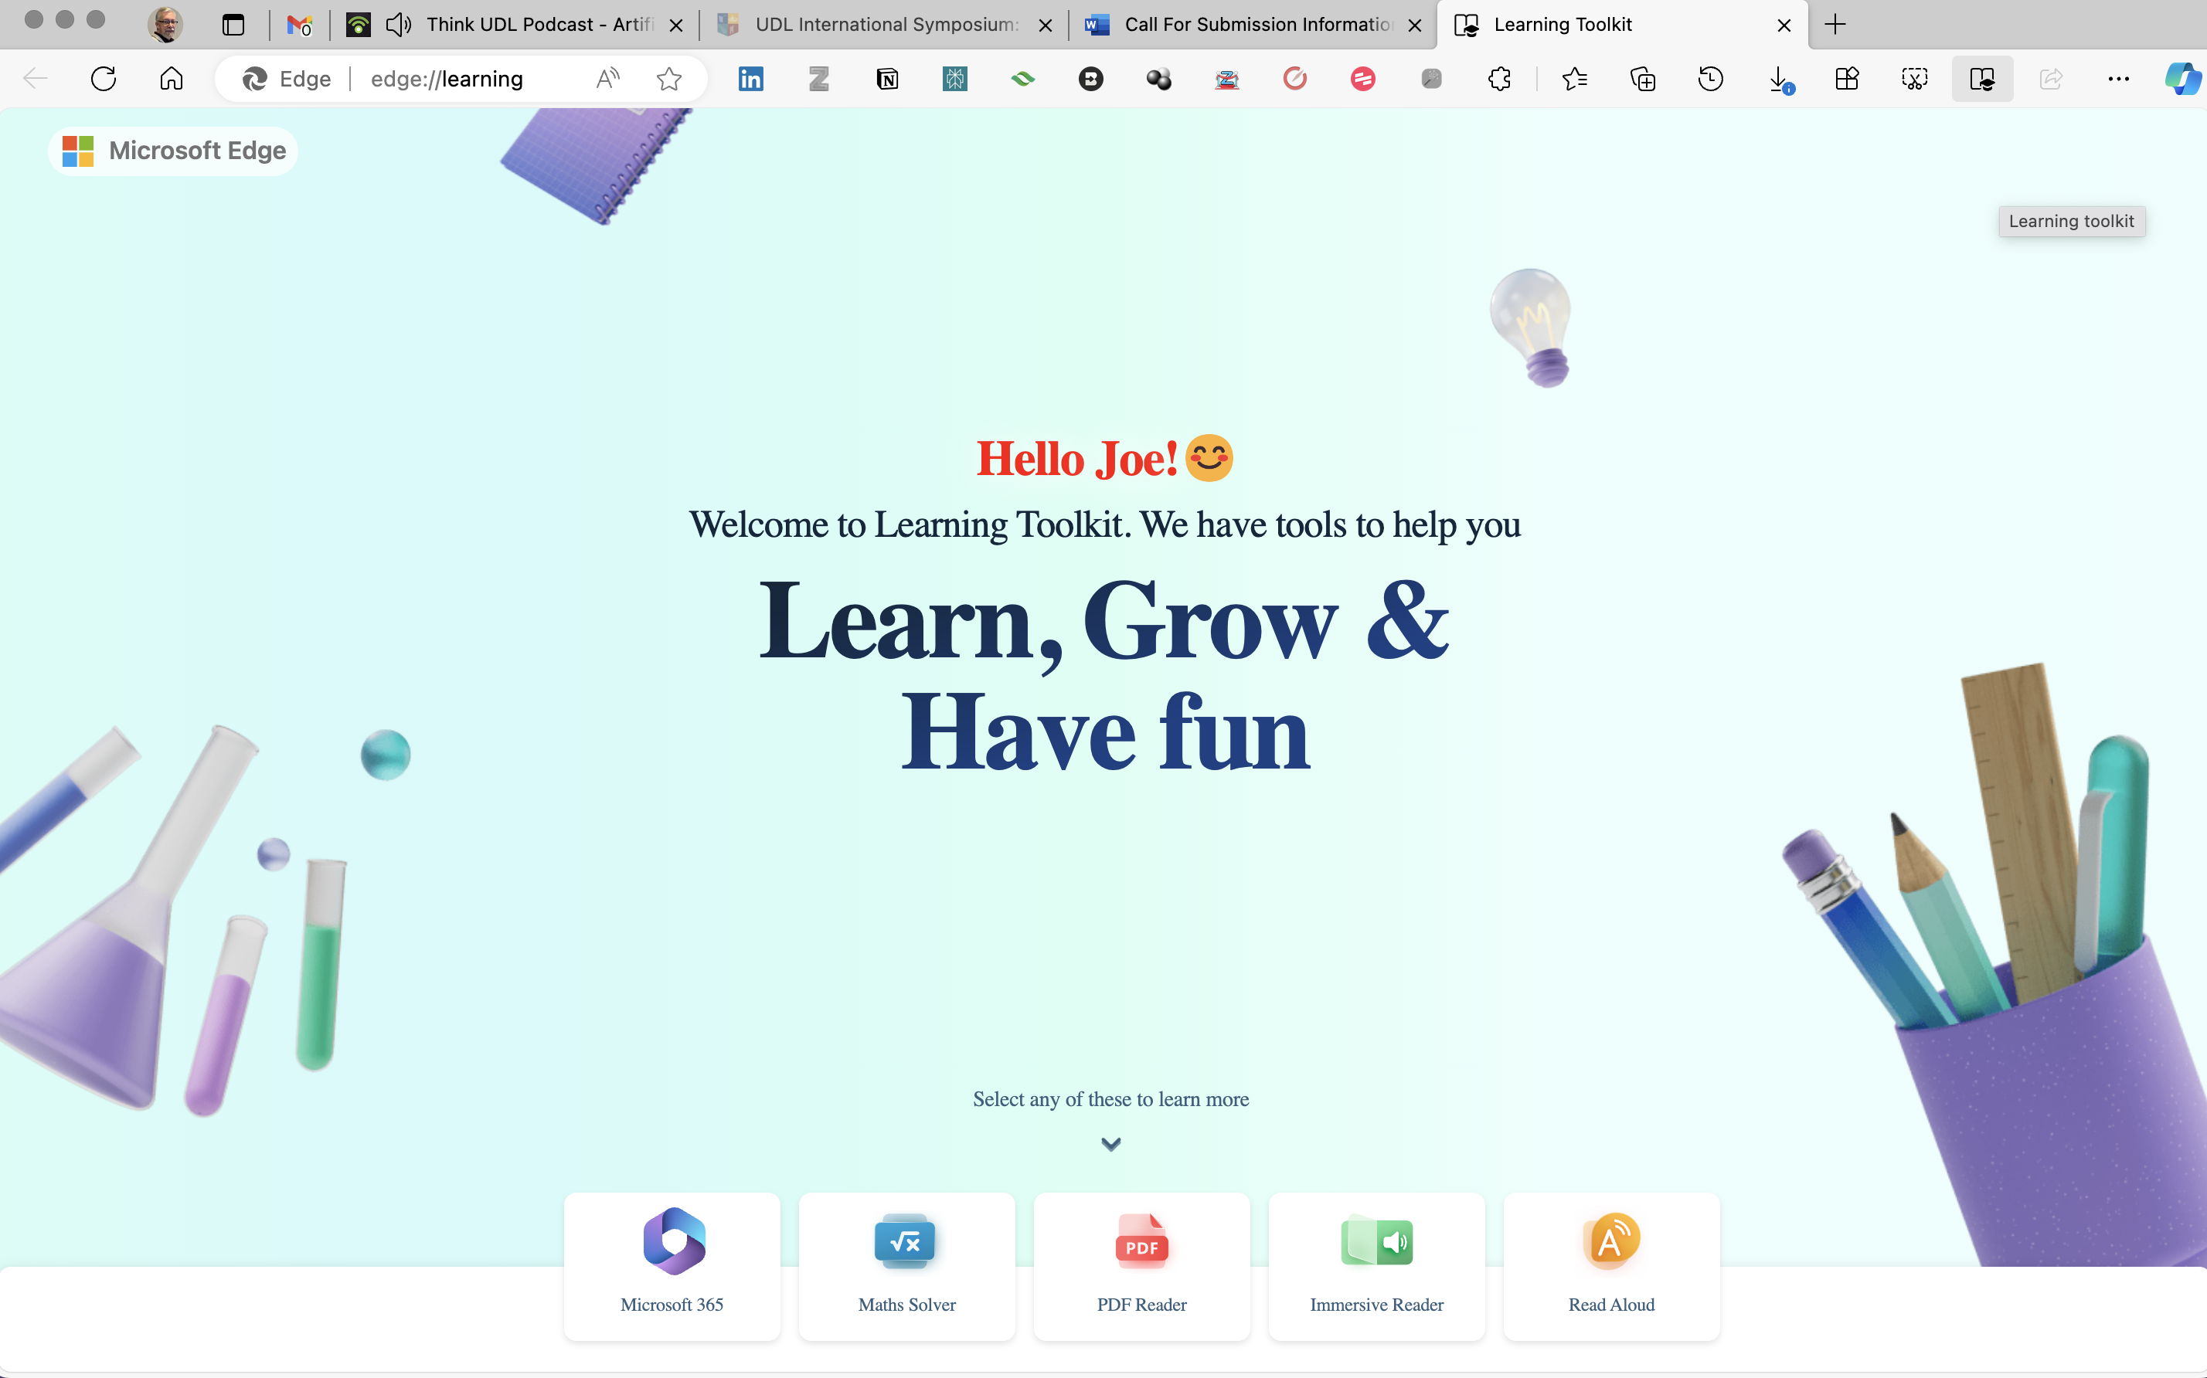
Microsoft Edge has a Learning Toolkit that points out some good accessibility tools – type edge://learning/ into your URL bar

Slide 16
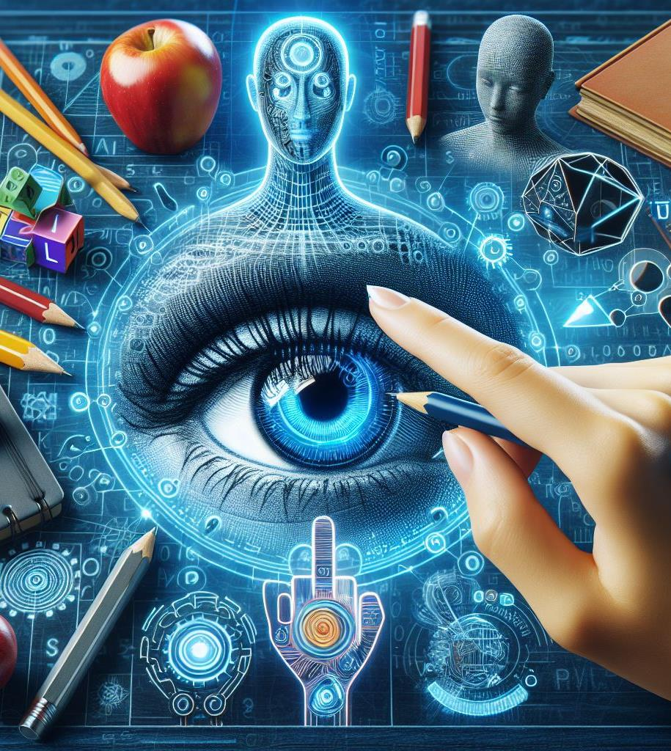
Artificial Intelligence
“AI in UDL facilitates personalized and accessible learning by adapting educational content to diverse student needs and preferences – ideally during the content creation process rather than afterwards as accommodations”

Slide 17
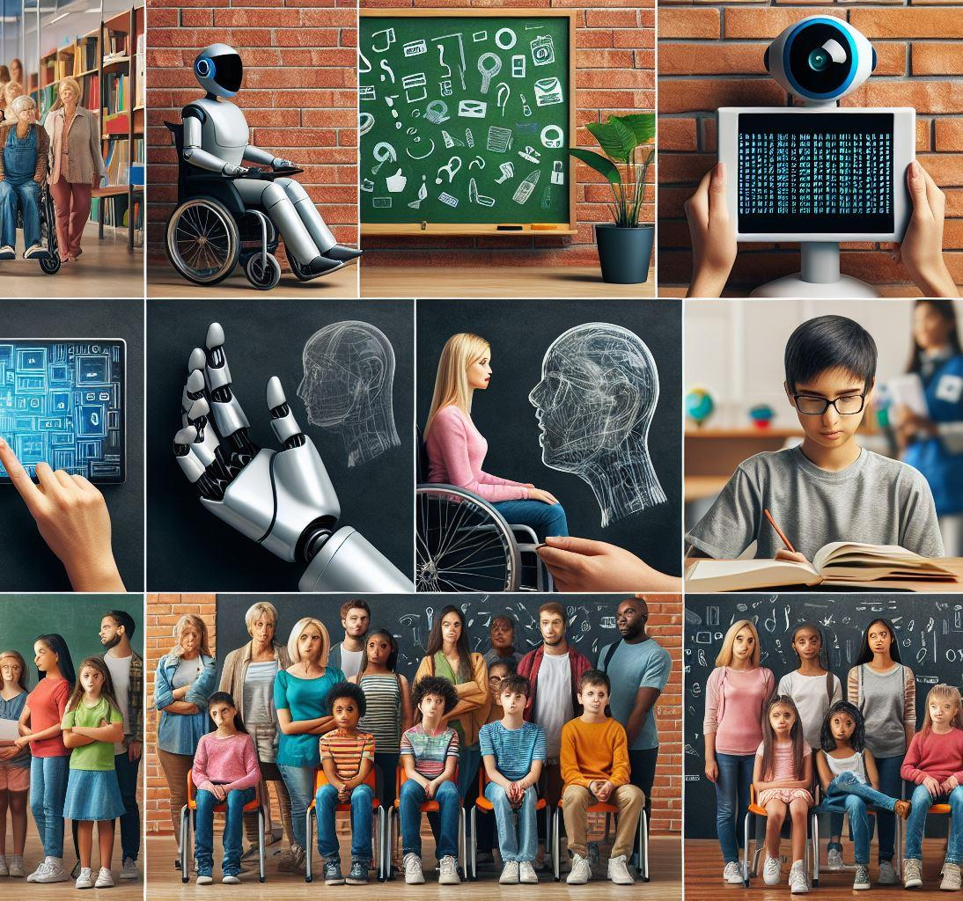
Practical AI examples
CoPilot for pictures – create a picture and then get everyone to comment and change it
Show and check Notion page against the accessibility WCAG guidelines and in a screen reader
Alt-text AI generator - Use April's bracelet and then it generates INCORRECT alt-text – good for discussion – don't trust AI (yet...)
Krisp – AI audio cleaner for better audio
Image created in CoPilot AI using the prompt “Create me an image showing accessibility in AI and teaching”

Slide 18
Practical AI examples (2)
Zoom AI – automated summary of calls/meetings/webinars.
Otter
ChatGPT – create a lesson plan. Get CPT to ask the students questions about a subject – act as a teacher/coach.
Claude – upload a document and get AI to summarise it
Image created in CoPilot AI using the prompt “Create me an image showing accessibility in AI and teaching”

Slide 19

Resources from Elizabeth
Blog posts by Elizabeth
  Heading structure
  Customising your mouse pointer
Published articles on equity and inclusion
ADCET’s resources on accessibility and UDL

Slide 20

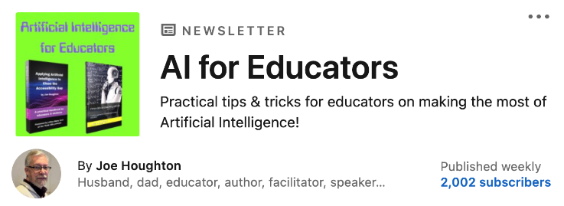

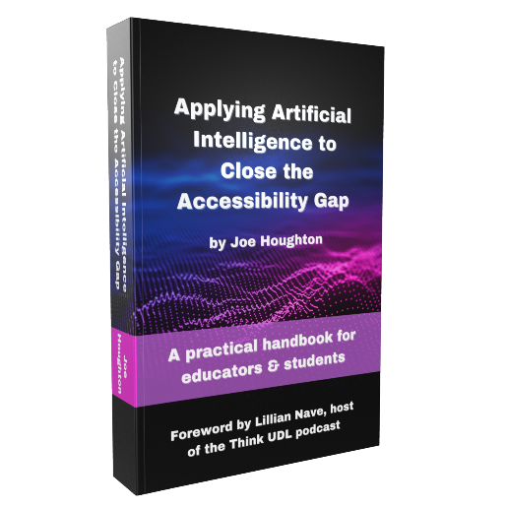

Resources from Joe
AI Newsletter link :
Subscribe on LinkedIn
Books by Joe
(all available on Amazon in hard, soft, Kindle and audio formats)
  Applying AI to close the Accessibility Gap (2024)
  Innovative Teaching with AI (2023)
  Project Management made easy – the ECCSR approach (2024)

Slide 21
Some Accessibility Tools
About Immersive Reader
How to improve accessibility using the accessibility checker
The 10 best accessibility tools for 2024

Slide 22
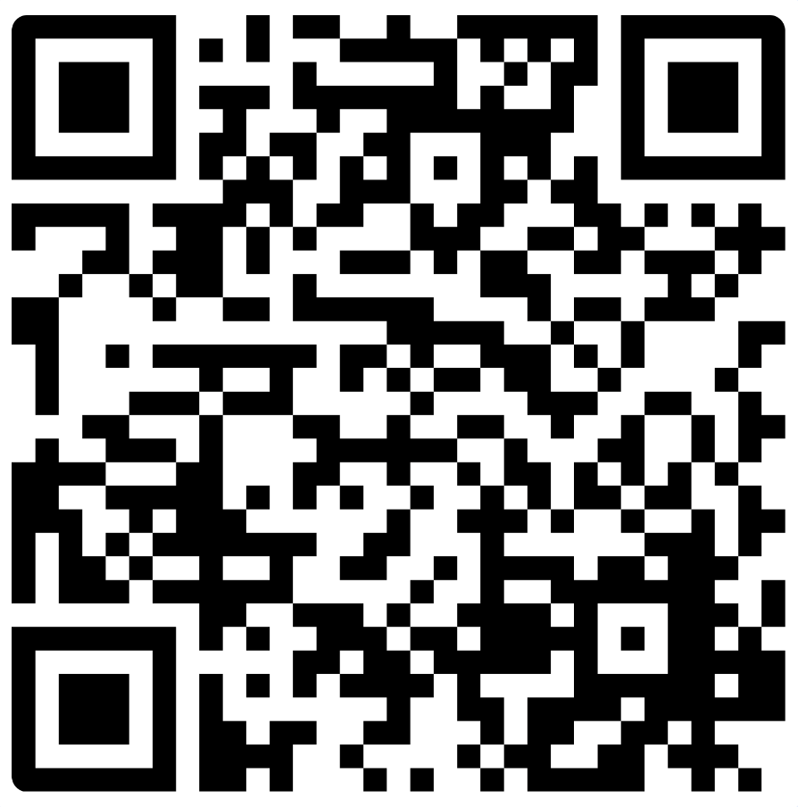
Conclusion
Are there any "perfect" apps to use for accessibility?
Quick Mentimeter feedback - https://www.menti.com/aldcz649mic5
Our own personal key takeaways

