Slide 1
Digital Maths - The future of inclusion and how we can get there

Slide 2
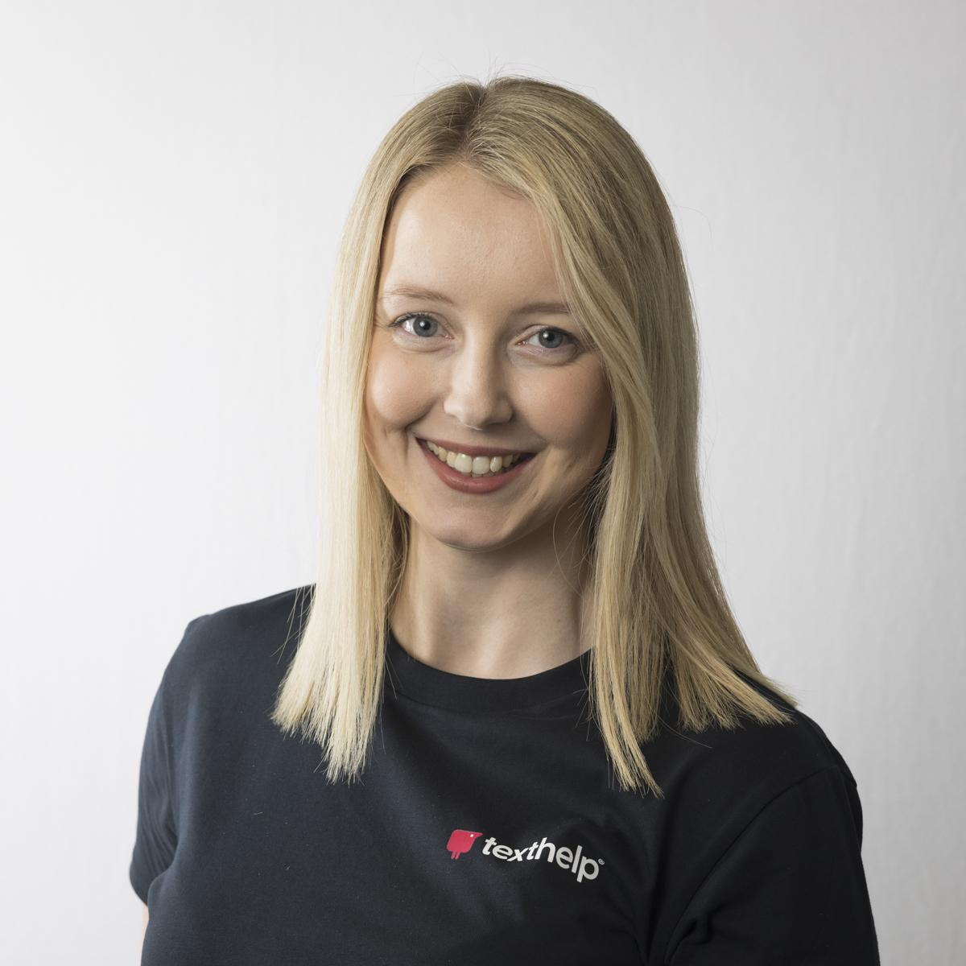
Welcome
Hello,
I’m Rachel
Customer Success Director
Email: r.coathup@texthelp.com
@TechMissC

Slide 3
ACKNOWLEDGEMENT OF COUNTRY

Slide 4
Inclusion

Slide 5
Visible vs Invisible
Visible
Invisible

Slide 6
How do you feel about Maths?

Slide 7
I am not good at maths …..

Slide 8
Mathematics Quote
Mathematics is a discipline that is often misunderstood. You hear people say repeatedly that there is always a right or wrong answer. Often this is the case but there is rarely a single correct solution.
Cavadino, S. (2022) Understanding and Solving Problems in Southall, E. [ed] If I could tell you one thing

Slide 9
Mathematics Equation
maths
success
engagement
motivation

Slide 10
impact on education and employment

Slide 11
Maths Quote 2
https://www.lboro.ac.uk/news-events/news/2021/june/lack-math-education-affects-brain-development/
"lack of math education negatively affects adolescent brain and cognitive development"
Loughborough University 2021

Slide 12
Learners with persistent maths problems in school are...
13%
29%
less likely to graduate high school
less likely to attend university
Source: PhysOrg.com
Notes:
https://phys.org/news/2011-04-early-math-skills-academic-success.html

Slide 13
kids don’t understand the importance of STEM
until it’s too late
Sources:
Australian Curriculum
Notes:
Sources:
Australian Curriculum https://www.dese.gov.au/australian-curriculum/national-stem-education-resources-toolkit/introductory-material/why-stem-important

Slide 14
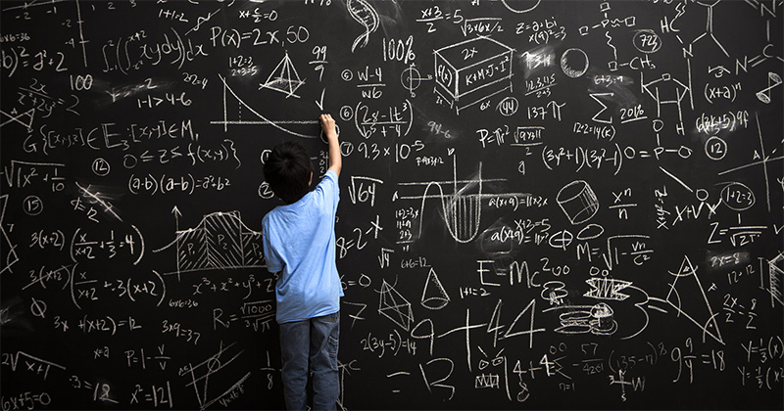
Image – Maths on Blackboard

Slide 15
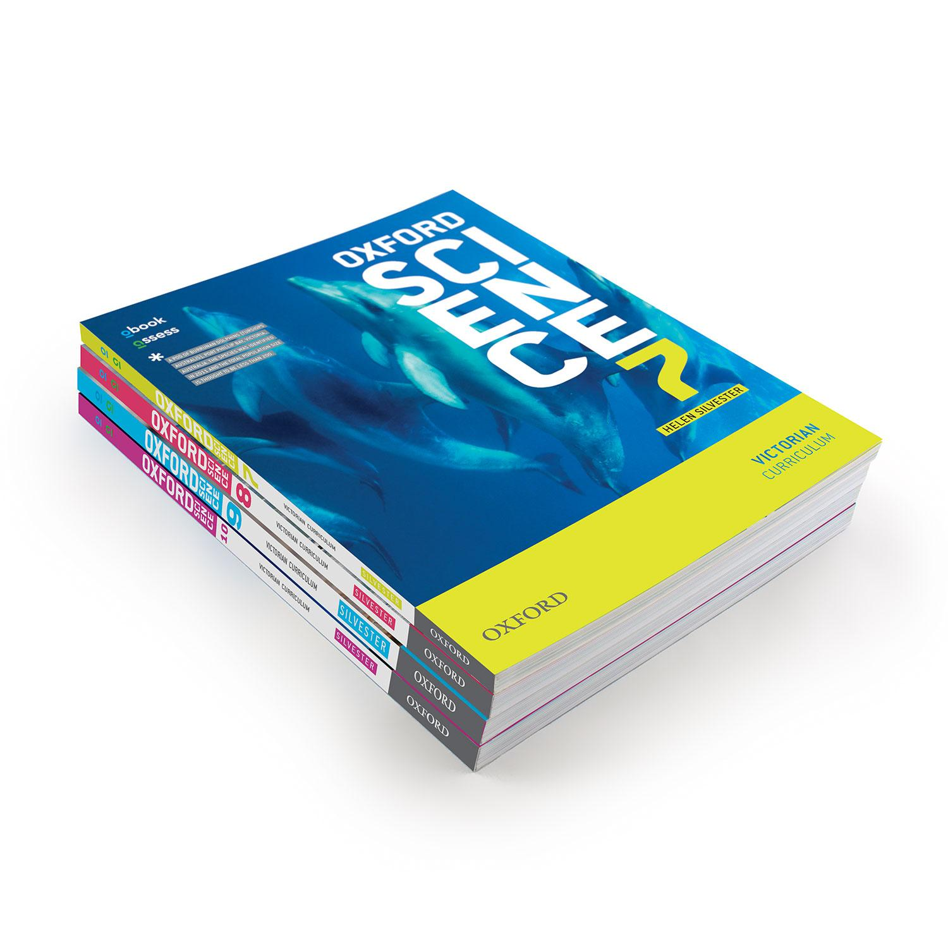
designed for the average?
See also The Myth of Average: Todd Rose at TEDxSonomaCounty
Notes:
(Barton & Heidema, 2002)
https://www.youtube.com/watch?v=4eBmyttcfU4

Slide 16
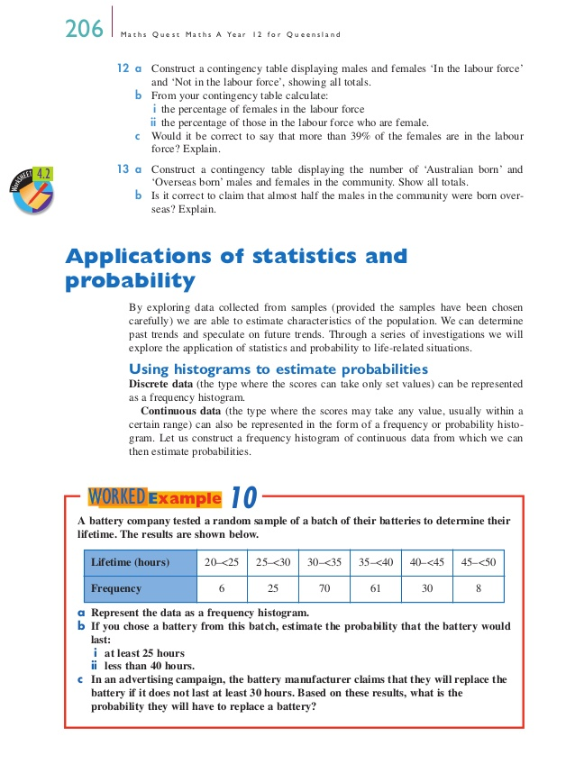
Math textbooks
Math textbooks contain more concepts per sentence and paragraph than any other type of text.
Joan M. Kenney (2005) Literacy Strategies for Improving Mathematics Instruction, ASCD, 2005

Slide 17
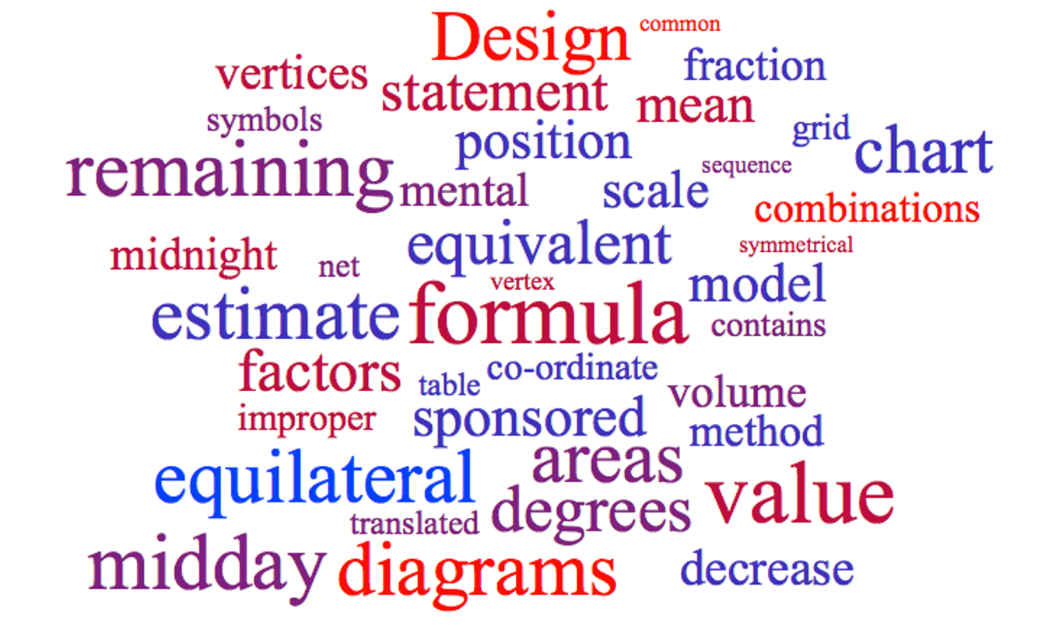
Categories of maths vocabulary
Categories of maths vocabulary
Specific - hypotenuse
Multiple meanings according to context - difference, cardinal, take away
Homophones - pi / pie
Alex Quigley (@HuntingEnglish
Does reading *really* matter in mathematics?
Notes:
https://www.theconfidentteacher.com/2021/04/does-reading-really-matter-in-mathematics/

Slide 18
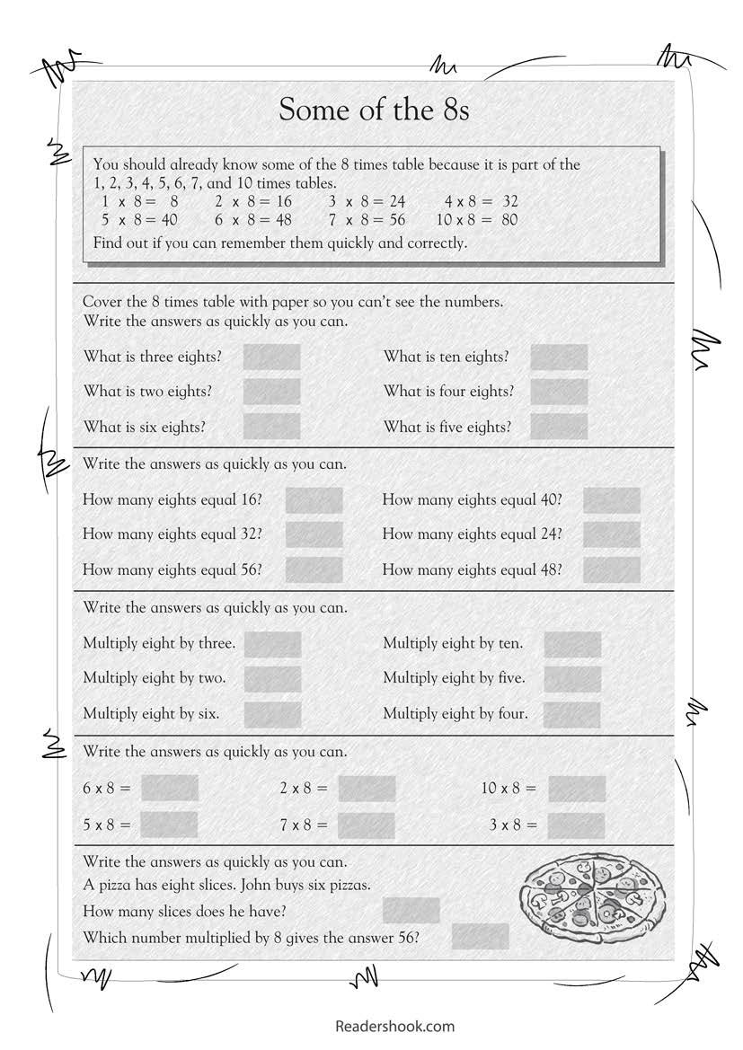
do maths or read maths?

Slide 19
Dyslexia

Slide 20
Dyslexia - difficulties
60%
Of individuals with dyslexia will have difficulties with maths
Source: British Dyslexia Association
Notes:
https://www.bdadyslexia.org.uk/dyscalculia/how-can-i-identify-dyscalculia/how-does-dyslexia-affect-maths-learning

Slide 21
Dyscalculia
Notes:
https://dsf.net.au/learning-difficulties/dyscalculia/what-is-dyscalculia

Slide 22
Dyscalculia – 6%
6%
Notes:
https://pubmed.ncbi.nlm.nih.gov/11138905/

Slide 23
Challenges
Word problems - Reading/Comprehension
Written Calculations
Memory and Processing
Confidence

Slide 24
Strengths
Spatial awareness
Multiple routes
Higher order thinking skills
Big Picture thinking

Slide 25
Talents of different thinkers
The talents of different thinkers
far outweigh the learning challenges that many experience.
And, given the right tools, many of these challenges can be overcome.

Slide 26
How do we make maths more accessible and support all students?

Slide 27
Digital maths is painful

Slide 28
Equatio

Slide 29
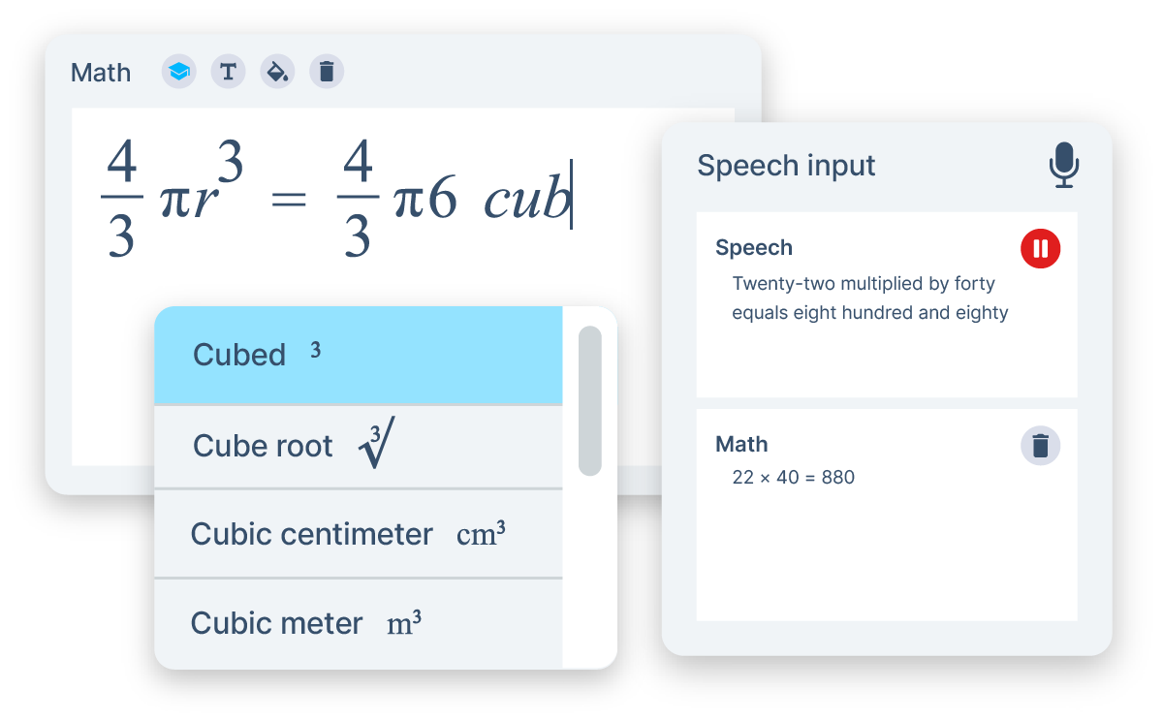
Take maths beyond paper and pen
Take maths beyond paper and pen
Equatio is a powerful equation editor that makes it easy to create digital, accessible maths. It saves time, lowers stress and eliminates frustration. It makes maths and science more accessible and engaging for every learner.

Slide 30
Platform integrations
Notes:
Canvas LMS Integration

Slide 31
Features at a glance
Equation editor: Create your maths and science expressions by typing right into the editor. Use Prediction to insert fractions, formulas and more.
Equatio mathspace: A web-based tool that allows maths learners to work freely in a digital space with equations, shapes, and freehand drawings.
Handwriting recognition: Handwrite maths expressions using a touchscreen device or mouse pointer.
LaTex Editor: Equatio’s technology has taken the hard work out of creating and editing LaTeX expressions.
Speech input: Dictate equations and formulas aloud. Equatio understands what you’re saying, turning your spoken input to written expressions.
STEM Tools: Equatio is not just for maths. We’ve got tools for science teachers too. With a chemical formula writer, periodic table, and more.
Graph Editor: Create and customise single or multiple graphs, plot ordered pairs or tables of points. Powered by Desmos graphing calculator.
Screenshot reader: Turn any equation across the web into accessible, editable maths with the Equatio Screenshot Reader.

Slide 32
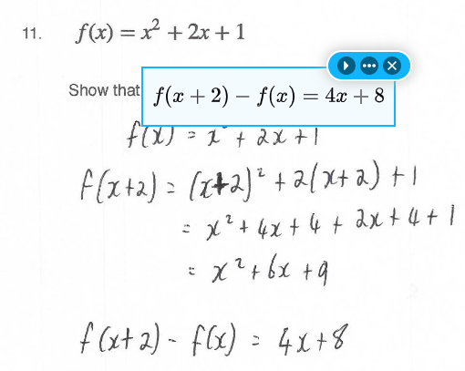
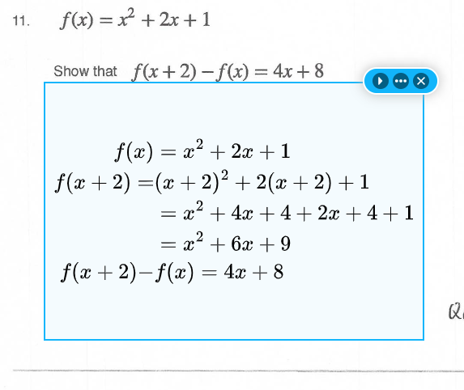
Read aloud
Screenshot reader
a squared plus b squared equals c squared

Slide 33
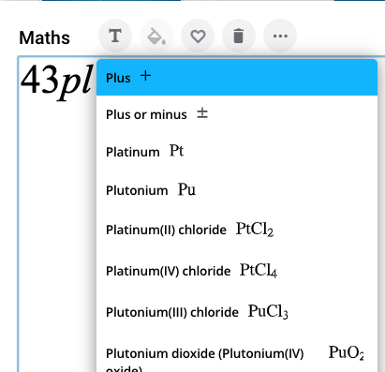
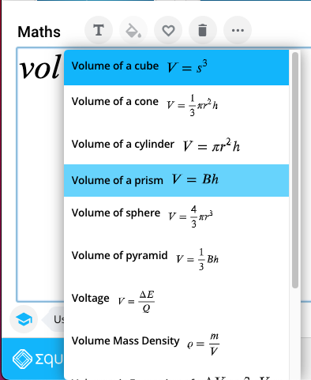
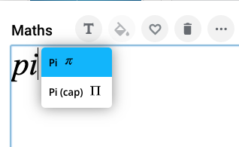
Vocabulary & Notation
Prediction

Slide 34
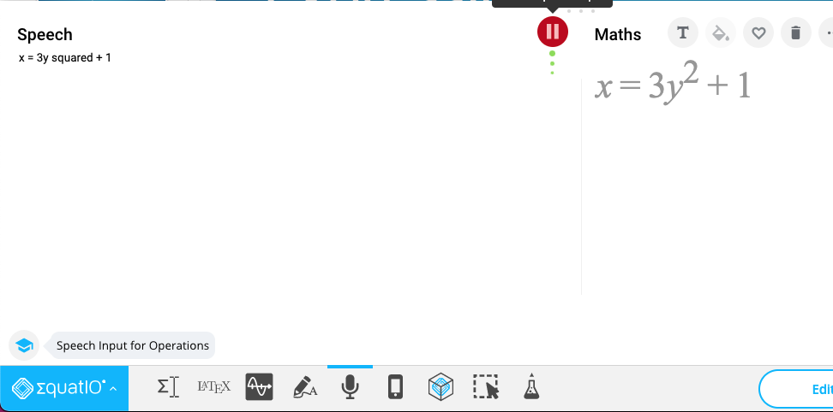
Expression
Voice

Slide 35
Expression
Handwriting

Slide 36
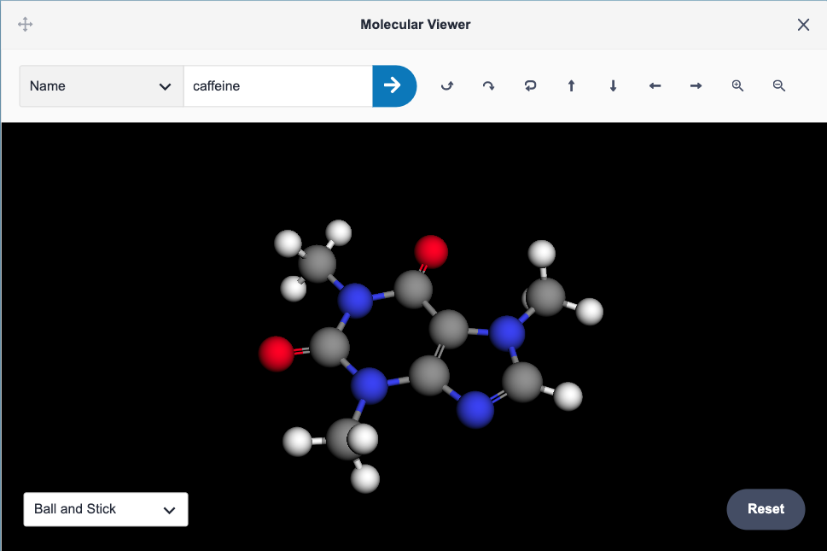
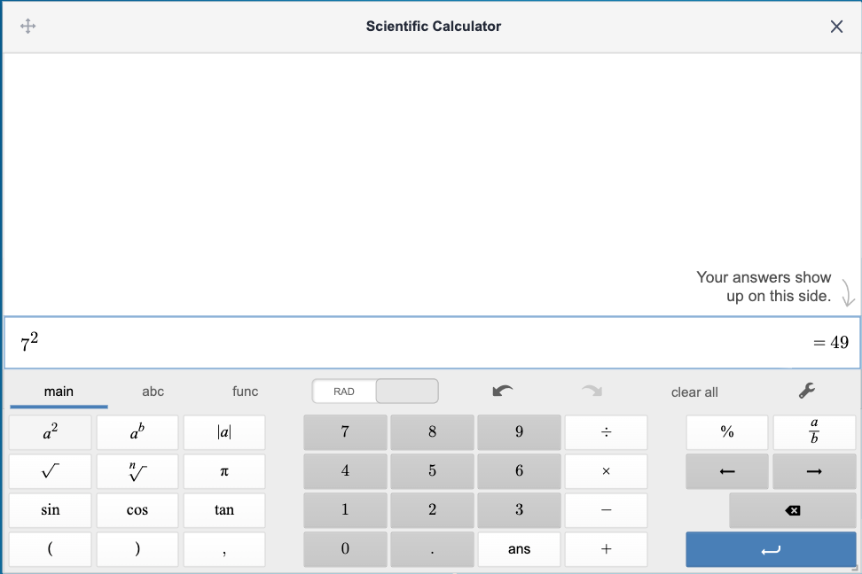
Tools

Slide 37
Access to MATHS learning
For many students access to MATHS learning looks like this.

Slide 38
Scaffolding
they should experience something that is more like this.

Slide 39
Universal Design for Learning
Multiple Means of Engagement
Provide options for:
engaging with content and learning in different ways
Multiple Means of Representation
Provide options for:
transforming information into useable information
Multiple Means of Expression
Provide options for:
action, expression and demonstrating understanding
www.texthelp.com/resources/universal-design-for-learning/
Notes:
https://www.texthelp.com/resources/universal-design-for-learning/
http://www.cast.org/our-work/research-development

Slide 40
Necessary for some. Useful for all.

Slide 41
Questions?
r.coathup@texthelp.com

