Slide 1
Beyond Accommodations - Why Universal Design Matters for ALL learners

Slide 2
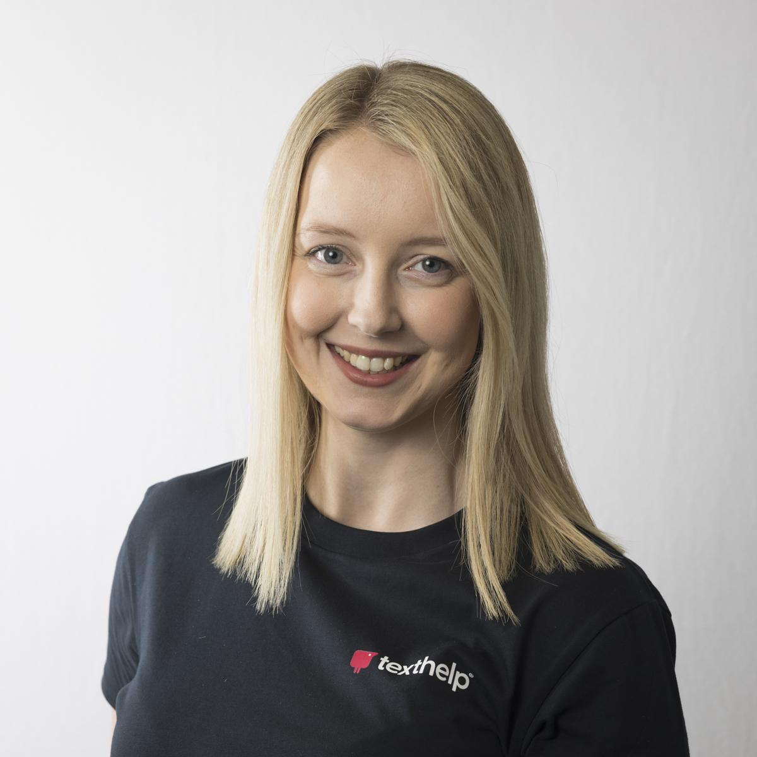
Welcome
Hello,
I’m Rachel
Customer Success Director
Email: r.coathup@texthelp.com
@TechMissC

Slide 3
ACKNOWLEDGEMENT OF COUNTRY

Slide 4
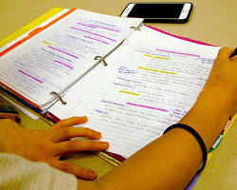
Images

Slide 5
Assistive Technology accessible to all.

Slide 6
Bowling ball image

Slide 7
Bowling ball image - split

Slide 8
Give students what they need, when they need it.

Slide 9
1 in 5 people are neurodivergent
Neurodivergence includes Attention Deficit Disorders, Autism, Dyslexia and Dyspraxia

Slide 10
6.3% - Uni
11% - TAFE
Australian Institute of Health and Welfare (2022) People with disability in Australia 2022, catalogue number DIS 72, AIHW, Australian Government.

Slide 11
Lack of literacy skills
47%
of Australian adults
lack the literacy skills to cope with the demands of everyday life and work
Notes:
Source: https://nces.ed.gov/surveys/ials/

Slide 12
Assistive Technology
3,528 employers said that by providing assistive technology, they have benefited from:
retaining a valued employee (85%)
an increase in employee and company productivity (53% and 21%)
improved interactions between colleagues (34%)
an increase in company morale (30%)
92% of employed people with a disability say that assistive technology helps them to work faster or better
Notes:
Source (Jobs Accommodation Network): https://askjan.org/topics/costs.cfm

Slide 13
Equality, Equity, Accessibility

Slide 14
Universal Design for Learning
Providing multiple means of:
Engagement
Representation
Expression

Slide 15
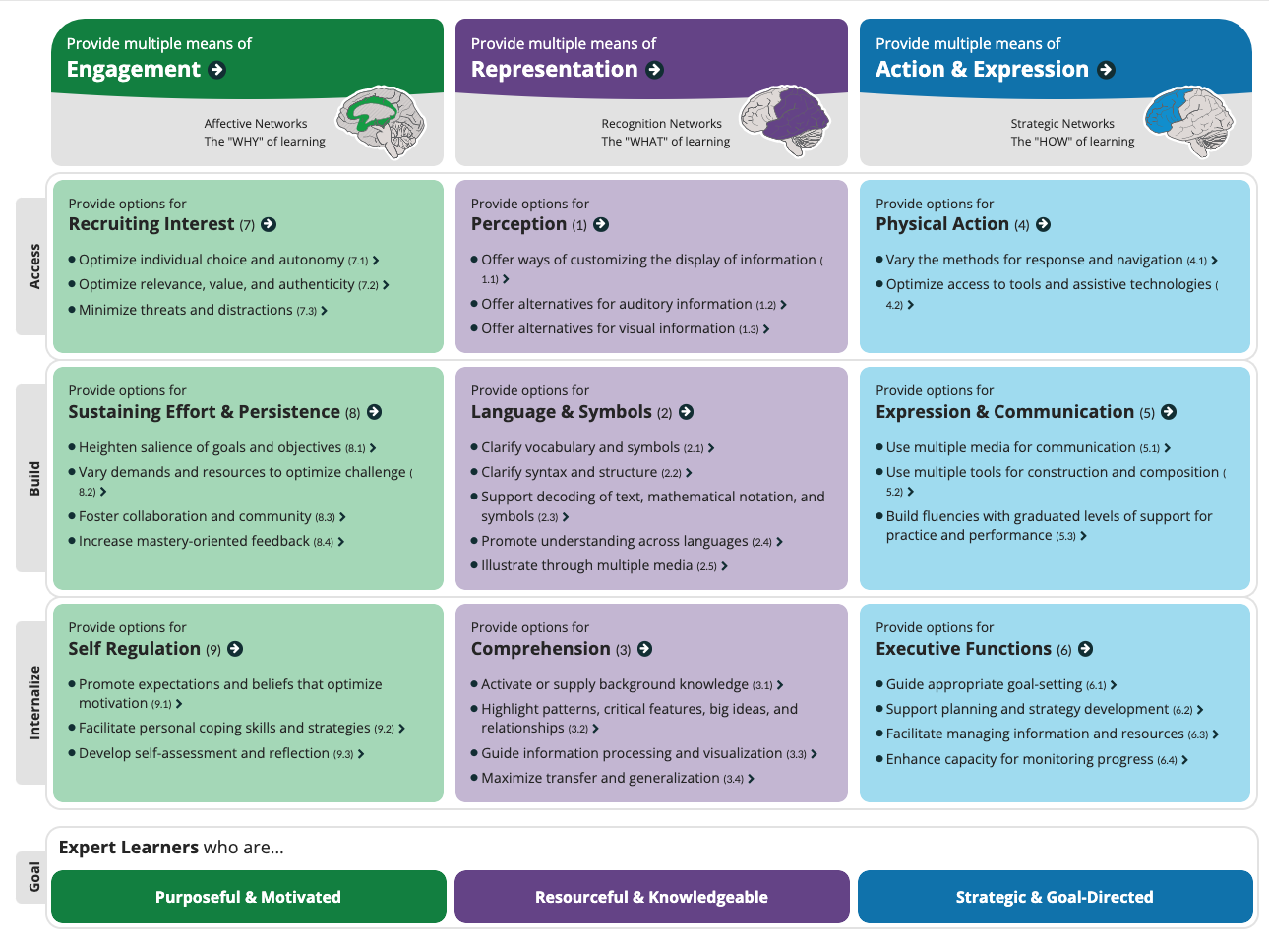
CAST Universal Design for Learning Table

Slide 16
UDL and student experience
Any device
Any platform
Anywhere

Slide 17
UDL Unlocked
A guide for unlocking potential with UDL
text.help/udl-unlocked

Slide 18
Read&Write

Slide 19
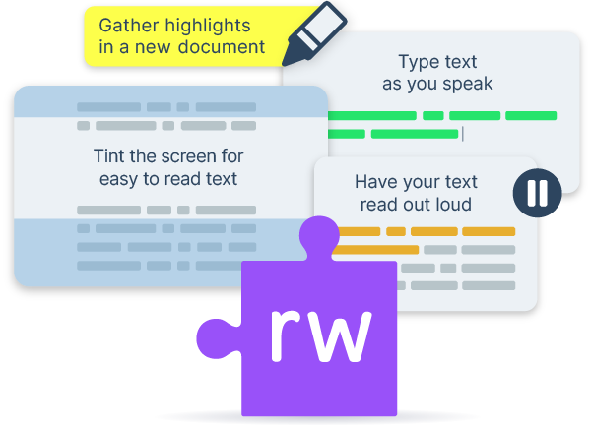
Help every student
Help every student read, write and study with confidence
Read&Write is our literacy support tool that offers help for everyday tasks. It has tools to meet the needs of different learners, right across the curriculum. Such as reading text out loud, understanding unfamiliar words and proofing written work.

Slide 20
Reading and Accessibility tools
Necessary for some, useful for all
Help every student reach their full potential by ensuring that learning is accessible to all
Meet the diverse needs of learners
Particularly useful for supporting learners with Specific Learning Differences
Play
Screenshot Reader
Audio Maker
Screen Masking

Slide 21
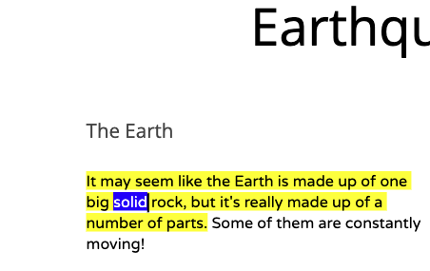
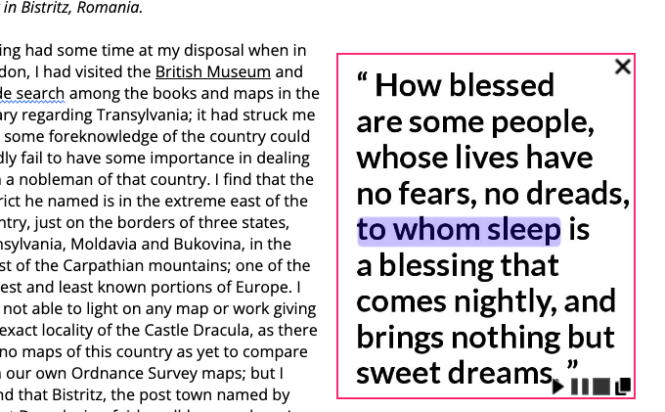
Text to speech
Reads words, passages, or whole documents aloud with easy-to-follow dual colour highlighting.

Slide 22
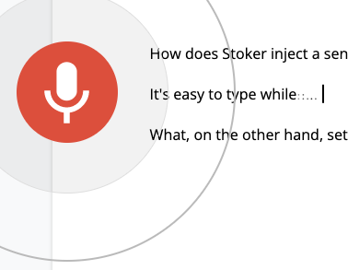
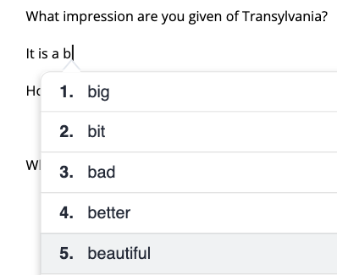
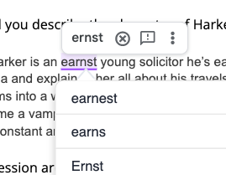
Writing Support
Enable students to dictate text, use word prediction with read aloud while typing, and use a dyslexic friendly spelling and grammar check tool.

Slide 23
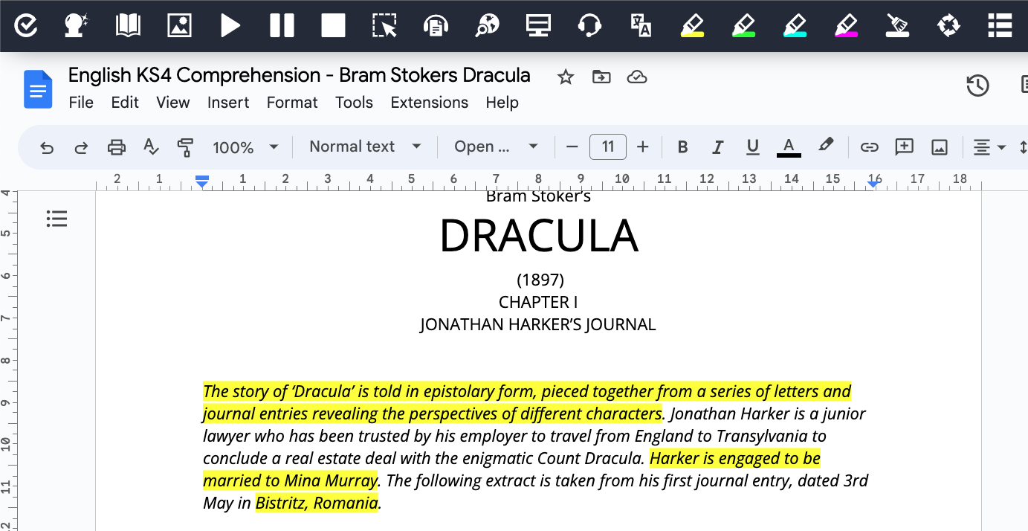
Summarise
Summarise key takeaways or points in advance with digital highlighters.

Slide 24
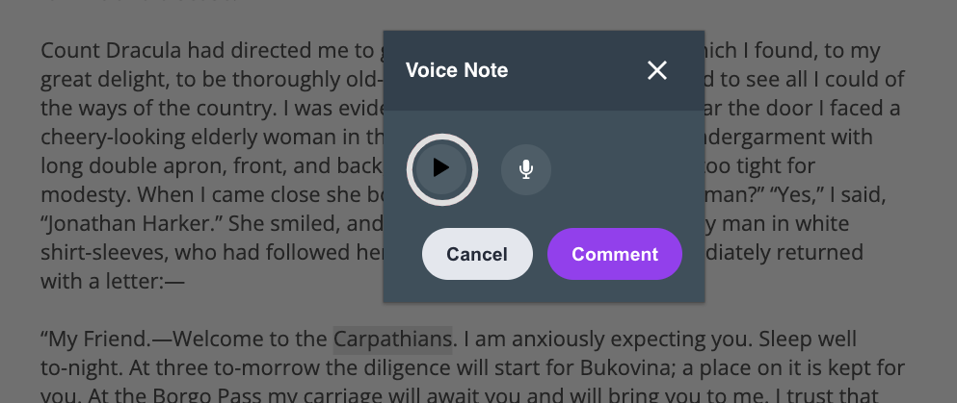
Use your voice
Use voice, not text for feedback, critique, comments and messages.

Slide 25
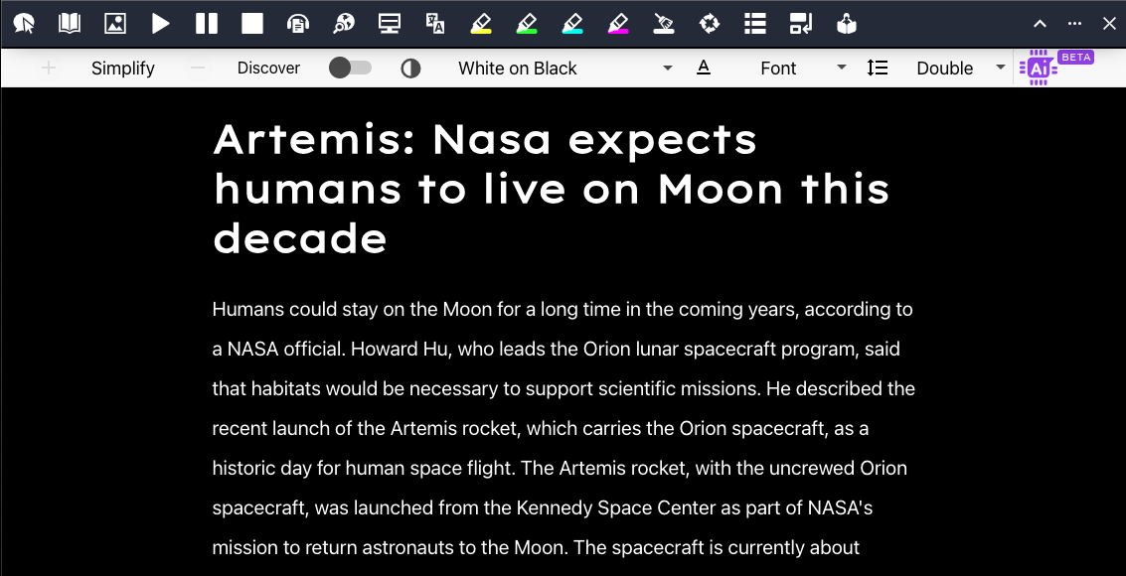
Simplifying Text
Using the power of AI to simplify text from web pages. Reducing its complexity, making it easier to read, yet keeping its meaning and context.

Slide 26
OrbitNote

Slide 27
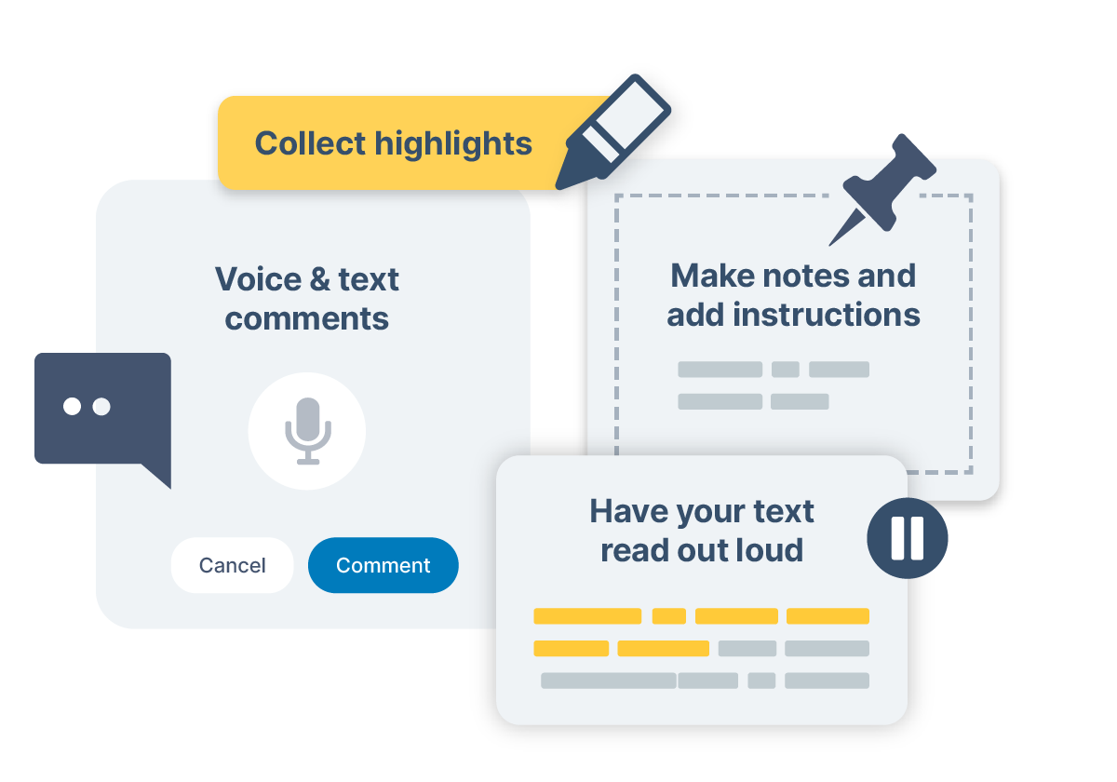
Make PDFs accessible and actionable
OrbitNote allows you to transform and interact with documents in a completely different way. Create an accessible, dynamic and collaborative space that works for everyone.

Slide 28
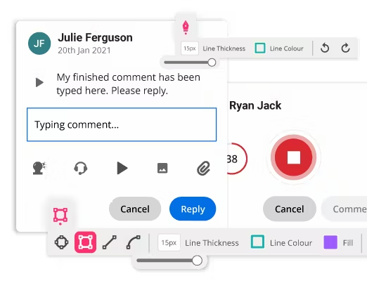
Complete work on PDFs
Type. Draw. Speak. OrbitNote encourages learners to express their understanding in many flexible ways.
They can type or draw their thoughts on the page, highlight the key points in a comprehension piece, add shapes and images to their work and even leave voice notes on a PDF.

Slide 29
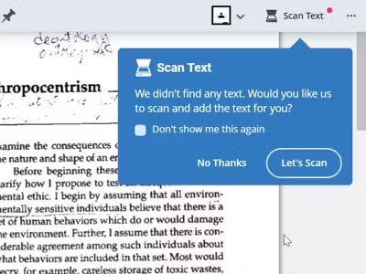
Make every PDF accessible
OrbitNote’s one-click Scan Text tool quickly transforms scanned classroom papers, images and inaccessible PDFs into accessible documents.
This means that students can have access to the tools they need to succeed, such as text to speech, talking dictionaries, highlighters and vocabulary support.

Slide 30
Necessary for some. Useful for all.

Slide 31
Questions?
r.coathup@texthelp.com

Slide 32
Digital Maths - The future of inclusion and how we can get there
Wednesday 28th February 1pm

