Slide 1
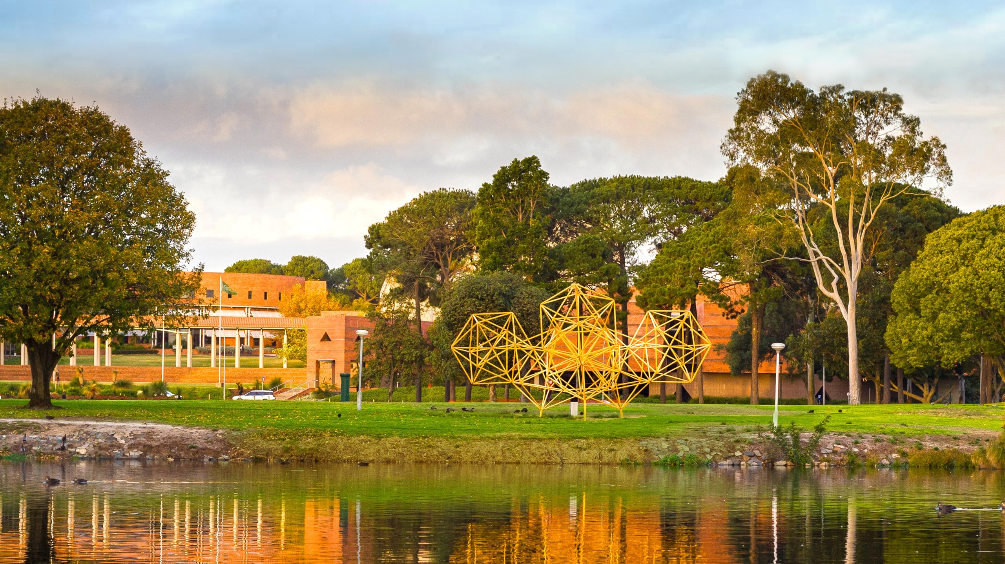
Slide 1: Title of presentation and presenter’s name
Making Labs Accessible for ALL
The Need for a Community of Practice to Share Innovations that Support Inclusivity and to Bring Universal Design into the Laboratory Teaching Space
Dr Vicky Barnett
A global university Western Australia | Dubai | Malaysia | Mauritius | Singapore

Slide 2
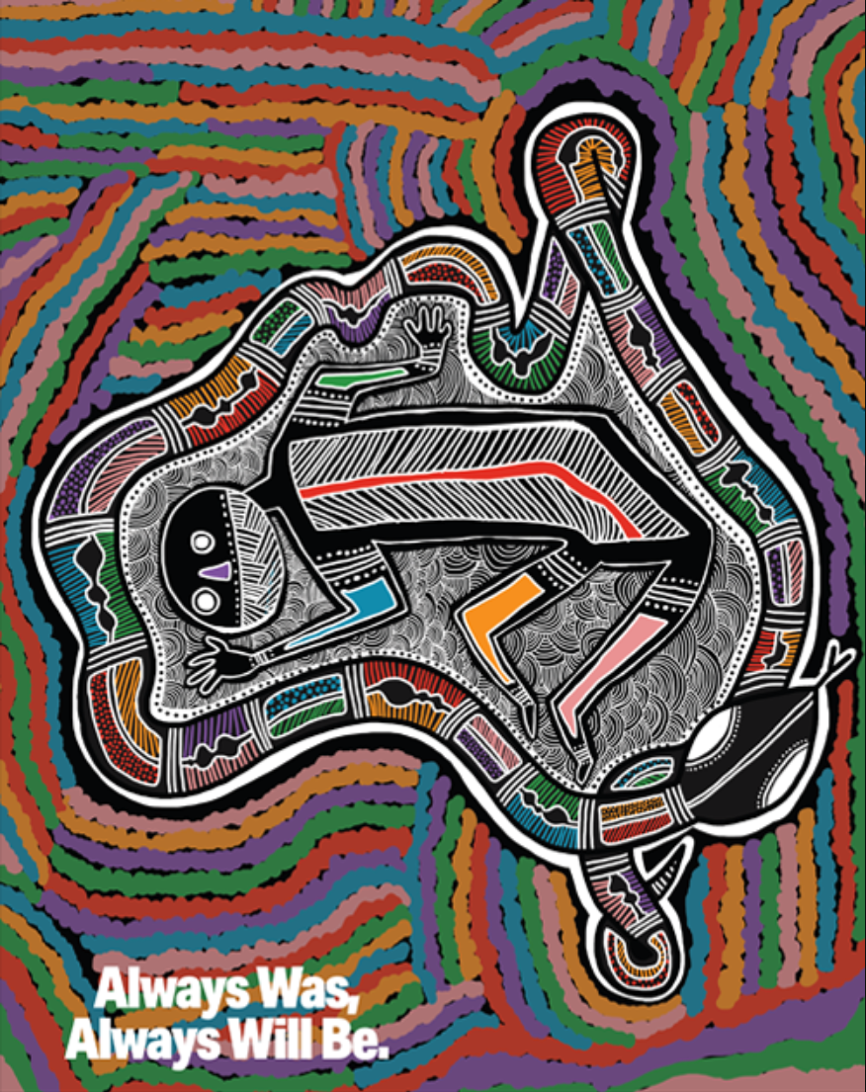
Acknowledgement of Country
Acknowledgement of Country
I wish to acknowledge the Traditional Owners of the Land on which the work I’m presenting today originated, the Whadjuk people of the Noongar Nation and pay my respect to their Elders past, present and emerging.

Slide 3
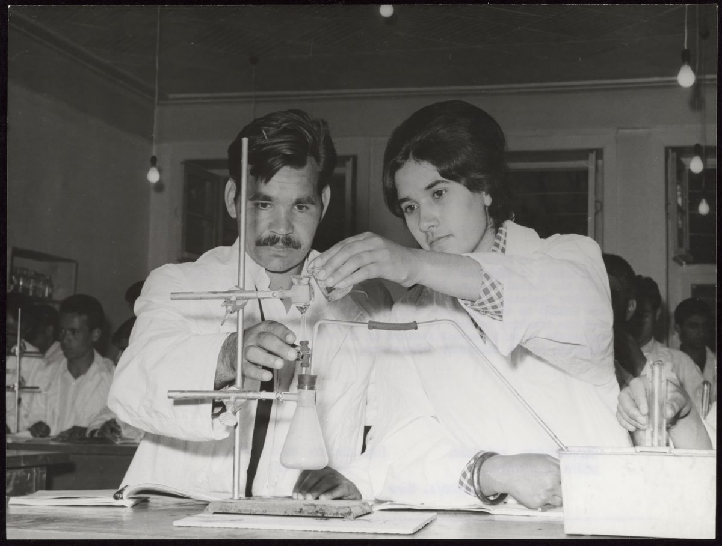
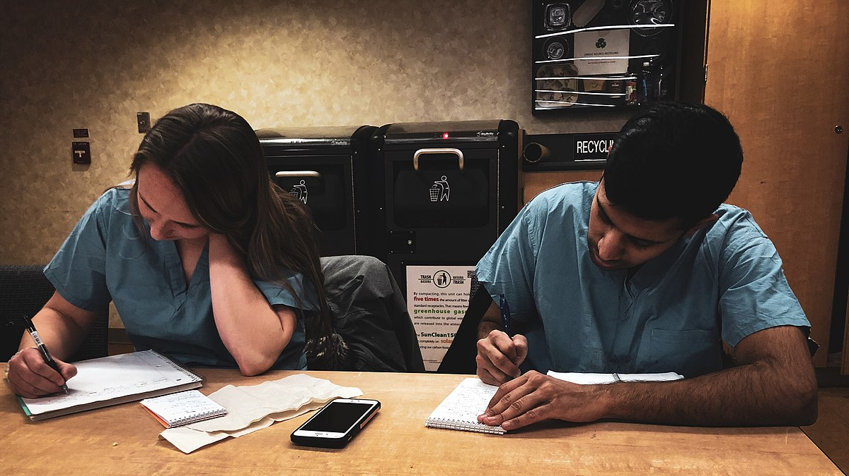
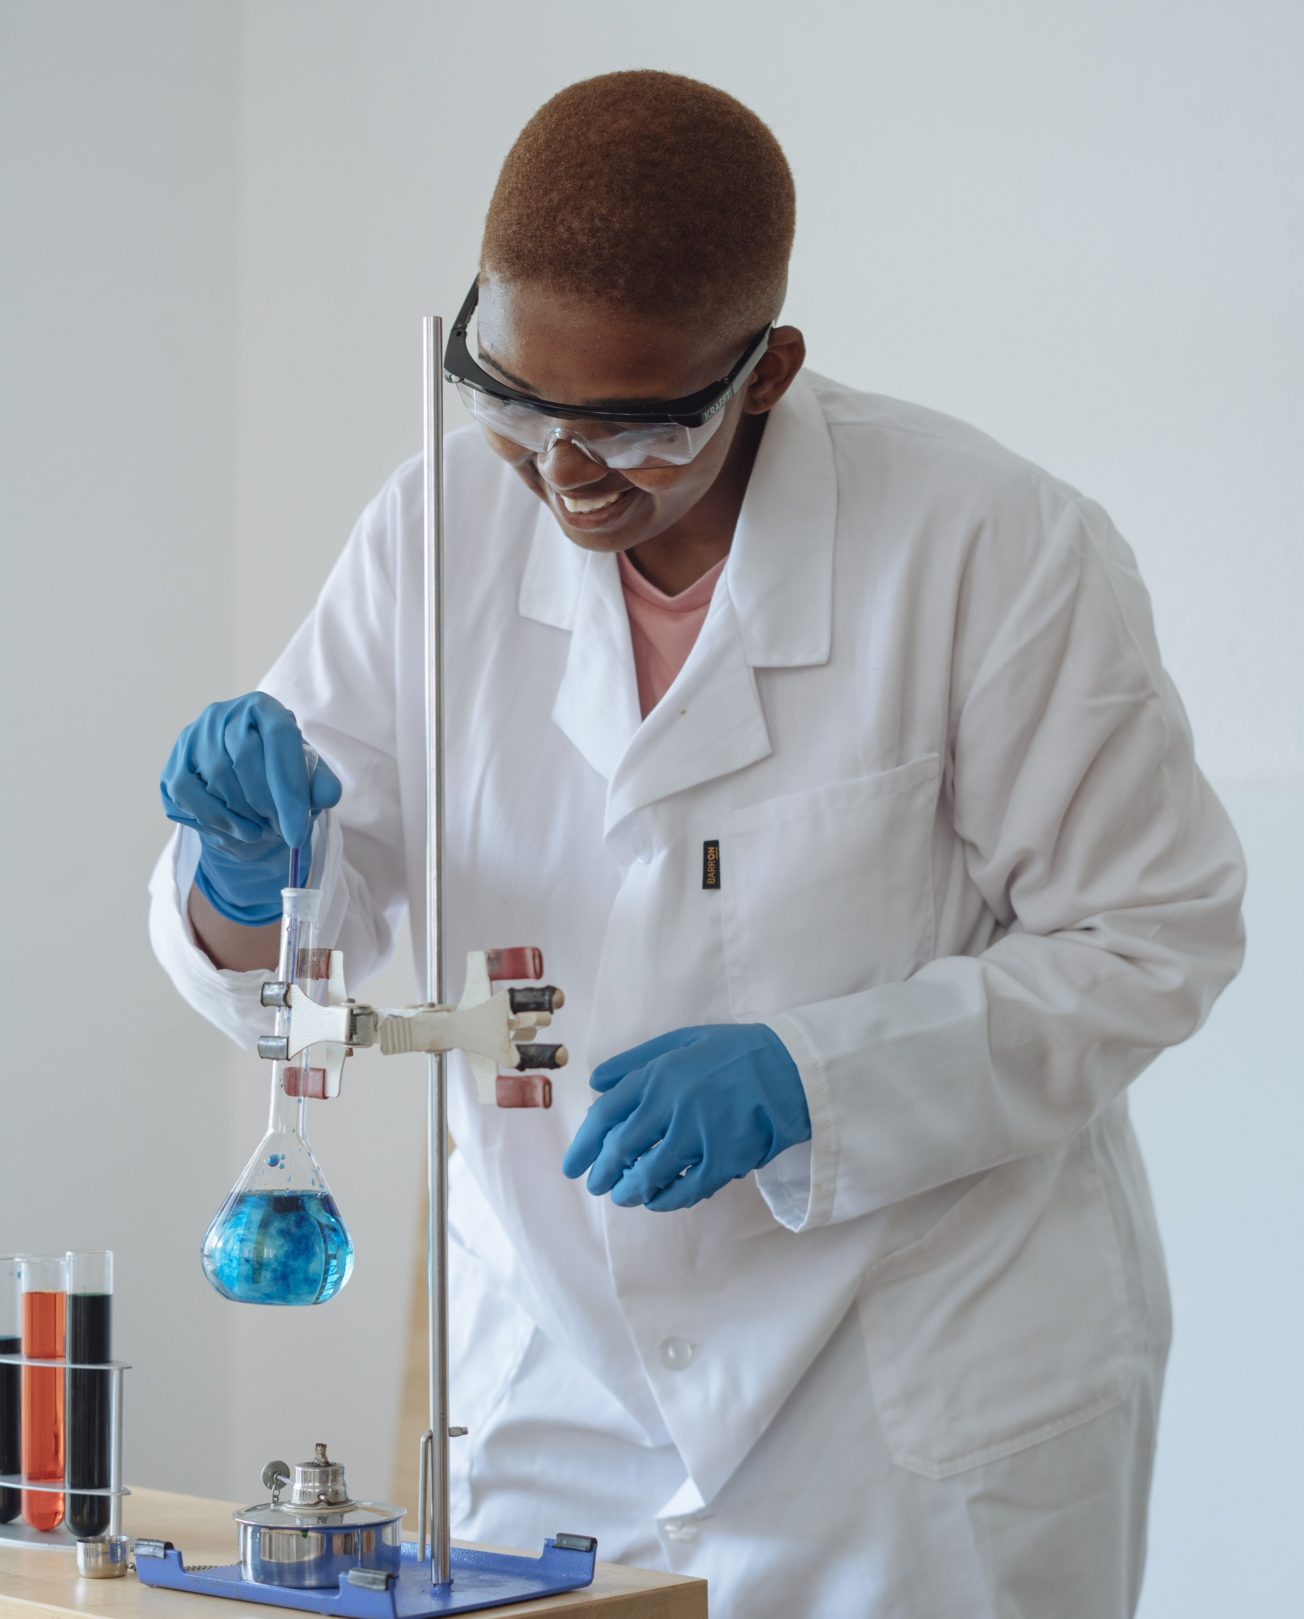
Science laboratories (‘scientific method’)
E.g. In both secondary and tertiary sectors, it is the experimental side of chemistry that students usually find the most engaging.
A modern science unit = practical skills + theory.
Practical experiences let students learn how to do experiments meaningfully and safely.
Much of what we now know about science is a result of past experiments.

Slide 4
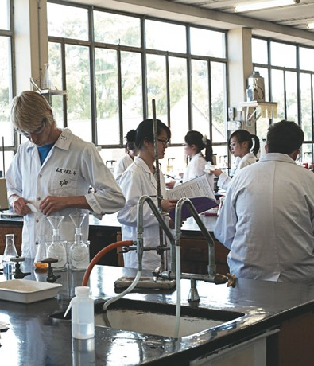
Traditional labs are not accessible for all
C
A
Visual impairment
Neurodivergence
B
D
Hearing impairment
Mobility impairment

Slide 5
Traditional labs are not accessible for all…
C
A
Visual impairment
Reliance on observation (instructions, readings, colour changes)
Signs & labels
Neurodivergence
Noisy
Crowded
B
D
Mobility impairment
High benches, sinks
Crowded
Narrow aisles
Hearing impairment
Alarms
Verbal instructions

Slide 6
Accessibility for all
1,464,415 people in 2021 requiring assistance with core activities
6.3% of all students attending university are living with disability
Legislations & Standards
Federal & state legislation to provide equitable treatment for people with disability in education:
Disability Discrimination Act (DDA) 1992
Disability Standards for Education 2005
Reflects Australia’s commitment to the United Nations Convention for the Rights of People with Disabilities (UNCRPD)
Compliance (tertiary education)
Instruments that tertiary education providers must uphold to meet compliance obligations:
Higher Education Standards Framework (Threshold Standards) 2021 (HESF), as overseen and governed by
Tertiary Education Quality and Standards Agency (TEQSA)
Specific reference to equity and diversity (Section 2.2)

Slide 7
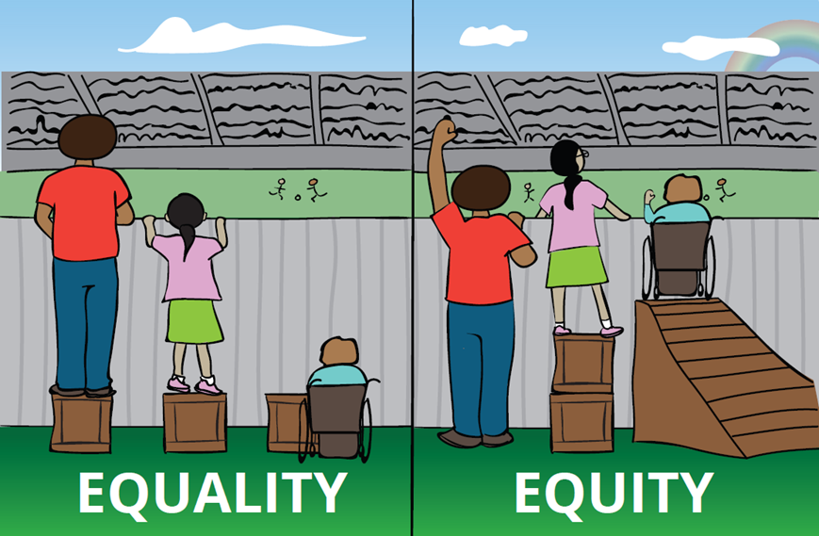
Accessibility for all…
Planning for & implementing compliance
Disability Access & Inclusion Plan (DAIP)
  Commitment statement
  Actions generated
  Ramps, accessible toilets, doors, lifts, classrooms, lecture theatres, IT, etc.
Universal Design Learning (UDL)
Classrooms
Teaching materials
Teaching practices
Laboratories ???

Slide 8
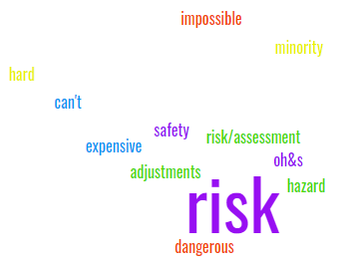
Lab Accessibility: Barriers
Legislations & Acts
Work Health and Safety Act 2020
Health & Safety
Physical Environment
Misinformed
Ableism
Disableism
Inexperience
+
Anxiety
=
Greater Safety Risks!
Compounded by:
procedures / policies
time / short notice
lack of “STEM” advocacy / experience

Slide 9
Lab Accessibility: “Adjustments”
CASE BY CASE
Access Plan provided to UC (short notice)
Meeting arranged: discipline staff (lab technicians, demonstrators, UC), student, student support.
“Reasonable adjustments” decided on / implemented
Some examples
Visually impaired student (e.g. dog, software)
Neurodiverse students (e.g. autism + full time support person)
Health (e.g. diabetes, epilepsy, hypoglycaemia, anxiety)
X Wheelchair access…
Work Health and Safety Act 2020

Slide 10
Lab Accessibility Case Studies
“Non-wheelchair accessible lab”…
2021 1st wheelchair user (Student X). X placed outside of lab in ‘safe’ corridor. AV equipment rigged so expt. performed by peers inside the lab can be watched on computer screen in the corridor (precedent set).
2022 2nd wheelchair user (Student Y, my student).
“Reasonable adjustment meeting”: Location Chemistry labs
Present: Student + Student Support Staff + 6 x Chemistry staff.
Chemistry staff explain why student can’t be in the lab (H&S)…
Y’s “reasonable adjustment” = above precedent but funding is approved for better IT…
Health & Safety
Physical Environment
Misinformed
Ableism
Disableism
Work Health and Safety Act 2020

Slide 11
Lab Accessibility Case Study
CASE STUDY: Wheelchair user in corridor watching expt. on computer screen.
Student(s) never complained (First Years rarely do). But I observed…
My life experiences and mental health first aid training screamed at me “this is wrong”!
  Most importantly Student Y is being excluded and marginalised. In workshop Y is engaged with her peers; in lab she appears despondent.
  Additionally, student Y’s lab partners appear flustered: Their lab experience is inauthentic and they are feeling pressure to use the AV equipment, and guilt when they don’t use it well enough.
  And also I feel terrible – my student is bravely miserable and I’m responsible!

Slide 12
Lab Accessibility: Driving Change
Barrier 1: Health & Safety (THIS IS SACROSANCT, #1 priority) & Ignorance (mine)
Legally where do we actually stand in regard to H&S?
Action: Get better informed. Renominate as a H&S representative & redo the 5-day training course: Ask instructor questions & read legislations and acts.
Barrier 2: Ignorance (mine)
What are our obligations to students with disability? Legally where do we stand?
Action: Get better informed. Reach out to a staff / students directly and actively involved in aspects of disability, accessibility and advocacy: a Senior Advisor for Diversity Inclusion and Belonging & our Student Guild Accessibility Officer (who happens to also be ‘Student X).
Work Health and Safety Act 2020
Discovery: My colleagues and I were misinformed…
We MUST find a way Safely ☺
Disability Discrimination Act (DDA) 1992: Federal law protecting rights of students with disability overrides state & territory legislation (e.g. H&S).

Slide 13
Lab Accessibility: Overcoming Barriers
We MUST find a way Safely ☺
LACoP
Community of Practice
Diverse minds
Awareness
Empowerment
Action:
Get better informed
Health & Safety
Physical Environment
Misinformed
Ableism
Disableism
Initial CoP a small group from six institutions across Australia
- We are already doing so much.
But a lot of practices could be improved by sharing our experiences…
This has begun…
E.g. Teams Group / photos
What are others doing?
Can we learn from / help each other?

Slide 14
Examples Neurodivergence
Support person
Lighting
Scheduling
Quiet space / retreat
Breaks
A
Noise reduction
Location in lab
Neurodivergence
Headphones

Slide 15
Examples Visual / Hearing impairment
Support person
Visual signals / alarms
Experimental design
Written instructions
Oral instructions
Noise loops
C
D
Specialised software
Visual impairment
Hearing impairment
Video instructions / closed captions
Magnifying glass
Specialised software
Accommodations for service dog

Slide 16
Examples Mobility impairment
Support person
Height adjustable bench or lower desk
Bunded trays / spill kits
Wider spacing between benches
Spill-proof apron
B
Access / doorways
Location in lab
Mobility impaired
Accessible toilets
Accessible storage (glassware, chemicals, equipment)
Accessible first aid / eye wash / etc
Lower sinks (washing glassware as well as hands)
Accessible fumehood

Slide 17
Lab Accessibility: Ideas into Action
The CoP showed what can be possible… but an institution-specific working group was also needed to brainstorm what can be done locally, and how…
LAWG
Lab Accessibility Working group
Diverse minds
Knowledge & Experience
Empowerment
Initially by invitation with a diverse representation of people & skillsets and who were invested in improving access to laboratory learning for students with disability, including:
Teaching staff / academics / coordinators
Student representation
Laboratory technical staff
IT expertise
Health and Safety representation
Disability / Accessibility / Inclusivity specialties
Student Support Services
Properties

Slide 18
Lab Accessibility: Changing a Culture
The journey:
Meetings / brainstorming / information sharing (Teams)
Lab accessibility tours / LAWG recommendations
DAIP launch (Truth Telling by Student X)
DVCA Lab tour
Presentations
Meetings (Stakeholders)
Setbacks (Case Study 3, 2023 still no access ☹)
Persistence
H&S – Risk Assessment (RA) template developed that incorporates disability & accessibility… (including psychosocial hazards!)
IR
Persistence…
LACoP / LAWG
Diverse minds
Knowledge & Experience
Empowerment
Diverse perspectives and skill sets = outcomes

Slide 19
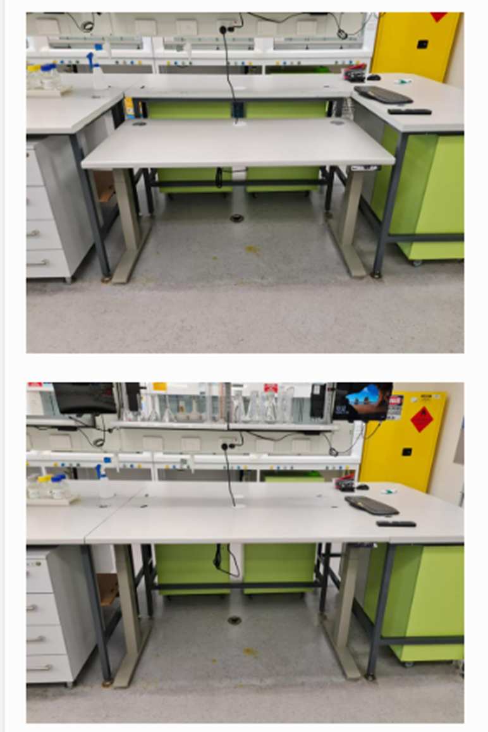
Lab Accessibility LACoP / LAWG: Outcomes
Outcomes (locally at Curtin):
Lab Accessibility is ‘on the map’:
  formally included in our latest DAIP (Disability Access and inclusion Plan)
  recently added as a focus area within the DIBC (Diversity, Inclusion and Belonging Committee)
“My” area now has a sit-stand lab bench that is accessible for a wheelchair user and a capital works request is submitted for additional improvements for 2024
Other areas at Curtin value lab accessibility and have invited LAWG to do tours and provide recommendations

Slide 20
Lab Accessibility: Where to from here?
Health & Safety
Physical Environment
Misinformed
Ableism
Disableism
My story and that of the impacted students I’ve described should have been easier and more straightforward than it was and I don’t want to see anyone else go through it.
There is insufficient STEM-specific awareness among many specialist advocates for accessibility, and there is insufficient accessibility-specific awareness among many STEM specialists.
This is a gap that needs to be closed.
Lab Accessibility must be included in every institution’s plans:
  DAIPs
  UDL initiatives
  Equity, Inclusion & Diversity
  Hopefully this might facilitate more discussion and better connections between accessibility advocates and STEM specialists.

Slide 21
Lab Accessibility: Where to from here? 2
RAs (Risk Assessments) need to be written in an inclusive way & include psychosocial harm as well as physical hazards.
Incorporating accessibility considerations into the RA helps identify (and justify) infrastructure and/or practices
Including psychosocial risk ensures that H&S cannot be used as a barrier to accessibility because exclusion causes psychological harm. It thus reinforces the fact that “we MUST make it happen, SAFELY”.
IRs (Inherent Requirement documents) are topical for several institutions.
Let’s ensure these are also checked over with an accessibility lens prior to publication – otherwise we risk creating a document that supports exclusion instead of inclusion (e.g. ambiguity of term “reasonable adjustments” in wording of Student Access Plans)

Slide 22
Lab Accessibility: Where to from here? 1
UDL (Universal Design Learning) must be applied to laboratory learning activities as well.
A UDL approach mitigates the need for ‘reasonable adjustments’ because in many cases the lab will already be ‘accessible’
B
A
Mobility impairment
Low desk
sit-stand benches
Neurodivergence
Quiet spaces
scheduling
C
Visual impairment
Aural instructions
Special equipment
Adjustments to lab
Guide dog space
Establish a broader nationwide CoP
Share practices / experiences (what has worked, what hasn’t)
Define what “Lab UDL” looks like, together
Brainstorm ideas
Empower / inform each other
Help each other with writing accessibility inclusive RAs & Lab instructions
And so much more…
D
Hearing impairment
Visual alarms
Written instructions
Sound loops

Slide 23
Acknowledgements
Thanks to the following people and organisations for supporting this journey:
Shared practices in original CoP: Curtin University, Edith Cowan University, University of Adelaide, University of Melbourne, University of Queensland, University of Wollongong, University of Newcastle, University of Tasmania.
Curtin staff and students who joined me and supported the LAWG
If you would like to join the Lab Accessibility Community of Practice, please email me at:
vicky.barnett@curtin.edu.au

Slide 24
Bibliography
Lachlan Dowsett, Vicky Barnett. Making Labs Accessible for ALL – A Comparative Study Across Australian Universities. Unpublished Student Report for CHEM3006, Curtin University, 2022; Available on request.
Ron Niemann, Dorothy L Miner, Anne B Swanson, Michael Woods. Teaching Chemistry to Students with Disabilities: A Manual for High Schools, Colleges, and Graduate Programs 4th Edition. American Chemical Society Committee on Chemists with Disabilities 2001.
Stacey Lowery Bretz. Evidence for the Importance of Laboratory Courses. J Chem Educ 2019;2(96):193-5.
Nancy McDaniel, Gerri Wolf, Chris Mahaffy, John Teggins. Inclusion of Students with Disabilities in a College Chemistry Laboratory Course Journal of Postsecondary Education and Disability. 1994;11:20-8.
Disability Discrimination Act 1992, (1992).
Disability discrimination, (2014).
Dipesh Prema, Ruby Dhand. Inclusion and accessibility in STEM education: Navigating the duty to accommodate disability rights. Canadian Journal of Disability Studies. 2019:121-42.
Australian Bureau of Statistics. Disability and carers: Census 2021 [Available from: https://www.abs.gov.au/statistics/health/disability/disability-and-carers-census/2021]
Australian Institute of Health and Welfare. People with disability in Australia 2022 [Available from: https://www.aihw.gov.au/reports/disability/people-with-disability-in-australia/contents/education-and-skills/engagement-in-education]
Australian Human Rights Commission. Disability Discrimination Act Action Plans: A Guide for the Tertiary Education Sector 2022 [Available from: https://humanrights.gov.au/our-work/disability-rights/disability-discrimination-act-action-plans-guide-tertiary-education#5].
ADCET website and resources within https://www.adcet.edu.au/
Risk Assessment Reference Number 5620 (Curtin’s CHARM system)

Slide 25
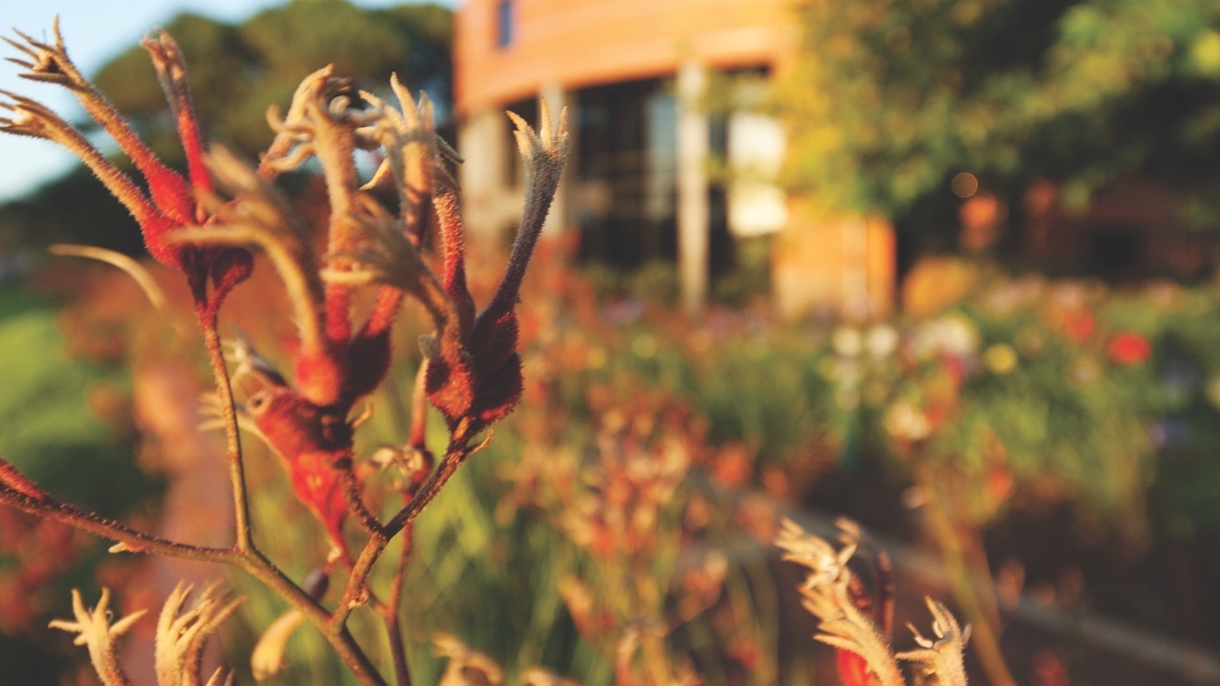
Thank you
Make tomorrow better.

