Slide 1
Access for all: championing accessibility in the university context
Dr Agata Mrva-Montoya and Julie Ganner AE

Slide 2
Acknowledgement of Country
We recognise and pay respect to the Elders and communities – past and present – of the lands that the University of Sydney campuses stand on. For thousands of years they have shared and exchanged knowledges across innumerable generations for the benefit of all.

Slide 3
Outline
“Accessibility” turn in the publishing industry
Books without barriers
Implementing accessibility in the university context
Planning for accessibility
Writing with accessibility in mind
Inclusive design and formats

Slide 4
“Accessibility” turn in publishing
Increasing recognition of the right of people with print disability
Digital technologies
Changing legal framework: the Marrakesh Treaty and the European Accessibility Act

Slide 5
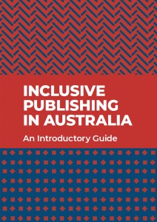
Australian Inclusive Publishing Initiative
Inclusive publishing in Australia: an introductory guide (2019)
Making content accessible: a guide to navigating Australian copyright law for disability access (2019)

Slide 6
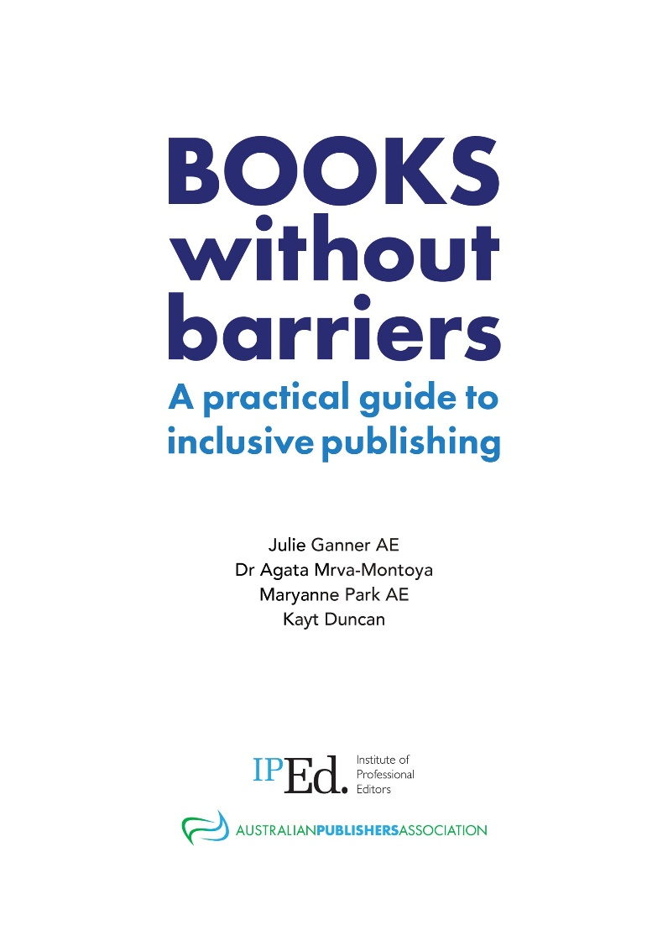
Books without barriers
Planning for inclusive publishing
Developing content
Describing images and tables
Producing accessible books
A style sheet template for accessibility best practice and a glossary

Slide 7
Implementing accessibility in the university context
Acquisition and curation of content and resources
Research and teaching support
Content creation and publishing

Slide 8
Planning and writing for accessibility

Slide 9
Planning for accessibility
Think of reading as a tactile and aural activity, not just a visual one.
Ensure your writing makes sense when the text can’t be seen.
Include meaningful captions, image descriptions and cross references.
Choose uncluttered images.

Slide 10
Writing with accessibility in mind
We need to ensure that a reader’s ability to perceive or understand content will not be impeded by:
the format of the material, or
the sense the person uses to read it.

Slide 11
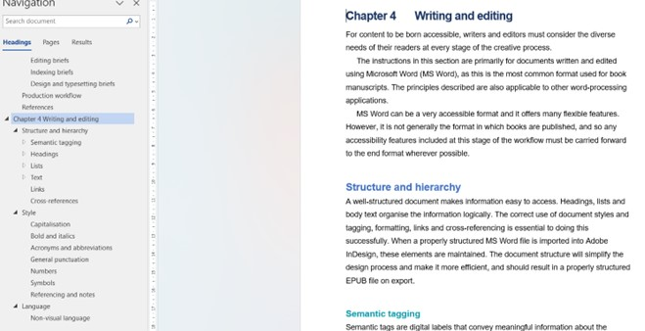
Navigation
Use Styles and the Navigation pane in MS Word to:
identify heading levels and other text elements
view the structure at a glance
jump through the manuscript to the section you want

Slide 12
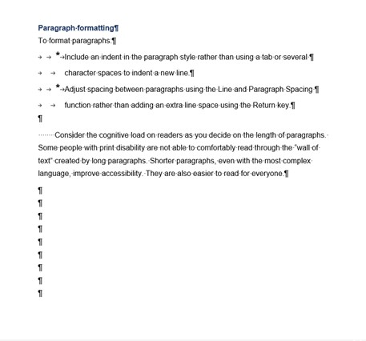
Formatting
Turn on the Show/Hide formatting tool.
Use the Line and Paragraph function to alter line spacing.
Start a new page by using the page break function (Insert + Page break, or Ctrl + Enter).
Use the Paragraph Borders function in Word Styles rather than text boxes.

Slide 13
Language
Figure 2. Roses in bloom
Provide numbered captions for illustrations.
Describe distinguishing features other than colour alone.
Photo: Pixabay

Slide 14
Style: Italics and bold
Avoid using italics and bold just for visual effect.
Use a block indent for long quotes and quote marks for short quotes.

Slide 15
Style: Capitalisation
Avoid using capital letters in text and headings.
ALL CAPS ARE DIFFICULT FOR MOST PEOPLE TO READ, PARTICULARLY THOSE WITH VISUAL AND PERCEPTUAL DISABILITIES.

Slide 16
Style: Punctuation
Use:
spaced en rules (text – text) rather than closed em rules (text—text)
double quotation marks
single quote marks only for quotes within quotes
minimal punctuation and capitalisation in references

Slide 17
Style: Symbols
Write the word in full before the symbol: copyright ©.
Always use the correct symbol, not just something that looks like it.

Slide 18
Style: Abbreviations
Explain acronyms the first time you use them.
Give the full name in full, followed by the abbreviation in parenthesis:
Australian Disability Clearinghouse on Education and Training (ADCET)
Avoid Latin abbreviations such as ie, eg.
Where you must use them, add full stops: e.g., 6 a.m.

Slide 19
Image descriptions
Alternative (alt text) provides a brief overview of the image.
It may be sufficient on its own.
It can be supplemented by a long description.
How much detail to include depends on the context.

Slide 20
Writing image descriptions
Describe all images unless they are purely decorative.
Think about the purpose of the image.
Emphasise the key information.
Keep the description as brief as possible.
Provide information and concepts in small chunks.
Provide each piece of information only once.
Be objective.
Include any text that is part of the image.

Slide 21
Tables 1
Use the Create Table tool to create tables (Insert + Table).
Treat a single column of information as a list.
Ensure all columns have headings.
Don’t leave empty cells.
Split large, complex tables into smaller, simpler ones.

Slide 22
Working with publishers
Champion accessibility best practice.
Ask lots of questions!

Slide 23
Inclusive design and formats

Slide 24
Key principles of inclusive design
Hierarchy
Consistency and proximity
Legibility and readability
Colour contrast and colour-blind friendly palettes
The appropriate use of images and graphic elements

Slide 25
Hierarchy
In visual design, hierarchy in text is conveyed through variations in weight, colour, spacing, size, placement and other signals.

Slide 26
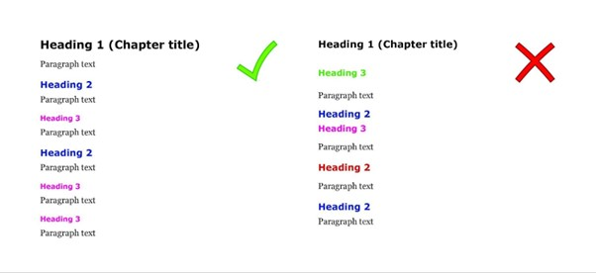
Hierarchy Overview

Slide 27
Consistency and proximity
Place headings, running header/footers and page numbers in a consistent location.
Structure similar information together.

Slide 28
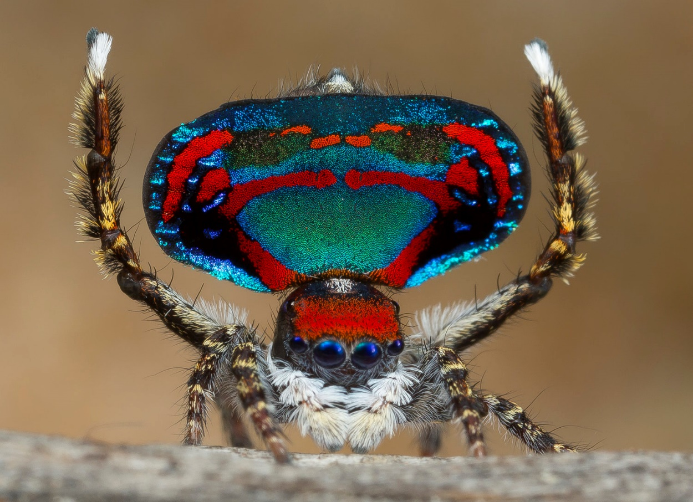
Captions
Figure 1: A male peacock spider waving his legs and tail fan to attract a female spider. Photograph © Jurgen Otto, Peacock Spider.org
Should be placed in consistent location, best above.

Slide 29
Legibility and readability 1
Legibility is related to the design of the typeface and the shape of the glyphs
Readability is influenced by how the text is arranged or typeset on a page
Sans serif versus serif debate is redundant

Slide 30
Problematic typefaces
extremely light and heavy weights
a complicated or decorative appearance
extreme stroke contrast (the ratio of thick to thin strokes)
smaller counters (enclosed or semi-enclosed negative shapes)
less open (or smaller) apertures (the openings within a letter, such as the curve of the letter “c” or a lowercase “a”)
“imposter” letters and “mirroring” letters such as I and 1, d and b, q and p.

Slide 31
Legibility and readability 2
Best to avoid text in all caps and italics
Ligatures should be avoided.
Font size, leading, tracking matter
Left-aligned text is best
Average line length should be between 45 and 80 characters.

Slide 32
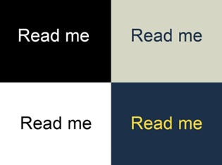
Colour
Contrast
Consistent use
Use colourblind-friendly palette
Colour should not be the sole means of conveying information, best to combine it with other design elements.

Slide 33
Maps, charts and graphics
Choose unambiguous colour combinations; that is, colours with strong contrast
Use additional visual variables such as such as shape, size, and pattern variations provided they can be easily described
Annotate features directly; that is, providing additional information (such as labels and keys) that explains, elaborates on or emphasises the visual elements.

Slide 34
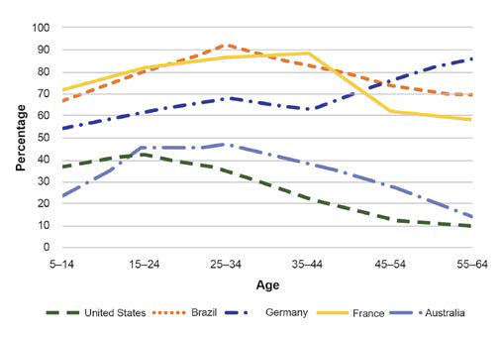
Graph example

Slide 35
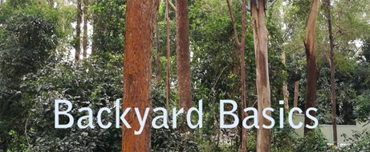
Images
Should be meaningful and clear
Avoid placing text over “busy” images
Avoid watermarks or complicated background designs

Slide 36
Tables 2
Should have:
clearly defined header borders
good colour contrast
adequate space between text and border so that the cell contents do not merge visually with the borders of the table
no empty cells
correct alignments (numbers vs text).

Slide 37
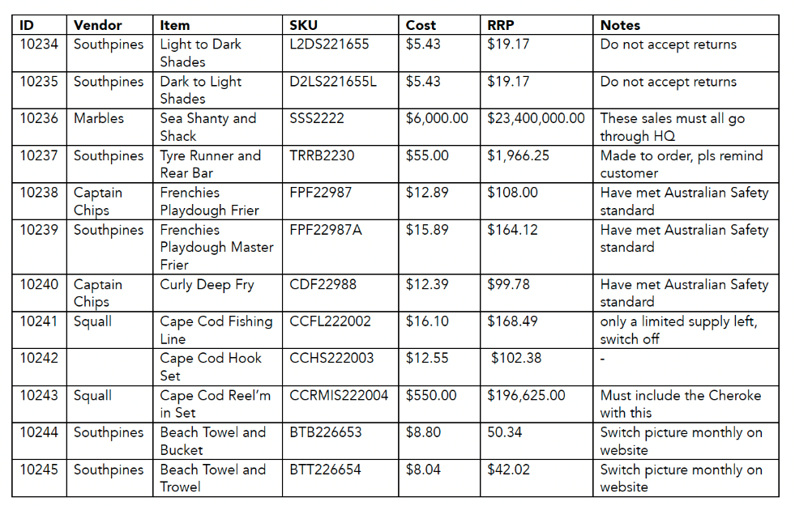
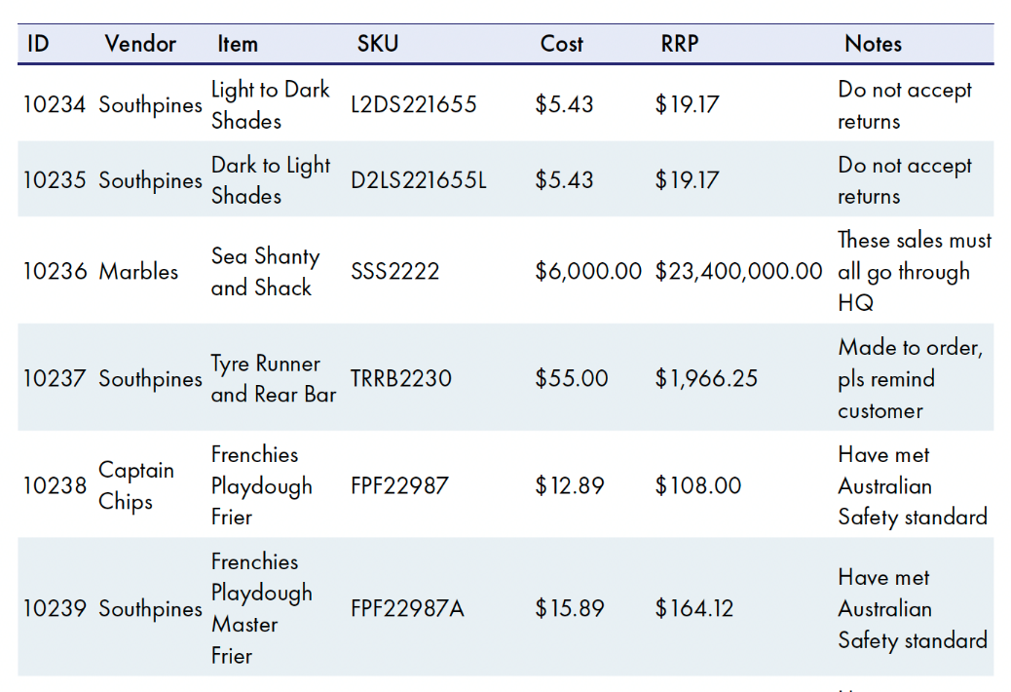
Table examples

Slide 38
Manuscript formatting
MS Word
Use styles
Follow the publisher guidelines
Provide alt text separately

Slide 39
Final output – short documents
Embed accessibility features into the document
MS Word or HTML are better than PDF
Power Point is better than PDF

Slide 40
Why is PDF problematic?
Readers cannot customise the reading experience
To be accessible, PDF needs structure tags, a labelled reading order, labelled headers, and image and table descriptions
PDF must be editable to be accessible via screen readers.

Slide 41
Final out-put – long-form document
MS Word, HTML and reflowable EPUB3 better than PDF
Reflowable EPUB3
Readers can customise the reading experience by changing the typeface and font size, spacing, margins and background.
It needs to include image and table descriptions (alt text), headings in logical order, HTML5 tags, pagelist, landmarks (frontmatter, bodymatter etc.), ARIA (Accessible Rich Internet Applications) role attributes, page title, accessibility metadata and identifying the main language, any language shifts and context breaks.

Slide 42
EPUB3 tools
WordtoEPUB (free)
PressBooks to EPUB ($$)
Adobe InDesign ($$$)
CircularFLO ($$)

Slide 43
Quality assurance
The review process is designed to check the content for accuracy, clarity and completeness, whereas accessibility testing focuses on checking the files to make sure everything works as it should.

Slide 44
Accessibility testing
Automatic:
MS Word: Tools > Check Accessibility
Adobe PDF: Tools > Accessibility > Accessibility Check
EPUB: Ace by DAISY app
Manual:
Using read aloud function or screen readers
Test with users with print disability

Slide 45
Platform accessibility
Canvas Accessibility Standards
Moodle Accessibility Toolkit
Open Journal System – Creating Accessible Content: A Guide for Journal Editors and Authors

Slide 46
Resources
Accessibility Toolkit, 2nd edition
Ganner, J., A. Mrva-Montoya, M. Park and K. Duncan (April 2023). Books without barriers: a practical guide to inclusive publishing. Institute of Professional Editors and the Australian Publishers Association
Accessible Libraries Canada
CAUL Checking Accessibility of Open Textbooks
UTS Learner Experience Lab: UTS students explain digital accessibility: Meet the students

Slide 47
Contact details
Dr Agata Mrva-Montoya
Julie Ganner AE
Discipline of Media and Communications, University of Sydney
and Institute of Professional Editors
agata.mrva-montoya@sydney.edu.au
aipi@iped-editors.org

