Slide 1


Adapting UDL for your context: Designing for Diversity
Ella Collins-White, Samantha Poulos, Sarah Humphreys,
Michelle Harrison, Alessandra Wollaston, Kria Coleman, Minh Huynh, Monique Laura

Slide 2

About this session
This session is being recorded. If you do not wish to appear on screen please hide camera
This session will be captioned (either live captioning or closed captions)
Session etiquette
Use Chat or Q+A function as directed by presenter
Indicate in the Chat or Q+A function for questions as directed by presenter
Where appropriate use raised hand emoji to ask questions
Ensure your surrounding environment is quiet when mic is on (e.g., phones, pets etc)
Turn off mic when not speaking

Slide 3
Acknowledgement of country
As we begin, I would like to acknowledge and pay respect to the traditional owners of the land on which the University of Sydney is built – the Gadigal of the Eora Nation. I pay respect to their Elders past and present, and to any First Nations people in attendance. As we share our own knowledge, teaching, learning and research practices within this space may we also pay respect to the knowledge embedded forever within the Aboriginal Custodianship of Country.

Slide 4
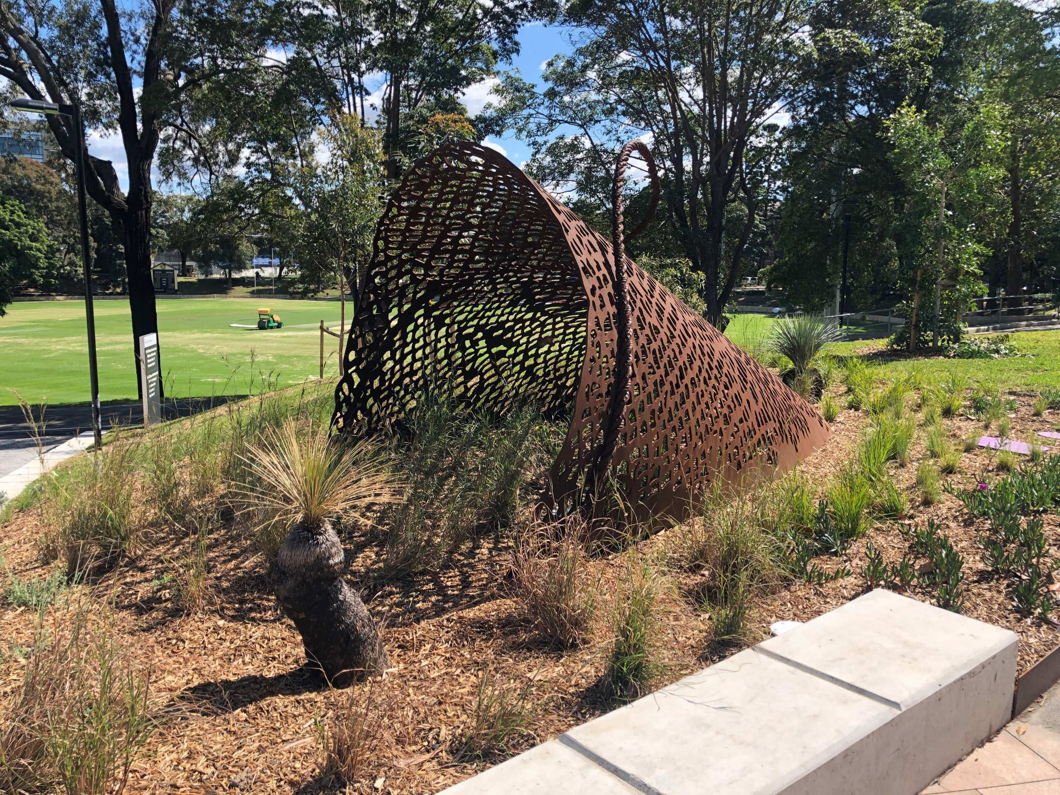
Statement of Intent
This workshop has been designed with diversity in mind. Today we have a range of learners from different perspectives, coming from teaching and educational roles across the the tertiary sector. This workshop will offer a space for many voices and perspectives to collaborate and consider how inclusive teaching and learning might be facilitated. Our aim is to spark conversation and ideas around how you might work towards designing for diversity in your different educational contexts by learning from us and each other.

Slide 5
What we’ll be covering
Designing for Diversity: adapting UDL for our context
Voices from our team: Learners, goals and challenges
Activity 1: Discussing your context
Voices from our team: Reframing as barriers
Activity 2: Barriers in your context
Voices from our team: Scaling with solutions and iterations
Q&A and final discussions

Slide 6
Designing for Diversity: adapting UDL for our context

Slide 7
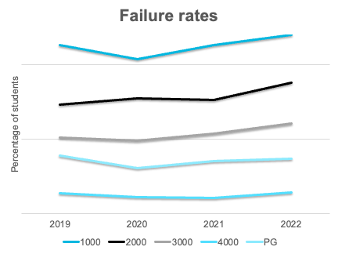
Failure rates have increased each semester since 2020
Failure rates vary hugely within student cohorts with noticeably lower success rates for:
First year students
International students
Equity students

Slide 8
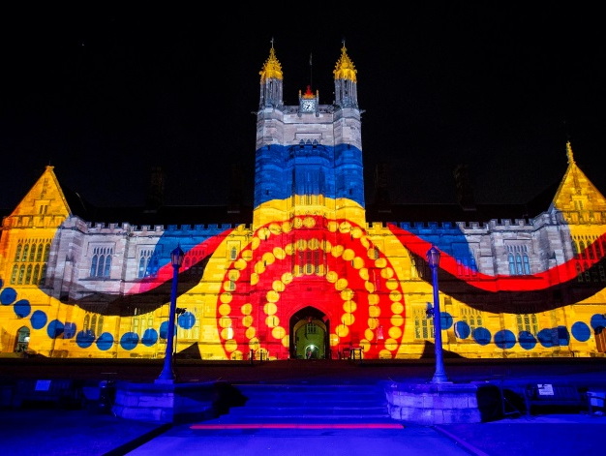
The 2032 Strategy
Our student-focus education is transformational
We will be the best Australian university for teaching and learning. Our students will attest to the transformational impact a Sydney education has on their lives, whenever and wherever they learn.
Our community thrives through diversity
Social equity is at the heart of our past and our future. By 2032 our community will be more diverse and inclusive, helping us all to shape a positive future.

Slide 9
Barriers to engagement with UDL
For our colleagues, engaging with the whole UDL guidelines was overwhelming. Inspired by the UDL Reporting Criteria and its focus on barriers and intentional design, Sarah Humphreys crafted our Designing for Diversity steps. Conceived as a mindset that colleagues could adopt, our challenge was to adapt the foundations of UDL for our context. In doing so we hoped we might lower barriers for our colleagues, foster their engagement with UDL, and reach our overarching goal of creating a better learning environment for all learners.

Slide 10
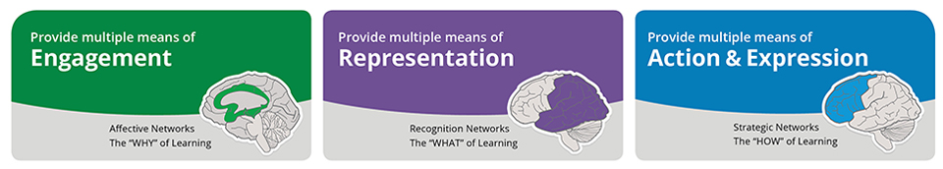
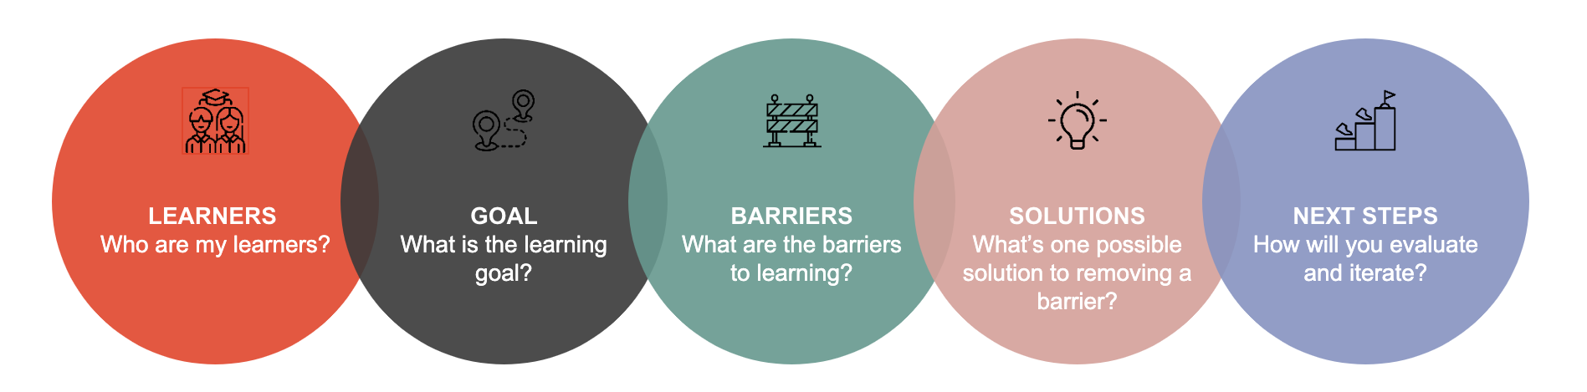
Engagement, Representation and Action and Expression

Slide 11
Designing for Diversity – a mindset
Drawing on the foundations of Universal Design for Learning which seeks to create environments where "all learners can access and participate in meaningful, challenging learning opportunities", the designing for diversity project consolidates the UDL check points and contextualises these steps for a University of Sydney environment. Making these accessible for you – our educational teams.

Slide 12
Voices from our team: Learners, goals and challenges

Slide 13

Learners, Goals and Challenges Video

Slide 14
Activity 1: Identify and Share
Thinking about your context, can you identify the challenges your learners of UDL tend to experience (your learners could be students, colleagues, staff, anyone you might need to communicate with).
Maybe your learners…
Misunderstand what UDL is?
Bring up the same questions / excuses?
Ask for alternative explanations?
Disengage?
Are unresponsive?
To participate in activity 1 and 2, share your thoughts in the google docs found here:
https://bitly.ws/TrIs

Slide 15
Barriers to student learning with Kria Coleman
First year Master of International Business - Students with diversity of language and cultural & educational backgrounds
What
Participation = oral contributions
Tracking all contributions to class
Why
How
Cultural and linguistic diversity
Diversity of academic backgrounds
First time studying in Australia
Widened definition of participation
Scaffolded weekly class preparation
Assess individual reflection on preparation, engagement, participation and learning
What
Class Participation
Goal: increase participation

Slide 16
Barriers to student learning with Kria Coleman
First year Master of International Business - Students with diversity of language and cultural & educational backgrounds
What
Take home task
Why
How
Short release (1 week to complete)
Off the shelf case study used repeatedly
Short release puts significant pressure of students
Readily searchable solutions encourages students to find easy solutions
Develop a fresh case study
Provide opportunities for students to develop contextual knowledge that provides a foundation for the task
What
Individual Assessment task
Goal: Reduce contract cheating

Slide 17
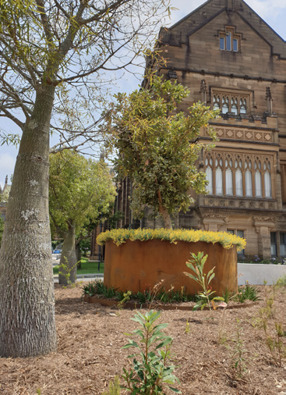
Activity 2: Reframe
Reflecting on these challenges with your colleagues, try to reframe them in terms of barriers in the learning environment.
My learners | Barrier in the learning environment
Misunderstand what UDL is? | The UDL guidelines are too complex
Bring up the same questions / excuses? | The 'takeaways' are not clear
Ask for alternative explanations? | The mode of delivering information is too ridged
Disengage?
Are unresponsive?

Slide 18

Solution and Iterations Video

Slide 19
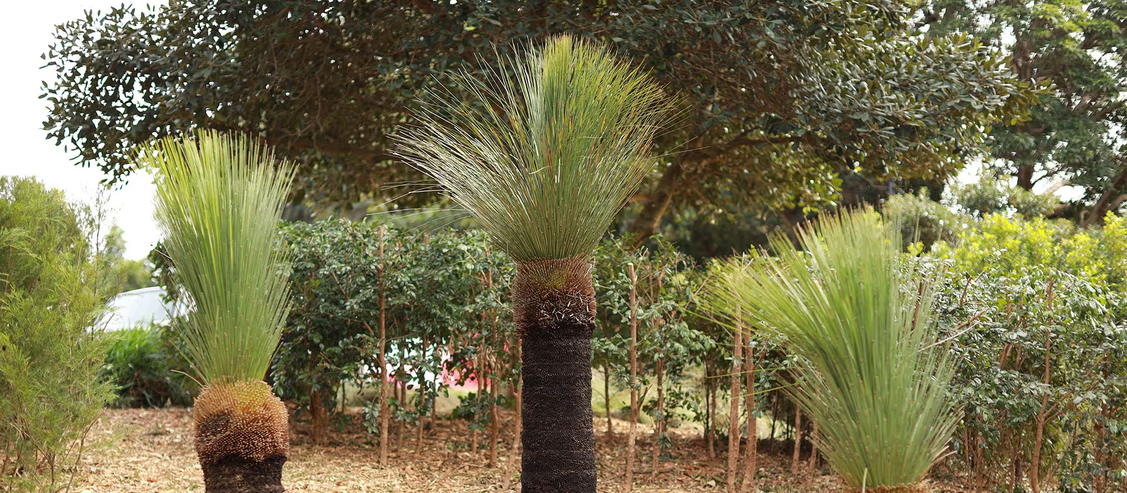
Thoughts, takeaways and Q&A
Please share any thoughts of questions you might have. Feel free to either put your hand up and vocally share or type your question/thought in the chat

Slide 20
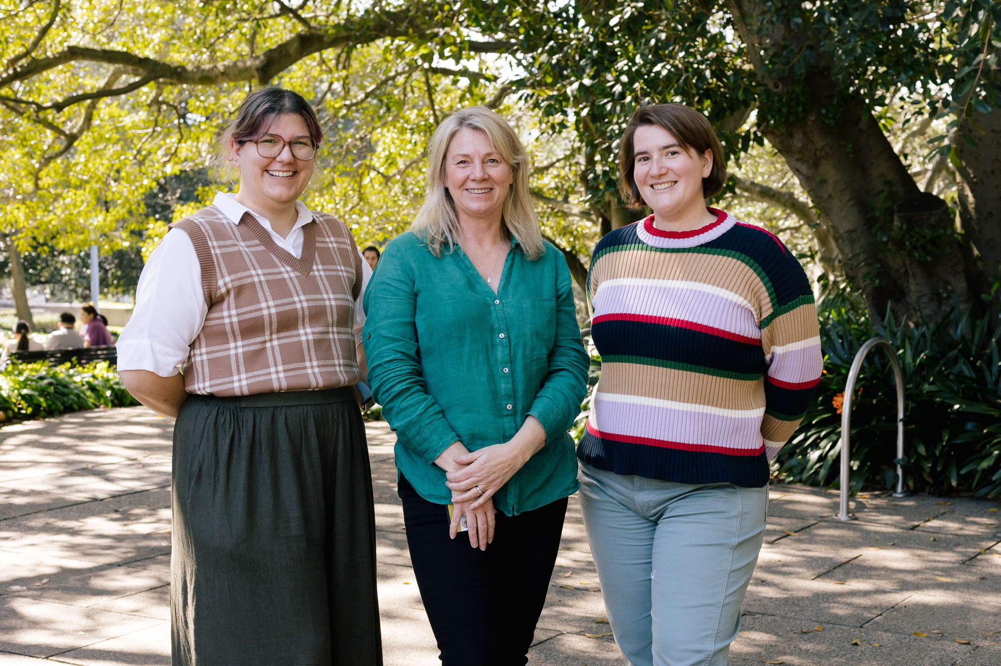
Contacts
Ella Collins-White
(ella.collins-white@sydney.edu.au)
Samantha Poulos
(samantha.poulos@sydney.edu.au)
Sarah Humphreys
(sarah.humphreys@sydney.edu.au)

