Slide 1
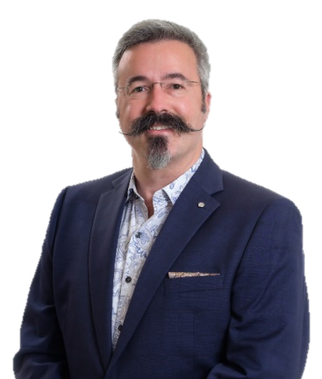

Universal Design for Learning
How to Talk with Your Colleagues about
UDL Symposium
September 7, 2023
Thomas J. Tobin
University of Wisconsin-Madison

Slide 2
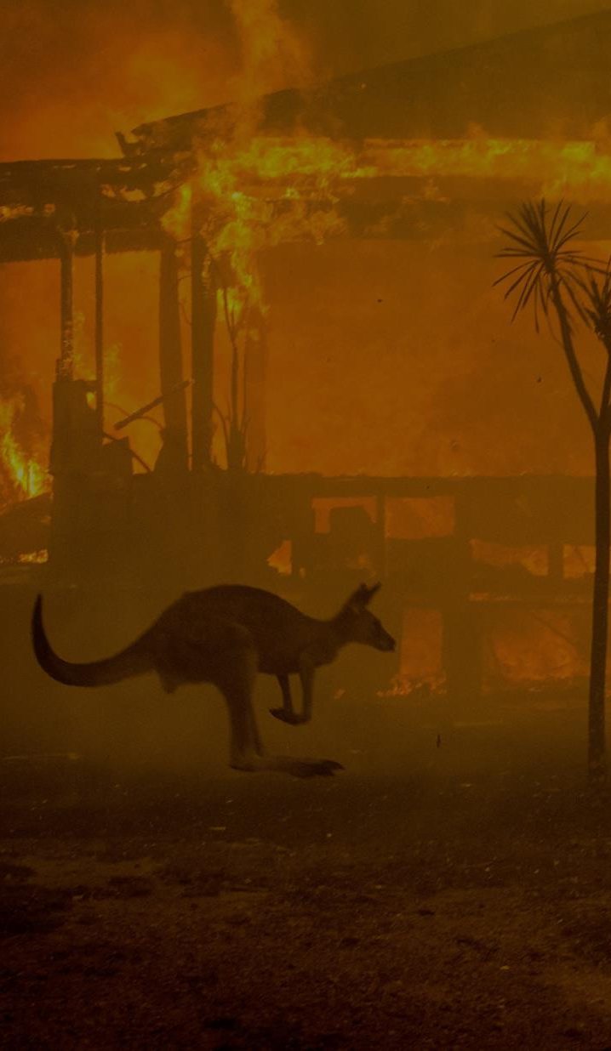

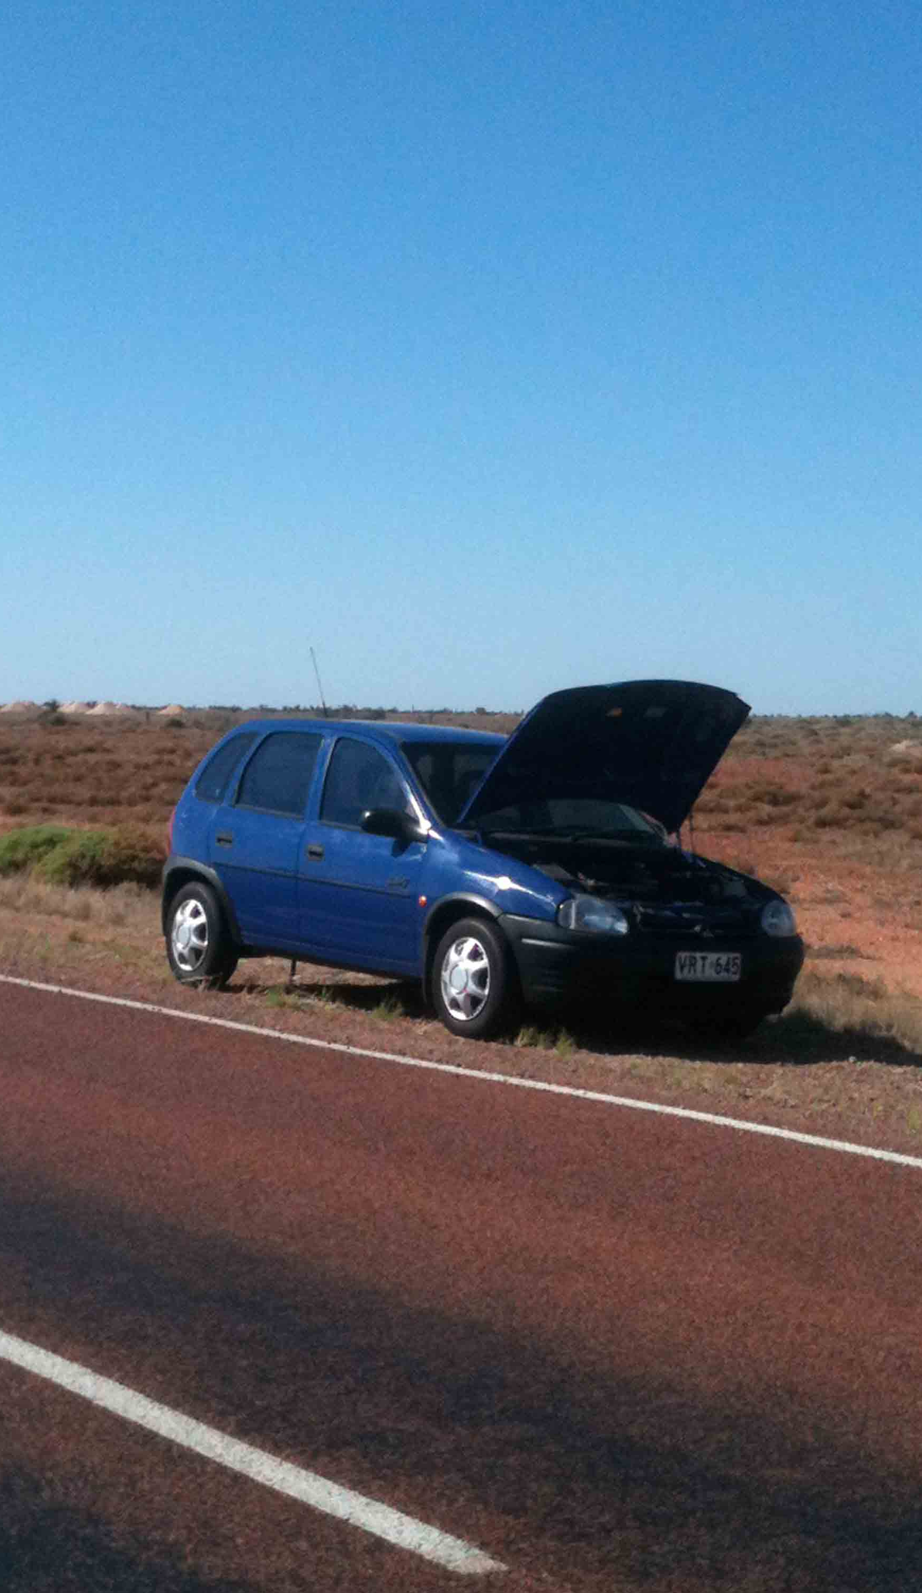

Beyond the book . . .
Images © ABC News Australia, BBC.

Slide 3

That Piece of Paper
What should our colleagues say to students?
Image ©2US Embassy Romania, Used under CC BY-ND license from Flickr.com.

Slide 4
That Piece of Paper
How might our colleagues actually feel?
Image ©2US Embassy Romania, Used under CC BY-ND license from Flickr.com.

Slide 5
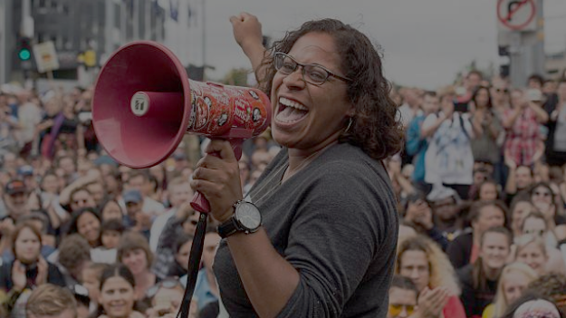
1: UDL Advocacy
Image © Getty Images Australia.

Slide 6
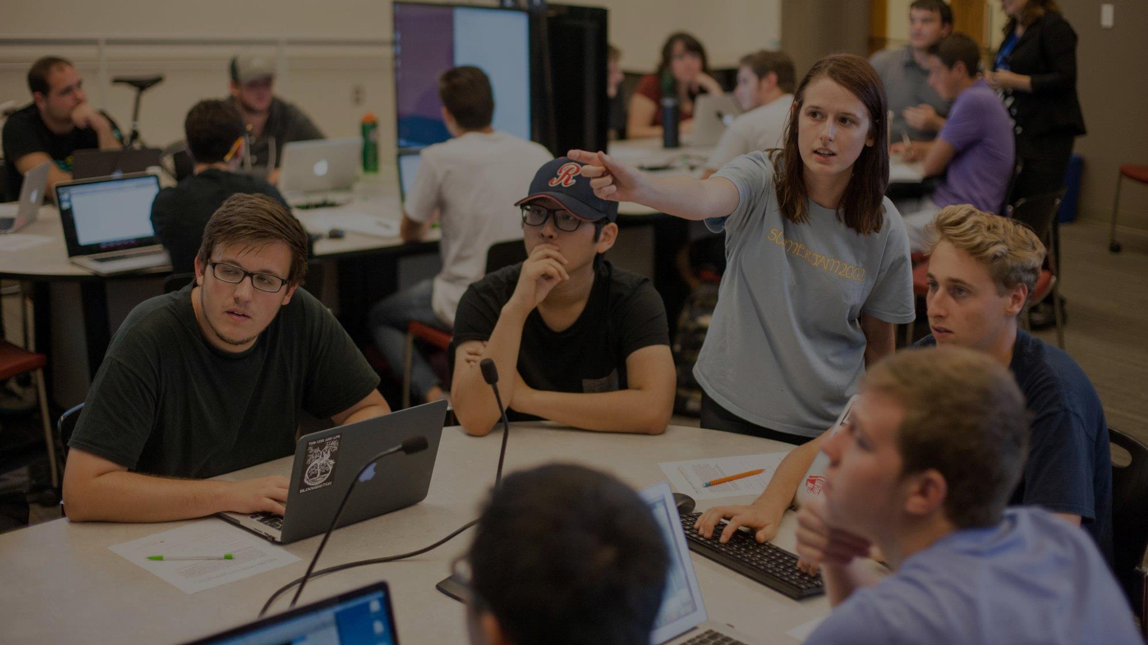
Universal Design for Learning
+1
Multiple means of
learner engagement
representing information
demonstrating skill
Image ©2017 Indiana University. Used under CC BY-ND license from Flickr.com

Slide 7
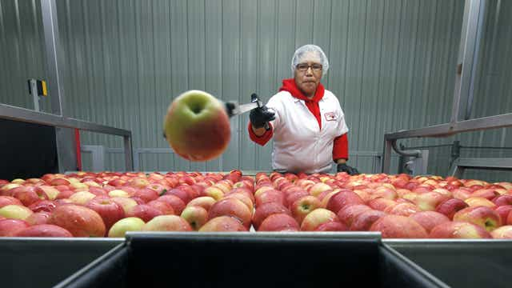
Fewer Routine Accommodations
Image © Democrat and Chronicle.

Slide 8
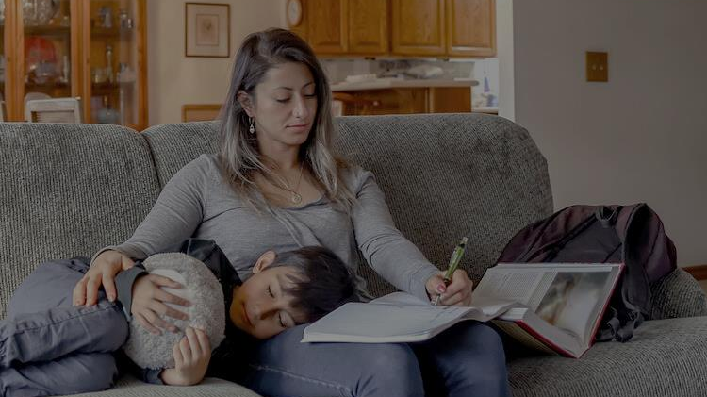
More time for study & practice
Image © Seldin Haring-Smith Foundation, Used under license from iStock.com.

Slide 9

Three New Frames
Image © Karolina Grabowska. Used under CC 0 license from pexels.com

Slide 10
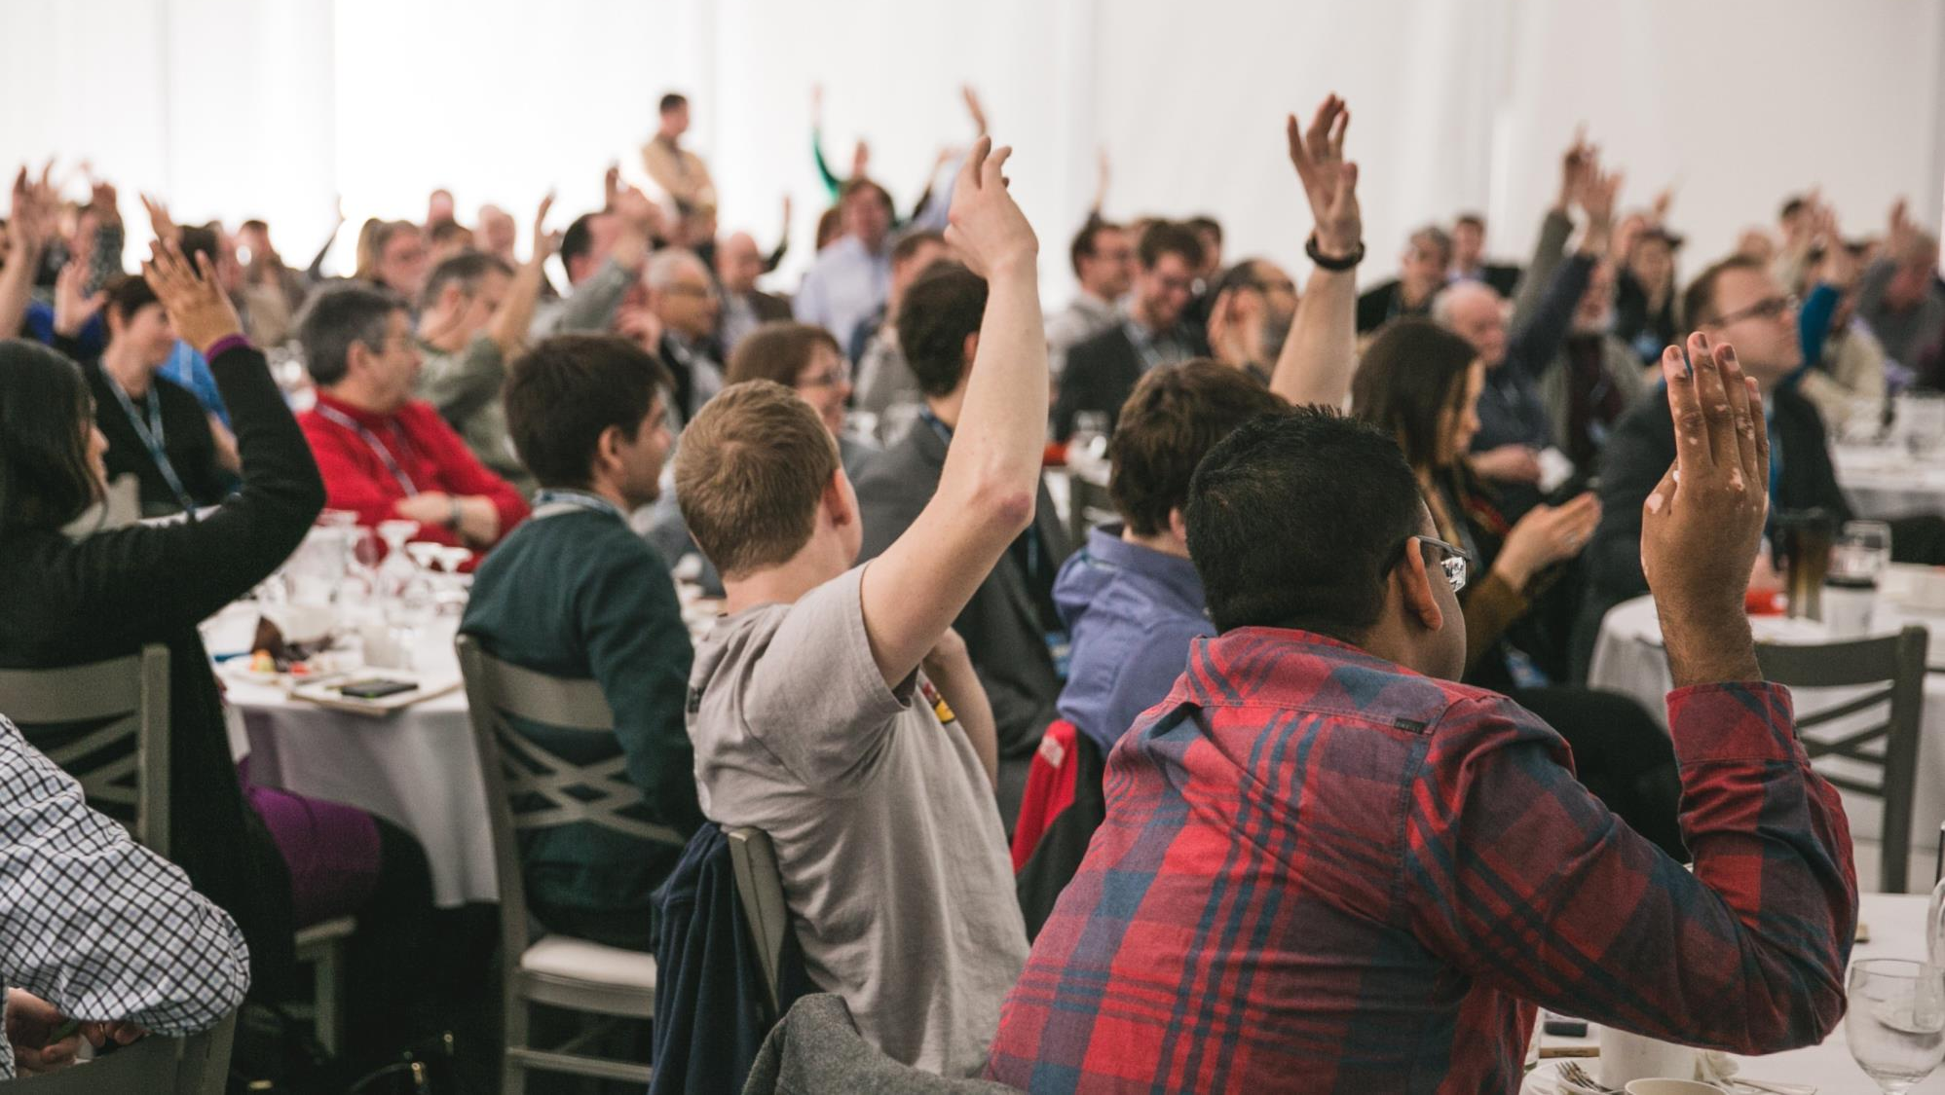
Scope
Image © Brodie Vissers. Used under CC 0 license from burst.shopify.com

Slide 11

Impact
Image © Max Fleischman. Used under CC 0 license from pexels.com

Slide 12

Budget
Image © Steve Buisinne. Used under CC 0 license from pixabay.com

Slide 13

Persistence
Retention
Satisfaction
Image © Business Insider Australia.

Slide 14

Your 5-Minute Message?
Image © Western University.

Slide 15

2: UDL Practice
Image © Janice Smith, pixabay.com

Slide 16
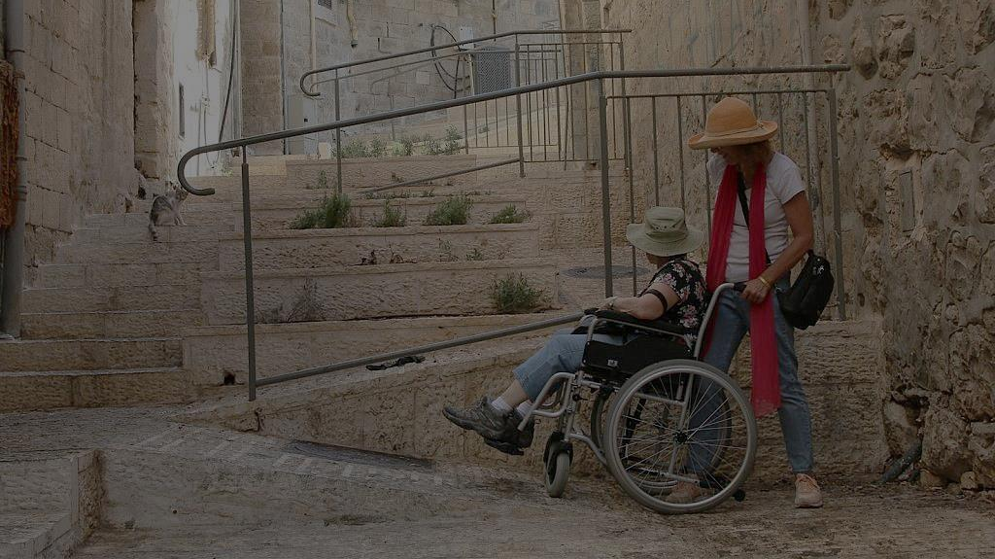
“Doing For” vs. Designing Into
Image © Times of Israel

Slide 17
Quote
A system that focuses only on "disorder" and individualised interventions misses the opportunity to address trauma through relational repair in every interaction.
— Elizabeth Gregory

Slide 18
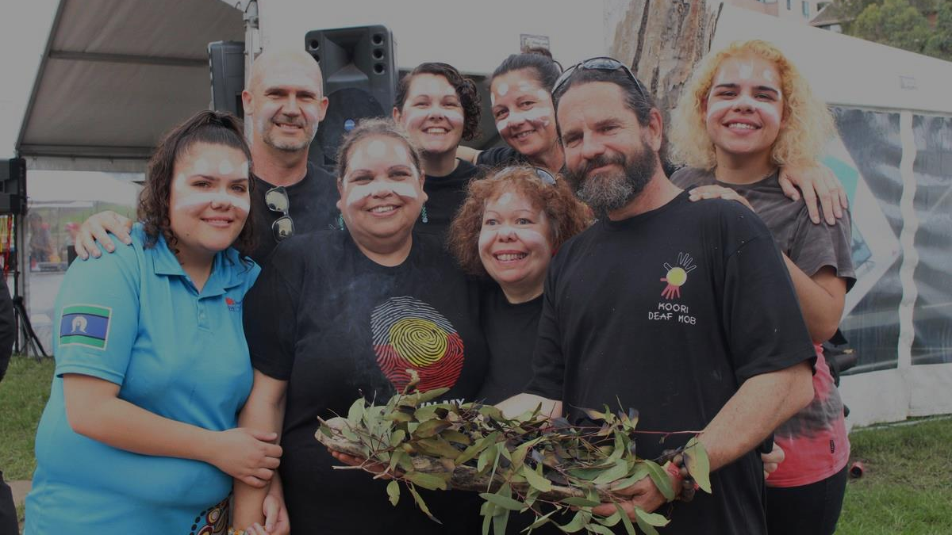
UDL in Disability
Support Services
Image © Koori Deaf Mob

Slide 19

4 Access Interactions
Materials, Each Other,
Institution, Community
Image © Helena Lopes. Used with permission from pexels.com.

Slide 20

Beyond Individual Inclusion Plans
Image © Microsoft Education Blog

Slide 21
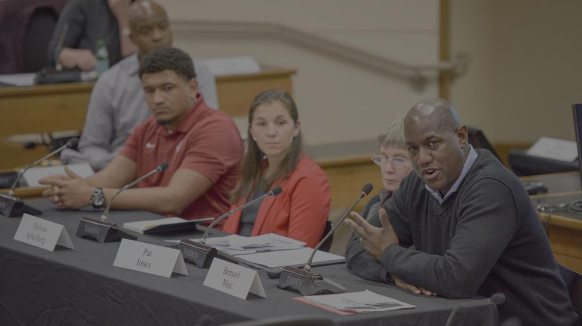
Role-Play: Talk to Your Leaders
Describe a UDL implementation.
Request an inclusive project.
What’s an expert-UDL DEI expansion?
Image © Stanford Daily.

Slide 22
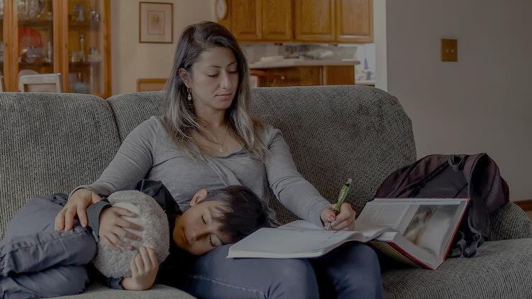
Quick Trick 1
Make UDL Echo DEI Statements
Image © Seldin Haring-Smith Foundation, Used under license from iStock.com.

Slide 23

Quick Trick 2
Pilots
Image © Maël Balland. Used under CC 0 license from pexels.com

Slide 24

Take-Aways
Image © Visit Melbourne

Slide 25
Conclusion
How to Talk with Your Colleagues about
Universal Design for Learning
UDL Symposium
September 7, 2023
Thomas J. Tobin
University of Wisconsin-Madison

