Slide 1
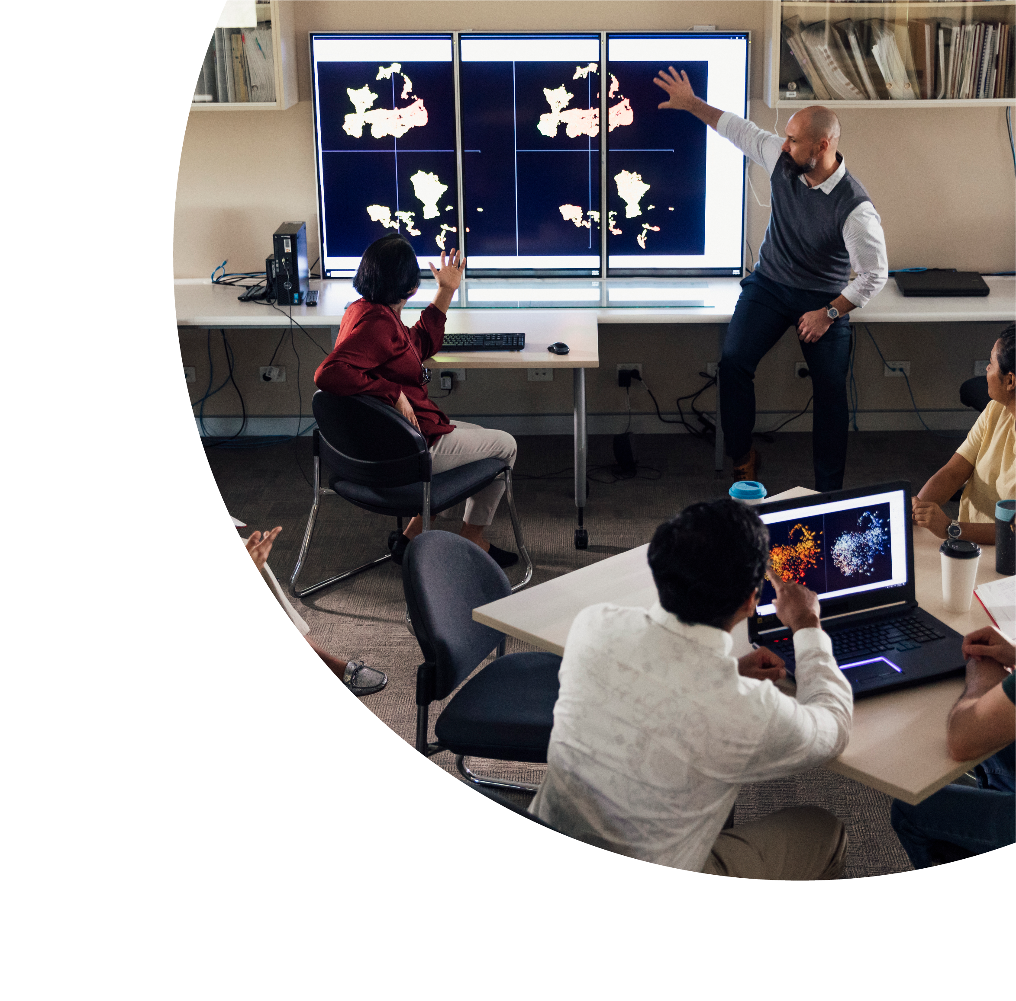


Incorporating the Pillars of UDL in University Course Design
Professor Terry Cumming
UNSW Sydney

Slide 2

About this session
This session is being recorded. If you do not wish to appear on screen please hide camera
This session will be captioned (either live captioning or closed captions)
Session etiquette
Use Chat or Q+A function as directed by presenter
Indicate in the Chat or Q+A function for questions as directed by presenter
Where appropriate use raised hand emoji to ask questions
Ensure your surrounding environment is quiet when mic is on (e.g., phones, pets etc)
Turn off mic when not speaking

Slide 3

Acknowledgement to traditional custodians
I would like to acknowledge the Gadigal people that are
the Traditional Custodians of this land. I would also like to pay
my respects to the Elders both past and present, and extend
that respect to other First Nations people who are present
here today.

Slide 4
What we’ll be covering
Ways to incorporate the principles of UDL in your course design
How to begin- getting organized for UDL
Providing multiple ways for students to access course content, engage in the course, and meet learning outcomes
Supporting students’ organizational/time management skills
Accessible communication

Slide 5
UDL in Higher Education Course Design: The Basics (1)
You are likely already doing quite a bit, as UDL is really just good teaching
Basically provide students with multiple means of:
  Representation
  Engagement
  Action and expression
Instructors are typically most adept at providing multiple means of representation through the use of lectures, videos in lectures, etc.

Slide 6
UDL in Higher Education Course Design: The Basics (2)
Often difficult to provide students with multiple means of action and expression
Student choice is uncommon
Covid spawned more instructor expertise in providing other means of engagement, and action/expression out of necessity, but student choice is still not prevalent in higher education courses.

Slide 7
How to Begin
Start with the course’s learning outcomes
  Link these to weekly learning outcomes and assessments
Think about how you can provide:
  Different modes of representation, engagement, action/expression for each
  Student choice

Slide 8
Design Organiser
Write in ideas for each learning objective, followed by the symbols that represent the learning mode of that activity

Slide 9
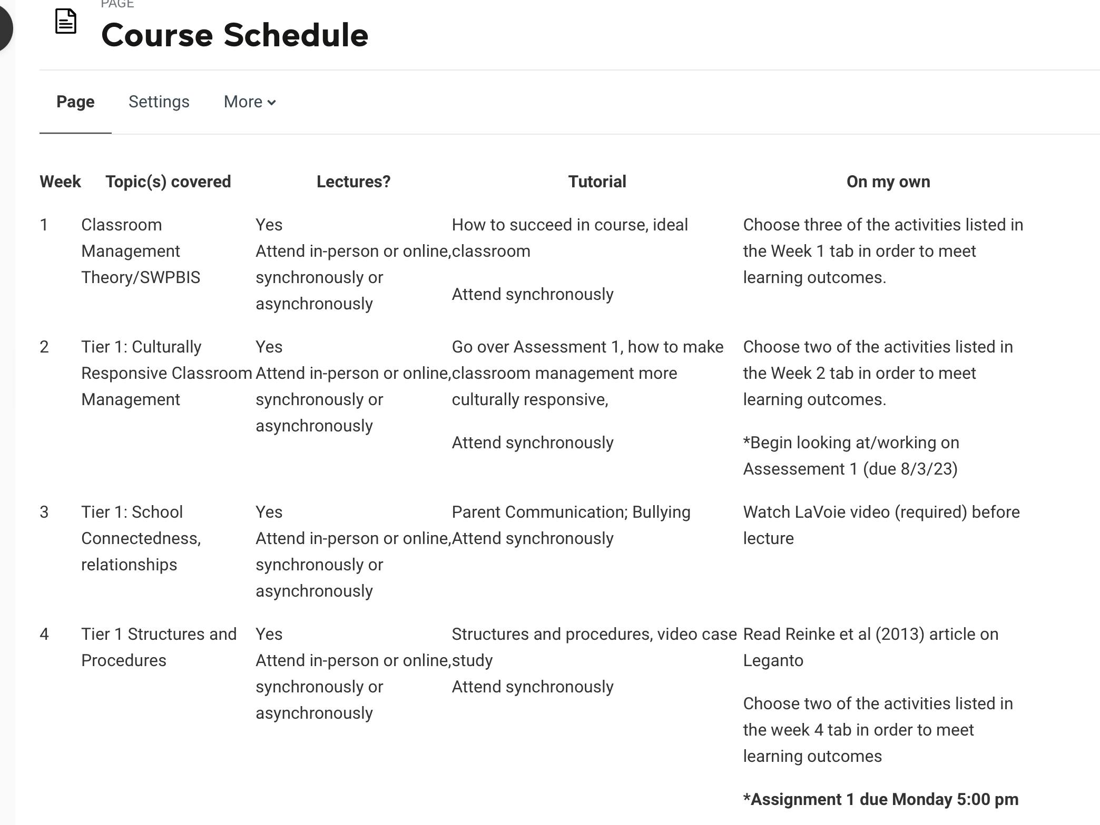
Supporting Organisation: Schedule

Slide 10
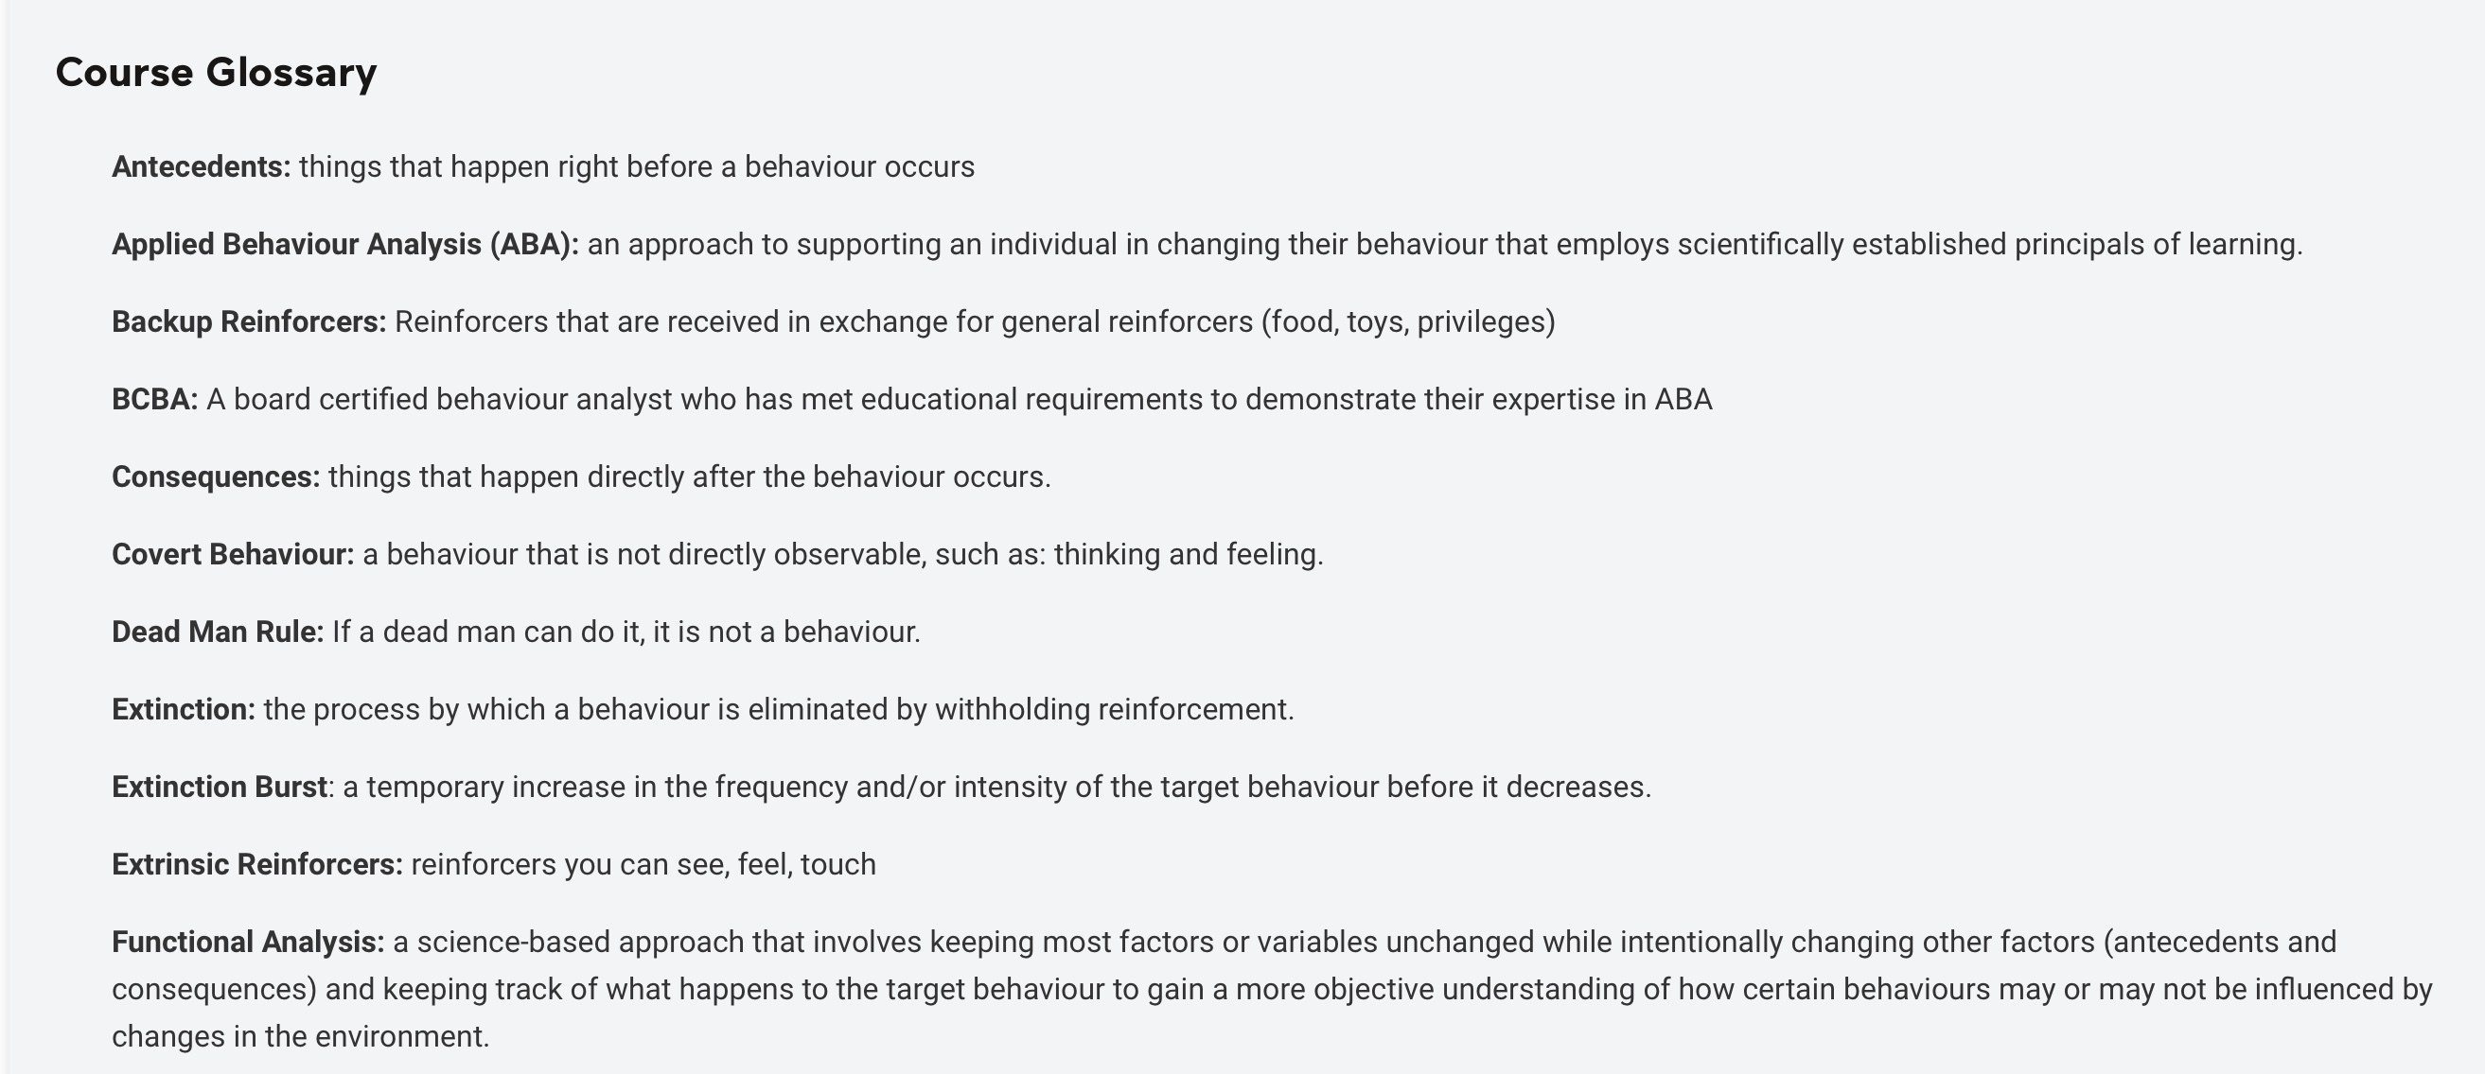
Supporting Organisation: Glossary

Slide 11
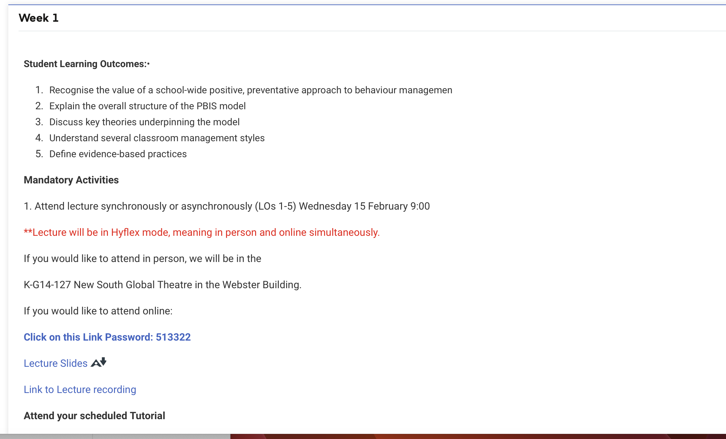
Weekly Structure Including Choice (1)

Slide 12
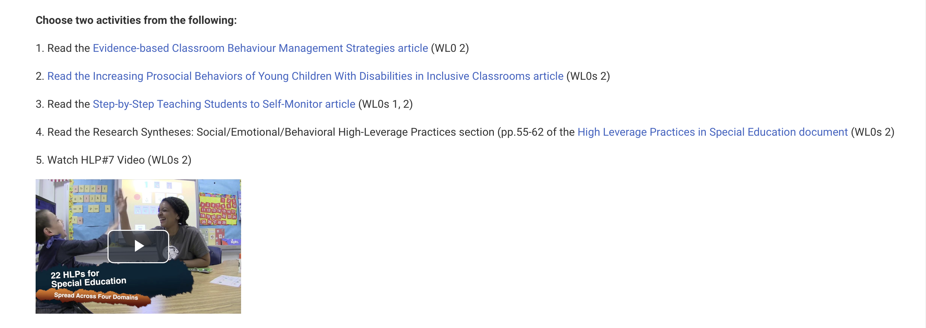
Weekly Structure Including Choice (2)

Slide 13
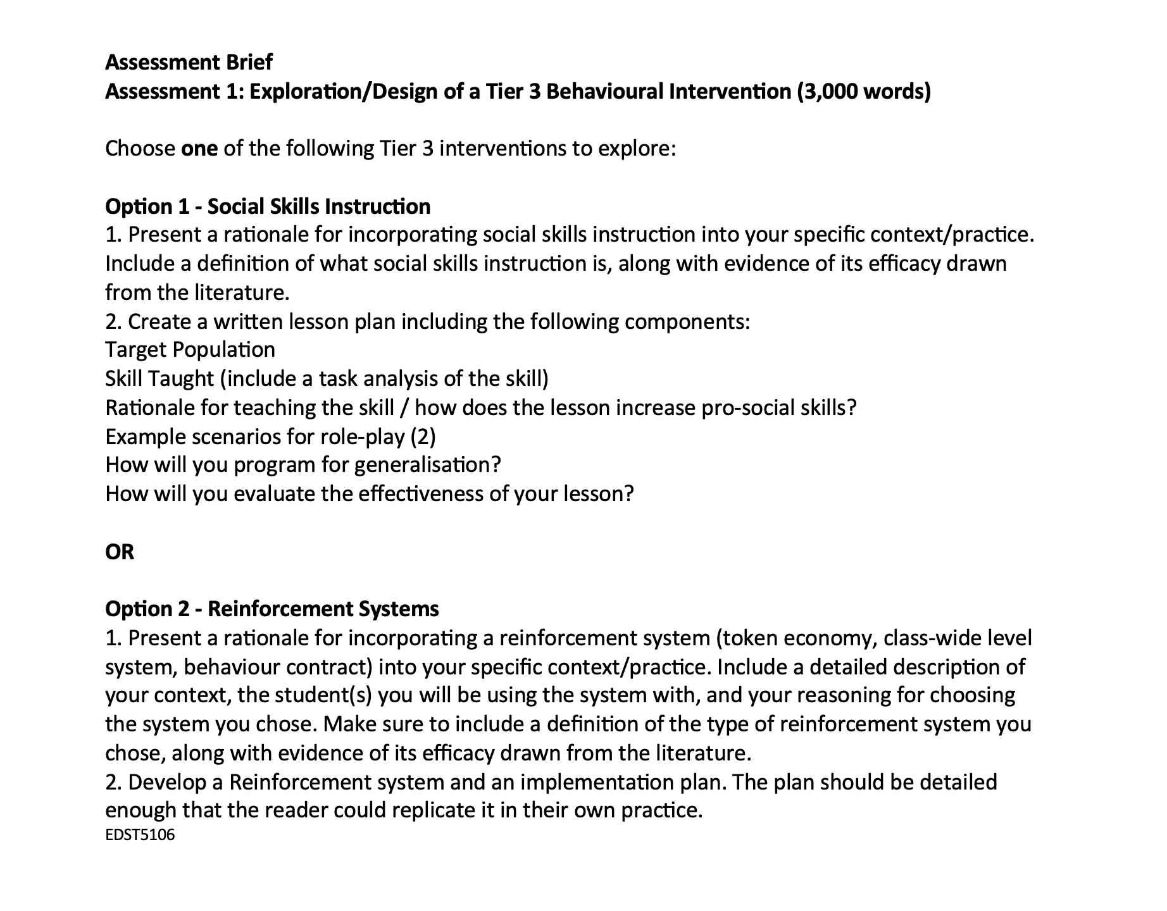
Assessment Choice

Slide 14
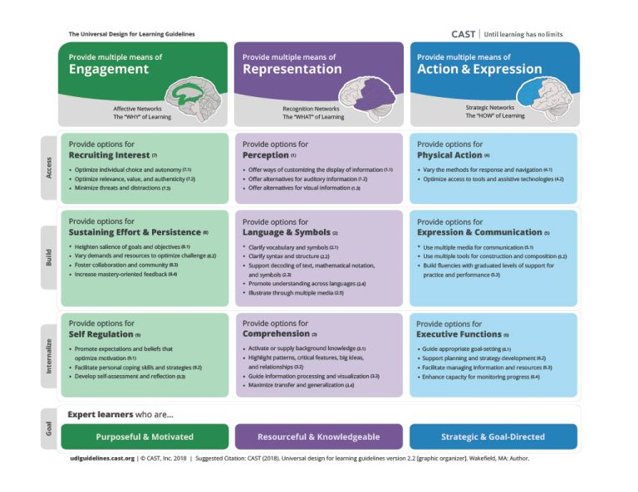
Conclusion or takeaways
Provide students with options for engagement, representation, action and expression
Try to include all modes: reading, listening, writing, discussing, doing
Support student organisation
Provide options for attending lectures
Provide options for assessment
Co-produce with students before class if possible but definitely during the course- “What can I do to better support your learning?”
Check out UDL on Campus for ideas and tips http://udloncampus.cast.org/page/udl_landing

Slide 15
Contacts
Terry Cumming
t.cumming@unsw.edu.au
9385 1944

Slide 16
Q & A session
Please raise your virtual hand or type your questions into the chat

