Slide 1
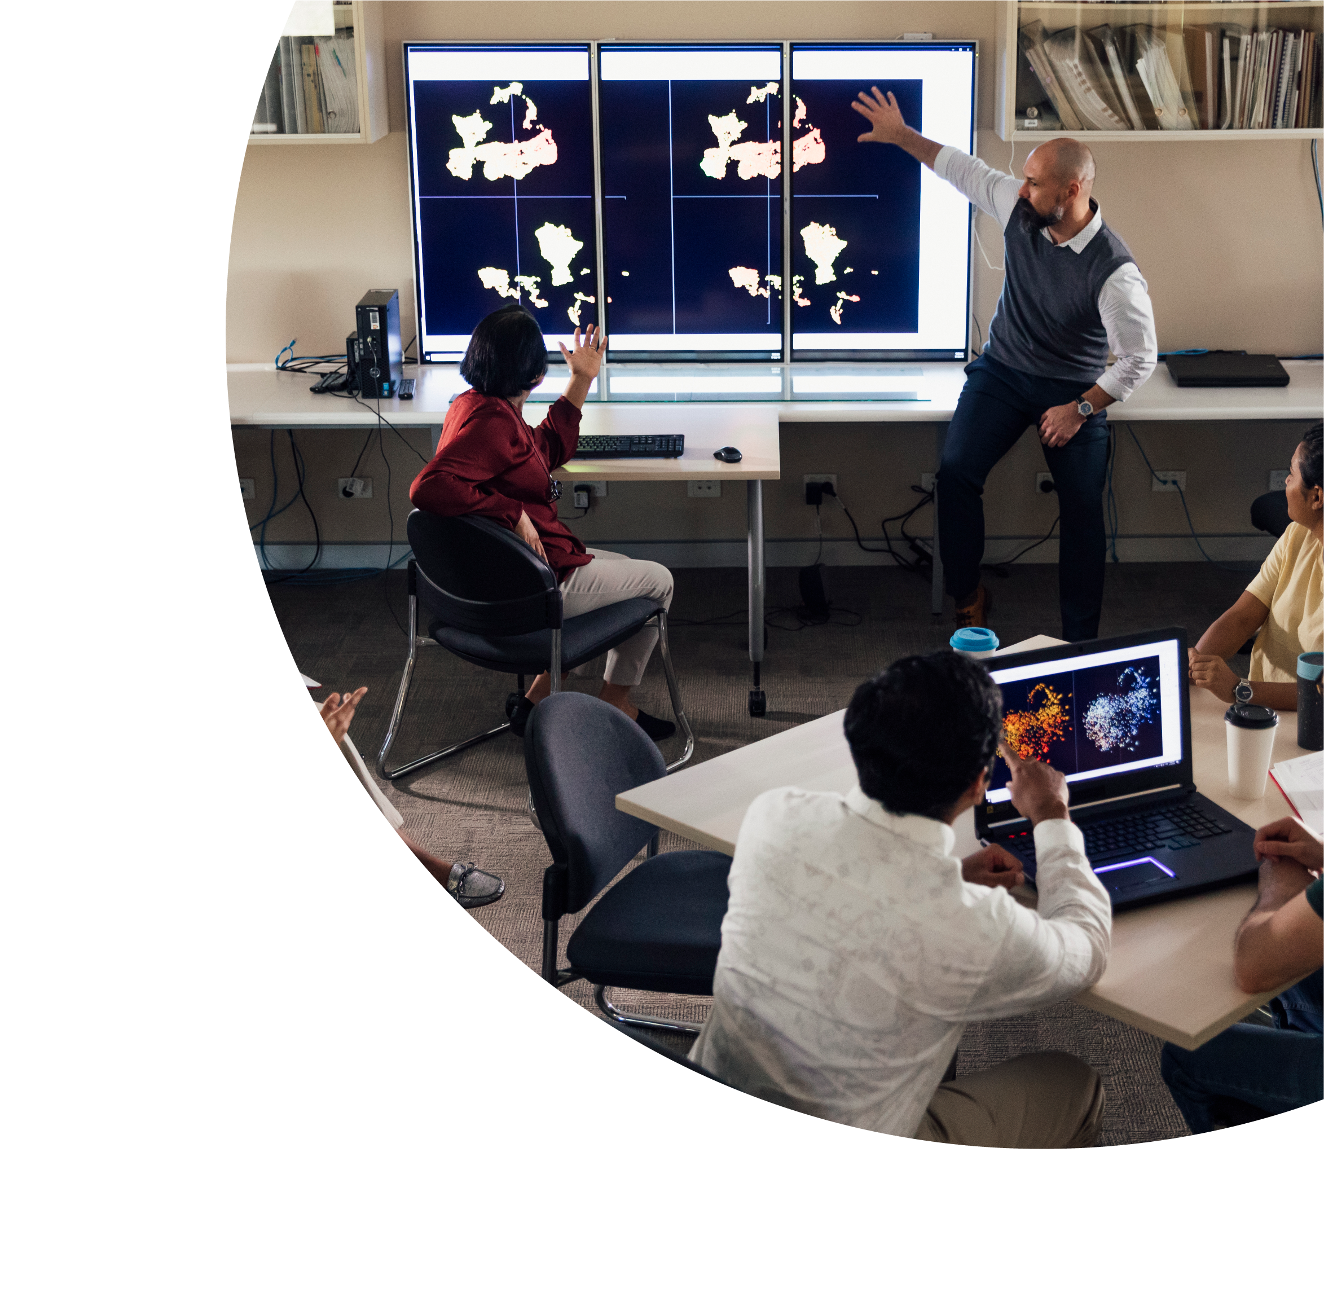
UDL in Uplift
Kashmira Dave &
Kate Mitchell

Slide 2
About this session
This session is being recorded. If you do not wish to appear on screen please hide camera
This session will be captioned (either live captioning or closed captions)
Session etiquette
Use Chat or Q+A function as directed by presenter
Indicate in the Chat or Q+A function for questions as directed by presenter
Where appropriate use raised hand emoji to ask questions
Ensure your surrounding environment is quiet when mic is on (e.g., phones, pets etc)
Turn off mic when not speaking

Slide 3
Acknowledgement to traditional custodians
University of New England (UNE) recognises the the Anaiwan people as traditional custodians of the land which the University stands.
We pay our respects to First Nations Elders past and present.
Want to do more?
Pay the rent [https://paytherent.net.au]
Indigenous Literacy Foundation [https://indigenousliteracyfoundation.org.au]
IndigenousX [https://indigenousx.com.au/]

Slide 4
What we’ll be covering
UNE Uplift – What is it? Why is it needed?
Uplift Elements – What’s included?
How we are progressing
Future work

Slide 5
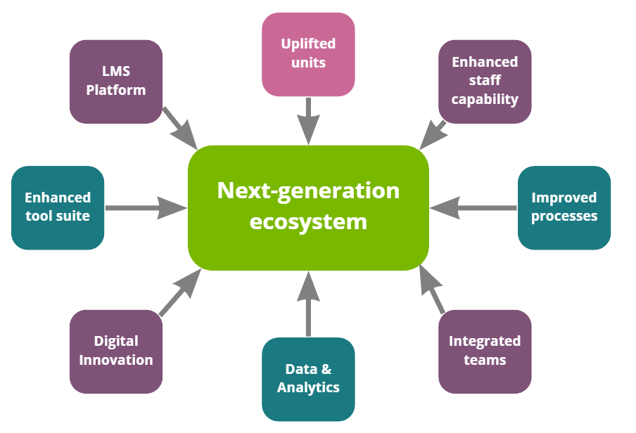
UNE Project Uplift
Image: UNE Next generation ecosystem, sourced from https://projectuplift.une.edu.au/

Slide 6
UNE Uplift – Current progress
Unit evaluation
Uplift Elements
Alignment to UNE Learning Standards and TELAS
Moodle theme and upgrade, rebrand (‘myLearn’)
Unit design and navigation consistency
MVP vs ongoing good practice
Image: UNE Uplift logo. Sourced from https://projectuplift.une.edu.au/

Slide 7
Uplift – 16 Elements
Image: UNE Uplift Elements, sourced from https://projectuplift.une.edu.au/unit-uplift/

Slide 8
Element 14: UDL
Domain: Layout and Interface
Rationale: All students can engage in learning in ways that maximise their success
TELAS 1.1, 1.3, 7.3, 8.2
UNE Online Learning Standards: 1, 7
Future Fit – Personalised Learning Journeys
Photo by S O C I A L . C U T on Unsplash

Slide 9
Element 14 in detail
Essentials:
Content, where applicable, is offered in multiple formats (audio/video/text)
Transcripts are provided for every video
Media has clear audio for automatic transcript accuracy
Media reflects the diversity of our student cohort
Guidance:
Consider providing multiple ways for student to engage with idea and present their own work.

Slide 10
Uplift Elements
Image: UNE Uplift Elements, sourced from https://projectuplift.une.edu.au/unit-uplift/

Slide 11
The How
‘Tiger Team’ for navigation consistency, Unit Outline, core elements, progress tracking
Learning Designer consultation
PDF to Moodle book/html conversion
Videos in Echo/Kaltura with captions
Encourage use of Reading List, rubrics, topic learning outcomes/reflection points.
Image: UNE Uplift logo. Sourced from https://projectuplift.une.edu.au/

Slide 12
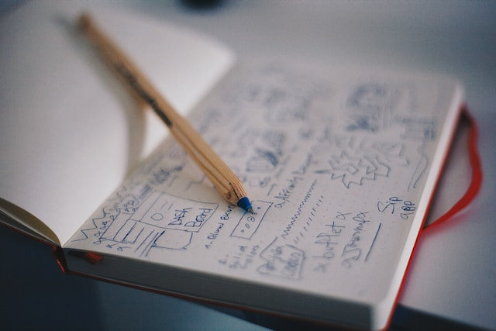
Challenges
Flying the plane while building it
Theme, accessibility and good practice
Communication and support
Photo by Med Badr Chemmaoui on Unsplash

Slide 13
Takeaways and future work
Accessibility and inclusion is ongoing
UDL can help start conversations - but needs unpacking
Projects vs sustainable, ongoing practice
Clarity, Scope and Communications
Resourcing teams to do the work

Slide 14
Contacts
Kate Mitchell
kmitch47@une.edu.au
Kashmira Dave
kdave3@une.edu.au

Slide 15
Q & A session
Feel free to ask questions!

