Slide 1
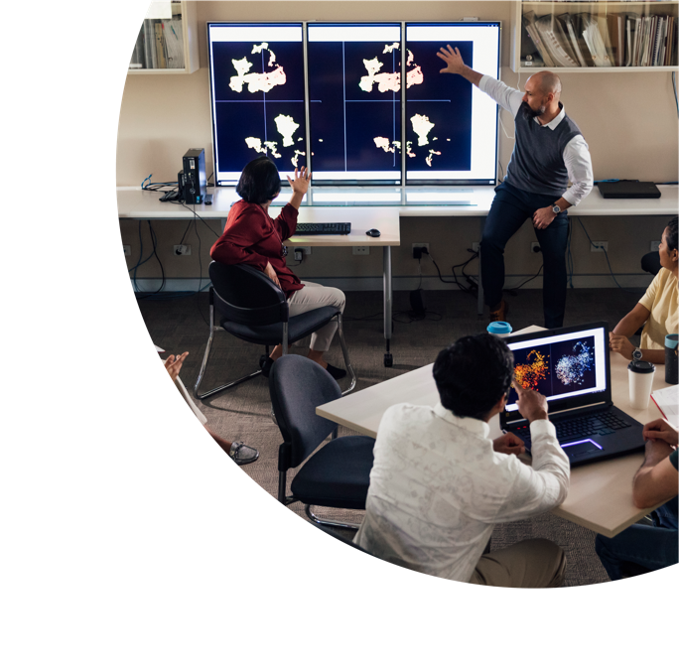
The UDL journey of TAFE NSW
Naomi McGrath
John J Fardoulis

Slide 2
About this session
This presentation has been pre-recorded. Captions and a transcript are available.
As we are recording this session, please hide your camera if you do not wish to appear on the screen.
Session etiquette
As the presentation has been pre-recorded, use the Chat if you have a Question and we will provide answers during the presentation.

Slide 3
Acknowledgement to traditional custodians
As we are meeting across the country in this virtual space, each of us stands upon the lands of many different Nations.
We'd like to take a moment to acknowledge the Traditional Custodians of all the Nations we are meeting from.
We pay our respect to all Elders; past, present and emerging and extend that respect to other Aboriginal and/or Torres Strait Islander Peoples joining us today.
Naomi is joining from the Gumbaynggirr Nation.
John is joining from the Darkinjung Nation.

Slide 4
What we’ll be covering
Who we are
Foundation
Where to next?

Slide 5
Who we are

Slide 6
Inclusive Design Team
The Inclusive Design Team consists of specialists in the following areas:
Universal Design for Learning (UDL)
Accessibility
Language, Literacy, Numeracy and Digital Skills (LLND)
Learning Design Support
Cultural Customisation.
We work collaboratively with product design and development teams to advocate and influence the adoption of:
Inclusive design and practices
Universal access to all products.

Slide 7
Naomi McGrath
Project Manager, Inclusive Design.
Worked in both Higher Education and the Vocational Education and Training sector.
Manages a team responsible for supporting inclusive practices within the product development lifecycle within the Product and Quality Group at TAFE NSW.
Bachelor of Communication Studies (Media & Culture), Graduate Certificate in Arts (Media Studies), Master of Learning & Development (Online & Distributed Learning), Professional Certificate in Web Accessibility.

Slide 8
John J Fardoulis
Lead Universal Design.
ICT programming and analysis background.
Web developer specialising in web accessibility.
Bachelor of Commerce (Computing & Information Systems), Diploma of Computer Programming Technology, Australian Computer Society Senior Member, Certified Professional, International Professional Practice Partnership accredited.
Worked in both Higher Education and the Vocational Education and Training sector.
Lived experience with neurodiversity and low vision.

Slide 9
Foundation
A showcase of resources developed for accessibility that is the foundation of our UDL journey

Slide 10
Flyer: UDL

Slide 11
Flyer: Accessible Images

Slide 12
Image Long Descriptions

Slide 13
Instructions for Caption and Transcript

Slide 14
Video and Scenario Transcripts

Slide 15
Writing Guide and Naming of Files

Slide 16
Guidelines: Rise Components

Slide 17
Guidelines: H5P Content Types

Slide 18
Self-paced learning

Slide 19
Where to next?

Slide 20
Inclusive Design Project
Embed inclusive practices (including universal design for learning) within course design and the use of digital resources (including accessible approaches for learning) to support the diverse and variable needs of all learners to enhance learner success.
Image source: https://www.salvationarmy.org.au/about-us/inclusion/

Slide 21
Inclusive Design Objectives
Diverse learners feel safe and supported.
Staff are confident to create and deliver inclusive education.
Promote equity and inclusion by meeting legal, ethical and regulatory requirements.
Inclusive Design Standards as a baseline.
Capability uplift program.

Slide 22
Inclusive Design Standards
Extensive research and gap analysis review.
Comprehensive consultation of 200+ stakeholders.
5 focus areas that align to produce inclusive products, resources and delivery practices.
30 standards within the focus areas to guide inclusivity in product development and delivery.
Resources and capability development to support and enhance each standard.

Slide 23
Resources to support Inclusive Design
UDL strategies database
The ID Hive
Inclusive Design Toolkit
Micro-learning videos
Inclusive Design Standards

Slide 24
Takeaways
It takes time – take the wins!
Connect with networks in your organisation.
Get support from Senior Management.
Don’t be afraid to make mistakes.
Take opportunities as they come.
Congratulate colleagues doing great work.
Slow and steady wins the race – take time on developing staff.
Think outside the box – Tip of the Week, WCAG Wednesday, Did you know? (newsletter).

