Slide 1
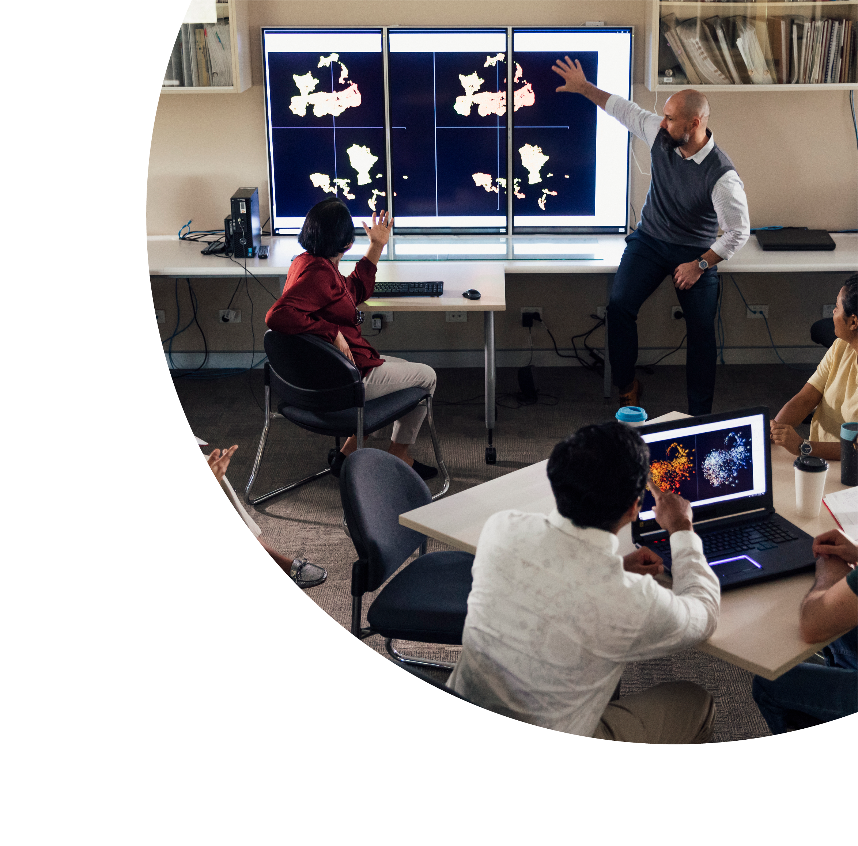


Institution-wide Embrace of Universal Design for Learning:
A Journey Towards Inclusive Excellence
Dr Leitha Delves
Edith Cowan University

Slide 2

About this session
This session is being recorded. If you do not wish to appear on screen please hide camera
This session will be captioned (either live captioning or closed captions)
Session etiquette
Use Chat or Q+A function as directed by presenter
Indicate in the Chat or Q+A function for questions as directed by presenter
Where appropriate use raised hand emoji to ask questions
Ensure your surrounding environment is quiet when mic is on (e.g., phones, pets etc)
Turn off mic when not speaking

Slide 3
Acknowledgement to traditional custodians
Edith Cowan University is committed to reconciliation and recognises the traditional custodians of the land upon which its campuses stand and their connection to this land. I acknowledge and pay my respects therefore to the Whadjuk Noongar people of the Joondalup area where I am today. I particularly acknowledge and offer my respect to Aboriginal and Torres Strait Islander Elders and Aboriginal and Torres Strait Islander people present.

Slide 4
Today’s topics
Strategic Integration of UDL Principles
Operationalising the Vision
The Importance of Staff Buy-In
Professional Learning for Empowerment
A Pilot Project
Impact Assessment
Sustainability and Next Steps

Slide 5
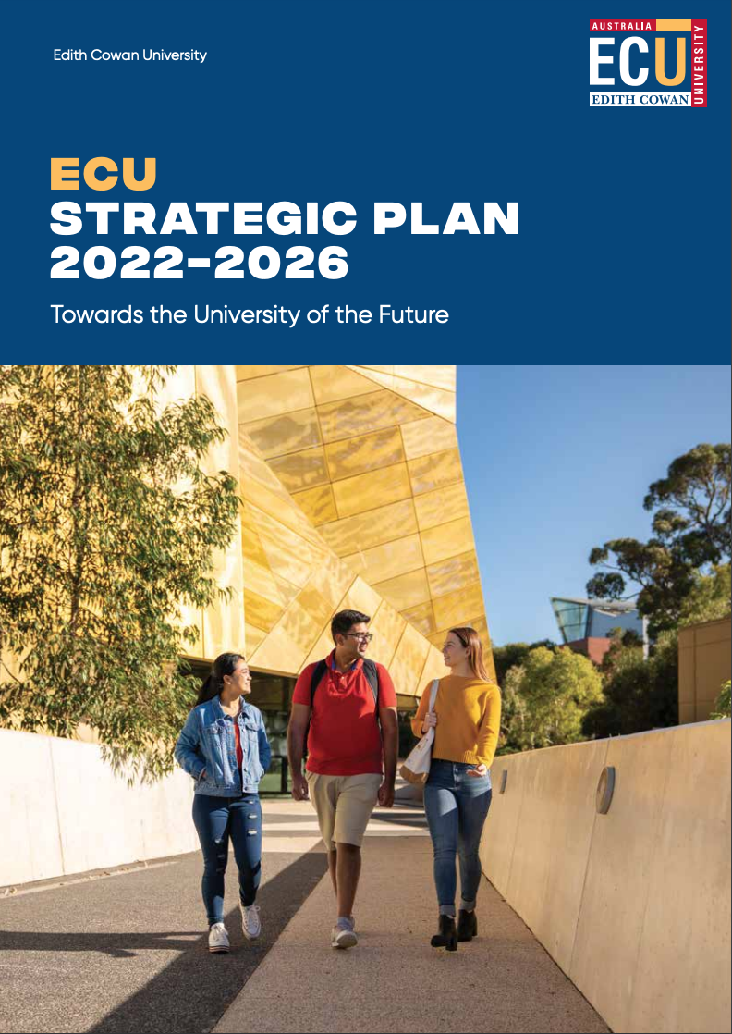
Strategic Integration of UDL Principles
ECU Strategic Plan 2022-2026
Goal 1: Delivering an exceptional student experience for success in work and life
Strategic Priority 1.4: Promoting equity, diversity and excellence
ECU will provide sector leadership in contemporary equity, diversity and inclusive practices, to widen participation and success in higher education.

Slide 6
Supporting Plans
Educational Experience Plan 2022-2026
Objective 13: Lead the sector in inclusive leadership, curriculum, and practices
13.5: Define and embed inclusive curriculum design criteria within major course review mechanisms.
13.6: Adhere to Universal Design principles in 100% of units to improve learning outcomes for all students, including students with disabilities.

Slide 7
Policy and Procedure
Curriculum Design Policy – principles
Curriculum Design Procedure - practice
4.49: Universal Design Principles will be used in all units to ensure built-in flexibility and improved access, availability and opportunity to information and learning for all students.
4.51: While meeting learning outcomes, assessment and accreditation demands, courses and units will be offered in ways that provide students with some flexibility and choice.

Slide 8
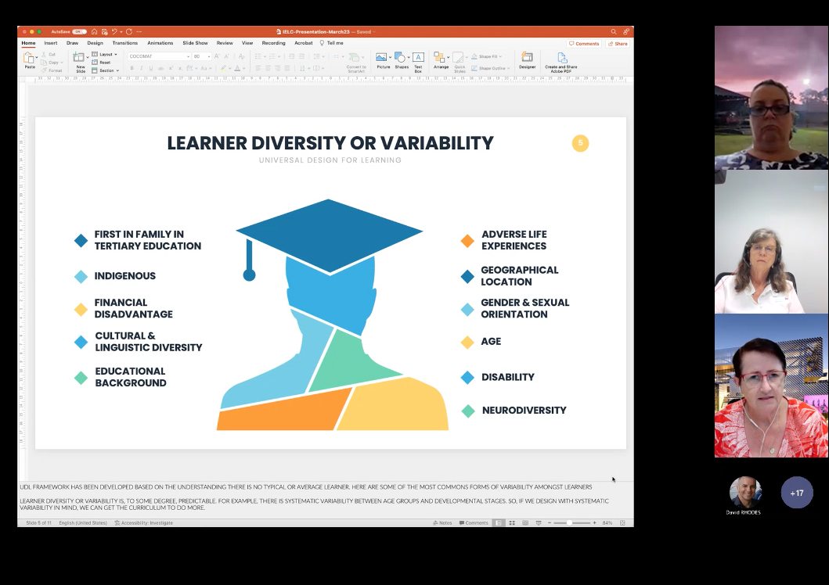
Inclusive Education Learning Community
IELC Priorities:
Increasing networking and educational opportunities for ECU staff
Raising awareness and resources for best practice inclusive curriculum
Embedding inclusive curriculum as a University-wide approach

Slide 9
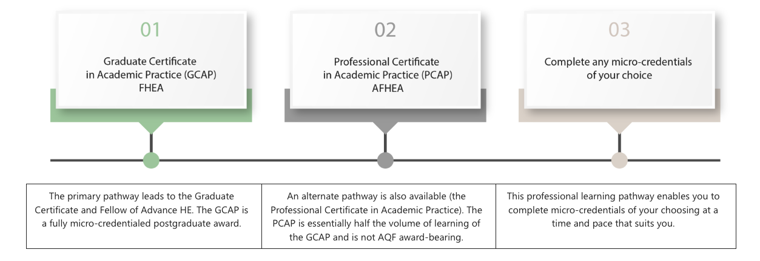
Professional Learning for Empowerment
Micro-credentials included:
Universal Design for Learning
Inclusive Practices
Designing Digitally Accessible Curriculum and Content

Slide 10
Pilot Project: Unit Exemplars
On board so far:
1 x UniPrep unit (new unit)
1 x Aviation unit (existing unit)
3 x micro-credentials (existing)
Work will include:
Recommendations for design or re-design of assessments, learning activities and learning materials according to UDL principles
Assistance with creation or re-development on learning materials
Assistance with design and set up of LMS site (Canvas)
Assistance with and feedback on assessment instructions and rubrics.

Slide 11
What Next?
Generative AI & Programmatic Assessment stealing the show?
Leitha Delves
l.delves@ecu.edu.au

Slide 12
Q & A session
To ask a question or make a comment, please use the raised hand emoji.

