Slide 1
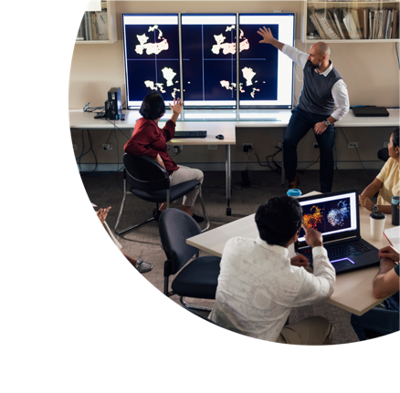


Why are autistic people (cautiously) excited about UDL in universities?
Dr Sandra Thom-Jones
(Autistic Professor)

Slide 2

About this session
This session is being recorded. If you do not wish to appear on screen please hide camera
This session will be captioned (either live captioning or closed captions)
Session etiquette
Use Chat or Q+A function as directed by presenter
Indicate in the Chat if you have a Question
Use Raised hand emoji to ask questions
Ensure your surrounding environment is quiet when mic is on (e.g., phones, pets etc)
Turn off mic when not speaking

Slide 3
Acknowledgement to traditional custodians
I begin today by acknowledging that I am presenting this session from the lands of the Wurundjeri People. I also acknowledge the Traditional Custodians of the various lands on which you all work today and the Aboriginal and Torres Strait Islander people participating in this symposium.

Slide 4
What we’ll be covering
Autistic Australians
Applying UDL approaches to autistic learning
Caveats on UDL approaches for autistic learning

Slide 5
Autistic Australians

Slide 6

A systemic problem
There is increasing evidence that the low enrolment, and lower completion, rates of autistic students are a function of structural, social and environmental barriers not lack of capability.
“Because when you get into the system, it feels like there are walls up everywhere that you can’t…get the information that you need…”
“I think a lot of autistic adults find it difficult because we kind of grow up, and then there's not as much support compared to younger students or even primary school aged students...”

Slide 7
WHY we learn (Engagement)
Passion over pragmatics
Patchy outcomes
Capture our interest
I can’t stop at one
Sandra’s Grades
A+
A
P
A
A+
F
A+

Slide 8
(Autistic) Engagement - What can UDL do?
Teachers
Find ways to connect coursework to our interests
Provide opportunities for us to contribute our expertise
Allow for interest-related extension activities
Don’t stomp on our enthusiasm
Administrators
Allow for flexibility in course structure (are core units really core?)

Slide 9
WHAT (ways) we learn
Communication barriers
  Expressive communication
  Receptive communication
  Nonverbal communication
Different learning styles
Challenging learning environments

Slide 10
Reading ‘between’ the lines

Slide 11



(Autistic) Representation - What can UDL do?
Teachers
Provide information in different formats (but not competing)
Decode subject outlines
Clarify important content (please don’t hint)
Check our understanding
Accept and support different ways of learning (and being)

Slide 12
(Autistic) Representation - What can UDL do? (cont.)
Administrators
Aim for consistency across courses
Make information available early
Create sensory friendly campuses
Provide accessible support services (not all teachers can do this well)

Slide 13
HOW we show what we learn
We have different communication skills (strengths and challenges)
We do our best when assignments are meaningful and we can see how they connect to our learning and our reasons for studying
We struggle with ambiguous rubrics
We often find oral presentations challenging
We often find group work (more than) challenging

Slide 14
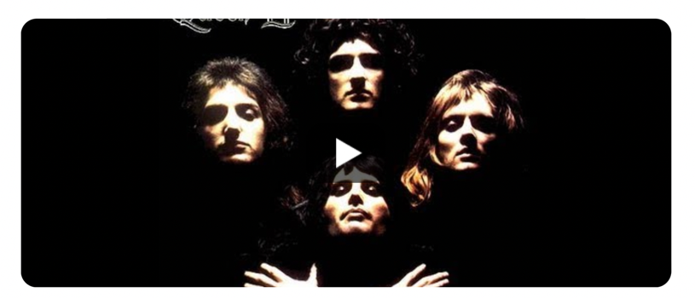
Group work?!
Is this the real life? Is this just fantasy?

Slide 15
(Autistic) Expression - What can UDL do?
Teachers
CLEAR assignments and rubrics
A range of options for presentations
Appropriate use of group work
Link assignments to pragmatics
Administrators
Balance assessments across courses
Autism informed review of assessment materials

Slide 16
And now for (some of) the Caveats…
Sensory Challenges
  Having information presented in multiple formats addresses diverse communication needs but can also be over-stimulating
Executive Function Challenges
  Some of us can be overwhelmed by too many choices. It is important to implement autism-friendly strategies to support decision making.
Every (autistic) person is different
  The risk that implementation of UDL will mean individual needs may be overlooked or minimised

Slide 17
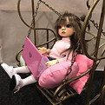
SO, is UDL the answer for autistic students?
A lifetime of being told that we need to change or hide the parts of ourselves that are different to others makes us understandably cautious about ‘universal’ approaches.
While so much of good UDL practice benefits autistic students, there is a need to retain openness to specific individual needs.

Slide 18
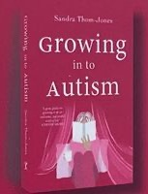




Contacts
Sandra Thom-Jones
Autistic Professor
autisticprofessor@gmail.com
www.autisticprofessor.com
Autistic Professor
@AutisticProf

Slide 19
Q & A session

