Slide 1
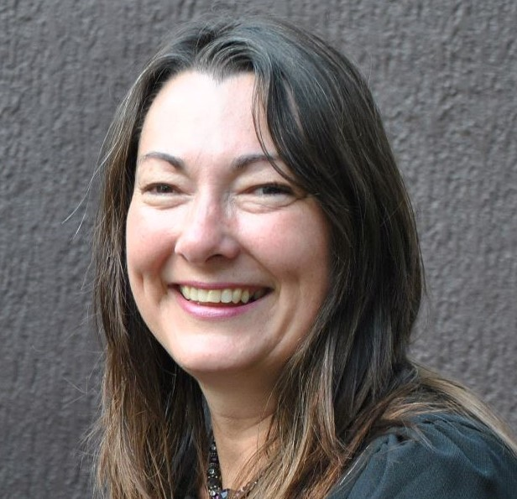
Universal online design - informed by accessibility, usability and social learning frameworks
Rae Jobst – Griffith University
Notes:
.

Slide 2
About this session
Recording, cameras and mics
Captions
Presentation: 15 minutes
Discussion: 10 minutes
Chat! Questions and comments welcome

Slide 3
Acknowledgement of traditional custodians
Logan is situated on the land of the Yuggera, Turrbal, Yugarabul, Jagera and Yugambeh peoples.
Artwork by Sid Domic

Slide 4
Today we will
Look for practical ways to UDL
Link different approaches to learning to help us UDL

Slide 5
A little about me, a little about you
What is outside your window?

Slide 6
UDL Principle 1: Provide multiple means of Engagement
Relevance – eg career readiness
Authentic

Slide 7
UDL Principle 2: Multiple means of Representation
Demystifying the language and the academic world
Co-created glossaries
“Jargon unlocked” discussions
Stories

Slide 8
UDL Principle 3: Provide multiple means of Action and Expression
Choose accessible tools
Be open to adjustments
Create synchronous and asynchronous opportunities

Slide 9
How have we already put UDL into practice?

Slide 10
We have …
Reduced unknowns
Explained technology
Chosen technology with accessibility features
Treated accessibility features as useful for everyone
Engaged via chat
Set the rules, thereby reducing anxiety

Slide 11
Usability: Presenting information

Slide 12
Want to DOUBLE your impact??

Slide 13
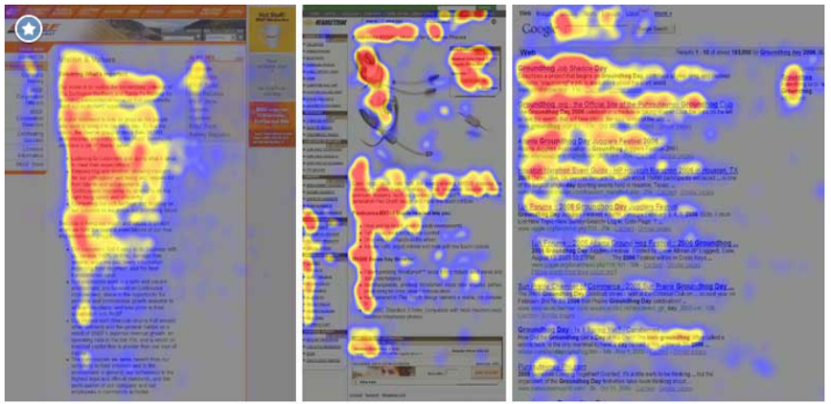
F-shaped Reading Pattern
Source: Pernice, K. (2017)

Slide 14
Why? What is behind these scanning patterns?
People want to be ….
Productive
Engaged
Successful

Slide 15
Design for how people read
Be scannable
Be concise
Be clear
Be consistent
Speak simply
Use the active voice
Don’t bury the lead
Use images

Slide 16
Don’t bury the lead – The Inverted Pyramid
Must know
Important to know
Nice to know

Slide 17
Don’t bury the lead – An example
For this assessment item, you must complete and record an oral presentation which draws upon your Environmental Analysis. Essentially, your Environmental Analysis is a written report, whereas the oral presentation is taking the essence of this report as a pitch to the CEO of your company, to get him/her to adopt your initiative. Thus, the two are highly interrelated and simply different means of expressing the same message. However, clearly different communication skills are needed for these two tasks.
The pure content aspect of your oral presentation is represented in the knowledge criterion for this assessment, and thus is only one of five criteria. See the Marking Criteria sub-heading below for more information.
Keep in mind that this is a pitch to the executive team in your organisation (they already know a lot of things about the company). Your objective is to get the thumbs up on your project proposal. You have to convince (persuade) the team that you have:
Analysed the situation sufficiently (you have addressed any macro and micro issues and developed a SWOT analysis accordingly)
Identified a new initiative (a challenge or opportunity that needs to be addressed)
Your presentation should be a maximum of 5 minutes long. You have to manage the time as well as getting your key points across, so think carefully about how you would like to structure your presentation.

Slide 18
Don’t bury the lead – A refurb
Assessment Task:
5-minute video pitch to Company CEO
Scenario
Based on your written Environmental Analysis, you are seeking executive endorsement of your strategy.
Your audience know the company so focus on your initiative not on background. The executive are known for sticking to time limits and will not watch a second over your allocated time.
Marking Criteria
etc

Slide 19
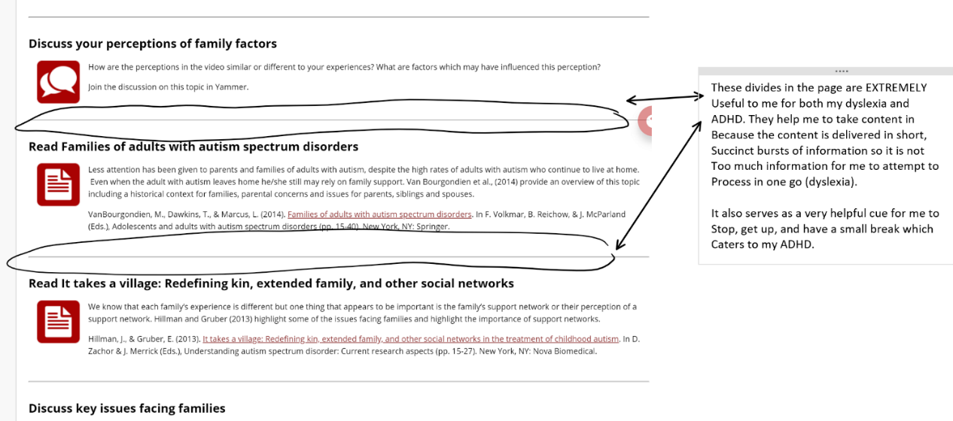
White space and dividers

Slide 20
Social learning

Slide 21
How do we know belonging matters?
At the heart of successful retention and success is a strong sense of
belonging in HE for all students. (1)
Early intervention with students to connect, prepare and engage is essential (2)
Student teacher interactions are reported by students to be highly important to their sense of belonging (3)
… as the belonging to the university level increases, it is considered university students' well-being levels will increase (4)

Slide 22
Legitimate Peripheral Participation: A way to think about participation
Periphery
Newcomers
Build trust and sense of safety
Support to take on a more active role
Active
Engagement
Collaboration
Shared knowledge
Centre
Mature participation
Leadership

Slide 23
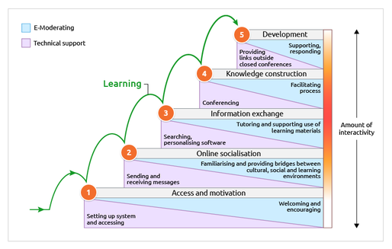
Salmon’s Five Stage Model

Slide 24
Be clear on expectations

Slide 25
Facilitating inclusion and respect
Greet people as they come into class
Easy early introduction activities
“Housekeeping” including accessibility tips
Check pronunciation – and share yours
Use people’s names
Summarise contributions
Use inclusive imagery and language
Acknowledgement of Country
“Welcome to the course”
Think, Pair, Share

Slide 26
Summary
Revisited UDL principles
Considered what we can learn from usability research
Considered what we can learn from social learning
Reflected on practice along the way

Slide 27
One thing I want to remember

Slide 28
How to contact me
Rae Jobst
r.jobst@griffith.edu.au

Slide 29
Your thoughts and questions

