Slide 1


Universal Design for Learning
Reach Everyone and Teach Everyone with
UDL Symposium
September 7, 2023
Thomas J. Tobin
University of Wisconsin-Madison

Slide 2
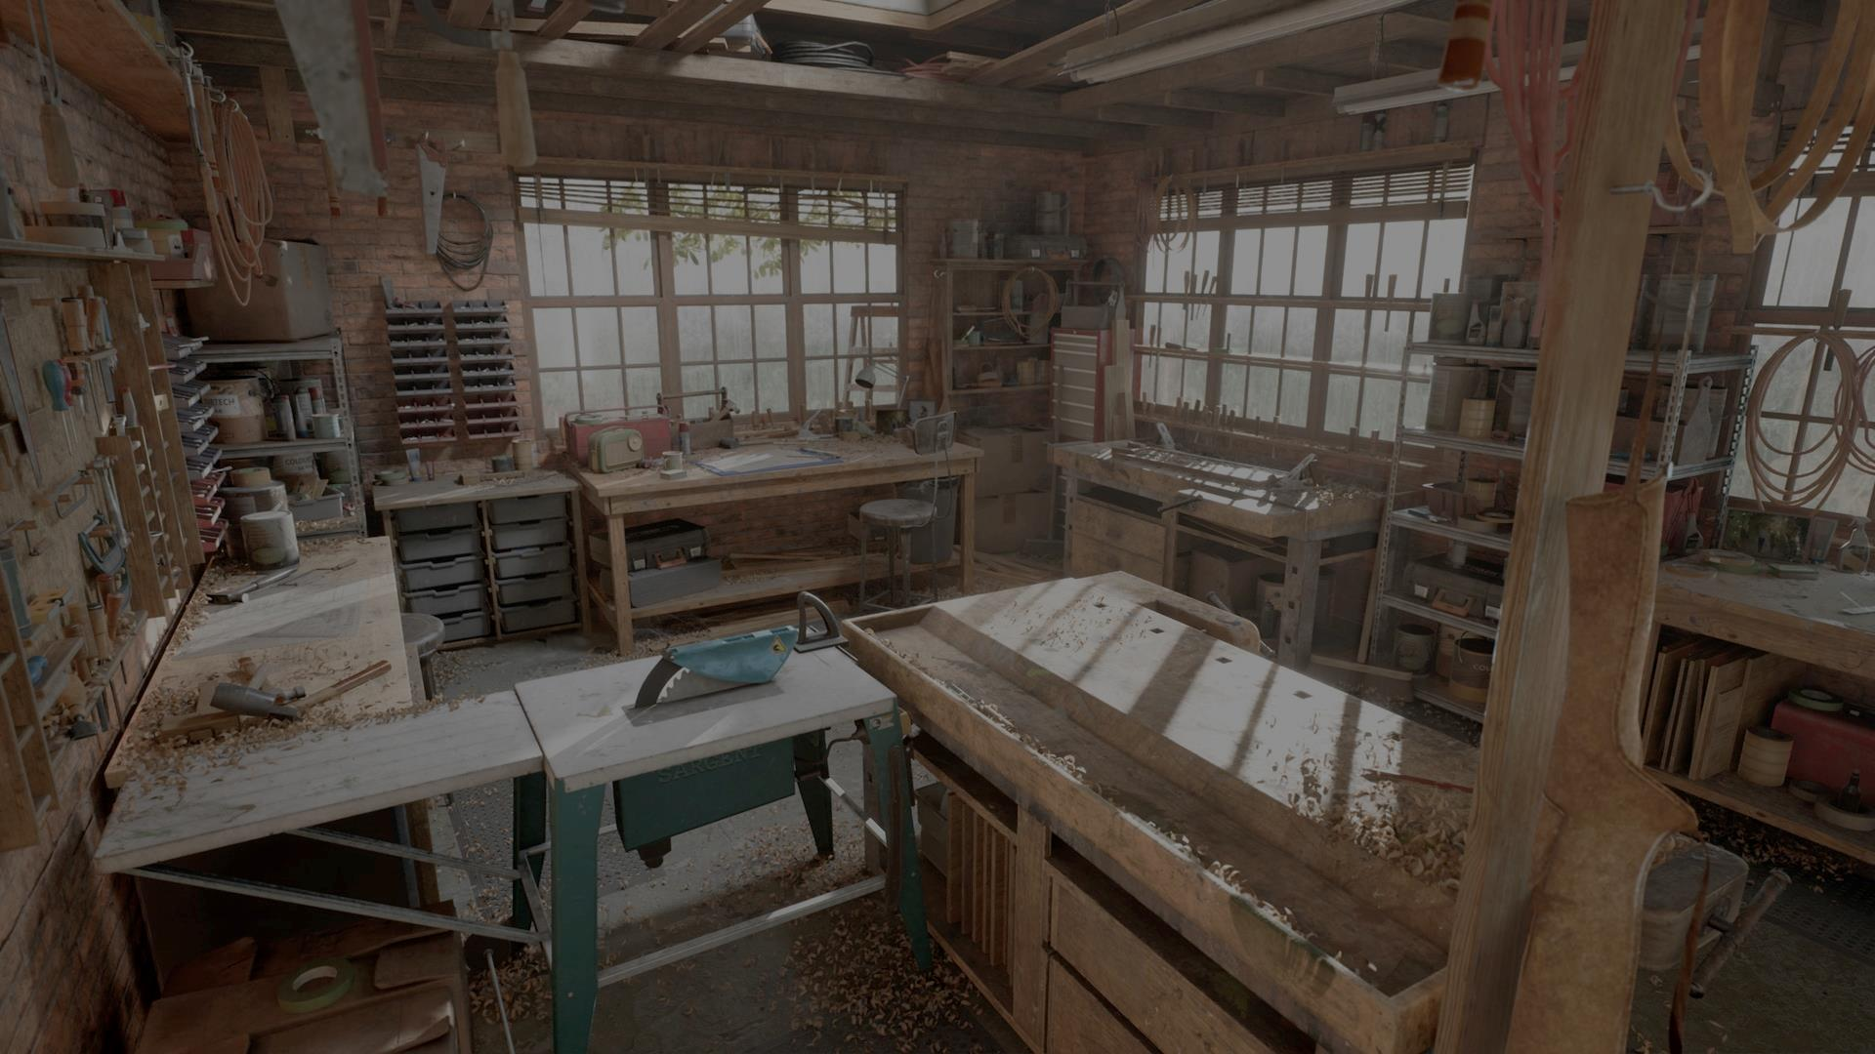
Welcome
Welcome to our workshop.
Image © Epic Games

Slide 3
Learning Objectives
Provide students with broader access to learning interactions.
Help learners find more time for study and practice.
Save instructors time and effort in the classroom.

Slide 4
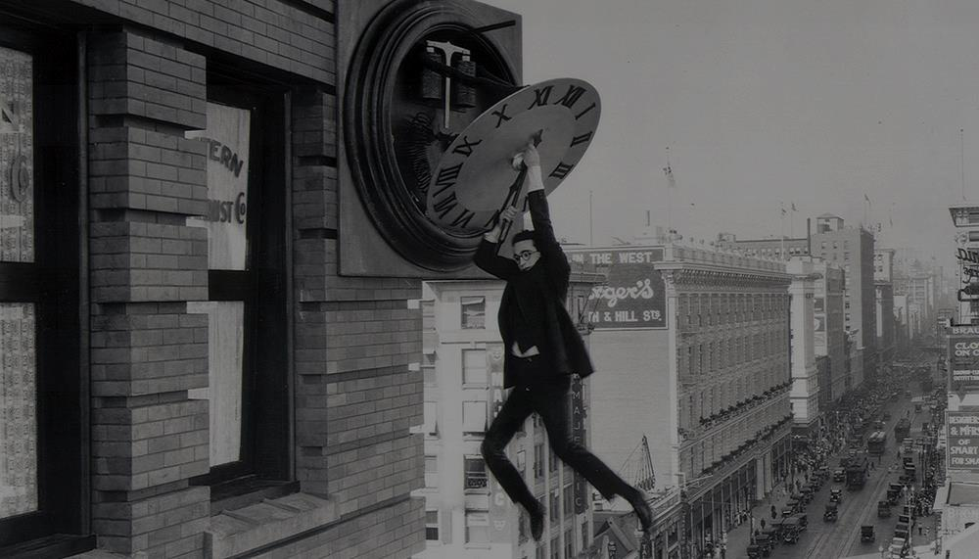
Your biggest concern?
Image © 1923 Hal Roach Studios. Image in the public domain.

Slide 5
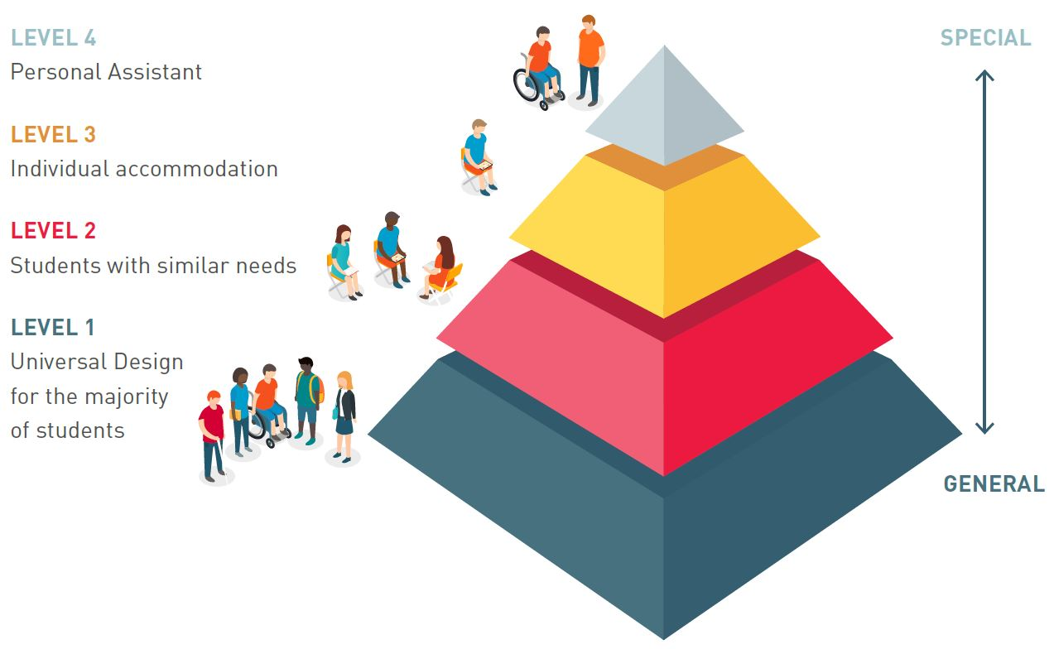
UDL helps us . . .
Image © AHEAD Ireland. Used with permission.
Notes:
5

Slide 6
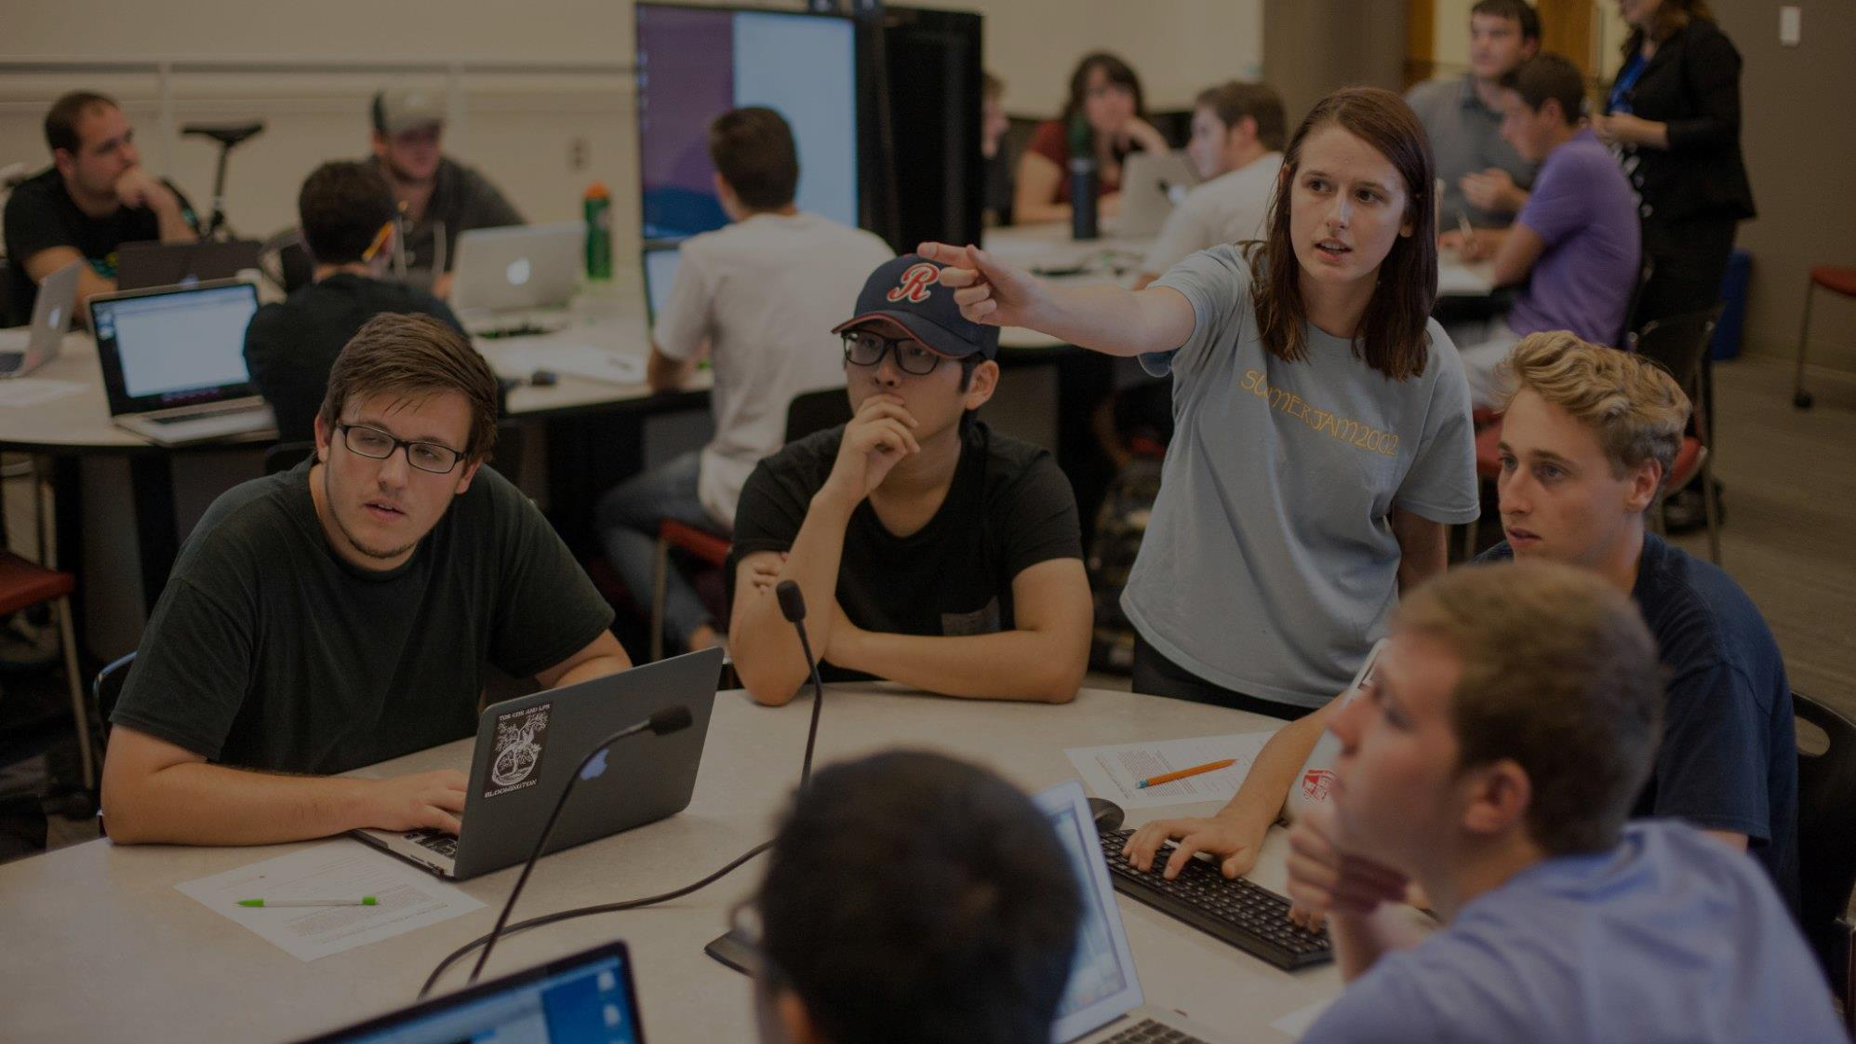
Universal Design for Learning
+1
Multiple means of
learner engagement
representing information
demonstrating skill
Image © Indiana University. Used under CC BY-ND license from Flickr.com

Slide 7

Five strategies for UDL

Slide 8
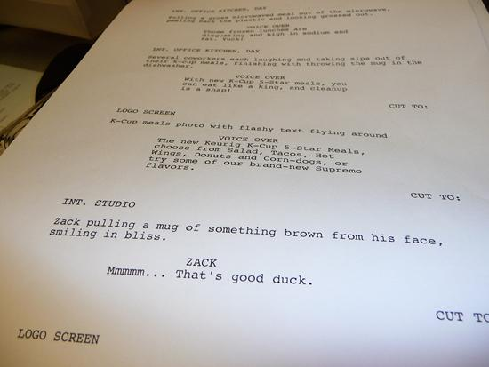
Strategy 1: start with text.

Slide 9
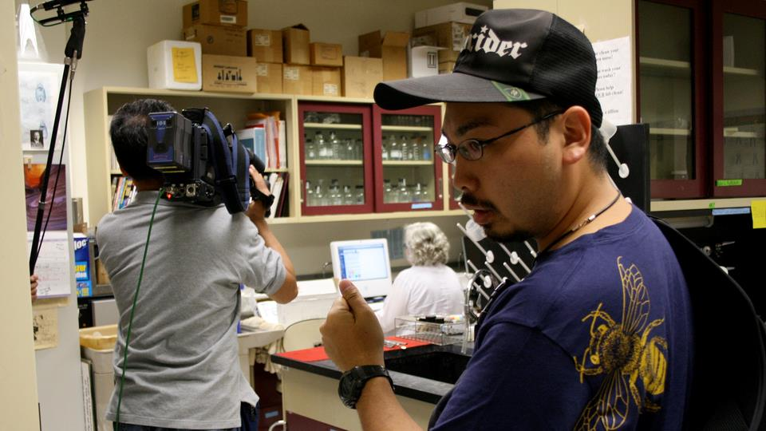

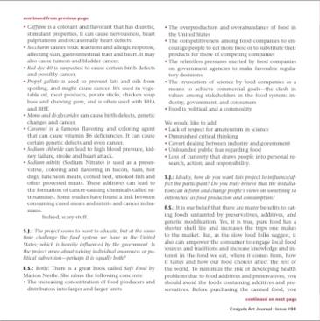
Strategy 2: make alternatives.

Slide 10

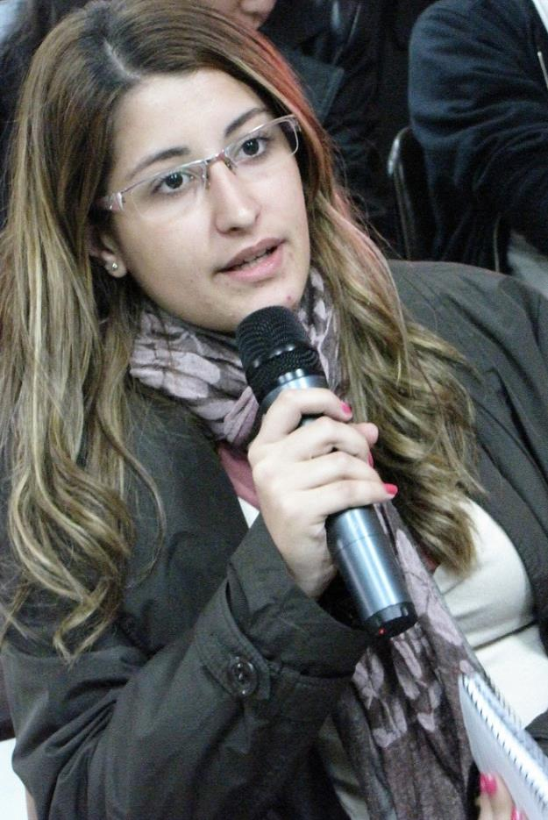
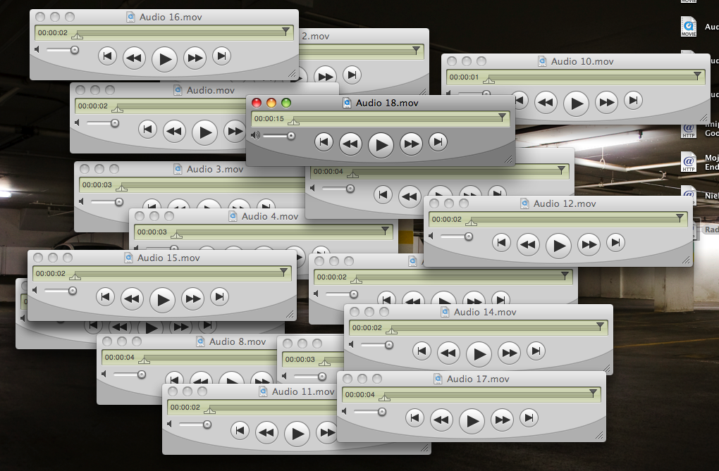
Strategy 3: let ‘em do it their way.
= =

Slide 11
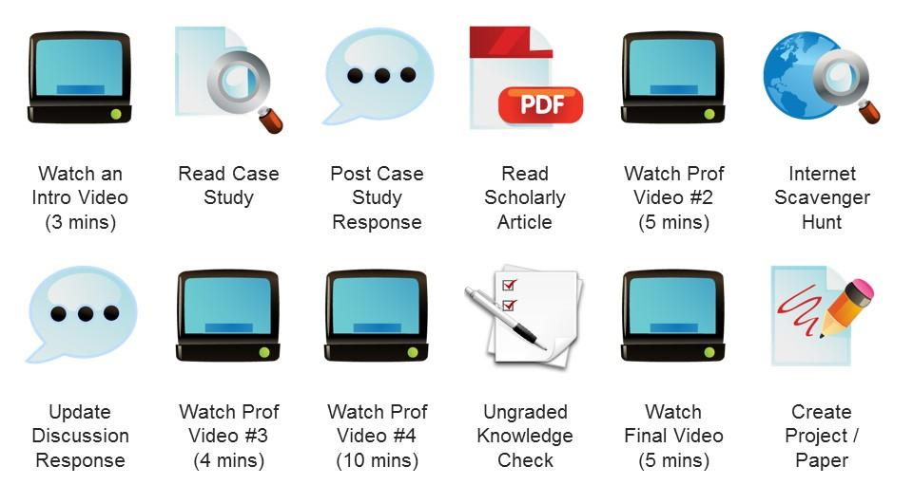
Strategy 4: go step by step.

Slide 12



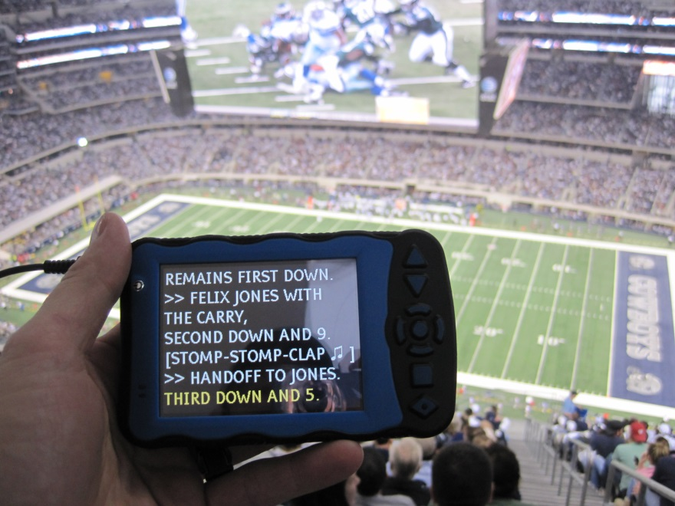


Strategy 5: set content free.
X

Slide 13
Summary of Strategies
Start new design processes with text.
Create alternatives for all multimedia.
Design alternate ways for learners to demonstrate each course objective.
Break tasks into separate components.
Expand, document, and share interactions using free-access methods.

Slide 14

Take-Aways
Image © Visit Melbourne

Slide 15
Conclusion
Reach Everyone and Teach Everyone with
Universal Design for Learning
UDL Symposium
September 7, 2023
Thomas J. Tobin
University of Wisconsin-Madison

