Slide 1
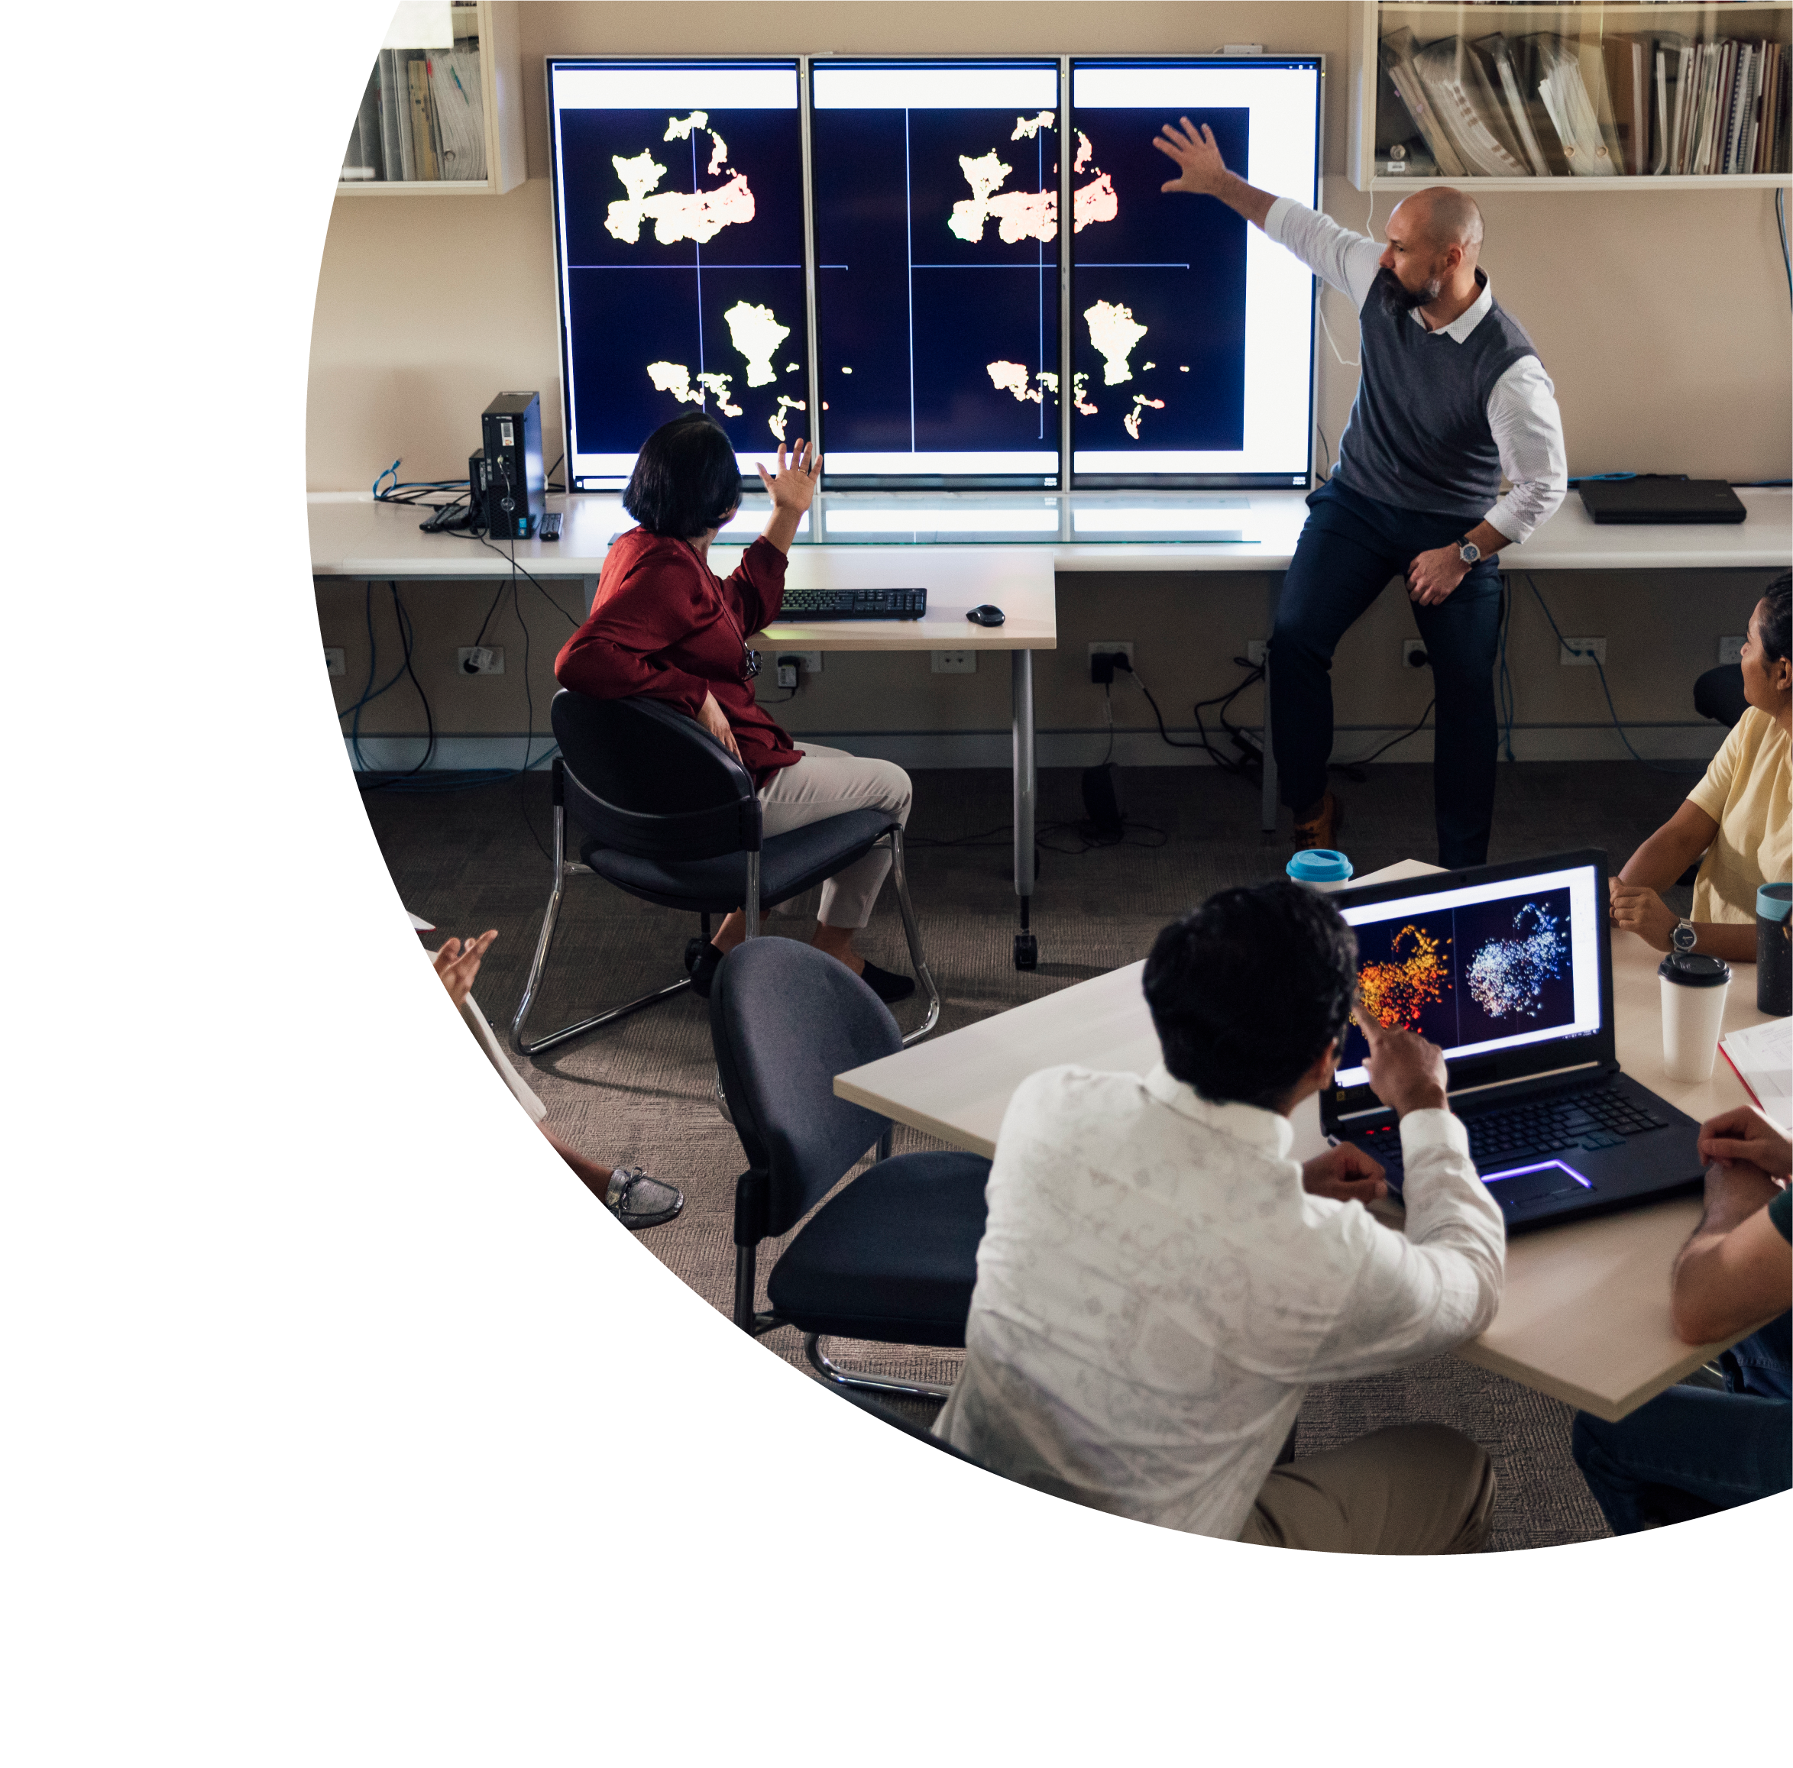


Levelling Up Your Online Teaching With Universal Design for Learning
Dr Erin Leif
Monash University

Slide 2

About this session
This session is being recorded. If you do not wish to appear on screen please hide camera
This session will be captioned (either live captioning or closed captions)
Session etiquette
Use Chat or Q+A function as directed by presenter
Indicate in the Chat or Q+A function for questions as directed by presenter
Where appropriate use raised hand emoji to ask questions
Ensure your surrounding environment is quiet when mic is on (e.g., phones, pets etc)
Turn off mic when not speaking

Slide 3
Acknowledgement of Country
I am joining you today from the lands of the Wurundjeri people of the Kulin Nation

Slide 4
What we’ll be covering
Describe common challenges that students may encounter when participating in online education
Propose solutions to common challenges using the Universal Design for Learning model
Practice applying strategies from Universal Design for Learning to your own online teaching practice

Slide 5
What is Online Education?
Online education refers to instruction that is delivered electronically through various multimedia and Internet platforms and applications
May be used interchangeably with other terms such as web-based learning, e-learning, computer-assisted instruction, and Internet-based learning
Some key terms:
  Learning management system
  Educational technology
  Synchronous teaching and learning
  Asynchronous teaching and learning

Slide 6
What Challenges Do Students Report in Online Education?
Knowing where to get help or accommodations
Problems with inaccessible technology
Lack of personal relationships with lecturers
Difficulty navigating the online learning environment
Not knowing what to do each week – too unstructured
Lack of opportunities to get to know classmates
Feeling like course content lacks purpose or is not pitched at the right level

Slide 7
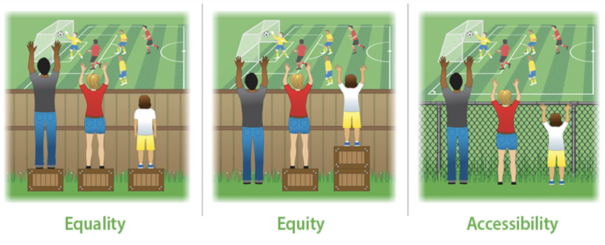
The Importance of Equity and Accessibility in Online Education

Slide 8
Pinch Points
What ‘pinch points’ have you encountered with designing and delivering online education?
Let’s discuss!

Slide 9
Universal Design for Learning and Online Education
What does UDL mean to you?
UDL is about proactively reducing barriers to participation and learning!

Slide 10

Examples From My Own Teaching

Slide 11
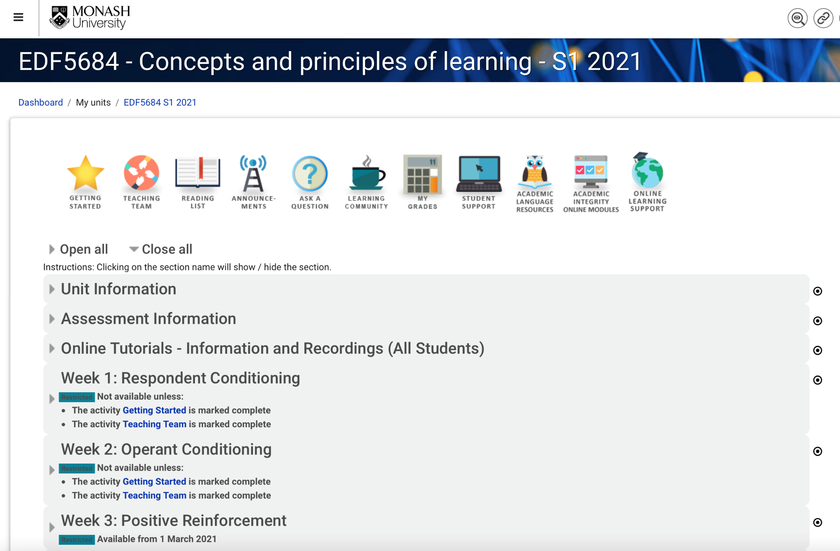
Step 1: Create a clear, consistent, and intuitive unit structure

Slide 12
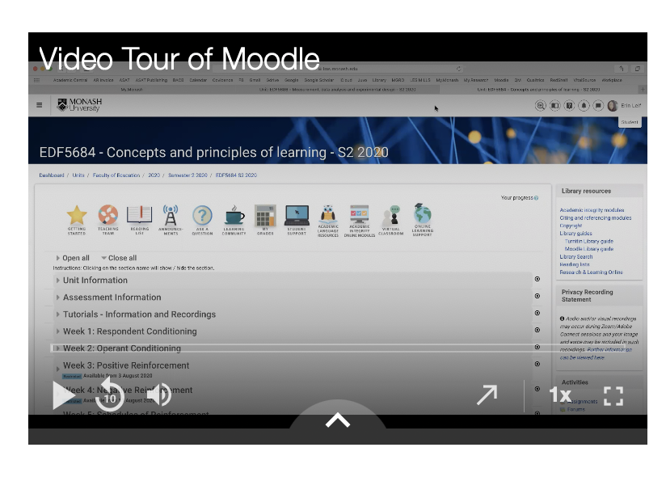
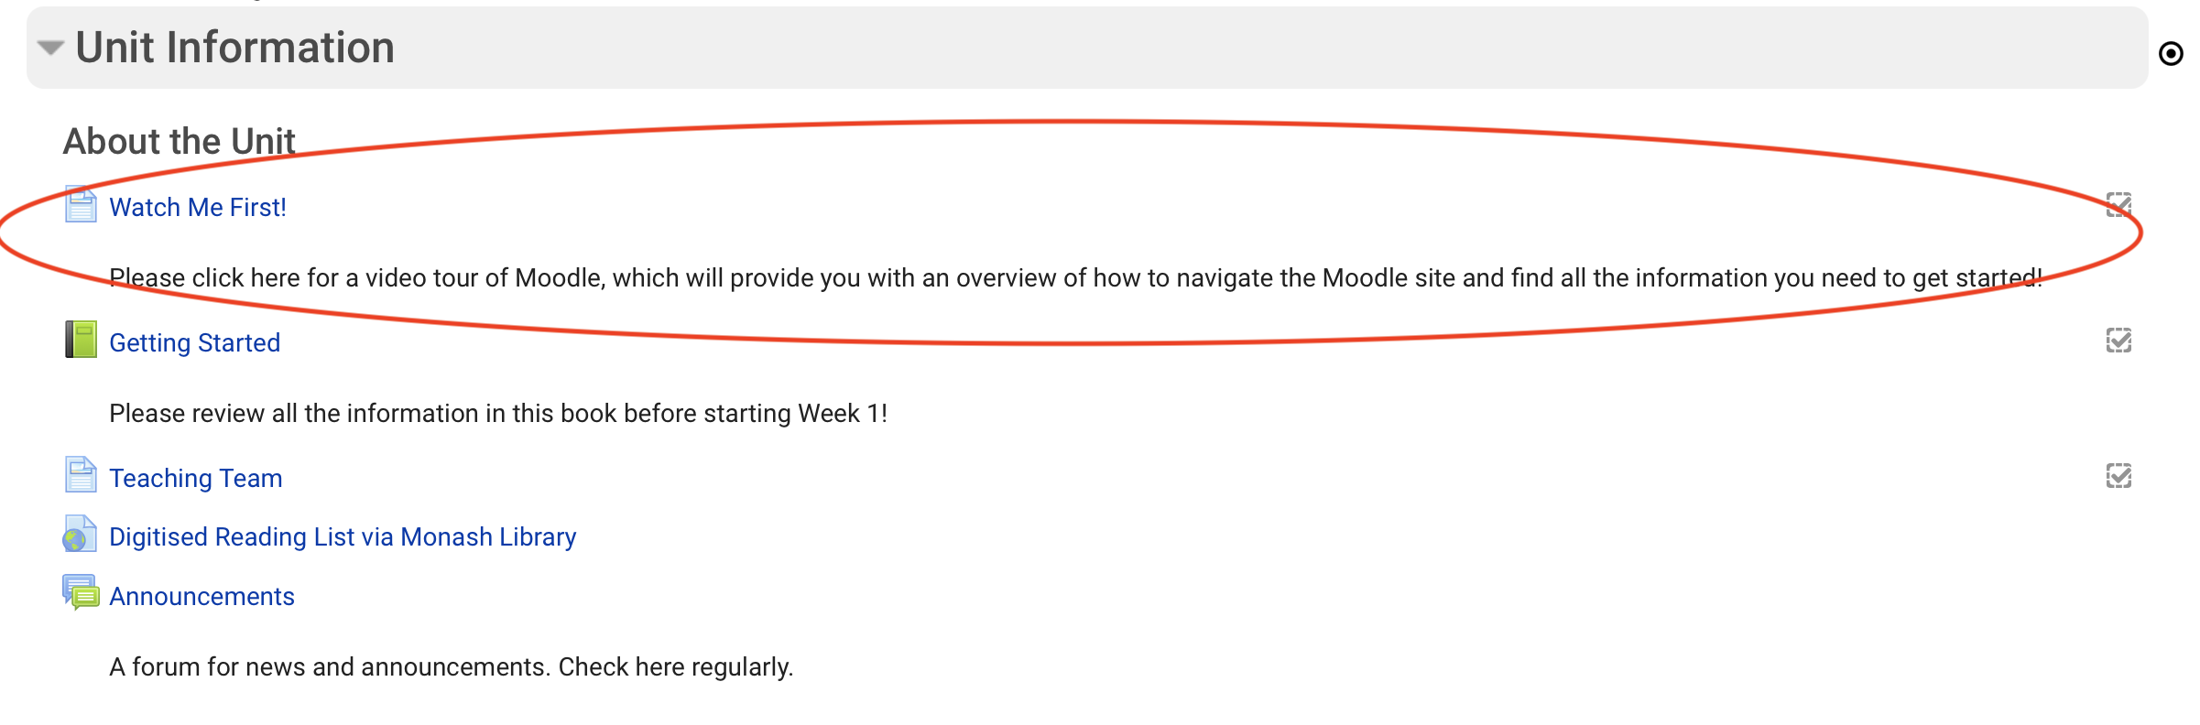
Step 2: Ensure students are welcomed into the unit and are provided with an induction

Slide 13
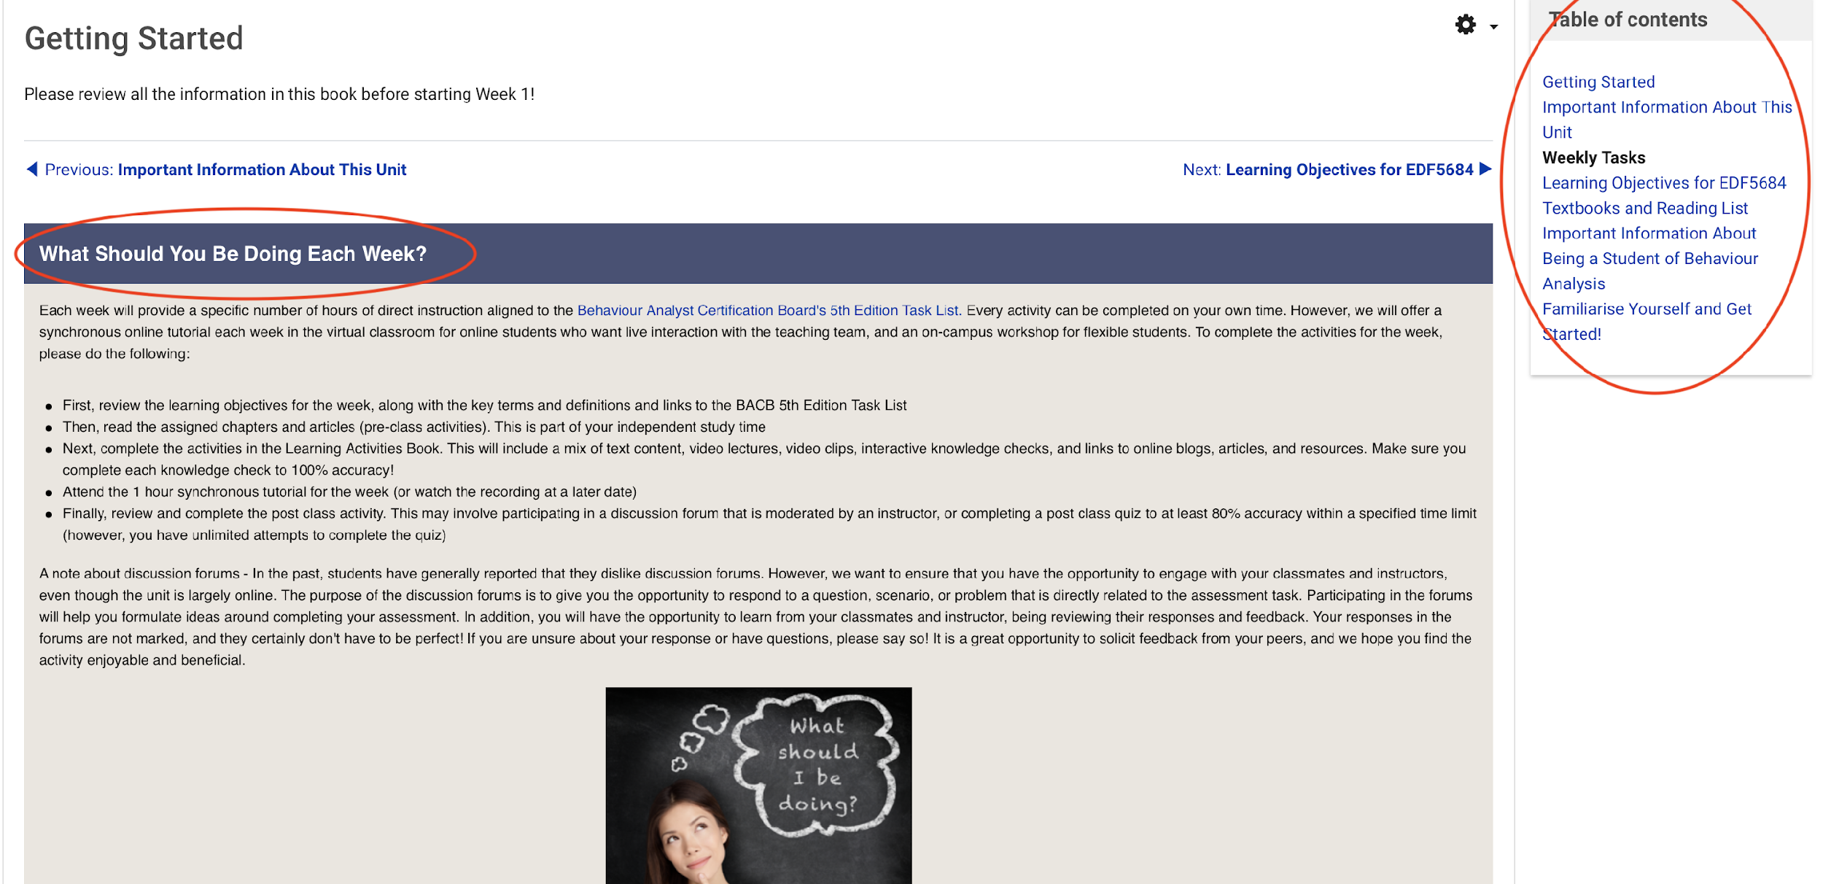
Example - The ‘Getting Started’ Book

Slide 14
Provide Links to Various Student Support Services
Disability support services
Language and literacy services
Technology support
Physical health support
Mental health and wellbeing support
Academic advising

Slide 15
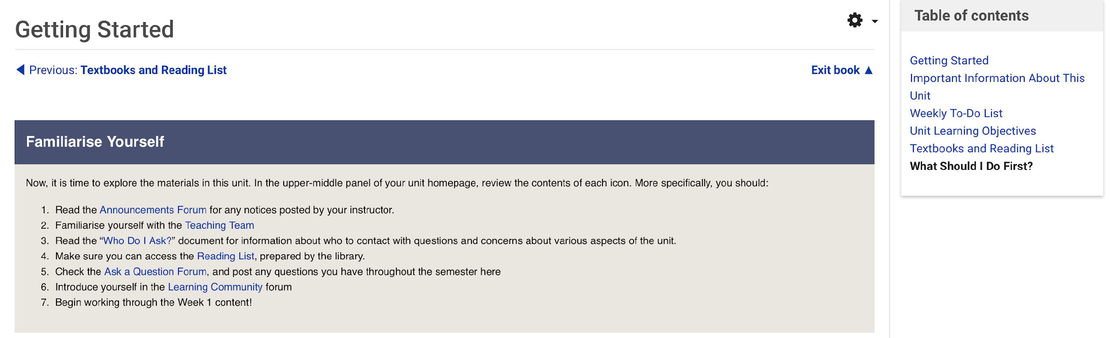
Example – What Should I do Next?

Slide 16
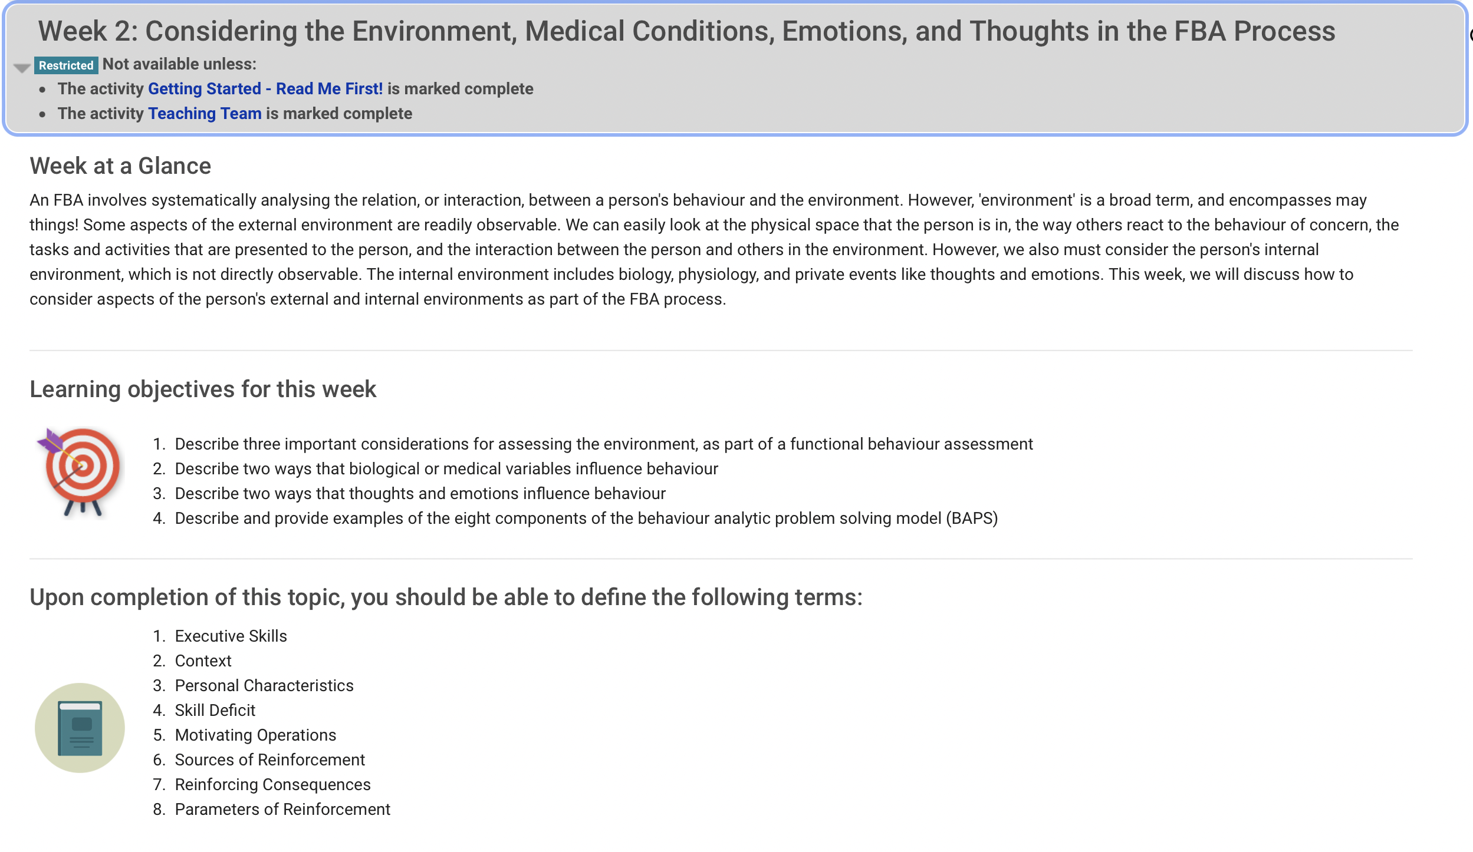
Step 3: Set up Each Week the Same Way

Slide 17
Step 3: Set up Each Week the Same Way (Part 2)

Slide 18
Step 3: Set up Each Week the Same Way (Part 3)

Slide 19
Step 3: Set up Each Week the Same Way (Part 4)

Slide 20
Step 4: Align learning objectives to weekly learning activities
Students are provided with a set of asynchronous online learning activities directly aligned to the weekly learning objectives
Interactive lessons are meant to replicate the teaching methods that would commonly be delivered in a face-to-face classroom
Consist of a series of video recorded lectures interspersed with active learning activities, presented to students in ‘Books’ divided into ‘Chapters’

Slide 21
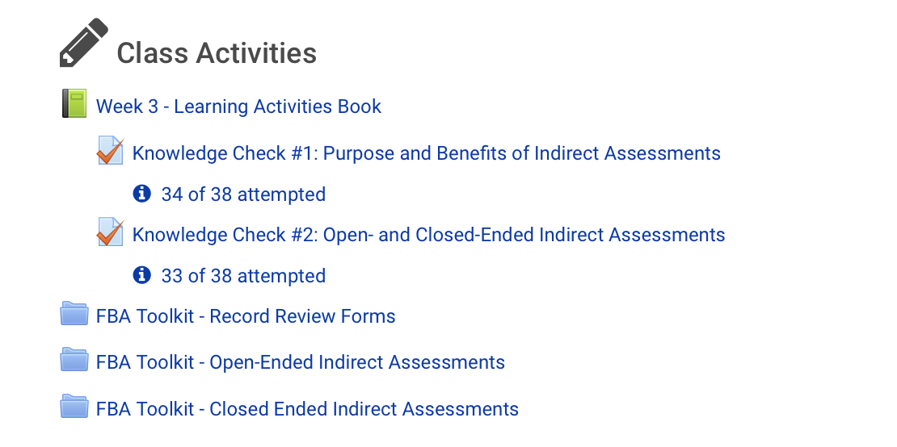
Example - Create your online class activities

Slide 22
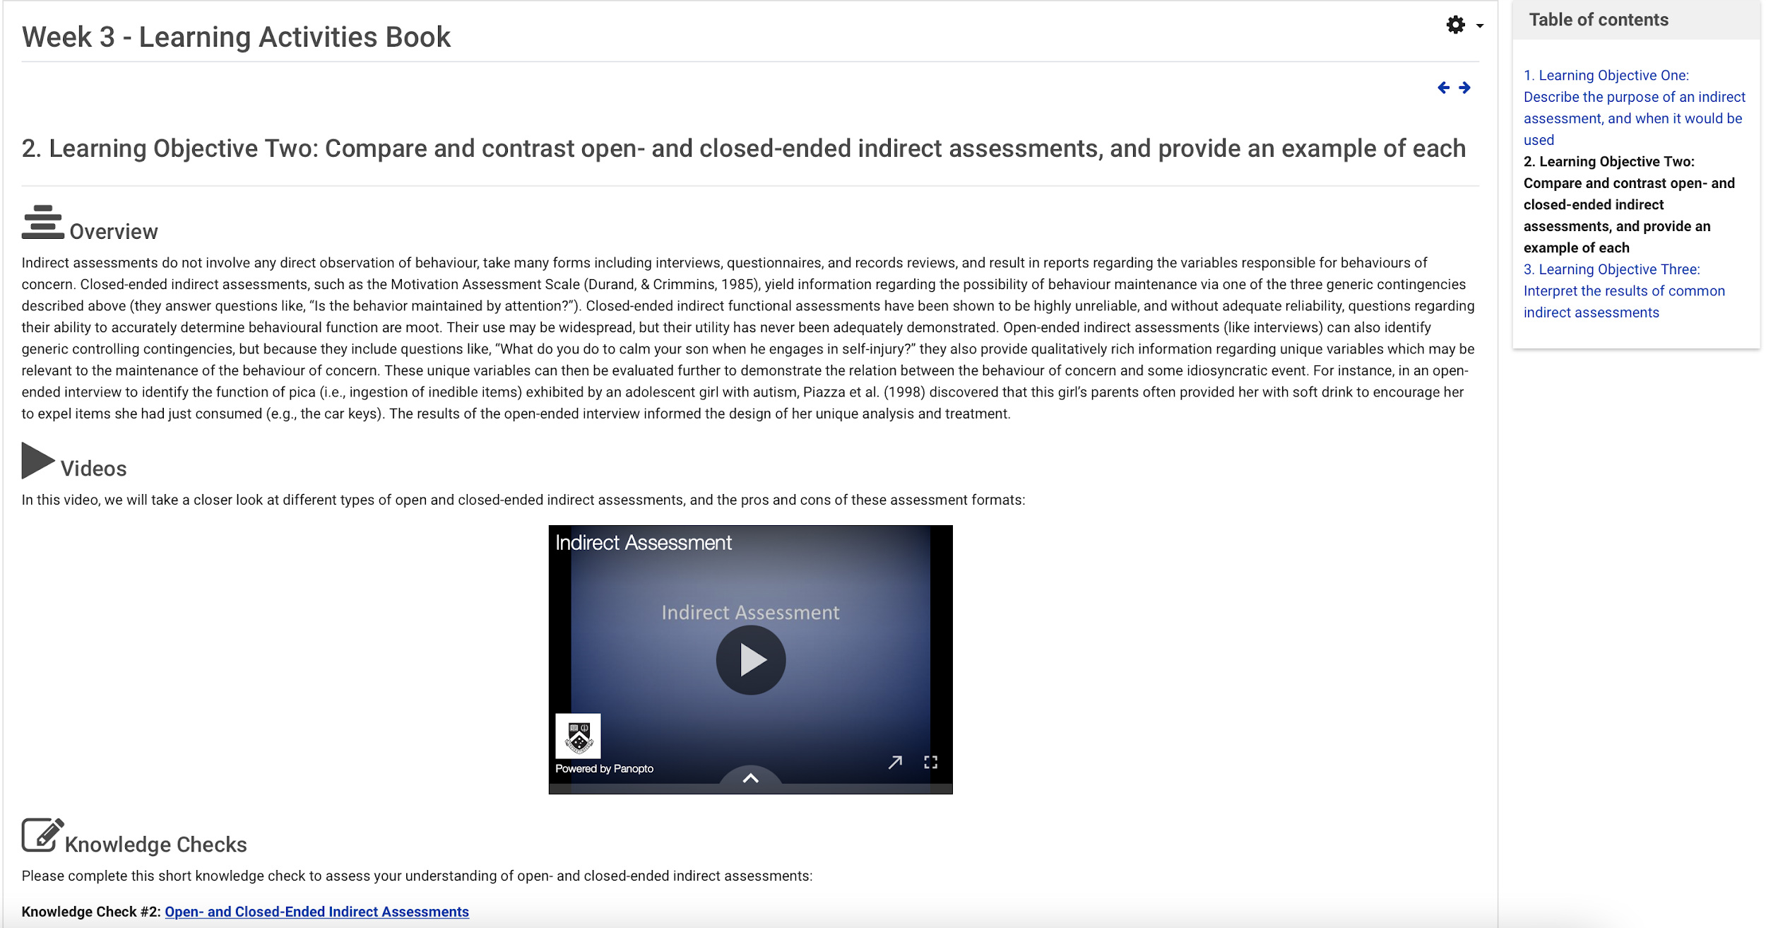
Example - The Learning Activities book

Slide 23
Example – Chapter Titles

Slide 24
Step 5: Create active student learning activities, using the principles of UDL!

Slide 25
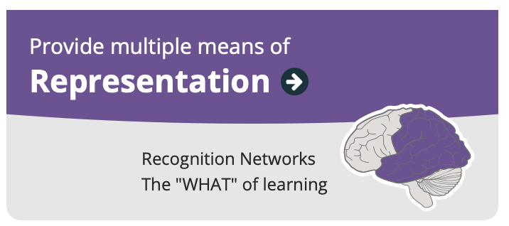
Principle of UDL #1
Examples:
  A textbook chapter
  A video lecture
  A TED talk
  A blog post
  A graphic
  A link to a website

Slide 26
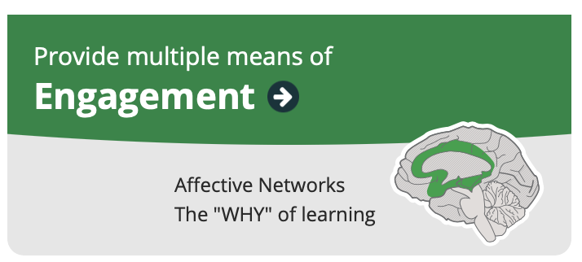
Principle of UDL #2
Examples:
  A knowledge check
  A quiz
  A discussion forum activity
  A reflection
  A wiki activity
  A group task
  A component of the assessment task

Slide 27
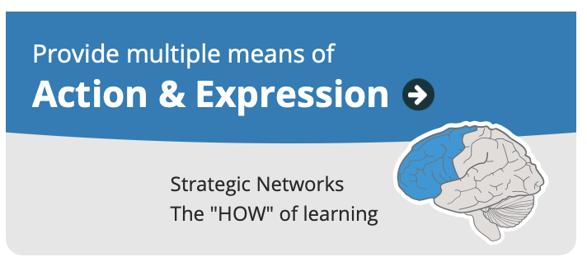
Principle of UDL #3
Example:
  Writing
  Talking
  Practicing
  Designing
  Critically analyzing
  Questioning
  Reflecting
  Linking

Slide 28
Step 6: Engage with Your Students in Multiple Ways
Weekly synchronous tutorials
  We use polling and group discussion to provide students with the opportunity to actively respond and the teaching team with the opportunity to (a) gauge student understanding of the material and (b) do more teaching if needed

Slide 29
Step 6: Engage with Your Students in Multiple Ways (Part 2)
Post-class discussion forums
  Allow the teaching team to gauge understanding in students who may not have otherwise indicated that they were confused
  Gives students the opportunity to teach material to each other, which requires that they define, synthesise, and relate the material that is being discussed
  Gives students the opportunity to prepare for the assessment tasks

Slide 30
Step 6: Engage with Your Students in Multiple Ways (Part 3)
Moodle analytics and completion settings on Moodle
We teach students how to use their Moodle ‘progress trackers’ to self-monitor their completion of the online learning activities on Moodle
We review the progress trackers at specific points throughout the semester, and check in on students who appear to be falling behind or who are not showing evidence of active engagement with the unit content

Slide 31
Step 7: Design with Accessibility in Mind From the Start
A few top tips:
  Ensure images have alternative text
  Ensure videos have captions/transcripts
  Don’t use text colour to convey meaning
  Don’t upload scanned documents. Do upload accessible word docs, PPT slide decks, and PDFs
  When selecting and using course technologies, make sure the developer has published an accessibility statement and link to the accessibility statement for each course technology you use (e.g., apps, miro boards, polling software, etc.)

Slide 32
Plus Ones
Think about your pinch point
What is one way (plus one) you might address your pinch point?
Let’s discuss!

Slide 33
Questions and Answers
What questions or concerns do you have about applying UDL in the online space?
Let’s discuss!

Slide 34

Takeaways
UDL is a blueprint, not a teaching strategy of educational technology
UDL can be applied in the online learning environment to address common challenges that students face!
Applying UDL in the online learning environment requires a proactive approach.
UDL is not an all or nothing activity. Pick one thing to focus on at a time.

Slide 35
Contacts
Please email me at Erin.Leif@monash.edu

