Slide 1
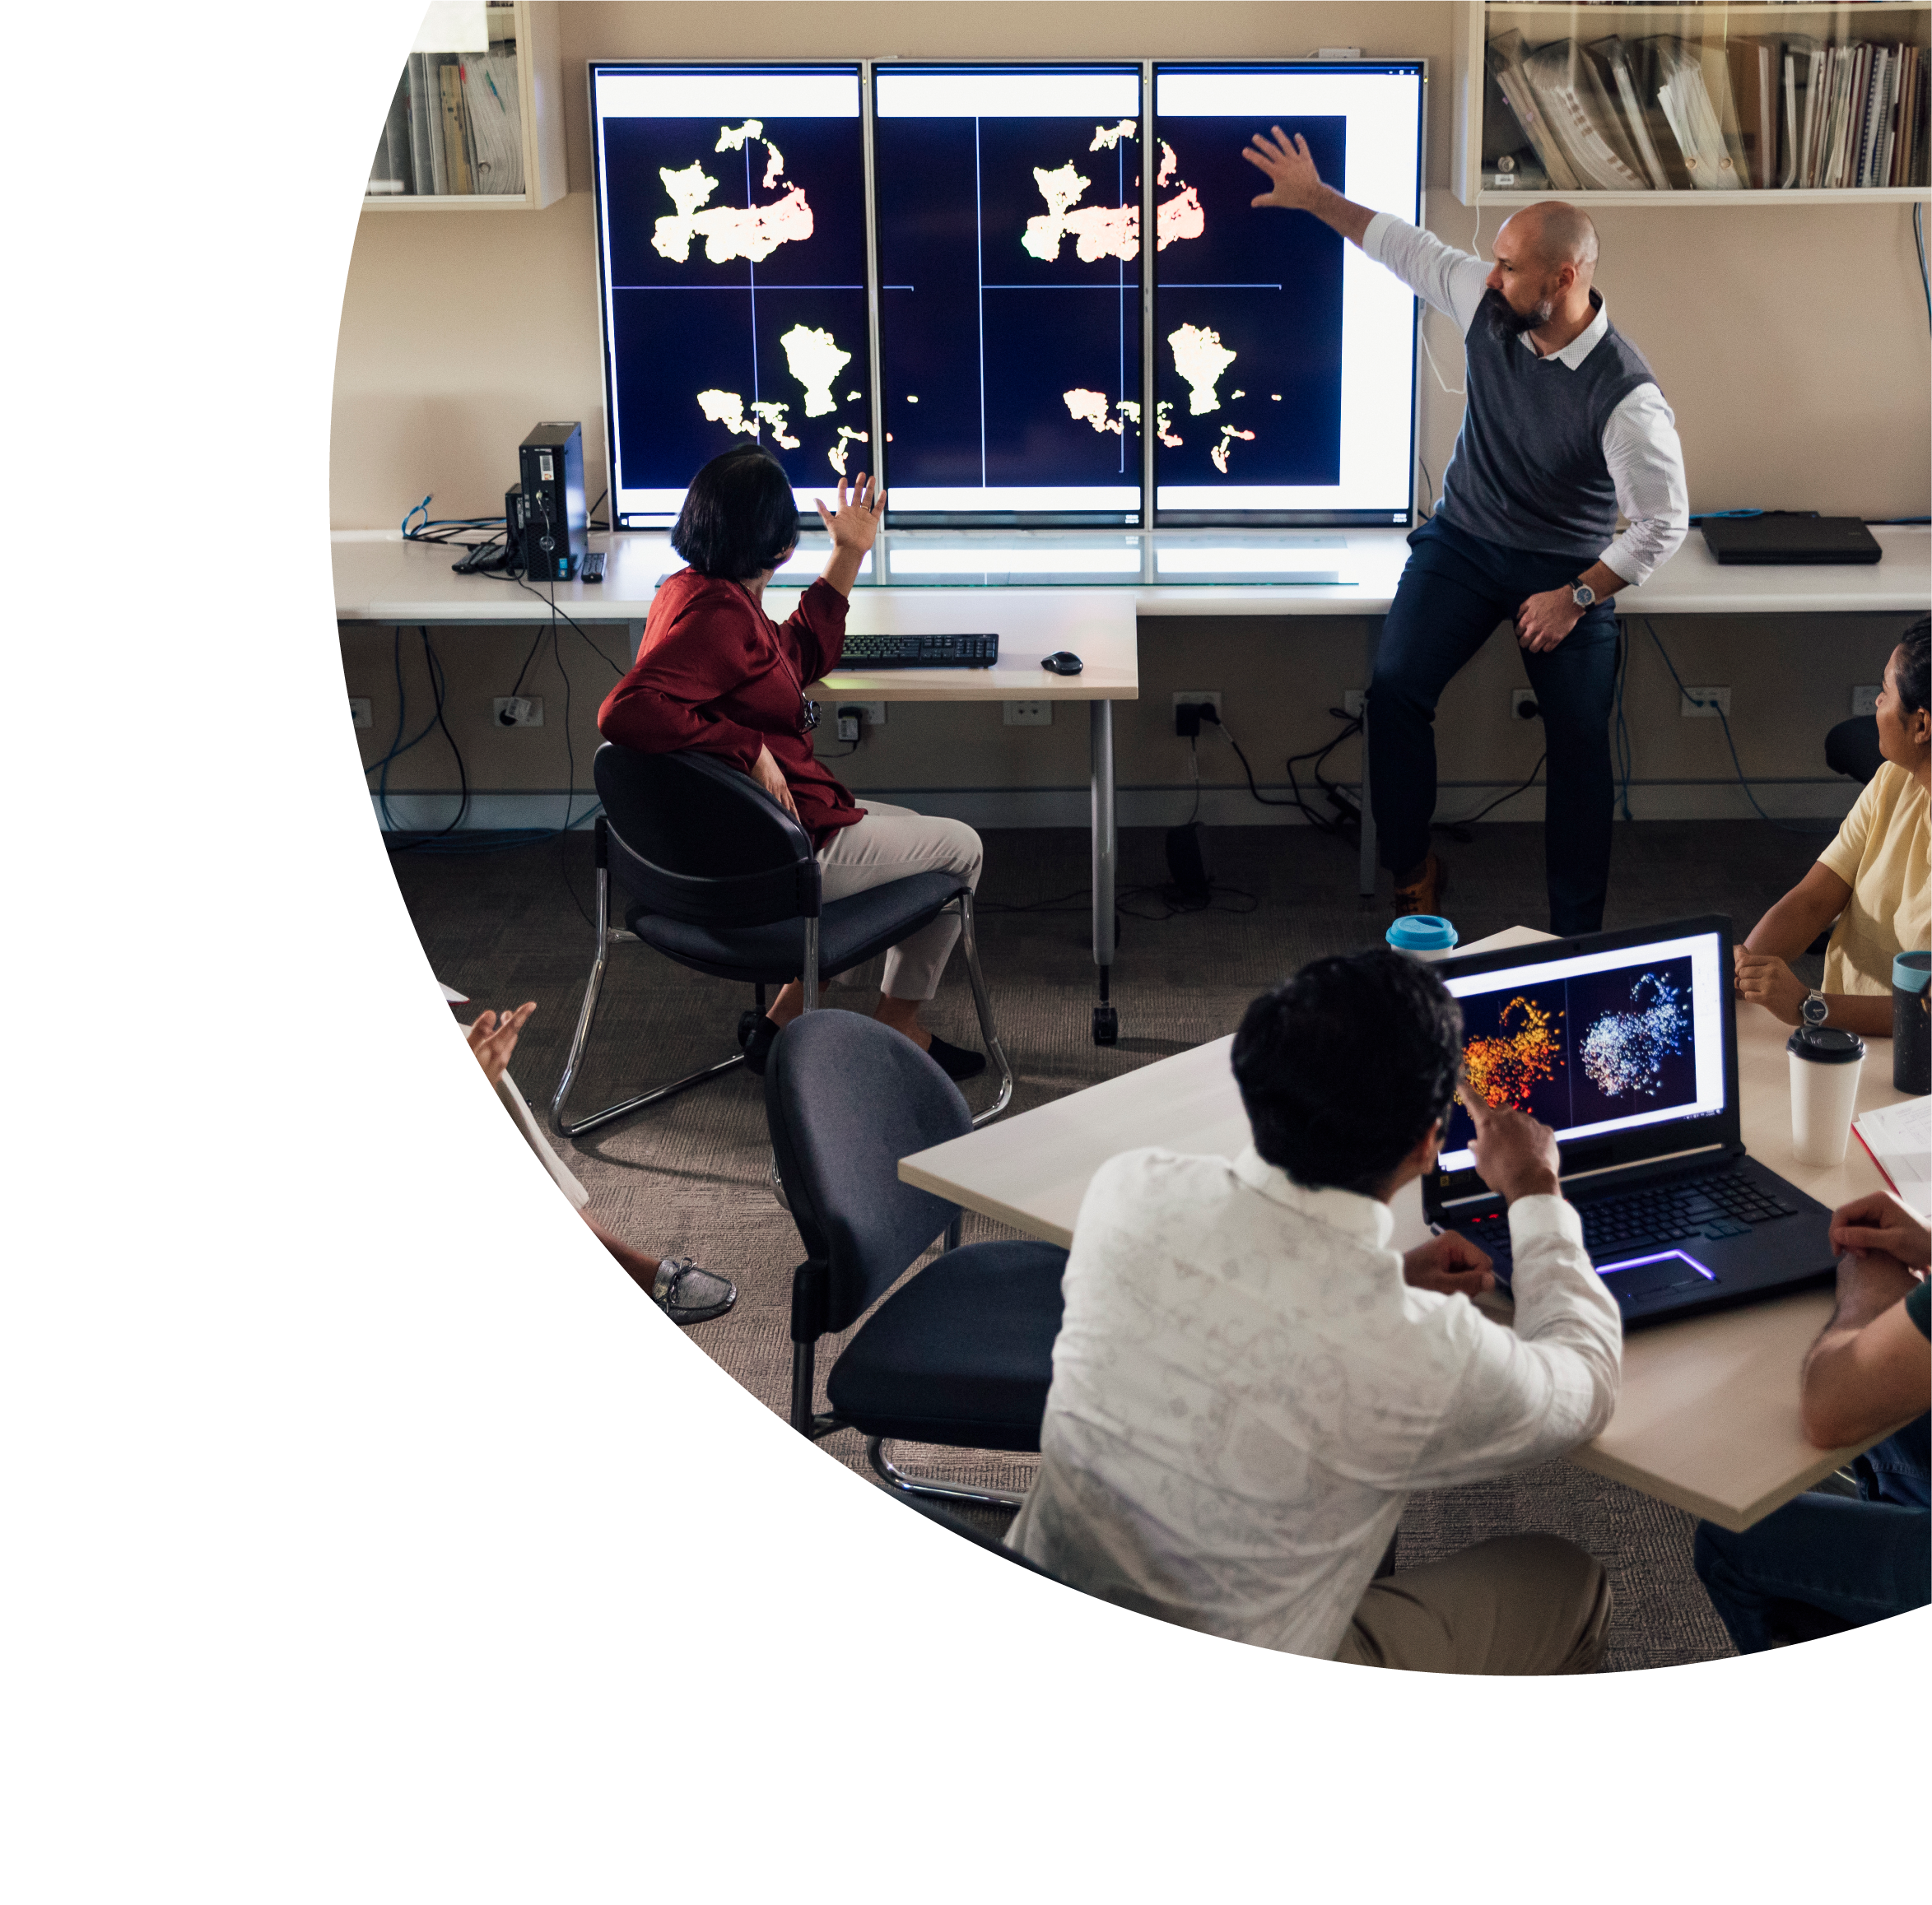


Creating innovative assessments through a UDL lens
Andy Smidt
University of Sydney

Slide 2

About this session
This session is being recorded. If you do not wish to appear on screen please hide camera
This session will be captioned (either live captioning or closed captions)
Session etiquette
Use Chat or Q+A function as directed by presenter
Indicate in the Chat or Q+A function for questions as directed by presenter
Where appropriate use raised hand emoji to ask questions
Ensure your surrounding environment is quiet when mic is on (e.g., phones, pets etc)
Turn off mic when not speaking

Slide 3
Acknowledgement to traditional custodians
Before we begin today, I would like to acknowledge the Traditional Owners of Australia and recognise their continuing connection to land, water and culture. I am currently on the land of the Birrabirigal people of the Eora Nation and pay my respects to their Elders, past, present and emerging. I further acknowledge the Traditional Owners of the country on which you are on and pay respects to their Elders, past, present and future.

Slide 4
What we’ll be covering
What are the challenges in designing assessments for inclusion
UDL perspectives on assessment
  Engagement
  Representation
  Action and Expression
Two examples of modifying assessments
How do you re-design assessments with UDL in mind

Slide 5
Challenges in designing inclusive assessments

Slide 6

Mentimeter
https://www.menti.com/aldard23h48e

Slide 7
Assessment and diversity
Assessment practices can discriminate against people from different backgrounds
Assessments may be set up to favour students with specific skills/backgrounds
Assessments may require skills that are not relevant to the topic being assessed

Slide 8
Tai, J. R. Ajjawi, M. Bearman, J. Dargusch, M. Dracup, L. Harris, and P. Mahoney. 2022. Re-Imagining Exams: How Do Assessment Adjustments Impact on Inclusion? Perth. https://www.ncsehe.edu.au/publications/exams-assessment-adjustments-inclusion/.

Slide 9
Tai et al, 2022
Exams and other high-stakes time-limited assessments can act as barriers to success for some students in higher education.
Though required by Australian law, adjustments do not necessarily lead to equitable academic outcomes nor do they always address students’ actual access requirements
A system which focuses only on making reactive accommodations is likely to become overwhelmed as diverse students increasingly participate in higher education.
Rather than continuing to view disability as a problem to address at an individual level, a shift to focus on inclusive assessment design may also hold promise for a broader range of diverse students.

Slide 10
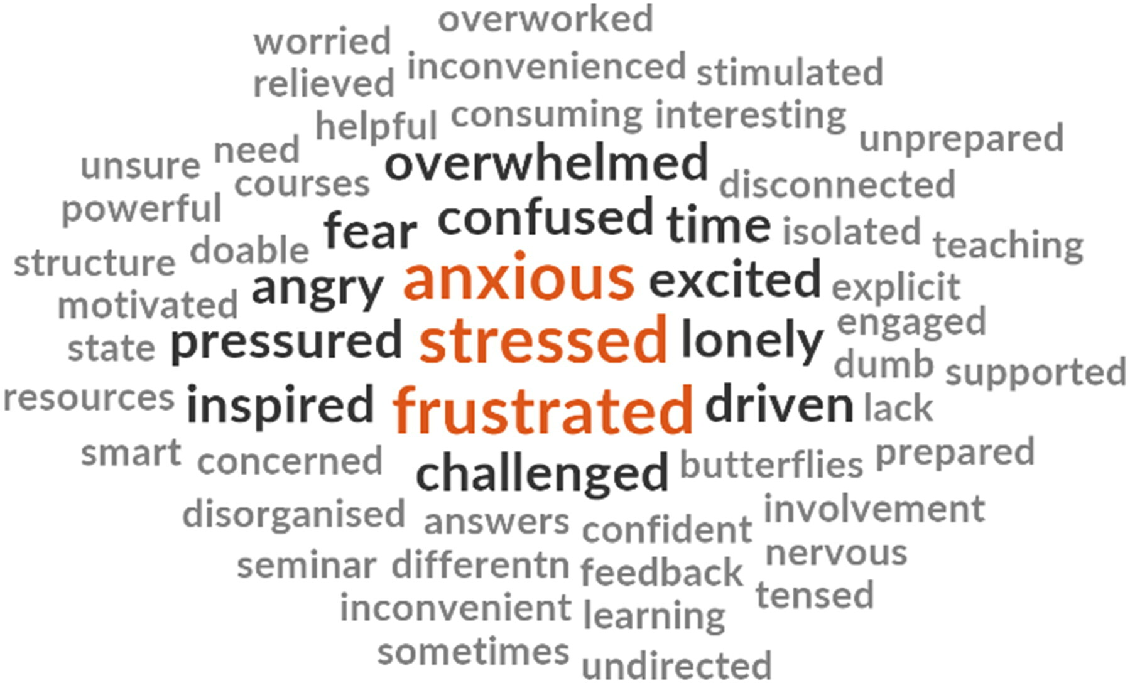
Word cloud of student responses to "How have assessments made you feel? What word comes to mind?".
Tai et al. (2022) Designing assessment for inclusion: an exploration of diverse students’ assessment experiences, Assessment & Evaluation in Higher Education, DOI: 10.1080/02602938.2022.2082373

Slide 11
What is the UDL perspective on assessment

Slide 12
Engagement
Students do well when they are motivated and enjoy learning
Material needs to be engaging but also clearly linked to why they are learning this material
Some learners thrive on spontaneity and novelty while others are disengaged, and scared, by those aspects, and prefer a predictable routine.
Some enjoy working alone, while others prefer to work with peers.

Slide 13
How do we apply this to assessments?

Slide 14
Applying this to assessments
Make the goals/purpose clear and authentic
Design for choice and agency (when possible)
Foster collaboration (encourage working in teams but not necessarily assess in teams)
Support self-assessment and reflection

Slide 15
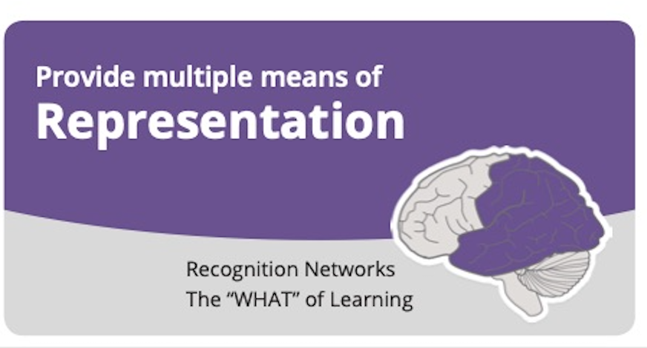
Representation
We might think that representation is about accessibility for those with a disability
But a key aspect of assessment is to ensure that all students understand what is required of them
Try to create a range of resources that illustrate for students what you are looking for
This could be a video, an annotated exemplar paper, a list of frequently asked questions etc
Reducing cognitive effort in understanding assessments reduces stress
https://www.umaryland.edu/web-accessibility/

Slide 16
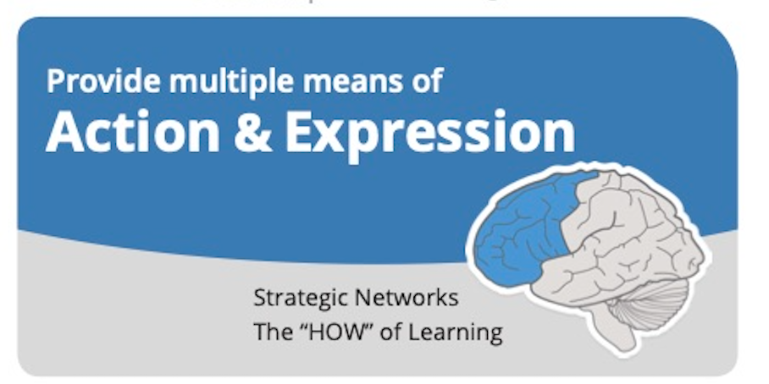
Action and Expression
This principle encourages instructors to create assessment tasks that allow students to demonstrate their learning in a way that suits them
This might be a presentation, a written assignment, a video or an illustration etc
The key here is providing choice
For this to be successful your rubrics need to focus on achievement of the learning objectives, rather than things like grammar, spelling, language etc. UNLESS these are learning objectives

Slide 17
Youtube video
https://youtu.be/9AqOnlL0K9k?si=8PhsE-dBE5PACPg5

Slide 18
Where do we start?

Slide 19
Key starting points
provide students with choices in their assessment both formative and summative
(Alsalamah, A. (2020). Assessing students in higher education in light of UDL principles. American Research Journal of Humanities & Social Science, 3(1), 24-27.)
before you start to choose the assessment methods for your course, you will start by considering that assessment is not just a measure of what students know; it has the capacity to shape a student’s attitude, goal setting, and engagement
  (Struyven, Dochy, & Janssens, 2005)

Slide 20
Step 1: Who are your students?

Slide 21
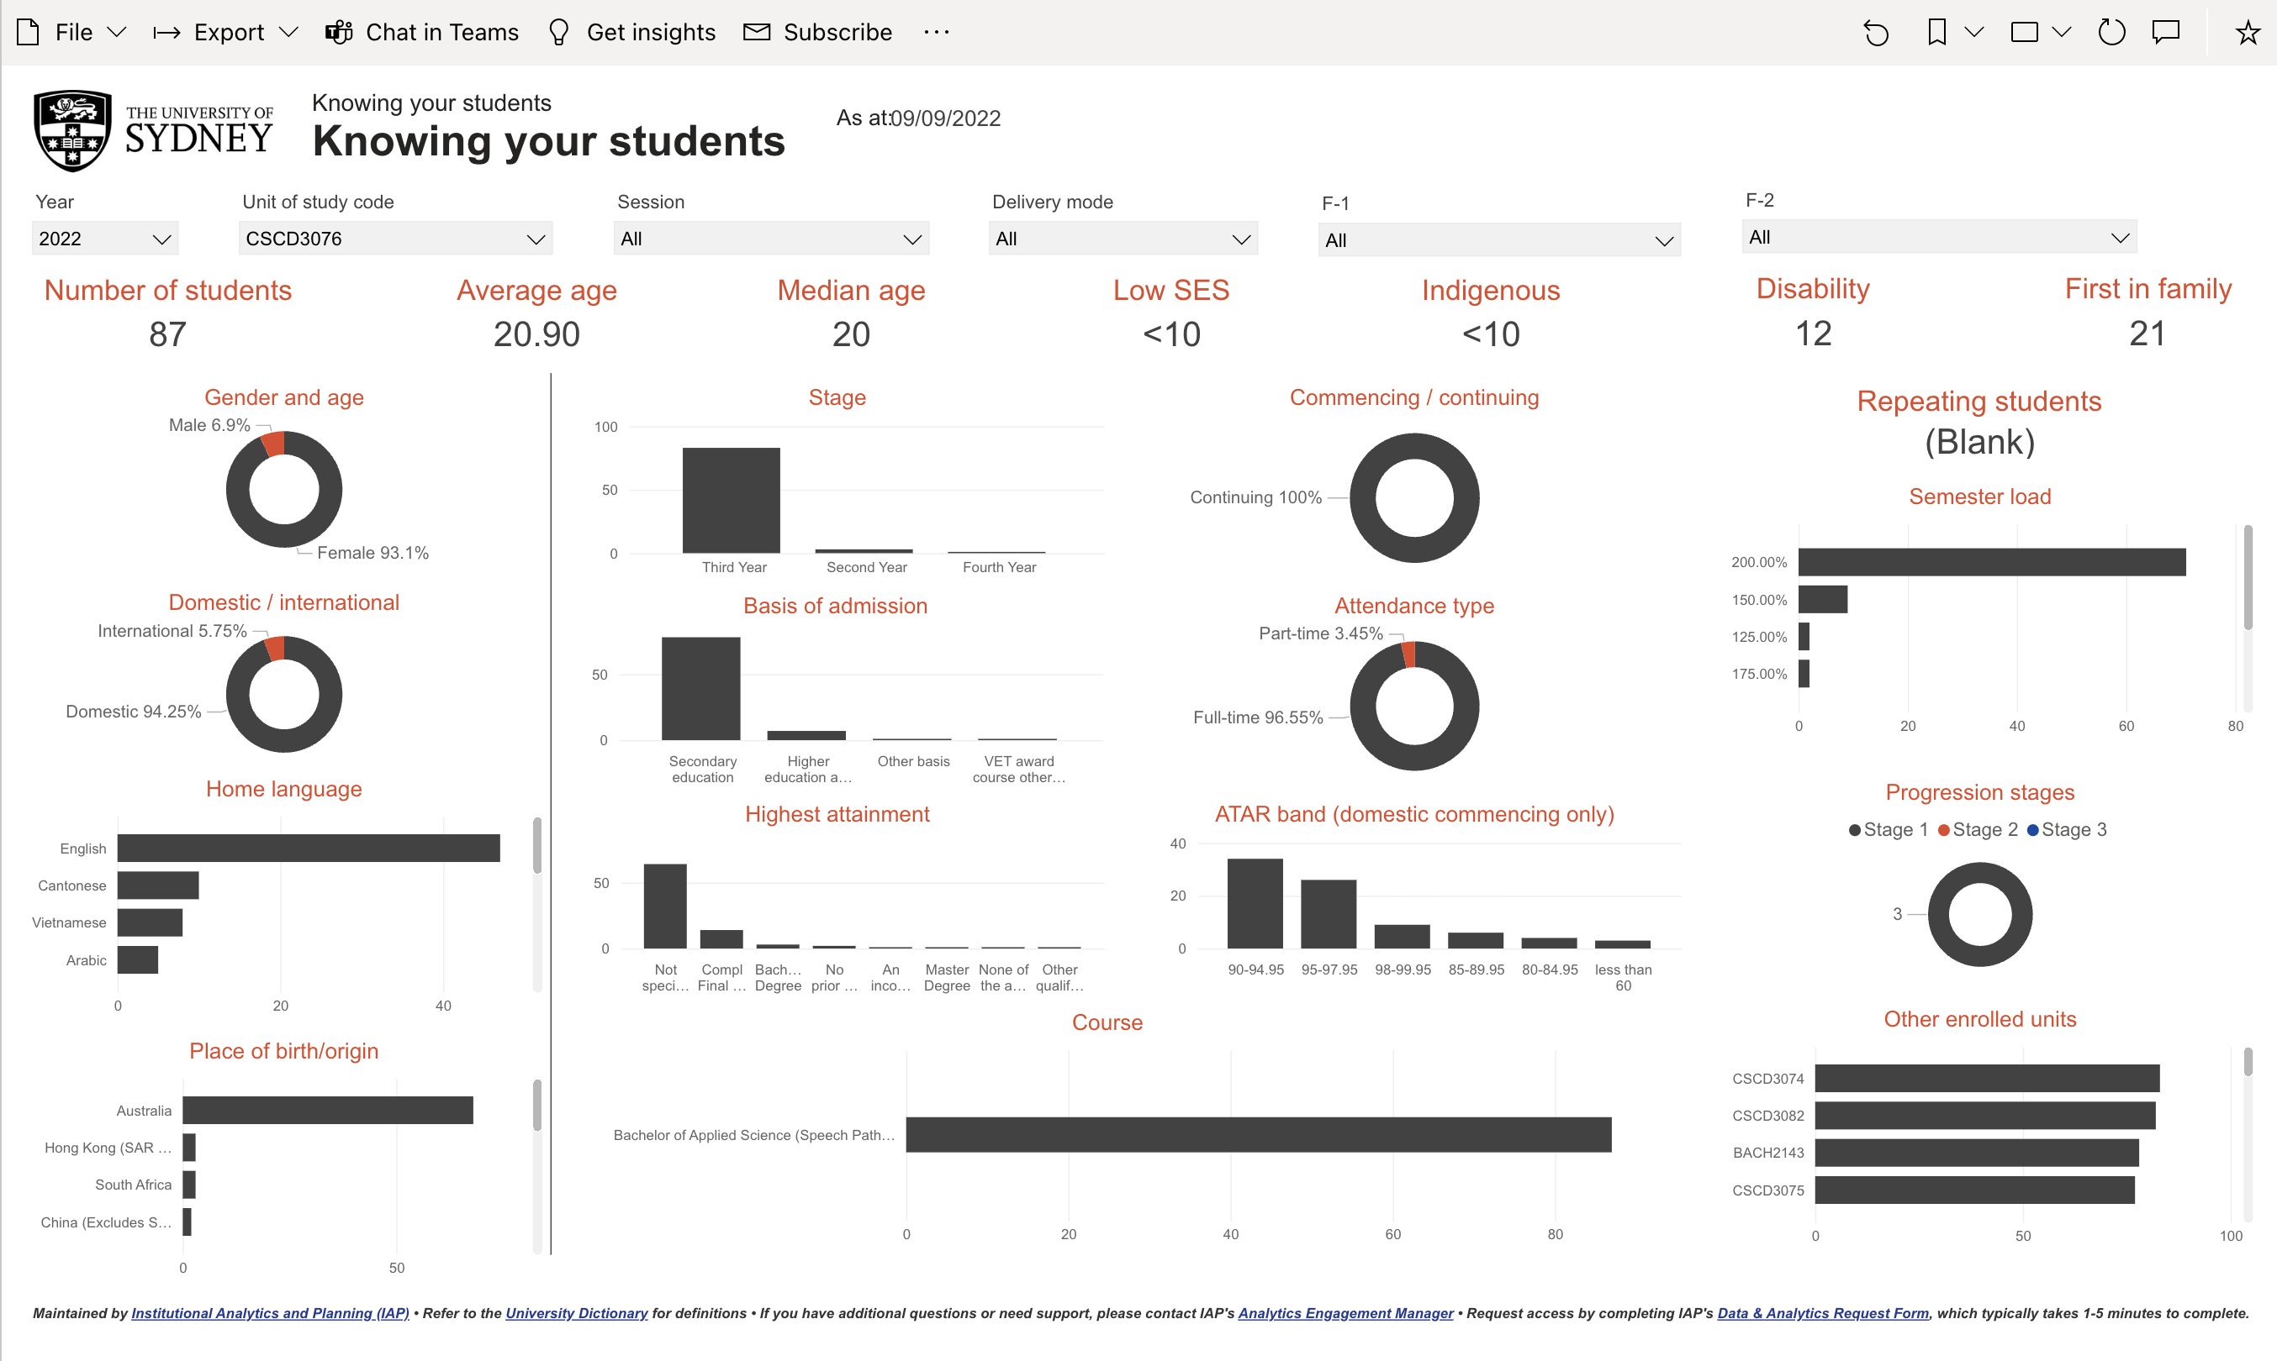
Who are your students?

Slide 22
Step 2: What is the purpose of this assessment? WHY are you assessing this?

Slide 23
Mentimeter
https://www.menti.com/aldard23h48e

Slide 24
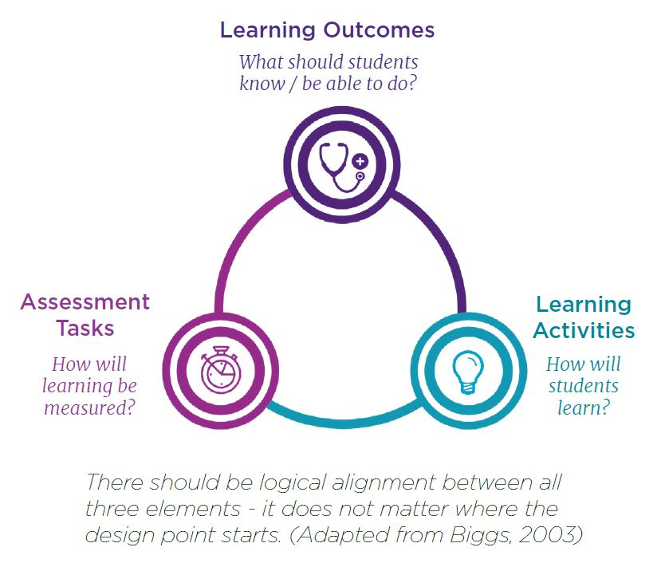
How do we map aka constructive alignment

Slide 25
Purposes of assessment
Type of assessment | Description | Purpose
Formative | Assessment for learning (does not record formal marks or grades). | To support learning towards summative assessment.
Summative | Assessment of learning (generates formal marks or grades). | To evaluate and formally record levels of attainment.
Diagnostic | Assessment of learning needs. | To guide learning effort and focus.
Dynamic | Assessment through unfamiliar challenges and contexts. | To determine ability to adapt.
Ipsative | Assessment of individual progress. | To determine individual learning progress.
Synoptic | Assessment of the synthesis of knowledge (eg programme level projects). | To evaluate ability to make connections and combine knowledge and ideas in action.
Prescriptive | Closed or tightly defined competencies or outcomes. | To measure against defined standards.
Negotiated | Flexibility in determining what and how of assessment (eg, student co-creation). | To empower and engage students.
Traditional | Assessment through standardised tests including recall of knowledge. | To assure consistency and for administrative efficiency.
Authentic | Contextual, applied, professional, and/or ‘real-world’ assessment. | To develop professional competencies and meaning in study.
From Curriculum design for mental health and wellbeing
Chris Wilson, Dr Gillian Knight, Dr Wendy Leadbeater, Rev Nicola Shephard, Dr Hala Shokr, Jon Taylor, Dr Elinor Vettraino, Adam Warren, Prof Helen Higson

Slide 26
Step 3: How will I mark this work?

Slide 27
Two examples
Weekly quizzes
Essay

Slide 28
Example 1: weekly quizzes
https://www.menti.com/aldard23h48e

Slide 29

Example 1: weekly quizzes
do you use weekly quizzes?
What is the purpose of your using these?
Is it to demonstrate understanding of key material, is it to encourage students to keep up with the material (are you on track?), is it to ensure that students have done the pre-reading?
Is it linked to workload for staff?
Does feedback on quizzes support ongoing learning/self-monitoring?
Do they add up to a significant number of marks?
Are they timed or untimed?

Slide 30
Purpose
Of learning
For learning
As learning

Slide 31
For keeping up with content
Keep quizzes untimed
Allow students unlimited attempts
Provide feedback that builds learning
Use them to judge where the cohort is up to
Low weighted/formative

Slide 32
Alternatives
Replace some or all of the quizzes by marked activities
  Post in discussion forum
  Peer review task
  Reflection task
  Collaborative online task (summarise a chapter of a text)
Offer alternative formats
  Create an infographic
  Record a podcast
  Make a video

Slide 33
Quizzes for marks (summative)
At a key point in the semester (after time to learn and understand the concepts)
Build competence beforehand from previous formative assessment
Reward those who completed all formative quizzes (repeat questions)
No surprises
Use formative results to identify key concepts in summative tests

Slide 34
Example 2: Essay
Writing an essay involves a range of skills that may not be key learning objectives such as formulating an argument, grammar and spelling, essay writing style, and so on
If essay writing style is a learning objective, then you will teach or provide links to materials to teach the skills you are assessing in this unit of study
If you are examining the content – what alternative ways can you use to assess the content?

Slide 35
Authentic writing examples
Write notes in clinical note writing style
Prepare a presentation that you would deliver in the workplace
Create a flyer for a product or approach (to inform clients in the workplace)
Create a website that consumers might access

Slide 36
Writing a rubric
Your rubric needs to focus on demonstrating learning of the key concepts
You can also award marks for effort and style – but keeping it non specific to the format

Slide 37
Using a rubric
Provide exemplars. Show students examples of “good” and “developing” work. Identify the characteristics that make the good ones good and the developing ones incomplete.
Break marks down into criteria. Use a list of criteria that relate to the learning objectives.
Break down into of quality (not frequency). Describe the best and worst levels of quality; then fill in the middle levels based on your knowledge of common problems and the discussion of developing work.
Include marks for effort. Students want to be rewarded for their hard work and this is important to maintain motivation. Ensure that students can’t pass based on effort alone but attention to detail and obvious effort should be noticed and rewarded.
Practice on exemplars. Get students to use the rubrics to evaluate the exemplars you gave them in Step 1.
Use self and peer assessment. Give students their task. As they work, stop them occasionally for self- and peer-assessment. Add marks for appraising peer work against the rubric
Revise. Always give students time to revise their work based on the feedback they get in Step 6.

Slide 38
Example rubric
 | Fail | Pass | Credit | Distinction | HD
Content of resource 3 marks | Resource contains incorrect information about the intervention approach Chosen intervention is not from provided list Information is disorganised and difficult to follow | Resource contains mostly correct information with some minor errors or omissions. Somewhat superficial coverage of the intervention No obvious attention to who will read/use this resource Key information is present but the layout or order of information lacks cohesion | Good quality information covering main aspects of this intervention Appropriate amount of detail about the intervention Information is clearly presented for non SLP reader | Thorough coverage of the key points of this intervention Links to other appropriate sources of information and support One or more aspects of strengths and weaknesses are identified Chosen content clearly focused on the reader (parent, carer, teacher) | Information is synthesised demonstrating sophisticated understanding of the intervention approach Multiple strengths and weaknesses identified All key aspects are carefully selected as most relevant to this intervention for parents/carers to understand
Length or Duration 2 marks | Resource does not follow word limits More than 30 words per powerpoint slide Slides seem busy Slides contain every word the person wants to say Leaflets include tiny font or very small margins | This resource is of an adequate length or duration – it could feel wordy in places with repeated information that could be culled with a careful edit No more than 30 words per slide Word limits adhered to | Clear succinct wording that does not include additional information that is not useful | AS for Credit and Additional information is linked within text or references are provided for reader to seek out additional information if required | As for D and All information included is relevant and clearly explained Coherent synthesis of information to provide the most relevant information within the word limit
Accessibility (parent friendly, spelling, grammar, plain English free of jargon) 2 marks | Technical language is used that may include jargon Several errors in spelling, grammar, terminology | Language includes some jargon with limited attempt to explain Style feels more scholarly than parent friendly Tone is overly simplistic as if explaining to a child More than 3 errors in grammar or spelling No links or inappropriate links provided. May include references as per a university assignment rather than an information resource | Minimal jargon is used Language is appropriate without being patronising Less than 3 errors in grammar or spelling Mostly appropriate links or references - as appropriate for a parent, carer, teacher, non speech pathologist | As for CR and Resource includes appropriate images and examples A well written resource appropriate for the audience with no more than 2 grammatical, spelling errors All included references and links are appropriate in a parent/carer resource (not a university assignment) | A professional looking resource including images that enhance the information Exemplary language used, appropriate for audience with no errors All references or links included are essential to understand the content
Presentation 2 marks | Resource is poorly organised and lacks attention to detail. This resource is presented in a way that is unattractive, with mixed fonts, odd spacing, no images, innapropriate images or overwhelming variety in colours and style | This presentation is adequately presented but with little attention to colours, fonts, layout and images The layout may lack logical flow Images included may not obviously add to the message of the resource even if they look nice Might feel more like a first draft than a final version | A nice-looking resource including some use of fonts, colours and layout Resource includes some appropriate images | As for CR and A resource that is well presented and professional. There is use of colour and layout that enhances the content All images are relevant and add to the written information | As for D and This resource is beautifully presented in an engaging way. There is obvious attention to detail regarding colours, font size, layout and images Professional level presentation

Slide 39
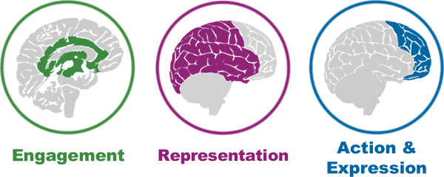
Padlets
Which aspect of UDL do you feel most strongly about?
Pick your colour!
Blue: Blue Padlet
Green: Green Padlet
Purple: Purple Padlet

Slide 40
Padlet Activity
Add information about 2 assessments you currently use – in just a few words for example
Weekly quiz, MCQ, no marking required, worth 1% per week
Final exam, 2 hours, written, in person, worth 50% of the course
Mid semester assignment essay. Take home 2 weeks, APA referencing, worth 30%

Slide 41
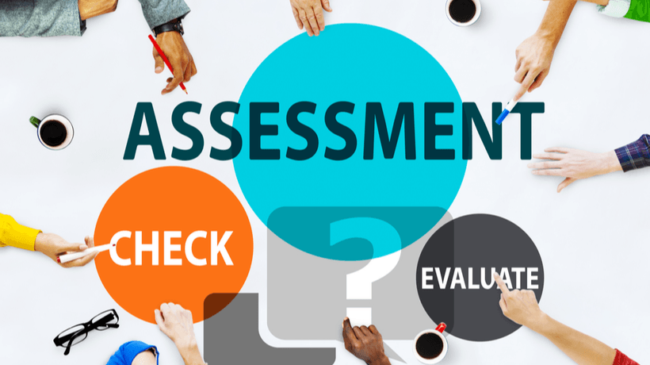
Re-designing assessments with UDL in mind

Slide 42
Factors to consider
Learning objectives
Low & high stakes assessment
Workload
Feedback

Slide 43
Redesigning your assessments:
1. Learning objectives
Students need to know why they are being assessed
They need to know the skills or abilities they are working on
They can then prioritize their goals and adjust learning strategies accordingly.
As an instructor, explaining how your assessments are tied to learning outcomes and objectives can be critical to engage your students and support goal setting.

Slide 44
Redesigning your assessments:
2: Low and high stakes assessments
Aka formative and summative assessment
Plan a hierarchical approach to formative and summative assessment
Offer a variety of modes of response to maintain motivation and meet the needs of all learners
Be clear on the purpose of formative assessments and how they link to summative ones

Slide 45
Redesigning your assessments:
3: Workload
Workload for both you and the students is a vital concept when redesigning assessments
Automate feedback for formative assessments
Think about ways to support students organisation (reminders, to-do lists etc)
Encourage students to work in teams to share workload

Slide 46
Redesigning your assessments:
4: Feedback and rubrics
Feedback is essential and needs to clearly link to learning objectives
Rubrics need to link to learning objectives and be broad enough to cover different modes of action and expression
Use the rubrics for peer feedback early in the process, this helps students become familiar with the rubric which can then improve their own work

Slide 47
Contacts
Dr Andy Smidt
Andy.Smidt@Sydney.edu.au

Slide 48
Links and resources
https://www.cast.org/binaries/content/assets/common/publications/downloads/cast-udltipsforassessment-20200920-a11y.pdf
https://slds.osu.edu/posts/documents/top-10-udl-tips.pdf
https://www.cultofpedagogy.com/rubric-repair/

Slide 49
Q & A session

