Slide 1




A hacker’s guide to UDL
Justin Wylie
CQ University

Slide 2

About this session
This session is being recorded. If you do not wish to appear on screen please hide camera
This session will be captioned (either live captioning or closed captions)
Session etiquette
Use Chat or Q+A function as directed by presenter
Indicate in the Chat or Q+A function for questions as directed by presenter
Where appropriate use raised hand emoji to ask questions
Ensure your surrounding environment is quiet when mic is on (e.g., phones, pets etc)
Turn off mic when not speaking

Slide 3
Acknowledgement to traditional custodians
I respectfully acknowledge the Traditional Custodians of the land on which we live, work and learn. I pay my respects to the First Nations people and their Elders, past, present and future.

Slide 4
What we’ll be doing in todays workshop
Why a hacker’s guide to UDL?
Shared document for ideas/ thoughts
Hack’s for creating an accessible word document - demonstration
Activity 1: Remediate an inaccessible MS Word document
Hack’s for accessibly adding content to an LMS - demonstration
Activity 2: Use your own LMS to make an accessible document
Questions & sharing

Slide 5
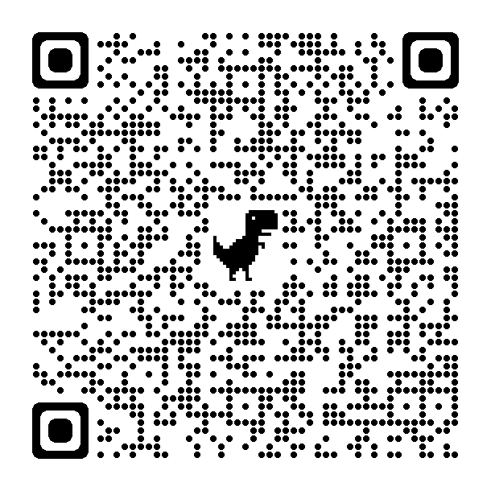
Shared document for ideas/ thoughts
Add your thoughts, ideas or questions
Parking lot
There is no single way to implement UDL!
These are strategies and tips I regularly use as a learning designer – but I know I’ll adapt as I learn more
https://tinyurl.com/Hacker-guide-UDL-notes

Slide 6

Why “a hacker’s guide?”
Mindset of exploring and mastering a topic through unconventional and innovative means
Practical tips, strategies, and insights to sustainably apply UDL to common student resources
Low hanging fruit
Including pedagogy that has a UDL basis
To present an achievable way to adapt your workflow to be create more inclusive student experience

Slide 7
Activity 1: Remediate an inaccessible MS Word document
Demonstration using Microsoft Word
Highlight hacks
Will add links in the chat

Slide 8
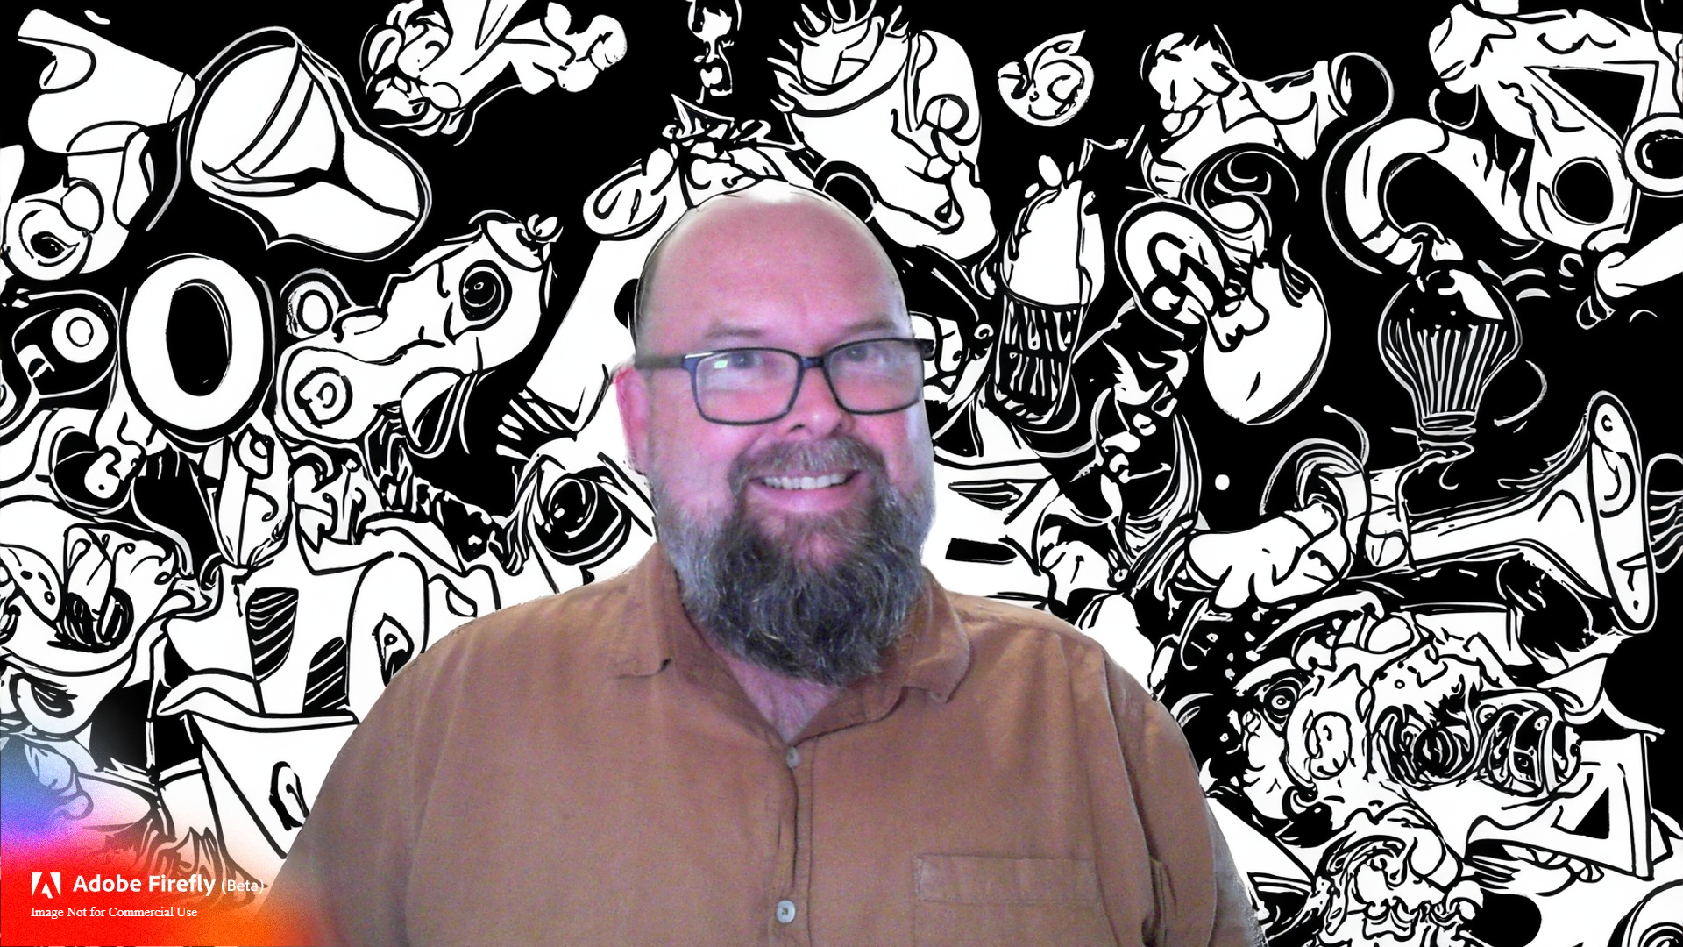
Contacts
Justin Wylie
Learning Design & Innovation
CQ University
Email: j.wylie@cqu.edu.au

