Slide 1
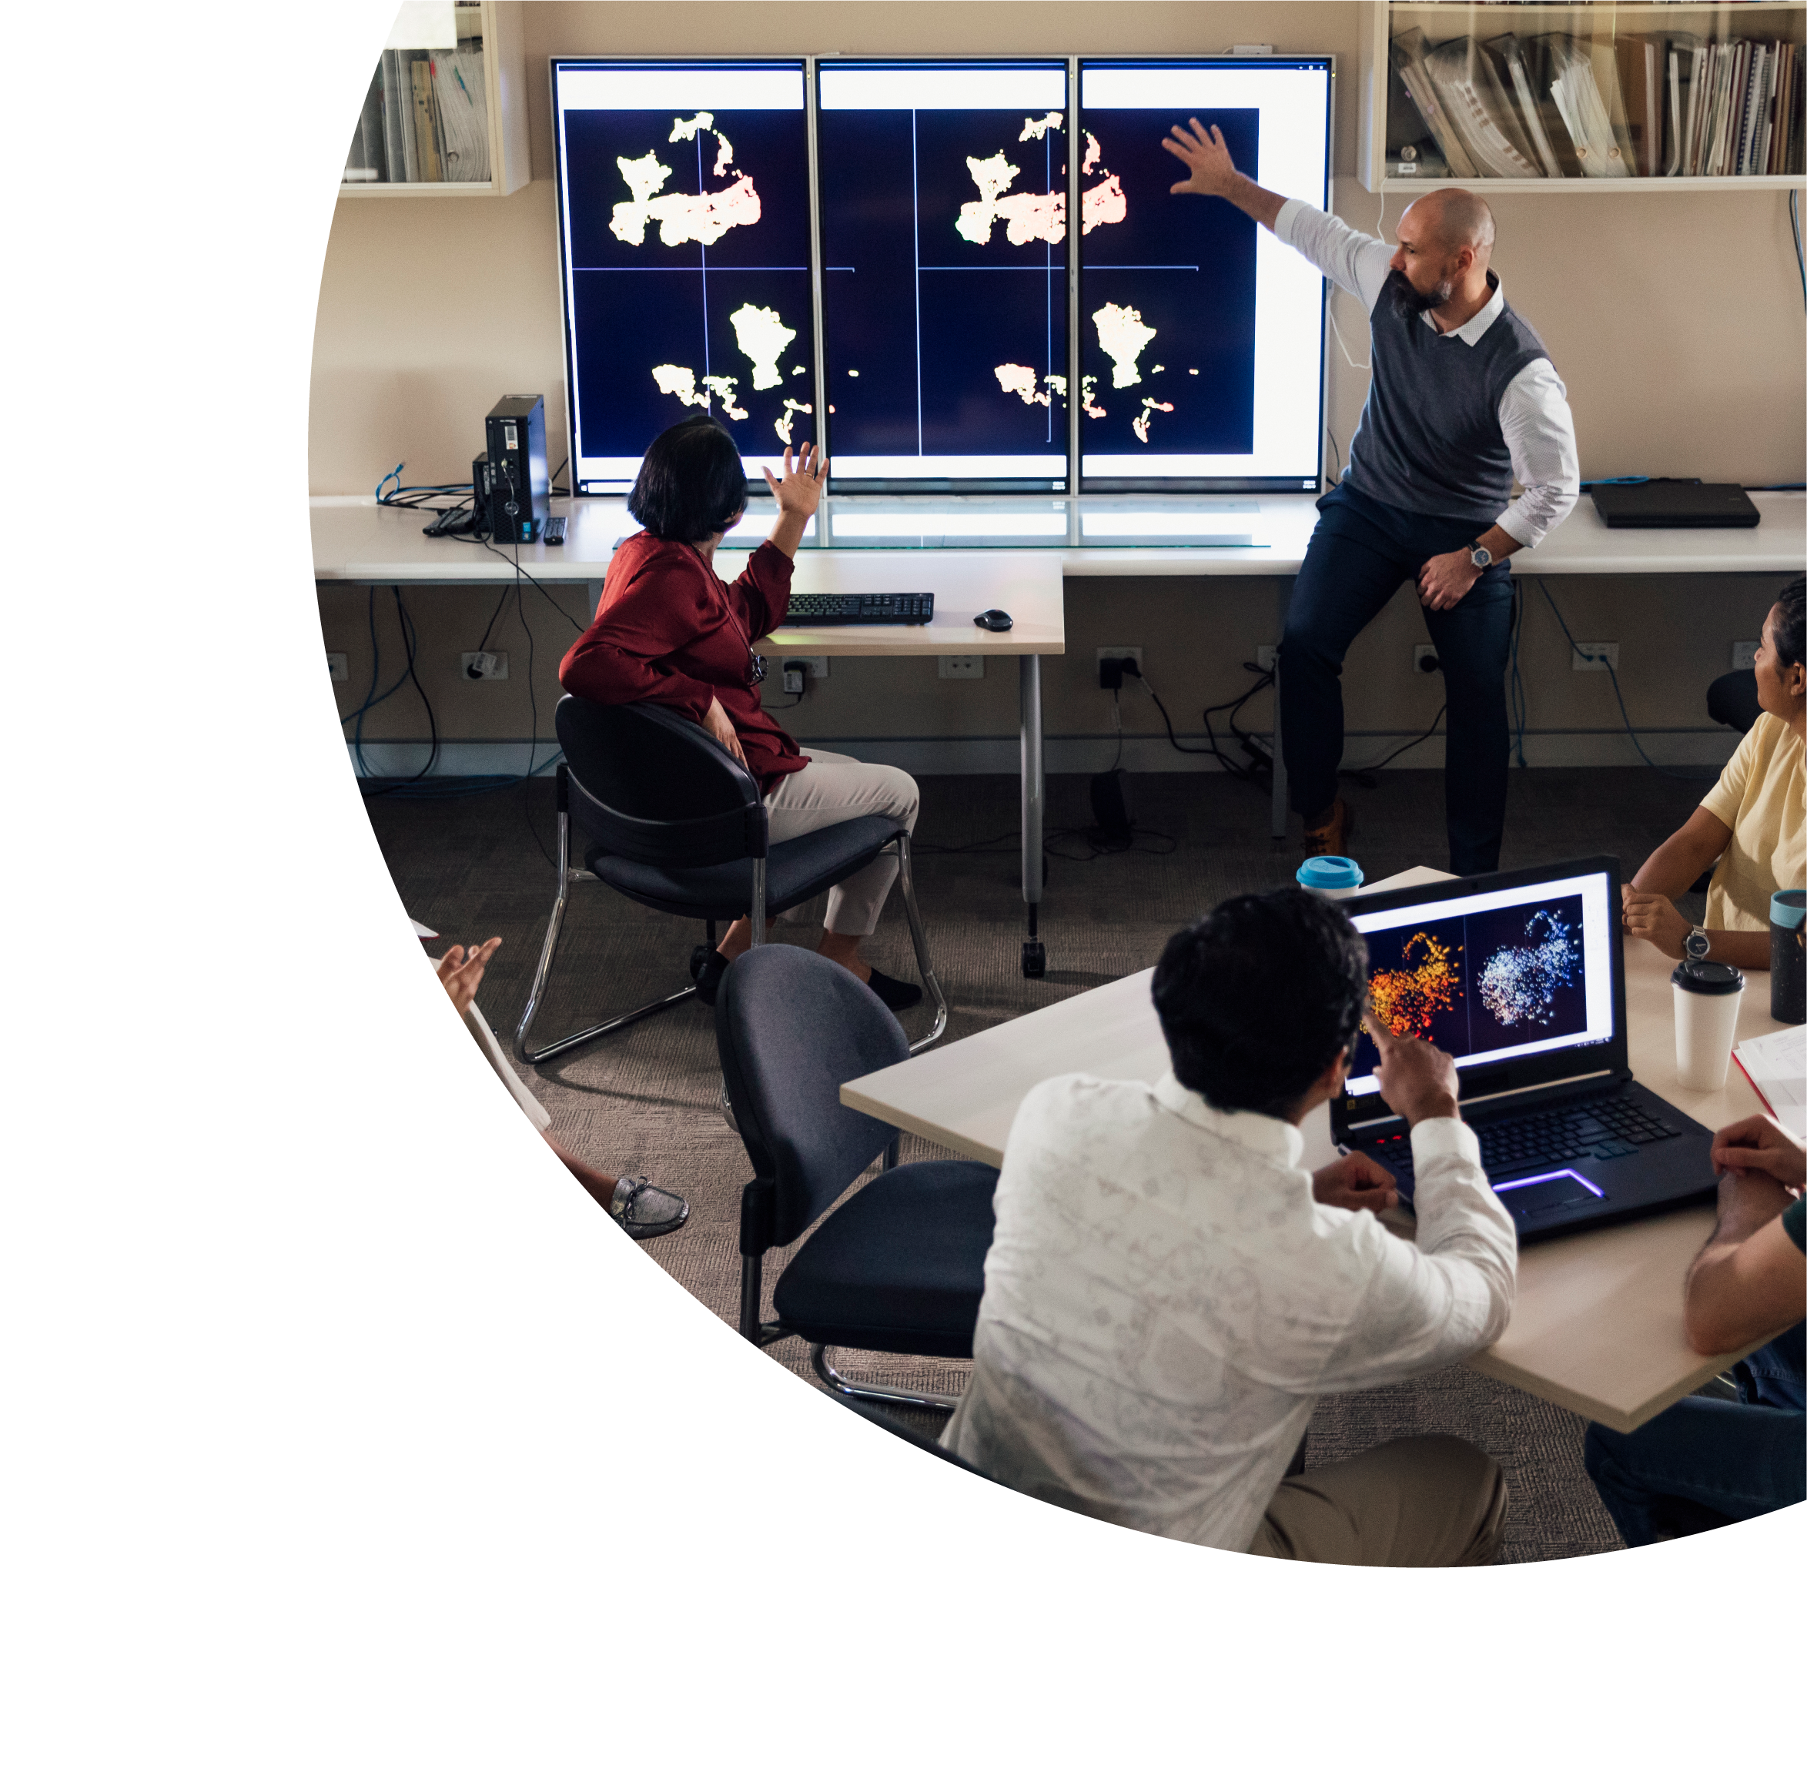
Large Scale Implementation of Same Language Subtitles: A Case Study
Dr Stuart Dinmore
University of South Australia Teaching Innovation Unit (TIU)

Slide 2
Acknowledgement to traditional custodians
I would like to acknowledge the traditional custodians of the lands that am speaking to you from today, the Kaurna people of the Adelaide plains.
I also acknowledge the traditional custodians of the land of which you are living, learning and working today.

Slide 3
About this session
This session is being recorded. If you do not wish to appear on screen, please hide camera
This session will be captioned (either live captioning or closed captions)
Session etiquette
Use Chat or Q+A function as directed by presenter
Indicate in the Chat or Q+A function for questions as directed by presenter
Where appropriate use raised hand emoji to ask questions
Ensure your surrounding environment is quiet when mic is on (e.g., phones, pets etc.)
Turn off mic when not speaking

Slide 4
What we’ll be covering
Multimedia in Higher Education
Multimedia and Accessibility – Putting the Universal in UDL
Benefits of same-language-subtitles (SLS)
Inform discussion with some student survey results
UniSA Online: A Case Study
How to achieve SLS implementation on a large-scale
Some things to consider

Slide 5
The growing use of multimedia
Why produce multimedia content for your students?
Flexibility for students and staff
Self-paced learning for students – particularly online students
Time management for students and teaching staff
Equitable access to content – subtitles, removing barriers to learning
For teachers and designers, remember to embrace the differences and use the medium to your advantage.

Slide 6
Did you ever rewind or pause a video while watching?

Slide 7
Advantages of Same-Language-Subtitles (SLS)
Makes content accessible for Deaf or hard of hearing people (about 3.6 million people in Australia have some form of hearing loss).
Helps attainment or comprehension of an additional language.
Makes content accessible in sound sensitive environments.
Increases the comprehension, spelling and pronunciation of discipline specific language.
Can be turned in to transcripts.
[ARTICLE] Video Captions Benefit Everyone – Morton Ann Gernsbacher (2015)

Slide 8
Did you read subtitles while viewing the course videos?

Slide 9
Did the subtitles increase your understanding of topics or concepts in the course?

Slide 10
Student Quotes from the Survey
As I am hearing impaired, I find subtitles essential for any video viewing. I can hear but have problem with some ranges of sounds that speaking forms part of. Without subtitles I’d be lost with videos. I also prefer videos to learn so it’s a good way to assist me.
I really appreciated the subtitles as sometimes i would miss a word or not know what it meant so having subtitles allowed me to look up the word later on.
Subtitles were very helpful when the presenter had a very strong accent that was hard to understand.
I really liked the subtitles option to the videos. Because it helped gain a better understanding of what was being said and also been much better to jot down notes. I think this feature made a huge different in my studies.
The captions are very helpful in that if I need to learn about new topics that aren't in my knowledge yet, I can see how words are spelt and do some of my own research too. They also help to follow along with and help some videos flow and relate information to each other.

Slide 11
UniSA Online: A Case Study
UniSA Online is a 100% online academic unit with 6-7 thousand students.
UniSA Online made a commitment right at it’s inception that it would offer 100% same language subtitles on all it’s content.
It is now supported by ~4500 pieces of multimedia content, all of which contain 100% accurate same-language-subtitles.
The multimedia (5 people) team pay for an external provider to create the subtitles.

Slide 12
Some things to consider
Autotranscription is very good but never 100% accurate. This will require human intervention as some stage.
The key factor in a high accuracy of autotranscription is audio quality. This means a clear recording with no background disturbance – this does not require an expensive microphone but much more to do with mic placement and a quiet recording environment.
Even high accuracy auto-transcribed subtitles are better than nothing.

Slide 13
Q & A session

Slide 14
Contact
Dr Stuart Dinmore
Senior Lecturer: Academic Development
Teaching Innovation Unit (TIU)
University of South Australia
stuart.dinmore@unisa.edu.au

