Slide 1
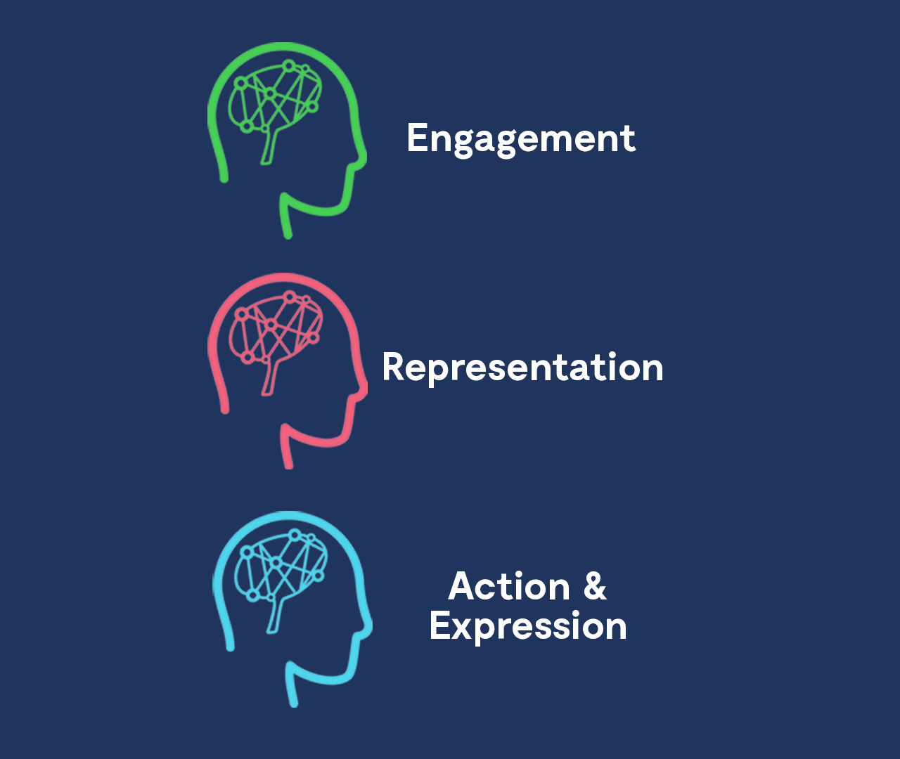
The UDL Educator Pathway
Annette van Lamoen and Michael Grawe, Ako Aotearoa

Slide 2
About this session
This session is being recorded. If you do not wish to appear on screen please hide camera
This session will be captioned (either live captioning or closed captions)
Session etiquette
Use Chat or Q+A function as directed by presenter
Indicate in the Chat if you have a Question
Use Raised hand emoji to ask questions
Ensure your surrounding environment is quiet when mic is on (e.g., phones, pets etc)
Turn off mic when not speaking

Slide 3
Opening montage video

Slide 4
Acknowledgement to traditional custodians
E ngā mana E ngā reo E ngā iwi E rau Rangatira mā Nau mai, haere mai!
To the various authorities
voices
peoples and leaders
welcome!

Slide 5
Opening karakia
E te hui
Whāia te mātauranga kia mārama
Kia whai take ngā mahi katoa
Tū māia, tū kaha
Aroha atu, aroha mai
Tātou ia tatou katoa
For this gathering
Seek knowledge for understanding
Have purpose in all that you do
Stand tall, be strong
Let us show respect
For each other

Slide 6
What we’ll be covering
Ako Aotearoa
Development of the UDL Educator Pathway
Pathways Awarua
A walk-through of the UDL Pathway
Q & A

Slide 7
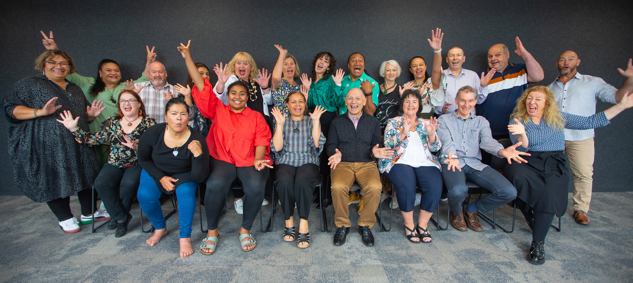
Team Ako Aotearoa

Slide 8
Why we developed the UDL Educator Pathway
Educators need to be lifelong learners, but need to be supported in their learning journey.
UDL as a tool for creating more inclusive learning and teaching environments, and fostering learner-centred teaching approaches.

Slide 9
Overview of the UDL Educator Pathway

Slide 10
Accessing the UDL Educator Pathway
How to access the UDL Educator Pathway

Slide 11
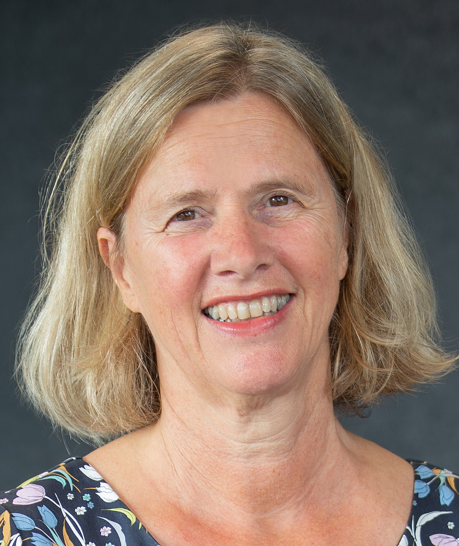
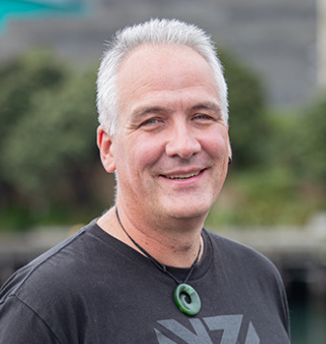
Feel free to get in touch
annette.vanlamoen@ako.ac.nz
michael.grawe@ako.ac.nz

Slide 12
Q & A session

Slide 13
Closing karakia
Kua mutu a mātou mahi
Mō tenei wā
Manaakitia mai mātou katoa
O mātou hoa
O mātou whānau
Āio ki te aorangi
Our work has finished
For the moment
Bless us all
Our colleagues
Our families
Peace to the universe

