Slide 1


Using UDL to lighten the load on executive processing in a Very Large Unit
Dr Natasha Todorov
Macquarie University
(natasha.todorov@mq.edu.au)

Slide 2

Acknowledgment of Country
We acknowledge the traditional custodians of the
land that Macquarie University is situated,
The Wallamattagal people of the Dharug nation,
whose customs and cultures have nurtured and
continue to nurture this land.
We also wish to acknowledge the Elders of the
Dharug Nation, past and present and pay our
respects to them.
We acknowledge Aboriginal and Torres Strait Islander people participating in this symposium.
Today, I am coming to this symposium from the
land of the Burramattagal clan of the Dharug people.

Slide 3
Our story…..
I convene a Very Large first-year Psychology Unit at Macquarie University along
with my Assistant Convenor Eva Tzschaschel (median enrolment 2500 students)
With the increase in enrolment, I began to suspect that we were also seeing an increase in the
number of students who identified as being neurodiverse.
The term neurodiverse is an umbrella term that takes in a variety of different diagnoses
with very different symptomology. e.g., people with autism, ADHD, dyslexia, and acalculia
One aspect of cognitive functioning that all of these have in common is
a difficulty with executive processing abilities

Slide 4
What problems might we see in our cohort?
Students who have a difficulty with executive processing may have
difficulties in any combination of the following abilities:
    • the ability to plan
    • the ability to organise
    • memory difficulties
    • the ability to set appropriate goals
    • the ability to shift from one task to another
    • the ability to appropriately self-reflect on performance

Slide 5
Aims:
Research indicates that factors such as available cognitive load in university students
with and without learning disabilities affect their academic performance.
Therefore, anything that lifts the processing requirements off a task will assist academic
performance on that task.
In the case of our students with executive processing difficulties the aims were to:
    make the ability to plan and organise easier,
    lift the load on memory, and
    teach students’ strategies to reflect on their performance and make clear and
    appropriate goals.

Slide 6
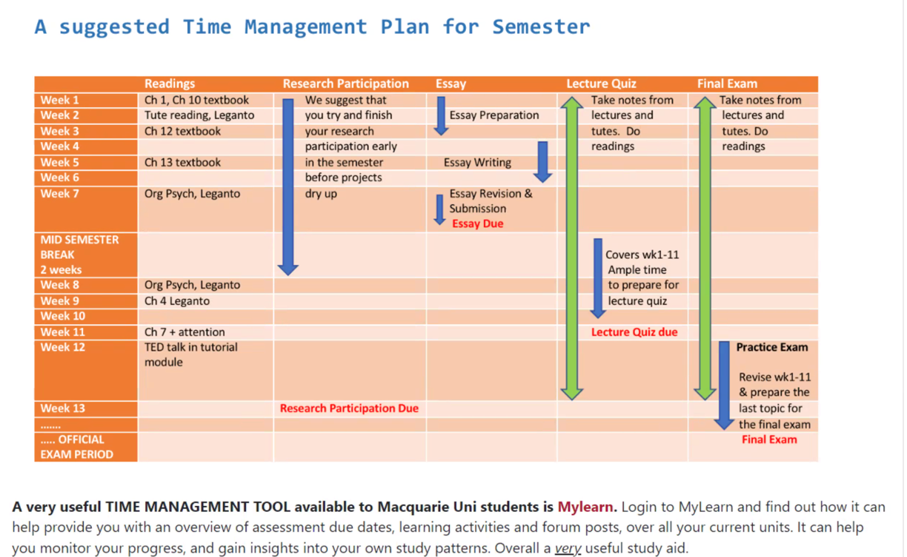
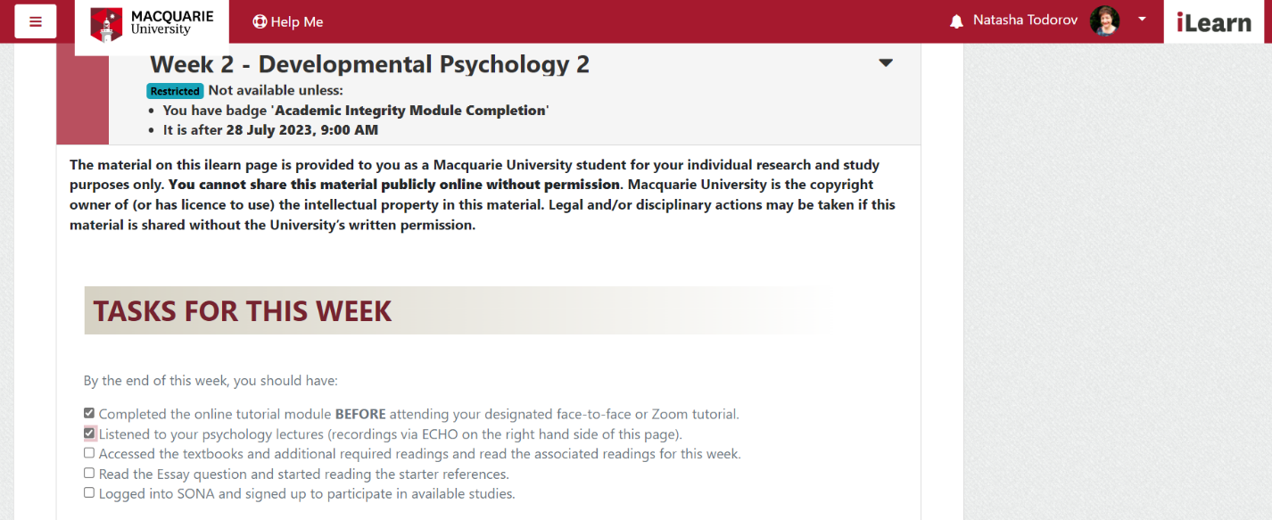
Tip 1: Time management
Explicitly teaching organisation and time
management (UDL Checkpoints 6.2; 7.3):
We provide a recommended timeline for success
and back it up with to-do lists with concrete
tickable boxes. Weekly “newsletters” act as
reminder reinforcements.

Slide 7
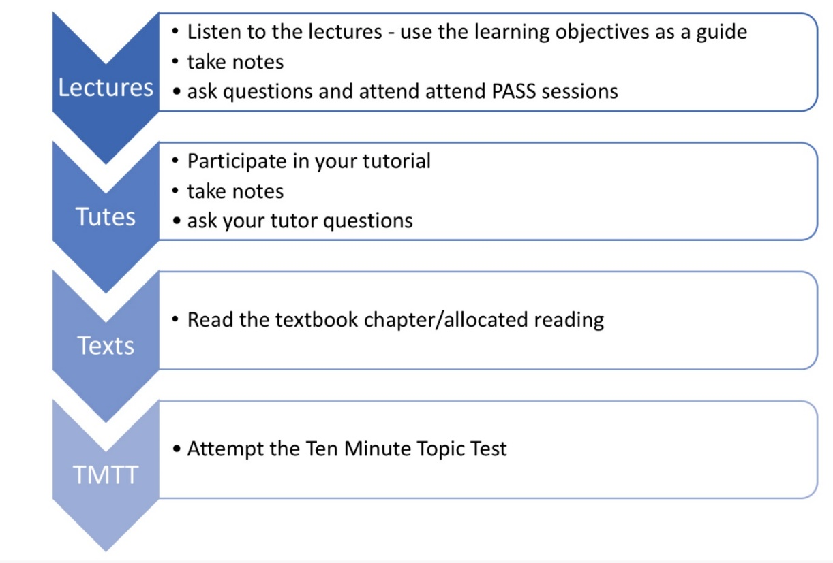
TIP 2: Explain seemingly random relationships
(1) the r’ship between academic tasks on the unit
Students are provided with a 4-step scaffold to
tackle each of the seven topics we teach in this
unit. This shows students how all the learning
activities work together to promote learning.
We publish learning objectives for all
lectures and tutorials (UDL Checkpoint 3.2).
First year students are only just learning how
to take lecture notes
This is very important in helping students focus
attention on lecture structure and learn to filter
out what is important in the stream of words.

Slide 8
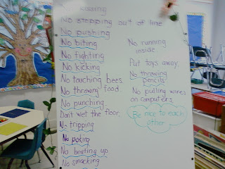
TIP 2 Continued:
(2) Why are university administrative rules so weird?
Explaining the rules, not just listing them
(UDL Checkpoint 7.2).
In the same way that we explained how all the
academic tasks fit together we explain our
administrative rules to our students
Students are less likely to get upset when they know
WHY we have seemingly random administrative
rules in place
There has to be a story there!!

Slide 9
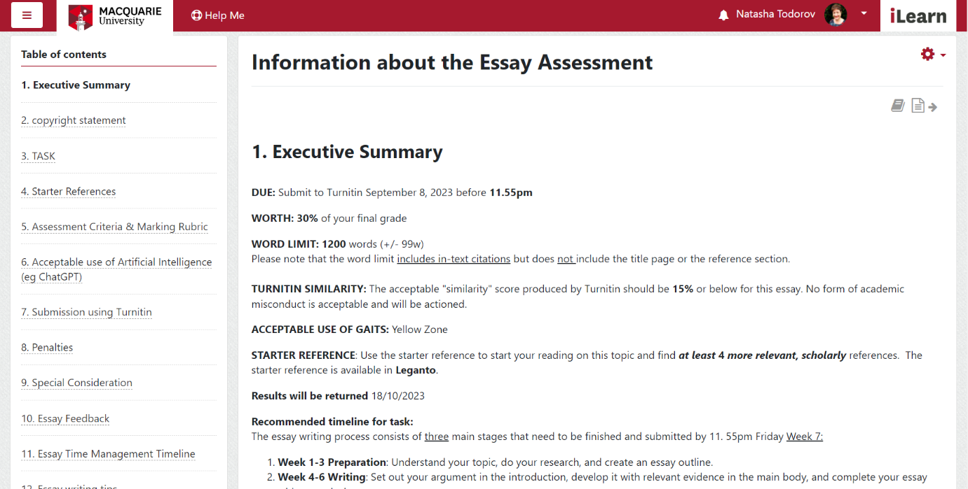
TIP 3: Presenting information for easier processing
Chunking and differentiating
information for easier processing
(UDL Checkpoint 3.3)
Rather than providing information in
long documents, information is
chunked into book chapters.
Importantly, each book starts with a
summary page listing all important
information, preventing students
getting buried in detail.
This works to differentiate the level of
information provided to students.

Slide 10
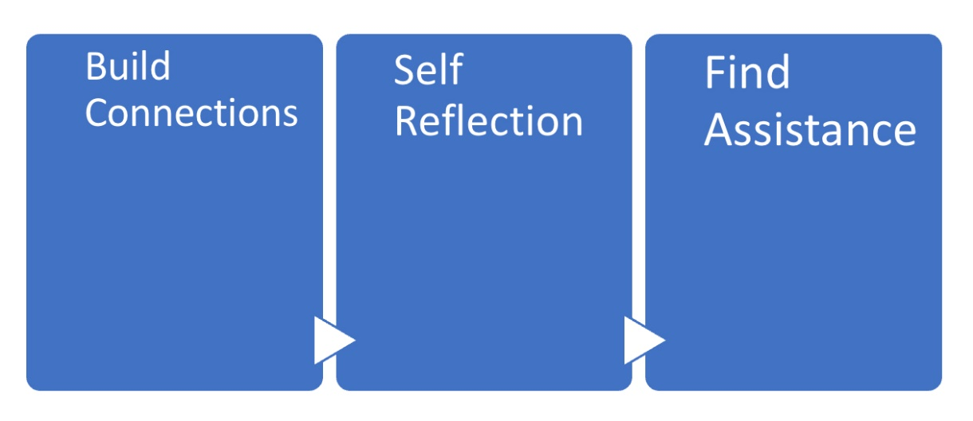
TIP 4: Encouraging academic resilience and explaining the role of generic skills
We provide a scaffold for “3 steps to success”
at Uni which describes a process for incorporating
generic skills into day-to-day academic activity
and then we teach those skills:
building connection with others and connections with
the content of the unit using active learning strategies
academic self reflection and
actively seeking assistance
To encourage and make finding assistance easier I
created a Student Support Services Hub
Multiple Means of Representation
(UDL Checkpoint 2.5)

Slide 11
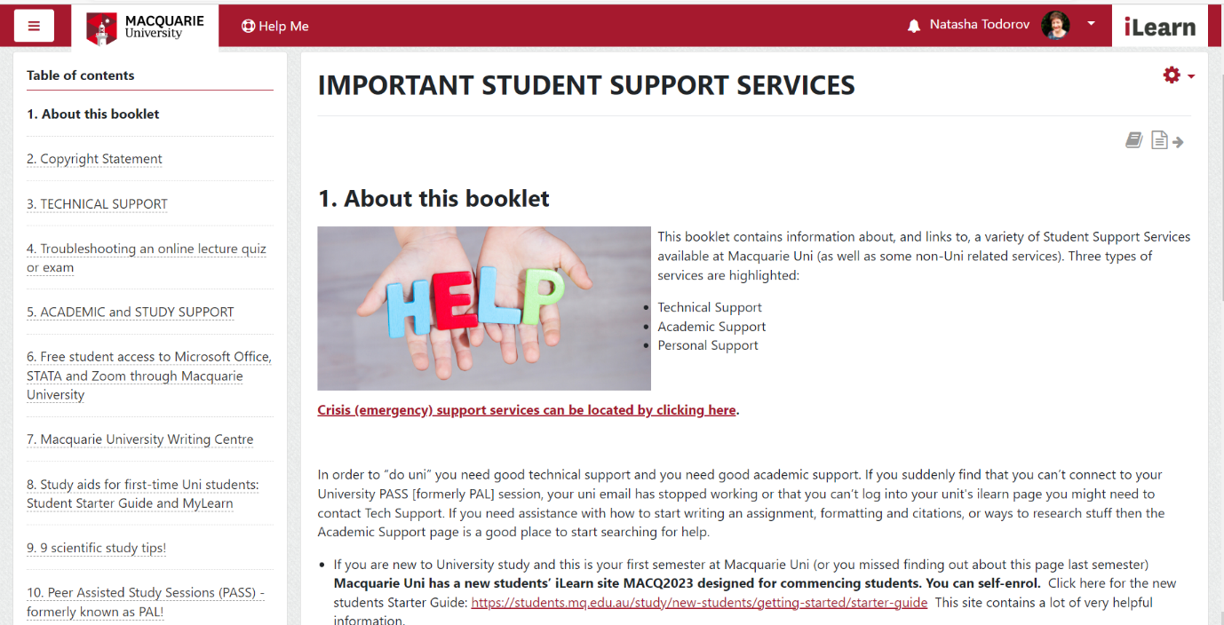
TIP 5: Make help easy to find help
Creating a Student Support Hub
(UDL Checkpoint 8.3).
Students who suffer anxiety, panic, or trauma are
often unable to search for information themselves
so having all that information in one place
reduces the cognitive load when stressed.
The Student Support Hub includes Technical,
Academic, Personal and Crisis support
The Student Support Hub has resources
for a number of diverse groups and has both
Macquarie Uni based and non-university
resources. Resources are available for students
who are based overseas.

Slide 12
A little look at the 2022 OUA student data…
 | 2021 (pre-UDL changes) | 2022 (post-UDL changes)
Student satisfaction | 96.5% | 95.3%
OUA Student achievement | 46.6% | 62.6%
Satisfaction measured by percentage of students
responding “yes” to question “Would you recommend
this unit to another student?” asked in end of
semester anonymous student unit review
Achievement measured by comparing average
unit grade obtained across all students enrolled in
Open University Australia (distance) version of first
year unit.
The data suggests that the changes we made
were successful in increasing student success
rates whilst maintaining high satisfaction rates.

Slide 13
Summary: 5 quick UDL tips to support first-year students
Tip 1: Teach time management explicitly
Tip 2: Explain seemingly random relationships
(e.g. the relationship between academic tasks, what all the weird admin rules are for)
Tip 3: Deliberately make changes to the way you present information for easier processing by the student
Tip 4: Encourage and teach generic skills to build academic resilience
Tip 5: Make seeking help as easy as possible

Slide 14
Summary: The generic skills we encourage students to practice
time management and organisational skills
active learning behaviours
academic self-reflection
help-seeking skills

Slide 15

Read all about it…
Thank you very much for listening today!
If you would like to read more detail about these
strategies I have published a post in the
Macquarie University Learning & Teaching blog
Teche that can be accessed by scanning
this QR code
or typing this into your browser:
bit.ly/VeryLargeUnit

