Slide 1


Why Disrupt?
Using UDL to foster belonging and break-down barriers
Samantha Poulos, Ella Collins-White, Sarah Humphreys

Slide 2

About this session
This session is being recorded. If you do not wish to appear on screen please hide camera
This session will be captioned (either live captioning or closed captions)
Session etiquette
Use Chat or Q+A function as directed by presenter
Indicate in the Chat or Q+A function for questions as directed by presenter
Where appropriate use raised hand emoji to ask questions
Ensure your surrounding environment is quiet when mic is on (e.g., phones, pets etc)
Turn off mic when not speaking

Slide 3
Acknowledgement of country
As we begin, I would like to acknowledge and pay respect to the traditional owners of the land on which the University of Sydney is built – the Gadigal of the Eora Nation. I pay respect to their Elders past and present, and to any First Nations people in attendance. As we share our own knowledge, teaching, learning and research practices within this space may we also pay respect to the knowledge embedded forever within the Aboriginal Custodianship of Country.​

Slide 4
What we’ll be covering
A sense of belonging is an extremely important part of a person being able to engage in and with a space.
Academic achievement is important, but sense of belonging is most strongly related to overall experience
What impacts a sense of belonging in the learning environment of the University of Sydney
What is in our capacity to change and why is it important to disrupt the long-held mindset of prestige and exclusivity of a sandstone university

Slide 5
Sense of Belonging
Academic achievement is important, but sense of belonging is most strongly related to overall experience
The coloured bars (right) indicate students' sense of belonging

Slide 6
Learning Environment
"The learning environment (LE) comprises the psychological, social, cultural, and physical setting in which learning occurs and in which experiences and expectations are co-created among its participants (Rusticus et al., 2020; Shochet et al., 2013). These individuals, who are primarily students, faculty and staff, engage in this environment and the learning process as they navigate through their personal motivations and emotions and various interpersonal interactions. This all takes place within a physical setting that consists of various cultural and administrative norms (e.g. school policies).”
“Having a sense of belonging was a key feature of the environment and discussions around a sense of community (or lack thereof) was a prominent theme among the students.”
(Rusticus et al, 2003)

Slide 7
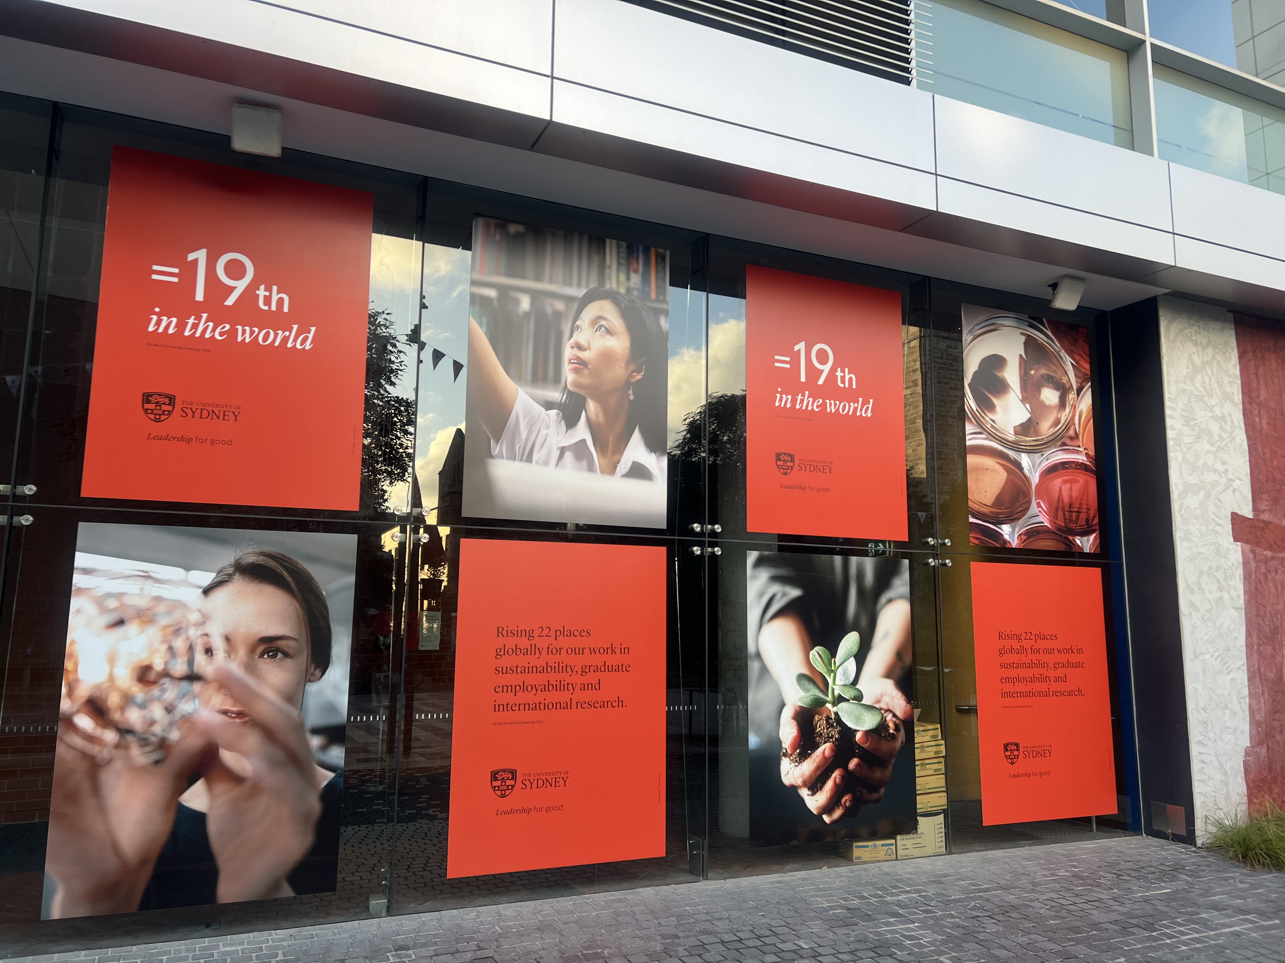
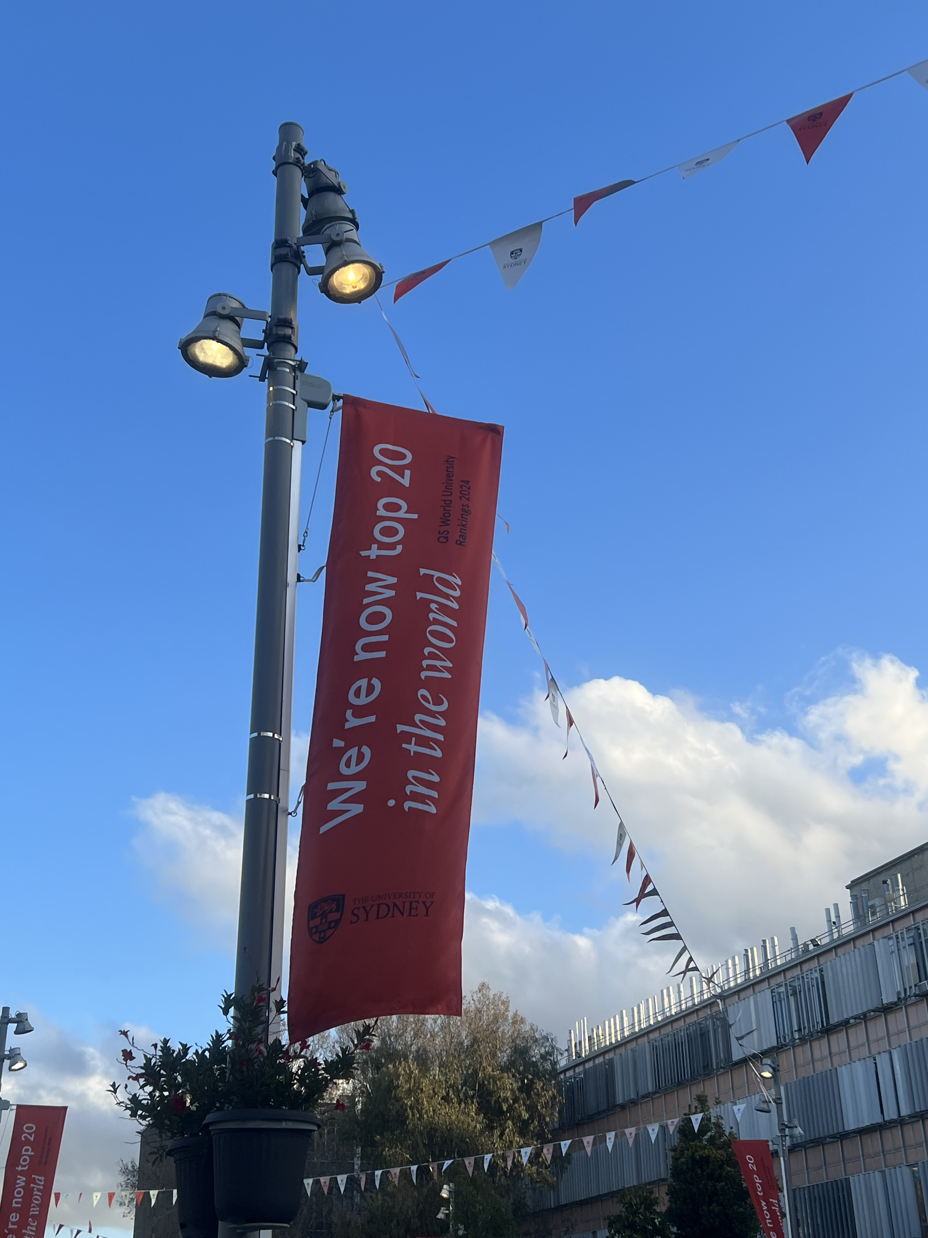
Physical environment cues
“Ambient belonging, we argue, can be ascertained rapidly, even from a cursory glance at a few objects.” (Cheryan et al, 2009, 1046)
Signposting at USYD indicates valued placed on academic success and ranking – suggests an environment of prestige and can create a sense of exclusion rather than one of belonging

Slide 8
Challenges of fostering inclusive learning environments
Broadly, research shows that, universities are becoming more inclusive and diverse than ever before, as we have more voices and perspectives present at all levels in the institution.
Our goal as educators who craft our learning environments is to foster a cultural change that values and supports the principles of UDL, resulting in transformational, student-focused education that is inclusive of all.
Paradox - developing an inclusive learning environment while also celebrating and promoting exclusiveness.

Slide 9
Important to continue to ask WHY
Asking why and using UDL to facilitating this asking of why will ideally contribute to a changing of a mindset
Disrupting the mysticism of our universities reputation in order to foster a more inclusive learning environment that centres student’s sense of belonging.

Slide 10
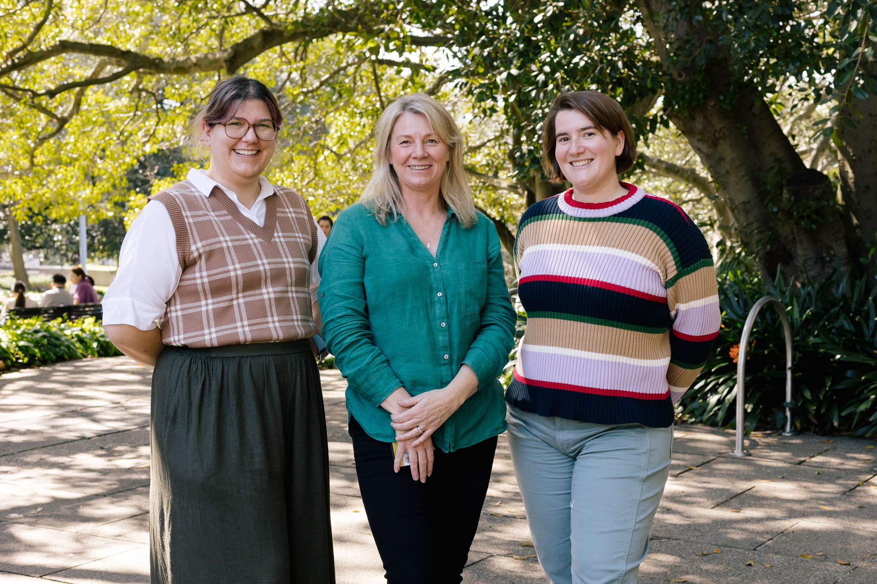
Contacts
Samantha Poulos
(samantha.poulos@sydney.edu.au)
Ella Collins-White
(ella.collins-white@sydney.edu.au)
Sarah Humphreys
(sarah.humphreys@sydney.edu.au)

Slide 11
Q & A session
Please share any thoughts of questions you might have. Feel free to either put your hand up and vocally share or type your question/thought in the chat​

